Slide 1
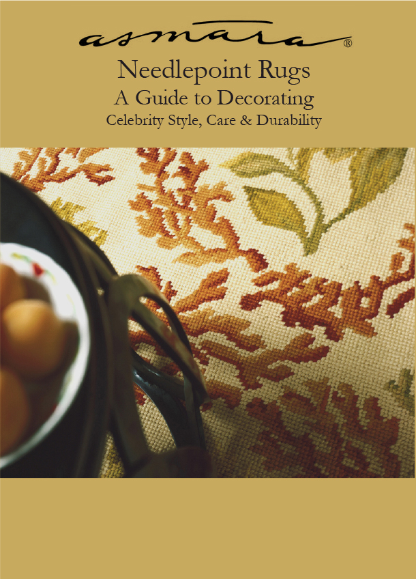
High quality needlepoint rugs such as Flowing Coral are highly durable due to millions of hand made stitches of resilient wool. Needlepoint rugs have a nubby surface resembling antique rugs. This makes them pair well with English and French antique furniture.

Slide 2
About the Author
Abid Ilahi is the founder and president of Asmara, Inc.

Slide 3
TABLE OF CONTENTS:
Needlepoint Rugs in Celebrity Interiors….……………………….1
Durability, Care and the Making of Needlepoint Rugs……….6
Manhattan Glam Style…..……….……….....…..………………..10

Slide 4
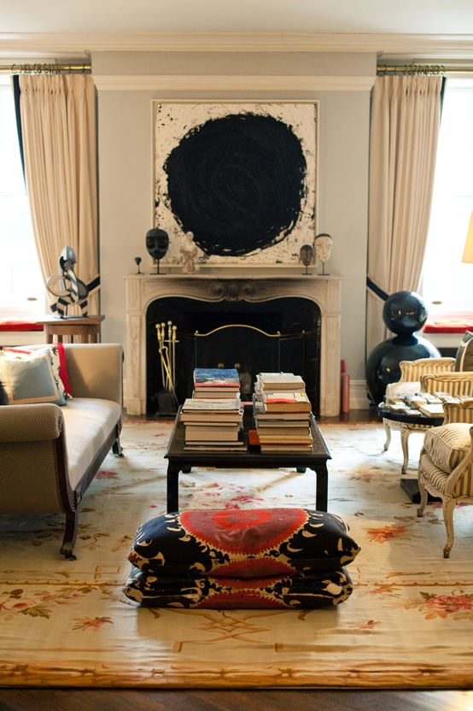
Chapter 1 - Needlepoint Rugs in Celebrity Interiors
Fashion designer Kate Spade’s mixed abstract art with a needlepoint rug in a 19th century French Aubusson design in her Manhattan living room. Image courtesy Pinterest.
Young fashion designers are recognizing the power of mixing traditional needlepoint rugs, with modern art, art deco furniture and ethnic textiles. An interiors filled exclusively with contemporary furnishings is just as boring as one in which every thing is traditional. It is true that it takes daring and imagination to mix so many disparate styles as Kate Spade has done. But how rewarding is the result!

Slide 5
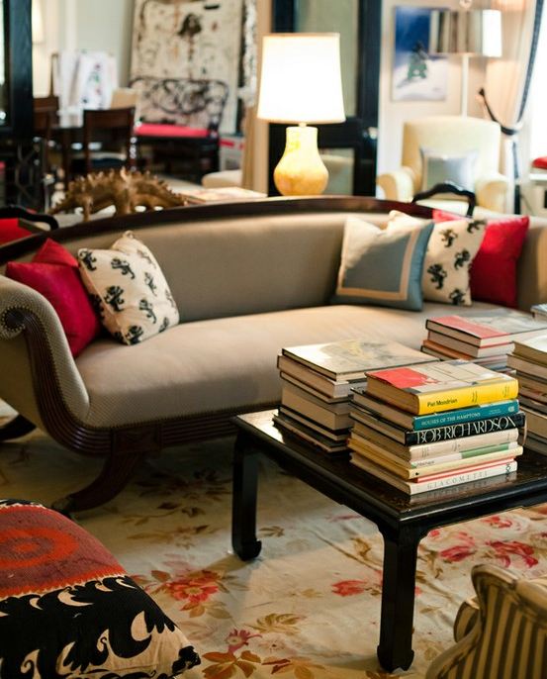
Chapter 1, page 2
Kate Spade shows how a needlepoint rug in a romantic 19th century French pattern can pull together contemporary, art deco and ethnic objects and give a room warmth and sophistication. Image courtesy Pinterest.
This living room literally exudes coziness. This is not just because of the fireplace but, more importantly, because the room is literally wrapped in shades of red. Red walls, fluffy red pillows and a plush red rug beckon you to nestle in a comfortable chair or sit back and relax on the sofa. The warm reds are balanced by crisp whites on the ceiling, fireplace mantel, book case and trim.

Slide 6
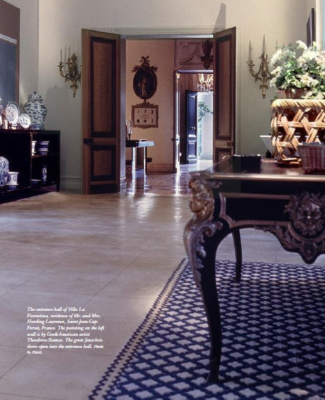
Chapter 1, page 3
Image courtesy Habitually Chic® Blog.
A French navy blue and white geometric needlepoint rug brings pattern to the blue salon of La Fiorentina a villa at the extreme end of the Saint Hospice point of the Saint Jean Cap Ferrat peninsula as decorated by the legendary Billy Baldwin in the 1970's for client Mary Wells Lawrence who was one of the most powerful advertising figures of the time.

Slide 7
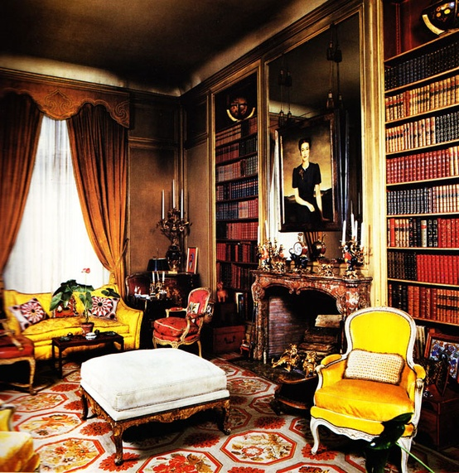
Chapter 1, page 4
Image courtesy of Pinterest Celebrity Rugs via Royals.
British Royal families prefer needlepoint rugs for their private homes even when they are living in exile in Paris as were the Duke and Duchess of Windsor. This elegant library was decorated by the famous decorating firm Maison Jansen who were later asked by Jackie Kennedy to decorate the White House. This cream, red, yellow and gold antique needlepoint rug combines architectural and floral elements and has the strength to pull together the brilliant yellows and reds in the furniture, drapes and leather bound volumes.

Slide 8
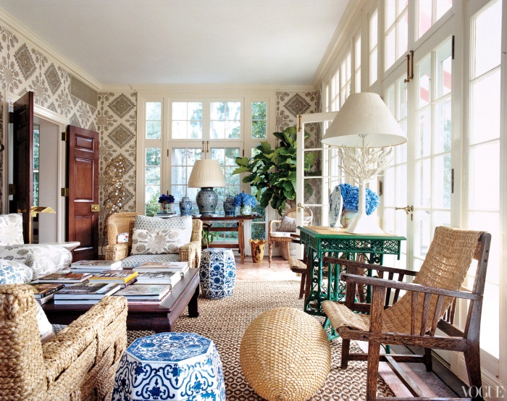
Chapter 1, page 5
Image courtesy Vogue Magazine
A geometric needlepoint rug with a small repeating brown and white pattern adds texture and warmth to Tory Burch's solarium. The colors and pattern of the rug tie together all the elements in the room such as the antique blue-and-white china, brown and white geometric wall covering and woven chairs.

Slide 9
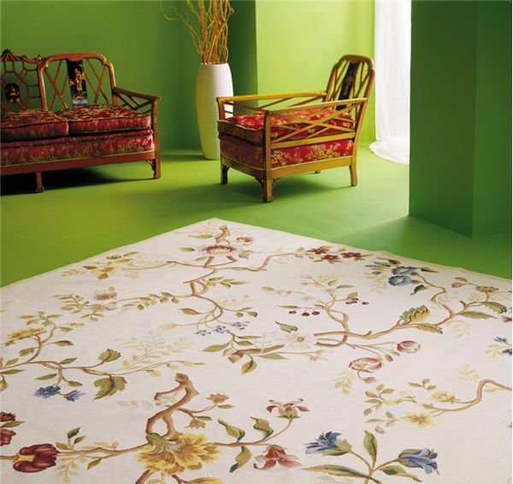
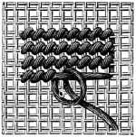
Chapter 2 – Durability, Care and the Making of Needlepoint Rugs
When clients ask interior designer Mary Ann Hart Beardman if a needlepoint rug is durable enough for active living rooms and dining rooms, she recalls the day when a neighbor’s large dog ran all over her living room needlepoint rug leaving large, wet and muddy paw prints all over the pristine cream background of her Branches needlepoint rug. Others may have panicked, but Mary knew better. She waited a day until the wet mud had completely dried and then vacuumed off the dirt without leaving a trace!
Mary Ann, owner of Bailey & Hart Interiors in Lake Forest, Illinois has clients who have had needlepoint rugs for years. The Branches needlepoint rug has been in Mary Ann's living room for 8 years, and she says the rug is “...in a high traffic area....I have had dogs with muddy feet, grandkids with food, and parties where adults have spilled wine and food, and the rug cleans beautifully. Actually, in 8 years I have never had it cleaned. The superior wool that Asmara uses enables it to clean up just by me doing it myself. As far as dirt and mud, I just let it dry and vacuum it. All dirt comes right up. I love this rug and never worry about traffic or spills... the best rug I have ever owned.”
Branches Rug Design © Asmara, Inc.
Branches needlepoint rug similar to the one in Mary Ann Hart Beardman's living room. Spills on a high quality needlepoint rug should be promptly lifted by dabbing with clean dry towels, absorbing as much of the liquid as possible. Make sure the rug dries completely. Regular vacuuming is very important. It lifts dirt and extends the life of the needlepoint rug. Unless they are heavily soiled, good quality rugs should not be routinely sent out for cleaning.

Slide 10
Chapter 2, page 7
Unlike oriental rugs, needlepoint rugs do not have a pile and are grouped under the category of "flat-weave" rugs which also includes Aubusson rugs. In comparison to oriental rugs, good quality needlepoint rugs are quite thin and this leads people to mistakenly assume they are too fragile for actively used rooms.
How to tell which needlepoint rugs are durable for active living rooms, dining rooms and bedrooms:
In order to be able to tell which needlepoint rugs are durable, we need to first understand the steps involved in making high quality needlepoint rugs
1. Durable needlepoint rugs are made with good quality wool yarn stitched on a strong canvas foundation.
Needlepoint rugs are still made entirely by hand, with nothing more than a hand sewing needle and wool yarn. The needlepoint embroider makes individual stitches with the needle and yarn on an “open grid canvas“ (see image above). The canvas is made of tightly twisted cotton threads that are mercerized to make them stronger and to allow the sewing needle to pass more easily through the holes in the canvas. Eventually the entire surface of the cotton canvas is covered with wool stitches and this becomes the needlepoint rug. Every square foot of the Asmara Branches needlepoint rug has 14,400 individual hand made wool stitches and a size 9'x12' Branches needlepoint rug contains more than 1.55 million hand stitches.
The durability of a needlepoint rug arises from the combined strength of the cotton canvas and the millions of handmade stitches in resilient wool yarn.
If either the wool or the cotton canvas is inferior, the durability of the needlepoint rug is compromised.

Slide 11
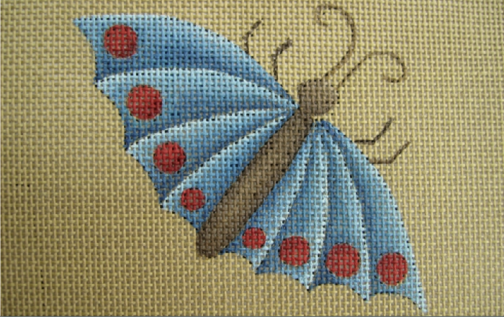
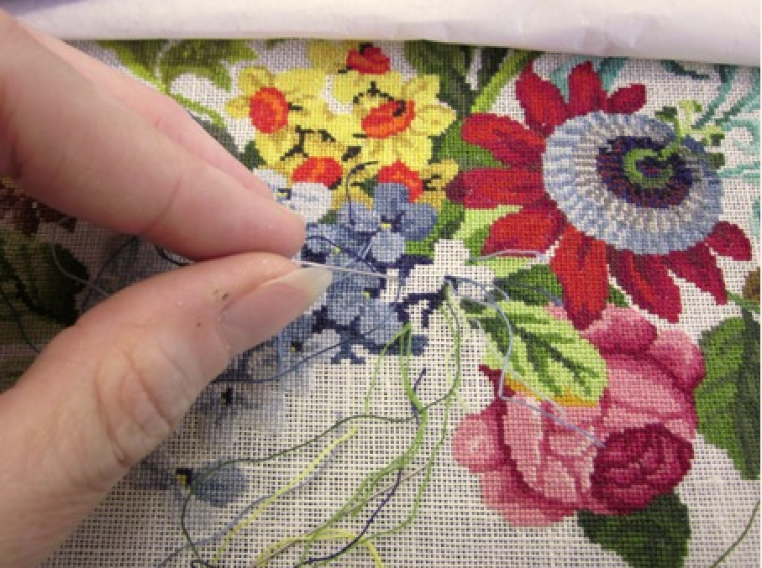
Chapter 2, page 8
Image courtesy The Royal School of Needlework, London.
To make it easy to follow the pattern, it is first hand painted on the "canvas". The needlepoint artisan uses custom dyed wool yarns and covers the canvas with wool stitches following every detail of the painted pattern. Millions of stitches in high quality wool on a sturdy cotton canvas foundation is what gives needlepoint rugs their exceptional durability.
Image courtesy The Royal School of Needlework, London.
An embroiderer hand stitching a floral needlepoint pattern with a sewing needle and wool yarn.

Slide 12
Chapter 2, page 9
2. Needlepoint rugs made with high quality wool are more durable and easier to clean
If you untwist good quality wool yarn, you will find 4 to 6 inch long, resilient fibers. Lower quality wool yarn is made of shorter, brittle fibers that break easily. The quality of the wool yarn determines how resistant the needlepoint rug is to abrasion and pulling which takes place during normal usage. Additionally, good quality yarn contains lanolin which is a natural protector against spills. Lanolin keeps the spilled liquids on the surface of the rug for a little longer, giving you more time to lift the liquid by absorbing it with a paper or cloth towel. Lift as much of the liquid as you can, and then make sure the rug is air dried to prevent mildew from setting in.
3. Chemically washed needlepoint rugs are less durable and less resistant to spills
In order to improve the appearance of poorly made needlepoint rugs, manufacturers wash them with a mixture of scouring chemicals that includes bleach. This chemical treatment removes the hard protective outer layer of the wool fiber and makes the wool softer and weaker. The real reason for chemical washing is it fades the colors and gives the rug a shiny look. A an untrained observer can be led to believe that the rug has an antique look when in reality the durability and authenticity of the rug have been compromised.
4. Use a good quality rug pad to enhance comfort and prolong the life of the needlepoint rug A good rug pad under a needlepoint rug gives additional cushioning and prolongs the life of the rug by allowing dirt to fall through the rug and onto the pad from where it should be removed by regular vacuuming of the pad and the rug. A pad also helps a needlepoint rug adhere to the floor and keep it from moving. Finally, a pad is essential when for installing a needlepoint rug as a wall to wall carpet.
5. Ask the manufacturer if their needlepoint rugs have been tested by an independent lab.
Independent testing labs such as the Independent Textile Testing Service in Dalton, Georgia perform wear and color fastness tests on all types of rugs and carpets. Ask if the manufacturer has had their needlepoint rugs independently tested by a lab and how it was rated.

Slide 13
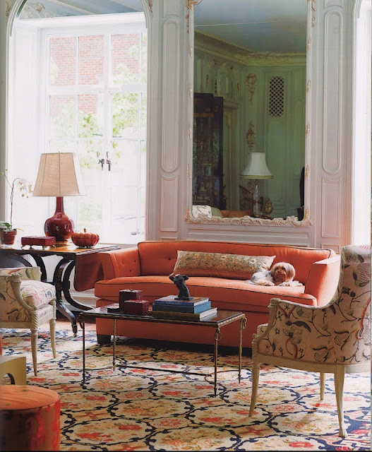
Chapter 3 – Manhattan Glam Style
Image courtesy Pinterest.
A navy, cream, red and yellow French needlepoint rug provides a stunning backdrop for a persimmon art deco sofa, neoclassical chairs and contemporary sculpture in this glamorous living room.

Slide 14
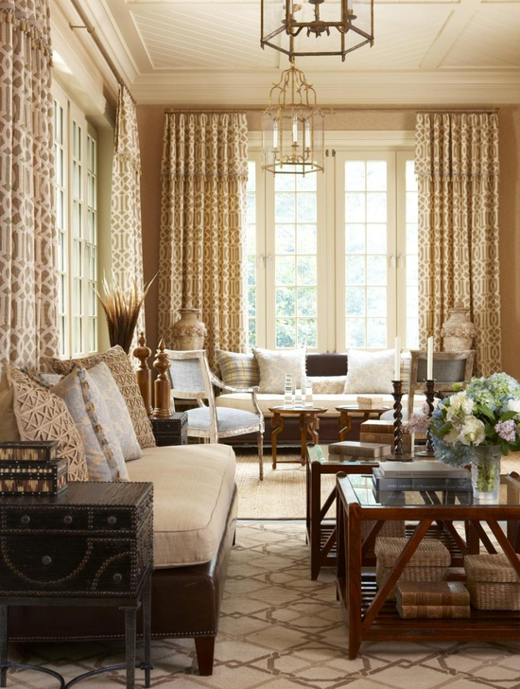
Chapter 3, page 11
Interior designer Cindy Rinfret made the color palette of this sun room harmonious with the beige and brown geometric needlepoint rug and created a subtle pop with a silver and blue French armchair.

