Slide 1
Adaptive Population Enrichment for Oncology Trials with Time to Event Endpoints
Cyrus Mehta, Ph.D.
President, Cytel Inc.

Slide 2
References and Acknowledgements
Statistical research with Sebastien Irle and Helmut Schäfer, Institute of Medical Biometry, University of Marburg, Germany
Problem formulation based on collaborations with the Pfizer Inc., and M.D. Anderson Cancer Center
Key Reference:
  Irle and Schäfer. “Interim design modifications in time-to-event studies.” JASA, 2012; 107:341-348
We thank Pranab Ghosh for expert programming of the simulation tools

Slide 3
Outline of Talk
Motivation for enrichment trials in oncology
Adaptive enrichment design for PFS endpoints
Statistical methodology
  Conditional error function in time-to-event trials
  Performing a closed test
Simulation guided design
Future directions

Slide 4
Current State of Oncology Trials
Failure rate for late stage oncology trials is almost 60% (Kola and Landis, 2004)
Two recent scientific developments can improve this track record
  development of molecularly targeted agents
  statistical methodology of adaptive trial design applied to time-to-event data
Fact: Some subgroups benefit differentially from others when treated with the targeted agent

Slide 5
Oncology Products Approved in the US for Selected Patient Populations
Compound/Target | Indication (prevalence target)
Crizotinib (Xalkori®)/ ALK-rearrangement | Non-small cell lung cancer with ALK-rearrangements (5%)
Vemurafenib (Zelboraf®)/ BRAF mutation | Advanced melanoma with mutant BRAF (30-40%)
Trametinib (Mekinist™)/ MEK | Advanced melanoma with mutant BRAF (30-40%)
Trastuzumab (Herceptin®); Lapatinib (Tykerb®)/ Her2 | Her2 expressing breast cancer (25%) Her2 expressing metastatic gastric cancer (20-30%)
Aromatase inhibitors (letrozole, exemestane) | ER(+) breast cancer (60-70%)
Rituximab (Rituxan®)/ CD20 | CD20(+) B-cell lymphomas (90%+)
Cetuximab (Erbitux®); Panitumumab (Vectibix®) / EGFR | Advanced Head/neck cancer (~100%) EGFR(+) metastatic colorectal cancer (60-80%) KRAS^{WT} metastatic colorectal cancer (60%)

Slide 6
Considerations for Evaluation of Biomarker Predictivity
Randomize patients in both biomarker subgroups
Evaluate predictivity in a phase 2 setting
  Phase 3 requires validated companion diagnostic
Issues to consider for the phase 2 trial
  Strength of preclinical evidence
  Prevalence of the marker
  Sample size limitations (160-200 patients)
  Time-to-event endpoint (PFS or OS)
  No more than 3-year study duration
  Reproducibility and validity of assays

Slide 7
Features of an Adaptive Enrichment Design
Two-stage design: all comers at Stage 1
Interim analysis at end of Stage 1, utilizing ALL available information (censored and complete)
Adaptation decision implemented in Stage 2:
  Proceed with no design change (except possible SSR)
  Proceed with biomarker subgroup (and possible SSR)
  Terminate for futility
Perform a closed test for the final analysis

Slide 8
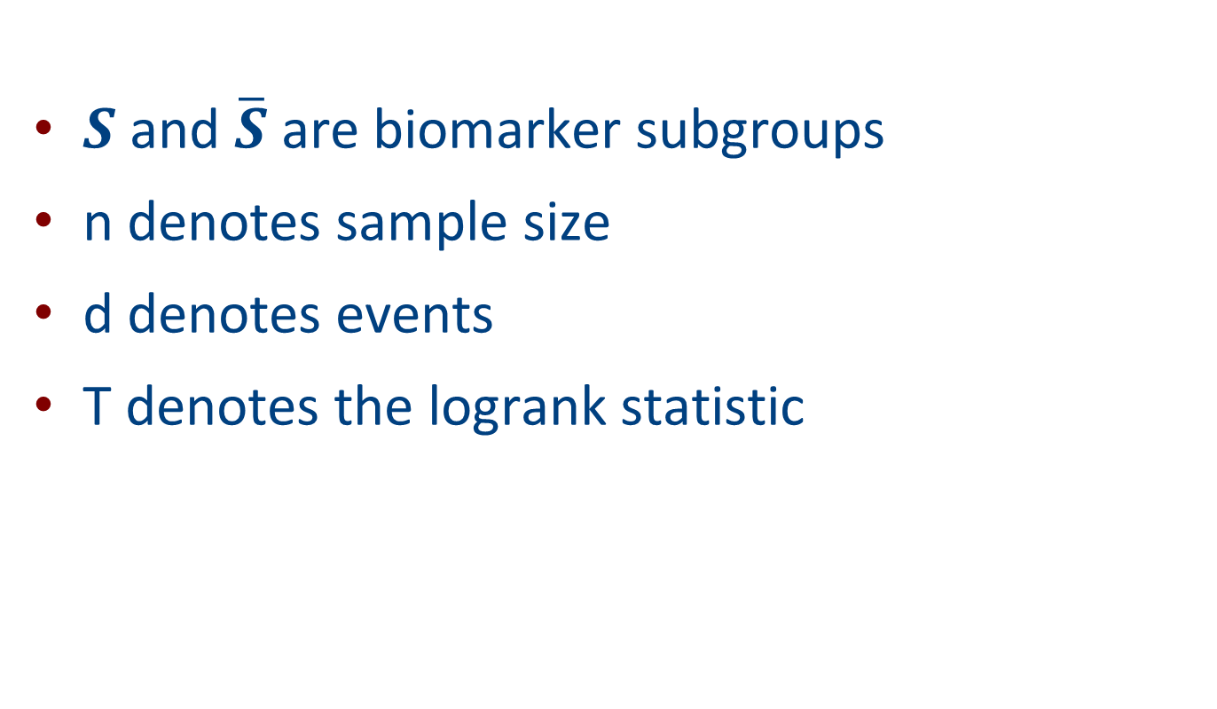
Notation
$S$ and $\overline{S}$ are biomarker subgroups
n denotes sample size
d denotes events
T denotes the logrank statistic

Slide 9



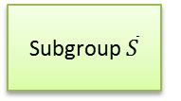
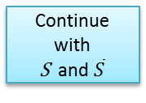
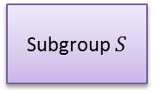

Schematic Representation of Protocol
Subgroup $S$
.5 Treatment
.5 Control
$n_{0}$ patients
Stop for Futility
$d0$ events
ALL COMERS
S
T
RAT
I
F
Y
INTERIM ANALYSIS
$$1/3$$
Continue with
S and $\overline{S}$
FINAL ANALYSIS
Perform a closed test of S
$$2/3$$
Subgroup $\overline{S}$
.5 Treatment
.5 Control
patients
Continue with
S only
events
If is dropped, randomize all remaining patients to subgroup S and increase its events

Slide 10











Time Line of S Subgroup
$$n_{0}^{}$$
$$n_{s}^{}$$
$$n_{\tilde{s}}^{}$$
$$d_{0}^{}$$
$$d_{s}^{}$$
$$d_{\tilde{s}}^{}$$
$$T_{0}^{}$$
$$T_{s}^{}$$
$$T_{\tilde{s}}^{}$$
0
Time Axis
$S_{}^{′}$ cohort
$S_{}^{′′}$ cohort
Interim
Analysis
Planned
Final
Analysis
Actual
Final
Analysis

Slide 11






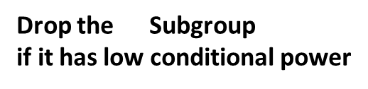




Time Line of $\overline{S}$ Subgroup
$${\overline{n}}_{0}^{}$$
$${\overline{n}}_{\overline{s}}^{}$$
$${\overline{d}}_{0}^{}$$
$${\overline{d}}_{\overline{s}}^{}$$
$${\overline{T}}_{0}^{}$$
$${\overline{T}}_{\overline{s}}^{}$$
0
Time Axis
$\overline{S^{′}}$ cohort
${\overline{S}}_{}^{′′}$ cohort
Interim
Analysis
Planned
Final
Analysis
$$\overline{S}$$
Drop the Subgroup
if it has low conditional power

Slide 12
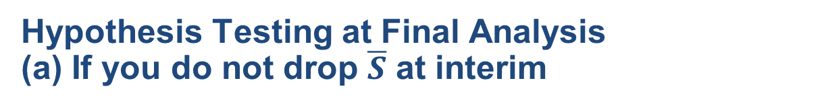
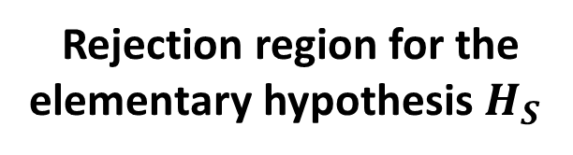

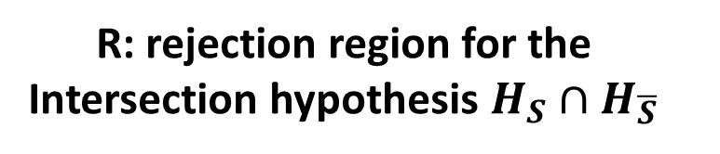
Hypothesis Testing at Final Analysis
(a) If you do not drop $\overline{S}$ at interim
R: rejection region for the
Intersection hypothesis $H_{S}∩H_{\overline{S}}$
$${\overline{T}}_{\overline{s}}$$
2.24
For closed testing both $H_{S}$ and $H_{S}∩H_{\overline{S}}$ must be rejected
1.96
2.24
$$T_{s}$$
Rejection region for the elementary hypothesis $H_{S}$

Slide 13
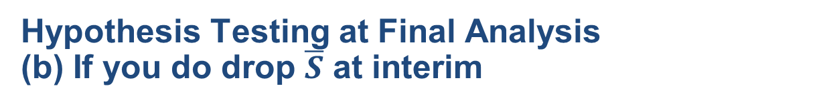
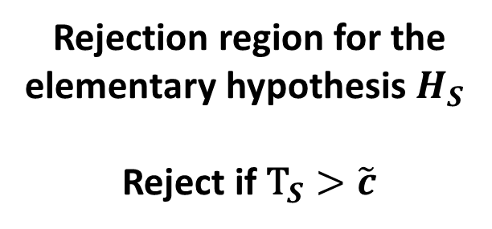

Hypothesis Testing at Final Analysis
(b) If you do drop $\overline{S}$ at interim
Rejection region for the elementary hypothesis $H_{S}$
Reject if ${\text{T}}_{S}>\tilde{c}$
$$\tilde{c}$$
$$T_{s}$$

Slide 14
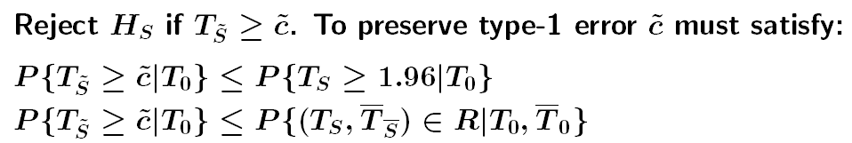
Preserving Type-1 Error: CER Method 1
( Mullër and Schafër, 2001)
$$n_{0}^{}$$
$$n_{s}^{}$$
$$n_{\tilde{s}}^{}$$
$$d_{0}^{}$$
$$d_{s}^{}$$
$$d_{\tilde{s}}^{}$$
$$T_{0}^{}$$
$$T_{s}^{}$$
$$T_{\tilde{s}}^{}$$
0
Time Axis
$S_{}^{′}$ cohort
$S_{}^{′′}$ cohort
Interim
Analysis
Planned
Final
Analysis
Actual
Final
Analysis

Slide 15
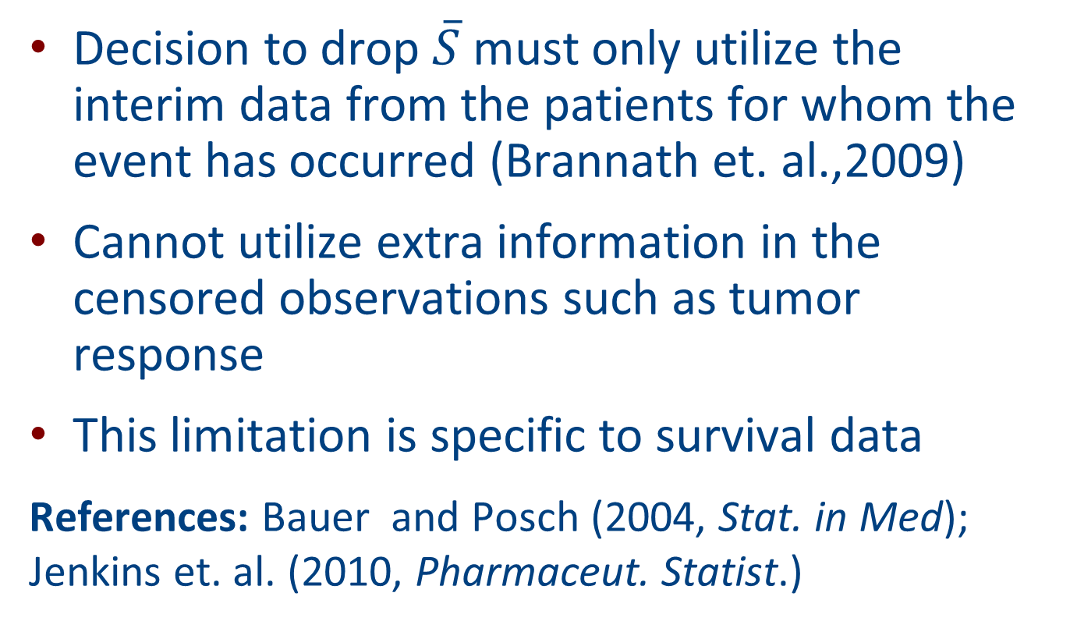
Comments on CER Method 1
Decision to drop $\overline{S}$ must only utilize the interim data from the patients for whom the event has occurred (Brannath et. al.,2009)
Cannot utilize extra information in the censored observations such as tumor response
This limitation is specific to survival data
References: Bauer and Posch (2004, Stat. in Med); Jenkins et. al. (2010, Pharmaceut. Statist.)

Slide 16
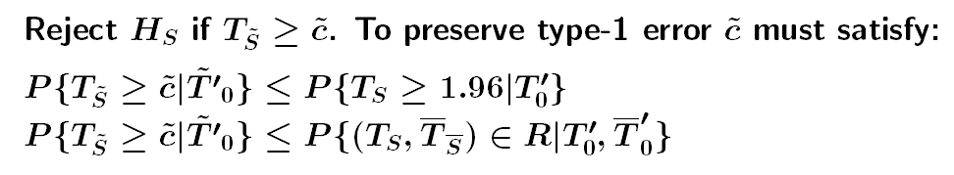



Preserving Type-1 Error: Method 2
(Irle, Schafër,Mehta, 2012, methodology)
$$n_{0}^{}$$
$$n_{s}^{}$$
$$n_{\tilde{s}}^{}$$
$$d_{0}^{}$$
$$d_{s}^{}$$
$$d_{\tilde{s}}^{}$$
$$T_{0}^{}$$
$${\tilde{T′}}_{0}$$
$$T_{0}^{}$$
$$T_{0}^{}$$
$$T_{s}^{}$$
$${T′}_{0}^{}$$
$$T_{\tilde{s}}^{}$$
0
Time Axis
$S_{}^{′}$ cohort
$S_{}^{′′}$ cohort
Interim
Analysis
Planned
Final
Analysis
Actual
Final
Analysis

Slide 17
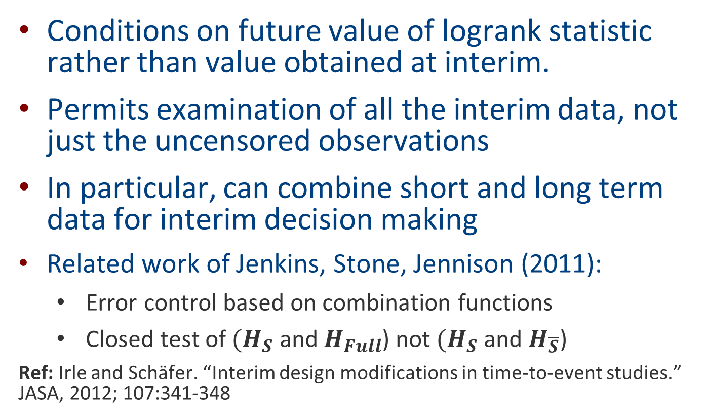
Comments on CER Method 2
Conditions on future value of logrank statistic rather than value obtained at interim.
Permits examination of all the interim data, not just the uncensored observations
In particular, can combine short and long term data for interim decision making
Related work of Jenkins, Stone, Jennison (2011):
  Error control based on combination functions
  Closed test of ${(H}_{S}$ and $H_{Full}$) not ${(H}_{S}$ and $H_{\overline{S}}$)
  Ref: Irle and Schäfer. “Interim design modifications in time-to-event studies.” JASA, 2012; 107:341-348

Slide 18
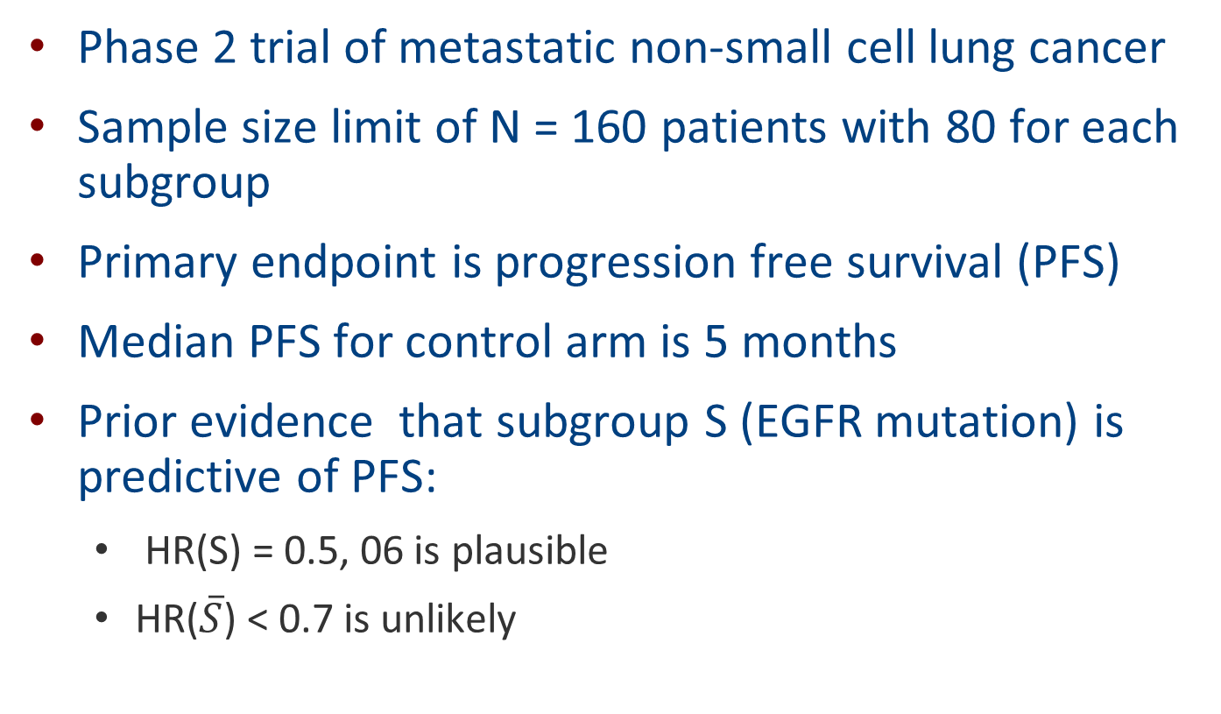
The setting for a simulation guided design
Phase 2 trial of metastatic non-small cell lung cancer
Sample size limit of N = 160 patients with 80 for each subgroup
Primary endpoint is progression free survival (PFS)
Median PFS for control arm is 5 months
Prior evidence that subgroup S (EGFR mutation) is predictive of PFS:
  HR(S) = 0.5, 06 is plausible
  HR($\overline{S}$) < 0.7 is unlikely

Slide 19

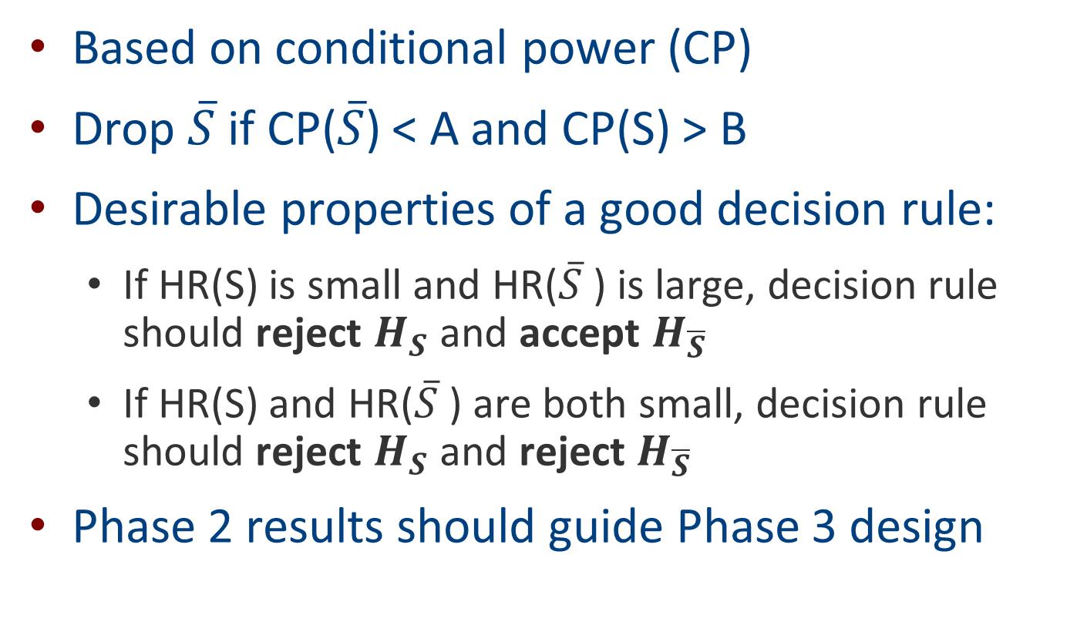
Decision Rule for Dropping $\overline{S}$ at Interim
Based on conditional power (CP)
Drop $\overline{S}$ if CP($\overline{S}$) < A and CP(S) > B
Desirable properties of a good decision rule:
  If HR(S) is small and HR($\overline{S}$) is large, decision rule should reject $H_{S}$ and accept $H_{\overline{S}}$
  If HR(S) and HR($\overline{S}$) are both small, decision rule should reject $H_{S}$ and reject $H_{\overline{S}}$
Phase 2 results should guide Phase 3 design

Slide 20
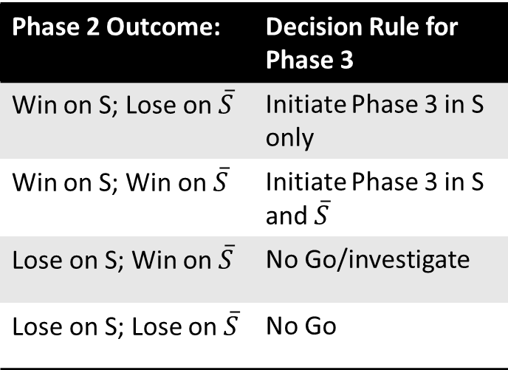
Use Phase 2 Simulations to Guide
Phase 3 Go/No-Go/Enrich Decisions
Decision rules for initiating a Phase 3 trial based on the results of the Phase 2 adaptive enrichment trial
Phase 2 Outcome: | Decision Rule for Phase 3
Win on S; Lose on $\overline{S}$ | Initiate Phase 3 in S only
Win on S; Win on $\overline{S}$ | Initiate Phase 3 in S and $\overline{S}$
Lose on S; Win on $\overline{S}$ | No Go/investigate
Lose on S; Lose on $\overline{S}$ | No Go

Slide 21
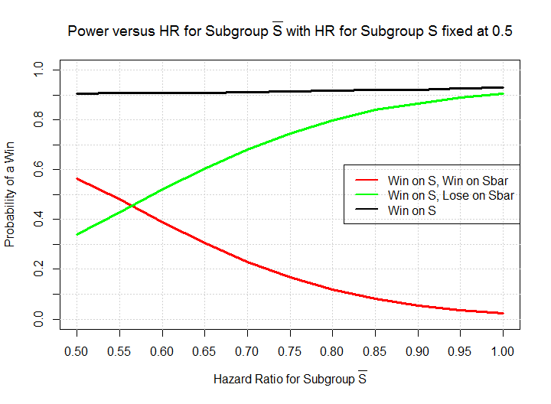
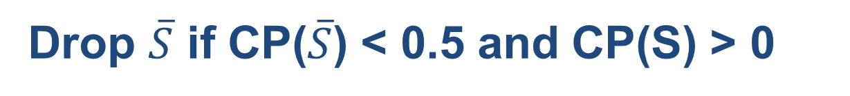
Drop $\overline{S}$ if CP($\overline{S}$) < 0.5 and CP(S) > 0
Assume HR(S) = 0.5

Slide 22
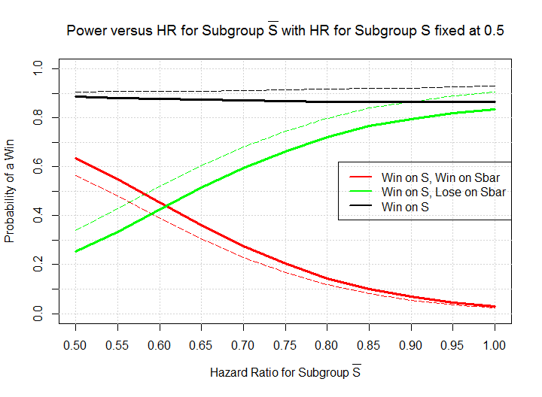
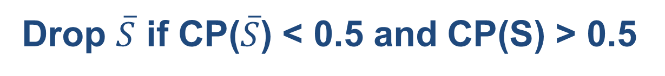
Drop $\overline{S}$ if CP($\overline{S}$) < 0.5 and CP(S) > 0.5
Assume HR(S) = 0.5

Slide 23
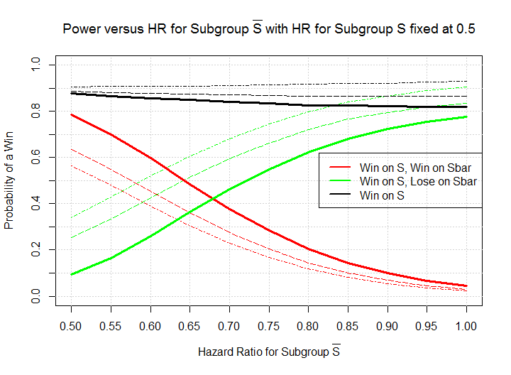

Never Drop $\overline{S}$ (apply closed test only)
Assume HR(S) = 0.5

Slide 24
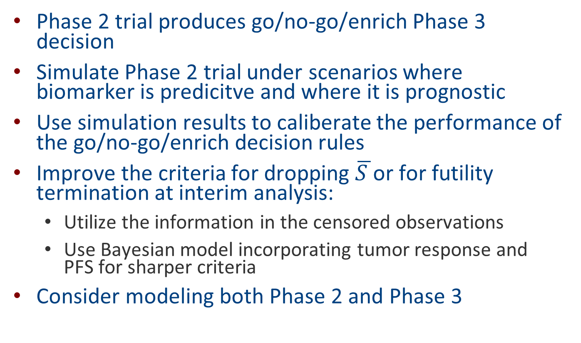
Concluding Remarks and Future Work
Phase 2 trial produces go/no-go/enrich Phase 3 decision
Simulate Phase 2 trial under scenarios where biomarker is predicitve and where it is prognostic
Use simulation results to caliberate the performance of the go/no-go/enrich decision rules
Improve the criteria for dropping $\overline{S }$or for futility termination at interim analysis:
  Utilize the information in the censored observations
  Use Bayesian model incorporating tumor response and PFS for sharper criteria
Consider modeling both Phase 2 and Phase 3

