Slide 1
Microsoft Azure Government Technical overview

Slide 2
Transform the datacenter
Today’s datacenter needs:
On-demand
Reduce cost & complexity
Rapid response to business
Hybrid cloud
Cloud options
on demand
Datacenter without
boundaries
Reduced cost and complexity
Cloud innovation
everywhere
Rapid response
to business
Dynamic application
delivery
Notes:
Clicking down on TDC What are customers asking of us…
On-demand – easily and flexibly extend to cloud as my business needs it. augment DC capacity at a snap (devtest or opening up shop in a new market) or scaling out an app to a public cloud on-demand (transient use pattern).
Reduce cost and complexity – help me simplify, help me standardize….break through clutter…new ways to think about my DC
Rapid response to business…..does it help me get faster?
What do we deliver?
DC w/o boundaries – ability to expand outside of your fall walls on demand (networking is key to this as we will see)
Cloud innovation everywhere – this stems from all our learning operating large scale cloud services in our datacenters and bringing them back to our enterprise products.
Dynamic app delivery – about delivering apps to market faster and providing the infra reqd to deliver apps to market faster, be the onprem or on public.
Of course, the extends across all the assets in our broad portfolio.

Slide 3
Microsoft Azure Infrastructure as a Service (IaaS)
Applications
Data
Customer managed
Runtime
Middleware
O/S
Virtualization
Virtualization
Storage
Servers
Servers
Networking
Storage
Networking
Notes:
From an IaaS perspective, Windows Azure is a cost-effective alternative to offload hardware and software resources and demands from on-premises and into the cloud to provide customers more IT agility and cost-effective solutions to better manage their IT resource mix:
The Microsoft Cloud OS, which is led by Windows Server, System Center, and Azure, enables customers to easily virtualize, deploy, manage and automate their workloads – whether in a private, public, or service provider cloud – and offers a consistent set of tools for development, management, and identity across the entire infrastructure.
While AWS is focused on moving customers’ workloads to Amazon’s public cloud, Microsoft delivers a truly hybrid platform that offers customers a choice in where they run their applications.
Microsoft customers have the flexibility to maintain a consistent platform with integrated virtualization to move workloads between environments without change.
Microsoft provides a truly hybrid cloud platform with a common set of technologies and capabilities across on-premises, Azure, and Service Provider clouds.
Microsoft customers can easily move virtual machines “as-is” across on-premises, Windows Azure, and 3rd party hoster.
With Microsoft’s Cloud OS, customers have the control to decide where to extend the platform to –on-premises, on hosting service provider, the Microsoft public cloud, or any mix of these.

Slide 4
Microsoft Azure Platform as a Service (PaaS)
Applications
Data
Customer managed
Virtualization
Servers
Virtualization
Middleware
Servers
Storage
Networking
O/S
Storage
Runtime
Networking
Runtime
Middleware
O/S
Notes:
With PaaS, Windows Azure offers your customers a solution to offload their platform components including virtualization, servers, storage, networking, runtime, middleware, and OS to again provide a cost-effective agile way to manage their IT budget and resources.
Microsoft customers get the best value, combining the lowest price with the flexibility of a hybrid environment and an enterprise-ready platform. Azure is unique in the sense that customers can easily migrate apps “as-is” from on-premises to Azure using IaaS virtual machines and later add more PaaS services to the application.
Microsoft Azure offers a comprehensive IaaS+PaaS platform. With IaaS, customers can immediately move apps “as is” to Azure and gain full control over the app environment.). As a PaaS, the underlying OS and system management tasks are automated, enabling developers to focus on apps. This leads to faster on-boarding to the public cloud and lets customer quickly develop apps while using the platform’s richness (scalability, tools, services.).
AWS is primarily an IaaS service that depends on partners to fulfill PaaS scenarios. This limits the flexibility of customers and necessitates them to continue to do the same as before (manage the infrastructure).

Slide 5
Azure: an open platform powered by choice
Partnered with open source communities
Interoperability between Microsoft and non-Microsoft technologies
Platform and tools independent
Compatibility with the tools developers already know
Most favored open source creative development frameworks such

Slide 6
What is Microsoft Azure Government?

Slide 7
Comprehensive cloud services
Infrastructure
Fabric
Services
Frameworks
Compute
Caching
Virtual machines
Cloud services
Identity
bob
Storage
Service Bus
SQL Database
NoSQL Database
CONUS physical infrastructure
servers/network/datacenters/operations
Media
Blob storage
Recovery
Networking
Automated
Managed resources
Elastic
Usage based
Notification Hubs
Dedicated connections
Virtual network
1
2
3
Traffic Manager
Tasks
U.S. Gov. Virginia and U.S. Gov. Iowa
NOC in Redmond and Washington DC
Notes:
This slide is used to illustrate the breadth of capabilities that Windows Azure has – up to this point you have talked about why cloud and our infrastructure and so th elead in to this slide is now to look at what actually is Windows Azure – what can it do… The following slide (which you can use instead) takes a different approach and just uses the big building blocks… Generally you would use this or that…

Slide 8
U.S. Public Sector requirements and needs
Needs
Requirements
Increase own agility
Specific security controls
Minimize datacenter investments
Specific compliance requirements
Maximize existing investments by adopting hybrid cloud approach
Specific government oversight requirements

Slide 9
Introducing Microsoft Azure Government A government-community cloud that extends world-class security and control for dedicated U.S. Public Sector workloads.
Provides a physical and network-isolated instance of Microsoft Azure.
Offers roadmap for meeting rigorous compliance demands (i.e. FedRAMP, CJIS, and HIPAA) of a government-only cloud.
Provides rich infrastructure, storage, and identity management capabilities delivered through cloud, on-premises, and hybrid solutions.
Delivers integrated, familiar experiences with Office 365 for Government in the cloud.
Stores data within the United States.
Provides screened U.S. citizens and policies to help protect customer data and applications.
Notes:
Azure Government delivers cloud speed, scale, and economics while addressing the security and compliance needs of U.S. federal agencies including the Department of Defense plus state and local governments and their solutions providers. Azure Government offers physical and network isolation from non-U.S. government deployments and requires specialized personnel screening . Azure Government will address government regulatory and compliance requirements such as FedRAMP, CJIS and HIPAA.
The only comprehensive and open platform for government— spanning infrastructure, data, and productivity — delivered through cloud, on-premise, and hybrid solutions.
Designed to meet the rigorous compliance and security demands that support the mission of government, healthcare, public safety, and defense.
Leveraging existing security infrastructure and then extending world-class security and control in the cloud.
Deployed quickly with finished services built into the Microsoft Government Cloud, providing improved management for IT in an environment users know.
Power greater insights and results with integrated, familiar experiences across Office and CRM in the cloud.

Slide 10
Azure Government: powerful datacenter security
Customer data, applications, and hardware reside in the continental United States (CONUS) in specially constructed datacenters. The datacenters are physically isolated from Azure commercial services and geographically distributed more than 500 miles apart to support business continuity scenarios.
Perimeter
Buildings
Computer room
24x7 security staff
Facility setback requirements
Barriers
Fencing
Alarms
Security operations center
Seismic bracing
East/Central locations: U.S. Gov. Iowa & U.S. Gov. Virginia
Two-factor access control: Biometric & card readers
Camera
Days of backup power

Slide 11
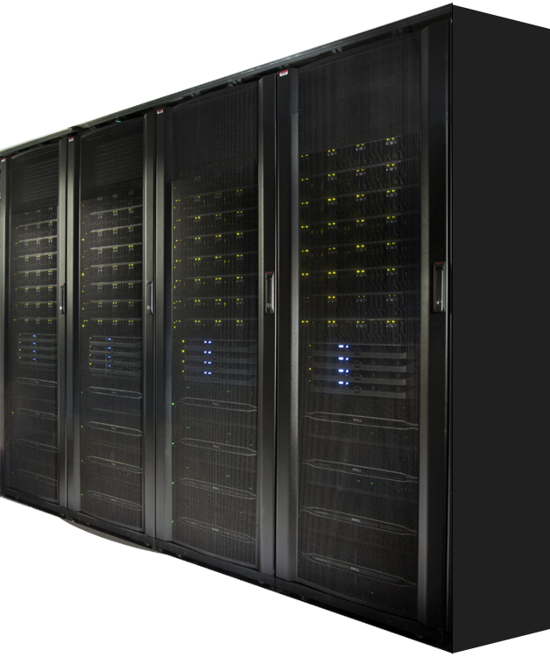
$97B
46%
Global cloud market in 2015
Public cloud service of net new growth in IT spend
MICROSOFT CLOUD PLATFORM SYSTEM
Delivers a Cloud Infrastructure Appliance for self-service IaaS and PaaS workloads
Cloud OS on-prem: Azure Pack, Windows Server & System Center
Microsoft-validated hardware and software
Optimized for hosting Microsoft applications

Slide 12
$97B
46%
Global cloud market in 2015
Public cloud service of net new growth in IT spend
CPS - Software
Pre-Deployed Infrastructure
Switches, Load Balancer, Storage, Compute, Network Edge
N + 2 fault tolerance (N +1 for networking)
Pre-configured as per best practices
Integrated Management
Configure, deploy, patching
Monitoring
Backup and DR
IaaS provider
Automation
Tenant Portal
8000 VM’s, 0.7 PB of usable workload storage
First party validation for workloads
PROVIDER
PORTAL
TENANT
PORTAL
SERVICE MANAGEMENT API
VIRTUAL
MACHINES
WEB
SITES
SERVICE
BUS
SQL
SERVER
SOFS / SMB 3.0 & STORAGE SPACES
HYPER-V
HOSTS
HYPER-V
NETWORKING
OEM HARDWARE INFRASTRUCTURE

Slide 13
CPS - Hardware
One Rack
512 Cores 4TB RAM
262 TB usable storage
160 Gb/s internal rack connectivity
20 Gb/s external
2322 Lbs
42U
16.6 KW Maximum
Networking
4 x Force 10 – S4810P
1 x Force 10 – S55
Compute Scale Unit (32 x Hyper-V hosts)
Dell PowerEdge C6220ii – 4 Nodes per 2U
Dual socket Intel IvyBridge (E5-2650v2 @ 2.6GHz)
128 GB memory
2 x 10 GbE Mellanox NIC’s (LBFO Team, NVGRE offload)
2 x 10 GbE Chelsio (iWARP/RDMA)
1 local SSD 200 GB(boot/paging)
Storage Scale Unit (4 x File servers, 4 x JBODS)
Dell PowerEdge R620v2 Servers (4 Server for Scale Out File Server
Dual socket Intel IvyBridge (E5-2650v2 @ 2.6GHz)
2 x LSI 9207-8E SAS Controllers (shared storage)
2 x 10 GbE Chelsio (iWARP/RDMA)
PowerVault MD3060e JBODs (48 HDD, 12 SSD)
4 TB HDDs and 800 GB SSDs
1 – 4 racks

Slide 14
High-density, industry-standard hardware
 | Rack 1 | Per Rack | Max per Stamp
Compute Nodes | 24 | 32 | 128
Sockets | 48 | 64 | 256
Cores | 384 | 512 | 2048
Memory | 3TB | 4TB | 16TB
File Servers | 4 | 4 | 16
HDD | 192 | 192 | 768
HDD Raw Storage Capacity | 768TB | 768TB | 3072TB
SSD (for Tiering) | 48 | 48 | 192
SSD Raw Storage Capacity | 38.4TB | 38.4TB | 153.6TB
Storage Used for Backup | 126TB | 126TB | 504TB
Storage Available for Workloads | 136TB | 156TB | 605TB

