Slide 1
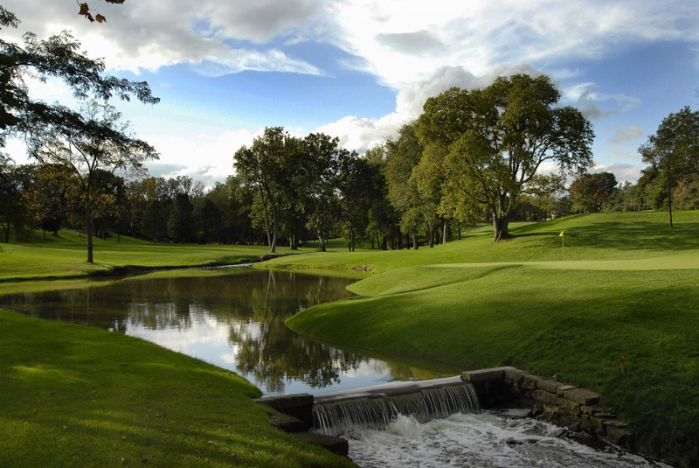
3rd Hole at Muirfield Village Golf Club
Let’s Talk Golf!

Slide 2
Agenda
Paul Latshaw Interview
Audience Q&A
Audience Polls Throughout

Slide 3
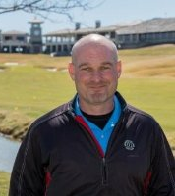
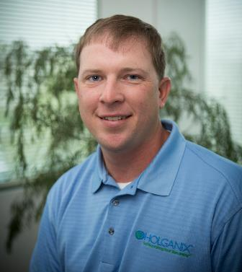
Meet your hosts!
Paul Latshaw MSM, CGCS
Superintendent, Muirfield Village Golf Club
Rob Dillinger
Sales Representative, Holganix LLC

Slide 4
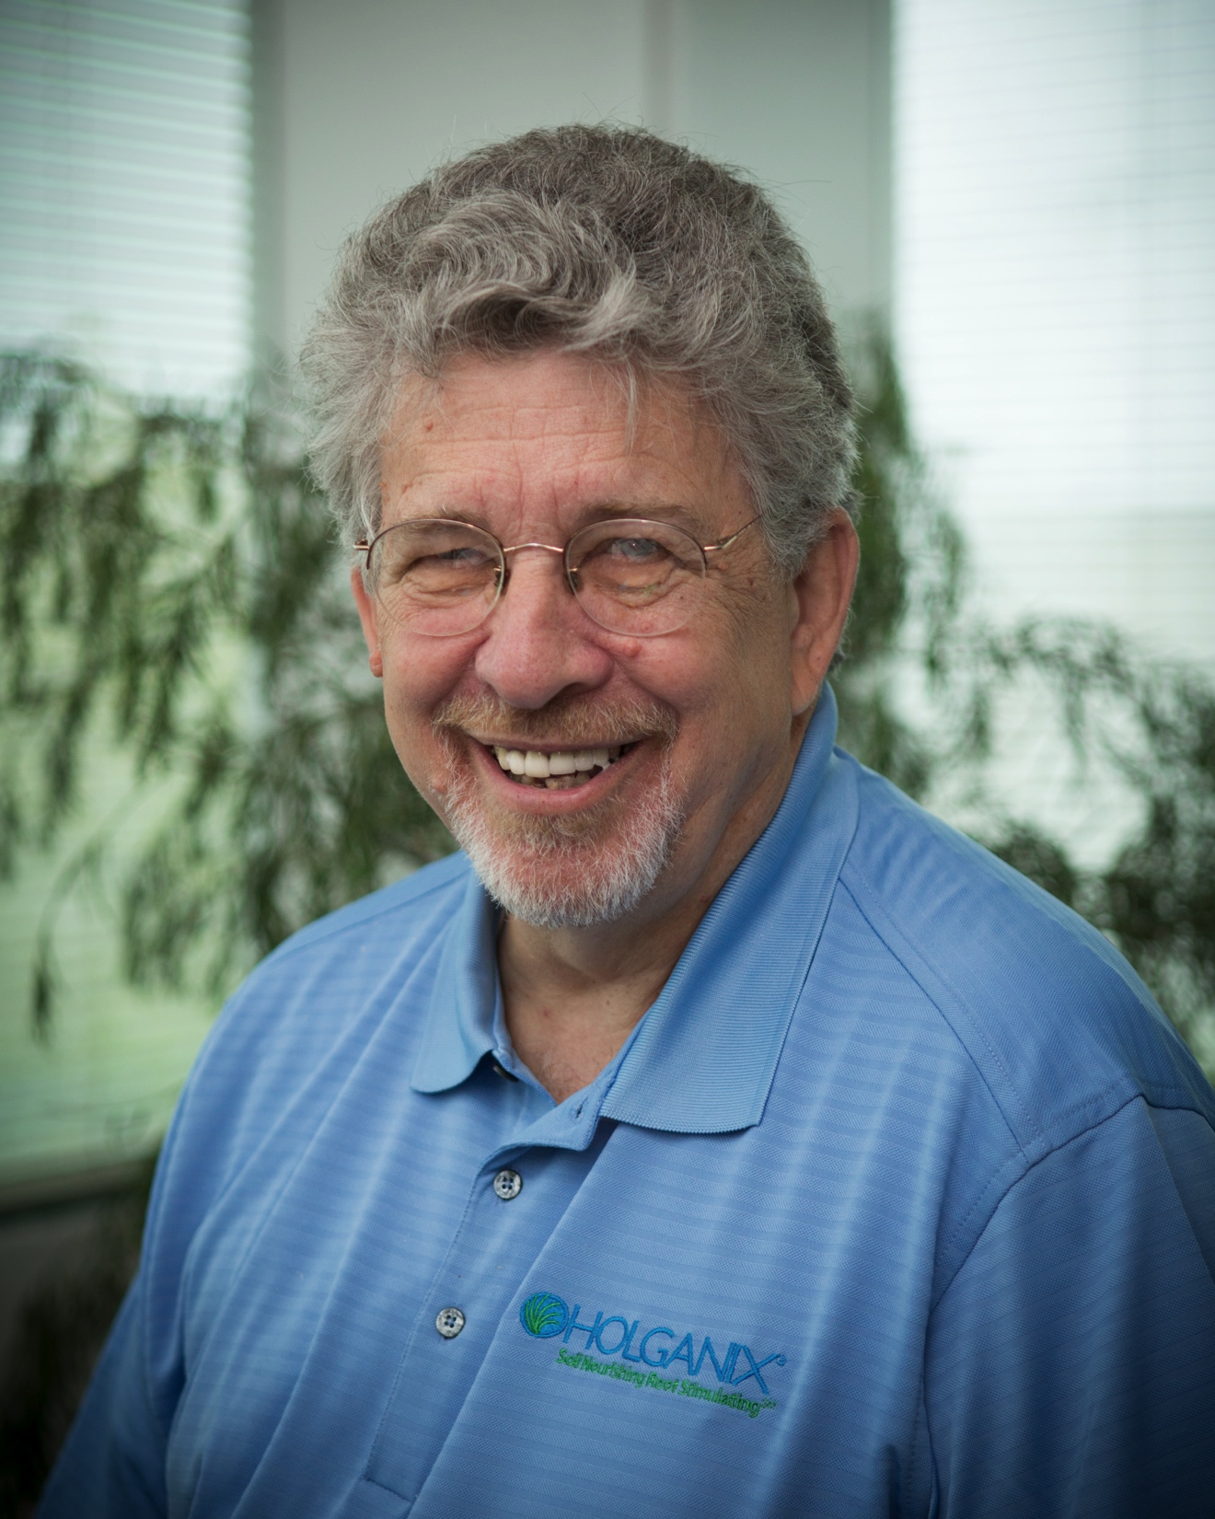
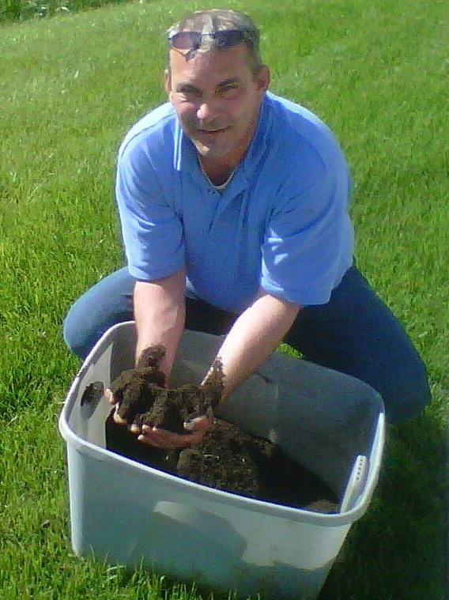
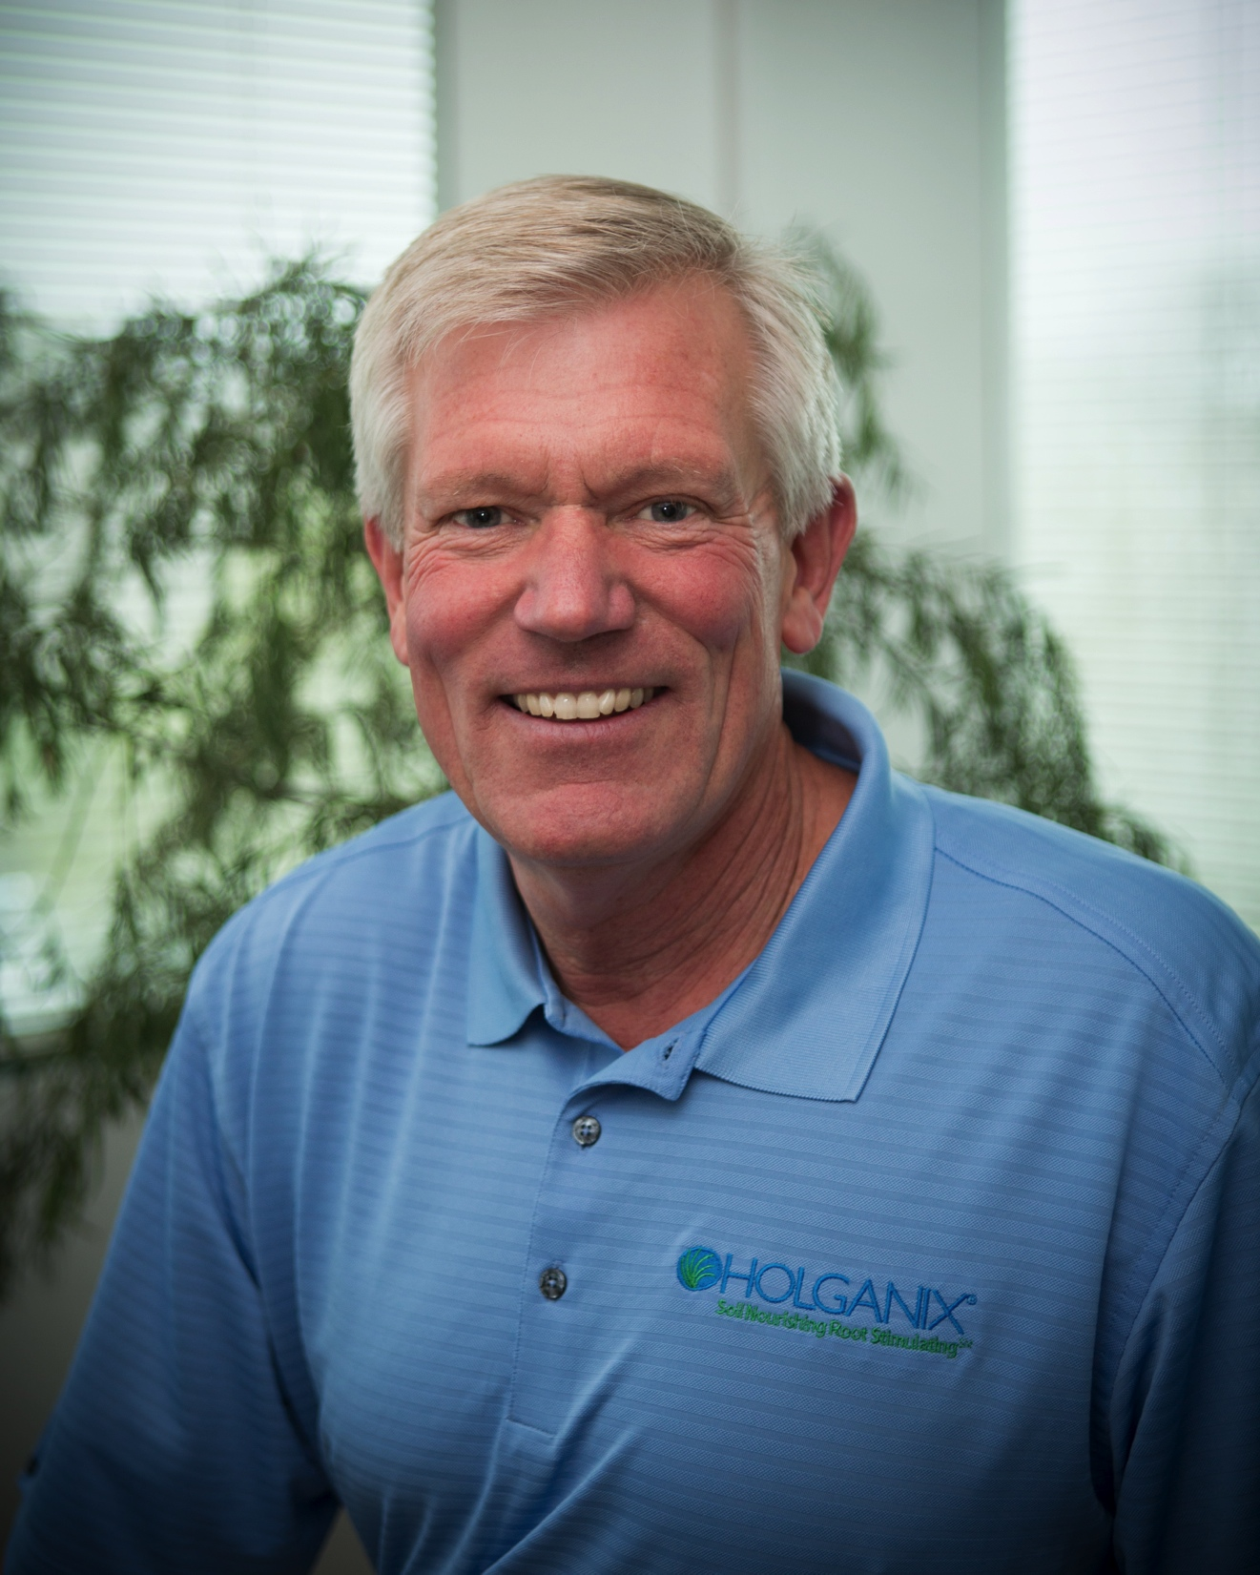
Agronomy Team
Robert Neidermyer Ph.D. Director of Plant and Soil Sciences, Holganix LLC
Stephen T. Lange
Vide President of R&D, Inventor, Holganix LLC
Dave Henricksen
Consultant Agronomist, Advanced Turf Solutions and Holganix LLC
Notes:
P

Slide 5
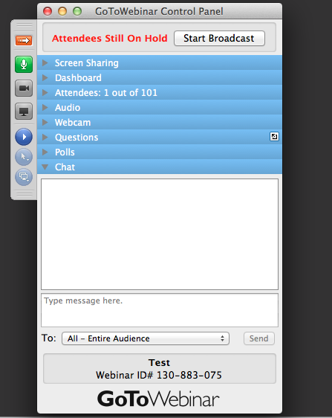
Webinar Semantics
Webinar Semantics
If you have a question, type it here!
Notes:
Insert updated pic

Slide 6
What problems are you facing?

Slide 7
A1
How many of you currently use Holganix?

Slide 8
What is Holganix?
A 100% organic plant & turf product that promotes strong plant health.

Slide 9
Key Ingredients
Compost tea
Endo & Ecto Mycorrhizae
Beneficial fungi & bacteria
Beneficial nematodes
compost tea, humic and fulvic acids, kelp extract, gluten, endomycorrhizae, ectomycorrhizae, nitrogen fixing bacteria, protozoa, nematodes, saccharomyces cerevisiae, polysaccharide, yucca extract, amino acids, zuxin, trochoderma ssp, lingin polymers, secondary and micronutrients
Notes:
Rework this

Slide 10
Q1
When did you first start using Holganix?

Slide 11
A2
Where on the course do you use Holganix?

Slide 12
Q2
Where on the course do you use Holganix?

Slide 13
Q3
What is your application rate? How often do you apply Holganix?

Slide 14
A3
How many of you have seen an improvement in rooting since using Holganix?

Slide 15
Q4
Since introducing Holganix, what changes have you seen with rooting?

Slide 16
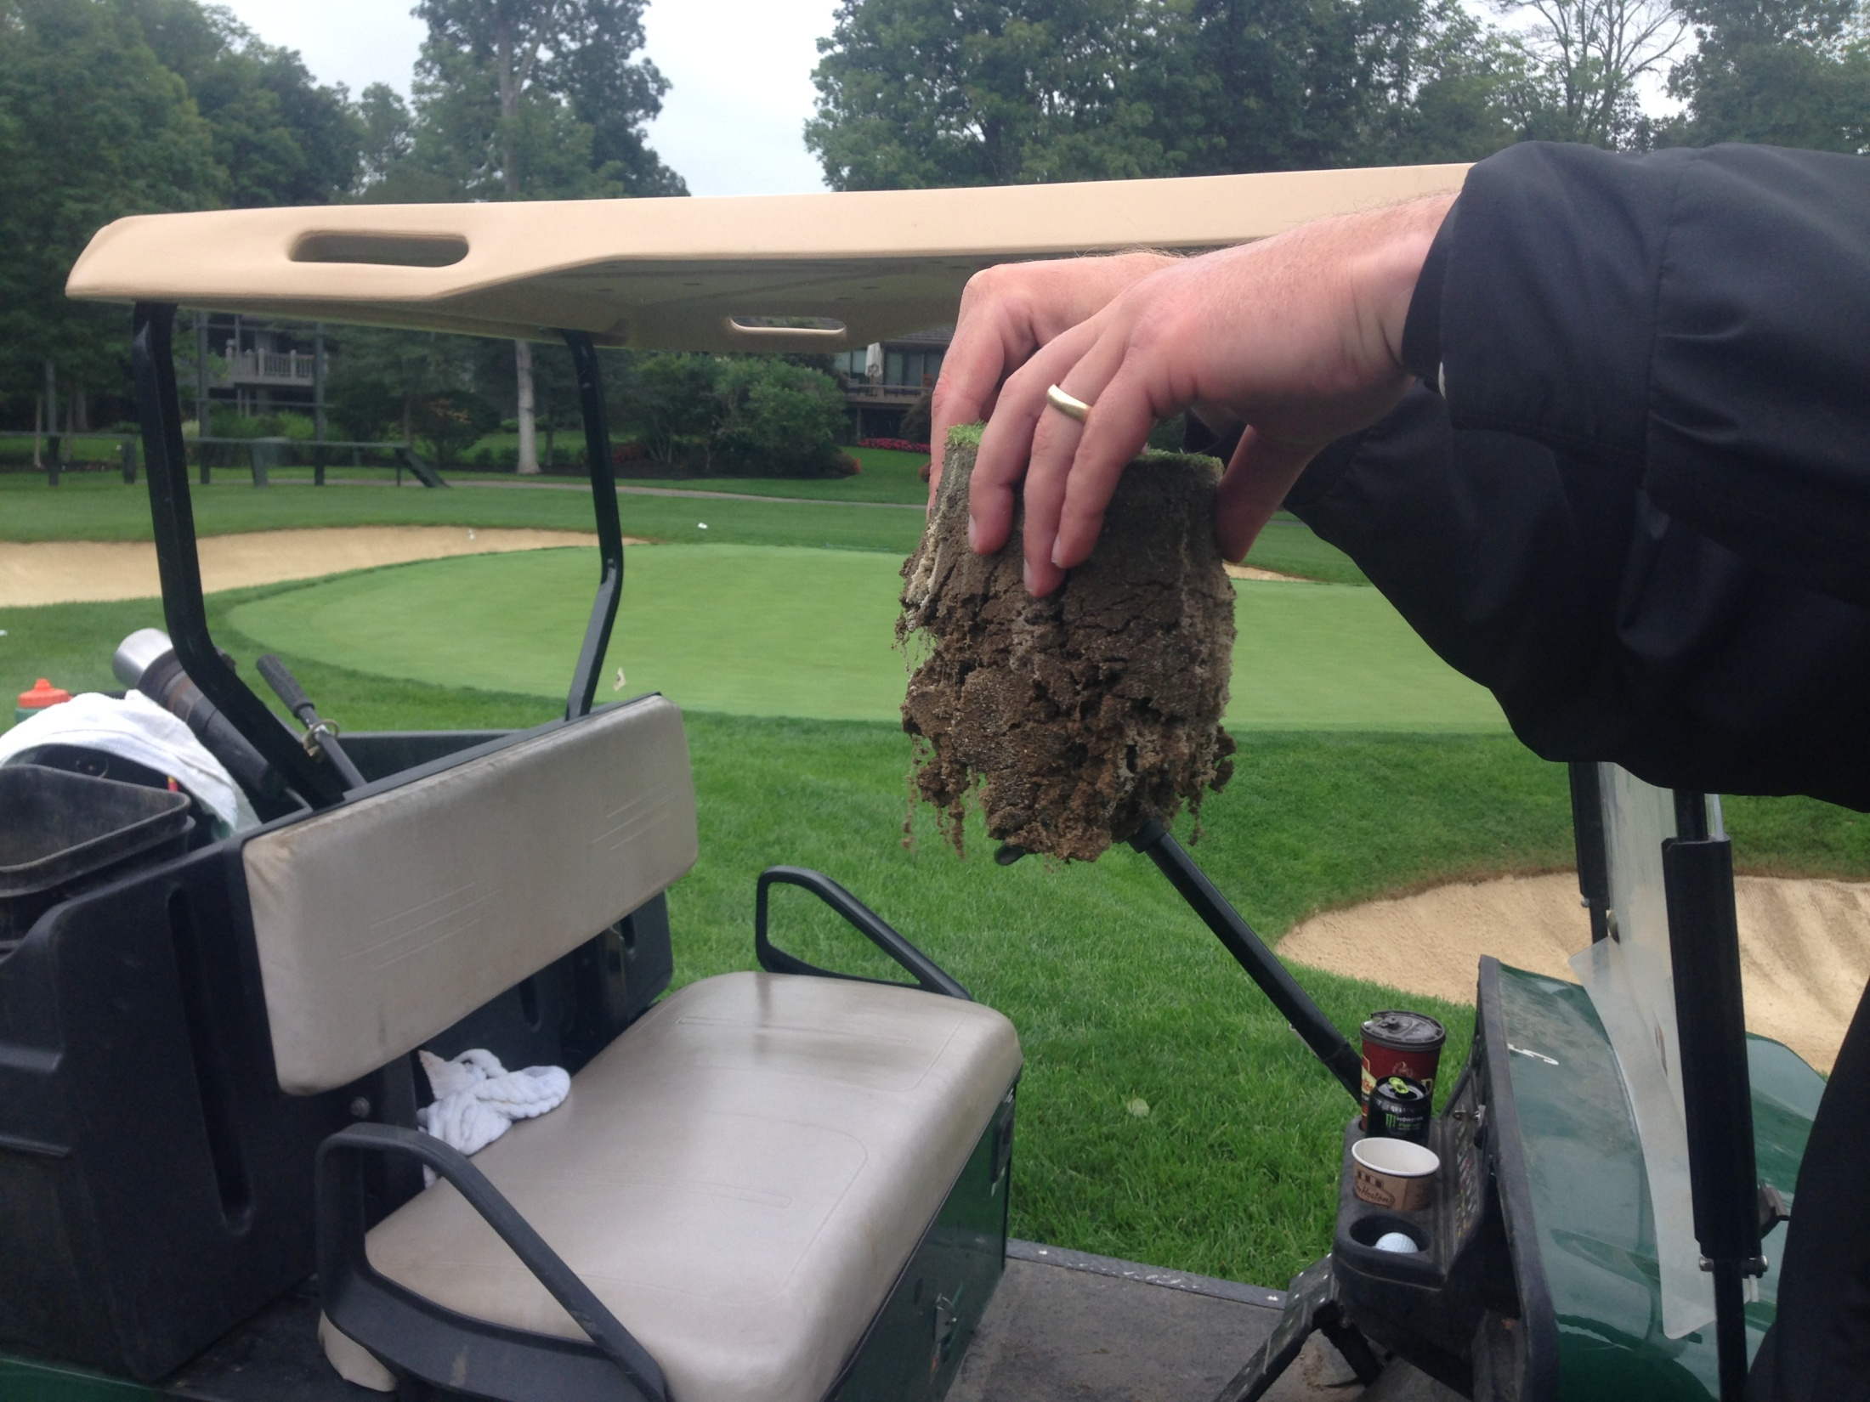
July 29, 2014
1st full year of Holganix program on greens, noticed an increase in the root mass and root length throughout the summer.
Muirfield Village Golf Club

Slide 17
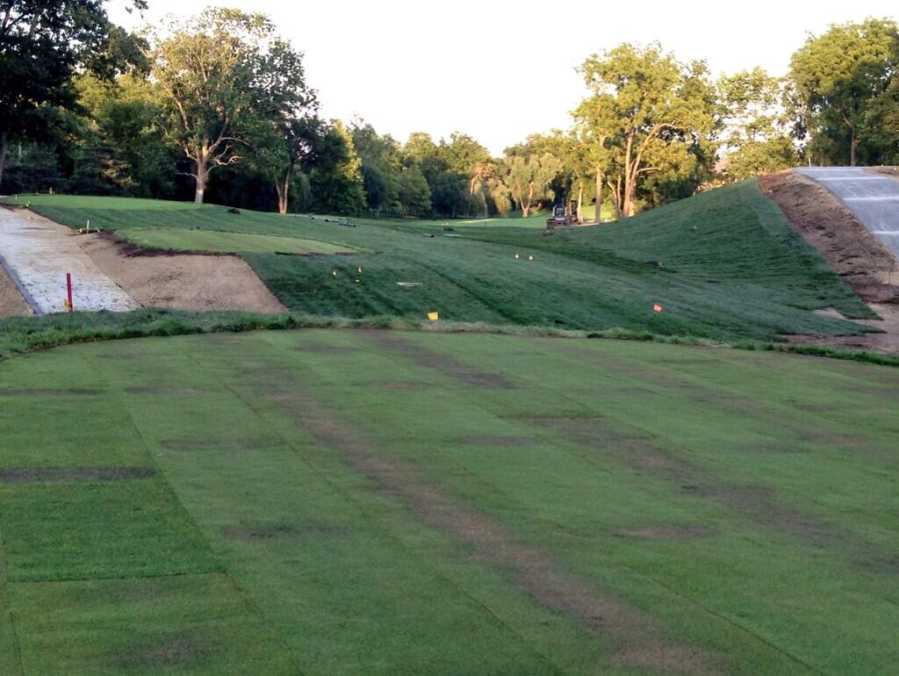
August 13, 2013
Holganix was sprayed on all of the new sod that was laid on 18 tee compound. Sod was laid 45 days prior to the Presidents Cup and needed to be rooted in and stable for players and patrons.
Muirfield Village Golf Club

Slide 18
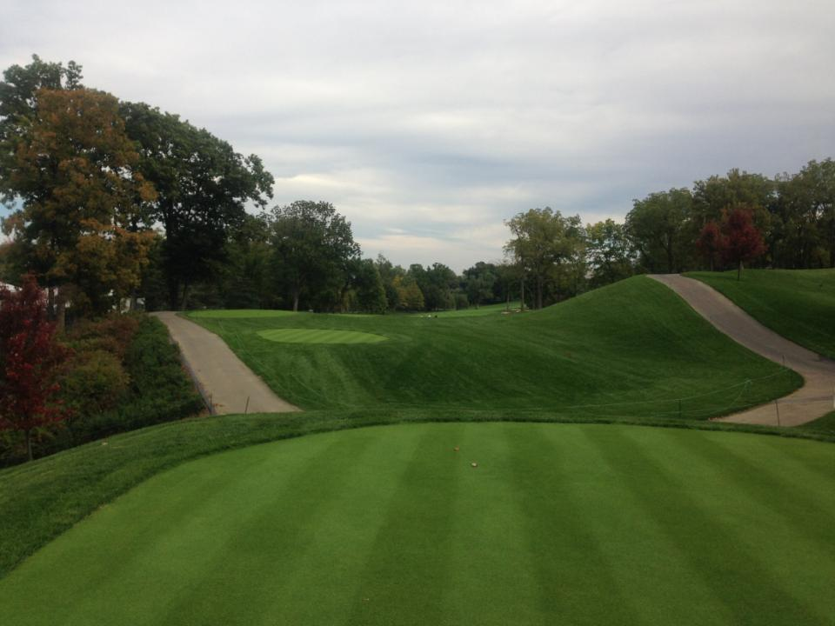
September 13, 2013
Holganix 14 oz/M
Turfscreen 1.2 oz/M
20-20-20 .1 lb/M N,P,K
Foliar Pak micros plus .25 oz/M
Muirfield Village Golf Club

Slide 19
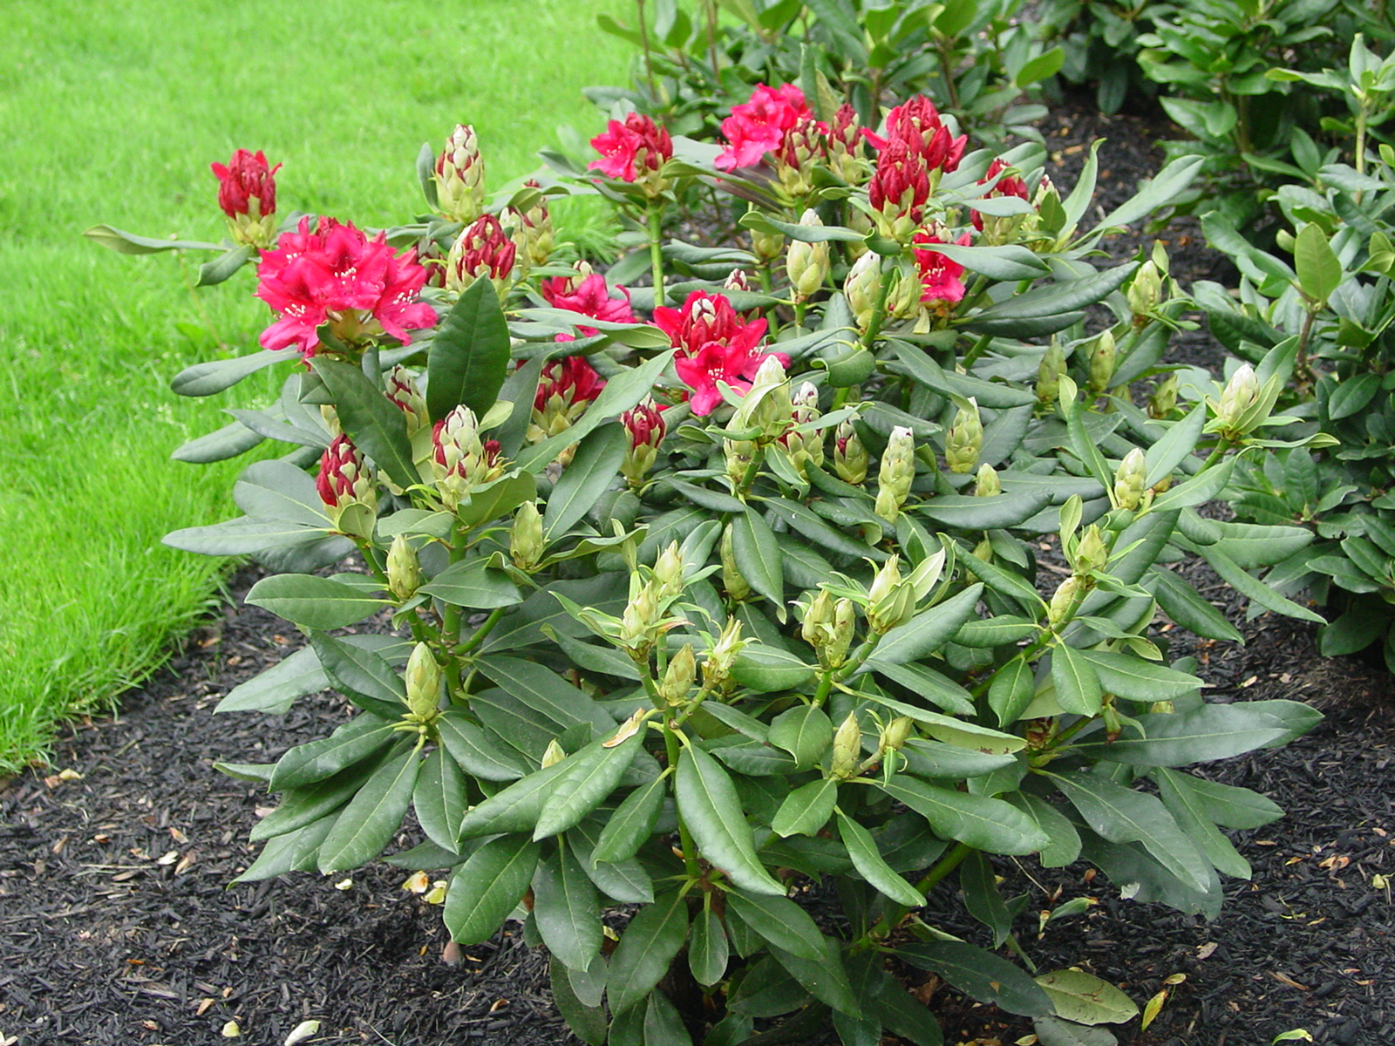
Rhododendrons
Significant decrease of phytophthora
Decrease in drought stress
Continual growth throughout the season
Better overall health
Spruce Trees
Increased vigor
Muirfield Village Golf Club
Notes:
Replace with the green house
Then two begonias then move this to plant health section

Slide 20
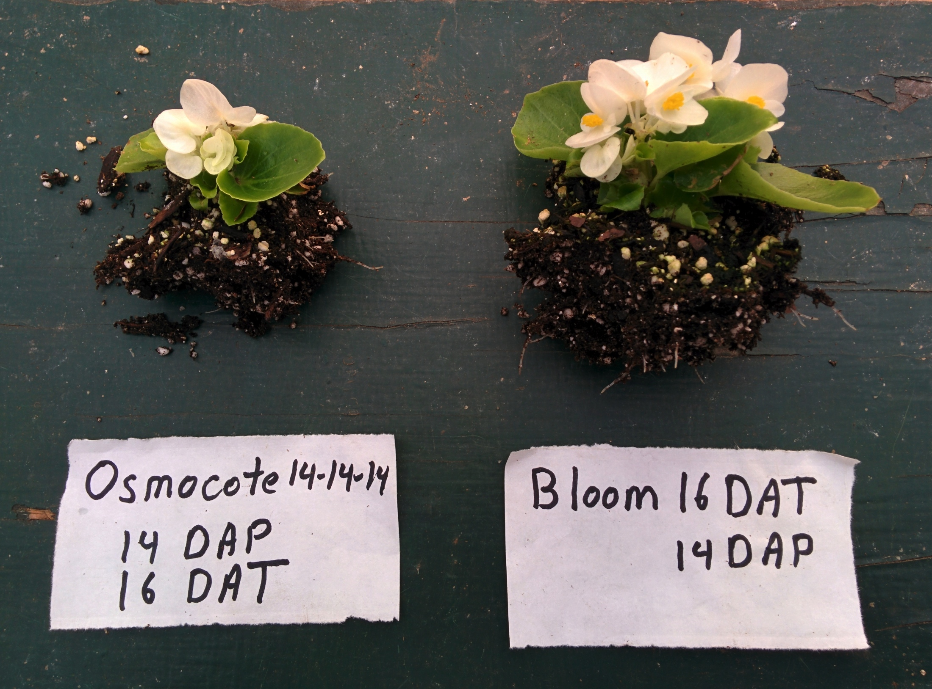

Slide 21
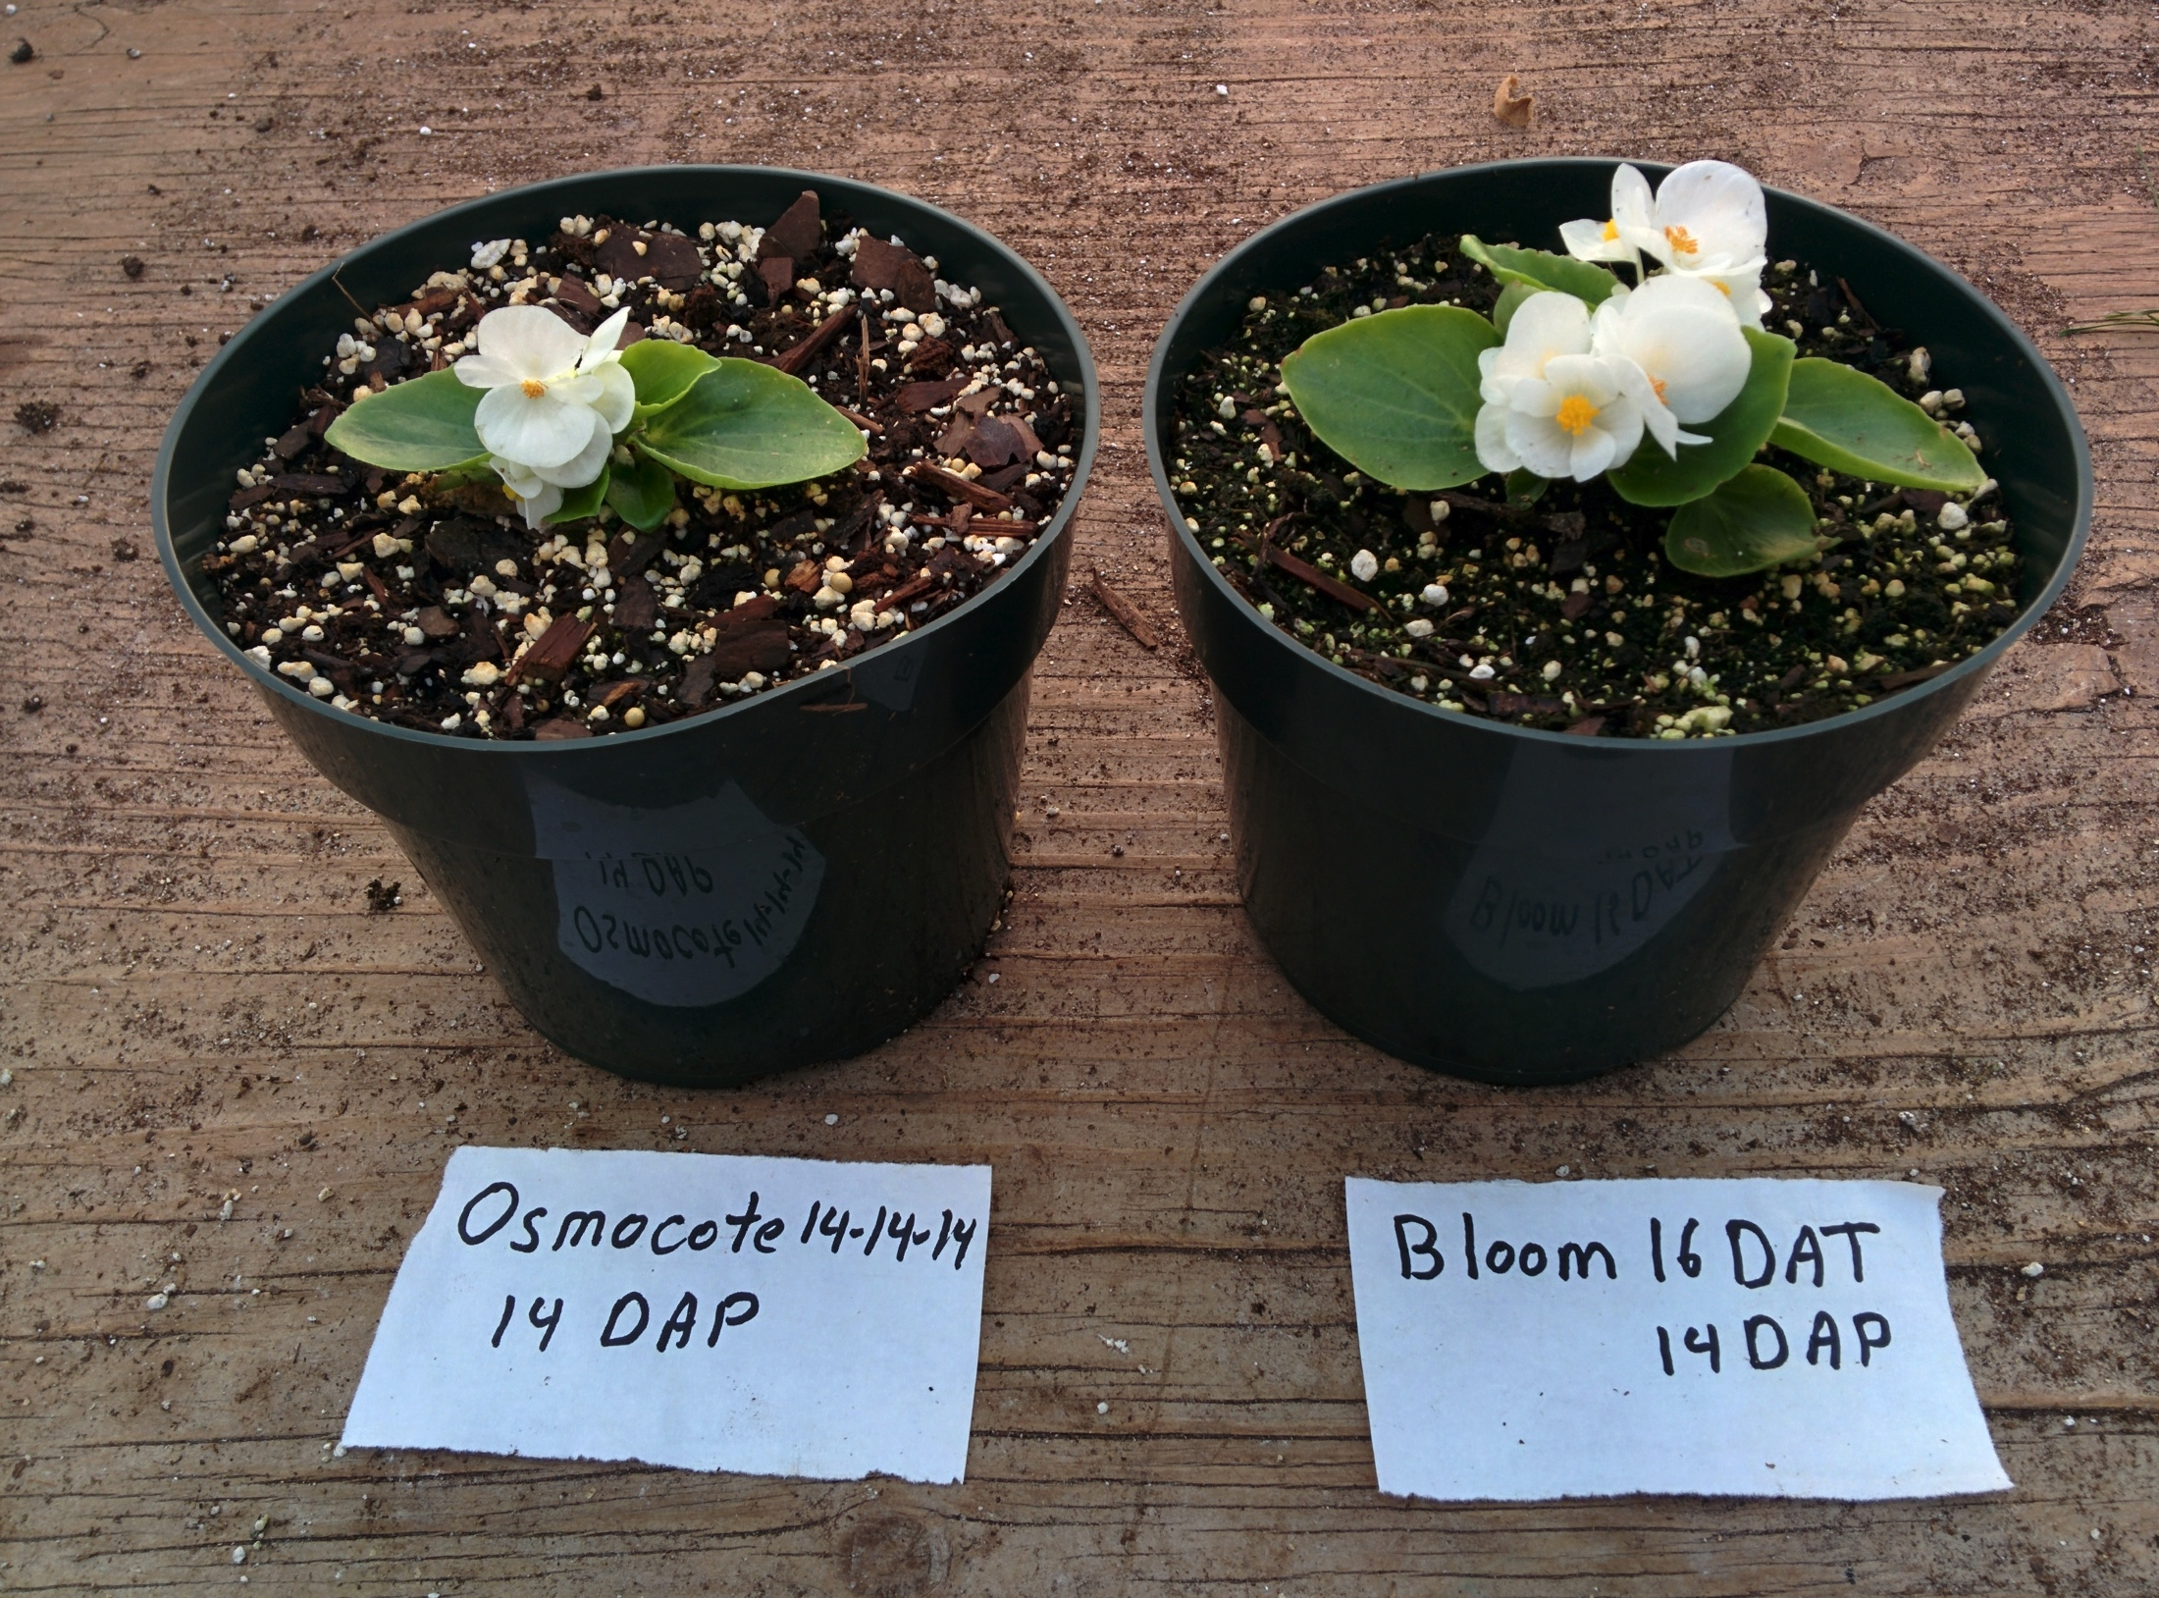
Notes:
Add greenhouse from tim

Slide 22
Q5
Since introducing Holganix, how has your turf/plant quality changed?

Slide 23
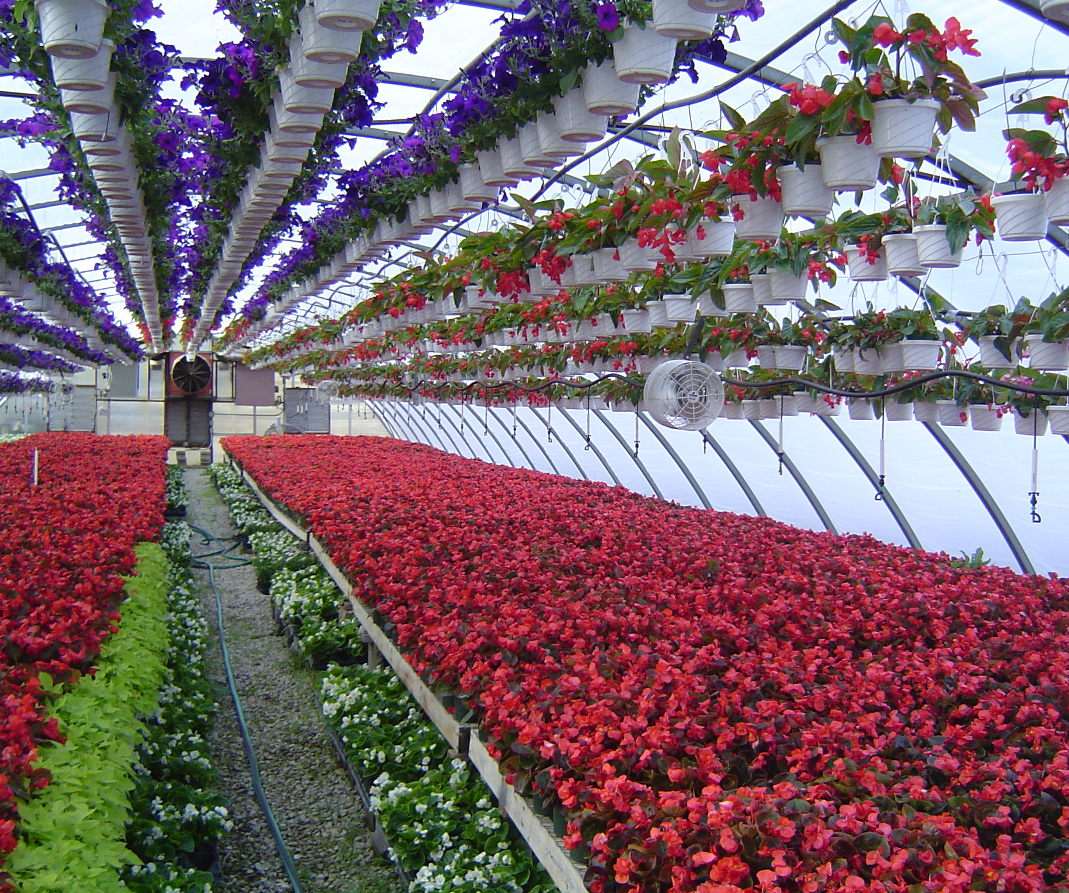
Notes:
Add greenhouse from tim

Slide 24
Q6
Since introducing Holganix, how has your water management changed in terms of irrigation frequency & duration?

Slide 25
Q7
How has Holganix helped with areas of heavy thatch?

Slide 26
Q8
What do your employees think about Holganix?

Slide 27
Q9
When you initially learned about Holganix, how did you feel about the refrigeration aspect?
Notes:
Agetation? What?

Slide 28
Q10
How easy is it to work with the Holganix team and the product?

Slide 29
Audience Questions:
Type your questions for Paul in the Chat Box!

Slide 30
Conclusion
Please take our survey!
Look for a follow up email with:
A recorded version of this webinar
Resources and information mentioned during the webinar

Slide 31
Additional Questions?
Contact Us!
Rob Dillinger
Email: Rdillinger@Holganix.com
Phone: 239-839-3606
Website: www.holganix.com

