Slide 1
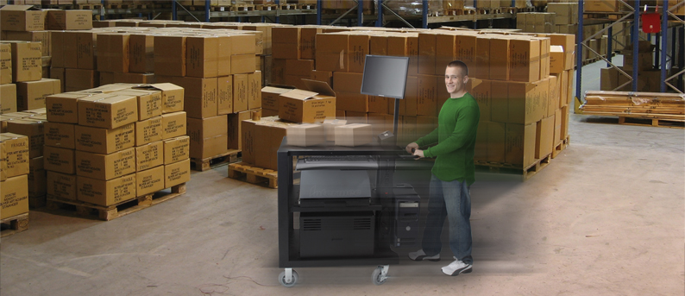
Theresa Lee
Thermal Product Manager - Toshiba
October 17, 2013
Theresa.lee@tabs.toshiba.com
Steve Stark
Sales Executive – Newcastle
sstark@newcastlesys.com
Christine Wheeler
Director Marketing – Newcastle
cwheeler@newcastlesys.com

Slide 2
Steve Stark
Channel Account Manager
Newcastle Systems, Inc.
D: 978-605-5118
sstark@newcastlesys.com
Christine Wheeler
Marketing Director
Newcastle Systems, Inc.
D: 978-605-5119
cwheeler@newcastlesys.com

Slide 3
Newcastle Company Overview
Why Mobile Workstations
Product Portfolio
Applications
Benefits of Mobile Printing
ROI
Success Stories
How to Sell

Slide 4
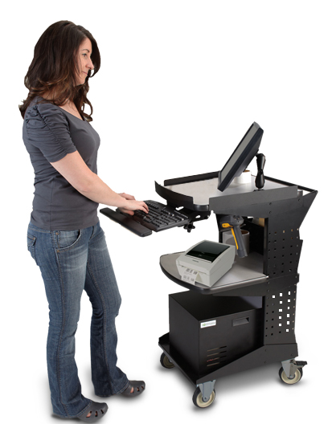
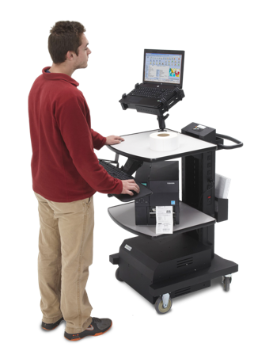
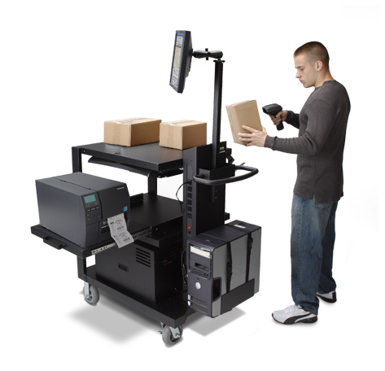
Who Is Newcastle Systems?
Founded in 2005 and headquartered in Middleton, MA (about 20 minutes north of Boston)
Leading solution provider of innovative mobile workplace and portable power systems in North America and beyond

Slide 5
Why Mobile Workstations?
Converting a stationary workplace to a mobile one is the easiest, most economical way to increase productivity of current workers and infrastructure
IMPROVING PROCESSES: Fully leverage your wireless facility by cutting cords and letting workstations move where they are needed
ENABLING PEOPLE: Let your workers have access to data and real-time information ANYWHERE in your facility
NO ADDITIONAL PURCHASES: Integrates with your current hardware and software

Slide 6
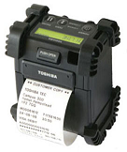
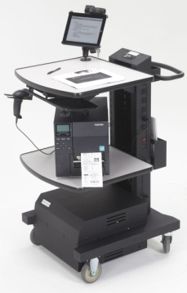
Difference between Mobile Solution vs. Portable Printers
Enable high speed & large volumes label printing
Need Industrial printers with large ribbon and label capacity
Use multiple peripheral devices (printer, tablet,
scanner, variety of labels)
Need flat surface work area
Use and store multiple label sizes & stock
Need 1 or 2 large screen displays
Durable Thermal Transfer quality labels required

Slide 7
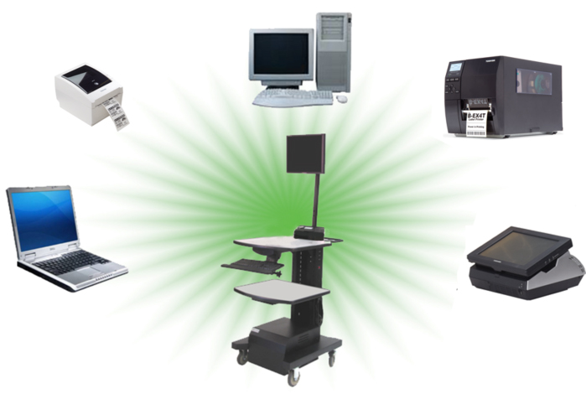
Add Mobility To Your Hardware

Slide 8
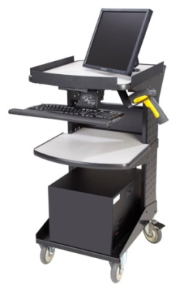
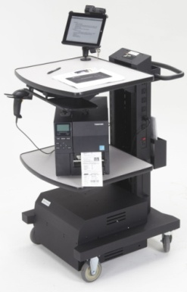
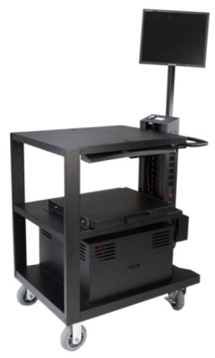
Product Portfolio
Cart Series: | RC Series Compact, Entry-Level Unit | NB Series Mid-Range Unit | PC Series Heavy-Duty Unit
Toshiba Printer: | BEV4D/4T | BEX4T2 | BEX4T1
Retail Floor: | l | l
Warehouse/DC: |  | l | l
Manufacturing: |  | l | l

Slide 9
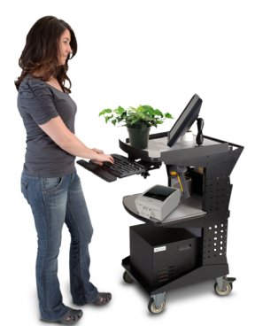
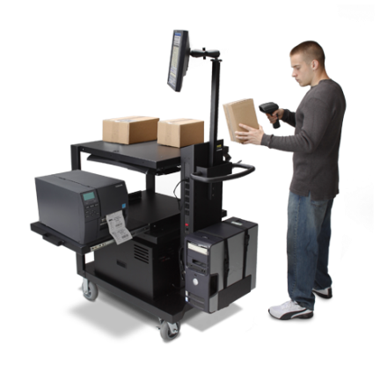
Product Portfolio
Cart Series: | RC Series Compact, Entry-Level Unit | NB Series Mid-Range Unit | PC Series Heavy-Duty Unit
Footprint (WxLxH): | 18.5” x 22” x 39” | 24” x 26” x 42” | 26” x 35.5” x 43” (30” shelf) 26” x 53.5” x 43” (48” shelf)
Typical Hardware: | Laptop/tablet , scanner, small printer (BEV4D/4T ) for 8 hours | Laptop/tablet , scanner, high-volume printer (BEX4T2) for 8-24 hours | PC/Monitor, scanner, high-volume printer (BEX4T1) for 8+ hours
Battery: | 40 & 100 AH | 40, 100, & 200 AH | 100, 200, & 300 AH
Power Swap : | No | Yes (enables 24 hrs. power) | Available Spring 2014
Weight: | 125 - 175 lbs. powered | 165 - 265 lbs. powered | 225 – 385 lbs. powered
Price Range: | $1,530 - $2,046 | $1,850 - $2,763 | $2,166 - $3,409 (30”) $2,418 - $3,649 (48”)

Slide 10
Product Portfolio
Toshiba Printer Series | BEV4D/4T Entry Level | BEX4T2 Mid Range | BEX4T1 High Performance
Carts | RC Series | NB Series | PC Series
Max Speed | 5 IPS | 12 IPS | 14 IPS
Ribbon | 110M | 600M | 800M
Connectivity (std) | Serial, Parallel, USB, Ethernet | USB, Ethernet | USB, Ethernet
Connectivity (opt) | None | Wireless | Wireless
Options | Cutter, Peel Mode | Cutter, Peel Mode | Cutter, Peel Mode, RFID
Weight (lbs) | 5.1 | 36.7 | 36.7
Price | $495- $795 | $1,695-$2,385 | $1,895 - $2,580

Slide 11
Application
RC Cart + Toshiba BEV4D/4T printer
Entry- Level Mobile Solution
Cart: Newcastle RC series
Printer: Toshiba BEV4D/4T
Hardware: PC/Laptop/Tablet, scanner, Low-Mid volume printer
Vertical: Retail in-store, Logistics Light Manufacturing
Application: Inventory in aisle, mark downs, shipping

Slide 12
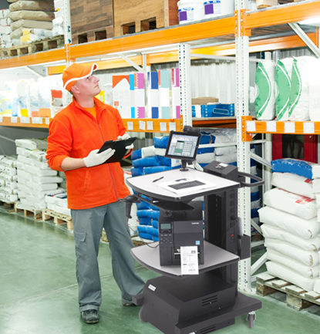
Application
NB Cart + Toshiba BEX4T2 printer
Mid-Range Mobile Solution
Cart: Newcastle NB series
Printer: Toshiba BEX4T2
Hardware: PC/Laptop/Tablet, Mid Volume Industrial Scanner, Printer
Vertical: Manufacturing, DC (Distribution Centers), Logistics (3PLs)
Application: Shipping/Receiving, Picking, Put-away, Cross-docking

Slide 13
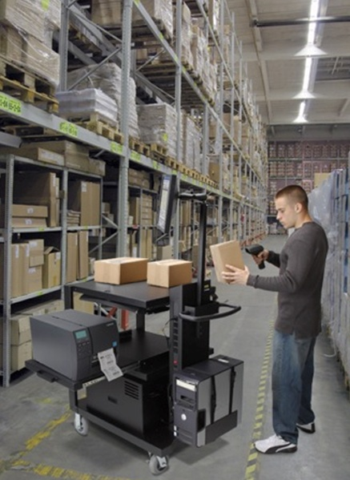
Application
PC Cart + Toshiba BEX4T1 printer
High-Performance Mobile Solution
Cart: Newcastle PC Series
Printer: Toshiba BEX4T1
Hardware: PC/Laptop/Tablet, High Volume Industrial Scanner, Printer
Vertical: Manufacturing, DC, Logistics (3PLs)
Application: Shipping/Receiving, Picking, Put-away, Cross-docking

Slide 14
Benefits of Mobility
Efficiency
Print labels at point of need
Receiving, Cross-Docking,
DC, Store Aisles & more
Relabeling or mark down labels at aisles
Eliminate batch printing at
central locations
Eliminate footsteps and
pick-ups
No errors in matching labels

Slide 15
Benefits of Mobility
Flexibility
Power laptops, tablets,
scanners, printers for (8-24+hrs)*
Adjustable accessories
Pull out shelf
Keyboard tray
Shelves, scanner holder & more
Label/ribbon storage
Supports high volume printing on demand
Fast charging battery 4 – 8 hrs
NEW Power Swap technology that enables 24/7 productivity
* Power Pack Size dependent

Slide 16
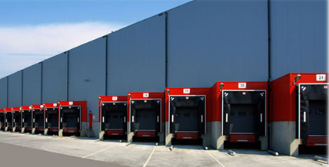
Benefits of Mobility
Cost Reduction
Eliminate costly Ethernet infrastructure
Improve accuracy
Save time and footsteps

Slide 17
Calculate the Savings
Enter # of min. spent walking to static desk, printer, etc. | 6 minutes
Enter average labor rate per hour | $22
Enter # of work hours per week | 40 hours
Enter # of mobile stations to implement | 5 units
Average Cost of Mobile Powered Cart (excluding optional accessories): | $2200

Slide 18
Potential Yearly Savings
$$ saved per year (when walking is eliminated) | $22,880.00
Hours saved per year | 1,040.00
# of months to payback cart purchase | 5.77

Slide 19
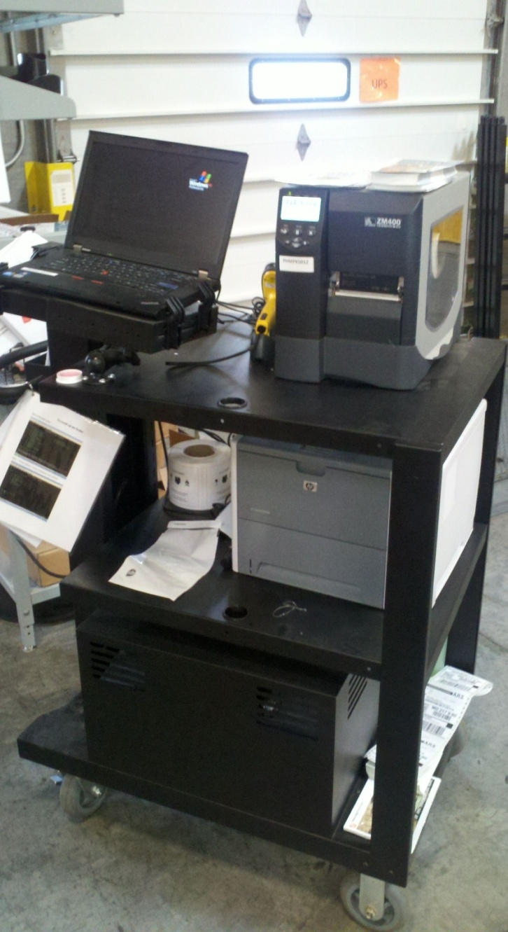
Success Story – Warehouse/DC
Home Depot
Leading home improvement retailer
Shipping department needed to improve labeling accuracy while eliminating walking time to stationary location to print pick ticket, packing slip and UPS label
PC Series w/laptop, barcode and laser printer has eliminated the walking time and has improved accuracy as labels and forms are printed on-demand

Slide 20
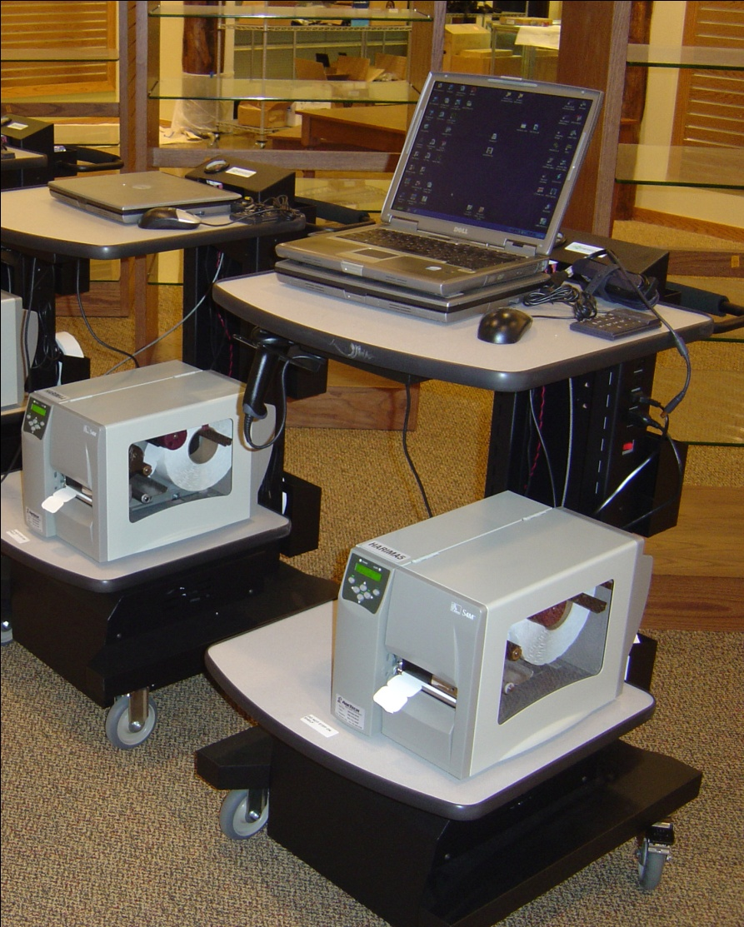
Success Story – Retail Floor
Cabelas
Leading specialty retailer of hunting, fishing and camping items
Previously used hand-held to scan empty product holders on floor. Clerk then had to check out back if items were in stock, update and print pricing labels
The NB Series w/laptop and barcode printer automated inventory and label printing on floor
Since the system deployment, they reported 60%+ reduction in stock outs, with as much as 33% more products available in its stores

Slide 21
How To Sell
TBS Sales find mobile printing opportunity
Contact Toshiba BDMs in regions
Toshiba BDM qualify opportunity with Newcastle Sales and TBS Sales
TBS signs up with Newcastle as reseller
TBS package printer, print cart, service, consumables, installations to customer

Slide 22
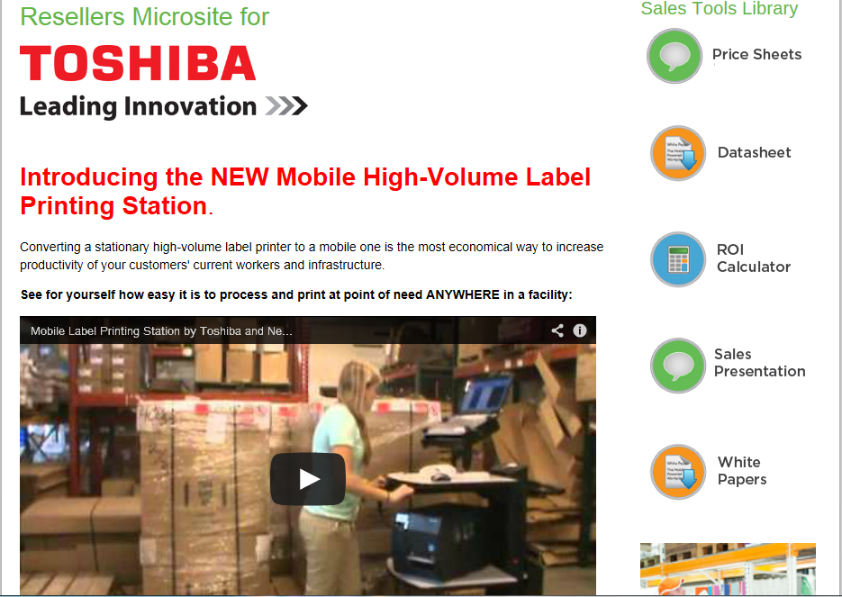
Microsite – Sale Tools
Microsite link: www.newcastlesys.com/toshiba
Price Sheets
Data Sheet
Sales Presentation
Family Comparison
White Papers
Warranty Statement
Videos
Sales Map & Contacts
Reseller Application

Slide 23
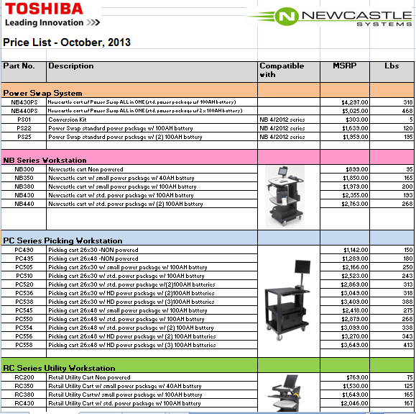
Pricing
Sell at List price

Slide 24
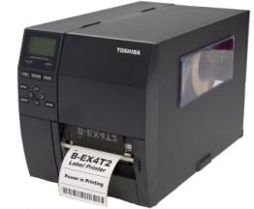
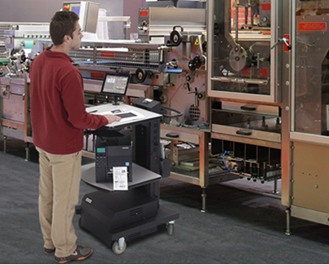
Warranty
Newcastle Mobile Carts
Metal Components
5 years from date of purchase
Electronic Components
1 year from ship date
Batteries
6 months *
Toshiba Printers
1 Year return to depot
All parts & labor
* Voided if battery is left in discharged state for more than 3 days.

Slide 25
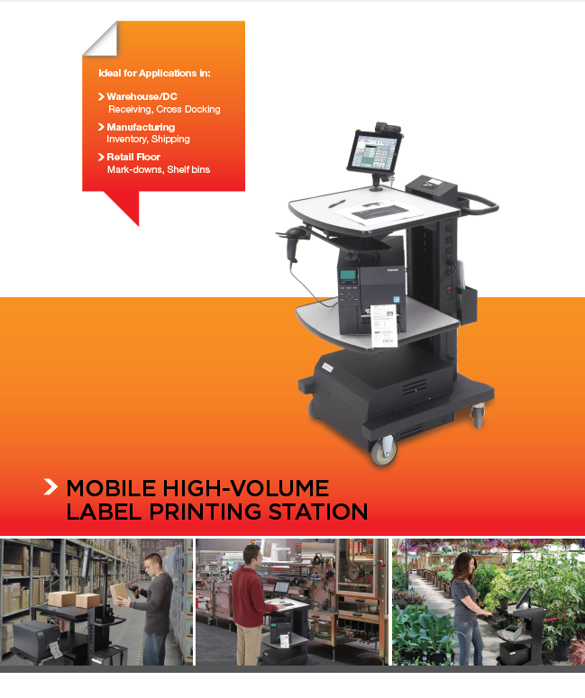
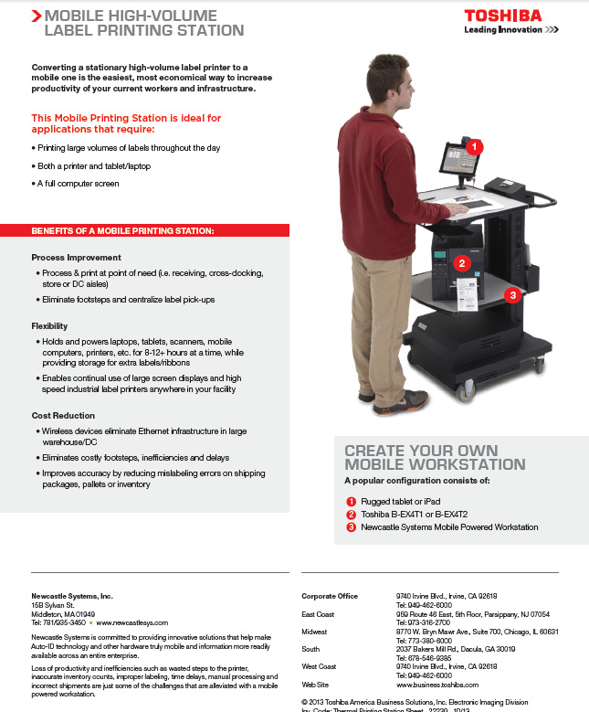
Brochure

Slide 26
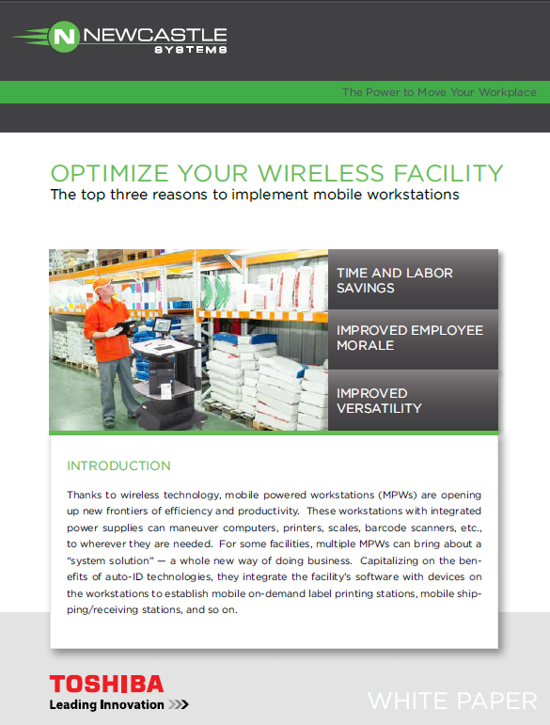
White Papers

Slide 27
Toshiba & Newcastle Sales Contacts
JEFF JACKMAN
NATIONAL ACCOUNT DIRECTOR
jeff. jackman@tabs.toshiba.com
(678) 276-9499
TOM WATT
BUSINESS DEVELOPMENT MANAGER
tom.watt@tabs.toshiba.com
(267) 784-1240
Chris Paquin
BUSINESS DEVELOPMENT
cpaquin@newcastlesys.com
978-605-5121
TONY DIPIETRO
BUSINESS
DEVELOPMENT MANAGER
tony.dipietro@tabs.toshiba.com
(443) 929-1607
Steve Stark
BUSINESS DEVELOPMENT
sstark@newcaslesys.com
(978) 605-5118
AK
JASON STEVENS
BUSINESS DEVELOPMENT MANAGER
Jason.stevens@tabs.toshiba.com
(303) 898-7038
WA
Steve Stark
BUSINESS DEVELOPMENT
sstark@newcaslesys.com
(978) 605-5118
MT
ND
ME
MN
WI
VT
OR
ID
SD
MI
NY
NH
MA
WY
PA
IA
NJ
NV
NE
IL
OH
MD
DE
John O’Kelly
BUSINESS DEVELOPMENT
jokelly@newcastlesys.com
978-605-5116
Steve Stark
BUSINESS DEVELOPMENT
sstark@newcaslesys.com
(978) 605-5118
UT
IN
WV
VA
CA
CO
KS
MO
KY
TN
NC
OK
AR
SC
AZ
NM
MS
GA
Chris Paquin
BUSINESS DEVELOPMENT
cpaquin@newcastlesys.com
978-605-5121
MS
AL
TX
LA
Chris Paquin
BUSINESS DEVELOPMENT
cpaquin@newcastlesys.com
978-605-5121
HI
FL
RON BROWN
BUSINESS DEVELOPMENT MANAGER
ron.brown@tabs.toshiba.com
(817) 932-4171
Ellen Hollingsworth
BUSINESS DEVELOPMENT
customerservice@newcastlesys.com
978-605-5117
John O’Kelly
BUSINESS DEVELOPMENT
jokelly@newcastlesys.com
978-605-5116

Slide 28
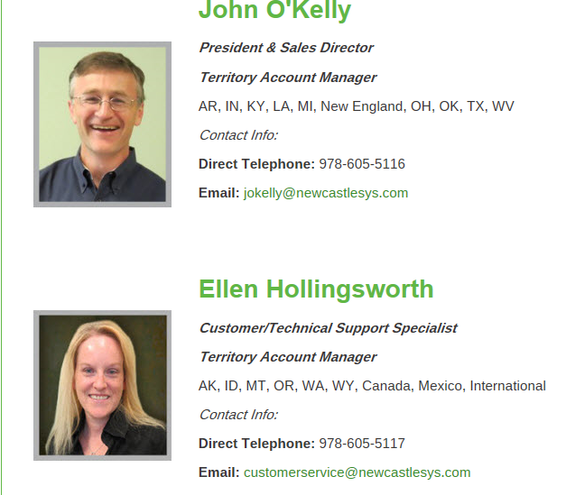
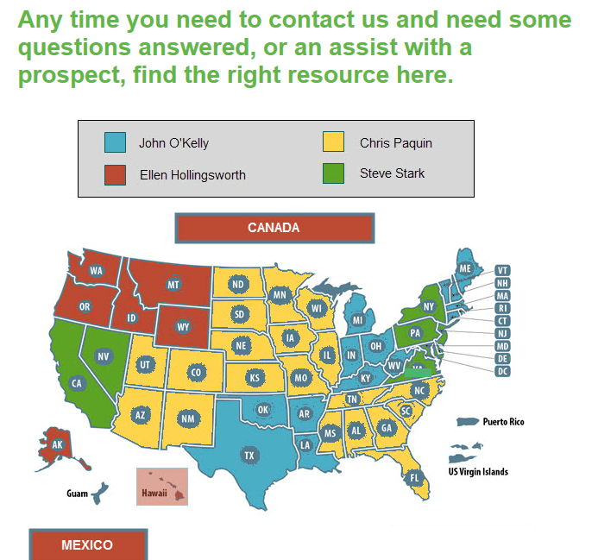
Newcastle Sales Contacts

Slide 29
Marketing Program
Program: DC Velocity eBlast
Dates: 10/29 and 12/4
Goal: Promote Awareness
of Mobile Printing Solution
Target: Warehouse/DC IT & Operation Managers
Method: eblast to 36,735 contacts
Message: Key Benefits of Mobile Printing
Lead: Prospects submit contact information to download white paper, ROI calculator and Brochure
Leads will be distributed to Toshiba BDMs & Newcastle Account Managers

Slide 30
Q & A

