Slide 1
Mouldy buildings
Dr. James Scott
Associate Professor, Division of Occupational & Environmental Health
Dalla Lana School of Public Health, Univ of Toronto
Laboratory Director, Sporometrics

Slide 2
Overview
Mould biology & health impact
Why here, why now?

Slide 3
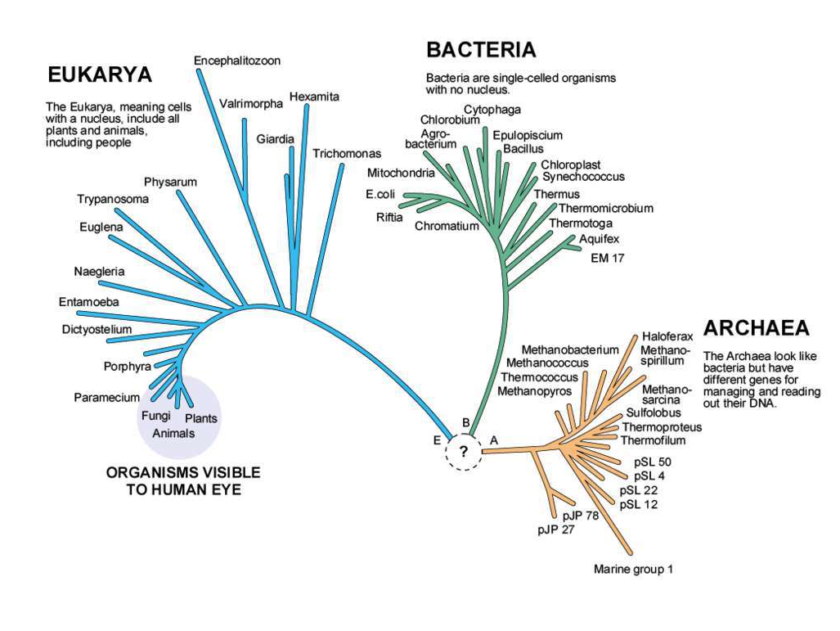
TREE OF LIFE
adapted from Dr. Carl Woese and Dr. Norman R. Pace, New York Times, April 14, 2008, p C1

Slide 4
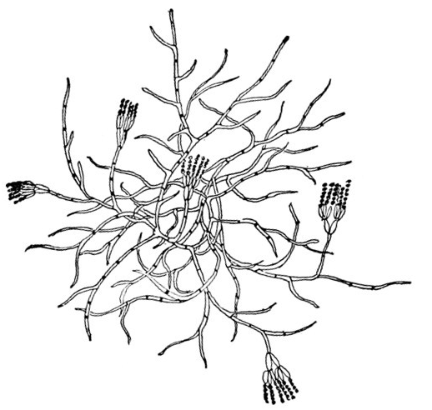
What is mould?
If mushrooms are the "trees" of the fungal world, then moulds are its "weeds"
Moulds are quick-growing, heavily spore-producing fungi
They grow on easily- digestible materials
just add water!
They make lots of toxins and allergens

Slide 5
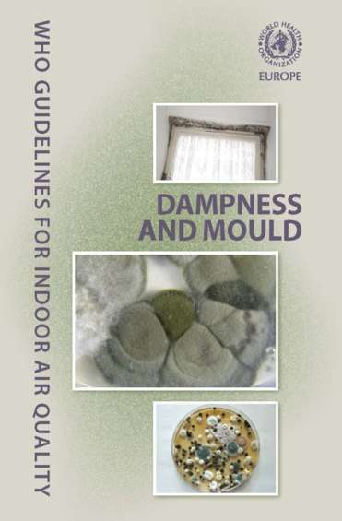
Moulds and health
Lots is known about indoor moulds and health
anyone can be affected, but kids are especially vulnerable
Kids who live in mouldy homes are sicker
more respiratory symptoms
more respiratory infections
higher rates of allergy and asthma
http://www.euro.who.int/__data/assets/pdf_file/0017/43325/E92645.pdf

Slide 6
Here's what we know
Mould grows when things get wet
It only takes about 2 days for it to start
It doesn't matter what the mould is
Forget "black mould" is bad
All mould is bad. Period.
It doesn't matter where the mould is
Its bad if you can see it
Its still bad even if you can't (its just harder to find)

Slide 7
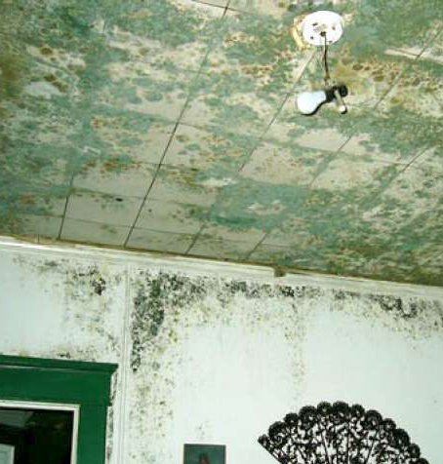
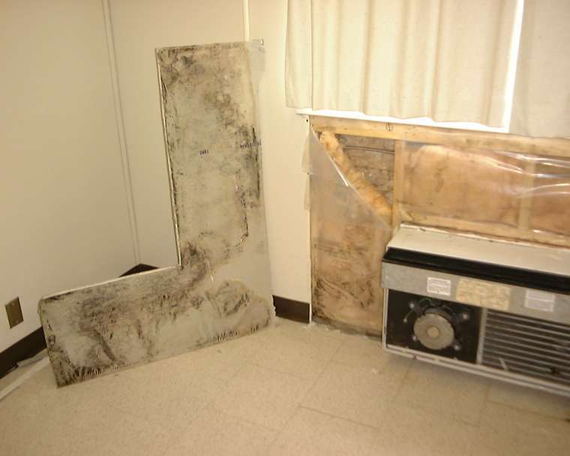
More mould = More risk

Slide 8
Mouldy housing: Why here? Why now?

Slide 9
1. Health demographics

Slide 10
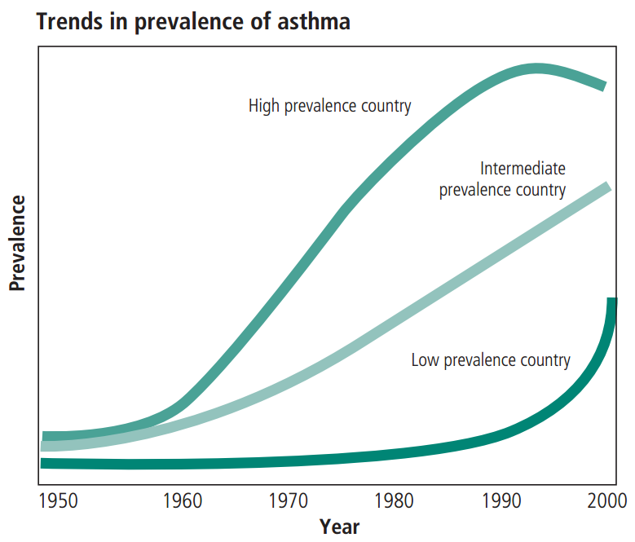
BOUSQUET, Jean; BOUSQUET, Philippe J.; GODARD, Philippe and DAURES, Jean-Pierre. The public health implications of asthma. Bull World Health Organ [online]. 2005, vol.83, n.7, pp. 548-554. ISSN 0042-9686.

Slide 11
2. Building materials (but first some explanation)

Slide 12
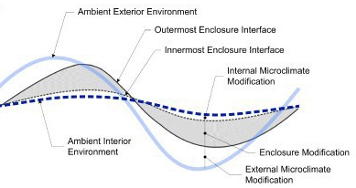
Homeostasis
INDOORS
OUTDOORS
Enironmental parameter
e.g., temperature
Time period
Notes:
We began building structures as a way to defy the environment around us, to protect ourselves from danger and to insulate ourselves from the ever-changing environment around us.

Slide 13
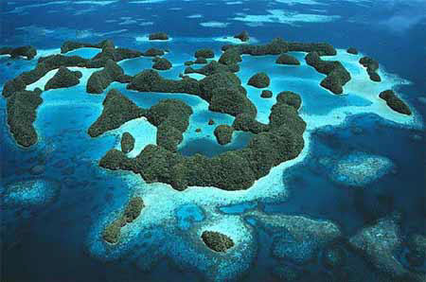
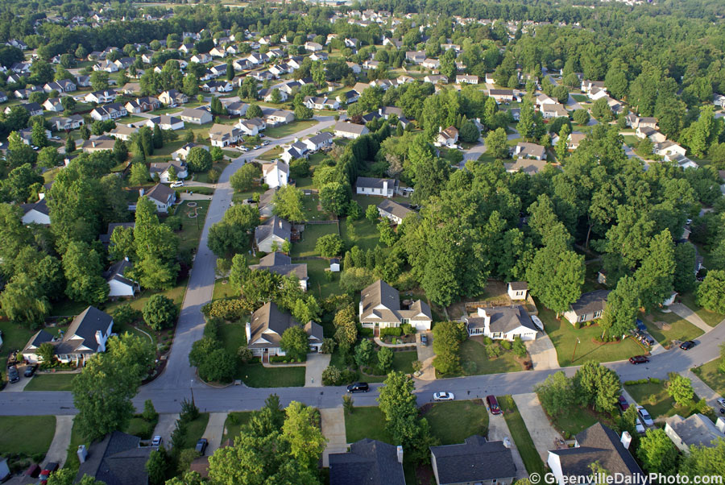
Insulate
Notes:
The word "insulate" comes from the Latin work for Island. Where we line, here, in the cooler part of North America, as in similar places around the world, the insulation afforded us by our houses serves a closely analogous purpose - it permits us to establish islands of stable tropical climate despite being surrounded by a sea of dynamic, temperate climate.

Slide 14
A brief history of construction
HEATING
FUELS
Wood,
dung
Coal,
gas
Petroleum,
electricity
BUILDING
MATERIALS
Wood, straw, mud, hides, stone, dung
Steel,
concrete,
asphalt
Paper, aluminum, wood composites,
plastics, glass,
Fired brick, plaster
BUILDINGS
Caves
Rudimentary
structures
Durable huts,
first cities
Stone
castles
Skyscraper
multi-storey,
single family
R2000, energy-efficiency, LEEDS
INNOVATION
Agriculture
Irrigation
Industry
Information
PERIOD
Neolithic
revolution
Urban
revolution
Industrial
revolution
Suburban
revolution
TIMELINE
10,000 BCE
3,000 BCE
1CE
Present
Adapted from: Schoenaur N, 6000 years of housing. 3rd ed, New York: WW Norton (2003)
Notes:
Indoor mould is a new problem. Moulds were not much of a problem is housing prior to what I've called the suburban revolution. There are a bunch of reasons for this, but the first reason is because we started to build with different materials.

Slide 15
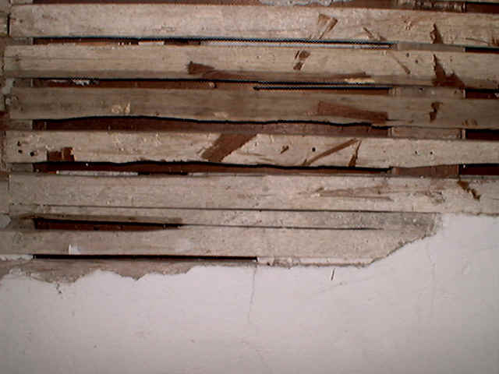
Plaster on lath
Notes:
It was not long ago that we constructed the interior walls of our houses here in the cooler region of North America like this...

Slide 16
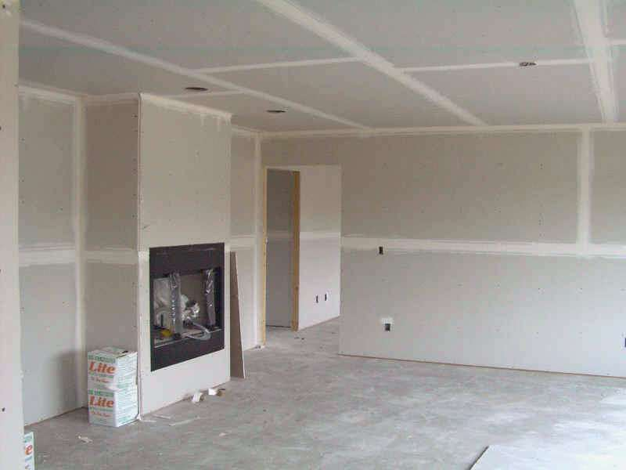
Notes:
But since the 1950s or 60s, we've been constructing them more like this, using prefabricated panels of paper-gypsum sandwich that we call wallboard. Its faster, its easier and its cheaper. But its probably not better.

Slide 17
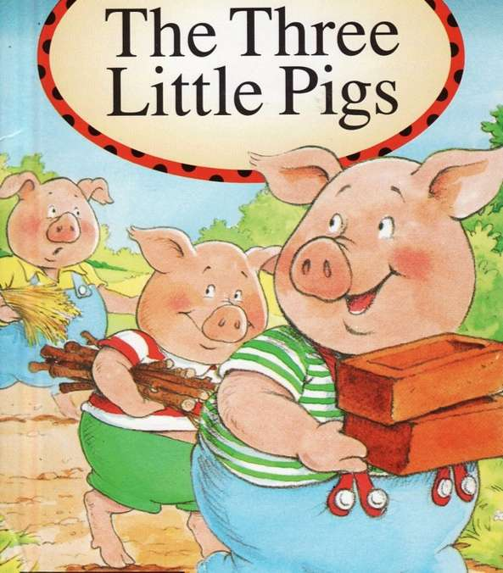
Notes:
Like my colleague Mac Pierce in Minnesota likes to remind audiences, even the stupidest of the Three Little Pigs, this one here, didn't build his house out of paper., and there's a good reason why.

Slide 18
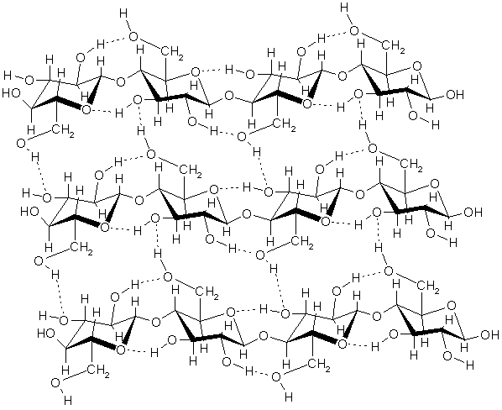
Cellulose
Notes:
Paper is celluose. It comes from wood and other plant material. Plants build their cell walls out of bundles of cellulose fibers, which are light and flexible but extremely strong. Cellulose is a polymer, which means that it is a substance that is composed of a bunch of small parts, in this case, the small parts are molecules of the sugar, glucose

Slide 19
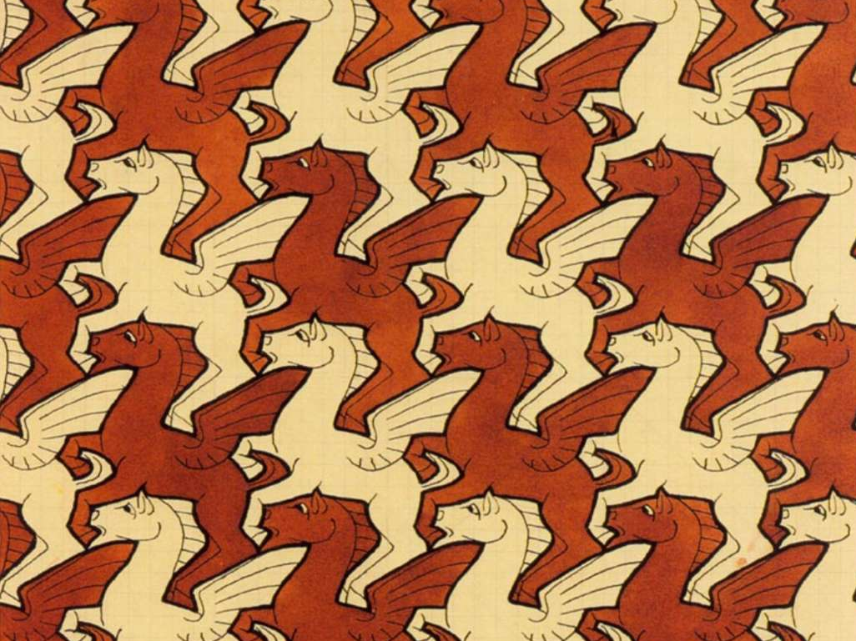
Notes:
Sort of like the flying horses in MC Escher's tessellation drawing of Pegasus.

Slide 20
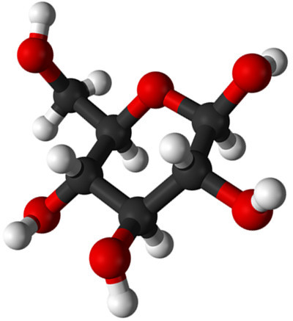
Glucose
its a sugar
its the core building block of cellulose, the construction material of plant cells
nearly all organisms on earth can use it
most fungi can convert celluose into glucose
but then how do trees and other plants avoid fungal attack?

Slide 21
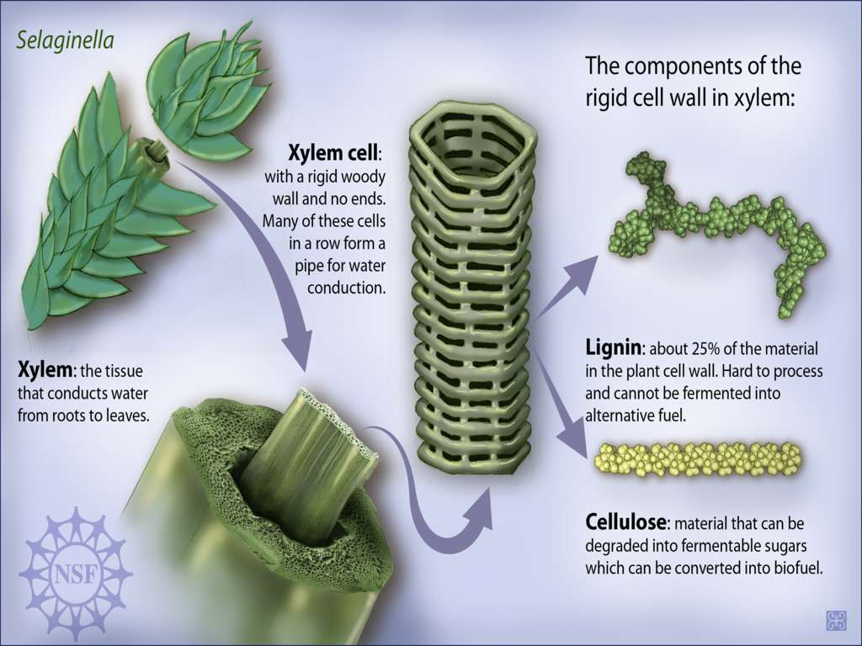
PBWiki - http://pbworks.com/
Notes:
They have evolved to protect their cellulose with a brown tar-like substance called "lignin". Lignin mostly prevents fungal enzymes from breaking down cellulose, protecting it. There are a small number fungi that can inactivate the lignin and attack the cellulose. These are the fungi responsible for destroying houses from antiquity up to the suburban revolution.

Slide 22
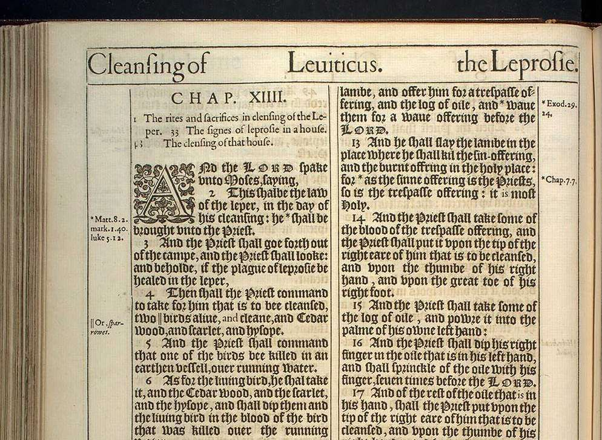
Notes:
These fungi are responsible for the "leprosy of the house" described in the 14th chapter of Leviticus, the third book of Moses.

Slide 23
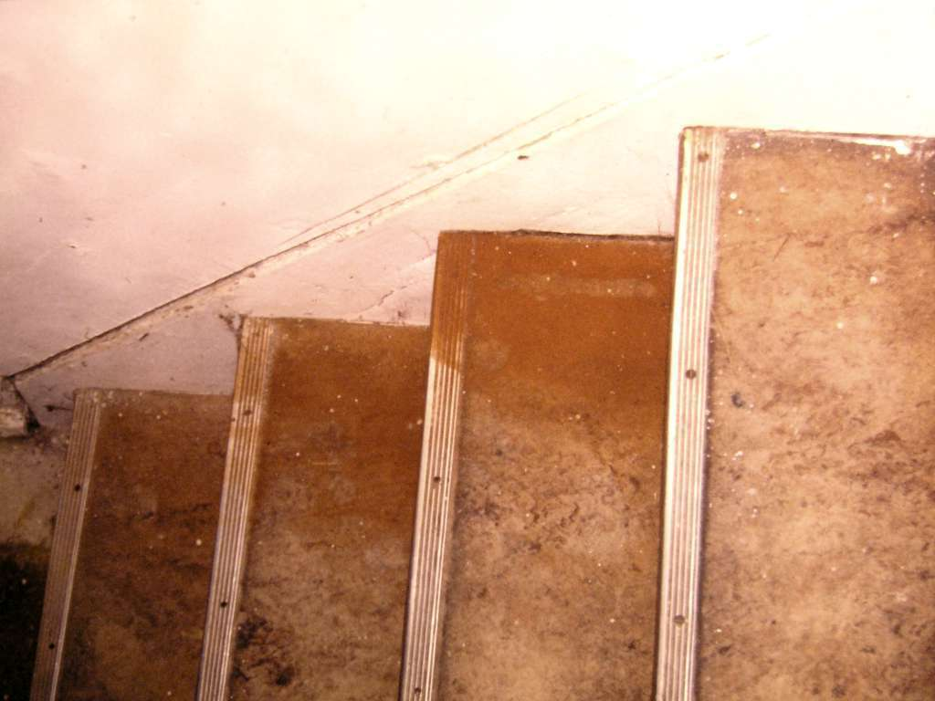
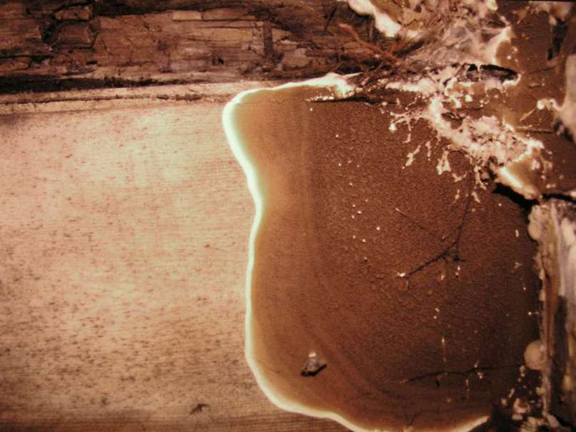
Notes:
The plague is "dry rot", and its caused by a very small and specialized group of mushrooms, with Latin names like Serpula, Merulius, and Poria. They attack whole wood, cellulose, lignin and all, and they reduce it to dust, in the process, emitting copious spores that resemble orange-brown dust. It's still a plague in Europe, where old wooden posts and beams are in contact with damp stone and soil. But its comparatively rare in North America.

Slide 24
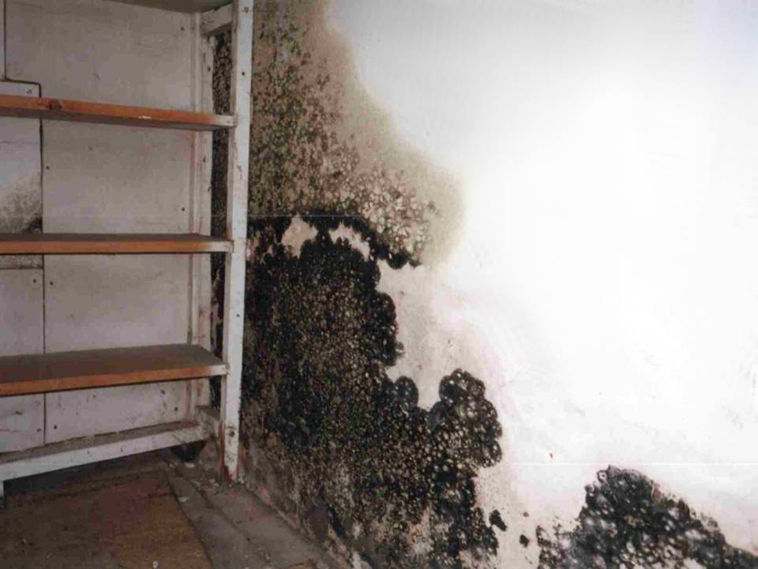
Bernard Siedlecki 1998
Notes:
But the modern house fungi are moulds, like this one. They are much more prolific, under the right moisture conditions they grow on a wide range of materials

Slide 25
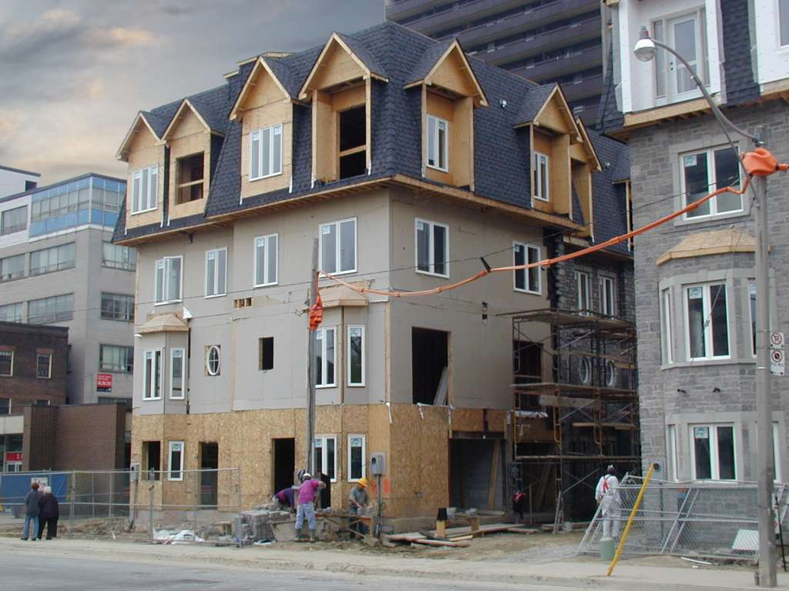
Townhouses
Spadina Rd, Toronto

Slide 26
3. Construction and maintenance practices

Slide 27
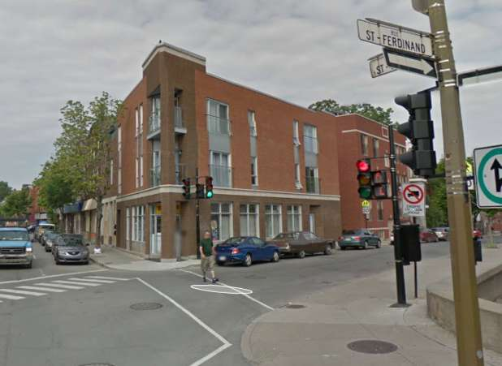
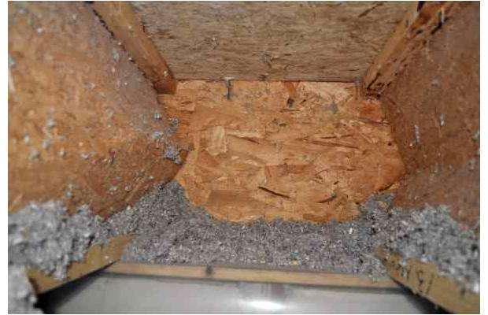
Crumbling condominium, 2009
Montreal, Quebec

Slide 28
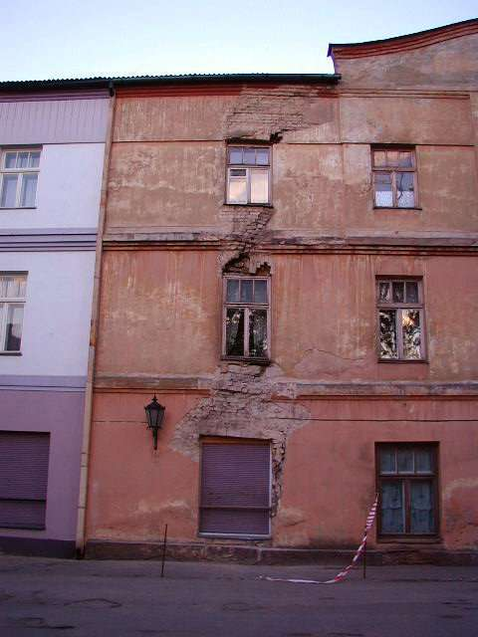
Crumbling building, 2000
Cĕsis, Latvia

Slide 29
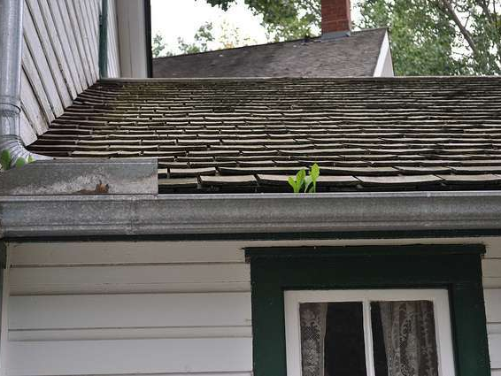
Weedy rain gutter
Unknown

Slide 30
4. Design

Slide 31
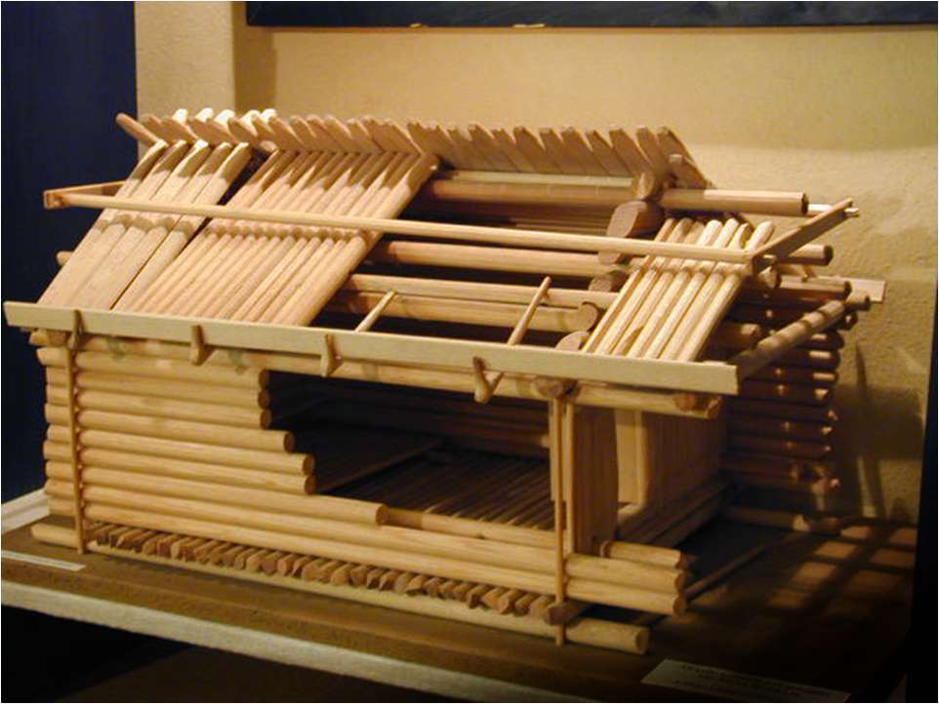
Traditional log house model, ca. AD 1200
Cĕsis, Latvia

Slide 32
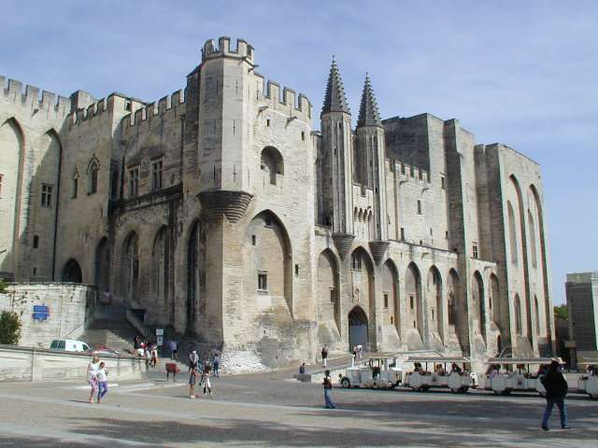
Palais des Papes by Pierre Poisson and Jean de Louvres, AD 1252-1364
Avignon, France

Slide 33
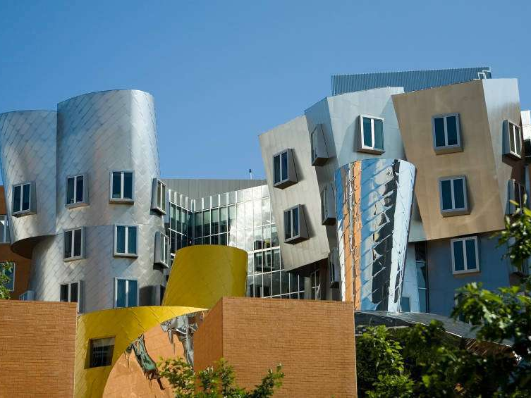
Ray and Maria Stata Center by Architect Frank Gehry, AD 2004
At the Massachusetts Institute of Technology (MIT) in Cambridge
Notes:
from Wikipedia: On October 31, 2007,[9] MIT sued[10] architect Frank Gehry and the construction companies, Skanska USA Building Inc. and NER Construction Management, for "providing deficient design services and drawings" which caused leaks to spring, masonry to crack, mold to grow, drainage to back up, and falling ice and debris to block emergency exits.[7] A Skanska spokesperson said that, prior to construction, Gehry ignored warnings from Skanska and a consulting company regarding flaws in his design of the amphitheater, and rejected a formal request from Skanska to modify the design.[7]
In an interview, Mr. Gehry, whose firm was paid $15 million for the project, said construction problems were inevitable in the design of complex buildings. "These things are complicated," he said, "and they involved a lot of people, and you never quite know where they went wrong. A building goes together with seven billion pieces of connective tissue. The chances of it getting done ever without something colliding or some misstep are small." "I think the issues are fairly minor," he added. "M.I.T. is after our insurance." Mr. Gehry said value engineering—the process by which elements of a project are eliminated to cut costs—was largely responsible for the problems. "There are things that were left out of the design," he said. "The client chose not to put certain devices on the roofs, to save money."[11] The lawsuit was reportedly settled in 2010 with most of the issues having been resolved.

Slide 34
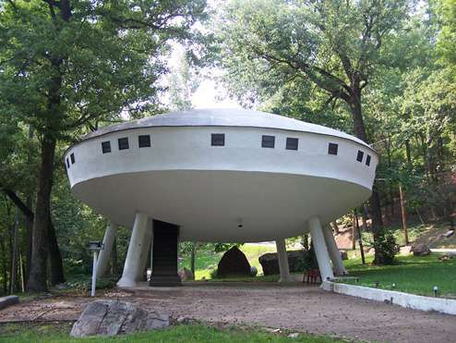
UFO house, designed by owner, ca. AD 2000
somewhere in rural Tennesseee

Slide 35
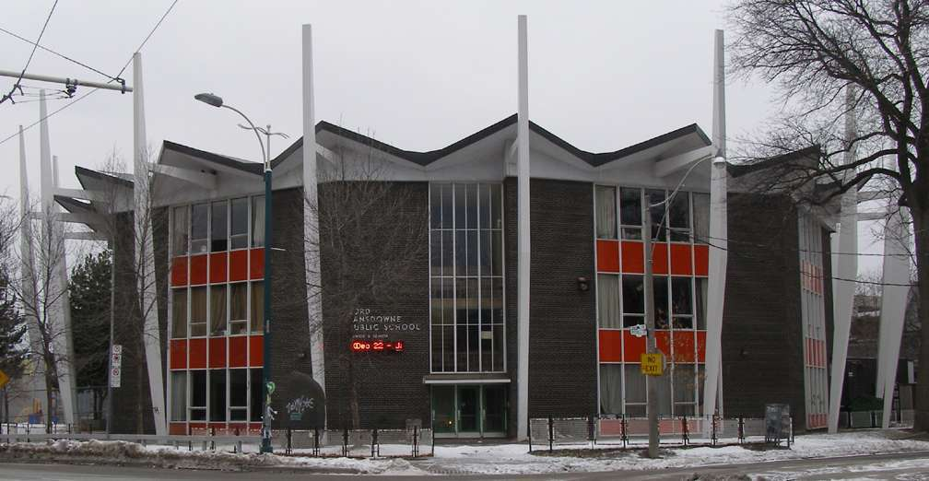
Lord Lansdown Public School, by Peter Pennington, AD 1960
Toronto, Canada

Slide 36
Why here, why now?
Increasingly susceptible population
Building materials
Construction & maintenance practices
Design

Slide 38
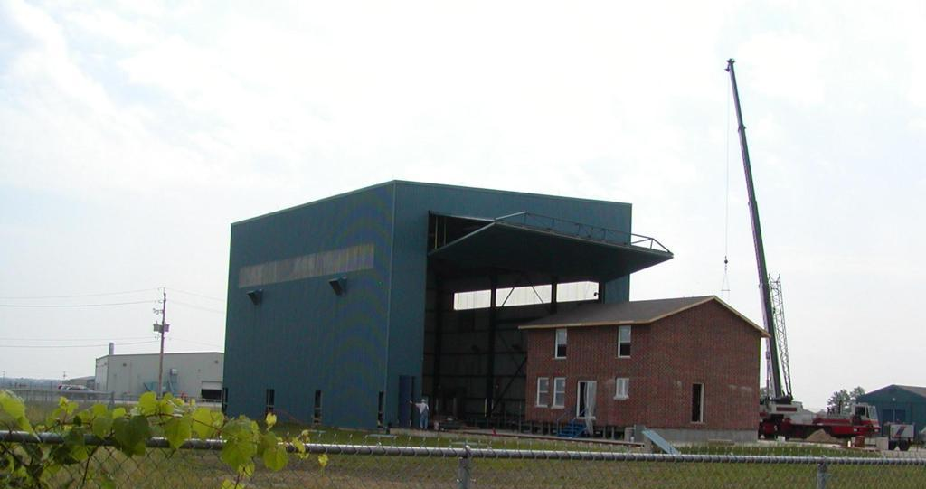
The Three Little Pigs Project - at the Insurance Research Lab for Better Homes: Testing the performance of light-frame buildings in extreme weather

Slide 39
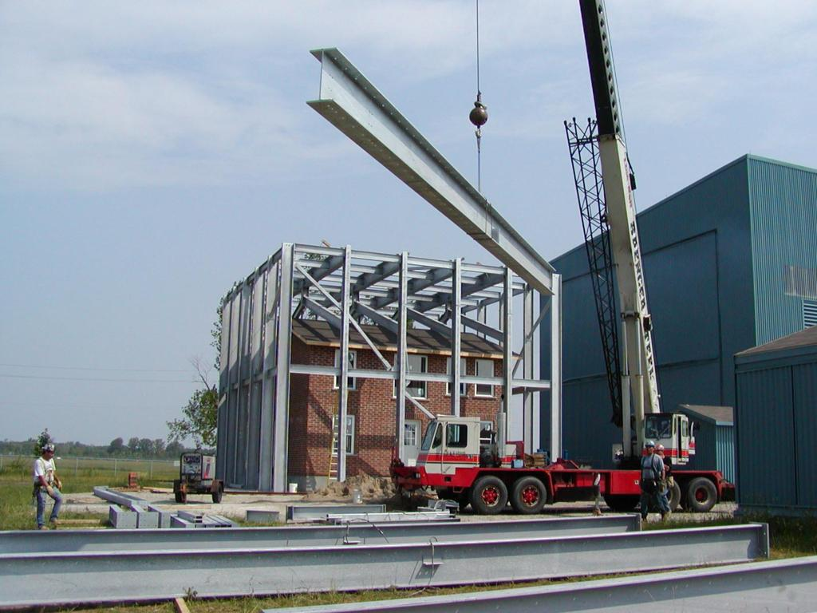

Slide 40
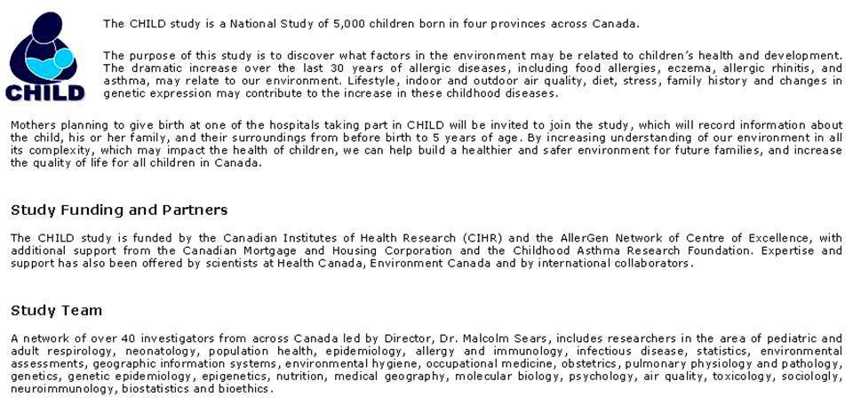
The Canadian Healthy Infant Longitudinal Development Study (CHILD)
www.canadianchildstudy.ca

Slide 43
CHILD Environmental exposures
Exposure | Inspection | Questionnaire | Sample | Traffic pollution models
Common allergens (dust mite, cat, dog, cockroach, moulds, rodent) |  |  | ✓
Environmental tobacco smoke |  | ✓
Endotoxin |  |  | ✓
Dampness / humidity | ✓ | ✓
Mould / 1,3 – β-D-glucan | ✓ |  | ✓
Semivolatile compounds (phthalates) | ✓ | ✓ | ✓
Particles – traffic, diesel exhaust |  |  | ✓ | ✓
Nitrogen dioxide, formaldehyde | ✓ | ✓

