Slide 1

State of the Banking Industry
James C. Mabry IV
Managing Director
May 30, 2013

Slide 2
General Information and Limitations
This presentation, and the oral or video presentation that supplements it, have been developed by and are proprietary to Keefe, Bruyette & Woods, Inc. (“KBW”) and were prepared exclusively for the benefit and internal use of the recipient. Neither this printed presentation, nor the oral or video presentation that supplements it, nor any of their contents, may be used, reproduced, disseminated, quoted or referred to for any other purpose without the prior written consent of KBW.
The analyses contained herein rely upon information obtained from the recipient or from public sources, the accuracy of which has not been independently verified, and cannot be assured by KBW. In addition, many of the projections and financial analyses herein are based on estimated financial performance prepared by or in consultation with the recipient and are intended only to suggest a reasonable range of results for discussion purposes. This presentation is incomplete without the oral or video presentation that supplements it.
Neither KBW nor any other party makes any representation or warranty regarding the information contained herein and no party may rely on such information, and KBW expressly disclaims any and all liability relating to or resulting from recipient’s use of these materials. The information, data and analyses contained herein are current only as of the date(s) indicated, and KBW has no intention, obligation or duty to update these materials after such date(s). This information should not be construed as, and KBW is not undertaking to provide, any advice relating to legal, regulatory, accounting or tax matters.
This presentation is protected under applicable copyright laws and does not carry any rights of publication or disclosure.
KBW, a U.S. registered broker-dealer and a member of the Financial Industry Regulatory Authority, is a full service investment bank specializing in the financial services industry. KBW and Stifel, Nicolaus & Company, Incorporated (“Stifel”) are affiliated broker-dealer subsidiaries of Stifel Financial Corp. (“Stifel Financial”) and, unless otherwise indicated, information presented herein with respect to the experience of KBW also includes transactions effected and matters conducted by the Financial Institutions Group of Stifel prior to February 15, 2013. In addition, certain pro forma information regarding KBW and Stifel also includes transactions effected and matters conducted by the Capital Markets Division of Legg Mason Wood Walker, Inc. (acquired by Stifel Financial on December 1, 2005), Ryan Beck & Co., Inc. (acquired by Stifel Financial on February 28, 2007), Thomas Weisel Partners LLC (acquired by Stifel Financial on July 1, 2010), Miller Buckfire & Co. LLC (acquired on December 20, 2012) and their respective affiliates. On March 15, 2013, Stifel Financial, the parent company of Stifel, entered into an Agreement to acquire Knight Capital Group’s Institutional Fixed Income Brokerage unit, subject to customary closing conditions and regulatory approvals. All transaction announcements included herein appear as a matter of record only. Dollar volume represents full credit to underwriter.
Independence of Research
KBW prohibits its employees from directly or indirectly offering a favorable research rating or specific price target, or offering or threatening to change a rating or price target, as consideration or inducement for the receipt of business or for compensation.

Slide 3
Table of Contents
Section
Tab
700 Years in 70 Seconds 1
Current Banking Environment 2
Washington: the Good, the Bad, the Ugly 3
Tomorrow’s Newspaper, Delivered Today 4

Slide 4
700 Years in 70 Seconds

Slide 5

Founders of Banking
Giovanni Di’ Medici

Slide 6
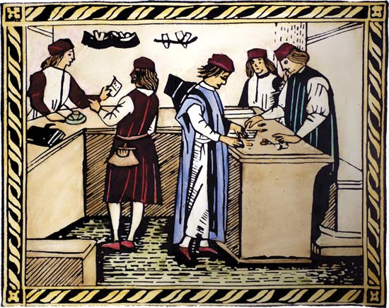
The One Who Started It All
Banking activities have been around for centuries
  Deposits originally consisted of cattle, grain, crops and precious metals
Modern-day banking started in Medieval Italy
  The most famous Italian bank was Medici Bank, founded by Giovanni Di’ Medici in 1397
  Built lavish branches as far north as London
  Enjoyed distinction as main banker for the Pope

Slide 7
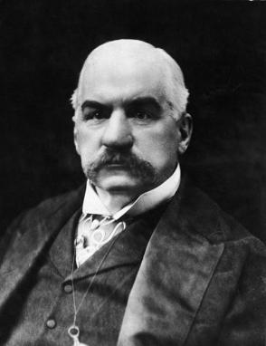
Founders of Banking
J.P. Morgan

Slide 8

Founders of Banking
Hugh McColl

Slide 9
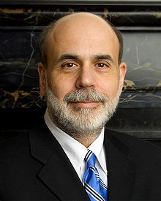
Founders of Banking
Ben Bernanke

Slide 10

Founders of Banking
Jamie Dimon

Slide 11
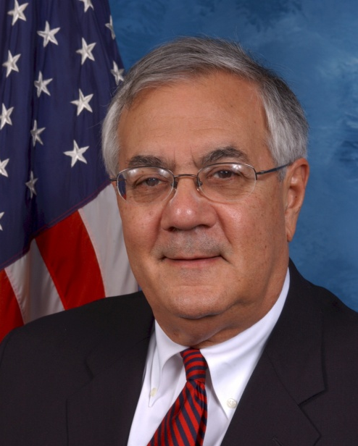
Founders of Banking
Barney Frank

Slide 12

Founders of Banking
Sheila Bair

Slide 13

Founders of Banking
Carl Chaney

Slide 14
Banks Through Recent History
1985
June 10th Supreme Court Ruling on Interstate Banking
1994
Riegle-Neal Interstate Banking and Branching Efficiency Act
1933
  Glass–Steagall Act
FDIC Formed
1999
Glass–Steagall Repealed
2007
Recent Crisis
Source: FDIC

Slide 15
From the Market Peak to Current
Sep. 14–17, 2008
BoA announces plans to acquire ML at 70% equity premium
  Lehman Bros files for Chapter 11
Initial AIG Bailout
Sep. 13, 2012
Fed Announces QE3
Mar. 1, 2013
Sequester is Implemented
Apr. 9, 2010
Eurozone Relief Rally
DJIA: 11,000
Mar. 13, 2012
Positive Stress Test Results
Mar. 14, 2008
Bear Stearns Fails
January 1, 2013
U.S. avoids fiscal cliff
May 11, 2012
JPM loses $2bn due to poor ‘hedging’ strategy
Oct. 14, 2008
Announcement of TARP
Quantitative Easing
QE2
QE3
Source: SNL Financial
Data as of 5/28/13
KBW Bank Index (BKX) includes 24 geographically diverse stocks representing national money center banks and leading regional institutions

Slide 16
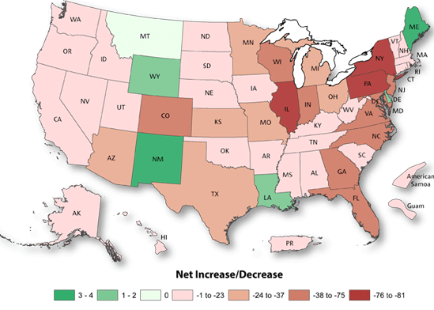






The Future of the Bank Branch
The pace of bank branch openings has slowed dramatically
  Driven by the industry’s push to cut costs
Only 5 states saw a net increase in the number of branches over the past 12 months
Net Branch Openings ⁽¹⁾
Most Active Branch Builders in Q1 ‘13
Most Active Branch Consolidators in Q1 ‘13
Source: SNL Financial
Represents the number of net openings and closings from April 1, 2012 to March 31, 2013

Slide 17
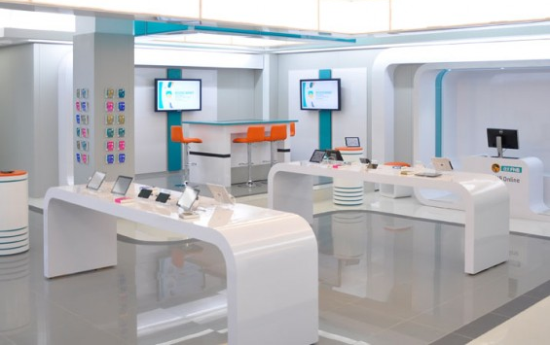


Back to the Future: Banking Edition
Apple Store or Bank Branch?
Coffee Shop or Bank Branch?
FNB (Johannesburg, South Africa)
Commonwealth Bank (Brisbane, Australia)
Mobile Devices: The Banks of the Future

Slide 18
Current Banking Environment

Slide 19
Current Banking Environment
The largest banks dominate the competitive landscape
The banking industry has experienced unprecedented change in recent years
Valuations have come up as profitability has returned to the banking sector
Strong 2013 equity markets have driven capital markets performance
Level of FDIC failures have slowed—will whole bank M&A return?
More regulatory uncertainty for all banks

Slide 20
The Banking Landscape
Distribution of Banks
Distribution of Assets ($bn)
158 banks nationwide account for 88% of assets
< $500 mm
$500 mm - $1.0 bn
$1.0 bn - $5.0 bn
> $5.0 bn
Source: SNL Financial; data as of 3/31/13

Slide 21
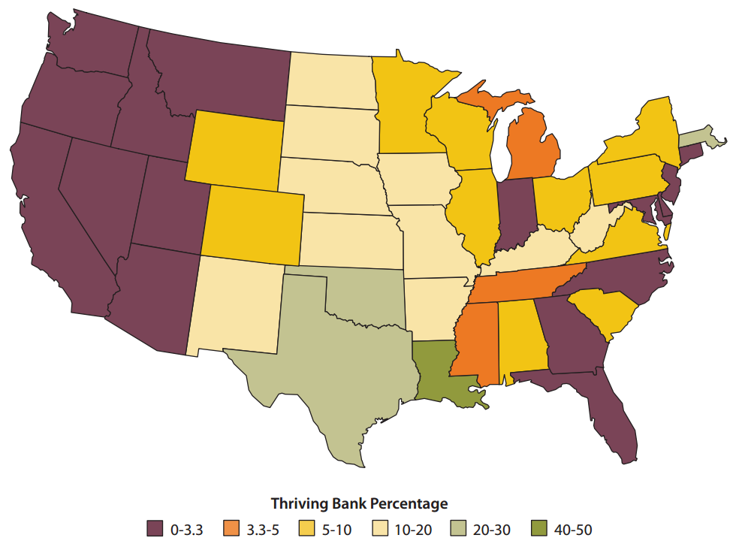
Thriving Banks by Region – According to the Fed
Percentage of Thriving Banks in Each State
Source: Federal Reserve Bank of St. Louis
Community banks defined as U.S. banks with less than $10.0 billion in assets
Thriving community banks defined as banks that maintained a composite CAMELS rating of 1 from 2006 to year end 2011

Slide 22
KBW Research Outlook for Banks
Earnings Outlook is Challenging Due to NIM Compression
Difficult earnings environment expected to persist due to NIM compression
  EPS growth is only estimated to be 7% in 2013 and 5% in 2014
  90% of banks are expected to have a decrease in NIM this year
Loan growth will remain challenging
  Low loan growth and competitive pricing
Expense initiatives will be increasingly focused upon
  Expense management is critical
  Branch rationalizations could be a meaningful catalyst for 2013 EPS
Loan Growth
May Be Difficult
to Achieve
Focus Will Shift to Expense Initiatives
Source: KBW Research, “Initial 1Q13 Trends Continue: KBW Bank Earnings Wrap-Up, v3”. Published 4/26/2013

Slide 23
The Good News
Credit is Yesterday’s Headline
Profitability is Up
Capital Levels are Strong
Investors Like Bank Stocks Again
Source: SNL Financial
Financial data as of 3/31/13; pricing data as of 5/10/13
The KBW Regional Bank Index (KRX) is a composition of 50 regionally diversified mid & small-cap banking institutions in the U.S. and is calculated using an equal-weighted method

Slide 24
The Bad News
Credit Levers are Pulled
Growth Outlook is Modest
8 banks with Negative EPS Outlook
Profitability is Still at Depressed Levels
ROAA (%)
ROATCE (%)
Source: SNL Financial
Financial data as of 3/31/13
The KBW Regional Bank Index (KRX) is a composition of 50 regionally diversified mid & small-cap banking institutions in the U.S. and is calculated using an equal-weighted method

Slide 25
Net Interest Margin Pressure Continues
3.63%
⁽¹⁾
Source: SNL Financial, KBW Research
Financial data represents median values for all regulated depositories
(1) Source: KBW Research, “Initial 1Q13 Trends Continue: KBW Bank Earnings Wrap-Up, v3”. Published 4/26/13
Notes:
Author: All data on page linked through FactSet (no backup to RC’s knowledge)
Anyone can update

Slide 26
Emphasis on Cost Control Will Continue
Efficiency Ratio (FTE)
Noninterest Expense / Average Assets
Source: SNL Financial
Financial data represents median values for all regulated depositories
Notes:
All data on page linked through FactSet

Slide 27
Valuation Drivers

Slide 28
Recent Market Performance
Performance Through Cycle (Since 12/31/07)
2012 – 2013 YTD
The Largest have
clearly outperformed
Source: SNL Financial
Pricing data as of 5/28/13
The KBW Regional Bank Index (KRX) is a composition of 50 regionally diversified mid & small-cap banking institutions in the U.S. and is calculated using an equal-weighted method
The KBW Bank Index (BKX) is a capitalization-weighted index composed of 24 geographically diverse stocks representing national money center banks and leading regional institutions

Slide 29
Valuation Increase by Region
Median Price to Tangible Book Value (%)
The Southeast has seen the greatest increase in valuation since market lows
Valuation Increase (%)
Source: SNL Financial
Pricing data as of 5/20/13
Note: March 9, 2009 represents the market low of the 2007-2009 recession
Includes all major-exchange traded banks and thrifts nationwide; excludes merger targets

Slide 30
Shift in Valuation from Book to Earnings
Price / Tangible Book Value (%)
Price / 2014 Consensus EPS Estimate (x)
Source: SNL Financial
Pricing data as of 5/15/13
Includes all major exchange traded banks and thrifts headquartered in the Southeast with assets between $1.0 billion and $10.0 billion
Excludes merger targets and banks without 2014 consensus estimates

Slide 31
Asset Size Drives Valuation
Price to Tangible Book Value vs. Asset Size
Source: SNL Financial
Pricing data as of 5/28/13
Includes all major exchange traded banks headquartered nationwide with assets less than $10.0 billion; excludes merger targets

Slide 32
Capital Markets Environment

Slide 33
Current Capital Markets Environment
2013 Sector Performance
LTM Equity Capital Markets Volume
Source: KBW Equity Capital Markets
Data as of 5/17/13

Slide 34
Capital Markets Environment for Banks
Investor Themes
Follow-on Offering Volume
2009 - 2012
Fortify balance sheet
  Fill credit holes
  Redeem TARP
Dry powder for offense
Current
Acquisition finance
Private Equity sell-downs
Re-emergence of the IPO market
Non-common solutions
P / PF TBV:
1.10x
1.10x
1.25x
1.25x
1.38x
Number of deals
Proceeds ($bn)
Source: SNL Financial and Dealogic

Slide 35
M&A Environment

Slide 36
Key Drivers for Increased Consolidation
Revenue headwinds for the industry
Slow / low growth economic environment
Regulatory/compliance requirements
Legacy asset quality problems
Overcapacity
Management and board fatigue
Limited access to capital markets
Possible constraints:
  Purchase accounting / classified asset ratios
  Classified / Capital Ratio
  Bid-ask spread
Notes:
RC and JHam know how to do this

Slide 37
Consolidation Trends Among U.S. Depository Institutions
Source: SNL Financial as of 12/31/12
Notes:
All data on page linked through FactSet

Slide 38
Recent M&A Trends
Whole Bank M&A Since 2000
FDIC-Assisted Acquisitions since 2000
Source: SNL Financial
Data as of 5/15/13

Slide 39
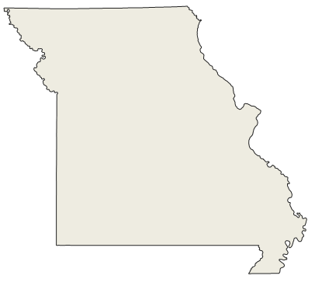
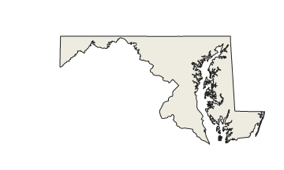
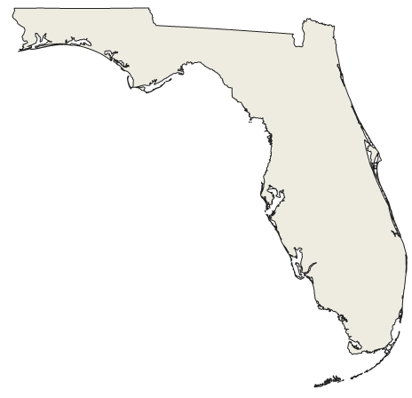
Will These Banks Fail?
Bank A
Bank B
Bank C
NO
NO
NO
Will this bank fail?
Will this bank fail?
Will this bank fail?
Source: SNL Financial
Data bank level as of 3/31/13

Slide 40
M&A Trends by Region
Comparison of Recent Pricing Multiples: 2010-2011 vs. 2012-2013 YTD
Change in Exit Multiples
Source: SNL Financial
Data as of 5/15/13
Includes all whole bank & thrift transactions announced nationwide since 12/31/09 with disclosed deal values

Slide 41
Buyers’ Capacity to Pay is Improving
12/31/11
Change
Today
32.7%
17.8%
11.4%
28.9%
1.8%
16.4%
Source: SNL Financial
Pricing data as of 5/9/13
Includes all major exchange traded bank and thrifts headquartered in the United States

Slide 42
What Matters to a Buyer?
Location, Location, Location
Asking the Right Questions
Is the target’s geography attractive?
How attractive is the target’s mix of loans and deposits?
Size of the target – will this acquisition “move the needle”?
How aggressive has the target been in managing credit?
Is the target perceived to be healthy and well-managed?
Are there any unique business lines or products that the target offers?
Core Bank Attributes
Size Matters
Credit Management
Management
Product & Service Line Diversification

Slide 43
What Matters to a Seller?
Price
Asking the Right Questions
Who can offer the highest price? Will there be future price appreciation?
Does the buyer have a liquid currency that will allow shareholders to trade?
Will there be board / management representation in the combined company?
What is the consideration mix (stock / cash)? Will the deal be tax-free?
How will our employees be treated? Will there be severance packages?
Is there potential to benefit from multiple “take-out” premiums if our buyer decides to sell in the future?
Liquidity
Board / Management Representation
Consideration
Employees
Double Dip Potential

Slide 44
Case Study: Transformational M&A Transaction

Slide 45
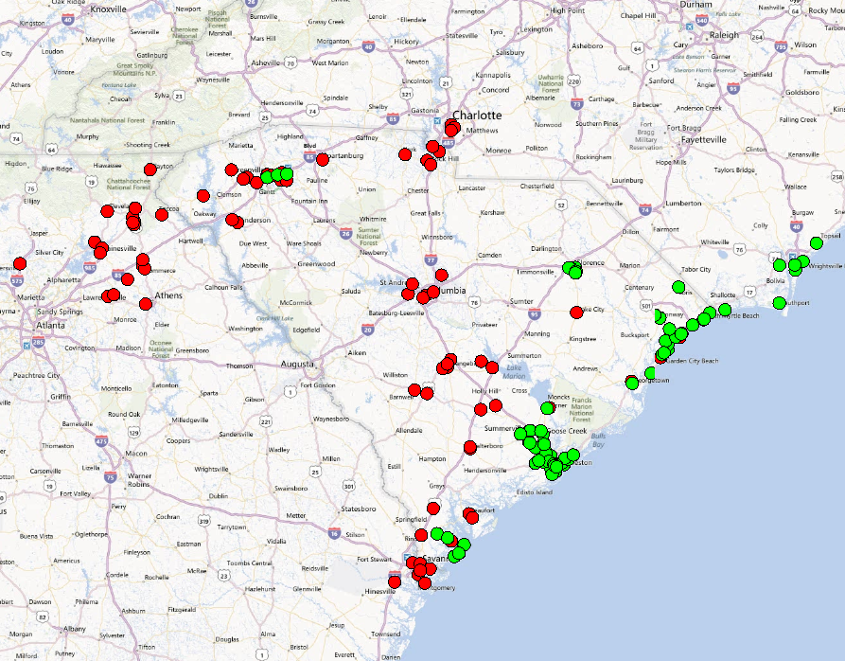

Pro Forma Footprint and Highlights
Acquisition Highlights: SCBT Financial Corporation – First Financial Holdings Inc.
  SCBT
  FFCH
Dollars in billions
Source: SNL Financial
Data as of 3/31/13
Pro forma figures exclude purchase accounting adjustments

Slide 46
Transaction Assumptions
Deal Value
Deal value of $302.5 million; 10.9% market premium; 130% of TBV
$65.0 million of Legacy TARP preferred equity to be rolled over at close
SCBT and FFCH consensus estimates through 2014; grown at median long term growth rates of 8.0% and 10.0%, respectively, per FactSet
Purchase accounting adjustments
  Mark to projected gross loan portfolio of (5.3%) or $132.4 million
  Mark to OREO of (30%) or $4.9 million
  Mark to FHLB of $26.4 million based upon estimated prepayment penalty
30.0% cost savings of FFCH’s projected 2014 noninterest expense of $128.5 million, per FactSet
Equal to 1.50% of FFCH’s transaction accounts of $1,697.1 million as of 3/31/13
Amortized using an accelerated method (SYD) over 10 years
Merger-related charges equal to $30.0 million after-tax
Earnings
Purchase Accounting Marks
Cost Savings
Core Deposit Intangibles
Merger Charges

Slide 47
Summary of Purchase Accounting Adjustments
Purchase Accounting / Goodwill Calculation
Total Purchase Price = Common + Preferred Consideration
Purchase Accounting Adjustments
Goodwill = Purchase Price Less Net Assets Acquired
Dollars in millions

Slide 48
Book Value Impact
Pro Forma Book Value Impact
2.25 Year Earnback
8.6% Initial Dilution
Note: Accretion analysis is the hypothetical impact given the assumptions on page 46, per KBW

Slide 49
Earnings Impact
Pro Forma Earnings Impact
20.5% accretion
21.4% accretion
22.5% accretion
23.6% accretion
18.6% accretion
Initial accretion limited due to phase-in of cost savings
Projected earnings based on 2014 FactSet EPS estimates and grown at median long term growth rate, per FactSet
Accretion analysis is the hypothetical impact given the assumptions on page 46, per KBW

Slide 50
Market Reaction
Price Performance since Transaction Announcement
SCBT: 18.0%
$50.94
KRX: 5.4%
$43.18
Source: SNL Financial; pricing data as of 5/28/13
Relative to the KRX

Slide 51
Washington: the Good, the Bad, the Ugly

Slide 52
The Good, the Bad, The Ugly
GOOD
Washington / Regulatory Actions
The U.S. Treasury is getting out of TARP
Confusing capital requirements surrounding Basel III
Regulatory guidelines are distracting banks from core competencies
BAD
UGLY

Slide 53
The Good: Treasury’s Exit from TARP
Treasury first invested $204.9 billion in 707 institutions and has earned back $216.7 billion to date
In early March 2012, Treasury indicated that it intended to exit the TARP program
To date, Treasury has conducted 15 Dutch auctions involving 121 TARP institutions
The Treasury currently has outstanding CPP investments of approximately $6.1 billion in 168 banks
  Approximately 1/3 of outstanding CPP is held by 2 financial institutions: SNV and BPOP
Source: U.S. Treasury, KBW Research: “KBW TARP Tracker – 102nd Edition”

Slide 54


The Good: Treasury’s Exit from TARP (Continued)
Status of the 707 TARP Banks
Outstanding TARP Investments
The Treasury currently has outstanding CPP investments of approximately $6.1 billion in 168 banks
2 banks (SNV and BPOP) account for 31% of Outstanding TARP Investments
Source: U.S. Treasury, KBW Research: “KBW TARP Tracker – 102nd Edition”

Slide 55

The Bad: Basel III
Many banks are still struggling to understand the implications of pending Basel III regulations
Rules have been postponed indefinitely so banks are finding it difficult to prepare for the new rules
Additional buffers have been created as part of the regulation which are confusing and difficult to apply in practice
Qualifying Subordinated Debentures
Countercyclical
buffer
Well-capitalized
Phasing out
CET1 Ratio
Allowable Deferred
Tax Assets
Newly Risk-Weighted
Assets

Slide 56
The Evolution of Basel
BASEL I
BASEL II
BASEL III
First Basel Accord in 1988
Strengthened the stability of the international banking system
Introduced risk-based capital
Classified assets into 5 categories, carrying various risk weights of 0% to 100%
U.S. banks currently operate under Basel I
Never adopted by U.S. Regulators before the Financial Crisis
Reduced risks by making capital more sensitive to risk
Risk weightings applied to more narrow categories of assets
Banks could opt for an “internal ratings based” (IRB) approach
Response to the 2007-2008 Financial Crisis
Most recent revision to international capital standards
Focus on increasing equity capital requirements for all banks
Expected to result in larger buffers for losses
Implementation has been delayed indefinitely
Source: The Federal Reserve Bank of Richmond, Economic Brief: “Basel III and the Continuing Evolution of Bank Capital Regulation”

Slide 57
“Well-Capitalized” Basel Standards
Implications of Falling below “Well-Capitalized”
Dividend restrictions
  Includes restrictions on preferred dividend payments
Management Compensation
Share repurchase limitations
Source: SNL Financial
Capital Conservation Buffer will be phased-in from 2016-2019

Slide 58

Basel III Implications & Reactions
Potential Responses to Increased Capital Requirements & Risk-weightings
Issue New Equity
Reduce Lending Activities / Alter Lending Composition
Increase Pricing / Rates on Loans
Liquidate Specific Assets
Find a Partner
… But Basel Isn’t Fully Implemented For Years
Basel III implementation has been delayed indefinitely
Banks already have started thinking about Basel III
The loans banks make today will be on the books when regulatory capital changes begin to phase-in
Today

Slide 59


Who is More Affected by Basel III?
Case 1: Money Centers and SIFI’s
Case 2: Community Banks
More deductions for Tier 1 Capital
  Greater variance in assets
Larger firms must implement wider and more complex systems changes
Basel III was aimed to reduce the risk of large “megabanks” not community banks
Limited access to capital
Fewer resources than large banks
Writing mortgages will be more complicated for banks with small staffs
Larger banks have had more time to prepare for new capital requirements
  Big banks have been off-loading non-core businesses since the financial crisis
Source: SNL Financial

Slide 60
Community Banks Respond to Basel III
Basel III Comment Letter
Responses to Basel III NPR
Banks
Responses
We may have made a few bad loans, but we didn’t cause the financial crisis
We can’t access the capital markets like the big guys
Basel III will keep us from lending, halting our business and local economic development
Please reconsider
Sincerely,
Your Community Bank
The Independent Community Bankers of America created a petition that called for an exemption for smaller institutions
Source: SNL Financial, FDIC, American Banker

Slide 61
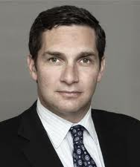



Feedback on Basel III
“We recommend that certain aspects of the Basel Ill framework should not be imposed on banking institutions with assets below $10 billion […] The expense burden related to Basel Ill could reduce community bank profitability and hinder lending capacity at a time when credit is needed to finance a needed business
expansion in the U.S.”
“Basel III relies on a set of subjective, simplifying assumptions to align a firm's capital and risk profiles. Even high levels of capital cannot save a firm from bad management or save an industry from the cumulative effects of excessive risk taking.”
Thomas B. Michaud
President & CEO
Keefe, Bruyette & Woods
Thomas M. Hoenig
Director
FDIC
“Regulators should also consider the portfolios of community banks compared to large banks […] Additionally, community banks around the country are considerably smaller and would find compliance more difficult than those banks with larger staffs.”
“This would be punitive for my bank and we would be forced to increase the cost of the credit to customers. It does not help a community bank like mine.”
Senator Al Franken
Minnesota (D)
W. David Lacy
CEO, Community Bank & Trust (Waco, TX)
Source: SNL Financial, FDIC, American Banker

Slide 62
The Ugly: Regulatory Changes are Consuming Management Attention
100 senior executives were surveyed in 2012 and 2013 regarding initiatives which take management time and attention away from core banking activities
Initiatives Consuming Management Attention
Source: American Banker, KPMG
Note: Only select initiatives shown
* Includes new product development, pricing strategies and geographic expansion

Slide 63
Tomorrow’s Newspaper, Delivered Today

Slide 64
October 23, 2014

Slide 65

Tomorrow’s Newspaper
October 23, 2014
financialgazette.com
The Financial Gazette
FDIC Slashes its Resolutions Department
FDIC-Assisted Closures Diminish with Only 2 Bank Failures Year to Date
Washington, DC – Early this morning the Board of Directors of the FDIC announced a significant downsizing of its resolutions department.
Since 2011, only 85 banks and thrifts have been seized by the FDIC compared to 92 in 2011 and 157 in 2010. The lack of failures coupled with continued federal spending cuts has directly led to the reduction of the resolutions department
As the economy continues to improve and the banking industry strengthens, Gruenberg believes
that banks will be able to outlast the economic downturn and work through their problems without “hitting the chopping block.”
He also reiterated that not all banks have gotten past the issues started in 2008. 542 banks still remain on the problem bank list; however, the FDIC will only seize banks and thrifts if they fall well below the “well-capitalized” threshold.
Going forward, Gruenberg predicts there will be 1-5 failures a year.
Continued on page 3
FDIC Failures Slow: Chairman of the Federal Deposit Insurance Corporation, Martin Gruenberg, explores the banking industry and the lessening role of FDIC resolutions to insure its stability

Slide 66
Where Have the FDIC-Assisted Acquisitions Gone?
FDIC failures continue to diminish and will return to mid 2000’s levels by 2014
FDIC Failures
?
Source: FDIC
Note: red box represents YTD annualized figures

Slide 67
January 15, 2015

Slide 68

Tomorrow’s Newspaper
January 15, 2015
financialgazette.com
The Financial Gazette
Bank of America Closes 2,000 Branches
Efficiency Efforts Continue to Develop in the Current Low-Rate Environment; Stock Responds Positively
Charlotte, NC – Bank of America Corporation announced this morning the implementation of a efficiency initiative which will close over 2,000 branches and lay off roughly 20,000 employees.
Chief Executive Officer, Bryan Moynihan, stated, “Staying afloat in today’s difficult banking environment can only be achieved by adapting to the current times. Today over 50% of checks are deposited via some sort of smart phone or widget. That being said, we decided to cut expenses in the most effective way: closing branches.”
Investors seem to agree with Moynihan’s thesis as the stock has increased nearly 5% in 3 days.
Several rumors have circled the banking sector regarding other big banks implementing similar strategies. Do not be surprised if the biggest 15 to 20 banks initiate a mass branch closure in the upcoming months.
Branch closures: Bank of America Corporation Chief Executive Officer, Brian Moynihan, defends the rationale behind the significant branch closings and cost savings initiative

Slide 69
Bank of America Closures: Is it Worth the Hassle?
General Assumptions:
  Assumes Bank of America closes 2,000 branches, or 36.9% of their branch network
  Assumes 10 employees work at each branch
  Assumes the following operating costs per branch:
    Salaries & Benefits (20%) = $450,000
    Rent & Utilities = $55,000
    Total Expenses per Branch = $505,000
  Total Expense Savings = 2,000 branches x $505,000 / branch = $1,010 million
Branch Expense Assumptions
Impact to Earnings ⁽¹⁾
6.3% Accretion
Assumes 35% tax rate, or after-tax expense savings of $656.5 million

Slide 70
March 14, 2016

Slide 71

Tomorrow’s Newspaper
March 14, 2016
financialgazette.com
The Financial Gazette
WFC, Last of “Too Big to Fail” Banks, Shutters Branches
Wells Fargo Initiates Plan to Close Nearly 3,000 Branches; Chipotle Seen as Big Winner
San Francisco, CA – After a year of continuous branch downsizing and expense cut initiatives, Wells Fargo Corporation announced it too will shutter several thousand branches in the upcoming years to improve efficiencies. This plan expects to cut 3,000 branches and 30,000 employees.
To many, this was a long time coming. 19 of the largest 20 banks had already initiated massive branch reduction measures, leaving Wells Fargo as the last man standing.
Now that over 16,000 branches have been closed by the largest banks nationwide, one may ask, “What has become of these former
bank branches?” Fast food and take-out restaurants, such as Chipotle Mexican Grill, have been assuming these locations to develop their network. Chipotle’s Chief Executive Officer, Steve Ells, exclaims, “These bank closures have been the best thing for the fast food industry since the digital cash register. Branch locations tend to be in the most appealing areas of each region, making them commonly seen and visited destinations.” Chipotle has nearly doubled in size since Bank of America announced their branch closures in January 2015 and has developed a drive-thru system.
Branch shutters continue: Wells Fargo Corporation Chief Executive Officer, John Stumpf, follows the lead of other national banking institutions in discontinuing a large portion of their branch network

Slide 72
Effects of a Mass Branch Closure
Branch Distribution Pre-Shutter
Branch Distribution Post-Shutter
Assumes top 20 banks & thrifts close ~40% of total branches
Total Branches: 99,057
Total Branches: 83,121
Top 20 banks nationwide
Banks outside the top 20
Source: SNL Financial
Includes all top-tier consolidated banks and thrifts headquartered nationwide; excludes merger targets

Slide 73
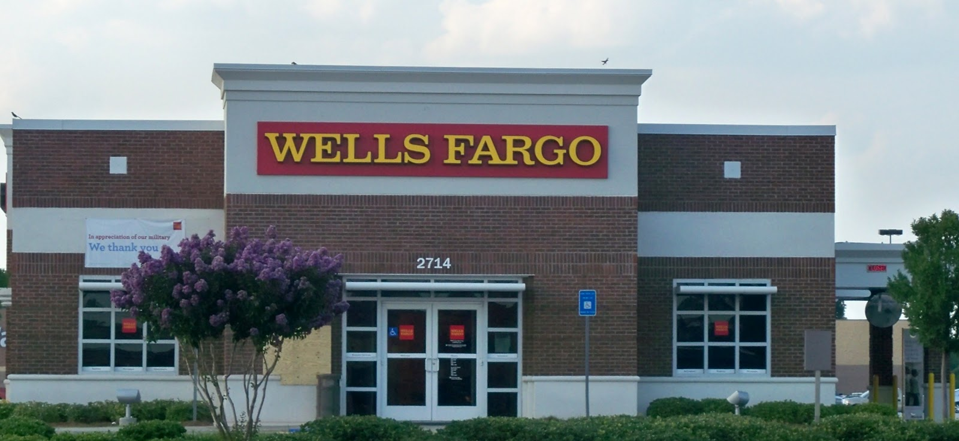


Unexpected Party Benefits From Branch Closures
Future of Bank Branches
Drive-thru

Slide 74
Chipotle’s Stock Hits 600!
Assumes Chipotle increases current store count from 1,458 to 2,458, or a 69% increase
Assumes earnings and stock price move in tandem
Chipotle’s Stock Price
69% increase

