Slide 1
Board Essentials:
Laying the Groundwork for Success
as presented by Club Benchmarking COO Russ Conde

Slide 2
Industry Facts
Governance in the club industry can be challenging because it is often influenced by politics and opinions in a way that would not be acceptable in corporate governance
As a group, the clubs that belong to the Club Managers Association of America represent a $20+ billion industry. The largest single club is on the order of $95 million in total operating revenue
There are about 3,000 club boards X 11 people on the average board which means there are 33,000 people governing clubs

Slide 3
Corporate Boards Versus Club Boards
 | Clubs | S&P 500
Size | 11 | 11
Term | 3 years | 1 year
Term Limits | 80% | 3%
Average Tenure | 3 years | 9 years
Nominating Process | ??? | Very Serious
Industry Business Model | Unknown | Front and Center

Slide 4
Three Modes of Governance
Operating for Today
Planning for Tomorrow
Making Sense & Driving Alignment
Mode I
Mode II
Mode III
Fiduciary
Governance
Strategic
Governance
Generative
Governance
Governance
  Governance as Leadership, 2005, Chait, Ryan, Taylor

Slide 5
Operating for Today
Planning for Tomorrow
Making Sense & Driving Alignment
Mode I
Mode II
Mode III
Fiduciary
Governance
Strategic
Governance
Generative
Governance
The long term health of a club is greatly enhanced when its Board strives to act in all three governance modes and to provide stable leadership that withstands the transition from Board to Board without causing changes in the plans, vision and mission of the club.
Stability over time is critical.

Slide 6
Observations
The club governance model is characterized by significant turnover
Transition of board members can cause transition in plans, policies, accounting methods, etc.
A club’s governance foundation should be consistent and independent of the individual governors that come and go
Taking time for education and assimilation of new governors is essential to preserving the club’s governance foundation once it has been established

Slide 7
The Core Concepts
Gross Margin funds the club
The “Dues Engine” powers gross margin
Food & Beverage is not a profit center
Capital – Predictable need requires predictable inflow

Slide 8
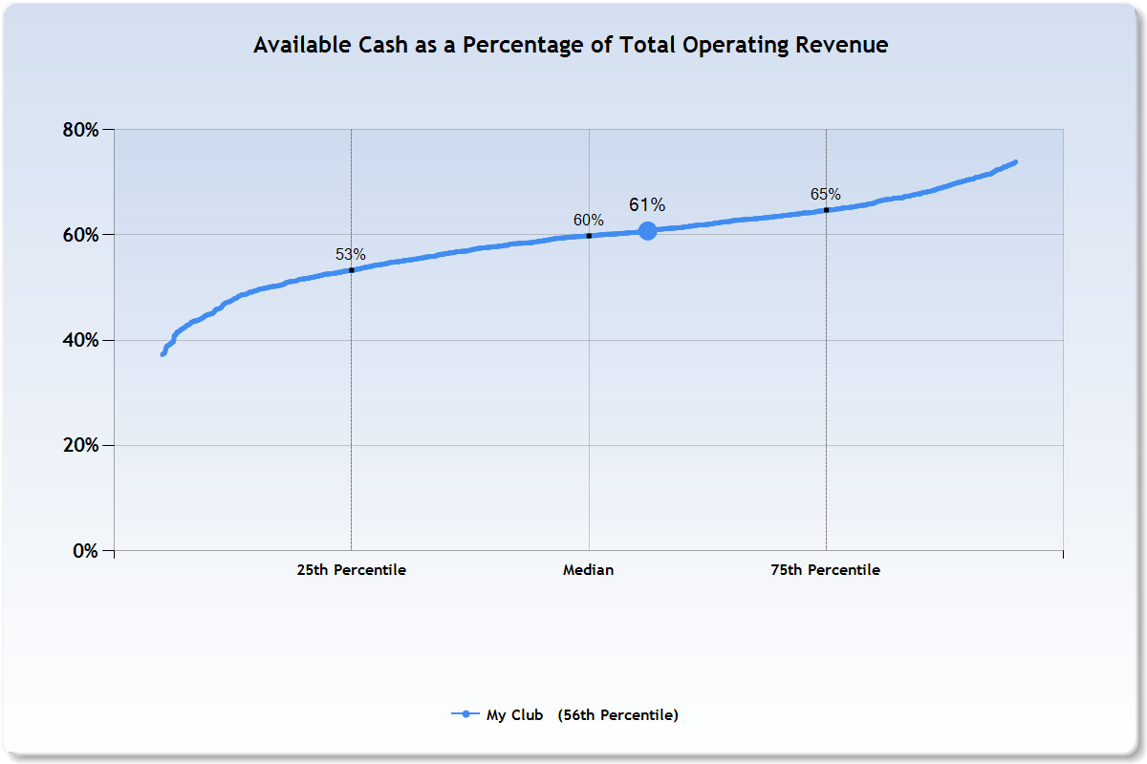
#1: Gross Margin Funds the Club
“Available Cash” aka Gross Margin
My Club
KEY QUESTION:
What percentage of the club’s total operating revenue is actually available to fund the operation?

Slide 9
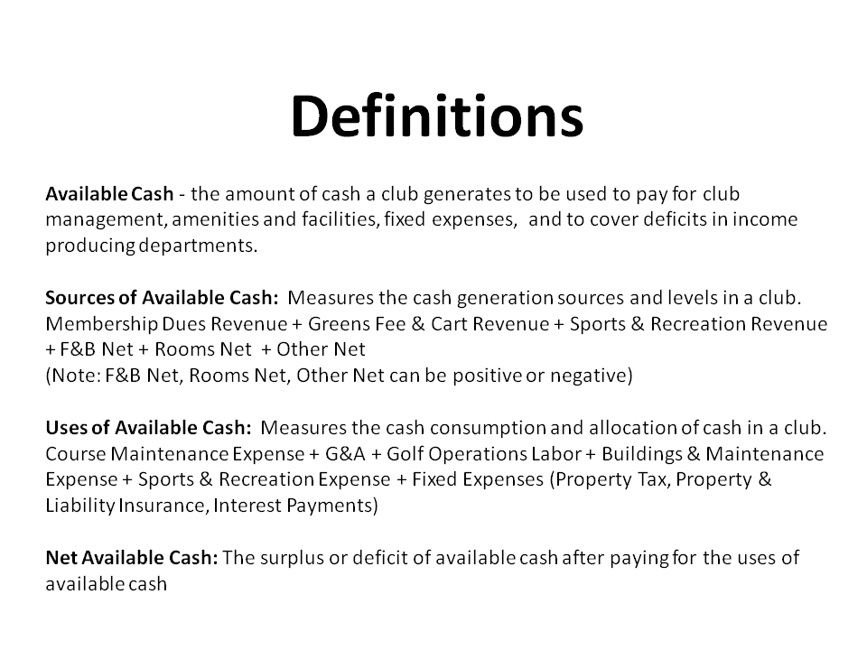
It is the operating bottom line of the club.

Slide 10
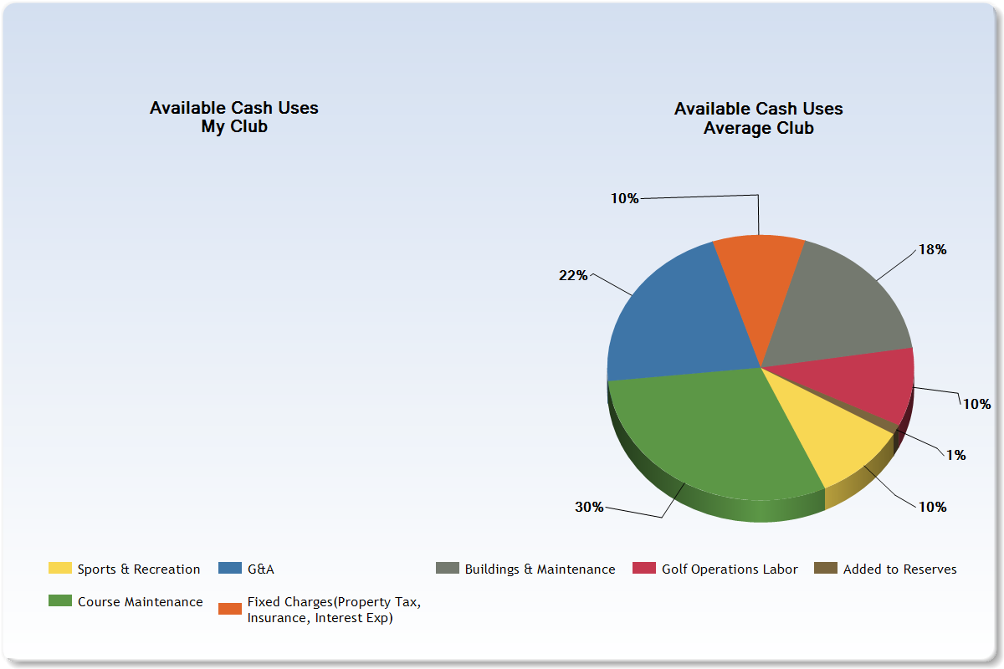
Gross Margin Uses
KEY QUESTIONS:
How is the club using its Available Cash?
How is that distribution similar to or different from industry norms?
How does that distribution look relative to clubs that are similar to ours?

Slide 11
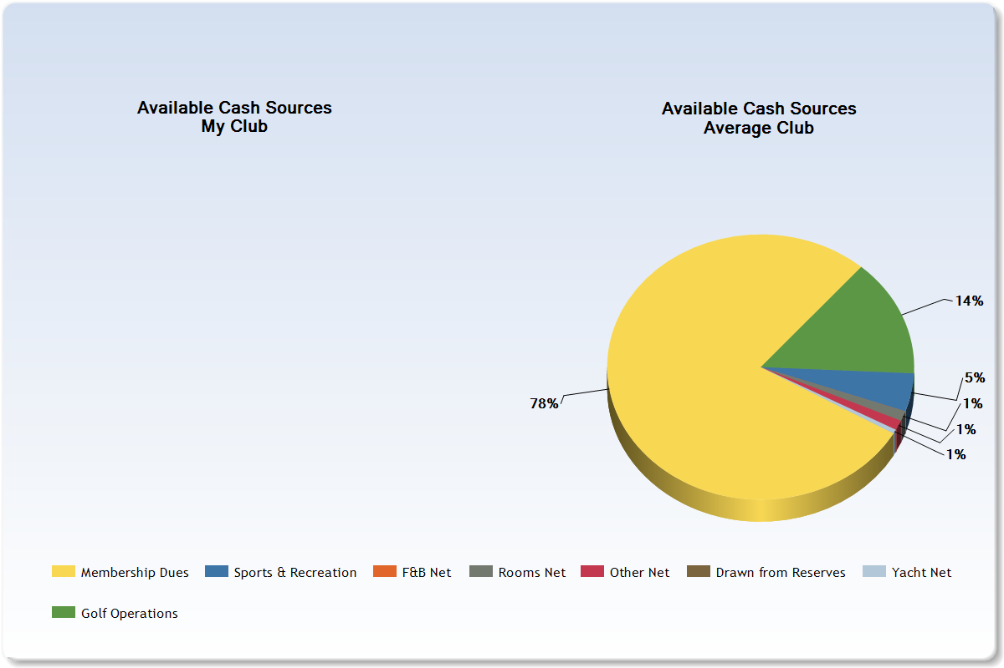
#2 Dues Fuels Gross Margin
KEY QUESTIONS:
How does the club produce Available Cash?
How is that distribution similar to or different from industry norms?
How does that distribution look relative to clubs that are similar to ours?
Dues
78%
In the club business model, dues are the primary source of Available Cash.

Slide 12
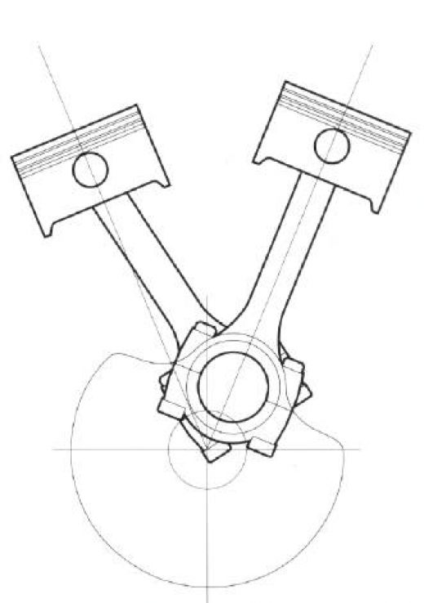
The Dues Engine
Number of Members
Dues per Member
KEY QUESTION:
What is the right optimization for our club?
Dues Revenue $$

Slide 13
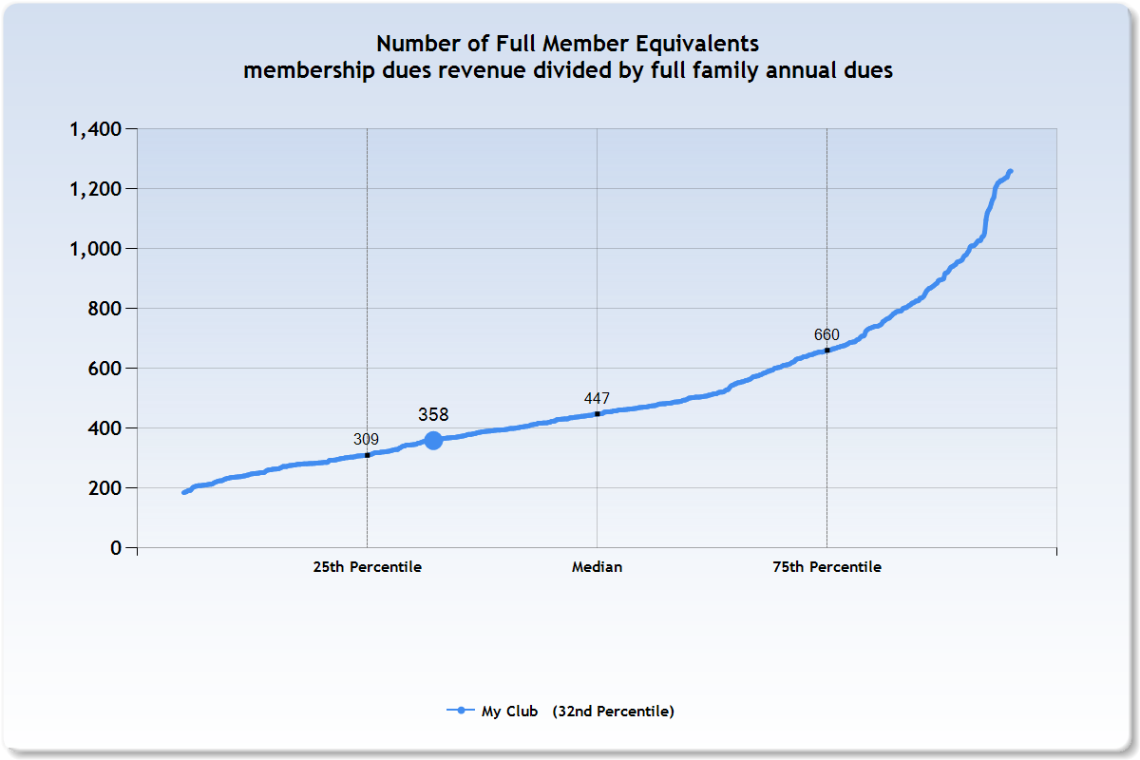
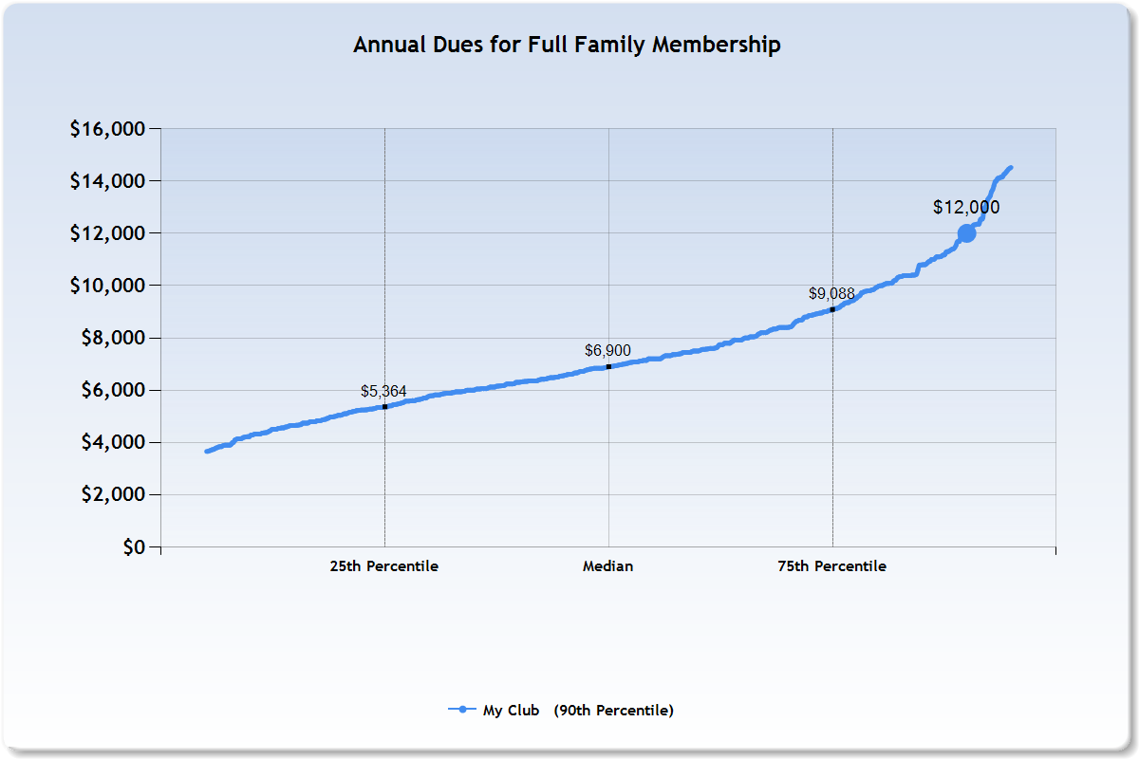
The Dues Engine
The strategic discussion is understanding your optimum balance between dues and member count – with laser focus
My Club
My Club
Drive in members
Increase bylaw capacity?
Regular dues increases

Slide 14
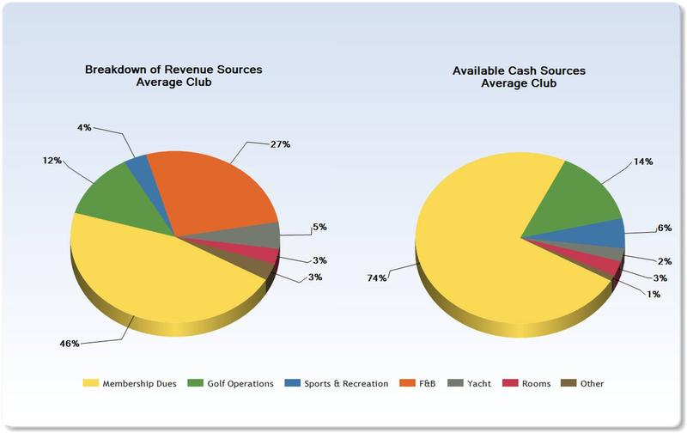
“Why don’t we make money in F&B?”
The most frequently asked question in club boardrooms is…
Because all revenue is not created equal
Food & Beverage does not contribute significantly to a club’s gross margin

Slide 15
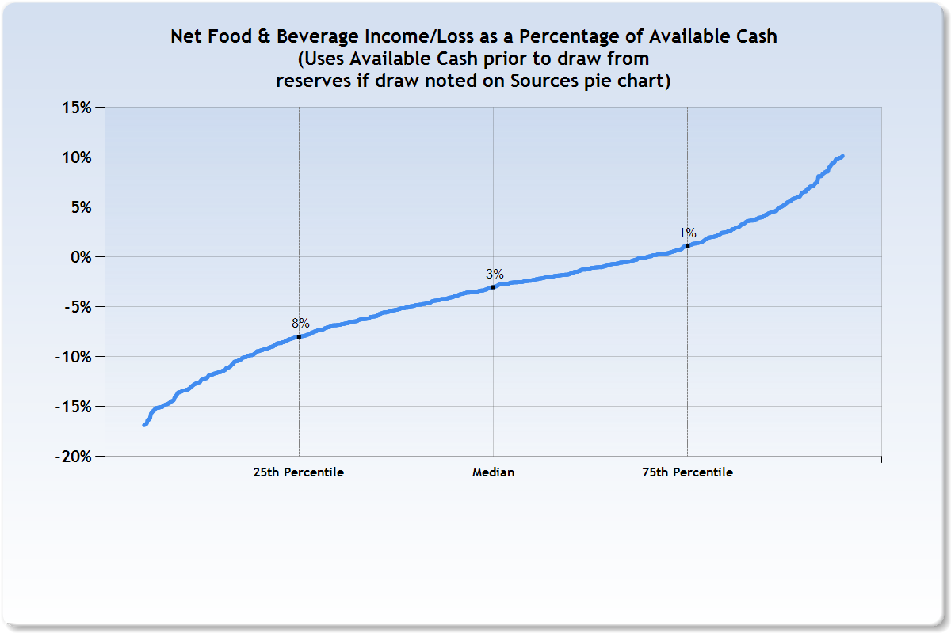
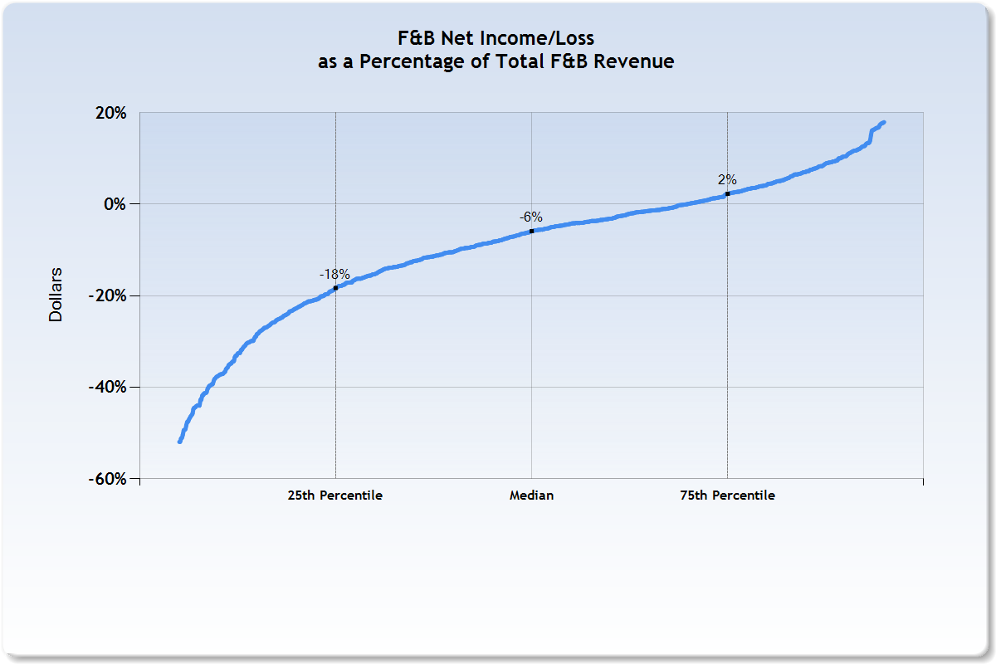
#3 Establish Fact-Based
Expectations for F&B
Club F&B is an important amenity, but it is not a profit center and it cannot make up for a weak dues engine.
F&B plays an important role, but not as a cash (margin) generator

Slide 16
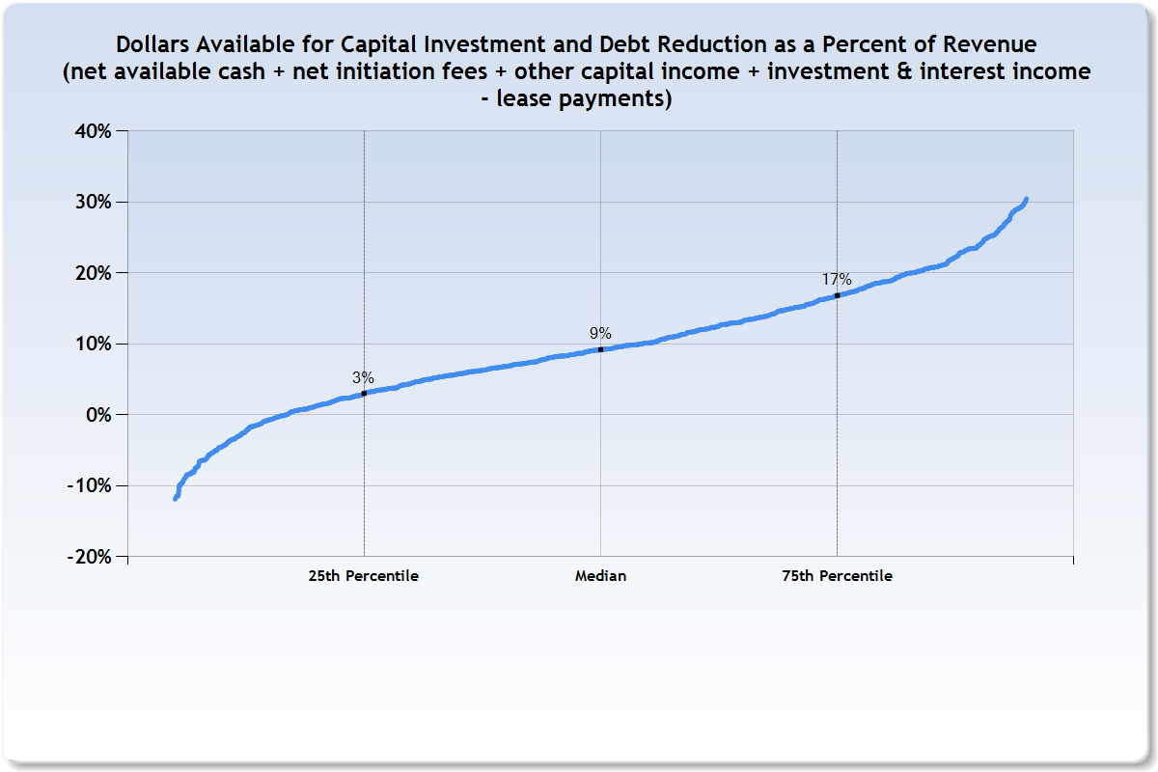
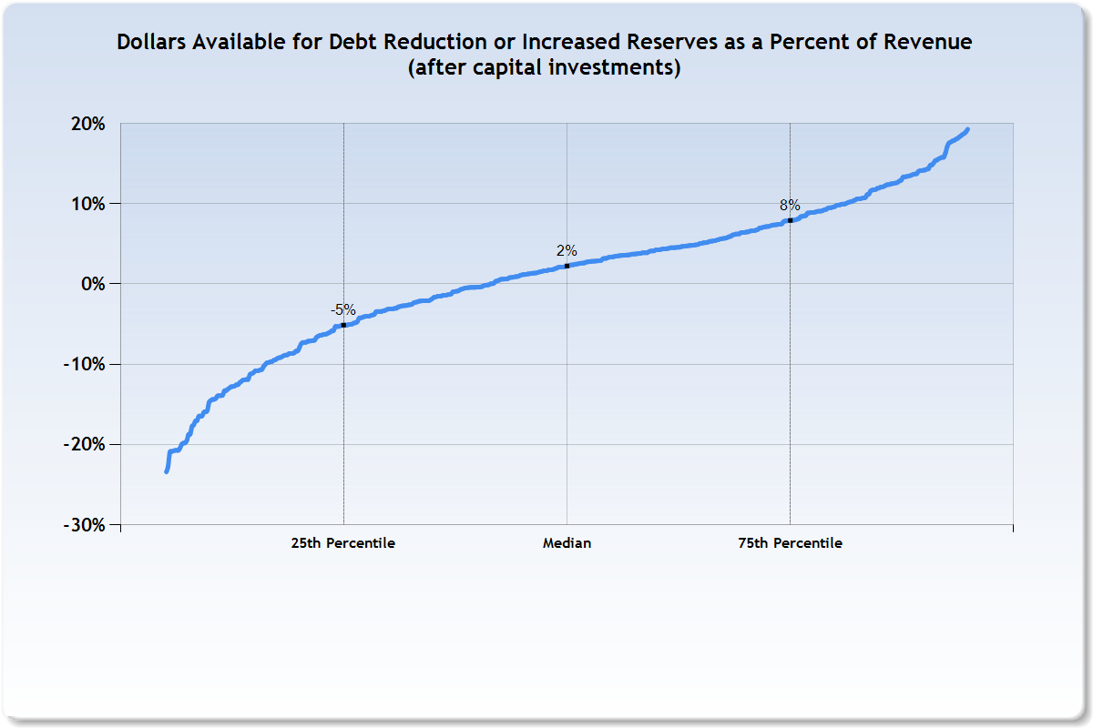
#4 Capital is Not Optional
DUES are the club’s blood flow and CAPITAL is its skeleton
KEY QUESTIONS:
What are the club’s capital needs?
How are those needs funded?
Steady capital keeps the club in a condition that is attractive to prospective members
Initiation fees alone are often too “lumpy” to support predictable inflow

Slide 17
The Board’s Objective
Establish a foundation for leadership which begins with understanding the common business model of clubs and its core drivers:
  The Dues Engine is the key driver of operations: How many members, how much will they pay, and what service level and amenities do they expect?
  F&B must be viewed in its proper context as an amenity
  Absolute separation of Operating and Capital funds
  Matching capital income with capital needs
The long term health of a club is greatly enhanced when its Board strives to act in all three governance modes and to provide stable leadership that withstands the transition from Board to Board without causing changes in the plans, vision and mission of the club. Stability over time is critical.

