Slide 1
Buyer Persona Template
How To Create
Buyer Personas For Your Business
© 2014 OverGo Studio

Slide 2
Buyer Persona Template
Table of Contents
What Are Buyer Personas? ...……………………………………………………………. Slide 3
What Are Negative Personas? ………………………………………......................….. Slide 4
How Can You Use Personas? …………………………………………………………... Slide 5
How Do You Create Personas? …………...………………………..……………......…. Slide 7
Blank Templates ……………………………………………………………………….. Slide 13
© 2014 OverGo Studio

Slide 3
Buyer Persona Template
What Are Buyer Personas?
Buyer personas are fictional, generalized representations of your ideal customers. They help you understand your customers (and prospective customers) better, and make it easier for you to tailor content to the specific needs, behaviors, and concerns of different groups.
The strongest buyer personas are based on market research as well as on insights you gather from your actual customer base (through surveys, interviews, etc.). Depending on your business, you could have as few as one or two personas, or as many as 10 or 20. (Note: If you’re new to personas, start small! You can always develop more personas later if needed.)
© 2014 OverGo Studio

Slide 4
Buyer Persona Template
What Are Negative Personas?
Whereas a buyer persona is a representation of an ideal customer, a negative -- or “exclusionary” -- persona is a representation of who you don’t want as a customer.
This could include, for example, professionals who are too advanced for your product or service, students who are only engaging with your content for research/knowledge, or potential customers who are just too expensive to acquire (because of a low average sale price, their propensity to churn, or their unlikeliness to purchase again from your company.)
© 2014 OverGo Studio

Slide 5
Buyer Persona Template
How Can You Use Personas?
At the most basic level, personas allow you to personalize or target your marketing for different segments of your audience. For example, instead of sending the same lead nurturing emails to everyone in your database, you can segment by buyer persona and tailor your messaging according to what you know about those different personas.
If you take the time to create negative personas, you’ll have the added advantage of being able to segment out the “bad apples” from the rest of your contacts, which can help you achieve a lower cost-per-lead and cost-per-customer (and see higher sales productivity).
© 2014 OverGo Studio

Slide 6
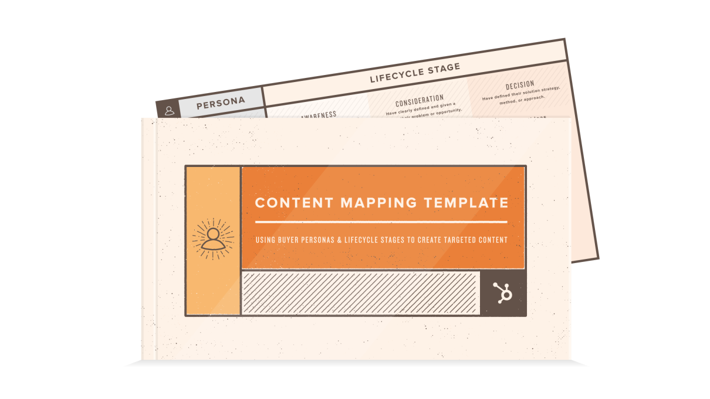
Buyer Persona Template
How Can You Use Personas?
When combined with lifecycle stage (i.e. how far along someone is in your sales cycle), buyer personas also allow you to map out and create highly targeted content.
To learn more about the “content mapping” process, right click here and select Hyperlink > Open Hyperlink.
© 2014 OverGo Studio

Slide 7
Buyer Persona Template
How Do You Create Buyer Personas?
Buyer personas are created through research, surveys, and interviews of your target audience. That includes a mix of customers, prospects, and those outside of your contact database who might align with your target audience.
Here are some practical methods for gathering the information you need to develop personas:
Interview customers either in person or over the phone to discover what they like about your product or service.
© 2014 OverGo Studio

Slide 8
Buyer Persona Template
How Do You Create Buyer Personas?
Look through your contacts database to uncover trends about how certain leads or customers find and consume your content.
When creating forms to use on your website, use form fields that capture important persona information. (For example, if all of your personas vary based on company size, ask each lead for information about company size on your forms. You could also gather information on what forms of social media your leads use by asking a question about social media accounts.)
Take into consideration your sales team's feedback on the leads they are interacting with most. (What types of sales cycles does your sales team work with? What generalizations can they make about the different types of customers you serve best?)
© 2014 OverGo Studio

Slide 9
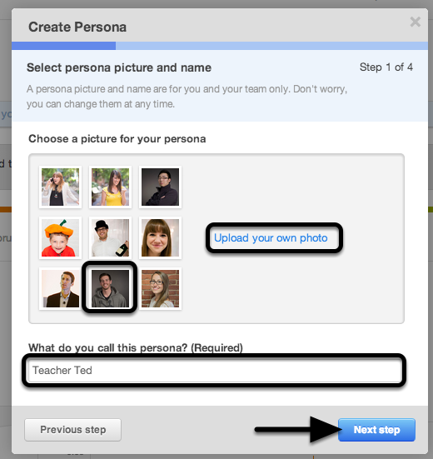
Buyer Persona Template
How Do You Create Buyer Personas?
HubSpot customers: You can create and manage your personas within the Contacts tool. Right click here, then select Hyperlink > Open Hyperlink to learn more!
Customers and non-customers alike: You can use the following 4-slide template to organize your persona data.
First, we’ll walk you through an example, then we’ll leave you with some blank templates so you can get to it!
© 2014 OverGo Studio

Slide 10
Buyer Persona Template
Sample Sally
Head of Human Resources
Worked at the same company for 10 years; worked her way up from HR Associate
Married with 2 children (10 and 8)
Skews female
Age 30-45
Dual HH Income: $140,000
Suburban
Calm demeanor
Probably has an assistant screening calls
Asks to receive collateral mailed/printed
© 2014 OverGo Studio

Slide 11
Buyer Persona Template
Sample Sally
Keep employees happy and turnover low
Support legal and finance teams
Getting everything done with a small staff
Rolling out changes to the entire company
Make it easy to manage all employee data in one place
Integrate with legal and finance teams’ systems
“It’s been difficult getting company-wide adoption of new technologies in the past.”
“I don’t have time to train new employees on a million different databases and platforms.”
“I’ve had to deal with so many painful integrations with other departments’ databases and software.”
© 2014 OverGo Studio

Slide 12
Buyer Persona Template
Sample Sally
I’m worried I’ll lose data transitioning to a new system.
I don’t want to have to train the entire company on how to use a new system.
Integrated HR Database Management
We give you an intuitive database that integrates with your existing software and platforms, and lifetime training to help new employees get up to speed quickly.
Your Turn!
We’ve provided blank templates for developing three personas.
(If you need more, simply select the slides on the left-hand side, right click, and choose “Duplicate.”)
© 2014 OverGo Studio

Slide 13
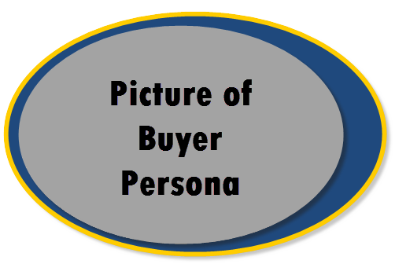
Buyer Persona Template
Buyer Persona Name
Background:
…..
….
….
…
Demographics:
…
….
…...
Identifiers:
…
….
….
….
….
© 2014 OverGo Studio

Slide 14
Buyer Persona Template
Buyer Persona Name
Goals:
….
…
….
…
Challenges:
﻿…
….
…
© 2014 OverGo Studio

Slide 15
Buyer Persona Template
Buyer Persona Name
How ‘Company Name’ helps:
…..
Common objections:
﻿….
….
© 2014 OverGo Studio

Slide 16
Buyer Persona Template
Buyer Persona Name
Marketing messaging:
….
Elevator Pitch:
….
© 2014 OverGo Studio

Slide 17
Buyer Persona Template
Buyer Persona Name
Personality Profile for ‘Buyer Persona Name’: 1. ………
Messaging Hypothesis: 2. ……
© 2014 OverGo Studio

Slide 18
Buyer Persona Template
Buyer Persona Name
Communication Guidelines
Motivated by: …
Emotional needs: …
Responds to: …
Environmental needs: …
Gathers info: …
Makes decisions: ….
Uses time: …
© 2014 OverGo Studio

Slide 19
Buyer Persona Template
Buyer Persona Name
Content Guidelines
….
Questions Customer’s would ask:
….
….
….
© 2014 OverGo Studio

Slide 20
Buyer Persona Template
About Us
We build. We execute. You love. You Grow.
We love to build and execute marketing processes that stimulate growth for our clients.
We know inbound marketing. We aren't like other inbound marketing agencies who started as traditional agencies and had to transition to new methods. We started as an inbound marketing agency, inbound is all we've ever known and it's all we've ever done.
We are your inbound marketing team. Click below to request a consult.
© 2014 OverGo Studio

