Slide 1
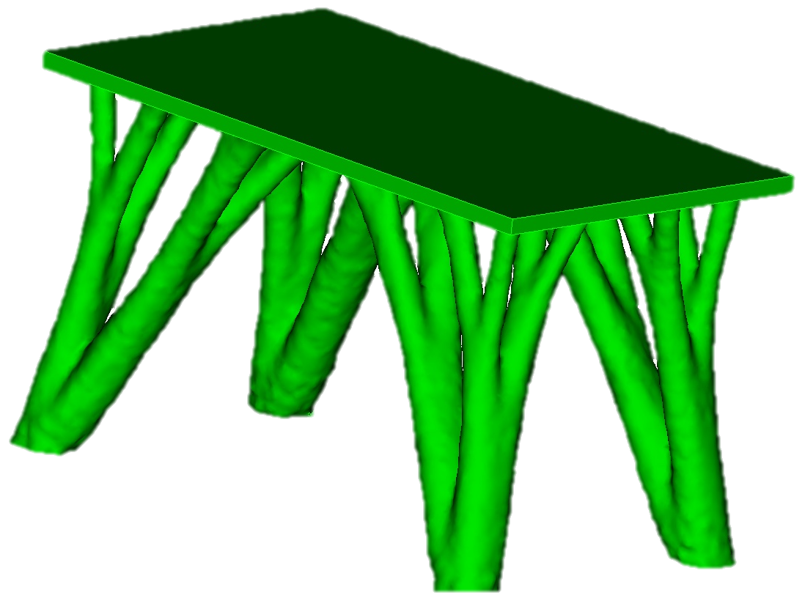

The Simulation Side of Additive Manufacturing
Ted Blacker
Simulation Modeling Sciences Department
5 June 2014
Additive IMOG Mtg
Realizing the vision of qualified metal parts
Contributors:
Miguel Aguilar
Brett Clark
Anthony Geller
Jeremy Lechman
Joshua Robbins
Matt Staten
Joshua Sugar
Roshan Quadros
Tom Voth
Patrick Xavier
Sandia National Laboratories is a multi-program laboratory operated by Sandia Corporation, a wholly owned subsidiary of Lockheed Martin company, for the U.S. Department of Energy’s National Nuclear Security Administration under contract DE-AC04-94AL85000.
SAND2014-18886 C

Slide 2

Realizing the Value of Additive
$$$
¢

Slide 3
SNL Additive Manufacturing Strategic Plan
Vision:
We will deliver innovative national security products – impossible to create with traditional technologies – by exploiting the revolutionary potential of Additive Manufacturing.
Four Pillars or Thrust Areas
Identify Compelling Applications
Provide Design / Analysis Tools
Provide Material Assurance
Enable Product Realization

Slide 4
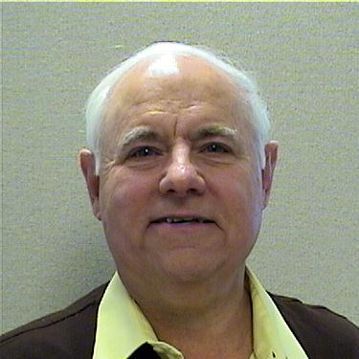
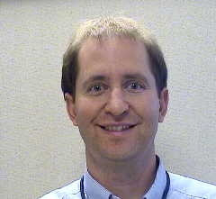

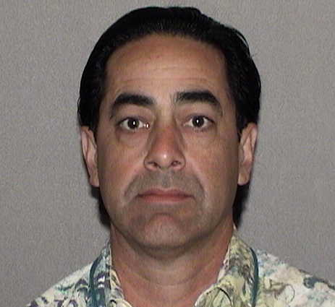

SNL Additive Manufacturing Strategic Plan
Mark Smith
Vision:
We will deliver innovative national security products – impossible to create with traditional technologies – by exploiting the revolutionary potential of Additive Manufacturing.
Four Pillars or Thrust Areas
Andre Claudet
Ted Blacker
Identify Compelling Applications
Provide Design / Analysis Tools
Bradley Jared
Larry Carrillo
Provide Material Assurance
Enable Product Realization

Slide 5
Modeling & Simulation Areas of Investment
1. Functional Design
2. Process Modeling
Topology Optimization
Particle Distribution Analysis
Melt Pool Mechanics
3. Process Planning
Automated Process Plan
Collision Avoidance
Optimization Design Environment
Micro to Macro Material Properties

Slide 6

Enabling Functional Design
1. Functional Design
Topology Optimization
Optimization Design Environment
Design Validation Analysis
Note: The Second Mouse Gets the Cheese
Optimization Design Environment
Adaptive Topological Optimization
Design
Export

Slide 7
Topology Optimization
Single Physics
Inter-Twined Code
φ_{i}
Topology Optimization Manager
Physics 1
e.g. Static
Physics Derivatives
u_{i},

Slide 8
Topology Optimization
φ_{i}
Multiple Physics
Encapsulated Code
φ_{i}
Topology Optimization Manager
Physics 1
e.g. Static
API
Optimization Toolkit
Physics 2
e.g. Thermal
Physics Derivatives
Physics 3
e.g. Modal
API
Topology Optimization Manager
u_{i}, w_{i}, z_{i}

Slide 9
Topology Optimization
φ_{i}
Sierra Example
φ_{i}
Topology Optimization Manager
Sierra SM
e.g. Static
API
Optimization Toolkit
Sierra TH
e.g. Thermal
Sierra Derivatives
Sierra SD
e.g. Modal
API
Topology Optimization Manager
u_{i}, w_{i}, z_{i}

Slide 10
Topology Optimization
φ_{i}
Albany Example
φ_{i}
Topology Optimization Manager
Albany Statics
API
Optimization Toolkit
Albany Thermal
e.g. Thermal
Albany Derivatives
Albany Modal
API
Topology Optimization Manager
u_{i}, w_{i}, z_{i}

Slide 11
Topology Optimization
φ_{i}
φ_{i}
E, F
Topology Optimization Manager
Physics 1
e.g. Static
API
UQ
Manager
Optimization Toolkit
Physics 2
e.g. Thermal
API
Physics 3
e.g. Modal
Topology Optimization Manager
Φ_{opt}
u_{i}, w_{i}, z_{i}

Slide 12
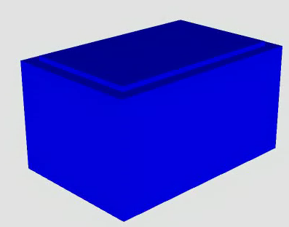
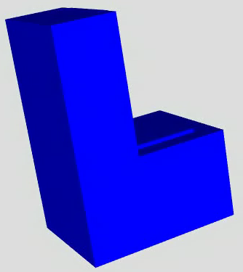
1. Functional Design
Topology Optimization
Design Environment
Topology Optimization

Slide 13
Exploring ODE (Opt. Design)
1. Functional Design
Topology Optimization
Optimization Design Environment
Design Validation Analysis
Optimization Design Environment
Topological Optimization
Design
Export

Slide 14
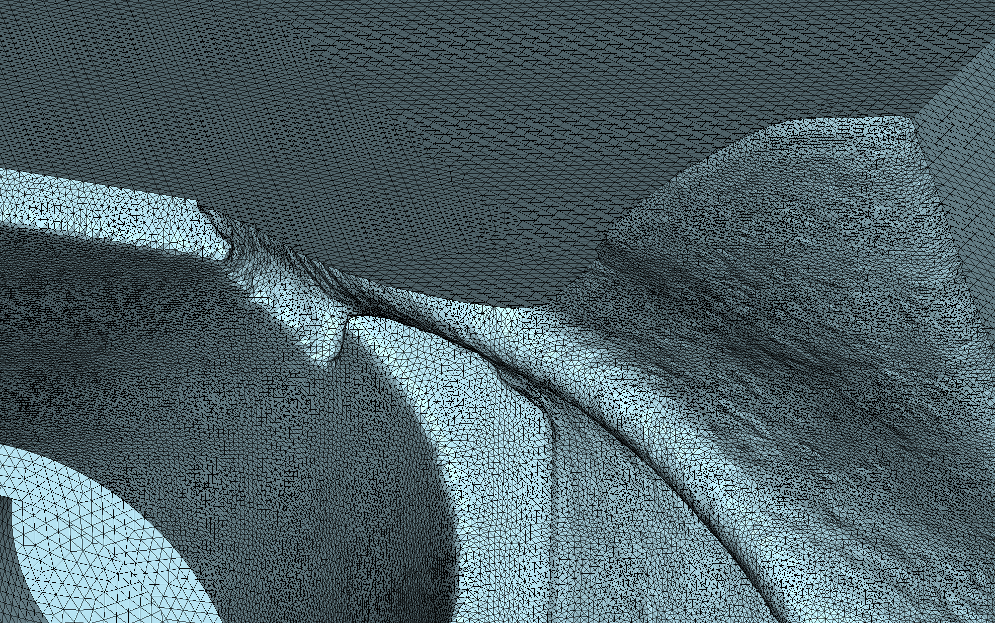
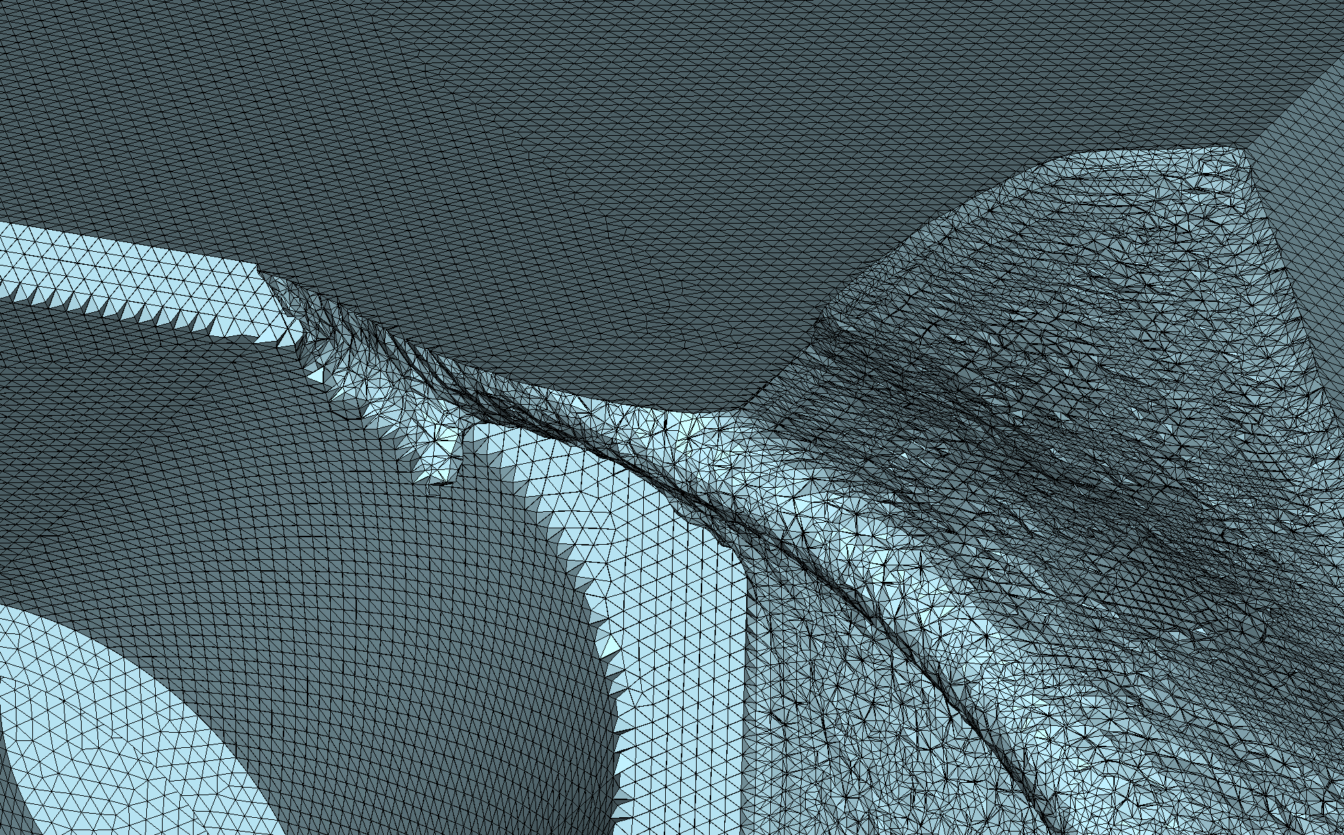
1. Functional Design
Topology Optimization
Design Environment
Topology Optimization
Adoption Issues

Slide 15

1. Functional Design
Topology Optimization
Design Environment
Topology Optimization
Adoption Issues
Facet Manipulations

Slide 16
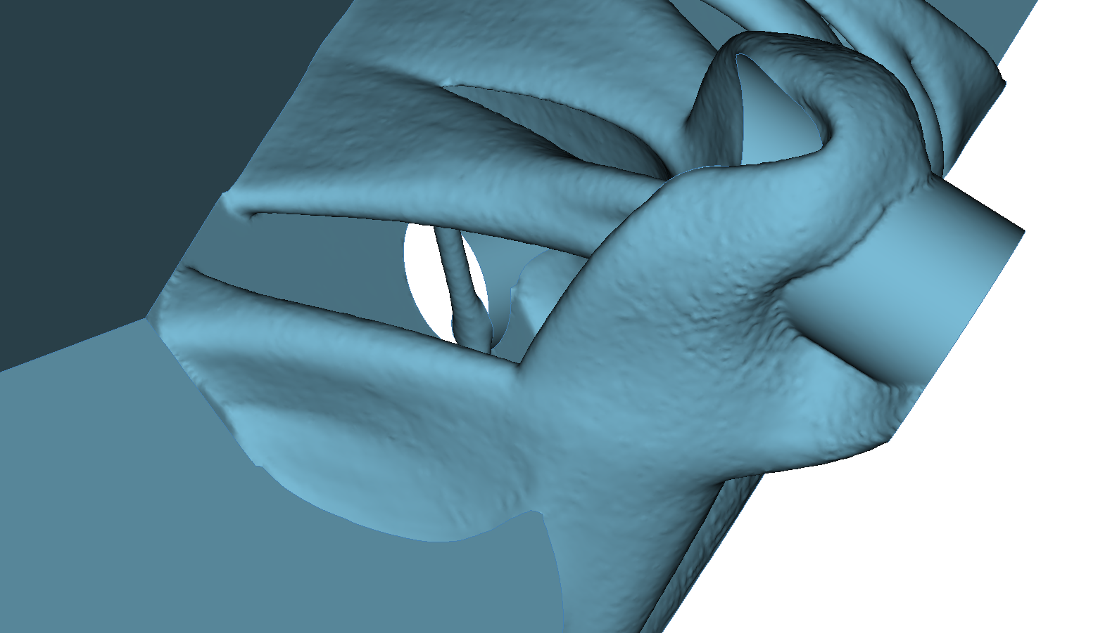
1. Functional Design
Topology Optimization
Design Environment
Topology Optimization
Adoption Issues
Facet Cleanup

Slide 17
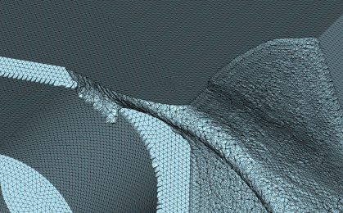

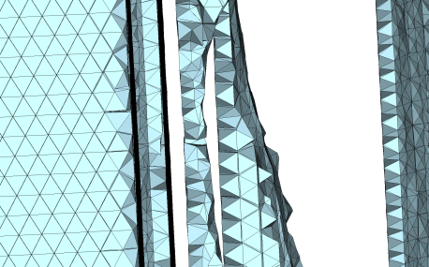
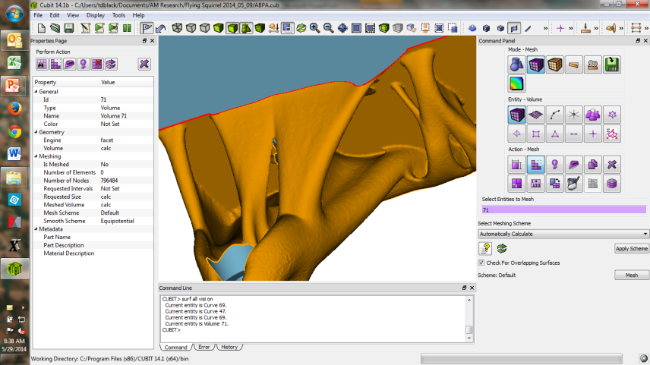
1. Functional Design
Topology Optimization
Design Environment
Topology Optimization
Adoption Issues
Conversion to CAD
Validation Meshing
Facet Cleanup
Sophisticated Design Control
Expertise Intensity
Model Size
Manual Intervention
Computational Power
Usability Issues
E, F
Topology Optimization Manager
φ_{i}
API
Physics
1
UQ
Manager
Optimization Toolkit
Physics 2
API
Physics 3
Topology Optimization Manager
Φ_{opt}
u_{i}, w_{i}, z_{i}

Slide 18
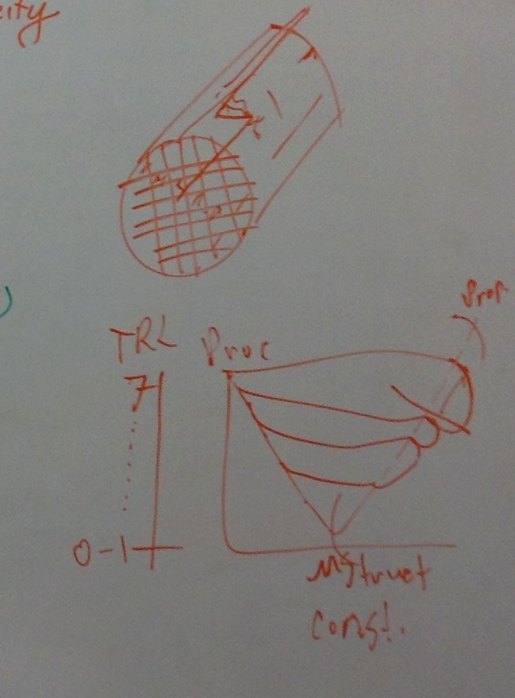
2. Process Modeling
Particle Distribution Analysis
Melt Pool Mechanics
Micro to Macro Material Properties
Process Modeling V Diagram
Particle Packing
Topology Issues & Surface Finish
Particle Heating
Partial Melt Interfaces
Wetting, Partial Melt & Flow
Solidification
(Nucleation Growth)
Molten Pool Dynamics
Solid Nucleation
(MD, Monte Carlo)

Slide 19
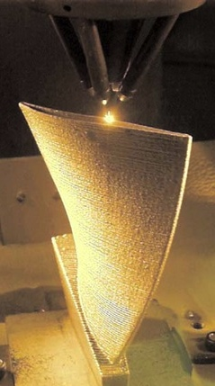
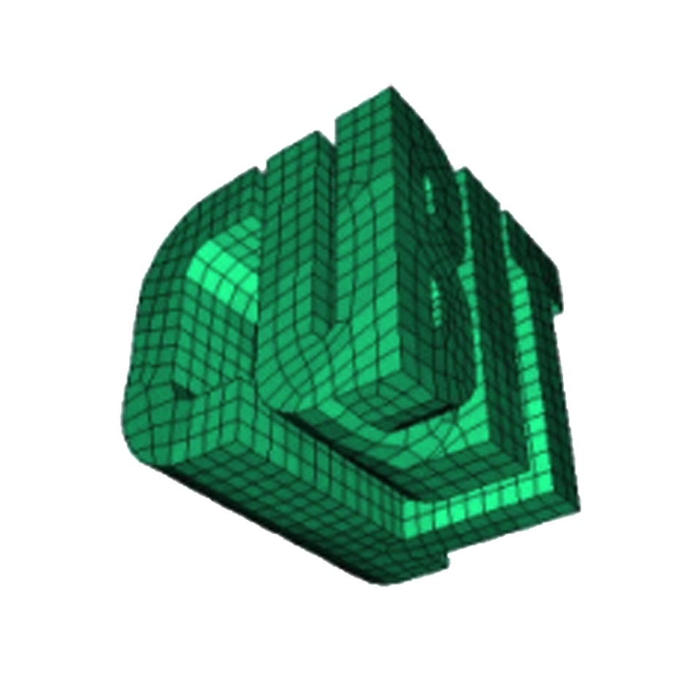
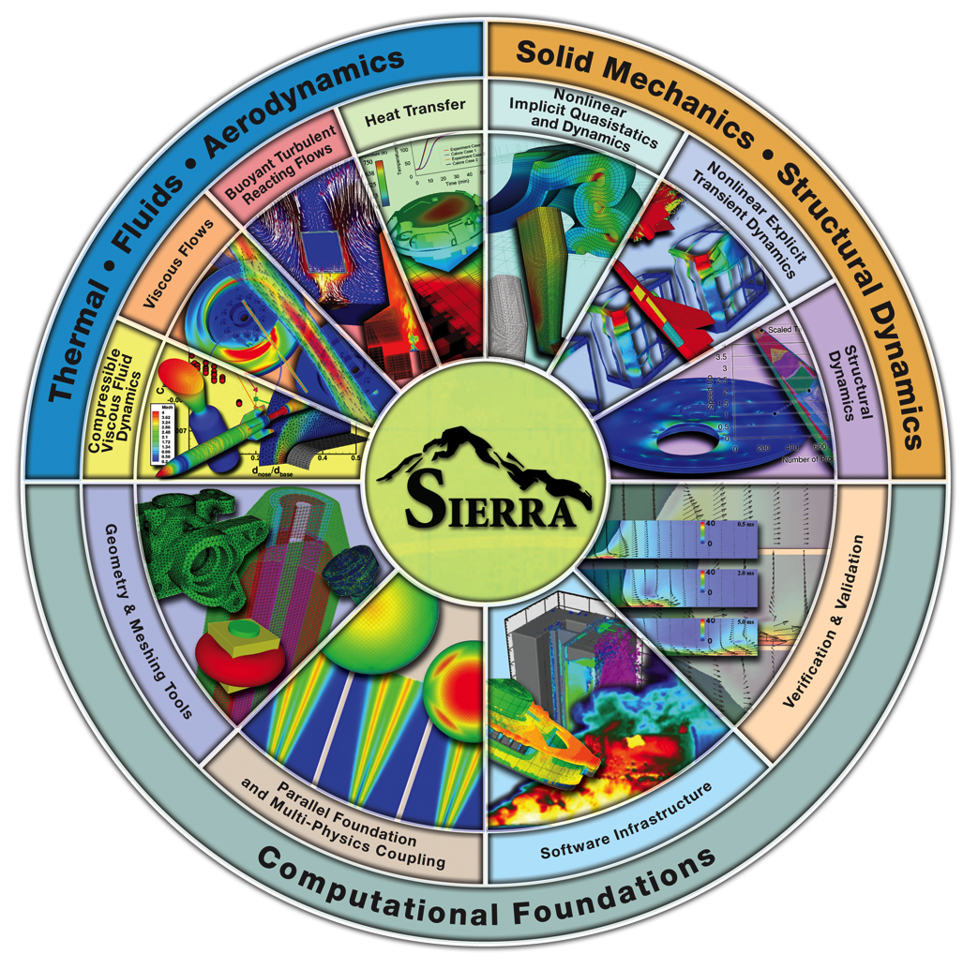
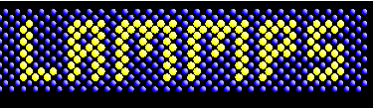

2. Process Modeling
Particle Distribution Analysis
Melt Pool Mechanics
Micro to Macro Material Properties
SNL Computational Tools

Slide 20
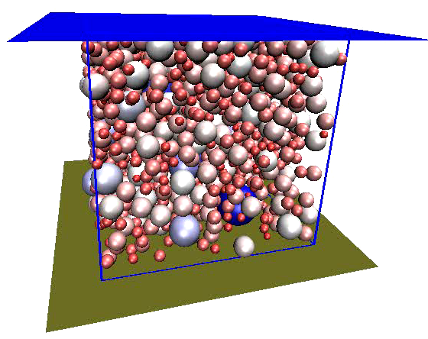
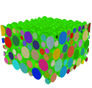

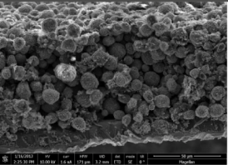
2. Process Modeling
Particle Distribution Analysis
Melt Pool Mechanics
Micro to Macro Material Properties
SNL Computational Tools
Computational μstructure generation
Meshing complex μstructure
Continuum modeling
Experimental microstructrue characterization

Slide 21
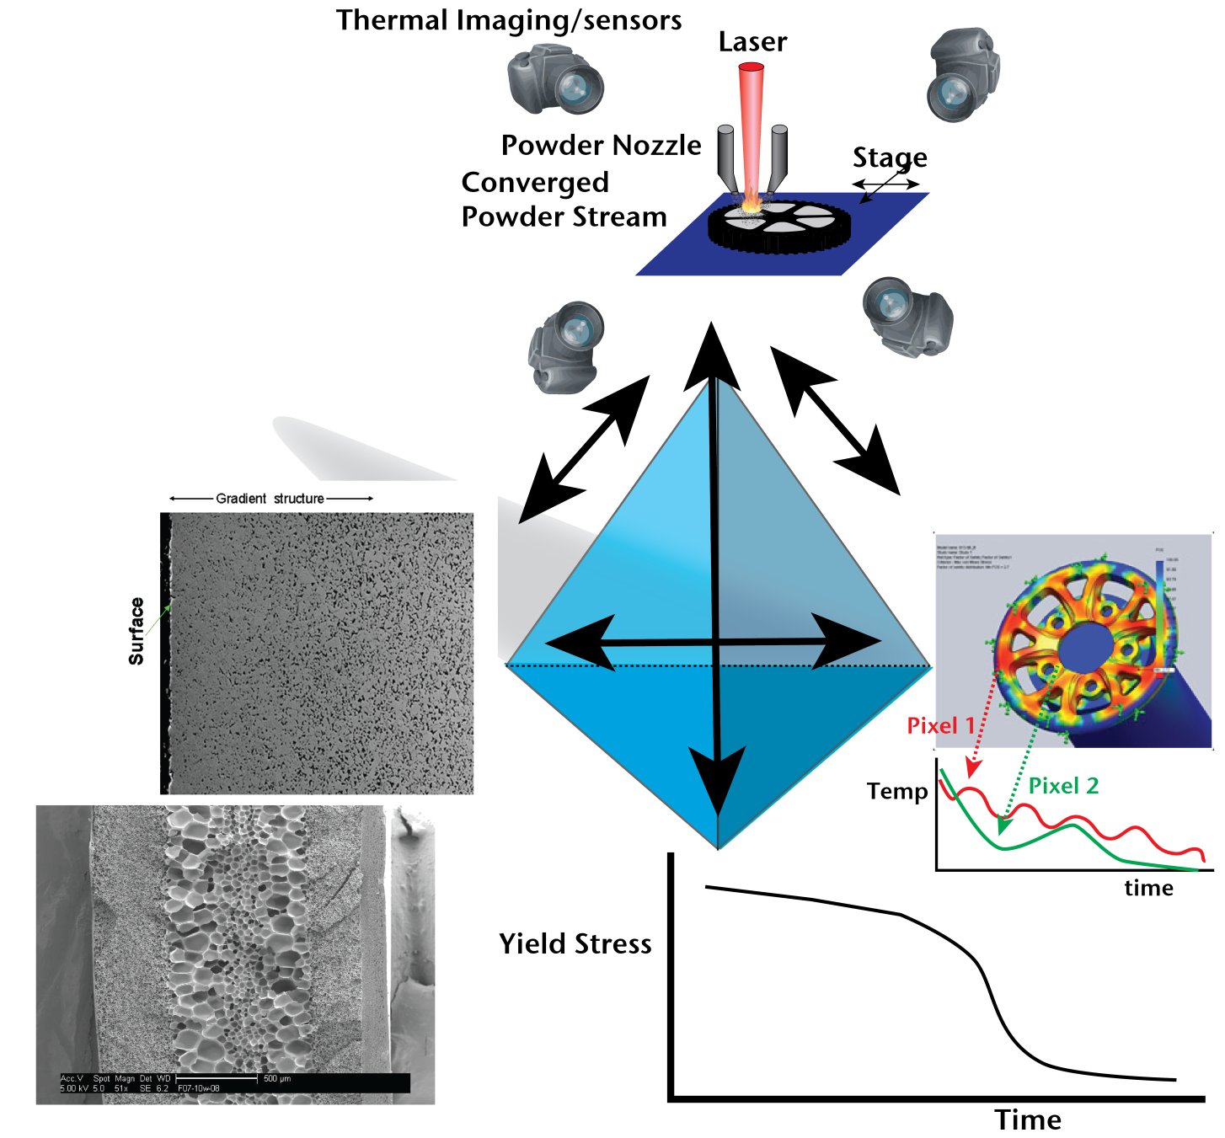
2. Process Modeling
Particle Distribution Analysis
Melt Pool Mechanics
Micro to Macro Material Properties
LENS
Process
Powder feed rate, laser scan rate, powder size, laser energy,
Complete thermal history reconstructed layer-by-layer from in situ thermal sensors
Microstructural Analysis
Property Prediction
http://weldracing.com/press/wp-content/uploads/2010/03/weld_tech_thermal_image_fig2.jpg
http://faculty.washington.edu/vkumar/microcel/images/processes/gradient.jpg
http://powder.metallurgy.utah.edu/research/research.php?page=FG%20WC-Co

Slide 22
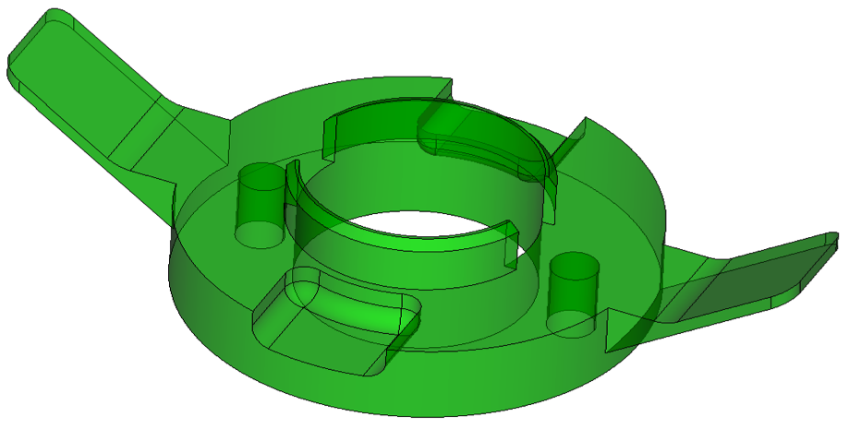
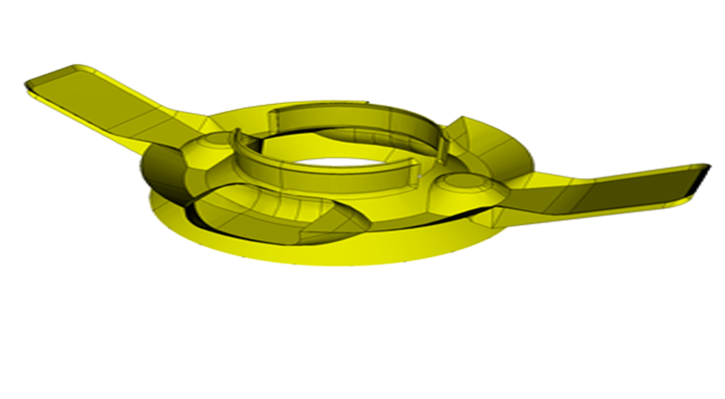
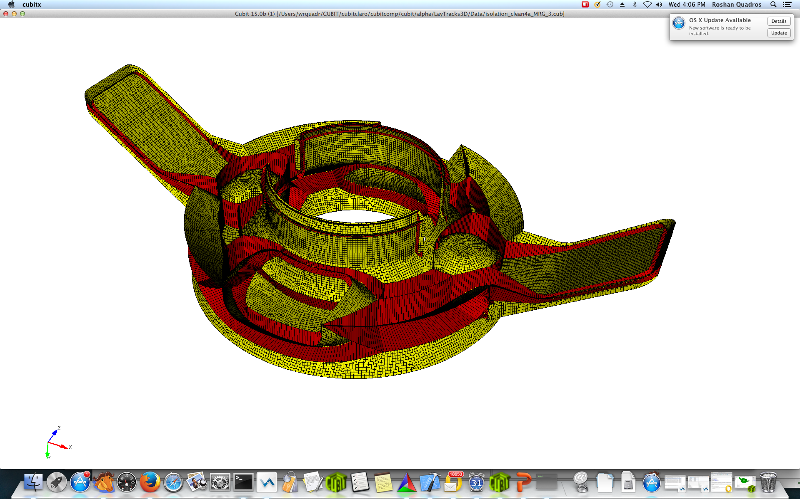
3. Process Planning
Automated Process Plan
Collision Avoidance
Skeleton-Informed Full-DOF
Direct Deposition Process Planning
Generate part skeleton and 3D tracks to surface

Slide 23
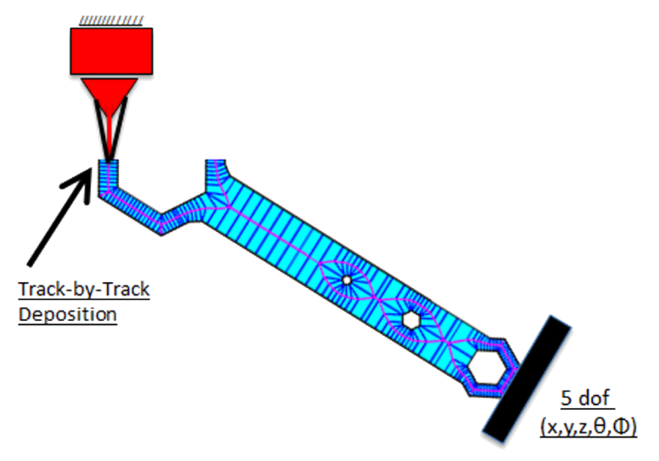
3. Process Planning
Automated Process Plan
Collision Avoidance
Skeleton-Informed Full-DOF
Direct Deposition Process Planning
Planning algorithm informed by skeleton and track
      Uses inverse problem for collision-freedom & completeness
      Plan segments:
          Extending
          Thickening
          Topology-Changing

Slide 24
Questions and Discussions
1. Functional Design
2. Process Modeling
Topology Optimization
Particle Distribution Analysis
Melt Pool Mechanics
3. Process Planning
Automated Process Plan
Collision Avoidance
Design Environment
Micro to Macro Material Properties

