Slide 1
Outline
Definitions MAS
Properties MAS
CAD models TJC
The challenges for computing TJC

Slide 2
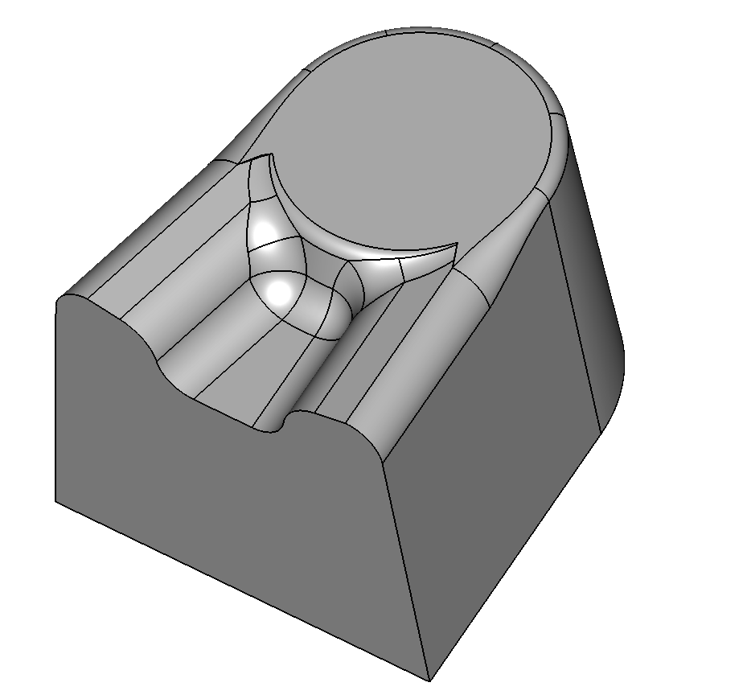
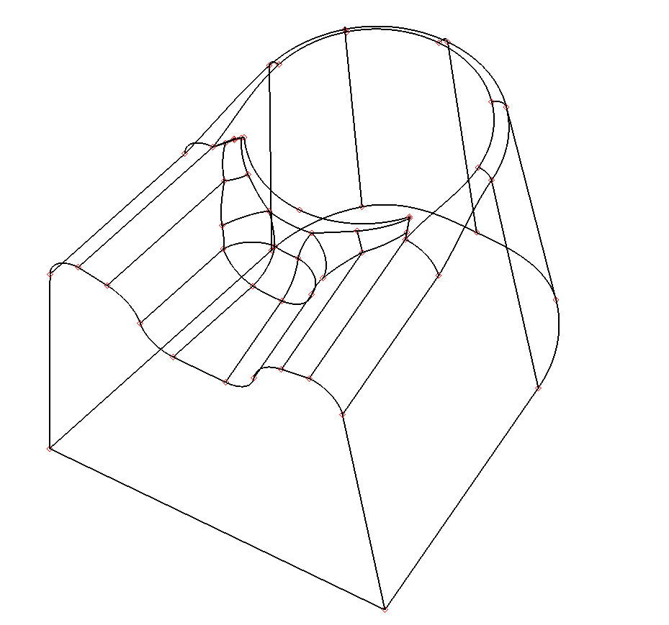
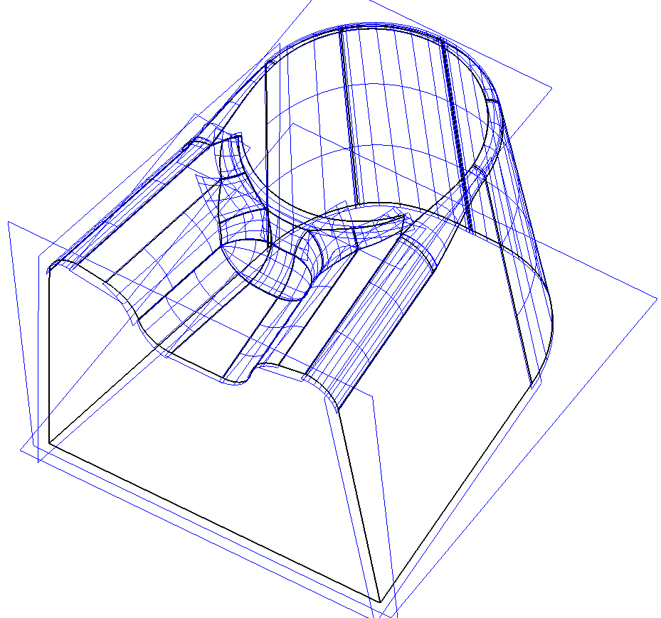
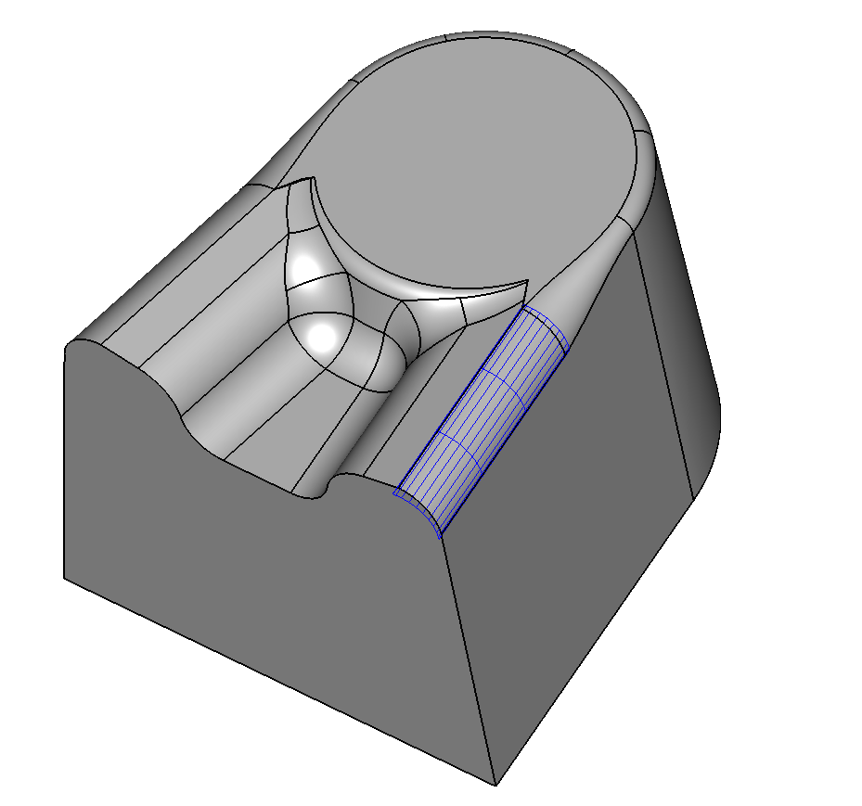
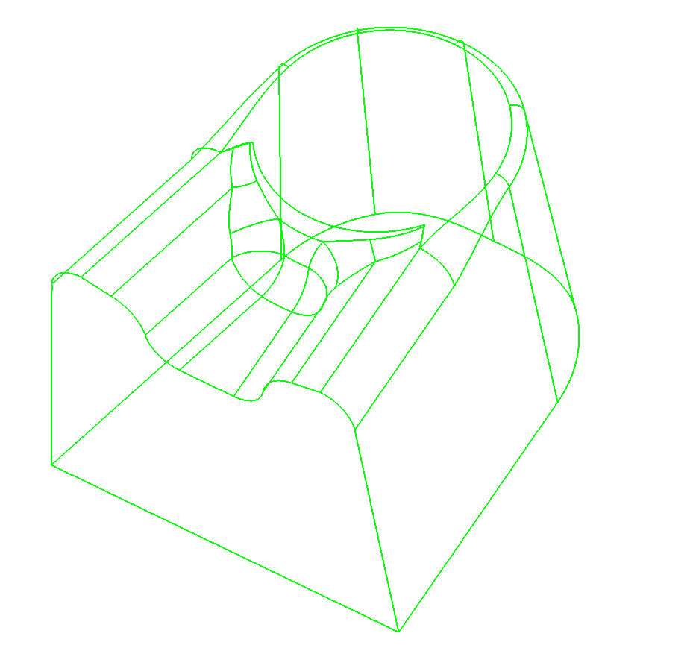
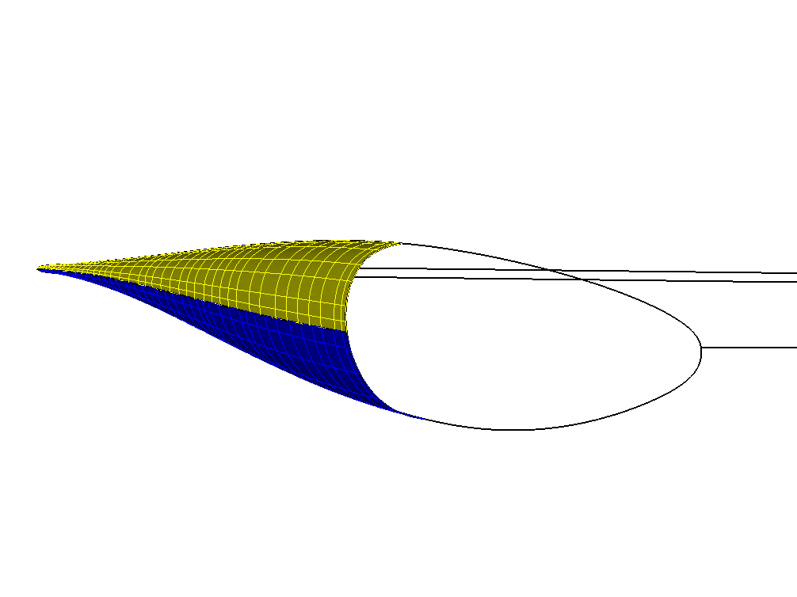
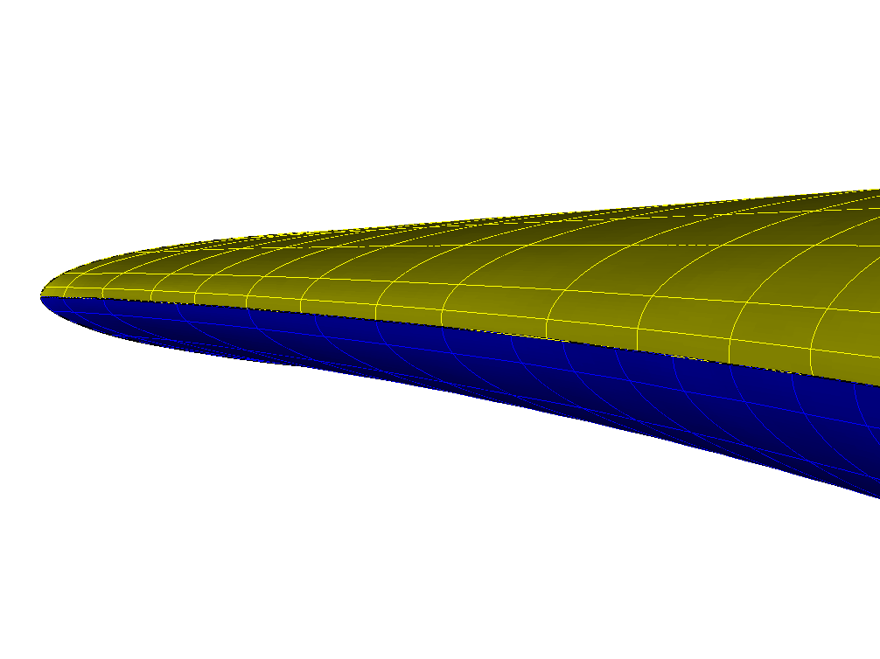
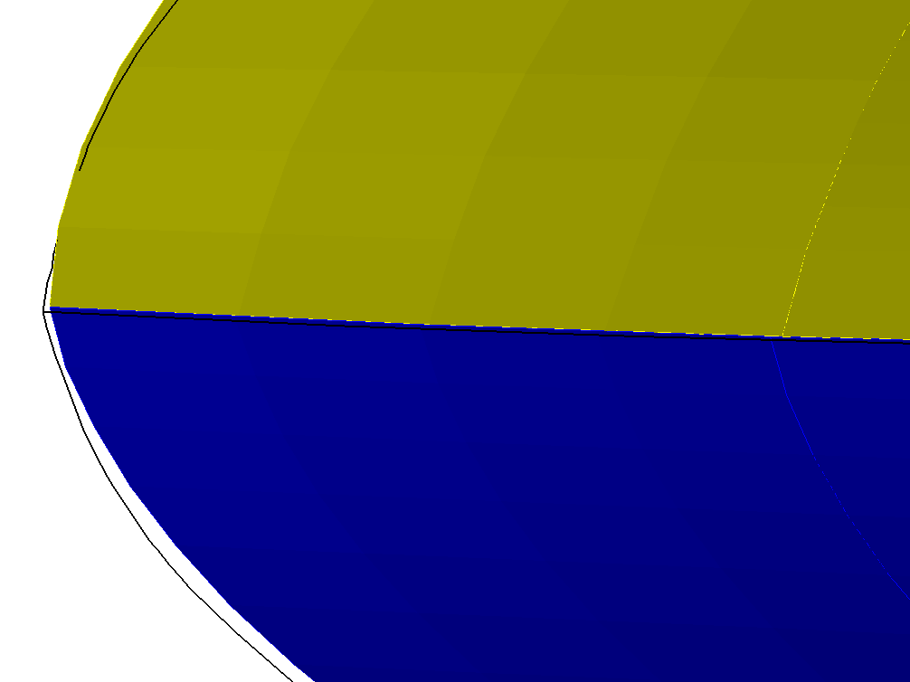
CAD models and B-reps
Industrial models are held as a boundary representation
Edges are bounded by vertices
Faces are bounded by edges and embedded in surfaces
Those surfaces are trimmed
Bodies are bounded by faces
Point containment requires a solid model (“topologically watertight”)
But CAD models have gaps
No guarantee of continuity where embedding surfaces meet
Vertices may not even lie on the edges
Not “geometrically watertight”

Slide 3
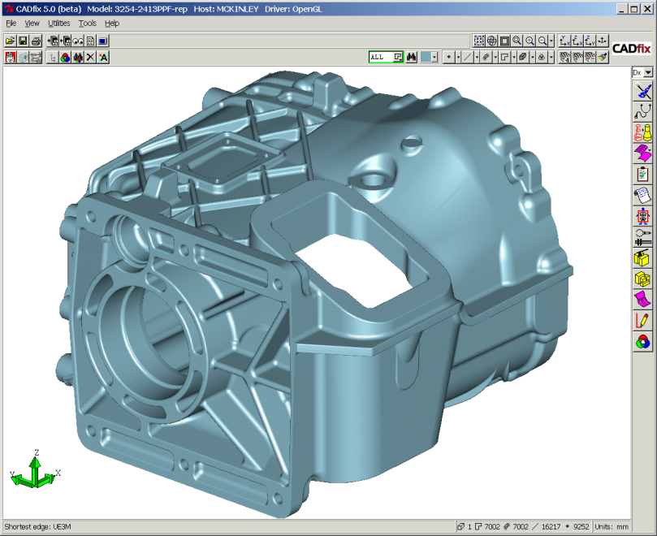
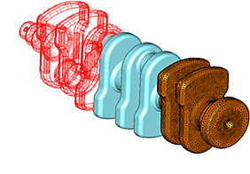
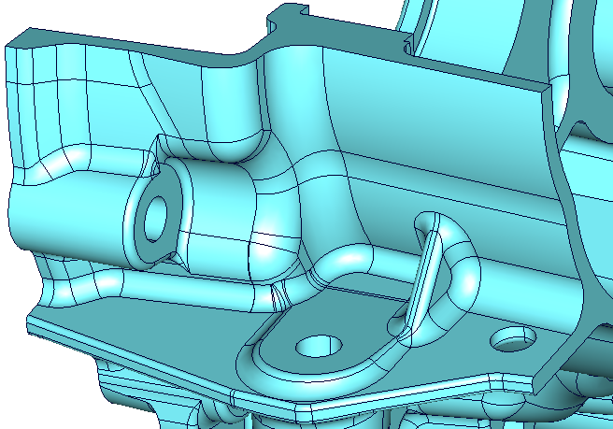
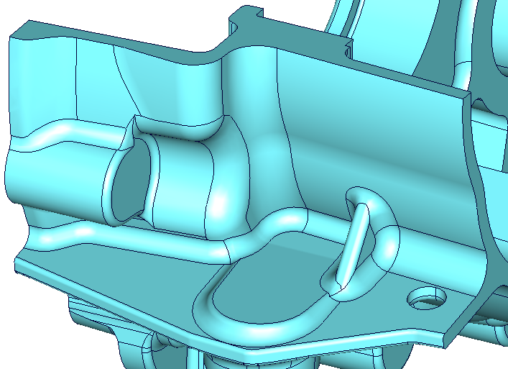
Tolerances and intent
CAD still works!
Models are built with the precision needed for their application, e.g.
manufacturing
meshing/analysis
A B-rep is fit for purpose if it stores the designer’s intended shape to within the modelling tolerance
There can be multiple versions of the same model for different purposes

Slide 4
Outline
Definitions MAS
Properties MAS
CAD models TJC
The challenges for computing TJC

Slide 5
Instability
MAT is discontinuous with respect to shape variation (MAS)
B-reps that are within tolerance of each other may have completely different medial axes
What should the topology of the medial axis be?

Slide 6
Potential pitfalls
Flaps into face/edge gaps
B-rep is always intended to store a connected solid
Flaps into edges with small dihedral angle
Depends on the angular precision of the B-rep
Spikes into curvature oscillations
Depends on the tolerance used for surface geometry

Slide 7
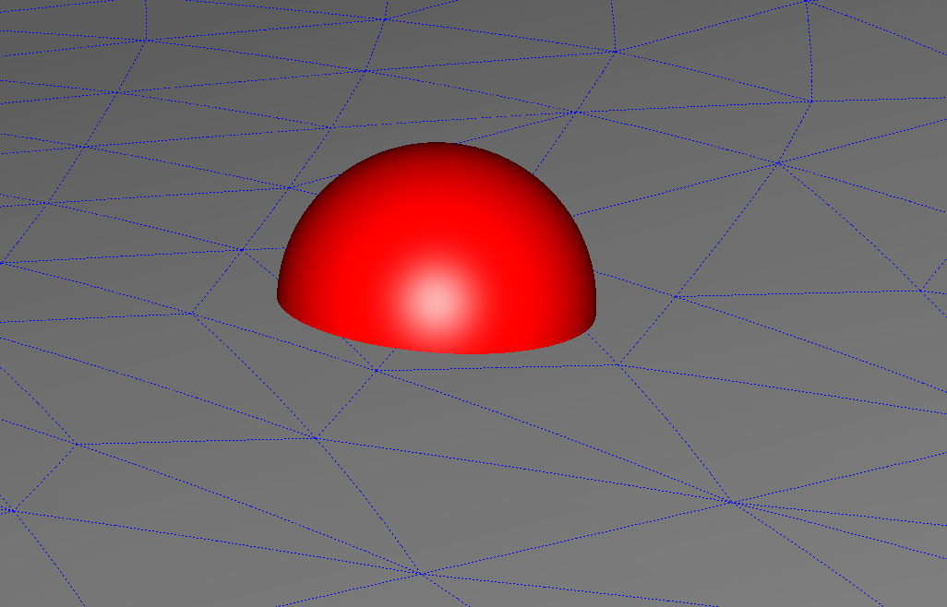
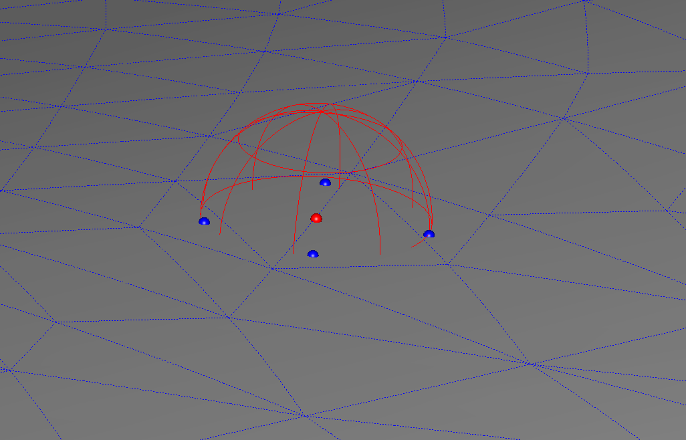
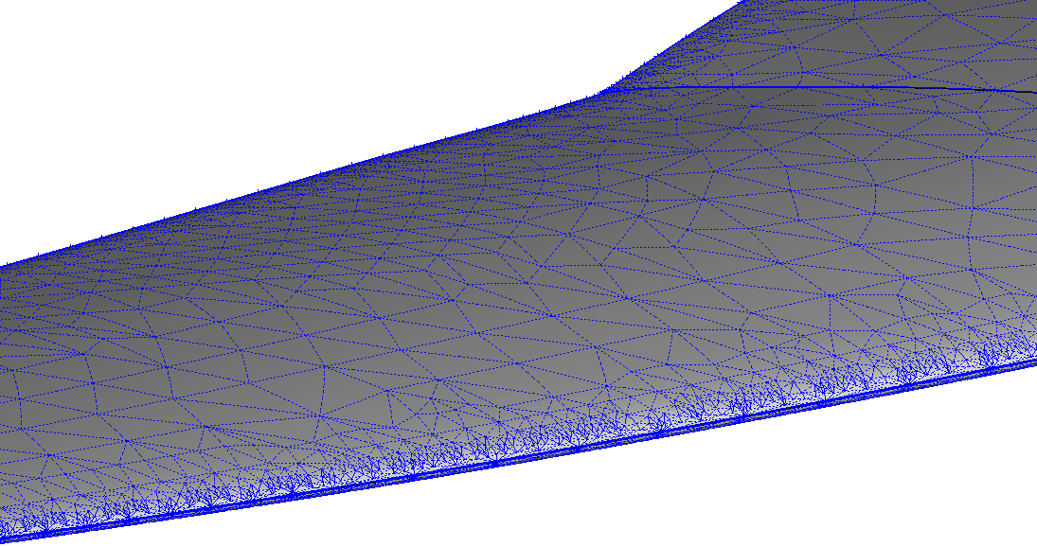
Medial axis and Voronoi diagrams
In 2D, the medial axis is the limit of the Voronoi diagram on a sequence of samples that becomes increasingly dense
Not true in 3D (Amenta, Bern and Eppstein, 1998)
Four samples create a “sliver” tetrahedron
Can Voronoi diagrams still be useful for computing 3D MATs?

Slide 8
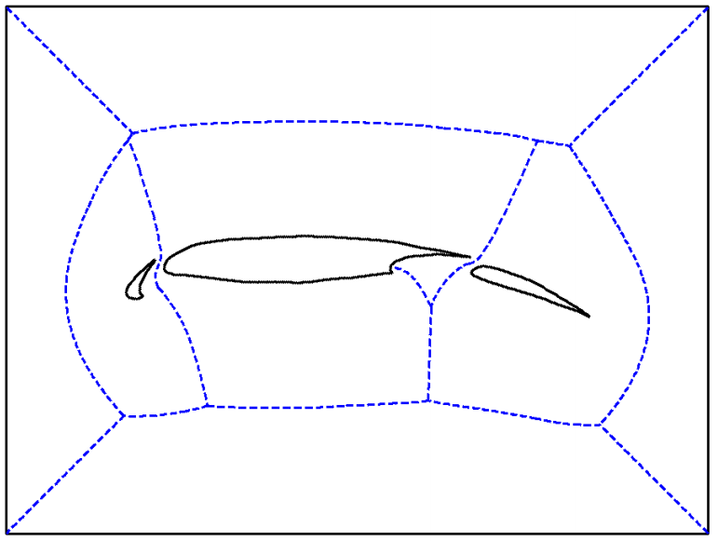
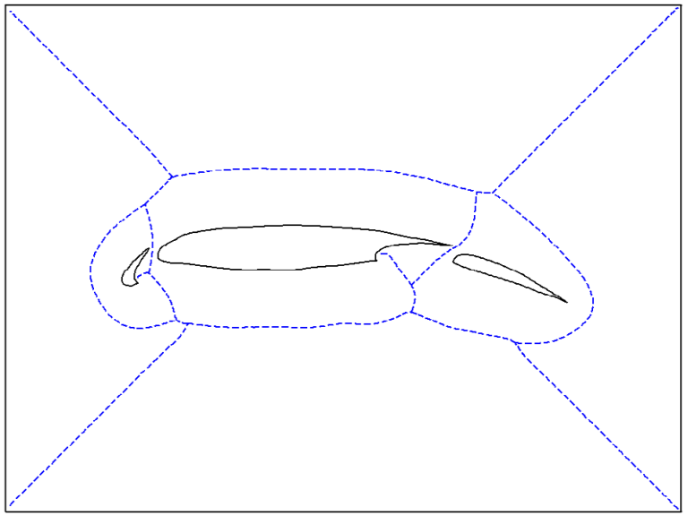
Medial axis and distance fields
The medial axis is the “set of singularities of the field of distance from the boundary” (MAS)
Detecting these singularities can provide a medial point cloud
Can be robust to noise or errors in input geometry
Makes it possible to compute MAT with respect to different metrics (Xia and Tucker, 2006)
But result may be
Not guaranteed connected
A finite thickness curve/ surface that approximates MAT
Lacking topology/connectivity
Can distance fields still be useful for computing 3D MATs?

Slide 9
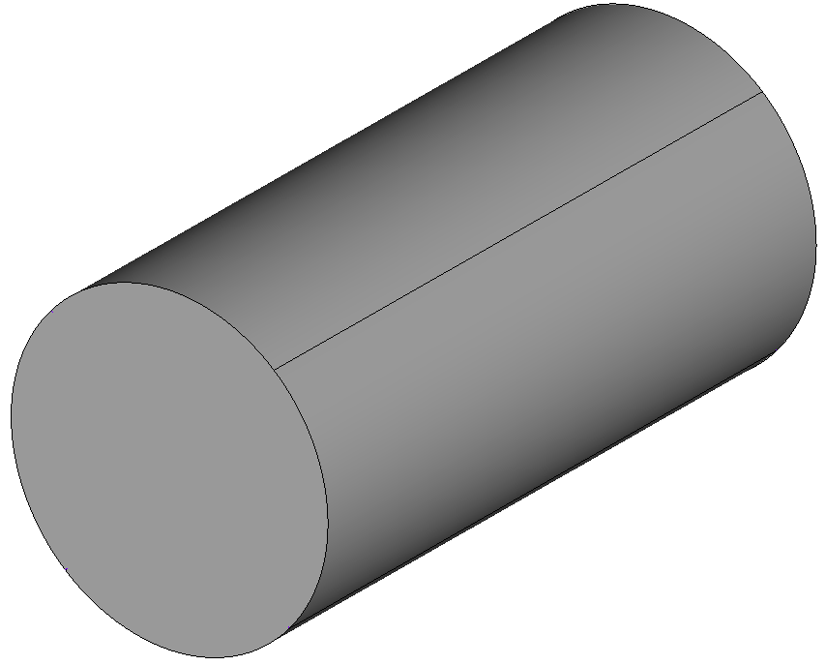
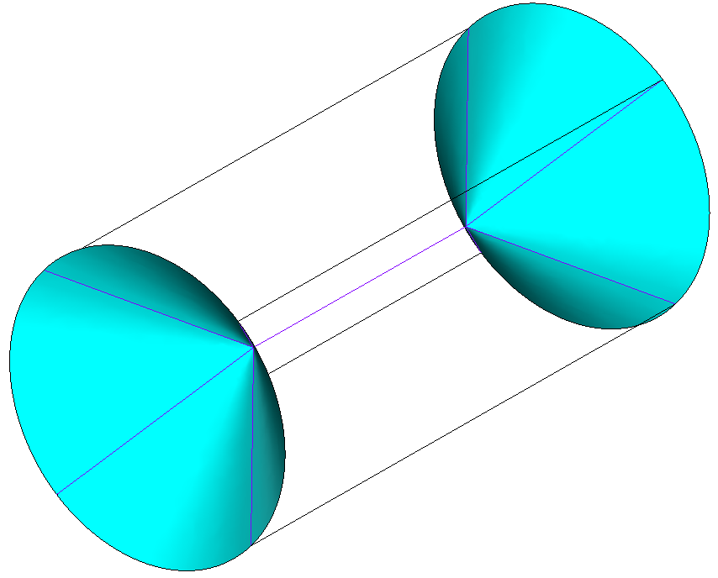
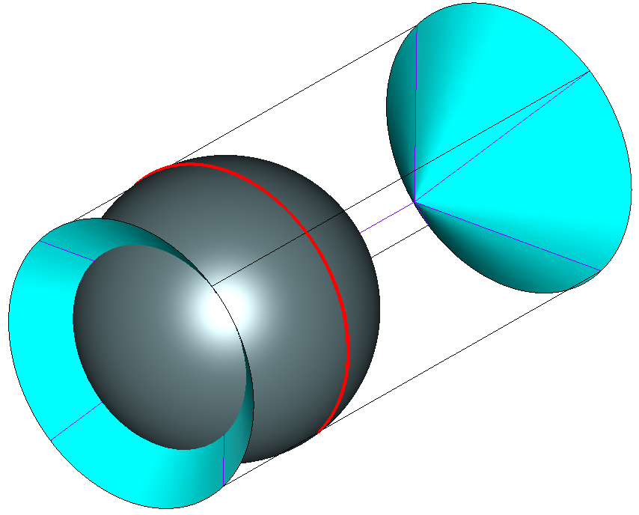
Finite and curvature contact
Medial spheres can touch a region instead of isolated points
Degenerate “finite contact” case
Curvature contact is the limit as region shrinks to a point
Challenging for algorithms to correctly collapse parts of the medial axis

Slide 10
Conclusion
Medial Axis Transforms are
rich geometry descriptions
a mechanism for domain partitioning
unstable and difficult to compute robustly
CAD boundary representations have
well-specified “watertight” topology
only approximate geometry
To be robust and useful, we need the Medial Axis Transform to capture what a model is intended to represent, which may be different to what it actually is
The required precision depends on the application

