Slide 1
Computing Stable and Compact Representation of Medial Axis
Wenping Wang
The University of Hong Kong

Slide 2
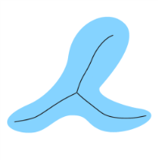
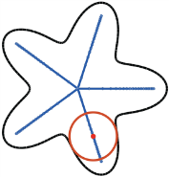
Properties of Medial Axis Transform
Medial representation of a shape
  First proposed by Blum (1967) – the set of centers and radii of inscribed maximal circles
  Encodes symmetry, thickness and structural components
  A complete shape representation of both object interior and boundary

Slide 3
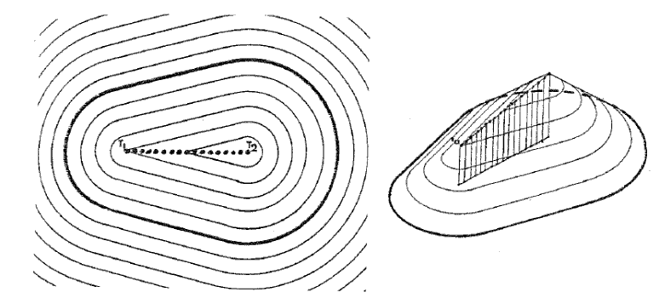
“A transformation for extracting new descriptors of shape”, Harry Blum (1967).

Slide 4
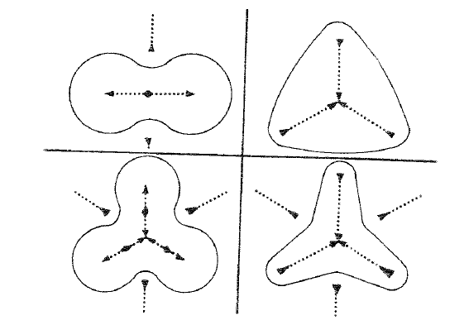
“A transformation for extracting new descriptors of shape”, Harry Blum (1967).

Slide 5
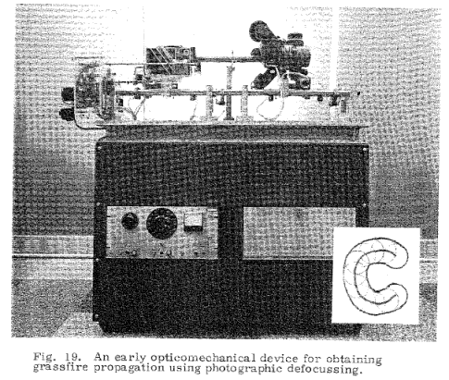
“A transformation for extracting new descriptors of shape”, Harry Blum (1967).

Slide 6
Applications
Object recognition
Shape matching
Path planning and collision detection
Skeleton-controlled animation
Geometric processing
Mesh generation
Network communication

Slide 7
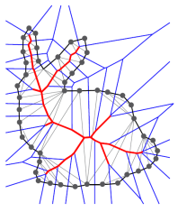
Voronoi-based Computation of MAT
Voronoi-based method (e.g. Amenta and Bern 1998)
Every Voronoi vertex is the circum-center of a triangle/tet in Delaunay triangulation.

Slide 8
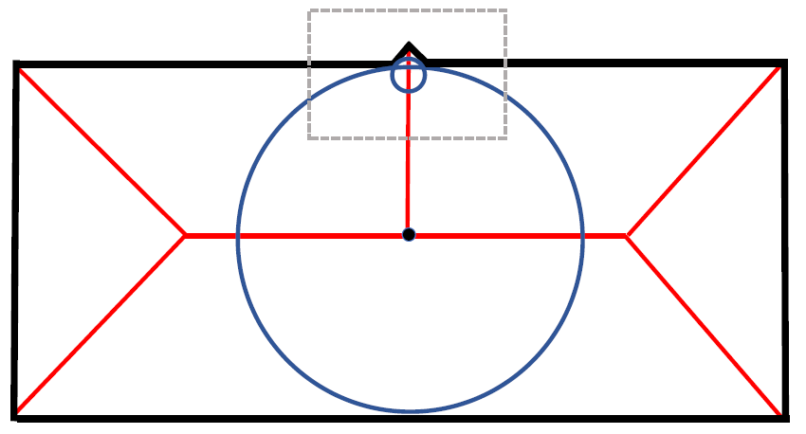
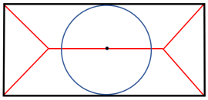
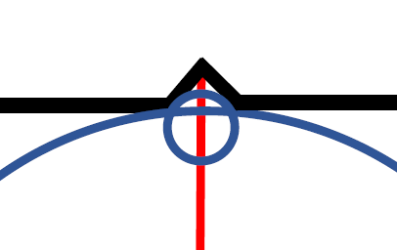
Instability of MAT
Small variations of the object boundary may cause large changes to the medial axis

Slide 9
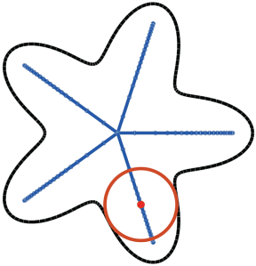
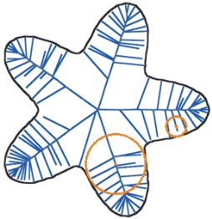
Instability in Computation of MAT
Medial axis of a shape with noisy boundary typically has numerous unstable branches (spikes), making it highly non-manifold
Smooth boundary
Noisy boundary

Slide 10
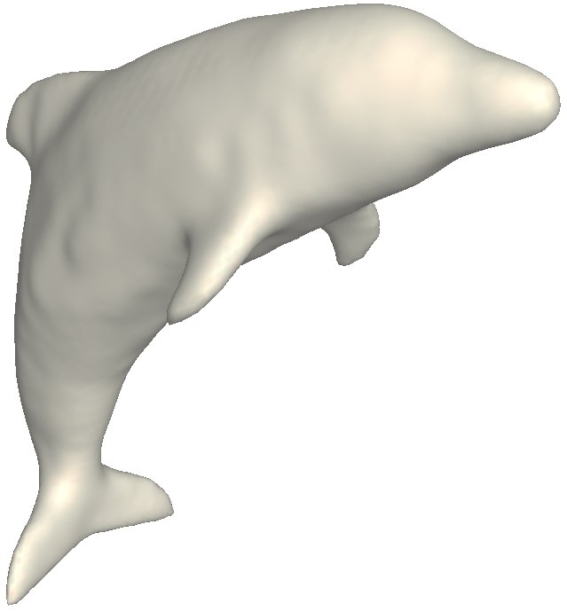
Structural Redundancy
Causes for spikes in 3D: (1) Boundary noise; and (2) Slivers in Delaunay triangulation of boundary sample points.
When four sample points are co-circular, its circumscribing sphere is not unique.
# of MA vertices = 54,241

Slide 11
Instability of MAT
Small variations of the object boundary may cause large changes to the medial axis

Slide 12
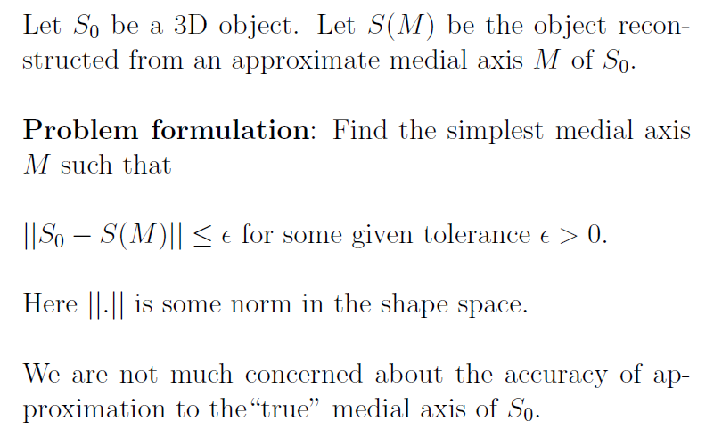
Principle of Approximating MAT

Slide 13
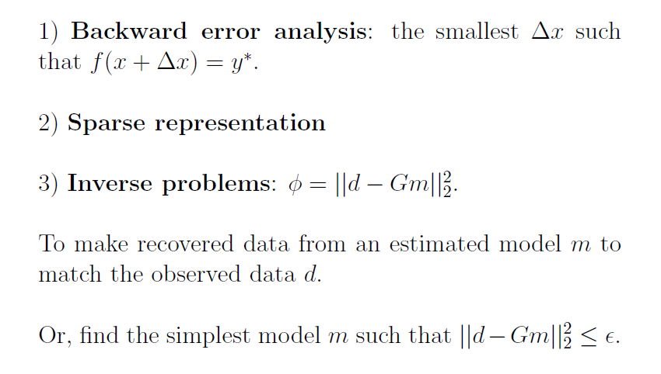
Analogies

Slide 14
Different Methods for Medial Axis Simplification
Angle-based filtering (Attali and Montanvert 1996; Amenta et al. 2001; Dey and Zhao 2002; Foskey et al. 2003)
  Scale-invariant. Does not ensure approximation accuracy
The λ-medial axis (Chazal and Lieutier 2005; Chaussard et al. 2009)
  Incapable of preserving fine feature of the original shape
Scale axis transform - SAT (Giesen et al. 2009; Miklos et al. 2010).
Removes spikes effectively. May change topology

Slide 15
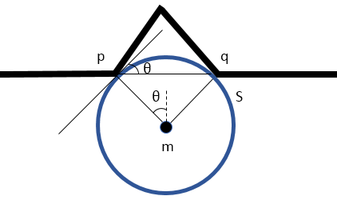
Different Approaches to Pruning Spikes

Slide 16
3D Medial Axis Simplification
Several methods exist for pruning unstable spikes on the medial axis
Issues
  Efficiency: Inefficient representation—MAT represented as the union of a large number of circles/spheres.
  Accuracy: Inaccurate representation—the simplified medial axis may have large approximation error to the original shape
Our goal
  To efficiently compute a clean, compact and accurate medial axis approximation

Slide 17
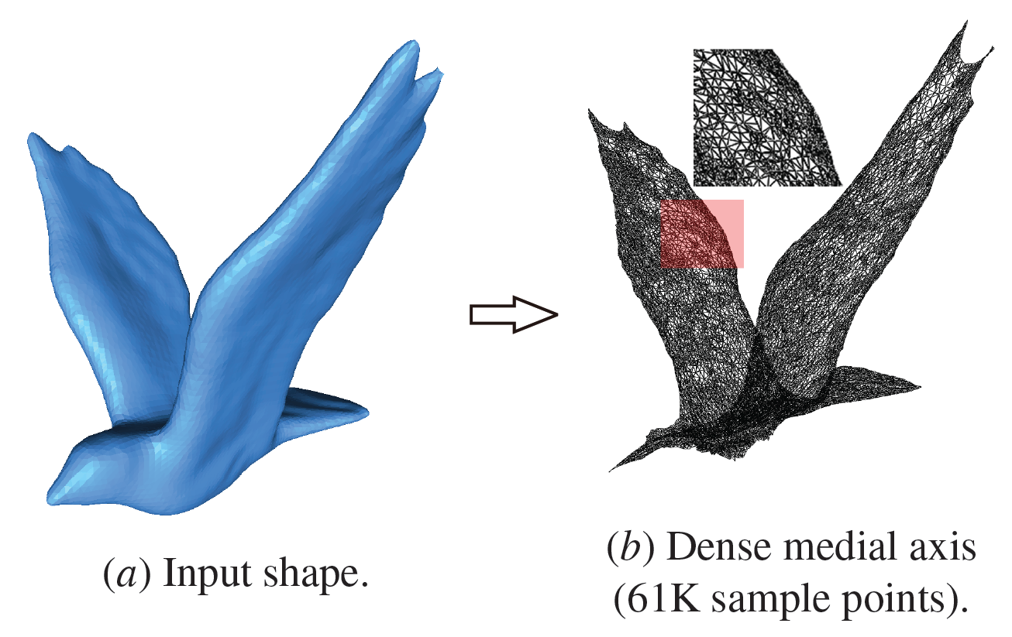
Data Redundancy with too many mesh vertices

Slide 18

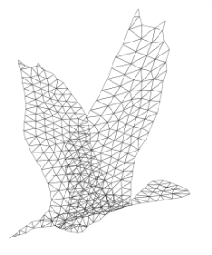
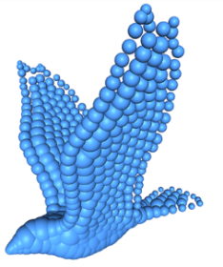
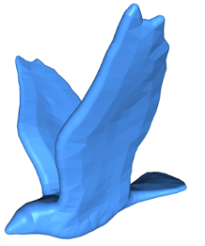
Compact Representation by Medial Meshes

Slide 19
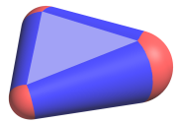
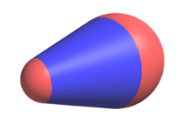
Medial Meshes
-- Approximation of MAT in 3D
The medial mesh is 2D simplicial complex approximating the medial axis of a 3D object.
Medial vertex: v = (p, r) where p is a 3D point, r the medial radius
Medial edge: (1−t) v₁ + t v₂, t ∈ [0,1] .
Medial face: a₁v₁+a₂v₂+a₃v₃, where a_{i} ≥ 0 and a₁+a₂+a₃=1.

Slide 20



Medial Meshes

Slide 21
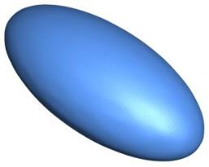
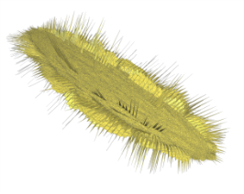
Instability of MAT of 3D Objects
Voronoi-based method generates unstable initial medial axis for 3D objects, due to noisy boundary sampling or slivers
Noise-free mesh
approximating an ellipsoid
Medial axis computed by
Voronoi-based method

Slide 22
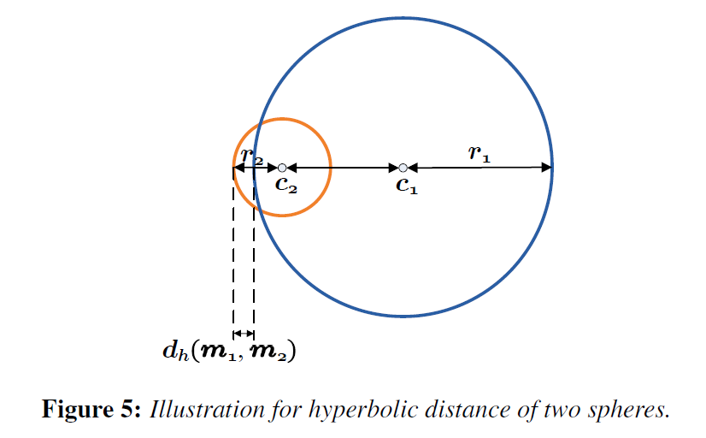
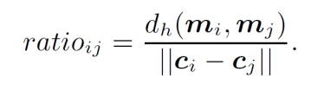
Understanding Unstable Branches
Stability Ratio

Slide 23
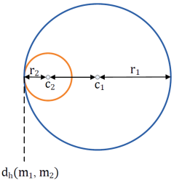
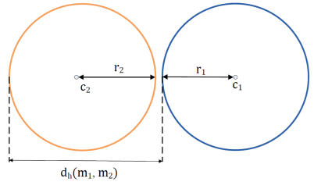
Two Extreme Cases
Stability Ratio = 0 or 1
ratio = 0
ratio = 1

Slide 24
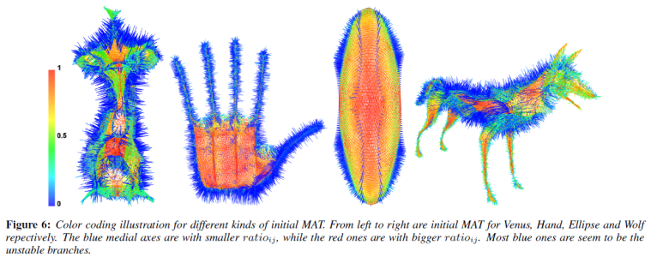
Understanding Unstable Branches
Visualization of stability ratio

Slide 25
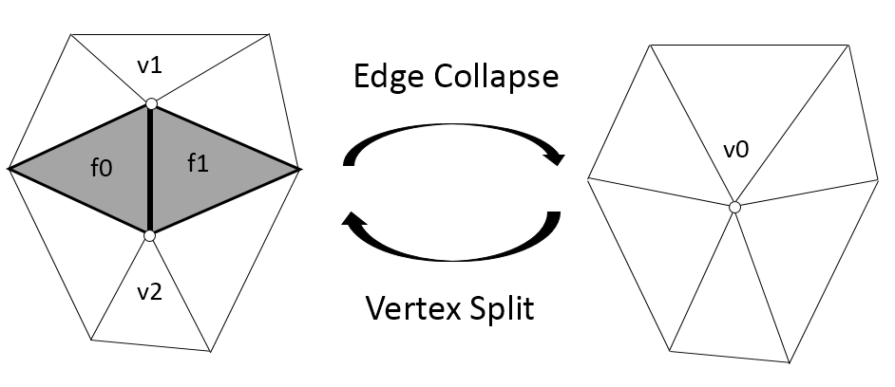
Simplification by Edge Contraction
Based on QEM by Garland and Heckbert (1997)
  Least squares errors are minimized with quadratic error minimization (QEM). (v1 and v2 are merged to v0)

Slide 26
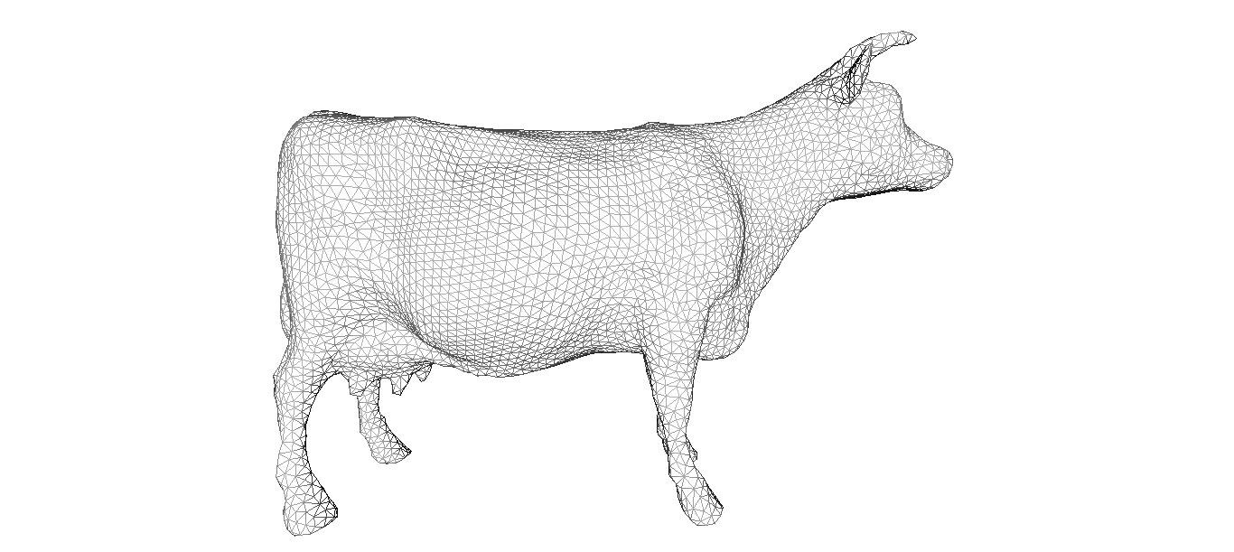
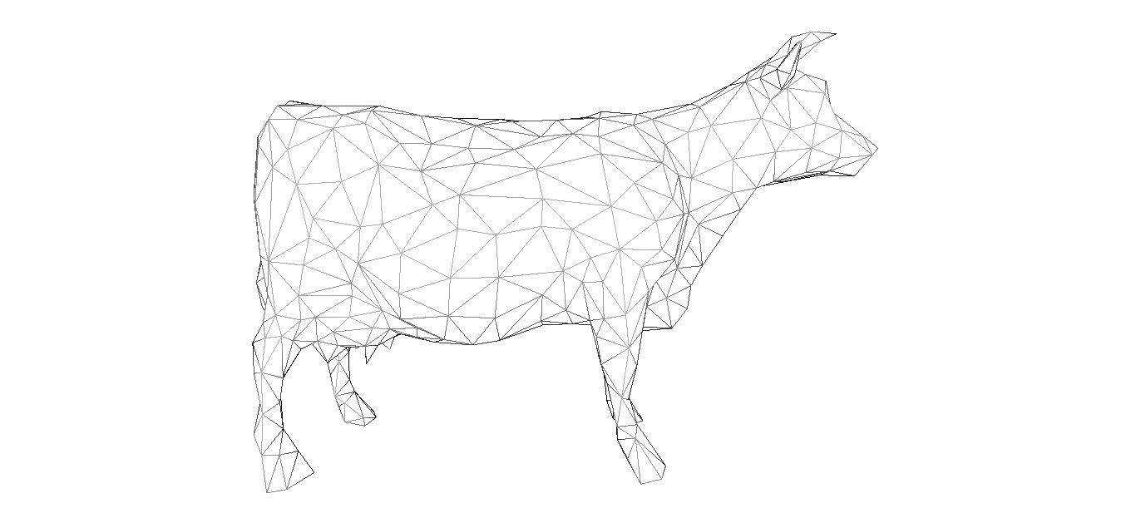
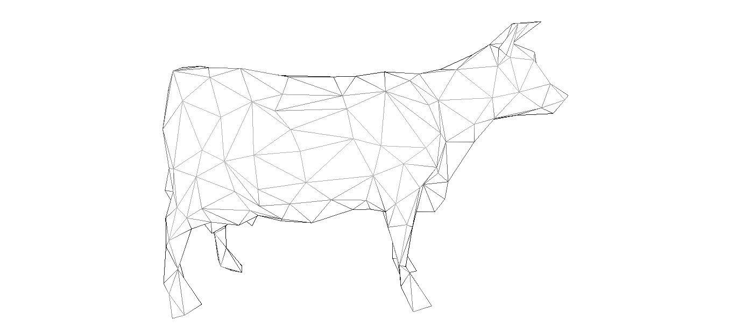
QEM for Mesh Decimation in 3D
Garland and Heckbert (1997)
#v = 6,938
#v = 500
#v = 250

Slide 27
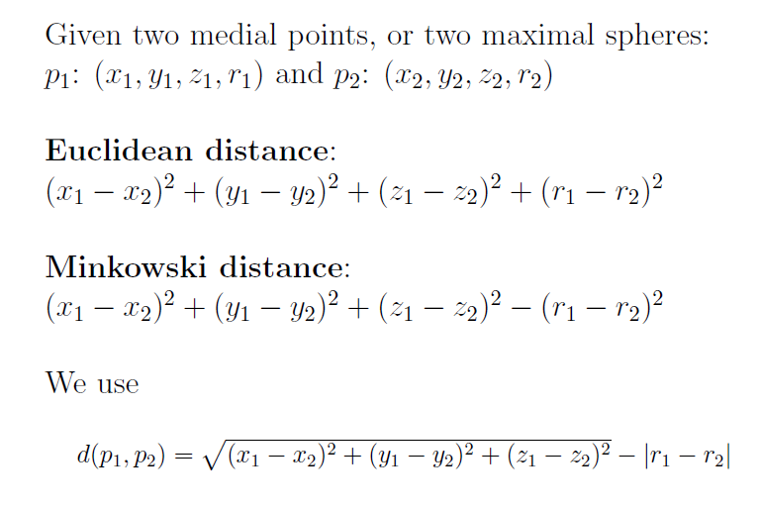
Metric for MAT Simplification

Slide 28
Geometric Interpretations

Slide 29
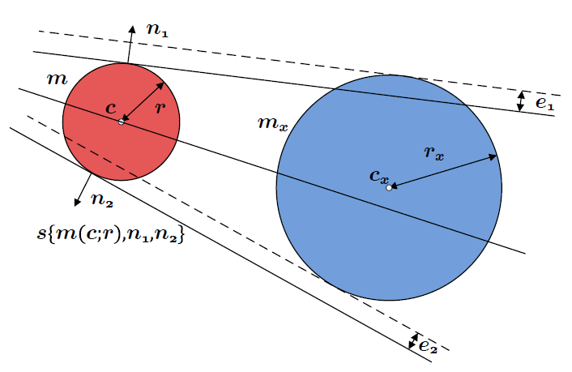

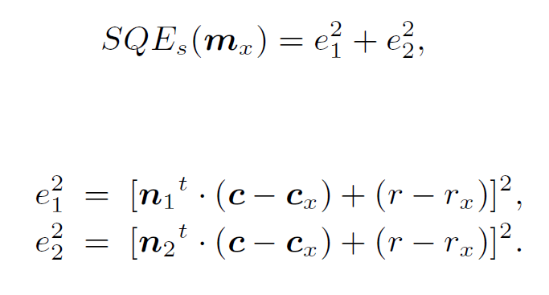
Quadratic Error for MAT Simplification

Slide 30
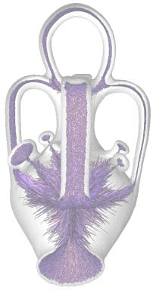
Which part to simplify first?
Spikes vs. Dense Smooth Region
Mesh decimation
Spike pruning

Slide 31
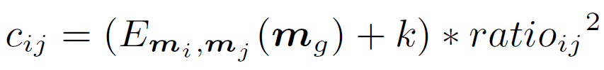
Remove Spikes First
  The merge cost is defined by

Slide 32
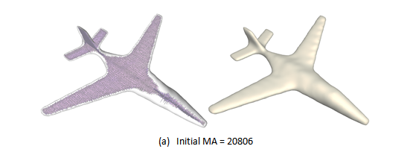
Experiments

Slide 33
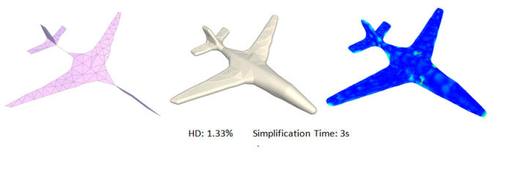
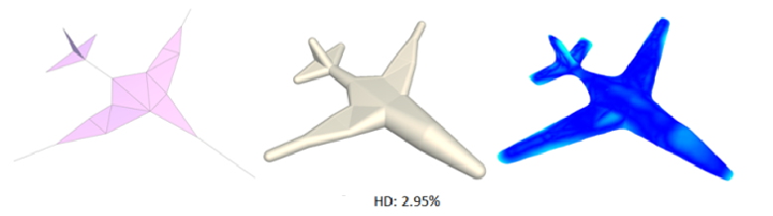
Plane (#v= 20 in 2 sec)
#v = 100
#v = 20

Slide 34
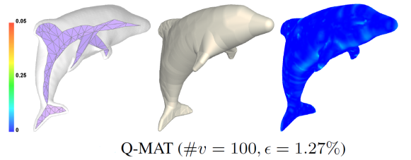
Dolphin (#v=100 in 12 sec)
#v = 54,241
#v = 100

Slide 35
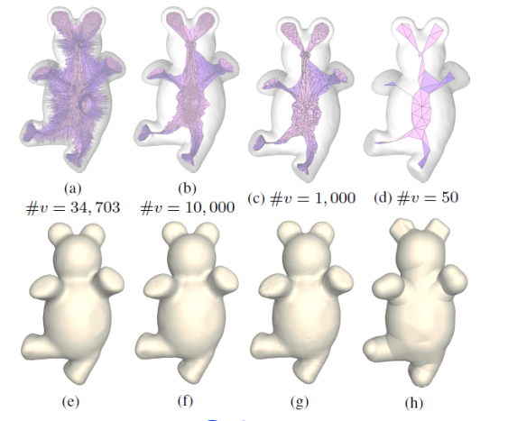
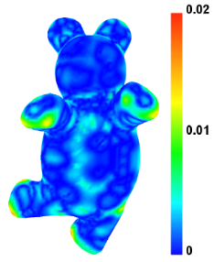
Bear (#v =50 in 7 sec)

Slide 36
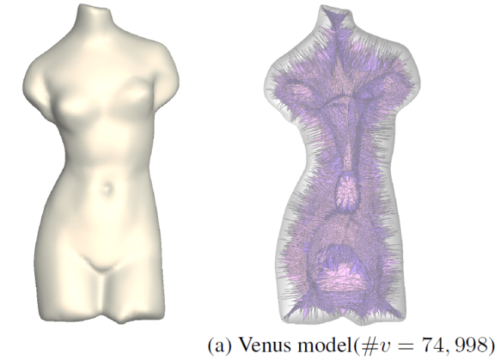
Initial MAT from Voronoi Diagram

Slide 37
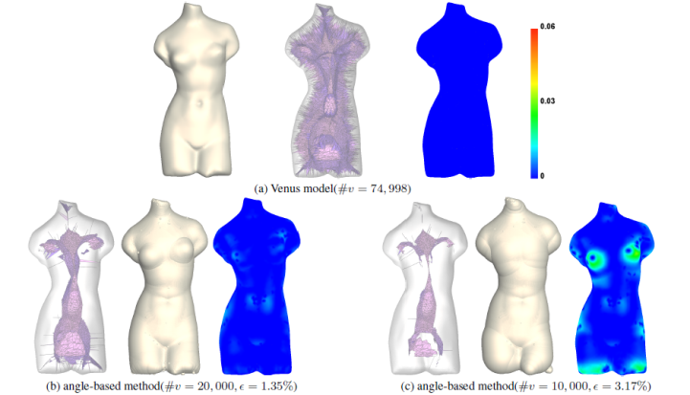
Compared with Angle Filtering

Slide 38
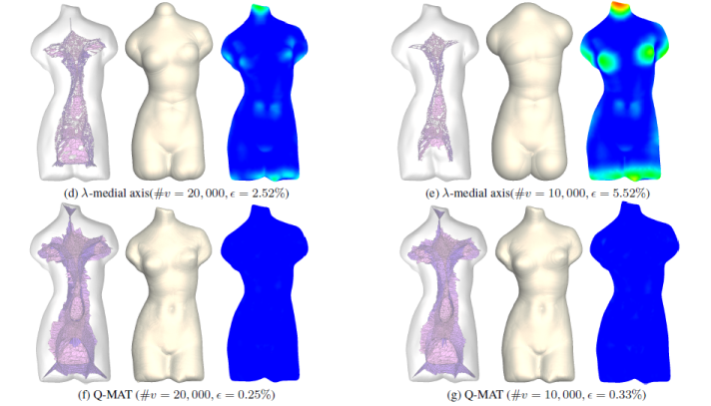
Compared with lambda-medial axis

Slide 39
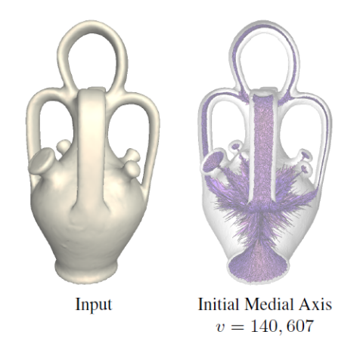
Comparison with SAT

Slide 40
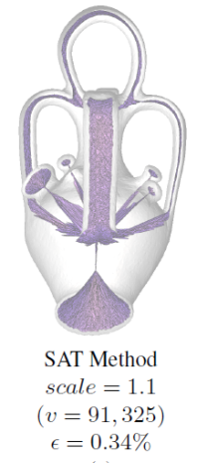
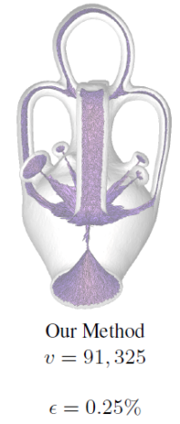
Comparison with SAT

Slide 41
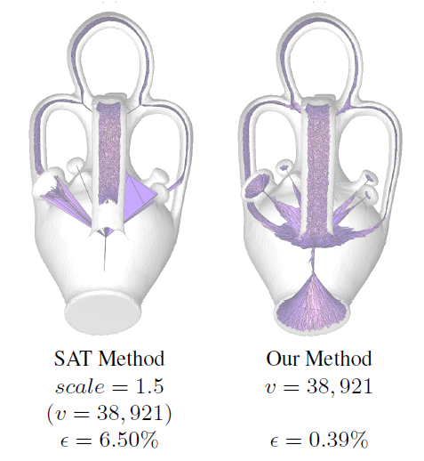
Comparison with SAT

Slide 42

Comparison with SAT

Slide 43

Medial Axis of Sphere
(Degeneracy Test)

Slide 44

Noise Test

Slide 45

Results

Slide 46

Results

Slide 47

More Results

Slide 48
Further Issues to Address
Topology preservation
Sharp feature preservation, e.g. for CAD models
Converting medial meshes to boundary surfaces
MAT for point clouds, noisy and incomplete data
MAT used for shape modeling and deformation
MAT as shape descriptor for matching and retrieval
….

Slide 49
Thank you!
Acknowledgements:
Pan Li, Bin Wang, Feng Sun, Xiaohu Guo
Caiming Zhang

