Slide 1
Medial axis computation of exact curves and surfaces
M. Ramanathan
Department of Engineering Design,
IIT Madras
http://ed.iitm.ac.in/~raman

Slide 2
Various skeletons
Curve skeletons
Mid-surface
Chordal axis transform (CAT)
Straight skeleton

Slide 3
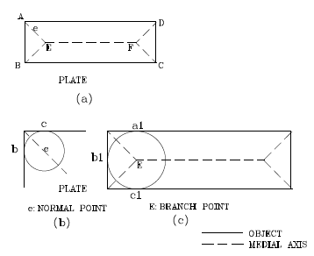
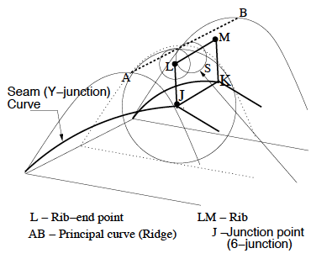
Definition
Medial Axis (MA) locus of points which lie at the centers of all closed balls (or disks in 2-D) which are maximal.
MAT = MA + Radius function

Slide 4
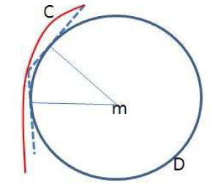
Input / Output
Exact representation – Curve/surface equations
Discrete representation – Point-set, voxels, tessellated, polylines, bi-arcs
  Output
Continuous-Approximate
Continuous-Exact
Discrete-Approximate
Discrete-Exact

Slide 5
Approaches
Wavefront propagation
Divide and conquer
Delaunay triangulation / Voronoi
Numerical tracing
Thinning
Distance transform
Bisector-based

Slide 6
Approach and input
Divide and conquer – Polygons, Polyhedra
Wavefront – Polygons (Curvilinear)
Delaunay/Voronoi – Point-set
Thinning and distance transform - Images

Slide 7
For exact representation
Bisectors in closed form - point, lines, conic curves.
Rational only for point-freeform curve, between two rational space curves.
In general, bisector between two rational curves is non-rational.
Bisectors, even between two simple geometries, need not be simple.

Slide 8
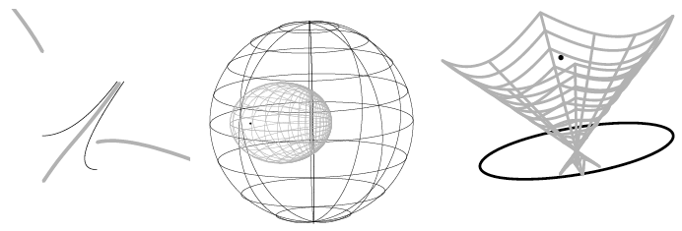
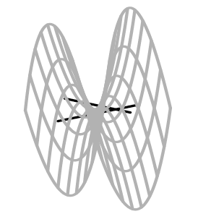
Bisector examples

Slide 9
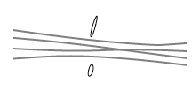
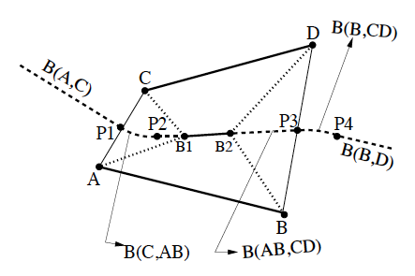
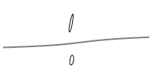
Bisectors vs. MA

Slide 10
Divide and conquer looks to be too complex
In a similar way, wavefront propagation also looks tedious.
Either numerical tracing of MA segments or symbolic representation of bisectors.

Slide 11
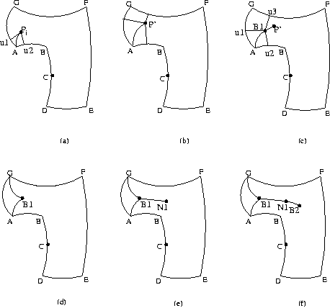
Tracing Algorithm

Slide 12
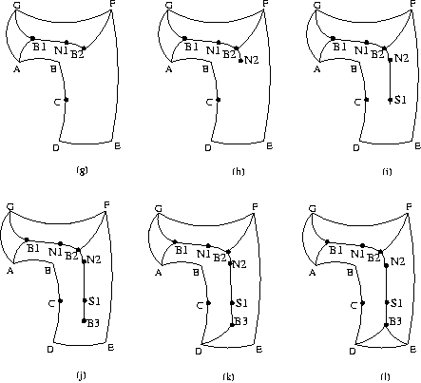
Tracing Algorithm (Contd.)

Slide 13
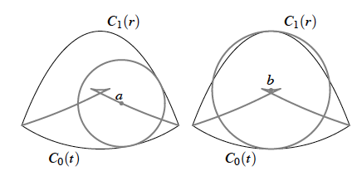
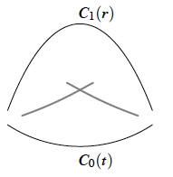
Curvature constraint

Slide 14
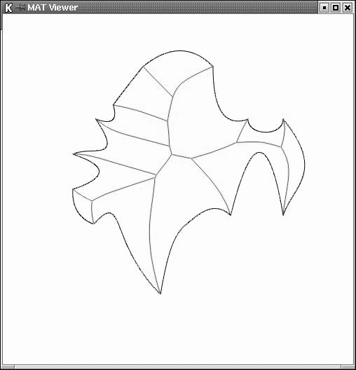
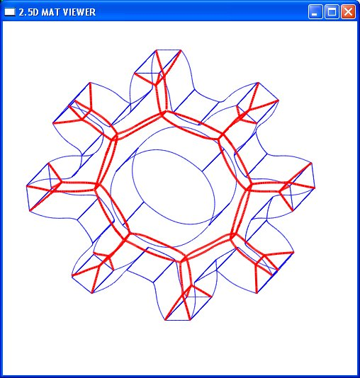
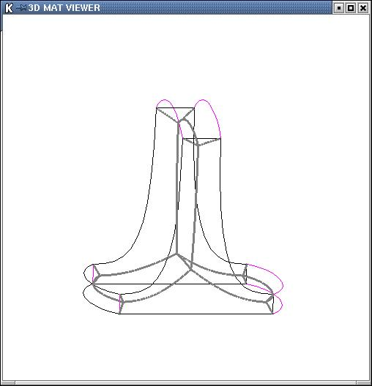
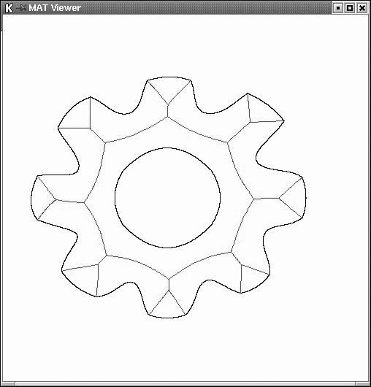
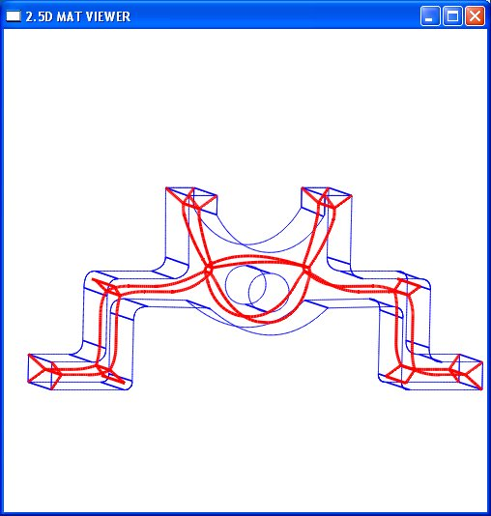
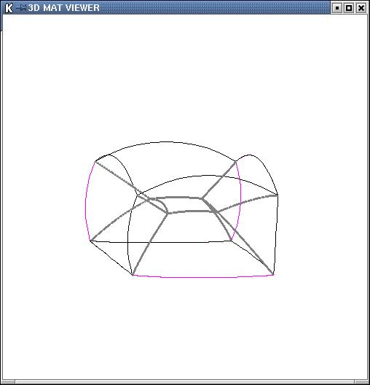
2D, 2.5D and 3D Objects

Slide 15
Definition (Voronoi cell)
Consider C₀(t), C₁(r₁), ... , C_{n}(r_{n}), disjoint rational planar closed regular C¹ free-form curves.
The Voronoi cell of a curve
C₀(t) is the set of all points
in R² closer to C₀(t) than to C_{j}(r_{j}), for all j > 0.
C₂(r₂)
C₁(r₁)
C₀(t)
C₃(r₃)
C₄(r₄)

Slide 16
Definition (Voronoi cell (Contd.))
We seek to extract the boundary of the Voronoi cell.
The boundary of the voronoi cell consists of points that are equidistant and minimal from two different curves.
C₂(r₂)
C₀(t), C₃(r₃)
C₁(r₁)
C₀(t)
C₃(r₃)
C₀(t), C₄(r₄)
C₄(r₄)

Slide 17
Definition (Voronoi cell (Contd.))
“The Voronoi cell consists of points that are equidistant and minimal from two different curves.”
The above definition excludes non-minimal-distance bisector points.
This definition excludes self-Voronoi edges.
r₃
r₄
r₂
r
C₁(r)
r₁
q
p
t
t
C₀(t)

Slide 18
Definition (Voronoi Diagram)
The
Voronoi Diagram (VD) is the union of the
Voronoi Cells (VC) of all the free-form curves.
C₀(t)

Slide 19
Outline of the algorithm
Euclidean space
tr-space
C₁(r)
Implicit bisector function
C₀(t)
Splitting into monotone pieces
Limiting constraints
Lower envelope algorithm

Slide 20
Key Issues
C₀(t)
C₀(t)
C₀(t)
C₂(r₂)
C₁(r₁)
C₁(r₁)
C₁(r₁)
Can the branch or junction points be identified without computing the bisectors or even portion of bisectors?

Slide 21
Our methodology
Voronoi neighborhood between two curves is created/changed at minimum distance point/branch point.
Hence these special points are solved for directly.
Minimum distance as antipodal or two touch disc.
Branch disc (BD) as three touch disc (TTD)

Slide 22
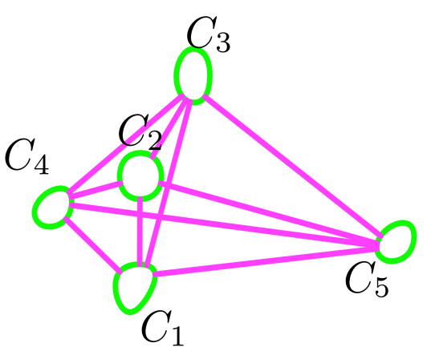
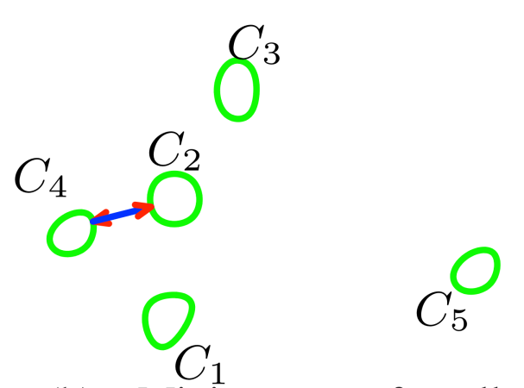
Initially all pairs of minimum antipodal discs (MADs) are solved and store in a list.
MADs are processed in increasing order of radius in the list.
Whenever discs are added connectivity information is maintained.
Three touch discs (TTDs) is solved for only when relevant neighborhood is formed and inserted into the list .
All consistent antipodal lines
Minimum radius antipodal

Slide 23
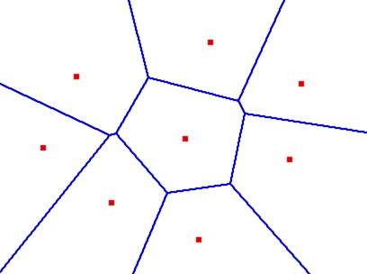
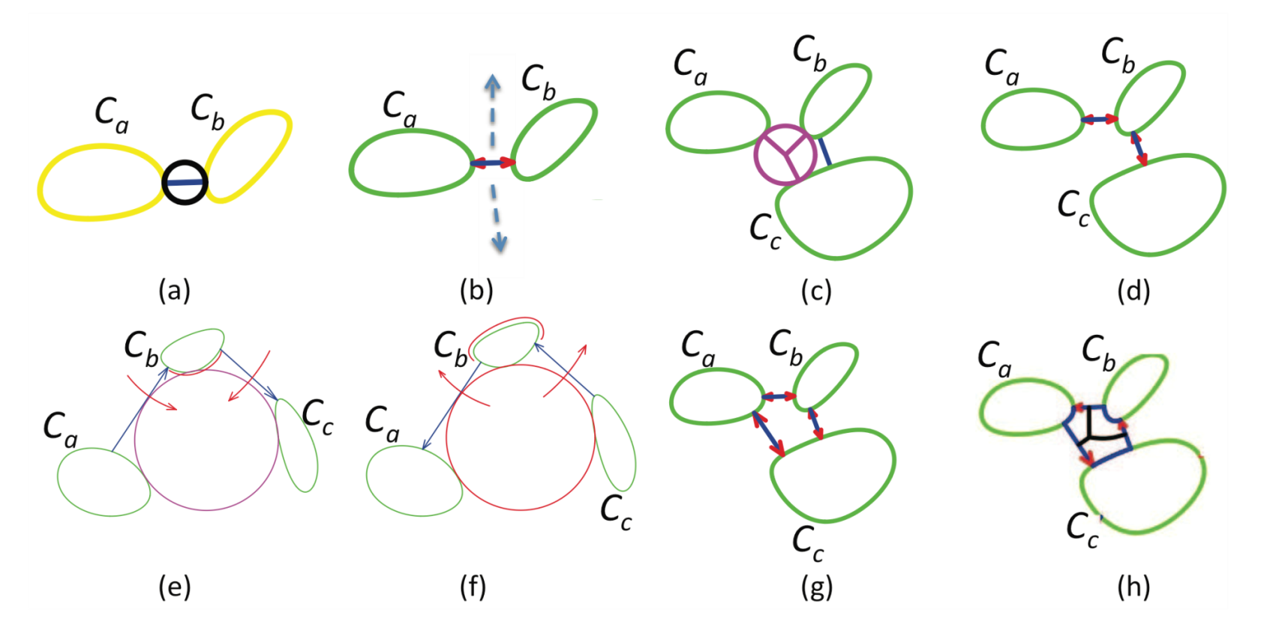




Illustration of the basic idea
Initial Radius list
After processing Rab, Rbc
TTD of (Ca, Cb, Cc) added
TTD is processed to decide if it is a branch disc

Slide 24
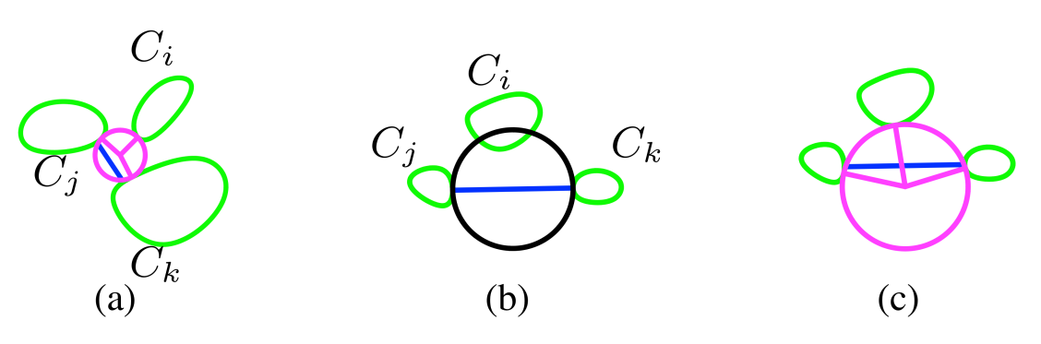
Emptiness check of ADs

Slide 25
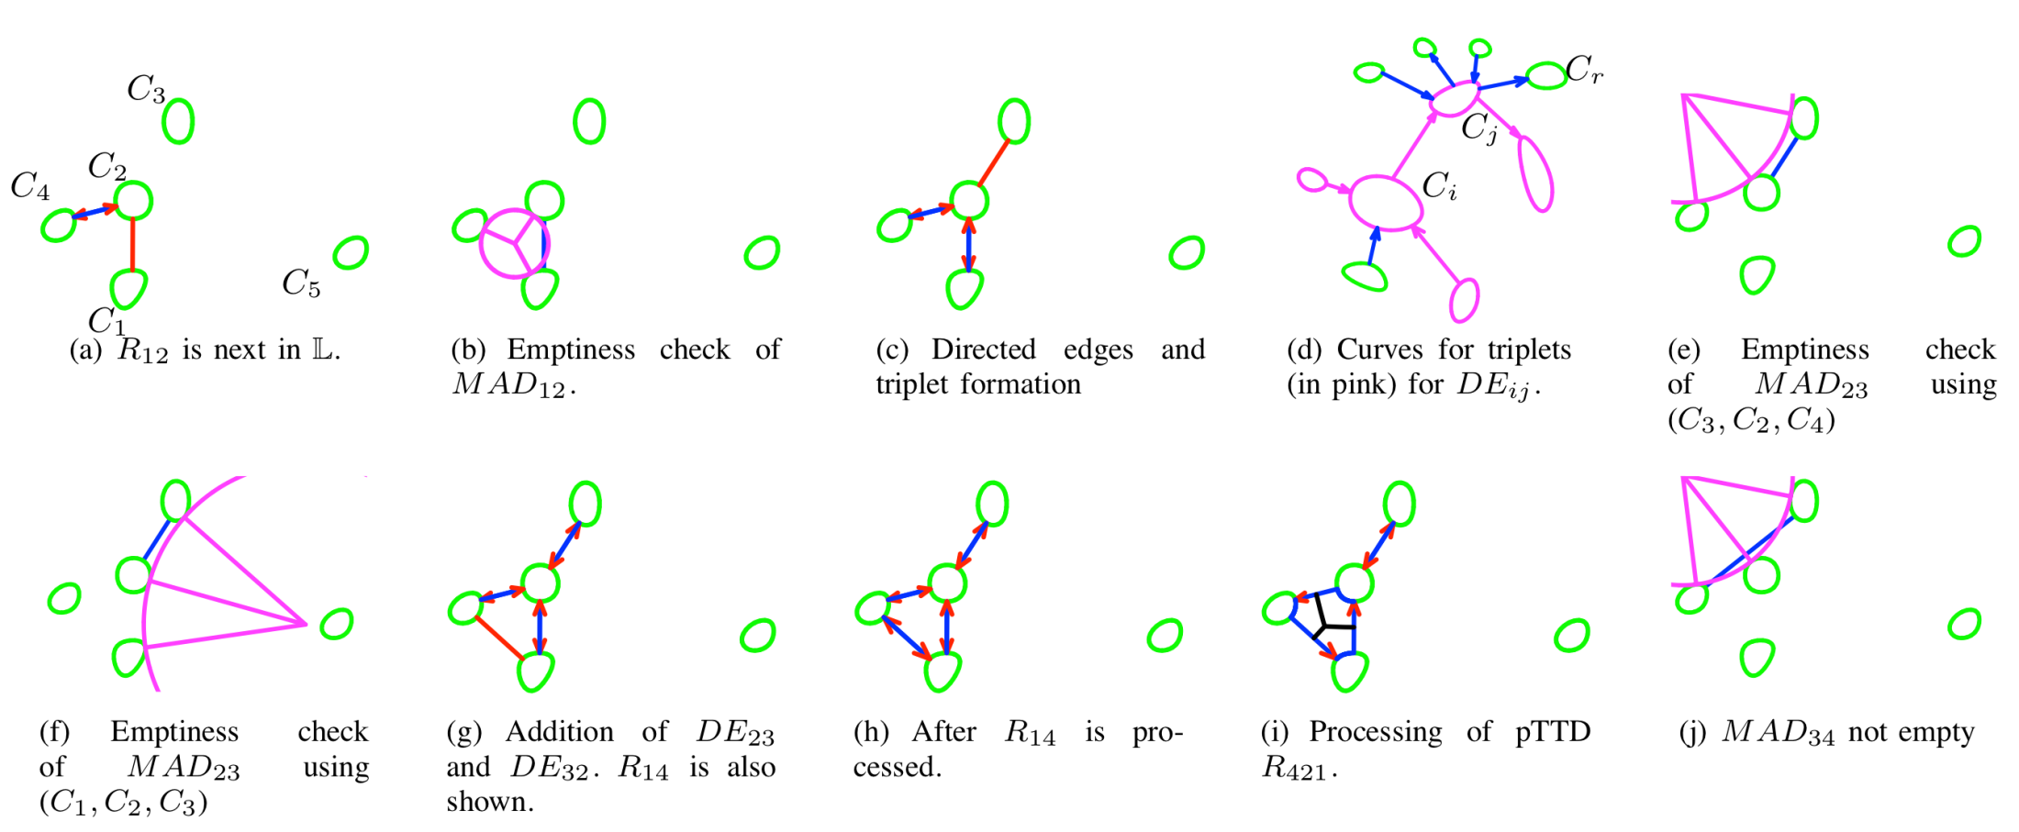
Algorithm steps

Slide 26
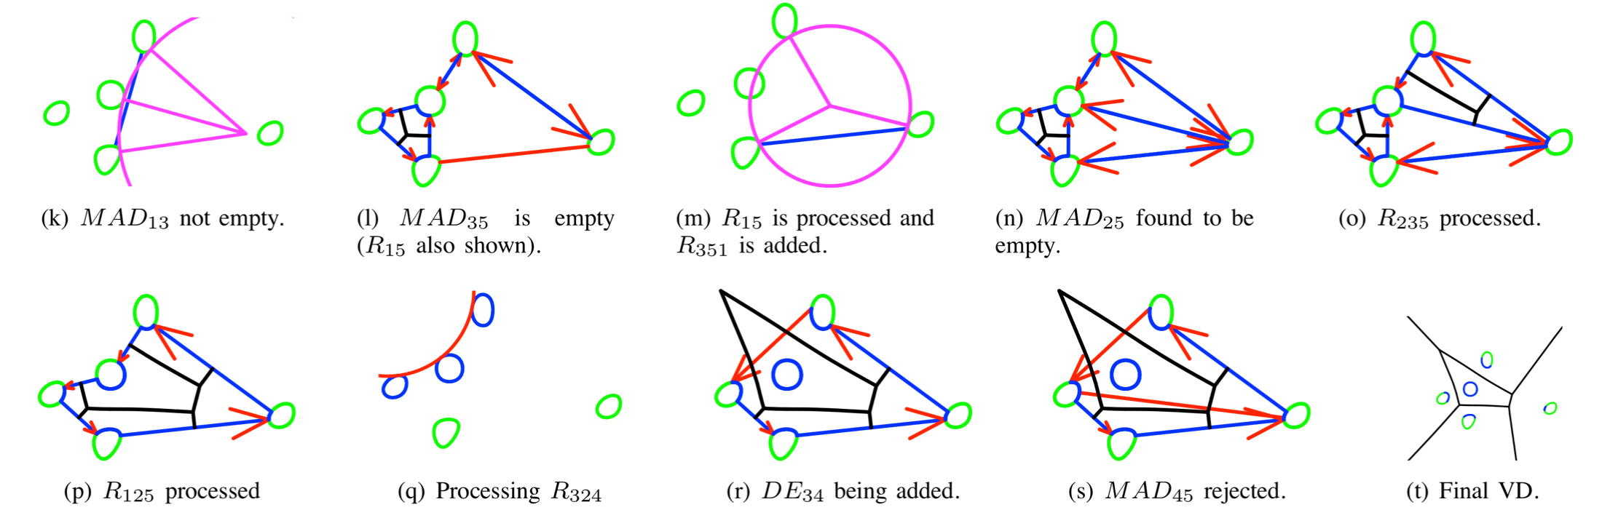
Algorithm continued
3
2
4
1
5

Slide 27
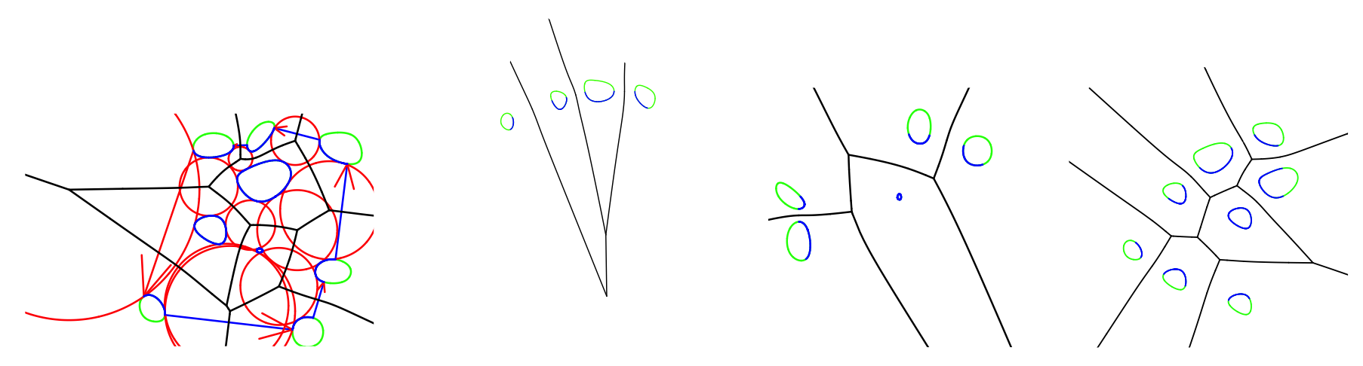
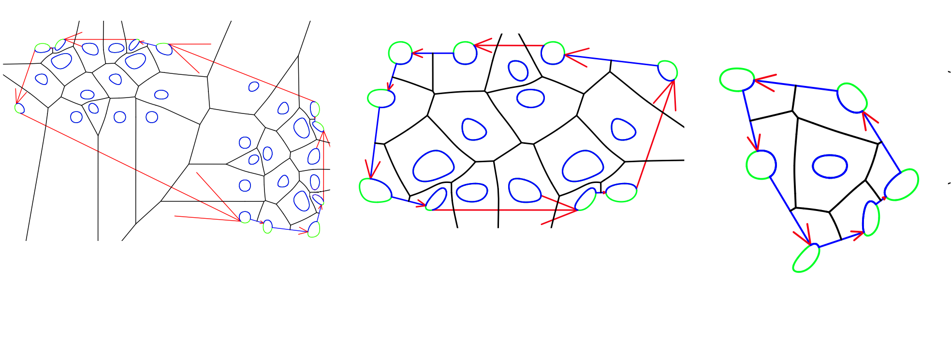
Results

Slide 28
Salient features
Given a curve of degree m, the degree of the bisector is 4m − 2. Computing TTD or AD has a degree of m+(m−1).
Instead of step sizes or intersection of bisectors, a simple directed edge existence is used.

Slide 29
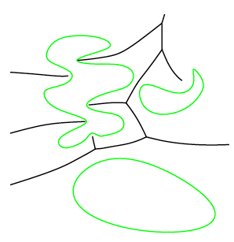
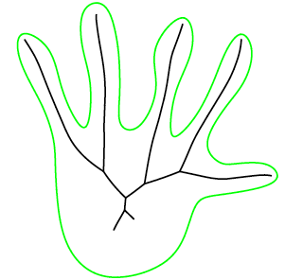
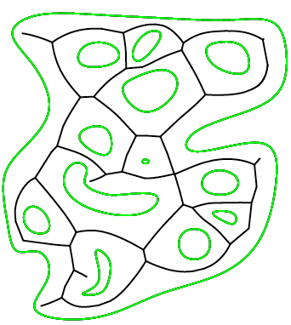
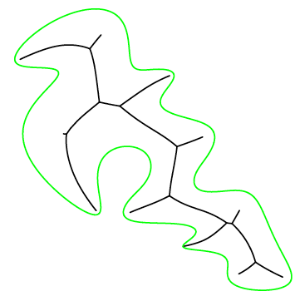
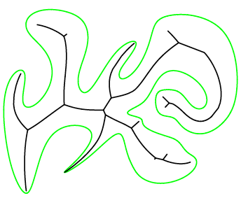
VD for non-convex curves and medial axis

Slide 30
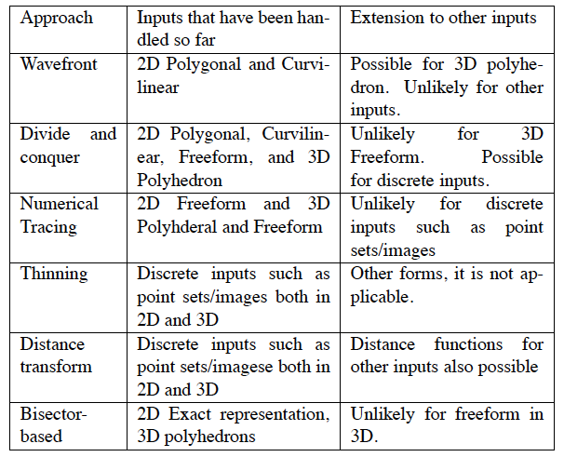
Approach vs. Input

Slide 31
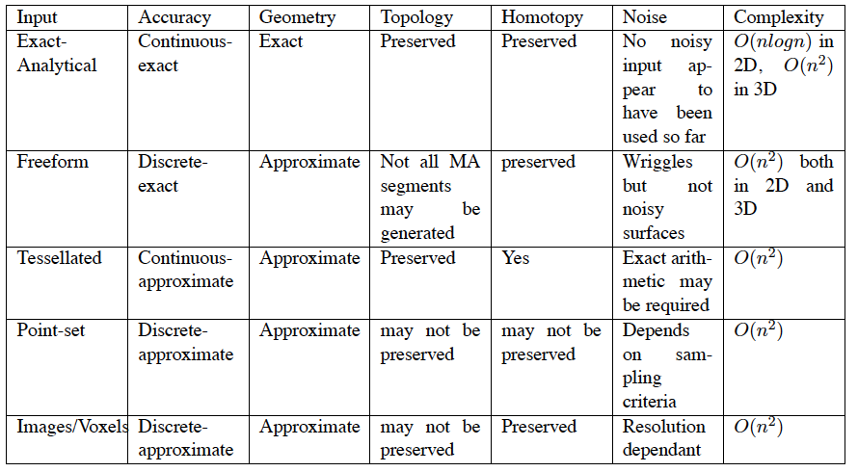
Comparison for different inputs

Slide 32
What’s next
Use bisector-less approach for 3D freeform surfaces to compute Junction points
Focus will be on reducing computational complexity.
Speeding up of computation using utilities such as GPU.
Relation between the elements in the MA to that of the object.

Slide 33
References
Ramanathan M., and B. Gurumoorthy " Constructing Medial Axis Transform of Planar domains with curved boundaries,", Computer-Aided Design, Volume 35, June 2003, pp 619-632.
Ramanathan M. and B. Gurumoorthy " Constructing Medial Axis Transform of extruded/revoloved 3D objects with free-form boundaries ", Computer-Aided Design, Volume 37, Number 13, November 2005, pp 1370-1387
Ramanathan M., and Gurumoorthy B., "Interior medial axis computation of 3D objects bound by free-form surfaces" , Computer-Aided Design, 42(12), 2010, 1217-1231
Iddo Hanniel, Ramanathan Muthuganapathy, Gershon Elber and Myugn-Soo Kim "Precise Voronoi Cell Extraction of Free-form Rational Planar Closed Curves ", Solid and Physical Modeling (SPM), 2005, MIT, USA, pp 51-59
Bharath Ram Sundar and Ramanathan Muthuganapathy, " Computation of Voronoi diagram of planar freeform closed curves using touching discs " , Proceedings of CAD/Graphics 2013, Hong Kong.

Slide 34
Discussions
Q & A

