Slide 1
CSA RISK MANAGEMENT IN A NEW ERA

Slide 2
CSA
The biggest CHANGE facing the
trucking industry since deregulation

Slide 3
DISCUSSION TOPICS
CSA
The Insurance Question
How have we managed Risk before CSA?
How does CSA Change the Game?
How we manage risk going forward?

Slide 4
THE INSURANCE QUESTION

Slide 5
HOW WILL CSA IMPACT INSURANCE AND UNDERWRITERS ?

Slide 6
How Underwriters think:
How are you managing your RISK?
What are your results?

Slide 7
Motor carriers are struggling with
3 Wicked Risk Problems

Slide 8
The Wicked Problems
1
Dealing with Compliance Risk*
driven by CSA
*
[ Dirty Secret: It’s not about compliance]

Slide 9
The Wicked Problems
2
Better managing and improving
Driver Performance

Slide 10
The Wicked Problems
3
Identifying and predicting
accidents and high risk profiles

Slide 11
THE PRE-CSA ERA?
How have we managed risk in

Slide 12
Safe Stat
Large Loss
Insurance Renewals
Compliance Audit

Slide 13
Below the waterline
Safety and Ops are not collaborating
Conflicting goals create challenges drivers can’t decipher
Driver managers and trainers don’t have time to mentor

Slide 14
“I have the
numbers
I need to do
my job”

Slide 15
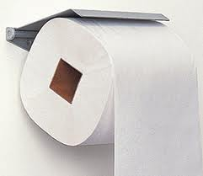
“IT spends their time building
custom reports that
nobody uses”

Slide 16
“My people have all the
Reports they need to
manage their drivers”

Slide 17
“We communicate with our drivers”

Slide 18
“Annual Performance reviews
are done for the file”

Slide 19
Information Overload
Information Available
Amount of Information
Information you can absorb
1960
2010

Slide 20
Driver Dyslexia…
Ops “LOVES me”
Safety “Loves Me NOT”

Slide 21
Compliance
Customers
Drivers
Technology

Slide 22
THE CSA GAME CHANGER
More Complexity
New Measurements to worry about
Yet another “thing” to Manage

Slide 23
“This will weed out the
weak Carriers”

Slide 24
CSA
_{52%} of large fleets
are Unfit

Slide 25
*
The Dirty Secret:
CSA is [-] about compliance and [+] about:
Transparency
Accountability
Speed of information

Slide 26
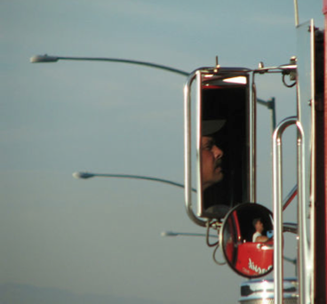
CSA
The Third Master
Safety
Operations
The Driver View

Slide 27
THE FUTURE ?
How will we manage risk in

Slide 29
What if
Integrate and solve
wicked problems

Slide 30
Making the simple complicated is commonplace;
Making the complicated simple that's creativity
Charles Mangus

Slide 31
the Performance scorecard
“a customized view of performance
that matters”

Slide 32
The Process and
Implementation Steps
Determine Metrics
Determine Weights
Start scoring
“It takes ALL 3”

Slide 33
Risk Management

Slide 34
Safety/CSA
Hard braking
High Speeds
Hours of Service

Slide 35
Operations
Miles or Revenue
Out of Route
Late Deliveries

Slide 36
Administration
Paperwork
Accuracy
Attend Safety Meetings

Slide 37
Maintenance
MPG
DVIRs

Slide 38
LEADING INDICATOR DASHBOARD
“The tool you can rely on to
manage your fleet”

Slide 39
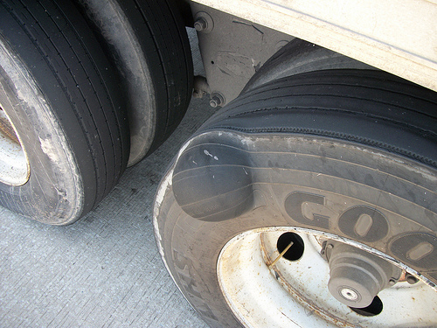
Creating sustainability and performance
beyond CSA
The 3 keys

Slide 40
MY FINAL THOUGHTS
Use CSA as a catalyst to create:
Transparency
Accountability
And Speed of information

Slide 41
CHANGE THE GAME
Address the 3 Wicked Problems
Drive performance and get RESULTS

Slide 42
CSA RISK MANAGEMENT IN A NEW ERA
MIKE NATALIZIO CEO/PRESIDENT

