Slide 1


RDU And
A BREAKTHROUGH
VIEW ON POLICY REVIEW
THURSDAY, OCTOBER 9, 2014

Slide 2
Estate Planning in 2014
AMERICAN TAXPAYER
RELIEF ACT OF 2012

Slide 3

American Taxpayer Relief Act of 2012
Bipartisan legislation was signed into law in January 2013. The legislation essentially extends many of the 2001 and 2003 tax cuts permanently.
ATRA 2012 increased the top federal estate tax rate up to 40% with a $5,000,000 estate and gift tax exemption (indexed).
Image courtesy of FineMark
RDU & a Breakthrough View on Policy Review

Slide 4
ESTATE TAXES
ATRA of 2012
The new law provides for a permanent estate tax rate of 40% and a permanent $5 million estate tax exemption for individuals ($10 million married) (indexed to $5.34 M / $10.68 M in 2014)
GIFT TAXES
The new law maintains “unification” of the $5 million estate tax exemption with a $5 million lifetime gift tax exemption per individual ($10 million married) (indexed to $5.34 M / $10.68 M in 2014)
This “unification” allows a married couple to gift assets worth about $10.68 million during lifetime with $0 out of pocket gift tax.
RDU & a Breakthrough View on Policy Review

Slide 5

ESTATE TAX PLANNING
(Martial/Credit Shelter Portions)
ATRA of 2012
The law permanently provides for an election of “portability” of the indexed $5 million estate tax exemption from the first death to the second death of a married couple via the 100% estate tax marital deduction
This could mean that the surviving spouse could have an indexed $10 million estate tax exemption at the second death without the need for splitting the estate into “marital” (A) and “credit shelter” (B) portions at first death.
ESTATE TAX PLANNING
(Martial/Credit Shelter Portions) (A-B Trust Plans)
However, planning on a case by case basis may still involve a marital-credit shelter split at the first death (A-B) so that future asset appreciation on the credit shelter portion (B) will NOT be included in the estate of the surviving spouse.
RDU & a Breakthrough View on Policy Review

Slide 6

Other Estate-Gift Tax Rules
“Stepped-up cost basis” to date of death value for capital assets included in the gross estate was permanently back in place already in 2011 after one year of “carryover cost basis” in 2010
Federal estate tax deduction for any state death taxes paid is permanent (ATRA 2012)
Lifetime exemption gifts ($5.34 M) are added back into taxable estate at death on Line 4 of Form 706. Only future appreciation above date of gift value is removed from taxable estate … TRA 1976
2014 Annual gift tax exclusions ($14,000 per donee each year) plus appreciation are totally removed from the taxable estate …
RDU & a Breakthrough View on Policy Review

Slide 7

State Death Taxes
About 20 States Levy State Death Taxes
2014 … RI-$921,655; MA-$1,000,000; CT-$2,000,000; NY-$2,062,500; NJ-$675,000 Marginal rates range from about 6% to 16%
State death taxes alone (RI and MA) could range from $99,000 ($2 million taxable estate) to $1,067,000 ($10 million taxable estate plus 16% of excess over $10 million)
$2,062,500
$1,000,000
$2,000,000
$921,655
$675,000
RDU & a Breakthrough View on Policy Review

Slide 8
Irrevocable
Life Insurance
Trusts-ILITs
The Cornerstone of
Estate Planning

Slide 9

Advantages of Life Insurance
Excellent financial leverage (premiums paid vs. death benefit)
Income tax free death benefit (IRC Section 101)
Estate tax free (ILIT is owner/beneficiary)
Gift tax free (annual gift exclusions)
Guaranteed death benefit insurance products (no-lapse UL or SUL)
Estate conserved for heirs at lowest “present value cost”
RDU & a Breakthrough View on Policy Review

Slide 10
ILIT Summary
Unique property (life insurance)
Legal ownership by third party (trust)
Asset management by trustee over an extended period of time beyond death
Superior financial results (High after-tax IRR at life expectancy)
Statutory “fiduciary” protection in most states (Uniform Prudent Investors Act)
RDU & a Breakthrough View on Policy Review

Slide 11

IRR for Guaranteed No-Lapse UL and SUL
No-lapse UL or SUL provides superior financial leverage at low PV cost
IRR as an after-tax value because death benefit is income tax free (IRC Section 101)
Assume 30% blended income tax rate
Run insurance illustration with IRR page
Determine IRR at LE or joint LE and convert to pre-tax equivalent IRR using blended income tax bracket
RDU & a Breakthrough View on Policy Review

Slide 12
UPIA, Policy Review,
& IRC Section
1035 Exchanges
Guidelines for Review and Exchange

Slide 13
UPIA Standards for Trustee to Follow …
A duty to beneficiaries to prudently manage assets
Uniform Prudent Investors Act (UPIA)
Assess risk tolerance by reviewing purpose of the trust
Take into account current economic conditions and tax consequences of investment decisions
Diversifying financial assets of the trust
Consider the special value of the asset in relation to the purpose of the trust to one or more of the beneficiaries
Trustee must mange trust assets by considering purpose, terms, and distribution requirements of trust
The potential effect of inflation or deflation
The expected total return on trust assets
Need for liquidity, income, and preservation and appreciation of capital
Make a reasonable effort to verify facts relevant to managing trust assets
RDU & a Breakthrough View on Policy Review

Slide 14
Trustee Fiduciary Responsibility to Trust Beneficiaries …
A Continuing Responsibility to Conduct “Due Diligence”
UPIA–Due Diligence Life Insurance Policy Review
Maintain the life insurance policy…pay the premiums on time
Policy performance as originally illustrated
Explore more cost efficient policy offering better guarantees
Continuing premiums far beyond what was originally illustrated
Taking steps to prevent a policy lapse
What are carrier’s rating for financial strength – Comdex?
Is death benefit guaranteed and for how long?
Is the face amount adequate to meet current needs? Too much? Not enough?
What is policy status? When is it projected to lapse if premiums are stopped?
How much guaranteed coverage can be provided at little or no additional premium cost?
Does policy allow COI charges to increase?
RDU & a Breakthrough View on Policy Review

Slide 15

Need the Following Policy Information to do a
“Life Insurance Review Analysis”
Life Insurance Policy Review Fact-Finding
Insured(s) and date(s) of birth
Policy owner and date issued
Total death benefit (base DB + DB of PUA)
Total cash value (guaranteed CV + CV of PUA)
Total loans (principal + accrued interest)
Net policy value (total cash value – total loans)
Adjusted “carryover” cost basis
Annual premium and remaining years to pay
In force policy illustration to analyze projected status of the policy. Continuing premiums vs. not continuing premiums
RDU & a Breakthrough View on Policy Review

Slide 16
Possible tax free exchanges
IRC Section 1035 Exchanges
Can income tax free and estate tax free life insurance be acquired at reduced or zero future premium cost by a Section 1035 exchange of existing cash values?…A “refinancing” of your life insurance portfolio
Can important contractual guarantees (no-lapse protection) be acquired as a result of the exchange?
Life insurance for life insurance
Life insurance for an annuity
Annuity for an annuity
Annuity CANNOT be exchanged for life insurance
RDU & a Breakthrough View on Policy Review

Slide 17
What Types of Policies Can be Exchanged?
IRC Section 1035 Exchanges
The old policy must cease to exist after the exchange. No “partial exchanges” for life insurance.
Single life for single life
Survivor life for survivor life
Survivor life (one insured already deceased) for single life is permitted
CANNOT exchange one single life for survivor life
CANNOT exchange two single lives for survivor life
RDU & a Breakthrough View on Policy Review

Slide 18
Taxable Surrender vs. Tax Free Exchange …
IRC Section 1035 Exchanges
What’s the Difference?
If old carrier pays the surrender check to the policy owner
This will be considered to be a taxable surrender to the extent of the policy gain. This is true even if the policy owner then places the funds into a second previously purchased policy.
If the old carrier pays the surrender check directly to the new carrier
This will be a tax free Section 1035 exchange with “carryover” of cost basis
Exchange of Policies with Loans
Loans can be carried over from the old policy to the new policy tax free.
New carrier will determine its own acceptable loan carryover ratio and issue the new policy with an outstanding loan.
Otherwise, if loan is simply discharged (eliminated) upon the exchange, the LESSER of the loan or the policy gain will be taxable income as discharge of debt “boot” income and generate a Form 1099-R
RDU & a Breakthrough View on Policy Review

Slide 19
Administrative Issues
IRC Section 1035 Exchanges
Must have the same insured before and after the exchange
Must have the same contract owner before and after the exchange
If a change of ownership is desired, change is done with the old carrier before the exchange …or with the new carrier after the exchange
Multiple policies can be exchanged for one policy as long as the insured and owner are the same…2 for 1; 3 for 1…1 for 2; 1 for 3
The adjusted cost basis of the old contract(s) “carries over” and becomes the cost basis of the new contract(s)
RDU & a Breakthrough View on Policy Review

Slide 20
Current estate LESS than $5.34 million (single)
$10.68 million (married) estate tax exemption
Policy Review Case Study #1
Facts:
Clients (63/60) purchased a $2 million no-lapse SUL policy in 2003 owned by ILIT with annual premium of $29,000 (Preferred) to cover estate taxes. Estate of $6 million. Estate tax exemption in 2003 was $2 million for married couple…$1 million each
2014:
Clients (74/71) now have estate of $7.5 million. Estate tax exemption $10.68 million married. Clients now have $0 federal taxes and $705,000 of state death taxes.
RDU & a Breakthrough View on Policy Review

Slide 21
Case Study #1
Clients would like to stop annual premiums of $29,000 on $2 million SUL policy and reduce coverage because they are no longer concerned about federal estate taxes. They are concerned about LTC expenses and state death taxes
Considerations:
Stop paying $29,000 annual premium into SUL policy and reduce the death benefit to $738,000 to provide no-lapse protection until age 92 of younger insured (net cash value of $116,000 in 2014)
Redirect $29,000 into annual premium for two new single life UL policies with LTC riders that will be personally owned.
$14,500 into $257,000 UL policy with LTC rider on male age 74 (Standard) and $14,500 into $364,000 UL policy with LTC rider on female age 71 (Standard)
RDU & a Breakthrough View on Policy Review

Slide 22

Case Study #1
Result of re-direction of $29,000 premium
The reduced death benefit of SUL policy owned by ILIT will cover current estimated state death taxes of $705,000
A pool of potential tax free LTC rider benefits has been created ($257,000 for male…$168 per day and $364,000 for female…$239 per day)
IRR on tax free death benefit at life expectancy for male is 4.34% (6.21% pre-tax equivalent) and 6.20% (8.86% pre-tax equivalent) at life expectancy for female if no LTC benefit claims are ever made
RDU & a Breakthrough View on Policy Review

Slide 23
Current estate in EXCESS of $5.34 million (single) $10.68 million (married) estate tax exemption
Policy Review Case Study #2
Facts:
Clients (58/58) purchased a $3 million Survivorship Whole Life policy in 1998 owned by an ILIT with annual premium of $45,000 (Preferred) to cover about $2.9 million of estate taxes. Estate of $7 million. Estate tax exemption in 1998 was $1.25 million for a married couple … $625,000 each
2014:
Clients (74/74) now have estate of $14 million. Estate tax exemption is $10.68 million married. Even with an estate that doubled in value, clients now have only about $1.9 million of combined federal and state death taxes due to the much larger federal estate tax exemption
RDU & a Breakthrough View on Policy Review

Slide 24

Facts about existing Survivorship policy
Case Study #2
$3,000,000 base + $400,000 DB of PUAs
$45,000 annual premium x 16 years = $720,000 cumulative premium (cost basis)
$1,020,000 total cash value ($890,000 guaranteed CV + $130,000 CV of PUAs)
Reduced paid-up DB of $1,750,000
RDU & a Breakthrough View on Policy Review

Slide 25
Case Study #2
Clients would like to consider stopping annual premiums of $45,000 on existing $3 million survivorship policy. Want to reduce the coverage while maintaining enough death benefit to offset current estate taxes of about $1.9 million. They ask for alternative uses of the $45,000 of freed up cash flow.
Considerations & Results:
Execute a tax free Section 1035 exchange of $1,020,000 to a no-lapse SUL policy with death benefit of $2,052,530 (standard) or $2,514,701 (preferred) to offset $1.9 million of combined federal and state estate taxes
Alternative Considerations:
Re-direct $45,000 each year into paying for grandchildren’s education tuition (unlimited gift exclusion under IRC 2503(e))
Re-direct $45,000 each year ($22,500 each) into 10 pay “combo” LTC products (i.e. MoneyGuard Flex-Pay for each spouse) to purchase a pool of tax free LTC benefits ($230,507 over 3 years-male and $533,482 over 7 years-female)
Re-direct $45,000 each year into tax deductible charitable gifts … maybe annual premium for life insurance with a favorite charity as the owner and beneficiary of UL or SUL policy
RDU & a Breakthrough View on Policy Review

Slide 26
THANK YOU

Slide 27
RDU
A BREAKTHROUGH VIEW
ON POLICY REVIEW
THURSDAY, OCTOBER 9, 2014

Slide 28
Risk Differentiation
Underwriting (RDU)
“Always do the good and right thing … and the client always comes first.”
Notes:
- To make the advisor a hero in front of his/her client
- Underwriting & underwriters as gatekeepers

Slide 29

The policy review landscape
Policy Review with RDU
Why now?
The power of risk assessment strength today…
RDU & a Breakthrough View on Policy Review

Slide 30

The marketing power of underwriting talent…
Policy Review with RDU
And the emergence of risk differentiation underwriting
RDU & a Breakthrough View on Policy Review

Slide 31
The RDU Rules of Recognition (R³)
Evidence
Premium Tolerance
RDU
Timing
RDU & a Breakthrough View on Policy Review

Slide 32

The unique qualities of the “individual” risk
The RDU Challenge
The embedded idiosyncrasies of the clinical impairment
RDU & a Breakthrough View on Policy Review
Notes:
- To differentiate an individual risk from the statistical groups of home office actuaries
More time, intellectual inquiry and expense
The ability to separate “one” client from the “law of large numbers”
The ability to recognize when a clinical impairment merits RDU
The ability to add subjectivity into an otherwise objective process (home office underwriting & mortality assessment)

Slide 33
How We Do RDU
The Advisor
as an underwriting advocate for the customer
The Educated Client
The Carrier Beneficiary
The Physician Participant
RDU & a Breakthrough View on Policy Review
Notes:
The ability to touch the client is the most intimate areas of their lives – their health and their mortality
Insurance medicine vs clinical medicine
The advisor underwriting advocate
Congratulating the client on test results
Engaging the client corps of physician care in ___ unique idiosyncrasies (subjectivity)
Doctor welcomes the opportunity on behalf of his or her patient

Slide 34
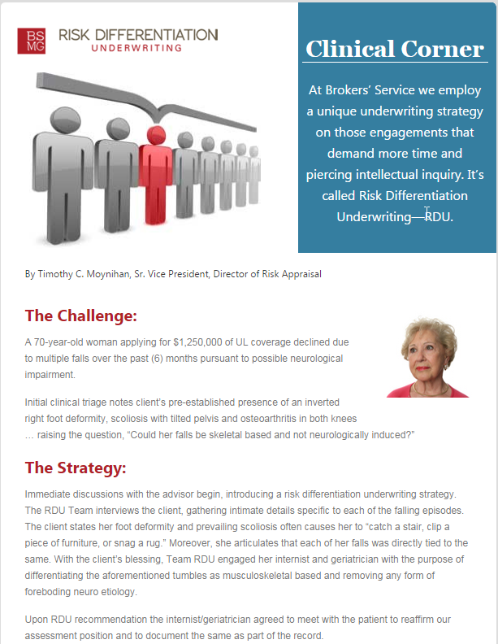
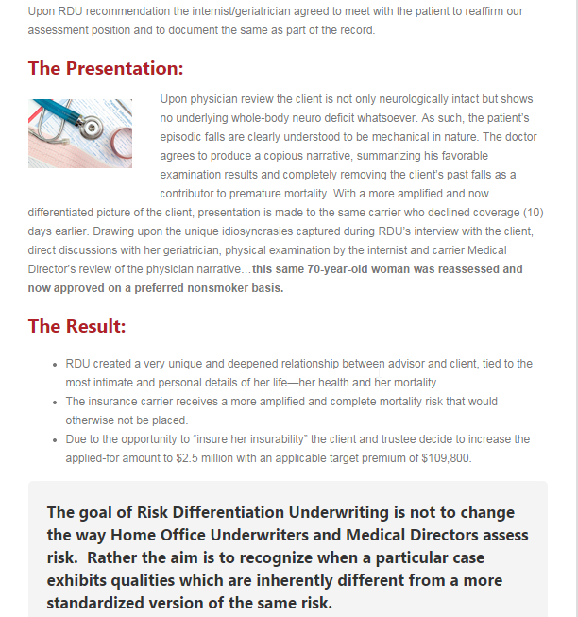
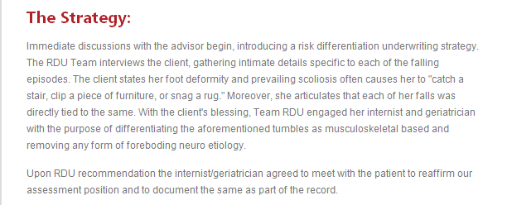
RDU In Action
RDU & a Breakthrough View on Policy Review
Notes:
The ability to touch the client is the most intimate areas of their lives – their health and their mortality
Insurance medicine vs clinical medicine
The advisor underwriting advocate
Congratulating the client on test results
Engaging the client corps of physician care in ___ unique idiosyncrasies (subjectivity)
Doctor welcomes the opportunity on behalf of his or her patient

Slide 35

The Point-of-Sale Differentiator
Going “Beyond the APS” …
The Importance of RDU
RDU & a Breakthrough View on Policy Review
Notes:
Going beyond the APS takes perseverance and tenacity
It takes intellectual inquiry and more exploration to employ RDU
1st class of Law school story
RDU as a key point-of-sale marketplace differentiation for the advisor…
rather than introducing it at the point of underwriting, results in disappointment
New study group – RDU & underwriting consistency

Slide 36
The RDU Advantage
Preconceived levels of comfort in the Home Office
The Underwriter and Medical Director
RDU & a Breakthrough View on Policy Review
Notes:
The facts/amplify
Underwriting is the home office are trained to ? To preconvceieved levels of comfort…
I was one for CIGNA for my first 10 years of the business
Expand the comfort zone of underwriter and medical directors
Medical directors are General Practitioners & Family Physicians
RDU physician consultants/specialists
Always do the good and right thing…and the client always comes first

Slide 37

Impairment intimacy
The Advisor/Client relationship
RDU & The Customer
RDU & a Breakthrough View on Policy Review
Notes:
The client boardroom story and RDU
The resulting deepened relationship with the advisor and client
Based upon a value added that differentiates the advisor from the competition

Slide 38


Slide 39
The RDU Win
The Client
The Carrier
The Advisor
RDU & a Breakthrough View on Policy Review
Notes:
Officially educated client who experiences the benefits of partnering in their own mortality assessment
Insurance medicine is clinical medicine
Compete and more amplified (?) case evidence in order to expand their assessment comfort zone
Place business that otherwise wouldn’t be…
A unique client relationship
A point-of-sale value added
Underwriting advocate
Independent and interdependent

Slide 40
THANK YOU

