Slide 1

Symbolic understanding of pictures in typical development and autism: divergent pathways?
Melissa L. Allen
National College of Ireland
March 26, 2015

Slide 2

Notes:
Pictures are symbolic, in that they refer to objects in the environment. Magritte’s classic painting ‘treachery of images’ pokes fun at what DeLoache and others would term the dual representation of pictures. The translated text reads ‘this is not a pipe’, suggesting that this image is instead a representation of one. Symbolic understanding requires that we look beyond the picture in and of itself to what it refers to.

Slide 3
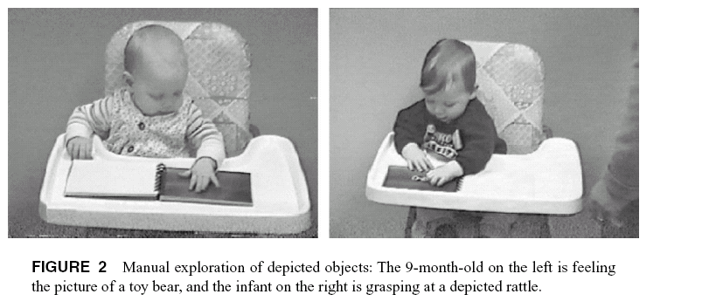
Early Actions on Pictures
DeLoache, et al. (1998), Psych Sci
Notes:
In typical development, very young children often explore pictures, sometimes trying to pick them up off the page or put a picture of a shoe on their foot

Slide 4
Developmental Trajectory
Notes:
There is abundant evidence suggesting that children begin to reason about pictures very early on in TD.

Slide 5
Picture Understanding in TD
Children begin to appreciate the symbolic capacity of pictures by 18-24 months (Preissler & Carey, 2004; Ganea, et al., 2009)
By 30 months, they can use pictures as a source of information about the world (DeLoache & Burns, 1994; Allen, Bloom, & Hodgson, 2010 )
Use intentional information and naming
Notes:
There is abundant evidence suggesting that children begin to reason about pictures very early on in TD. Describe DeLoache’s classic search task.

Slide 6
Bloom & Markson (1998)
This is picture of a spider and a tree.
Notes:
In Bloom & Markson’s classic study, they showed 3 and 4 year old children scribbles like the following, and told children, for example that one was a spider and one was a tree. The astute among you will notice that these don’t actually resemble real spiders or trees. If I ask you to please point to the spider (demo) – you’ve done exactly what the 3 & 4 year olds did and used relative size as a cue to artist intentions.
Given the link between intentions and pictorial understanding, we might predict a deficit or difference in picture understanding by individuals who have impairment in this domain

Slide 7
Autism Spectrum Disorder (ASD)
Socio-Communicative Impairment
Restricted and Repetitive Behaviors
Social-emotional reciprocity
Deficits in non-verbal communicative behaviours
Difficulty understanding and maintaining relationships
Notes:
One of the defining factors of ASD is socio-communicative impairment.
(Flexible and spontaneous conversation)
Indeed children with ASD have difficulties with language and social understanding, including intentions and ‘theory of mind’ – understanding that others have thoughts, desires and beliefs ( and that these might be different from one’s own).
Reciprocity – flexible and spontaneous conversation, turn-taking
NV Behaviors – gaze and pointing and the integration of these skills for communicative purposes
Relationships – wanting to be alone, difficulty maintaining friends or understanding the roles in society
one of the most fundamental cognitive abilities is symbolic appreciation, and difficulties in this area may help explain some of these key deficits in communication.
Emphasize SPECTRUM, and how the studies I will describe involve children with sig cog and language abilities

Slide 8
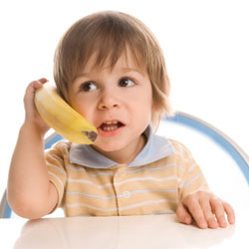
Noted Symbolic Difficulties
Symbolic play & pretense
Notes:
Surprisingly little work on picture understanding in ASD, particularly given how many individuals (particularly on the ‘lower’ functioning end of the spectrum) use pictures as a primary mode of communication. Give example of non-verbal and PECS here, and characteristics of children used in subsequent studies.

Slide 9

Picture Understanding in ASD
Children with ASD learn picture-word-object relations associatively(Preissler, 2008; Preissler & Carey, 2004)
Mediated by use of picture system
“whisk”
“whisk”
Notes:
Describe original task.
Only a single study that bears further exploration, as well as examining possible mediating factors.
Limitations: black and white pictures

Slide 10
Research Questions
Is symbolic understanding of pictures in ASD affected by iconicity?
Is symbolic understanding of pictures in ASD directed by naming?
Are children with ASD naïve realists when interpreting pictures?
Notes:
Overall this will inform us whether children with ASD have a symbolic understanding of pictures

Slide 11
Study 1: Method
Within-subjects component (Iconicity):
Color photograph
Greyscale photograph
Color line drawing
Black and white line drawing
Group | N | CA | MA (BPVS) | CARS
ASD | 20 | 9.7 (5.3-14) | 3.7 (2.4-5.7) | 43
TD | 20 | 3.3 (2.5-5.3) | 3.5 (2.6-5.7) | --
Hartley & Allen, 2015, JADD

Slide 12



Training Phase
“this is a zepper”
(picture)
Mapping Trial
“show me a zepper”
(picture)
(object)
Generalization Trial
“show me a zepper”
(picture)
(object)
Notes:
Treachery of images- dual representation;
TD children begin to appreciate this symbolic capacity by 18-24 months, and by 30 months they can use pictures as a source of information

Slide 13

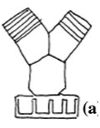

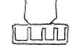
Stimuli
B&W line drawing Greyscale photo Color line drawing Color photo

Slide 14
Mapping trials:
Symbolic Responses
*
*
*
*

Slide 15
Generalization trials:
Symbolic Responses
*
*
*
*

Slide 16
Study 1: Discussion
Typically developing children generalize labels learned via pictures to real referents, regardless of iconicity
Children with ASD are more likely to form associative relations
However, they are more likely to map words to objects when the pictures are colored (50% vs 25%)
Importance of perceptual similarity between picture and referent

Slide 17

Study 2: Naming
Do children with ASD use labels as a cue for a symbolic interpretation of pictures?
Monkey?
Car?
Preissler & Bloom (2007), Psych Science
Hartley & Allen (2015), JADD
Notes:
Same participants as Study 1
Group (ASD vs. TD)
Condition (Labelled or Unlabelled)

Slide 18
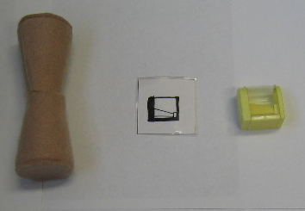
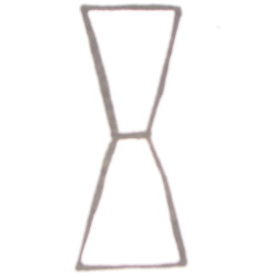
Target Picture
Label Condition: This is a wug!
Non-Label Condition: Look at this!
Target Object Picture Dist Object
TEST Q: Can you show me another one?

Slide 19
Target Object Picture Dist Object
TD
Label 92.5 2.5
Non-label 22.5 77.5
TD (ASD)
Label 92.5 (82.5) 2.5 (15)
Non-label 22.5 (57.5) 77.5 (37.5)
Notes:
TD children view the picture as a symbol when it is labelled, and as an object in its own right when it is not labelled (dual representation)
However, children with ASD tend to categorize the picture with its referent (no ‘flip’ of responses), which does not differ between conditions. Thus, not using labels in the same way

Slide 20
Study 2: Discussion
Typically developing children use names as a cue to interpret pictures symbolically
Children with ASD are not using labels in the same way
Reliance on perceptual information?
Notes:
Labels are used to categorize pictures on a conceptual level
;

Slide 21


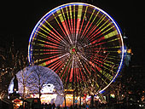

Slide 22
Study 3
Do young children follow an intentional or realism route to picture interpretation?
Group (ASD vs. TD)
Picture Type (Abstract & Realistic Conditions)
Group | N | CA | MA (BPVS) | SCQ
ASD | 15 | 9.7 yrs | 3.7 yrs | 42.7
TD | 15 | 3.3 yrs | 3.7 yrs | -
Bloom & Markson (1997), Psych Science
Hartley & Allen (2014), Cognition

Slide 23
Abstract Condition
“I’m going to show you some pictures now. These pictures have been drawn by a little boy called Joe. Sadly, Joe has a broken arm and can not draw very well. Because of his broken arm, Joe’s pictures did not always look how he wanted them to look.”

Slide 24
Abstract Condition
“Joe has drawn pictures of an elephant and a mouse. I’m going to show you his pictures of a mouse and an elephant. Remember, Joe has a broken arm so his pictures might not look quite right.”

Slide 25


Abstract Condition
Picture Selection
“Look! Joe has drawn an elephant and a mouse. These are drawings of a mouse and an elephant.”
“Can you show me the elephant?”

Slide 26
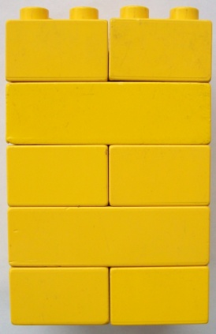
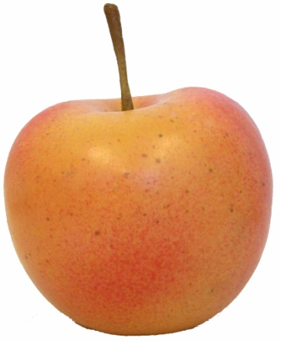
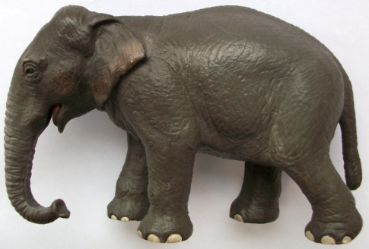
Abstract Condition
Object Selection
Intended referent
Perceptual referent
Distractor
“What was Joe trying to draw?”
Notes:
4 trials, request 2 large referents and 2 small referents.

Slide 27
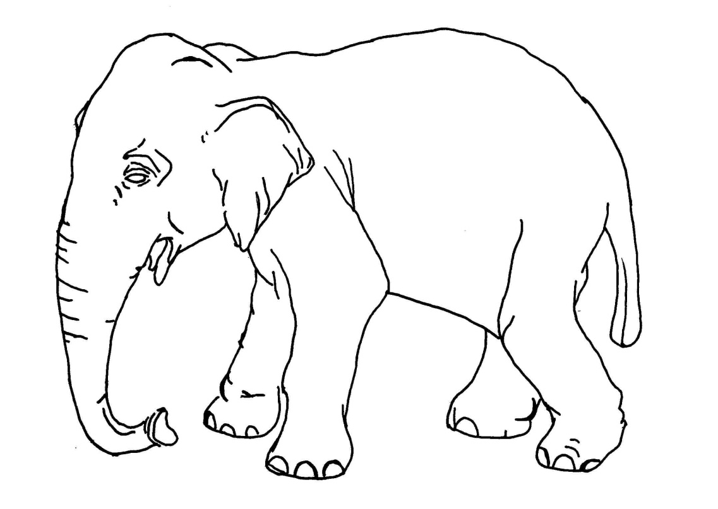
Realistic Condition
Picture Selection
“Ben has drawn pictures of an elephant and a mouse. I’m going to show you his pictures of a mouse and an elephant.
“Look! Ben has drawn an elephant and a mouse. These are drawings of a mouse and an elephant.”
“Can you show me the mouse?”

Slide 28


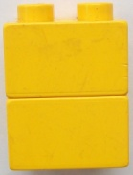
Realistic Condition
Object Selection
“Now look at these!”
“What was Ben trying to draw?”

Slide 29
Results
Picture Selection
*
A significant group difference was obtained in Abstract Condition (t(26) = 2.24, p < .05)
Both groups performed above chance.
Notes:
Both groups were able to use relative size to discern the appropriate label for an ambiguous picture, although a group difference was obtained. When the picture was realistic, as expected, both groups performed at ceiling.

Slide 30
Results
Object Selection
*
Significant group difference in Abstract Condition:
Group x Response Type interaction, F(1, 26) = 23.33, MSE = 2.15, p < .001, p²=.47.
Only TD above chance, but both groups at ceiling in Realistic Condition
Notes:
MacNemar shows difference between trial types

Slide 31
Study 3: Discussion
In the Abstract condition, children with ASD used relative size to infer picture-referent relations in the absence of perceptual resemblance
“elephant”
However, they linked the abstract picture to a perceptually related distractor rather than intended referent

Slide 32
Study 3: Discussion
In contrast, typically developing children can use relative size to infer representational status, and link this to the correct real world referent
One piece of evidence that children with ASD follow a realist route while typically developing children follow an intentional one

Slide 33
General Discussion
Typically developing children understand the symbolic relation between pictures, words and the objects they refer to
Use naming and intentional information to help form these links
Children with ASD instead form associative relations between pictures, words and objects
They focus on perceptual resemblance (color, shape) when interpreting pictures

Slide 34
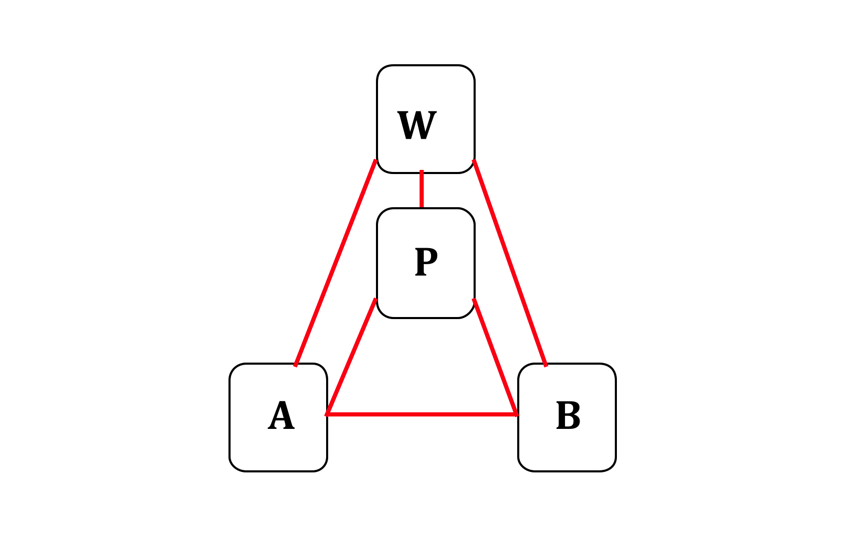
Naïve realists?
Children with ASD are failing to use intent to reason about depictions
They may be ‘naïve realists’ – evaluating pictures at face value
  A viewer analyzes the world as it stands before him, making sense of his environment through perceptual analysis
  Literal interpretation

Slide 35
Future Directions
Medium of learning (traditional picture books vs. iPads) for symbolic understanding, word learning, and engagement
What dimensions children with ASD use to generalize words (shape, color, size)?
Creation of pictures – artistic style, meaning, intent

Slide 36
Acknowledgements
Parents and children
Susan Carey
Paul Bloom
Patricia Ganea
Calum Hartley
Charlotte Field
British Academy, Autism Speaks, Friends Funding

Slide 37
Response Categories
Also analyzed responses across trials (Mapping, Generalization, Novelty Bias)
  Robust symbolic (map word from picture to object, and successfully generalize to new category member)
  Fragile symbolic (map word from picture to object, but fail to generalize)
  Associative (map word to picture only)
  Other

Slide 38
Response Category
Iconicity of picture
 | B&W line | Greyscale photo | Color line | Color photo
ASD
Symbolic (Robust) | 4 | 3 | 7 | 5
Symbolic (Fragile) | 0 | 2 | 2 | 4
Associative | 14 | 12 | 10 | 9
TD
Symbolic (Robust) | 16 | 10 | 12 | 16
Symbolic (Fragile) | 0 | 0 | 1 | 1
Associative | 3 | 4 | 1 | 1

Slide 39
Mapping: TD

Slide 40
Mapping: ASD

