Slide 1
Measure Up with Standardized Assessments
HARMONY UNIVERSITY
The Provider Unit of
Harmony Healthcare International, Inc. (HHI)
Presented by:
Deb Lee, OTR/L
Harmony Regional Consultant
Joyce Sadewicz, PT, RAC-CT
Field Operations

Slide 2
Speaker Bio (Debbie Lee)
Regional Consultant for Harmony Healthcare International, Inc.
Over 20 years of experience in the Long-Term Care
Specialty in training SNF to identify the unique and subtle barriers to overcoming independence.
OTR/L
OT/ Standardization
Advanced Treatment planning.
Standardized testing
Therapy Documentation/Rx
Case Mix (Specialty in State of Maine)

Slide 3
Speaker Bio (Joyce Sadewicz)
Field Operations and Regional Consultant for Harmony Healthcare International (HHI)
Education
Bachelor of Science in Physical Therapy from Russell Sage College and Albany Medical School
Extensive knowledge in reimbursement and management of patient care
Clinical Case Manager
MDS and reimbursement in a PPS environment
Knowledge of the RAI process in the Medicare PPS setting as well as the Case Mix setting
Experience
Over 15 years of experience in Physical Therapy, working with neurologically impaired children and adolescents
Invaluable Physical Therapy experience working in acute care a city hospital with an active inpatient and outpatient program as well as a regional burn center and trauma unit
Manager of the Physical and Occupational Therapy Departments
Manager of the Work Tolerance Center, an outpatient work-hardening program
Manager of 40 rehab personnel with a combined budget of $1.5 million in a 440 bed acute care setting with multiple outpatient sites
Rehabilitation Manager in a long-term care facility

Slide 4
Measure Up with Standardized Assessments
Disclosures: The planners and presenters of this educational activity have no relationship with commercial entities or conflicts of interest to disclose
Planners:
Elisa Bovee, MS, OTR/L
Diane Buckley, BSN, RN, RAC-CT
Beckie Dow, RN, RAC-MT
Keri Hart, MS CCC, SLP, RAC-CT
Kristen Mastrangelo, OTR/L, MBA, NHA
Christine Twombly, RNC, RAC-MT, LHRM
Presenter:
Deb Lee, OTR/L
Joyce Sadewicz, PT, RAC-CT

Slide 5
Communication & Coaching: A Nurse’s Guide to Creating a Harmonious Atmosphere Disclosure
Speaker:
Deb Lee, OTR/L
Joyce Sadewicz, PT, RAC-CT
The speaker has no relevant financial relationships to disclose
The speaker has no relevant nonfinancial relationships to disclose

Slide 6
Measure Up with Standardized Assessments Criteria for Successful Completion
Complete Sign-in and Sign-Out on Attendance Form
Attendance for entire session
Completion and submission of speaker evaluation form.

Slide 7
Objectives
The learner will be able to identify the Benefits of utilizing Standardized assessments
The learner will be able to summarize appropriate use of standardized therapy assessments
The learner will be able to detail the reasons standardized assessments can be used to evidence progress and support Medicare Part G-codes

Slide 8
Importance of Accurate Documentation
Importance of Accurate Documentation
Therapist
Patient/Family
Legal
Notes:
With the spiraling cost of health care in the United States, we must demonstrate the effectiveness and efficiency of our therapy treatment. As payers, health care systems and the public question the efficacy and cost effectiveness of rehabilitation, appropriate documentation is becoming more important. Therapists must have a more scientific basis for their practice.

Slide 9
Importance of Accurate Documentation
Payment Reviews
Medicare Part A Reviews are increasing
Objective data to support gains
Medicare Part B Reviews
Objective documentation to support Functional reporting of G-Codes
Pre and Post Payment
Medicaid Audits for Case Mix

Slide 10
Scientific Basis
Scientific Basis for Practice
Evidenced based
Supports medical necessity
Starting point for measurable goals
Notes:
With the spiraling cost of health care in the United States, we must demonstrate the effectiveness and efficiency of our therapy treatment. As payers, health care systems and the public question the efficacy and cost effectiveness of rehabilitation, appropriate documentation is becoming more important. Therapists must have a more scientific basis for their practice.

Slide 11
Standardized Testing
What is a standardized test?
The procedure, apparatus and scoring are fixed
Uniformity each time it is administered
Instructions are clear, detailed and complete
Notes:
How does it differ from objective observations? From non standardized tests? Can anyone name a standardized test?

Slide 12
Test Selection
Test Selection
A test must be valid for the situation.
Can it be interpreted soundly?
Does the information serve the purpose?
Know the test and consider the patient.
Notes:
Taking liberties with standardized procedures will invalidate the test results.

Slide 13
Effectiveness and Efficiency
Effectiveness and Efficiency
Are you testing what you think you are?
Time is short, can you administer the test efficiently?
How do you make it efficient?
Notes:
With the spiraling cost of health care in the United States, we must demonstrate the effectiveness and efficiency of our therapy treatment. As payers, health care systems and the public question the efficacy and cost effectiveness of rehabilitation, appropriate documentation is becoming more important. Therapists must have a more scientific basis for their practice.

Slide 14
Relevance of Standardized Tests
Evidence based treatment is best practice and referrals are increasingly based on objective, value-based criteria including metric-driven rehabilitation performance, successful return to home rates, re-hospitalization rates and patient experience ratings.
Notes:
The need for and the value of standards for tests and measurements is clear. Evidence based treatment is best practice and referrals are increasingly based on objective, value-based criteria including metric-driven rehabilitation performance, successful return to home rates, re-hospitalization rates and patient experience ratings.
Has your facility been asked for outcomes by new ACO? By a local hospital concerned about re-hospitalization rates?

Slide 15
Selecting Standardized Tests
Selecting appropriate tests and measurements can determine:
A patient’s status on their initial therapy evaluation
An objective assessment of their particular strengths and needs
Along with interpretation of the data establish the baseline for the patient’s status
Directs the development of the plan for therapeutic intervention to achieve the goals you set for the patient
Is critical for superior quality and results
Notes:
Selecting and administering appropriate tests and measurements to determine a patient’s status on their initial therapy evaluation, objectively assessing their particular strengths and needs, is critical for superior quality and results with therapy. These initial findings, with interpretation of the data, establish the baseline for the patient’s status. It directs the development of the plan for therapeutic intervention to achieve the goals we set for the patient.

Slide 16
Selecting Standardized Tests
Essential to evaluate the effectiveness of your treatment interventions
How objective and accurate are your findings?
How reliable?
How valid?
How can you select the appropriate interventions for patients if assessments are vague?
Notes:
When activity tolerance is stated to be decreased, how are we going to measure progress or decline?

Slide 17
Why Not A Standardized Test?
Reported reasons for not using standardized outcome measures:
Length of time for patients to complete them
Length of time for clinicians to analyze the data
Difficulty for patients in completing them
Performance based measures relevant for your patients in a skilled nursing center may not be part of a therapist’s repertoire or easy to find
Notes:
Are your therapists already stressed by productivity expectations, a high caseload, the unexpected admission that needs an evaluation just when they wanted to leave? Do they stay to evaluate a patient, risking their ability to be punctual meeting a school bus or do an errand? What are the chances that they are going to use a length standardized test or try a test that they don’t know well? Or that they think the patient may not cooperate with?

Slide 18
“Most people see what they want to, or at least what they expect to”
-Martha Grimes
Notes:
This quote by Martha Grimes really spoke to me. You can become blind by seeing each patient as a similar to the last total hip fracture or stroke patient you had or by treating the “frequent flyer” patient as they were the last time you saw them. Excellence comes from meticulous attention to the details and in identifying that detailed accurate objective baseline that progress or decline can be measured from.

Slide 19
Key Factors
Tests used most often:
Assessments that are familiar
Easily administered
Readily available in the clinic
Easily scored
Time efficient
Used to support Medicare Part B G-Codes
Notes:
Using the same tests for each patient is rarely going to provide the individualized best practices that we are striving for.

Slide 20
Key Factors
Is the selection of a standardized test based on:
Availability
Ease to administer
To satisfy a manager requiring a set number of standardized tests ?
Notes:
Using the same tests for each patient is rarely going to provide the individualized best practices that we are striving for.

Slide 21
Key Factors
Tests should be used based on appropriateness, or the quality of the services provided diminishes
Notes:
Using the same tests for each patient is rarely going to provide the individualized best practices that we are striving for.

Slide 22
The Benefits
Those who do use appropriate standardized tests report:
Enhanced communication with patients and families
These tests helped direct the plan of care
Establishing incremental measureable, functional goals was easier
Documenting progress was facilitated by standardized testing

Slide 23
Implementing Effective Standardized Testing
Testing Routinely and Effectively
Is your therapy department using standardized tests beyond the occasional Berg or Tinetti balance test?

Slide 24
Balance is the Key to Life

Slide 25
How Do You Get It Done?
Set a goal to learn a new test each month
PT, OT and SLP to pick a new test to learn
Trial administration to a specified number of appropriate patients
Review the results

Slide 26
How Do You Get It Done?
Make the test readily available for use
Wall pockets to make it easy to “grab and go”
Hanging files
Plenty of copies

Slide 27
How Do You Get It Done?
Set up the environment
Supplies for tests available
Measure out distances and mark walls or floor
Have the right equipment (Kettle test)

Slide 28
How Do You Document the Results?
Who does the Standardized Test?
Registered Therapist versus Assistant?
State Practice Acts
Scope of Practice
Medicare Regulations
Payer Source

Slide 29
How Do You Document the Results?
When do you do the test?
Initial Evaluation?
The following treatment?
When you need to identify an new deficit?
When you need to highlight a deficit to support continued therapy?

Slide 30
How Do You Document the Results?
Where do the results actually go?
Do you have space on the evaluation form or in the EMR for the information?
Refer the reader to the location of the information
Do your forms have room for further testing or re-testing?

Slide 31
How Do You Document the Results?
Interpretation of the results
Validity for population
Demonstrating progress or decline
Practical application
Writing the goals

Slide 32
How Do You Document the Results?
Writing the goals
Functional
As evidenced by …
Measureable
Reproducible

Slide 33
How Do You Document the Results?
When do you re-test?
When therapist available
Progress note
Recertification
Depending on patient’s progress
At discharge

Slide 34
Types of Standardized Testing
Gait Speed
Timed Up and Go
Brief Cognitive Assessment Tool
Kitchen Picture Test
Chair Stand Test
Dynamic Gait Index
Notes:
Thee are assessments that are available at no cost, online.

Slide 35
Types of Standardized Testing
Functional Reach Test/Modified Functional Reach Test
Balance Tests – Tinetti, Berg, Brunel
Borg Rating of Perceived Exertion Scale
Modified Borg Scale of Perceived Dyspnea
Manual Ability Measure

Slide 36
Types of Standardized Testing
Kettle Test
Elderly Mobility Scale
The ManageMed Screening
Kitchen Task Assessment
Executive Function Performance Test
Barthel ADL Index
Sitting Balance Scale

Slide 37
Gait Speed
Gait Speed
Walking Speed or Gait Velocity
Called the Sixth Vital Sign
Is a Predictor and Outcome measure across multiple diagnoses
Predicts post hospital discharge location 78% of the time
Is easy to administer, easy to interpret
Notes:
Can predict future health status, predicting falls, fear of falling, functional decline, mortality. Can help determine outcomes such as discharge location, functional status and the need for rehabilitation. The progression of gait speed has been linked to meaningful changes in quality of life and in walking behavior at home and in the community.
It can be completed in less than 2 minutes, calculated by dividing the distance by time and you just need a stopwatch and markers along a walking path. Gait velocity data is available as a reference to determine if a patient is a safe community ambulator. Would the patient make it across the street safely before the light turns green? Gait speed normative data is available by gender and age groups and related to function such as whether a patient will be dependent or independent in ADLs and IADLs.

Slide 38
Notes:
Steps to perform assessment:
Ensure there is a straight path that measures 20 feet (5 feet for acceleration; 10 feet for steady walk, 5 feet for deceleration)
Markers are placed at the 5 feet and 15 feet positions along the path
Patient starts to walk at the normal pace from one end of the path to the opposite one
Therapists measures time it takes patient to get from 5 feet marker to 15 feet marker

Slide 39
Types of Standardized Testing
Brief Cognitive Assessment Tool
Administered in 10 -15 minutes
Has a “cut” score separating dementia from mild cognitive impairment (MCI)
Has score ranges for MCI, mild dementia and moderate dementia
Predicts diagnosis, functional status and Instrumental Activities of Daily Living (IADL)
Notes:
21 items, 50 point scale. Assesses orientation, verbal recall, visual recognition, visual recall, attention, abstraction, language, executive functions and visuo-spatial processing. It correlates positively with ADL and IADL performance. It is available for fee on line and you can utilize the free scoring programs online.
Short form administered in less than 5 minutes is not as comprehensive

Slide 40
Kitchen Picture Test
Kitchen Picture Test
Visually presented test of practical judgment.
Illustrates a kitchen scene with 3 dangerous situations unfolding.

Slide 41
Kitchen Picture Test
Notes:
Ths test looks at expressive language, practical judgment and memory. The instructions for this test has the patient describe what they see while the examiner rates areas such as fluency, naming, repetition and word substitution. Then the patient is asked about safety problems and to rate the problem situation with the most important one to deal with first, the second, then third. Later the patient is asked to recall what these problems were.

Slide 42
Chair Stand Test
Assesses leg strength and endurance
Requires a straight back chair 17 inches high and a stopwatch
The number of complete chair stands (up and down is one chair stand) without using arm rests completed in 30 seconds is counted
Notes:
The Chair Stand Test developed by Jones and Rikli was designed specifically to test lower body strength in older adults. Traditional strength testing methodology widely used by physical and occupational therapists consists of Manual Muscle Testing. However, a normal muscle grade does not necessarily indicate a patient's ability to return to his or her normal level of activity. More functional strength testing is recommended to paint a more accurate and complete picture of where and how strength deficits may hinder daily activities. There are a variety of functional tests available to therapists. Many include other factors such as balance and mobility in addition to strength. An example is the Timed Up and Go Test, TUG.

Slide 43
Chair Stand Test
Tables show average, above and below average ranges for male and female age groups
Repeated testing can show small incremental gains not evident with manual muscle testing
Notes:
Normal values for the number of stands per 30 seconds is listed by gender and by age range. Arm rests can be used if needed for safety or assistance and this should be documented. Repeated testing will still show if there is progress or a decline from the initial evaluation if arm rests are used.

Slide 44
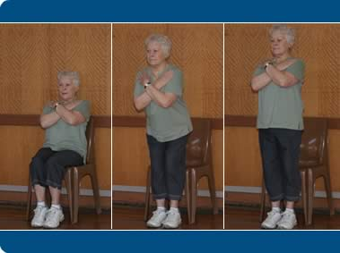
Chair Stand Test

Slide 45
Functional Reach Test
Is administered standing
Takes about 5 minutes
The Modified Functional Reach Test adapted for patients unable to stand, is administered sitting
Research data, norms for Frail Elderly, Parkinson’s and Stroke patients
Notes:
The standing instructions for the functional reach test are to stand next a wall and position the arm that is closer to the wall at 90 degrees of shoulder flexion with a closed fist. The assessor records the starting positon at the 3rd metacarpal head and instructs the patient to “Reach as far forward as you can without taking a step. The difference between the start and end position is measured. Three trials are done and the average of the last 2 trials is used to determine their fall risk and for measuring progress on subsequent trials.

Slide 46
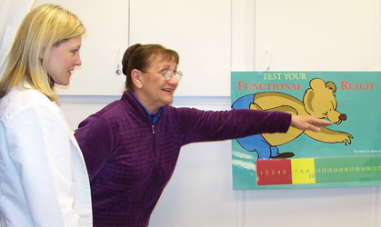
Functional Reach Test

Slide 47
Manual Ability Measure
Easy to use and practical rating scale for 20 common hand tasks
Takes 15 minutes to administer
Task oriented
Psychometrically sound
Overall manual ability change can be compared or change at an item level assessed
Notes:
Looks at meaningful tasks like cutting meat, wringing a towel, turning a key to open a door, opening a medicine bottle with a child proof cap, cutting nails with a nail clipper. This occupation based assessment has scoring for both musculoskeletal conditions and for neurological conditions. This tool has gone through vigorous research, is psychometrically sound and lends itself to using the list of tasks for setting short-term and long-term goals.

Slide 48
Manual Ability Measure

Slide 49
Kettle Test
Assesses cognitive functional performance including attention, working memory, executive function
Patient prepares two hot drinks.
10 – 30 minutes to administer test
Need electric kettle, ingredients for beverages on a tray with other ingredients that are “distractors”

Slide 50
Kettle Test

Slide 51
Elderly Mobility Scale
7 item performance based test includes transfer, gait and balance tasks essential for basic ADLs.
15 – 20 minutes to administer
Can be used for assessment and as an outcome measure
Need stop watch, access to a bed and chair, space for a 6 meter walk

Slide 52
Elderly Mobility Scale

Slide 53
Brunel Balance Assessment
Assesses functional balance for patients with a wide range of abilities
Hierarchical series of functional performance tests
Test has three sections:
Sitting
Standing
Stepping

Slide 54
Brunel Balance Assessment
Sections are divided into several levels
Each level has a score, allowing for gains within a level to be identified even if the patient does not progress to the next level
Testing can start at a level that is reasonable for that patient
Reliable, valid and sensitive to change

Slide 55
Brunel Balance Assessment

Slide 56
Barthel ADL Index
Assesses the ability of a patient to care for themself
10 items measure performance in ADL areas
5 minutes or less to administer
Used in 16 major diagnostic conditions

Slide 57
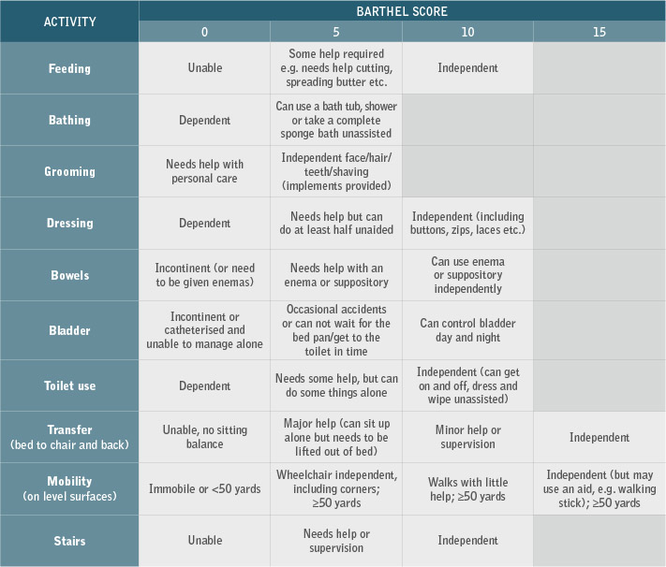
Barthel ADL Index

Slide 58
ManageMed Screening
Standardized functional screening to determine if a patient can manage a moderately difficult medication
routine - 3 different medications with 3 different schedules and doses.
15 – 20 minutes to administer
Test group was elders 65 and over

Slide 59
ManageMed Screening

Slide 60
Kitchen Task Assessment
Measures the support needed for the patient to prepare cooked pudding from a commercial package
Components such as initiation, organization and safety scored on a scale from 0 – 3
Standardized on patient’s with Alzheimer’s disease

Slide 61
Kitchen Task Assessment

Slide 62
Executive Function Performance Test
Patients complete these tasks (in order)
Hand washing
Oatmeal Preparation
Telephone
Taking Medication
Paying Bills

Slide 63
Executive Function Performance Test
30 – 45 minutes to administer
For Geriatric, Stroke and Multiple Sclerosis patients
Determines capacity for independent functioning, which executive functions are impacting function and the amount of assist needed to complete the task

Slide 64
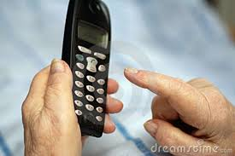
Executive Function Performance Test

Slide 65
Borg Scale for Rating of Perceived Exertion
Measures perceived exertion (how hard you feel your body is working) on a scale of 6 – 20
Multiplying the score by 10 in a healthy adult is expected to coincide with the heart rate so a perceived exertion of 12 would equal a heart rate of roughly 120 beats per minute

Slide 66
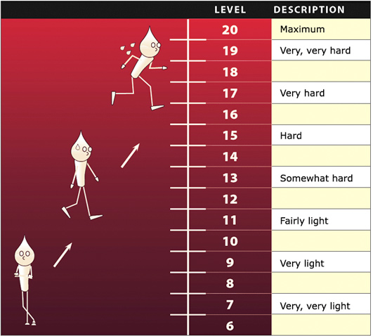
Borg Scale of Perceived Exertion

Slide 67
Modified Borg Scale for Perceived Dyspnea
Subjective scale that measures how hard you are breathing on scale of 0 to 10
As strength and activity tolerance improve with exercise, feelings of breathlessness and patient’s score on this scale decreases

Slide 68
Modified Borg Scale for Perceived Dyspnea

Slide 69
Timed Up and Go
Assesses mobility, balance, walking ability, and fall risk in older adults.
Takes less than 3 minutes to administer
Need a standard armchair and a stopwatch
Standardized for many populations including Frail Elderly and Community Dwelling Older Adults

Slide 70
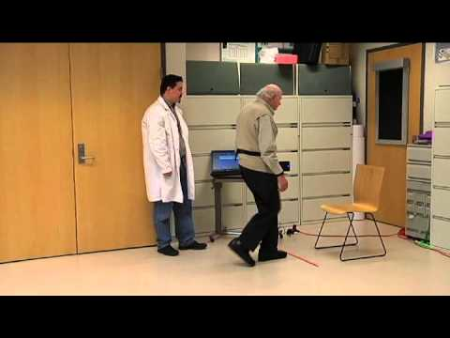
Timed Up and Go Test

Slide 71
Time to Try It Out
Look at your playing card now
Are you a diamond or a heart?
If you are a diamond, meet Deb on the right side of the room
If you are a heart, meet Joyce on the left side of the room

Slide 72
Time to Try It Out
Deb will take you through the Manual Ability Measure and the Functional Reach Test
Joyce will take you through the Gait Speed Test and the Chair Stand Test
Now is your chance to write the goals related to the results of the test

Slide 73
Evaluate Where You’re At
"Change is the only constant." – Heraclitus, Greek philosopher
Open an honest dialogue about what's happening in healthcare, why we need objective testing
Convince therapists that change is necessary
Notes:
What was true more than 2,000 years ago is just as true today. We live in a world where change is constant but feeling apprehensive and uneasy about it is normal. Overcoming resistance to change is

Slide 74
Evaluate Where You’re At
Put in place the structure for change and continually check for barriers
Set achievable goals, consider trying one new test every month
Celebrate success! Share examples of how testing is facilitating better treatment and easier documentation
Notes:
Have a vision and communicate it effectively, showing how testing can make documentation easier not harder, how it is improving the treatment we offer and how it leads to better results, an improved quality of life for our patients.

Slide 75
References
The Rehabilitation Measures Database (www.rehabmeasures.org)
The Geriatric Examination Tool Kit (http://web.missouri.edu/~proste/tool)
The BCAT Test System (http://thebcat.com)
Mental Health, Vol 30(4), 2007, 1-23
Notes:
Have a vision and communicate it effectively, showing how testing can make documentation easier not harder, how it is improving the treatment we offer and how it leads to better results, an improved quality of life for our patients.

Slide 76
References
The Rehabilitation Measures Database (www.rehabmeasures.org)
The Geriatric Examination Tool Kit (http://web.missouri.edu/~proste/tool)
The BCAT Test System (http://thebcat.com)
Notes:
Have a vision and communicate it effectively, showing how testing can make documentation easier not harder, how it is improving the treatment we offer and how it leads to better results, an improved quality of life for our patients.

Slide 77
References
Chen, C. C., & Bode, R. K. (2010). Psychometric validation of the Manual Ability Measure (MAM-36) in patients with neurological and
Musculoskeletal disorders.
Archives of Physical Medicine and Rehabilitation, 91(3), 414-20.
Notes:
Have a vision and communicate it effectively, showing how testing can make documentation easier not harder, how it is improving the treatment we offer and how it leads to better results, an improved quality of life for our patients.

Slide 78
References
The Manage Med Screening: An interdisciplinary tool for quickly assessing medication management skills. Robnett, Regula H.; Dionne, Chantel; Jacques, Rebecca; LaChance, Allyson; Mailhot, Melissa Clinical Gerontologist: The Journal of Aging and Mental Health, Vol 30(4), 2007, 1-23
Notes:
Have a vision and communicate it effectively, showing how testing can make documentation easier not harder, how it is improving the treatment we offer and how it leads to better results, an improved quality of life for our patients.

Slide 79
Questions/Answers
Harmony Healthcare International
1 (800) 530 – 4413
Jsadewicz@harmony-healthcare.com
Dlee@harmony-healthcare.com
Harmony Healthcare International, Inc.
79

Slide 80
Harmony Healthcare International
Have you Considered a Customized Complimentary HARMONY(HHI) MEDICARE PROGRAM EVALUATION
or
CASE MIX ANALYSIS
for your Facility?
Perhaps your facility has potential for additional revenue
Assess your facility against key indicators and national norms
Email us at for more information
RUGS@harmony-healthcare.com
Analysis is cost & obligation free
Harmony Healthcare International, Inc.
Notes:
80

