Slide 1
BlueSky Takes the Guesswork Out of “On-The-Fly” Margins And “Take Home Pay” For Pay Packages

Slide 2
BlueSky’s New Pay Package Drills All The Way Down To Include State Unemployment And Worker Compensation Costs To The Exact Percentage

Slide 3
Prepopulate All State SUI and WC Values!

Slide 4
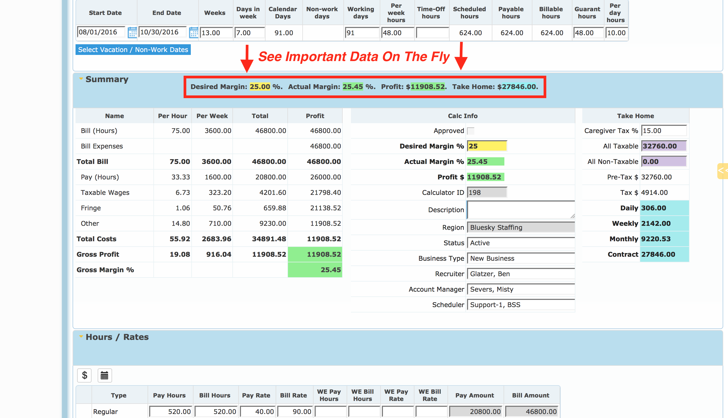

Slide 5
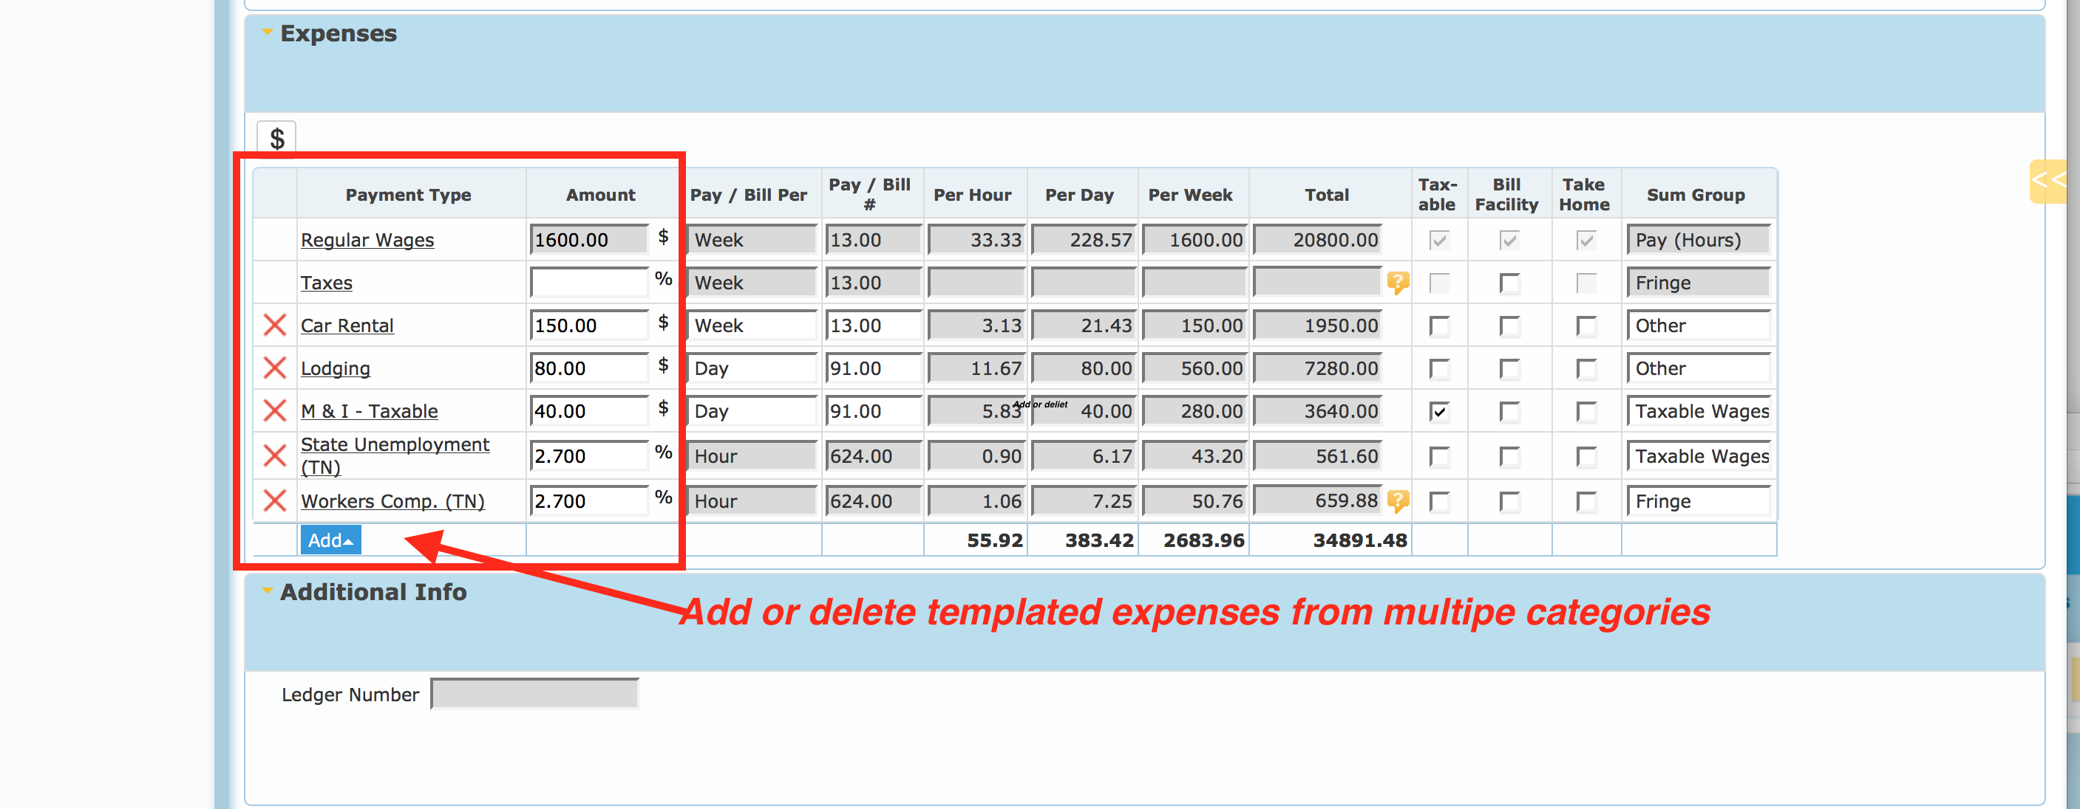

Slide 6
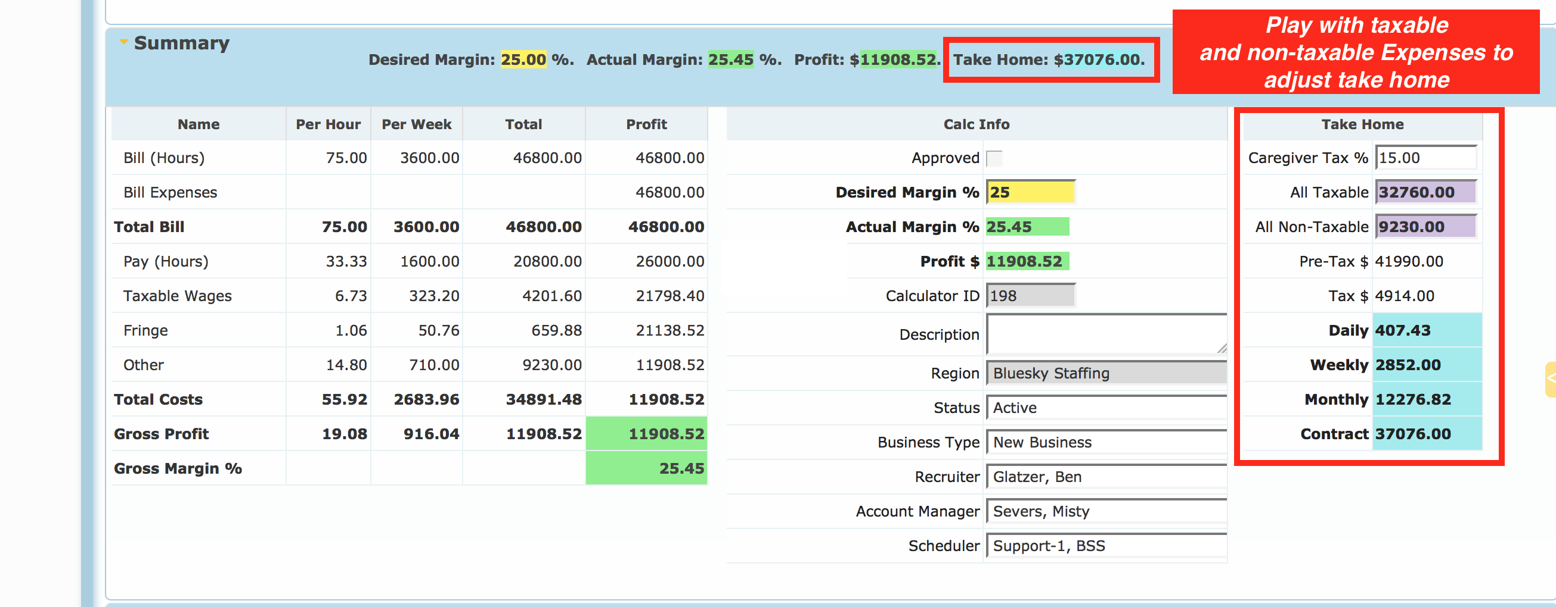

Slide 7
BlueSky Has the Tools to Take You To The Next Level! See us at www.whatisbluesky.com

