Slide 1
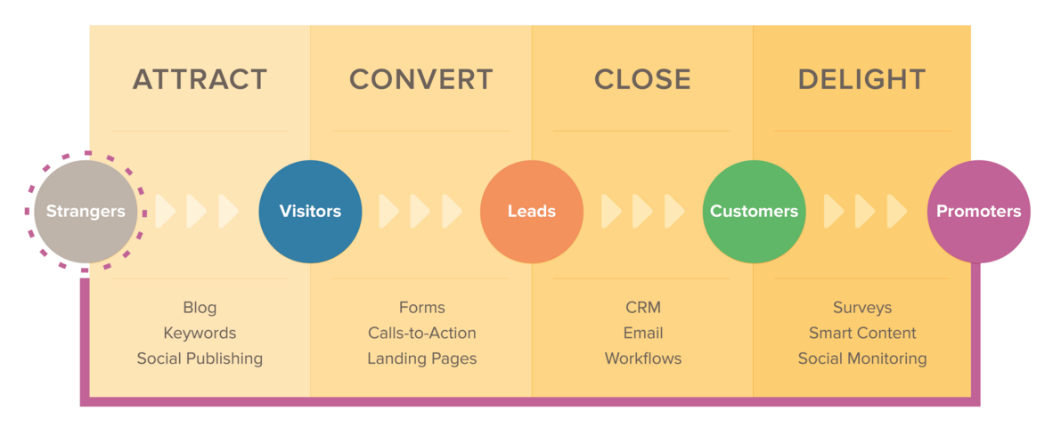
Tips to Grow Your Business with Inbound Marketing
Attract, Convert, Close, Delight

Slide 2
Research
When it comes to inbound marketing, research is really quite simple.
3 components to success
Know your business
Know your industry
Know your customer

Slide 3
Define Your Business
At Kirk Donovan Enterprises …….
We can develop a strategy for your company to establish a solid presence in the marketplace.
We will develop the right business persona and work with you to define the ethos, culture and principles to enforce customer loyalty.
What are your revenue goals ? How much growth do you expect and in what time frame?
Breakdown your business goals, what are you trying to achieve?
Increase amount of leads
Attract more traffic
Convert more leads
Revenue your sales process
How does your company interacts with customers ? What is the content used to educate prospects ? What message does your brand deliver?

Slide 4
Study up on Your Industry
Tips to Stay on the TOP
Check out your competitors what does their on-line presence entail?
Stay current with news and events.
Compare your goals to current industry goals. (this ensures your goals are realistic and attainable)
If possible engage in a business to business marketplace, be outgoing, visible network.
Hubspot found, inbound leads cost 60% less than outbound leads. Inbound marketing provides a much more focused program that matches today’s buyer behavior.
You may think you couldn’t possibly learn another thing about your industry, but in fact it is quite the opposite
In order to stay on your A game industry research is A must
There will always be changes, updates, and new innovations around the corner

Slide 5
Understand your Customer
Questions to Ask
What 5 questions does your sales team answer the most?
What are the biggest problems and discouragements your customers have when they come to you?
What are your customers demographics?
What messaging do they respond to most?
Ask yourself …..who within the company has the most insight and direct contact with potential customers?
For most companies the answer will be The Sales Team
Don’t stop there. Interview various departments within your organization, marketing team, production, HR……you will be surprised how many fresh, new outlooks you may collect to help you build your target audience.

Slide 6
Atlanta’s Best Digital Advertising Agency
Can’t seem to find enough time in your busy schedule to develop successful inbound strategy?
At Kirk Donovan Enterprises our proficient marketing team will target your ideal audience, grow your on-line presence, and expand your companies brand.
Services our Atlanta Digital Marketing will include to attract your target audience:
Blogging- Blogs help better connect potential or current customers to your brand, our marketing experts can create engaging and educational content to make your audience keep coming back for more.
Calls-To-Action- Once we create that great content we will lead your potential customers to that next step. Including a call-to-action directs your visitor further down the buyers journey making the process simple and helpful.
Landing pages- We will build out your site’s pages to help convert new customers effectively.
Social media engagement- This is an effective tool that almost acts as a free advertising booster for your business. Using social platforms such as, Facebook, Twitter, & LinkedIn shows you what your prospects are looking for and gets you front row seats to popular industry trends and topics. Let us help you with your Social Media Digital Marketing Strategy.

Slide 7
Search Engine Optimization
If you want your company to get found anywhere in the world by what your customers are searching for its essential to build quality organic SEO.
In order to get found for keywords your customers are searching for (which is everything “know your customer,” above), it is important to optimize every page on your website.
When it comes to SEO don’t forget to:
Include keywords within the page content, in elements such as
Header
Page Text
2. Include keywords within the page properties, such as
URL
Meta Description
Include keywords when uploading and inserting your images
Putting keywords in the name of the image
Using an alt tag with the key word in it
4. Link keywords in your content to other pages on your site

Slide 8
Content
Blogging and premium content is the universal remote of inbound marketing
Blogging is all about bringing visitors to your site
Increases organic traffic
According to Hubspot companies that blog generate 67% more leads per month than those that do not.
Blogging Best Practices
Publish the right content-Write content around questions, issues, and challenges your potential customers want answers to.
Publish content consistently-This all depends on your time and budget. Remember the more premium content you create the more quality leads you attract.
Determine the right angle- Start blogging on topics you know best of, check out what competitors are blogging about, use outside resources to find your niche.
Use a calls-to-action (CTA)- Using CTA’s at the end of your blog urges visitors to download premium content and will definitely help grow your leads and sales.

Slide 9
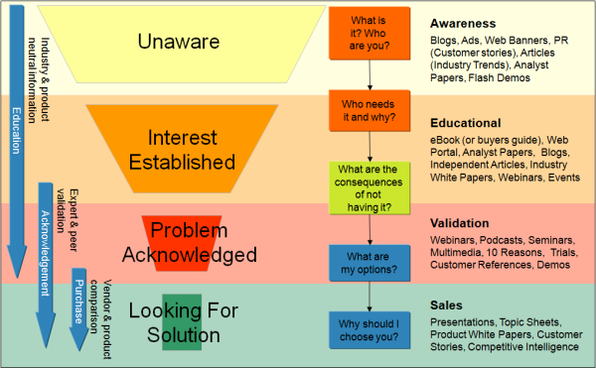
Lead Communication
Once you start bringing in leads it’s time to figure out how you want to communicate with them
But how do we determine communication?
This is based off of numerous factors: who they are, what specific service or product they want from you, what questions they want answered, and how much communication they have had with you thus far…..
Depending on where your customers lie on the buyers journey will help you determine the best style and content to choose when interacting with prospects. E.g., Blogs, eBooks, Info graphs, Webinars, or Product White Papers
At Kirk Donovan Enterprises we offer exceptional services in marketing automation in order to effectively personalize content for your customers and deliver the content when they need it.
The Buyers Journey

Slide 10
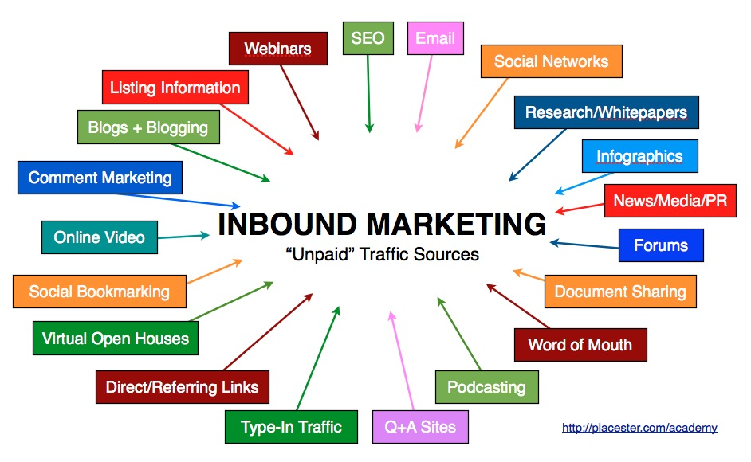
Lead Nurturing
Determine your timing
Aline your lead nurturing with your sales cycle. You don’t want to bombard your them with email so quickly that they unsubscribe from all email communication
Consistently refine your messaging
Provide them with content they are craving. If they download an offer, then you know the kind of information they are interested in.
Decide what to give them
This is where blogging becomes useful, as you can send them blog post in lead nurturing emails. This provides them with more information, and it gets them back to your website where they can interact with your business further.
Making sure your lead is qualified and sales-ready before talking to your sales team

Slide 11
Simple Enough, right?
I hope these tips have given you a better understanding on how integrating inbound marketing can help grow your business
Kirk Donovan Enterprises has the marketing resources for optimizing SEO that will attract the right visitors, create premium content to nurture and convert your prospects, set up your nurtured leads for success throughout the sales process, and help your organization close more business. Call today (404) 317-9662
Check This Out ! Click Here to see what Kirk Donovan Enterprises has available to grow your business through Inbound Marketing.

