Slide 1
Designing your program
By Rob Tyndall
Notes:
Your tittle slide

Slide 2
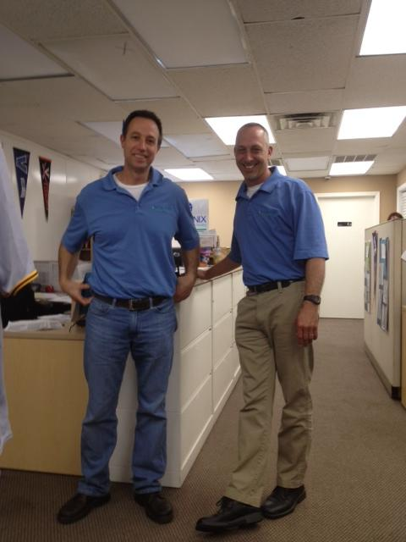
Rob Tyndall
Rtyndall@holganix.com
866-56-EARTH

Slide 3
Do you currently use Holganix?
Notes:
Let’s figure out how many are prospects vs users?

Slide 4
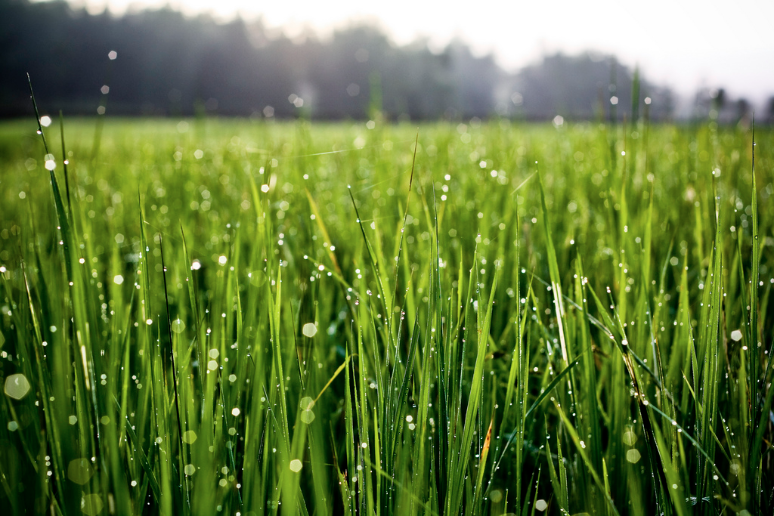
What is Holganix?
100% organic, bio nutritional product that promotes
strong plant health resulting in beautiful, vigorous plants.
Notes:
Just as a refresher for prospects and new-bees

Slide 5
The program
Notes:
Alright, enough of the chit chat let’s dig into your presentation!

Slide 6
Program choices
Liquid
Granular
Hybrid
Notes:
Maybe get rid of this slide? More refresher for what Holganix is.

Slide 7
Liquid
Cold weather spraying can be problematic
Equipment
Hose sprayer
Mechanized ride on sprayer
Deliver more living biology
Materials are more cost effective
Notes:
Maybe get rid of this slide? More refresher for what Holganix is.

Slide 8
Granular
Less equipment expense
Push sprayer
Mechanized ride on
Deliver high amounts of carbon
Do not get full spectrum of life as liquid Holganix
Notes:
Maybe get rid of this slide? More refresher for what Holganix is.

Slide 9
Hybrid
Allows flexibility
Cold weather - granular
Rest of year - liquid
Notes:
Maybe get rid of this slide? More refresher for what Holganix is.

Slide 10
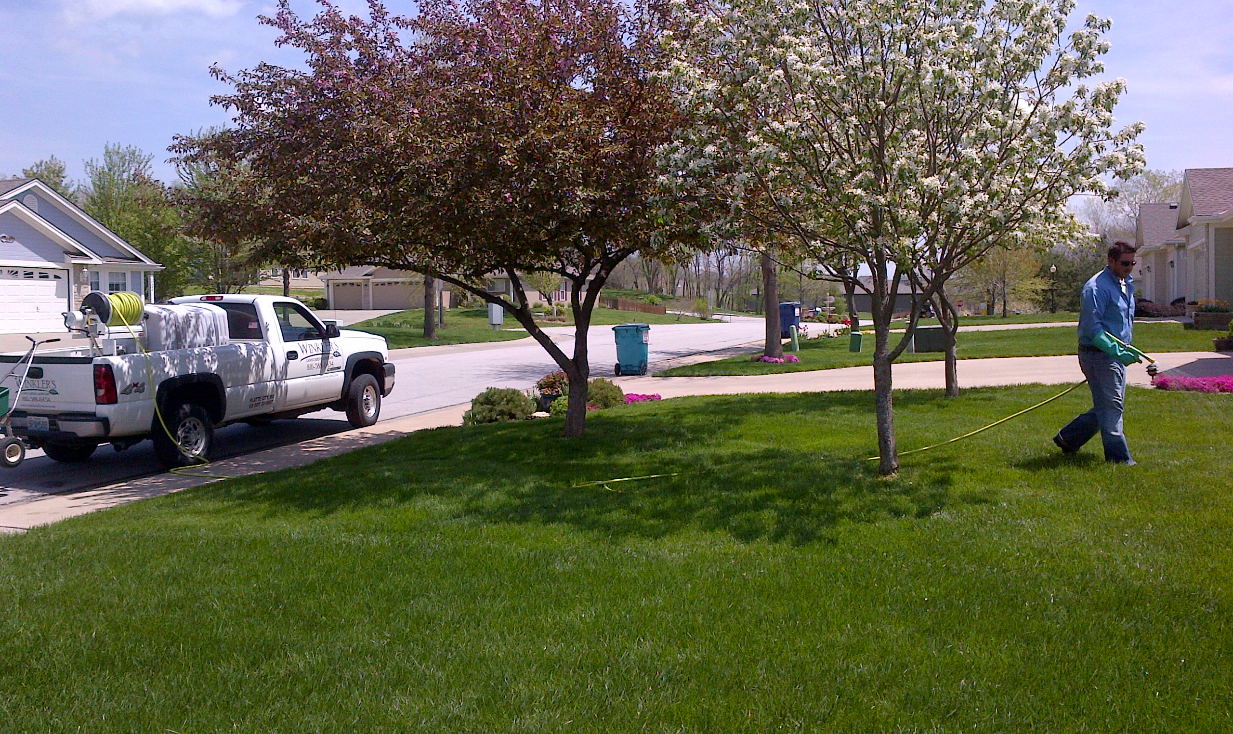
New program vs. Current program
Notes:
What does your current program look like?

Slide 11
New program
We have templates for Holganix programs
Notes:
Maybe get rid of this slide? More refresher for what Holganix is.

Slide 12
Current program
# of apps
Single of split app pre –emergent
Compatibility of products
Reductions
Notes:
Maybe get rid of this slide? More refresher for what Holganix is.

Slide 13
Reductions
Annual Nitrogen = 50%
Pre-Emergent = 20%
Herbicide = 30%
Notes:
Maybe get rid of this slide? More refresher for what Holganix is.

Slide 14
Variables

Slide 15
Variables
Grass type
Pre-emergents
State and federal regulations
Notes:
Variables to consider when designing your fertility program

Slide 16
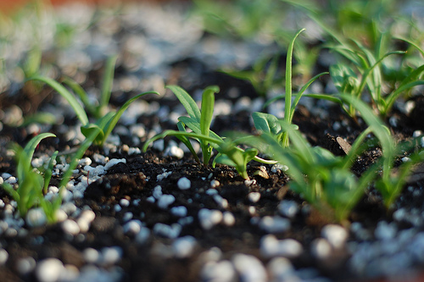
Grasses
Warm Season
35 oz Holganix annually
usually divided over minimum of 5 applications
Cool Season
28 oz Holganix annually
usually divided over minimum of 4 applications
Notes:
What products are we incorporating with Holganix? Are they compatible?
Compatibility web page: http://www.holganix.com/products/compatibility-list/

Slide 17
Pre-emergent
Single application or split application
Months of control per label
Notes:
What products are we incorporating with Holganix? Are they compatible?
Compatibility web page: http://www.holganix.com/products/compatibility-list/

Slide 18
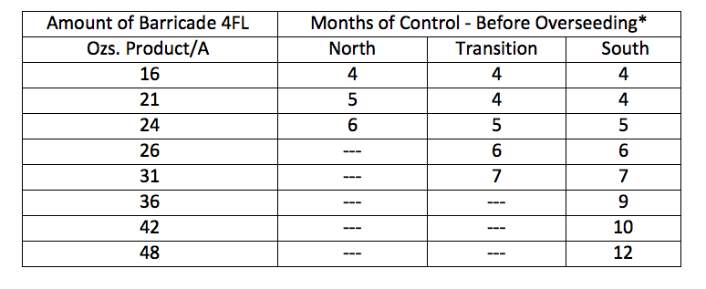
Barricade 4FL
Notes:
What kind of equipment do we look at? Why choose one over the other?

Slide 19
State & federal regulations/nutrient management
Limits on annual amount of nitrogen
Slow release requirements
Parts of NJ require 20% slow
Phosphorous bans
Fertilizer black out periods
Holganix can be applied
Notes:
What products are we incorporating with Holganix? Are they compatible?
Compatibility web page: http://www.holganix.com/products/compatibility-list/

Slide 20
Program examples

Slide 21
12 Holganix Pre-Built Programs
Value
Premium
Granular
Fast Release
20% Slow Release
Liquid
Fast Release
20% Slow Release
Hybrid
Fast Release
20% Slow Release
Granular
Fast Release
20% Slow Release
Liquid
Fast Release
20% Slow Release
Hybrid
Fast Release
20% Slow Release

Slide 28
 |  |  | Premium Lawn Granular Program
Round | General dates | Classification | Product | Rate per Bag
1 | 3/1 -4/15
Total N .5 lb per 1,000 sq ft |  | Fertilizer & Crabgrass pre-emergent | 12-0-2 with .37 prodiamine | 12,500 sq ft
2 | 4/16 - 6/22
Total N .4 lb per 1,000 sq ft |  | Fertilizer | 10-1-2 | 12,500 sq ft
3 | 6/23 - 8/31
Total N .44 lb per 1,000 sq ft |  | Fertilizer | 11-0-0 with .2% Merit | 12,500 sq ft
4 | 9/1 - 10/15
Total N .4 lb per 1,000 sq ft |  | Fertilizer | 10-1-2 | 12,500 sq ft
5 | 10/16 - 11/30
Total N .4 lb per 1,000 sq ft |  | Fertilizer | 10-1-2 | 12,500 sq ft
Spot spray weed control where and when necessary.
Note: If Phosphorous is banned, substitute 10-0-0 or 10-0-3 for the 10-1-2.

Slide 29
 |  |  | Premium Lawn Granular Program - Slow Release
Round | General dates | Classification | Product | Rate per Bag
1 | 3/1 -4/15
Total N .5 lb per 1,000 sq ft |  | Fertilizer & Crabgrass pre-emergent | 12-0-2 with .37 prodiamine (20% slow release) | 12,500 sq ft
2 | 4/16 - 6/22
Total N .4 lb per 1,000 sq ft |  | Fertilizer | 10-0-3 (45% slow release) | 12,500 sq ft
Preventative grub control is generally best applied in June/July. However, Holganix only makes a fast release fertilizer with grub control.
3 | 6/23 - 8/31
Total N .4 lb per 1,000 sq ft |  | Fertilizer | 10-0-3 (45% slow release) | 12,500 sq ft
4 | 9/1 - 10/15
Total N .4 lb per 1,000 sq ft |  | Fertilizer | 10-0-3 (45% slow release | 12,500 sq ft
5 | 10/16 - 11/30
Total N .4 lb per 1,000 sq ft |  | Fertilizer | 10-0-3 (45% slow release) | 12,500 sq ft
Spot spray weed control where and when necessary.

Slide 34
Rob Tyndall
Rtyndall@holganix.com
866-56-EARTH

