Slide 1
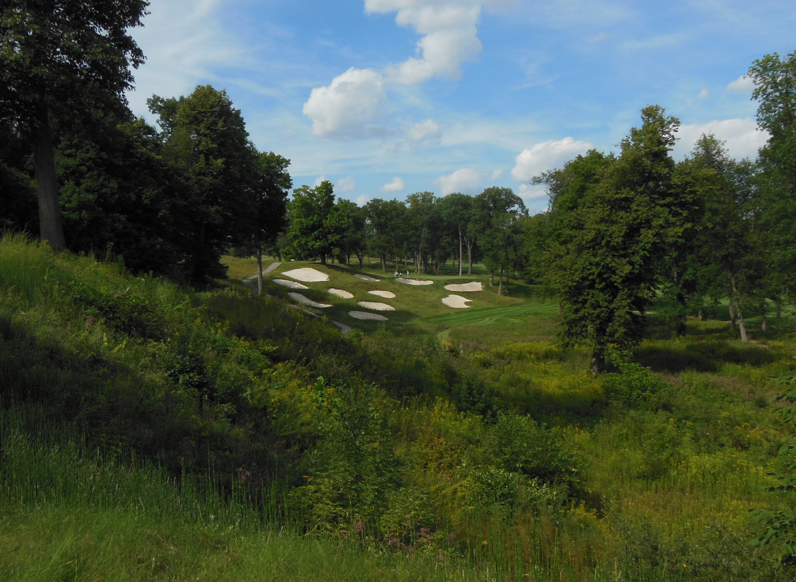
Sustainability in Golf Maintenance and Preparations for Winter 2015
Cale A. Bigelow – Purdue Turf Science

Slide 2
“Sustainability” in simple terms:
We hear a lot about “sustainable energy, sustainable business models, sustainable agriculture, etc.”
What is it really?
In simple terms: Sustainability is defined as “the quality of not being harmful to the environment or depleting natural resources, and thereby supporting long-term ecological balance” (Dictionary.com)
In reality …

Slide 3
“Sustainability” in simple terms:
In reality…“Sustainability” more broadly includes three major inter-related components. The 3 “E’s”:
Environmental protection/Resource conservation
Economic prosperity and continuity
Equity or the social well being

Slide 4
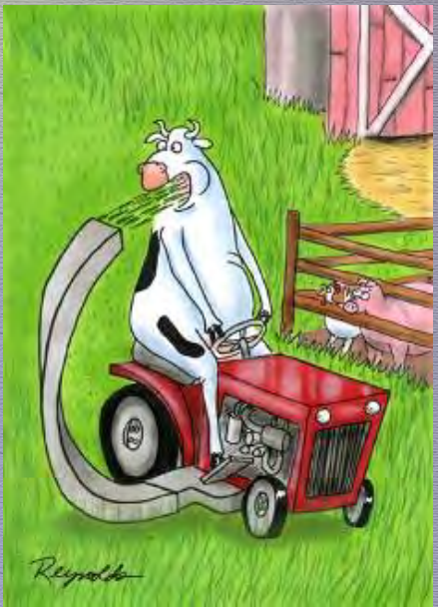
Sustainability Goals?
Resource efficiency
Operational efficiency
Increased/more diverse? Habitats
Improved playability
Appropriate Aesthetic Beauty
Reduced liability for the facility
“Better” working environment/morale

Slide 5
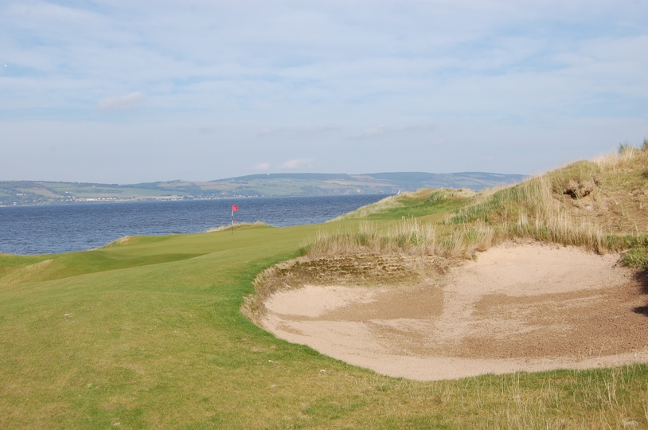
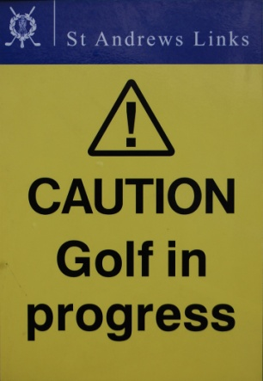
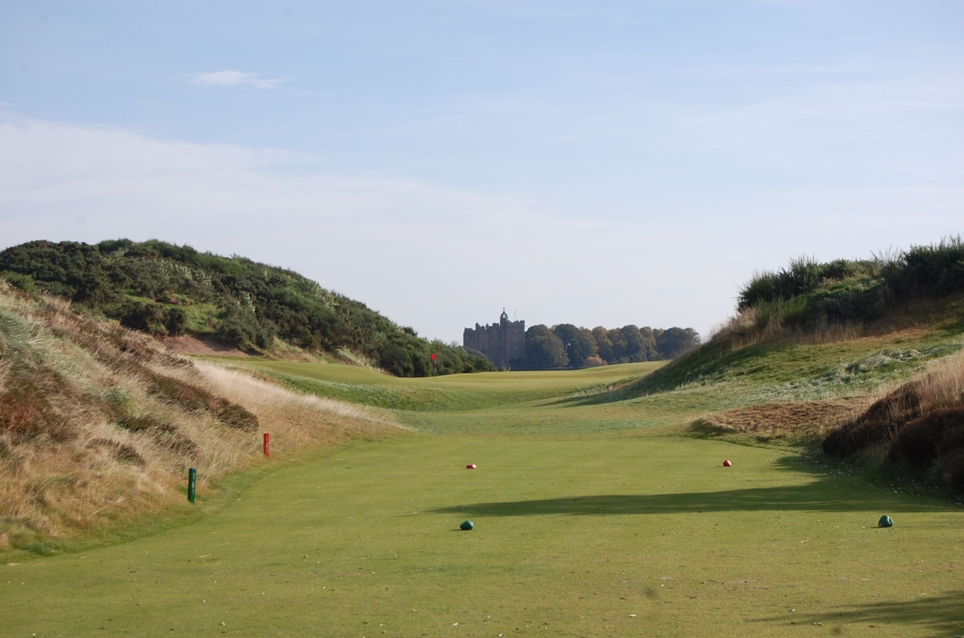
European Golf Turf Management = Reduced Inputs…More “Sustainable”?
5

Slide 6
Alternative and/or Sustainable practices are the ONLY option in some places

Slide 7
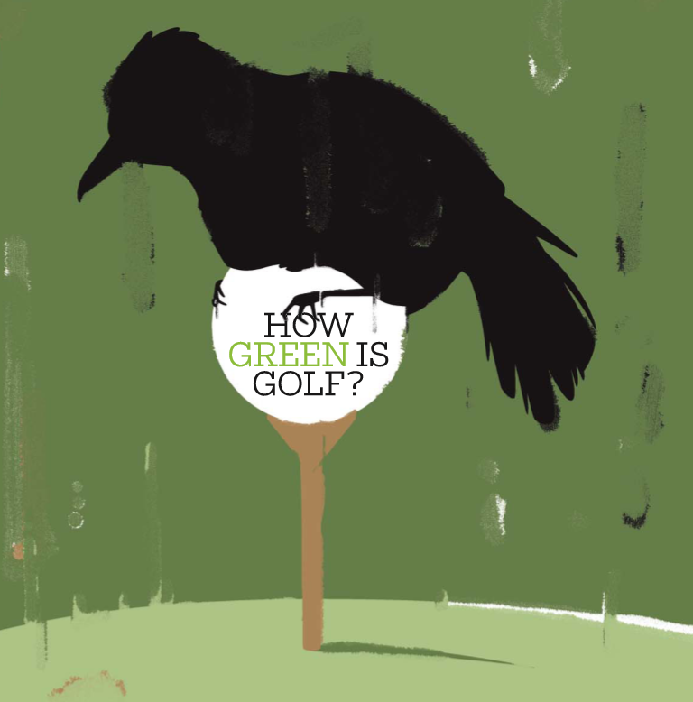
Take a look in the Mirror… How “Green” is Golf in the USA?
John Barton 2008 Golf Digest article

Slide 8
Challenges facing golf maintenance?
Resources and utilization of the resources
WATER!!!
Fertilizers, chemicals, and more…

Slide 9
Take a look in the Mirror… How “Green” is Golf?
Are there things that we can actually do to be better? or more “sustainable” from a 3 “E’s” standpoint?
Are there regulations looming that we need to address or think about today?
John Barton 2008 Golf Digest article

Slide 10
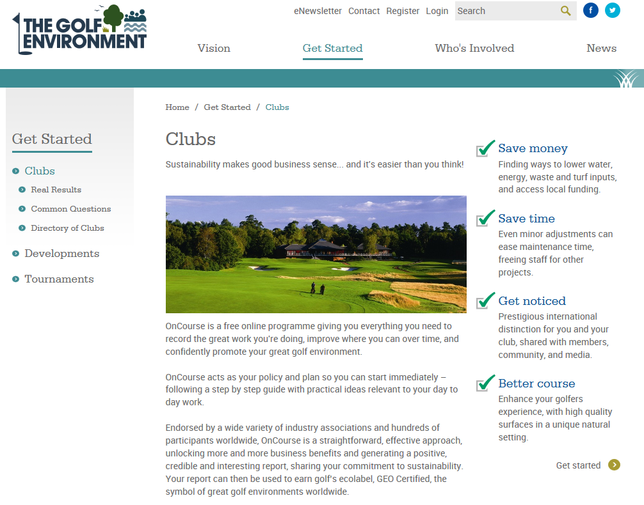
Stewardship/Environmental Accounting Programs?

Slide 11
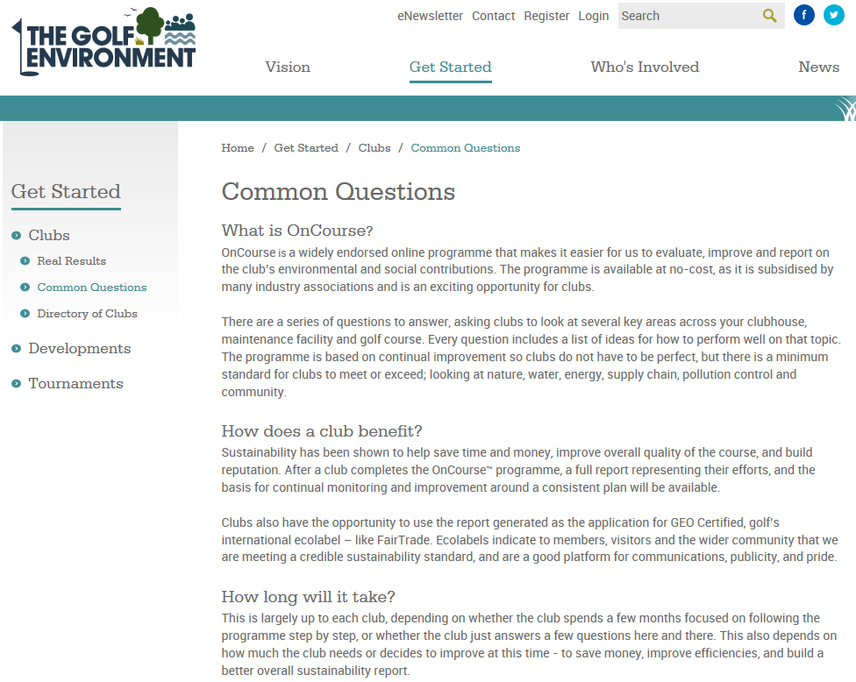
The GEO “OnCourse” Program is one example:

Slide 12
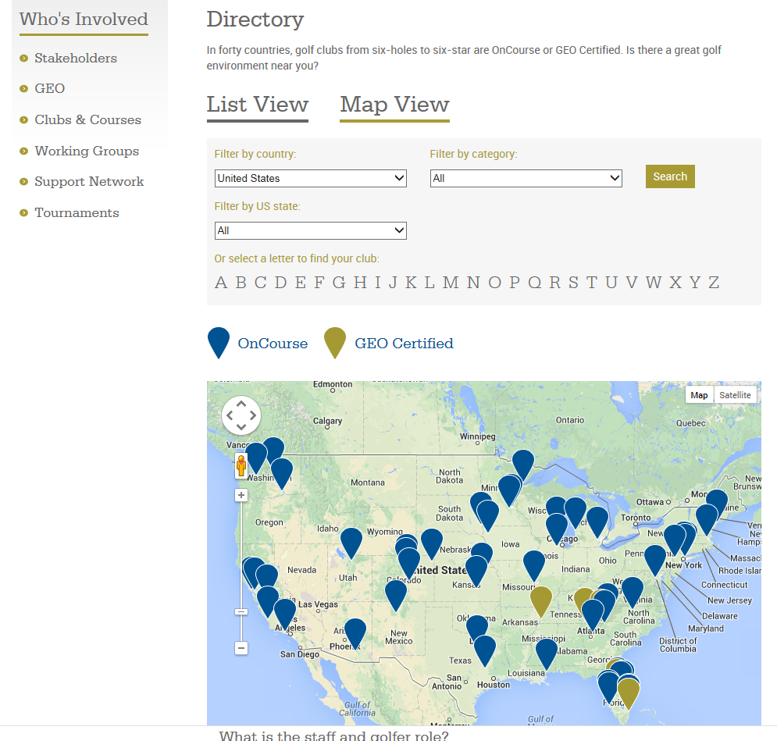

Slide 13
Think about all of your resource inputs…
Are there places you can be more efficient?
What might the benefits actually be from challenging the “Norm”?
John Barton 2008 Golf Digest article

Slide 14
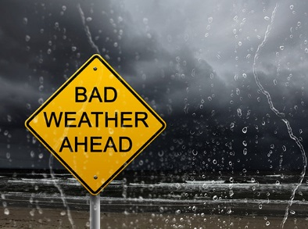
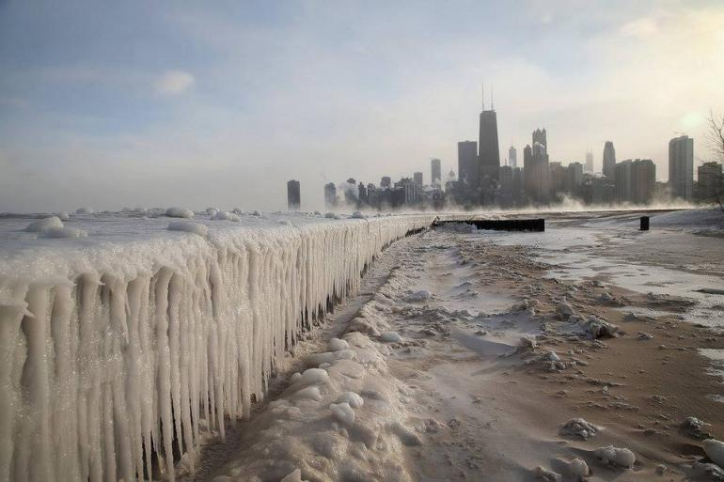
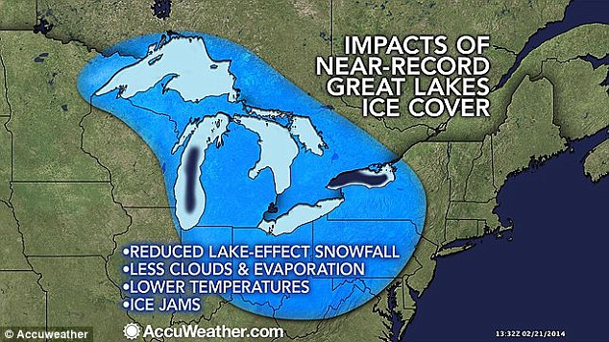
Winter Preparation?

Slide 15
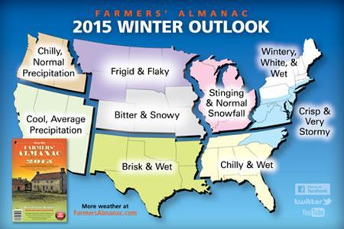
Really??? Not again..

Slide 16
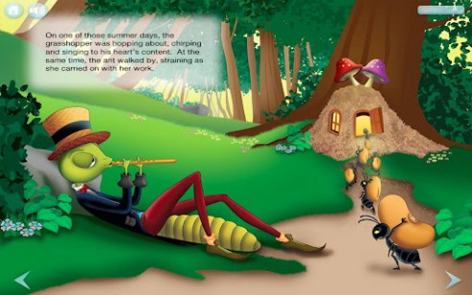
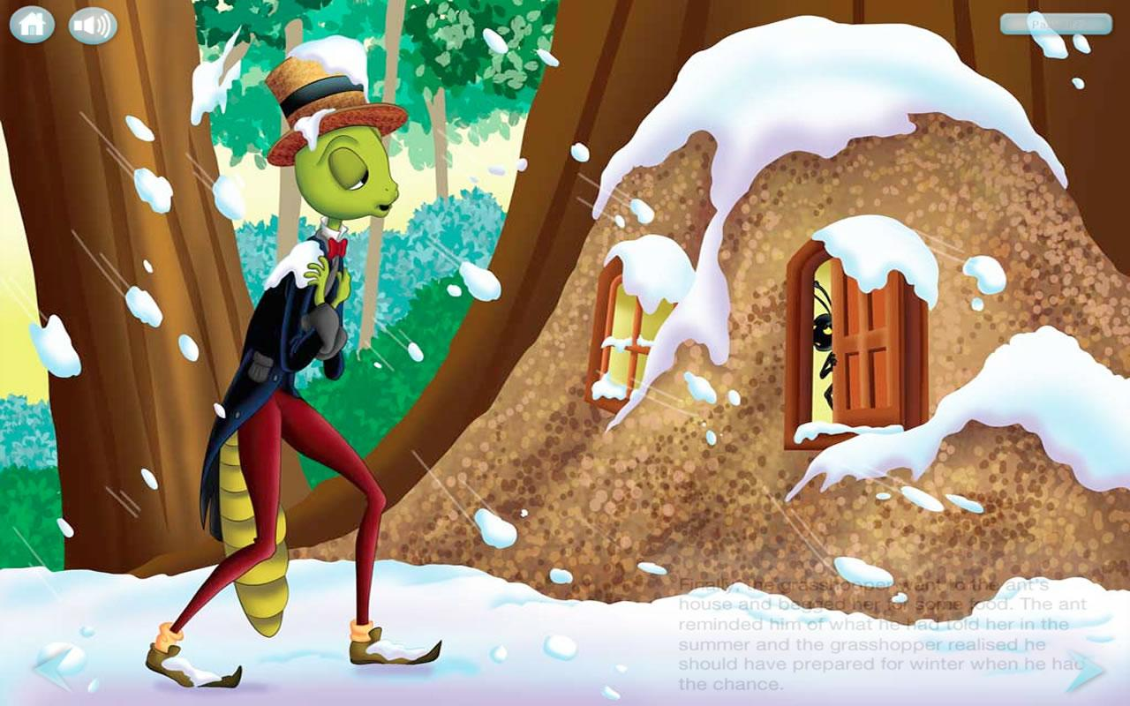
A cautionary tale… “The Grasshopper and the Ant”

Slide 17
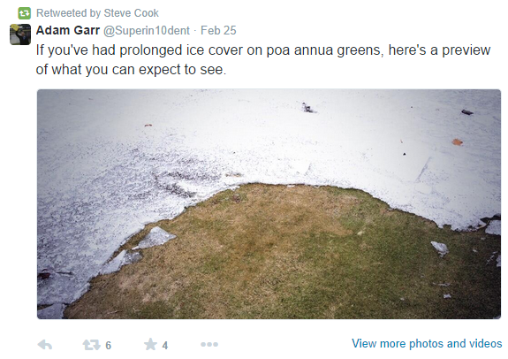
No BIG Secrets: The first step in Preparation is to Have a Plan!
Sometimes our memories are very short…
“What have you done for me lately?”
Is spring 2014 a distant memory?
Go back and take a look at some of your photos from this spring…
What did you learn from the “PolarVortex”?

Slide 18
Many Past and Present Resources from Agronomic Experts to Help you Get Started

Slide 19
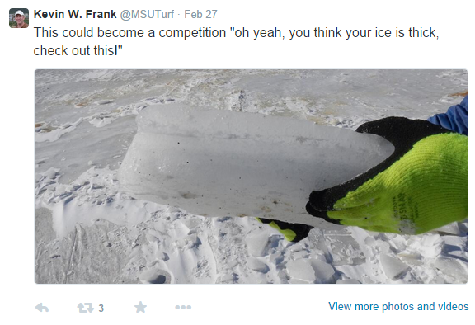
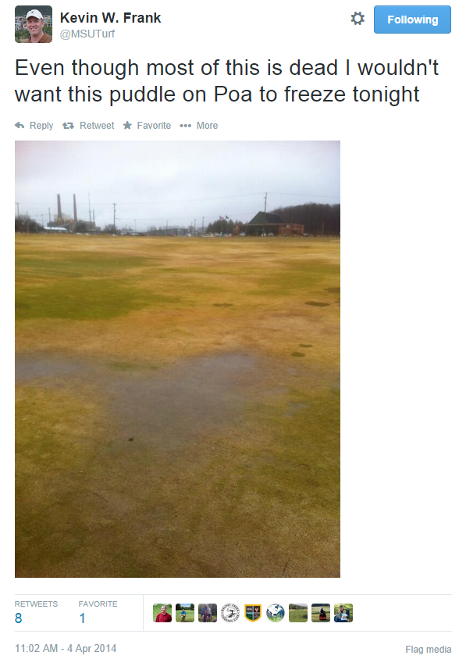
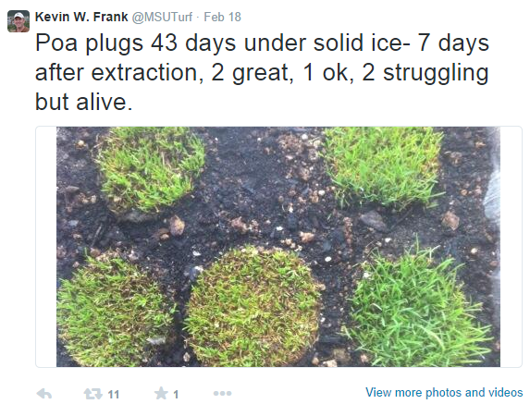
My colleagues a bit further north had a very long early spring…

Slide 20
My colleagues a bit further north had a very long early spring…

Slide 21
Major Reasons for Winter-kill
Growing a species (or cultivar) prone to winter damage
Extended exposure to low temperatures
Wind desiccation
Snow mold damage
Suffocation under ice

Slide 22
How the Plant Prepares for Winter?
Shorter days, Cooler air AND SOIL temps signal the plant to begin acclimation process
Survival?
Its all about the…

Slide 23
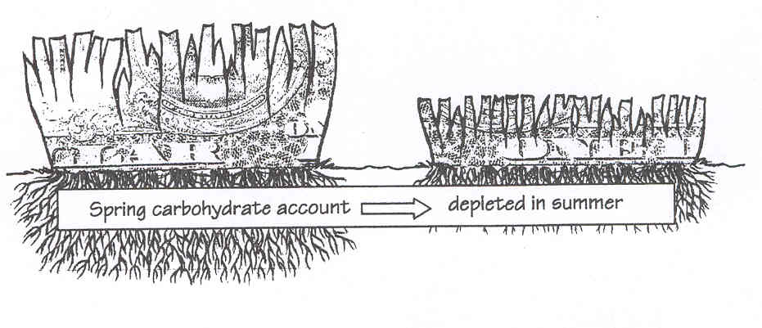
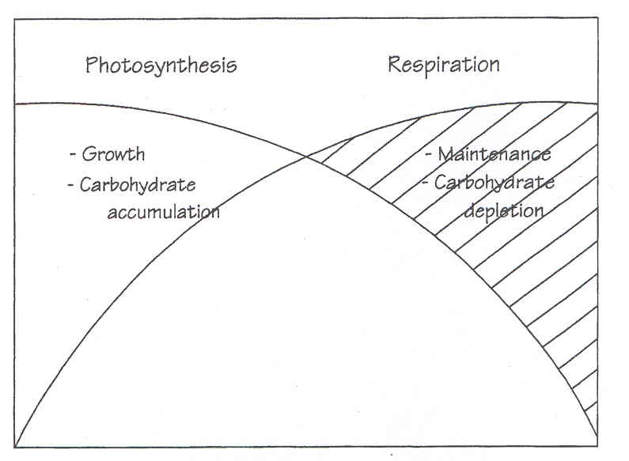
How the Plant Prepares?
Shorter days, Cooler air AND SOIL temps signal the plant to begin acclimation process
Its all about the…
In our case as turf managers its all about the CHOS! or carbohydrates

Slide 24
How the Plant Prepares?
The shorter days and cooler temperatures trigger the winter acclimation processes in plants. Its all about the CHOS! or carbohydrates
A major part of that process involves the accumulation of carbohydrates that are stored in the roots and crown tissues and utilized to protect the cells from the effects of cold temperatures and hydration events. ”HEALTHY PLANTS” will survive

Slide 25
Your Plan: It’s all about the Base
Plants respond to their environment and certainly this time of year prefer to be grown in full sunlight conditions to maximize carbohydrates but…
The soil environment is the foundation of health turf.
Are there any limitations?
Chemical? Or Physical?
When is the last time you conducted a soil evaluation? = testing
Compaction
Seasonal wetness issues

Slide 26
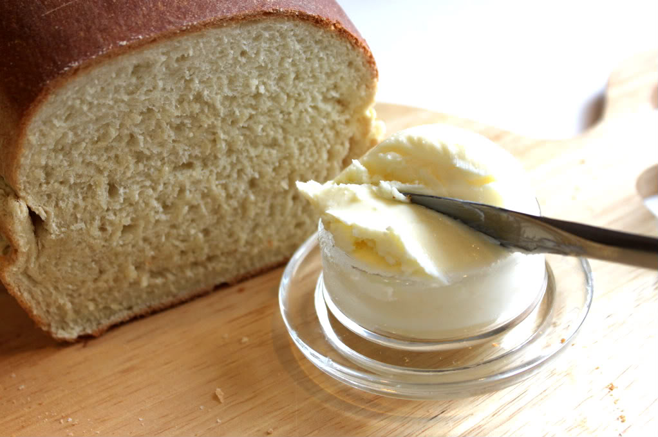
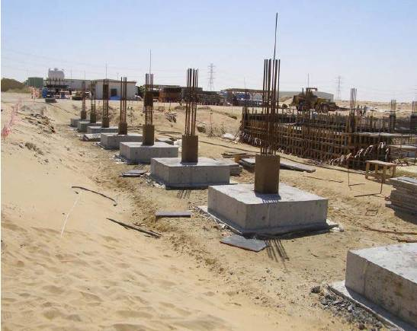
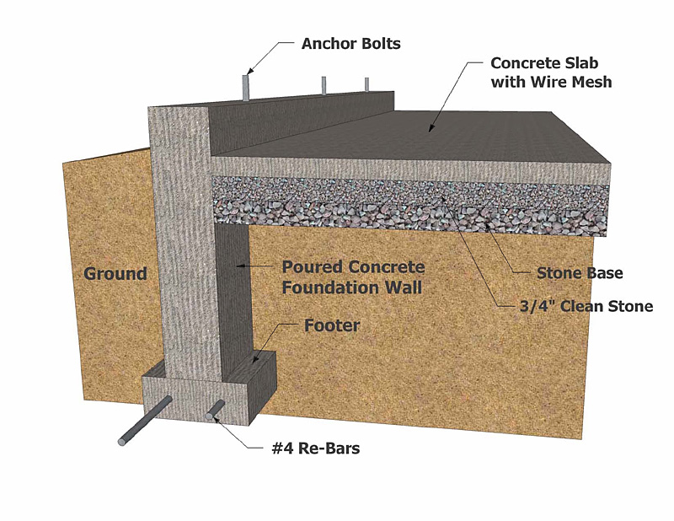
Foundations: Your Bread and Butter
Think
Strong Foundations

Slide 27
Promoting Turf Health: HOW?
Where to start?
Growing environment
Sunlight!!!
Cultural practices, adjustments?
Fundamentals:
Mowing practices
Water management and soil drainage
Fertility
Other:
Coring program?
Sand topdressing?
Pest protection for snow mold?
Covers in Northern climates
AVOID significant mechanical injury issues

Slide 28
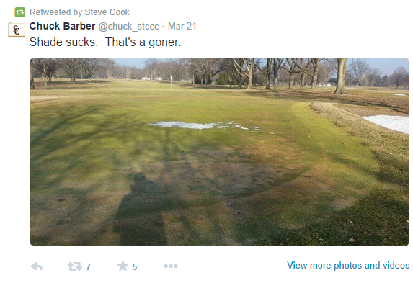
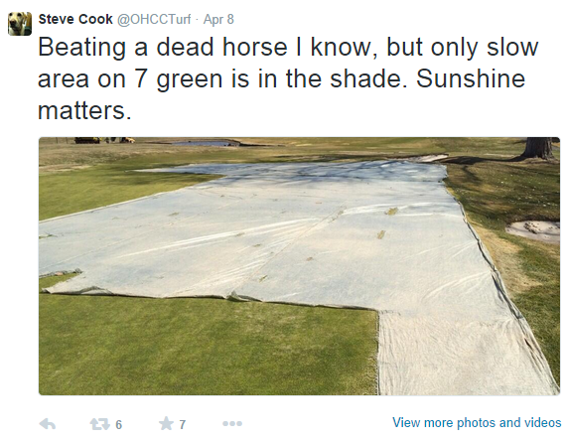
The Growing Environment Matters!

Slide 29
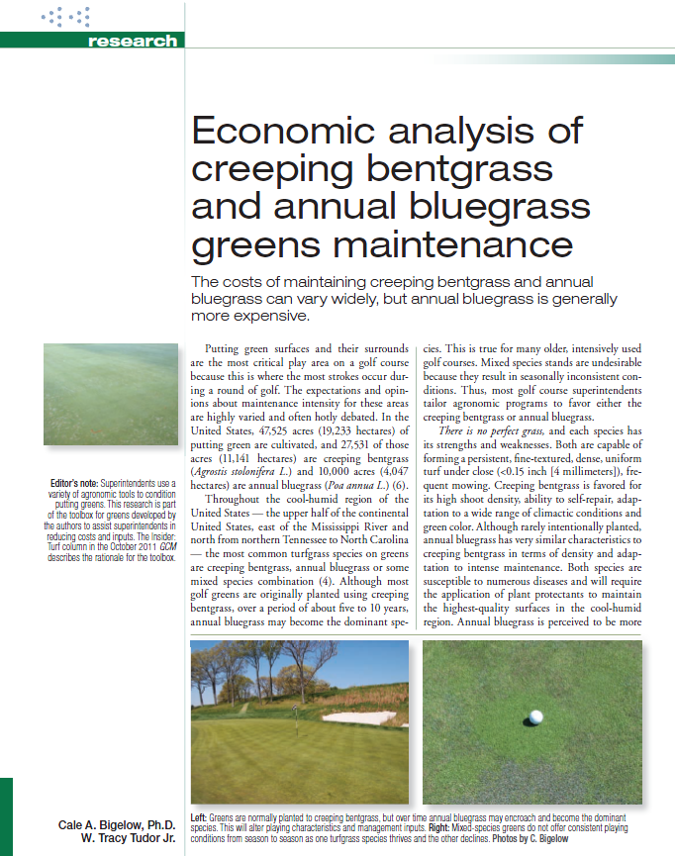
Golf Course Management: Oct. 2012
or
“The Species Matters!!!”

Slide 30
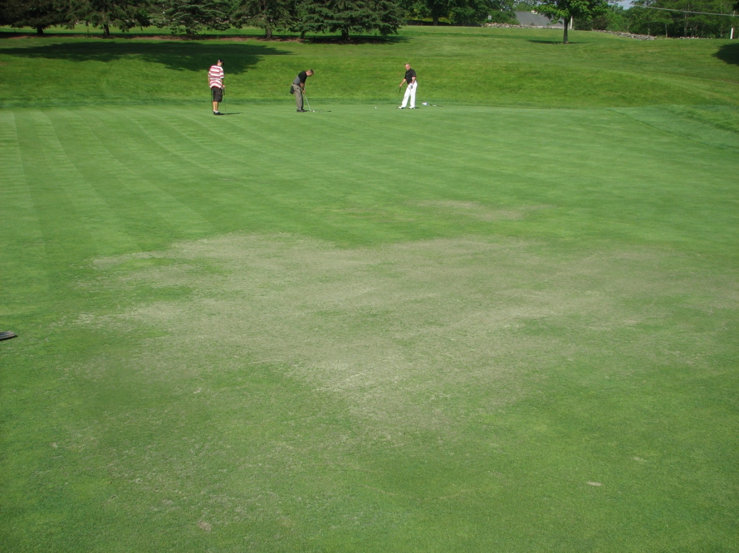
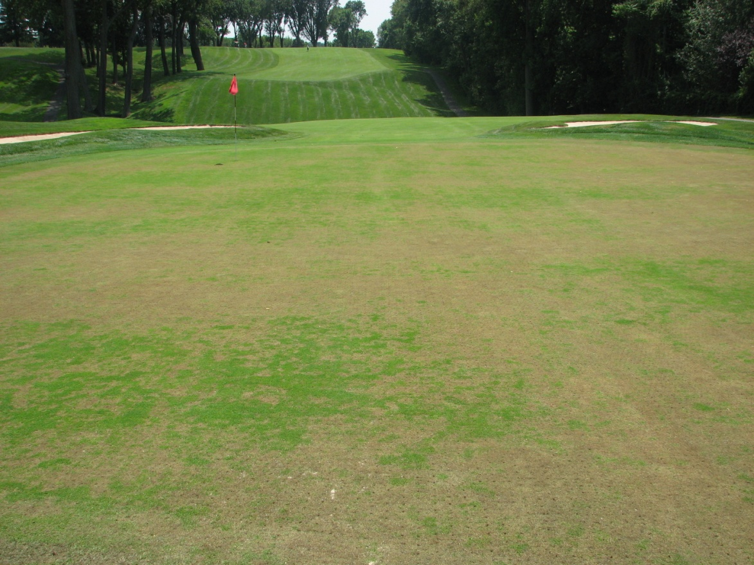
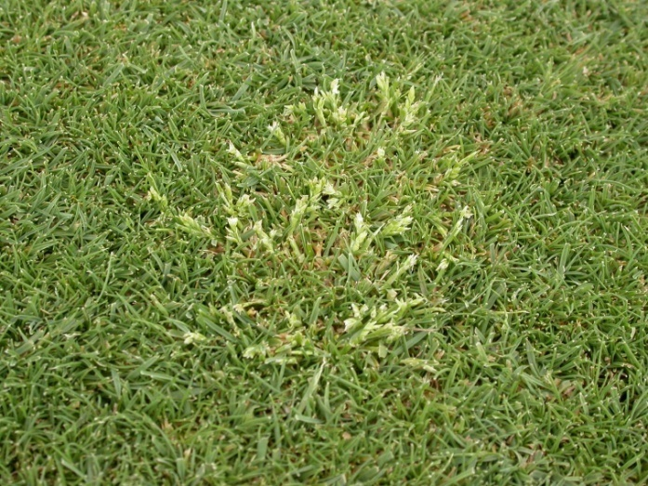
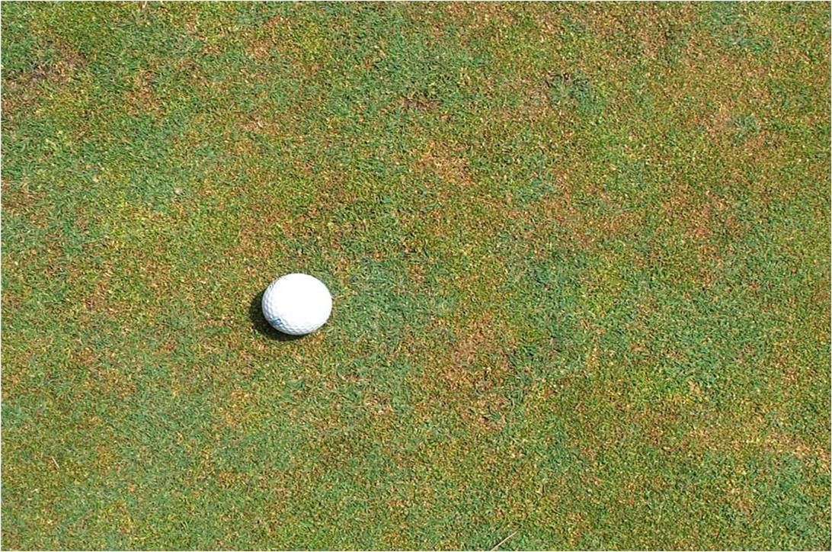
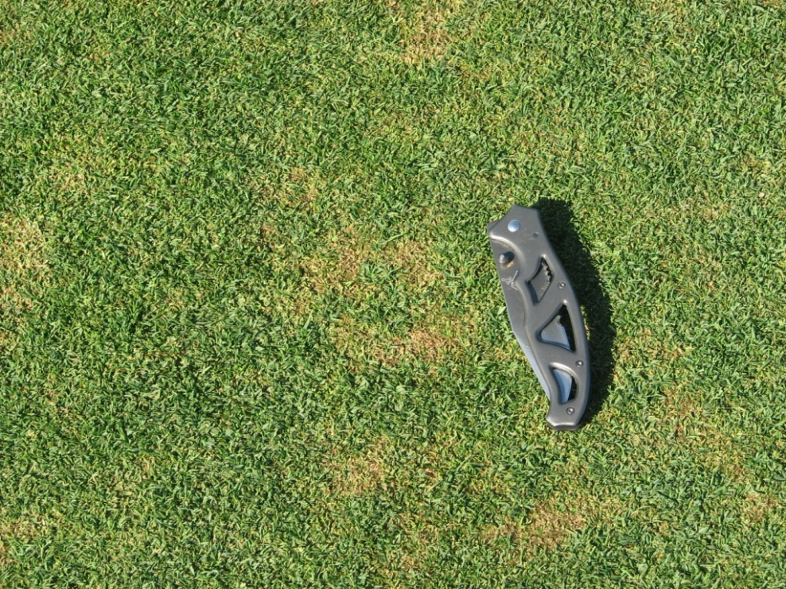
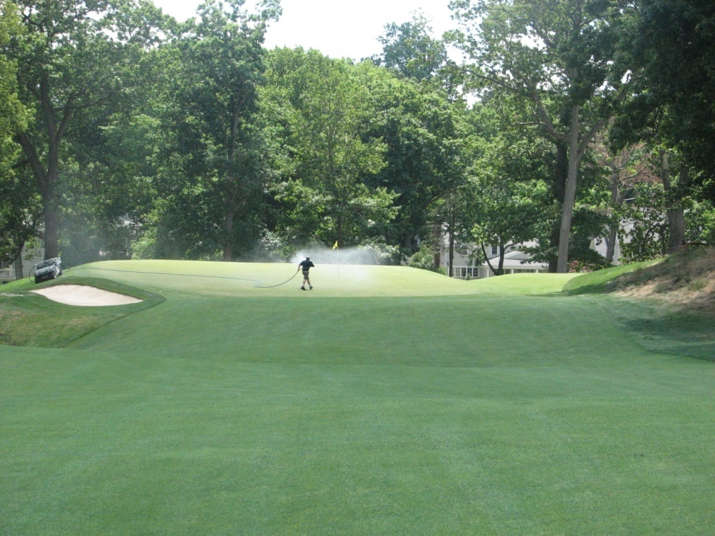
Why ABG?
Summer and Winter Reliability Concerns?
Spring Seedheads
Pest Issues?
Increased Maintenance Expenses?

Slide 31
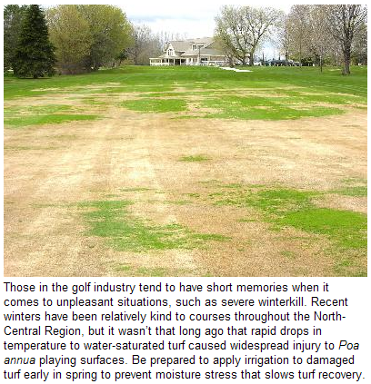
Not Only is Annual Bluegrass a Weaker Species in Summer, but… Winter?
B. Vavrek, USGA Green Section

Slide 32
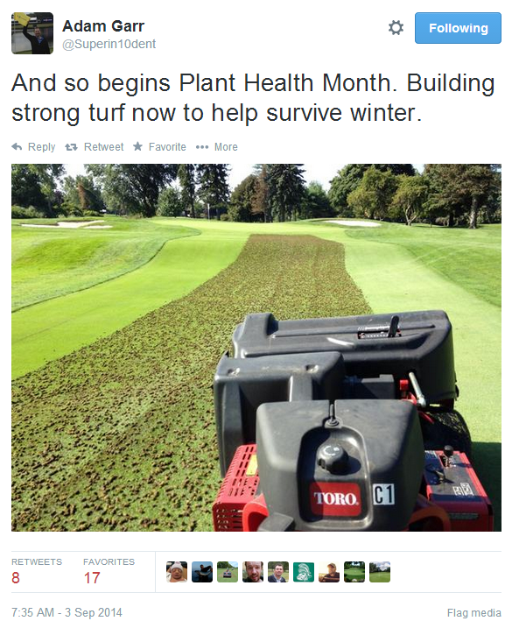
Do what you can NOW to take care of the Soil Environment

Slide 33
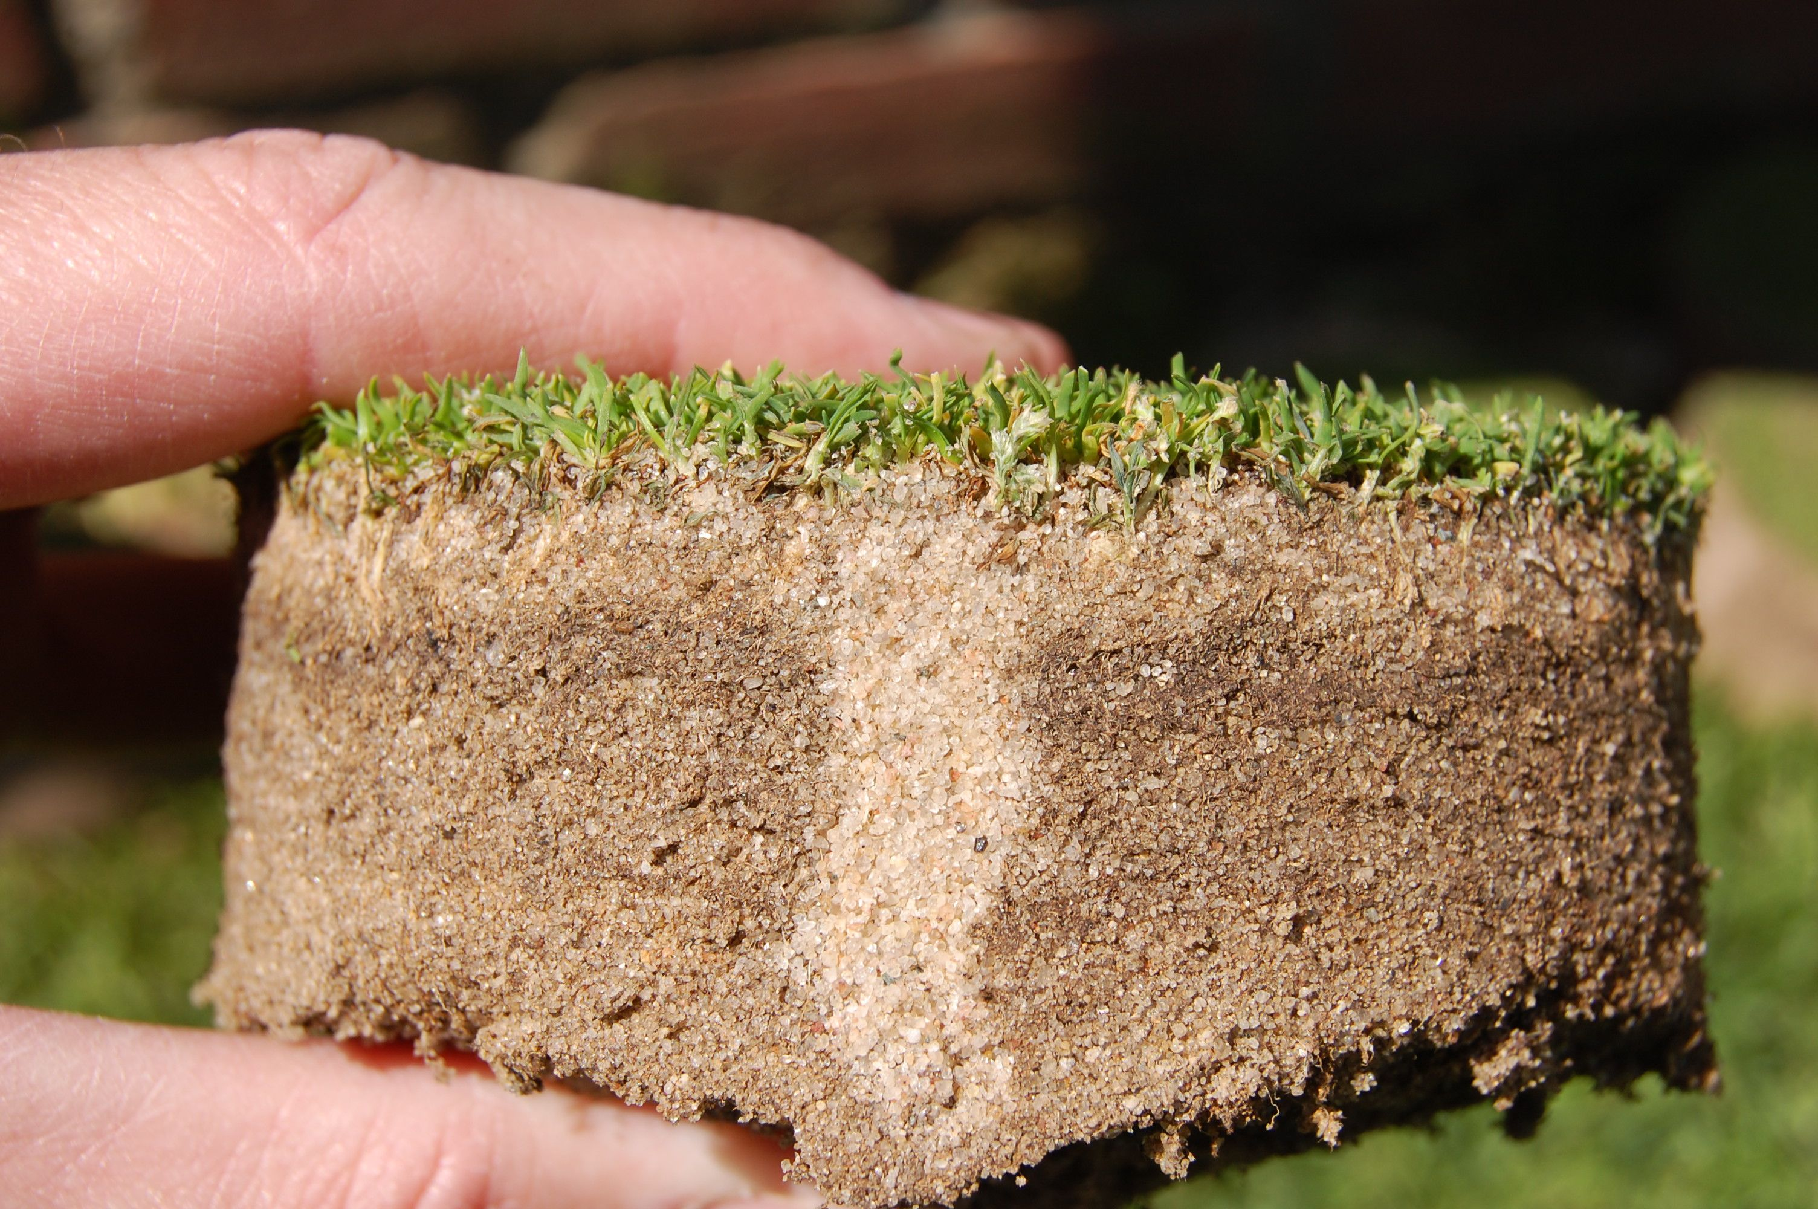
The Rootzone Matters! Plant crowns, or other growing points elevated from the soil/thatch interface are not well buffered from temperature extremes…

Slide 34
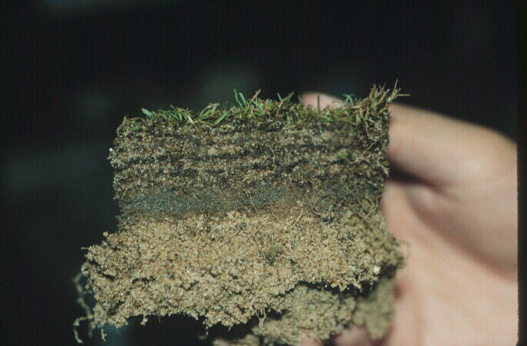
Other Thatch and Drainage Issues Must be Corrected
Excessive thatch and improper topdressing will contribute to layering.
This ultimately will limit the ability of the rootzone to drain/breathe (e.g. in extreme cases make it anoxic).

Slide 35
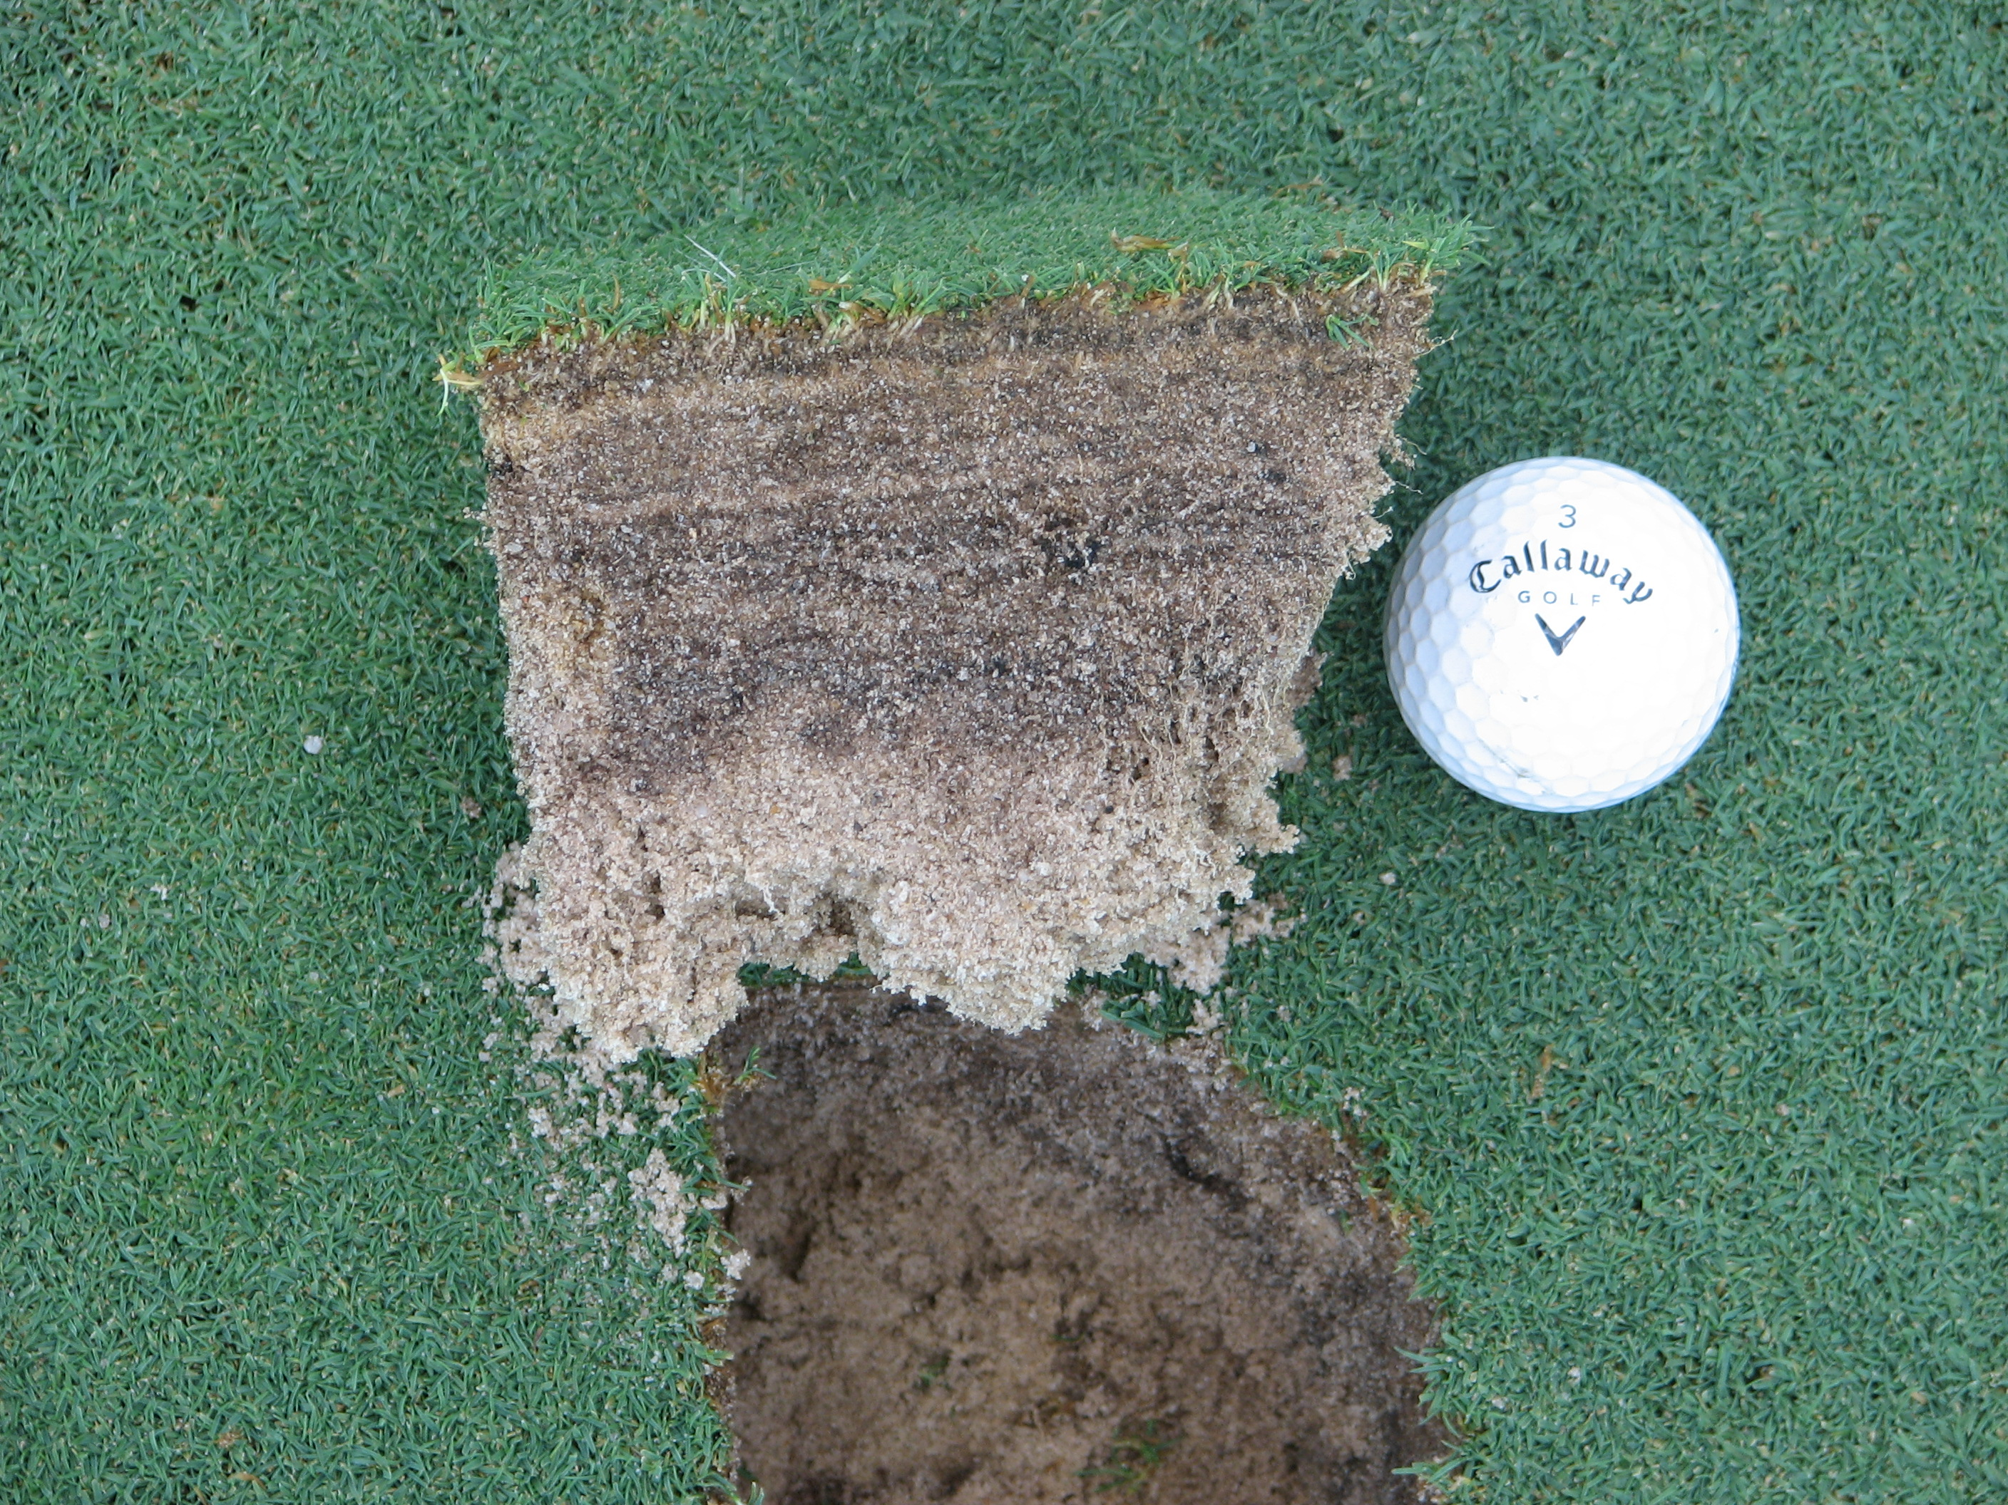
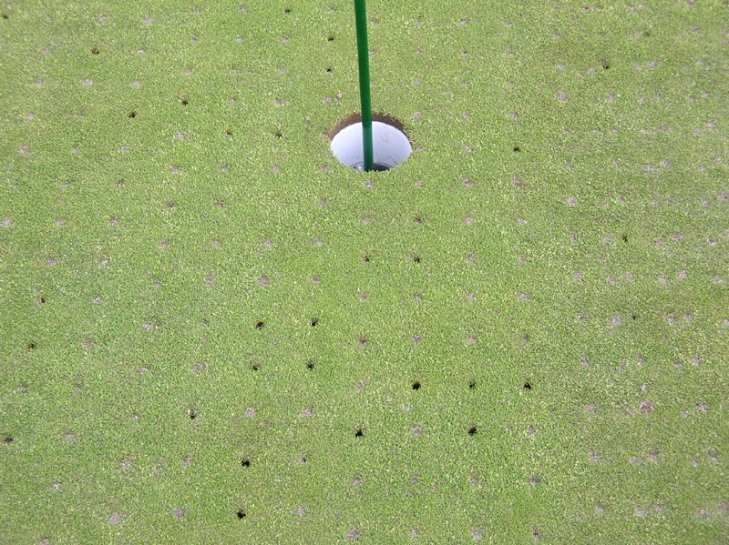
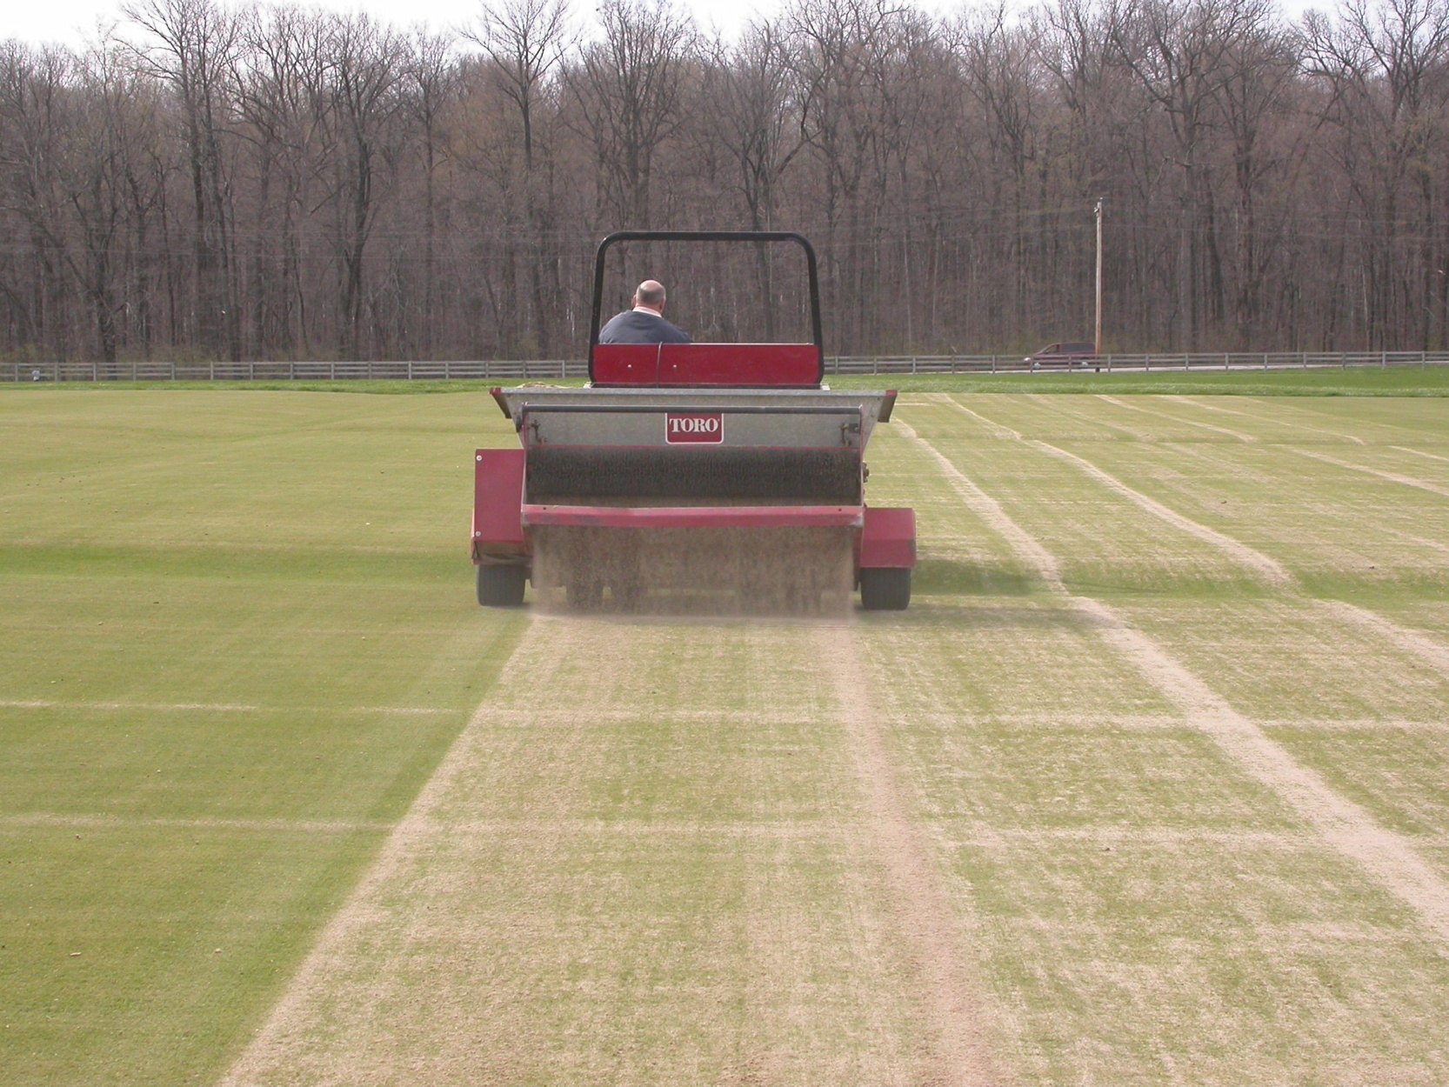
Take home point: Surface Organic Matter MUST be managed!!!
How much? Agronomists suggest targeting about 100-200 pounds of “dry sand”/1000 ft²
***Be aware of application depth and any potential mechanical injury issues (BRUSH/DRAG?)

Slide 36
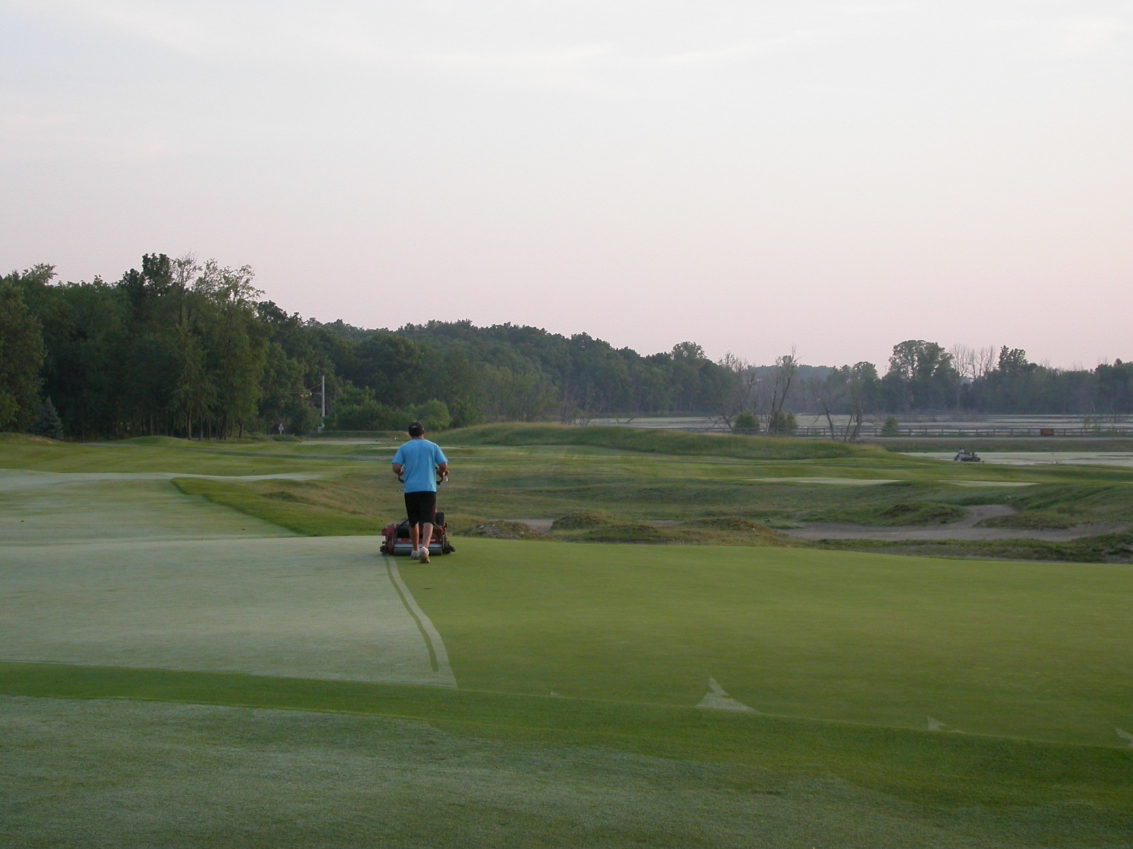
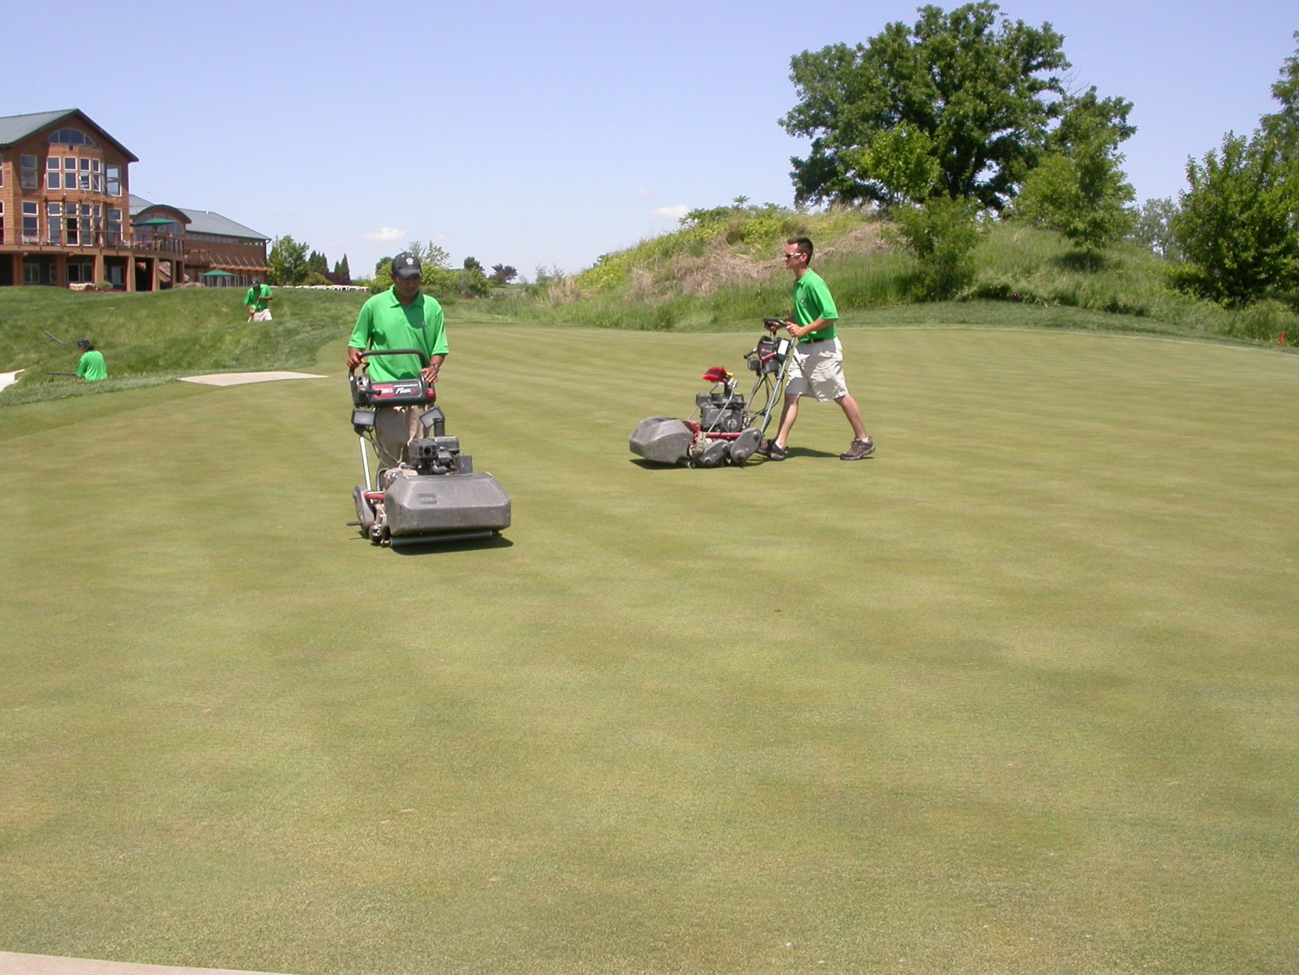
The Most Basic of all Maintenance and Conditioning Practices… How much in fall?
The Double Cut, The Swipe Cut, The Dry Cut and the List goes on….

Slide 37
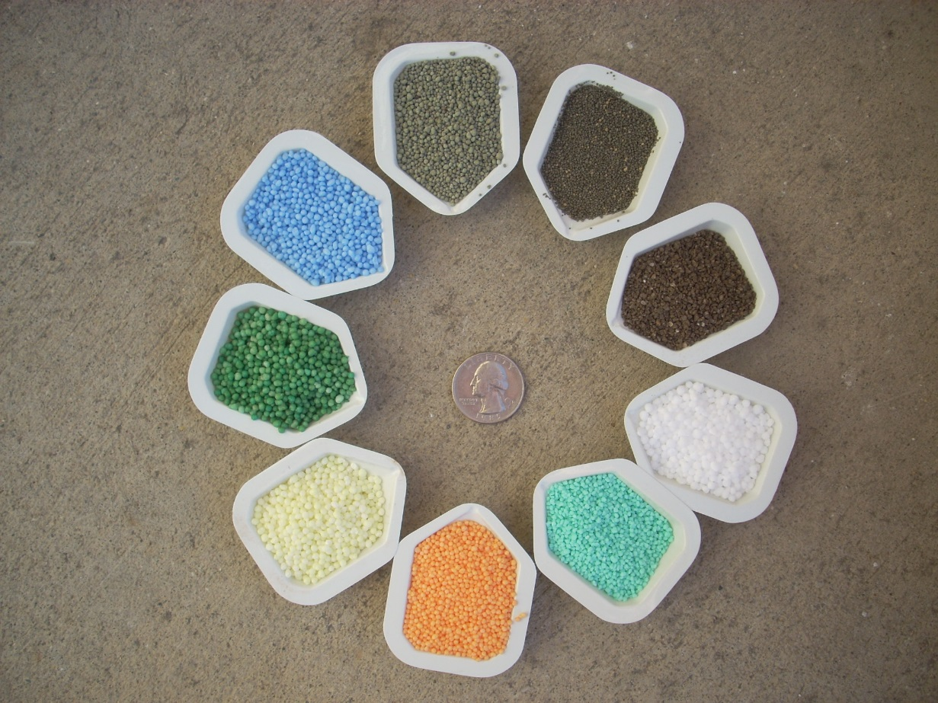
Thoughts on Fertility?
The first answer is YES!!!
The second answer is a bit more complicated… How?

Slide 38
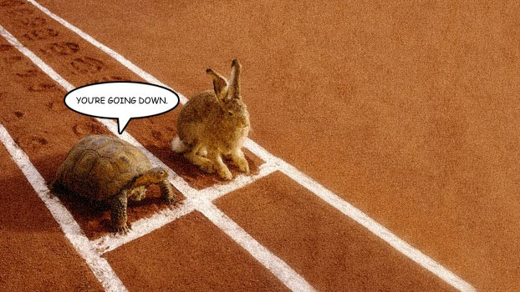
General Fertility Program?
Fall Nitrogen = Yes!!! But how…
Many product options… but your fertility program all begins with nitrogen fertility
This nutrient is the catalyst for uptake of so many other nutrients
Goal: apply nitrogen in a controlled manner to NOT force too much leaf growth and not compromising root growth or carbohydrate storage.

Slide 39
General Fertility Program?
Goal: apply nitrogen in a controlled manner to NOT force too much leaf growth and not compromising root growth or carbohydrate storage.
Light, frequent applications with soluble sources early in the autumn Sept-Oct. then transitioning to careful controlled applications later in the season.
Perhaps moving to a bit more controlled release sources later in the season or very low rates of soluble sources
Application technology???? Granular vs. liquid applications?
Late fall “dormant” applications with controlled release N-sources should not affect the hardening off process.
Ultimately: Remember N fertility should be applied to stimulate and support the CHO reserves (It’s all about the BASE/CHO’s)

Slide 40
General Fertility Program?
In addition to your Nitrogen strategy, what nutrients are already present/absent?
If there are “macro-nutrient” deficiencies (P-K-Ca-Mg-S) these need to be corrected.
Some studies suggest a 1:2 ratio of nitrogen and potassium to improve winter hardiness
But… if soil is not deficient then there is likely no need for excess potassium

Slide 41
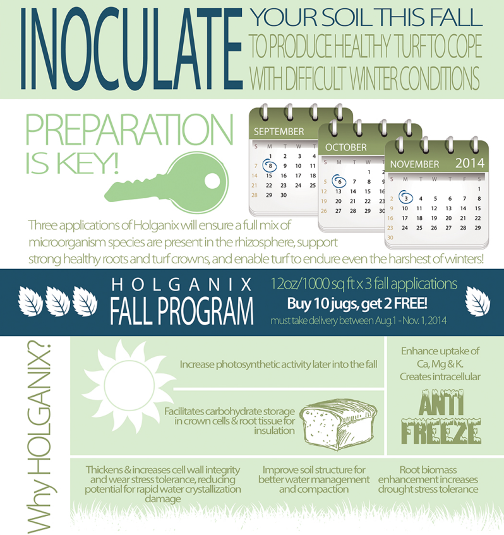
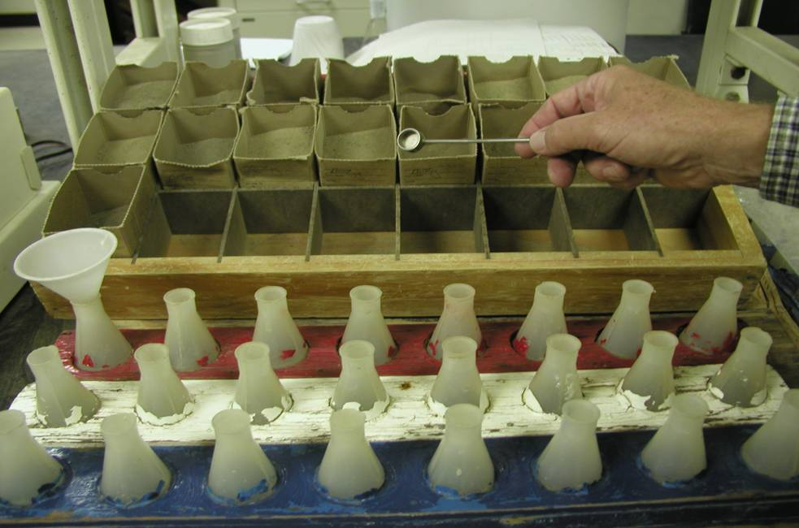
Programs?, Supplements?
It all comes back to ensuring there are no limitations to plant optimum plant health….
Soil testing, the use of soil supplements?

Slide 42
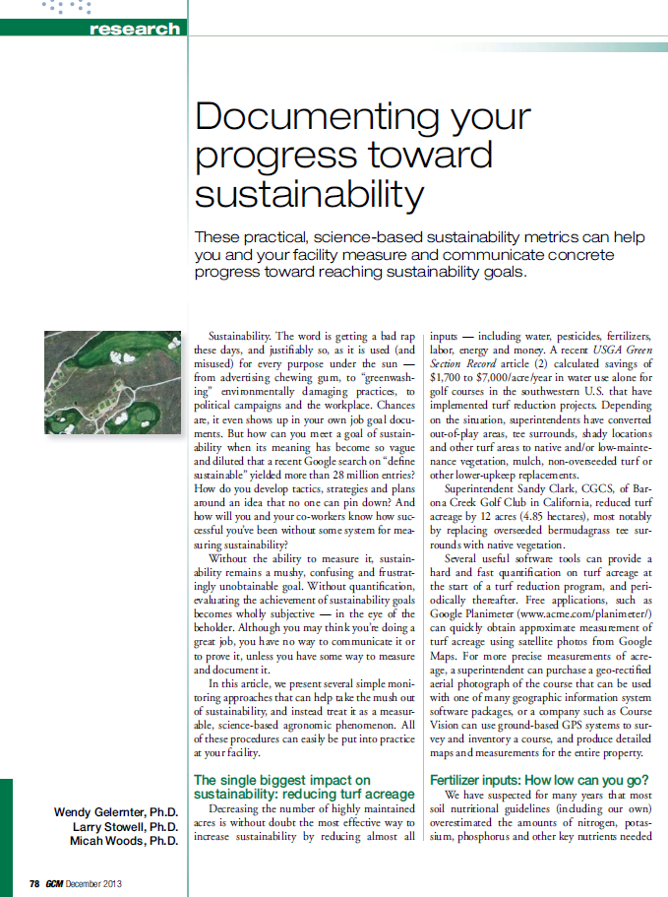
Agronomic Components of Sustainability Equation-Fertility
Note…. As we go toward lower nutrient application goals, the importance of soil biology will likely plays an even larger role in our programs.
We still have A LOT to learn/understand in this area.

Slide 43
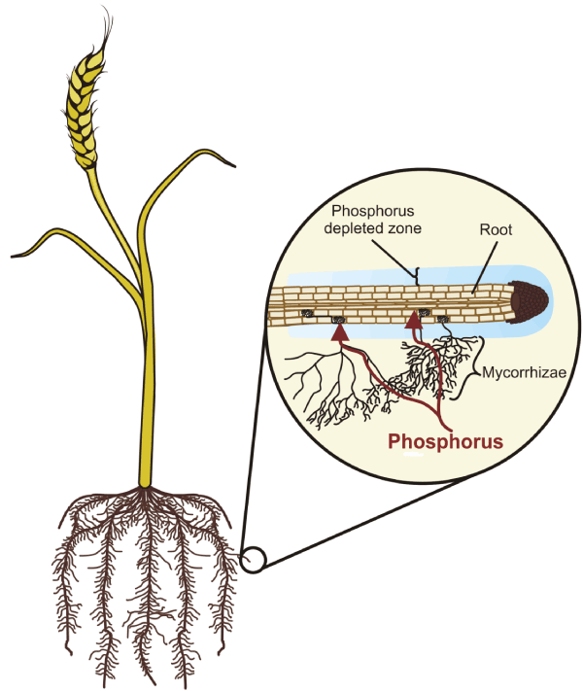
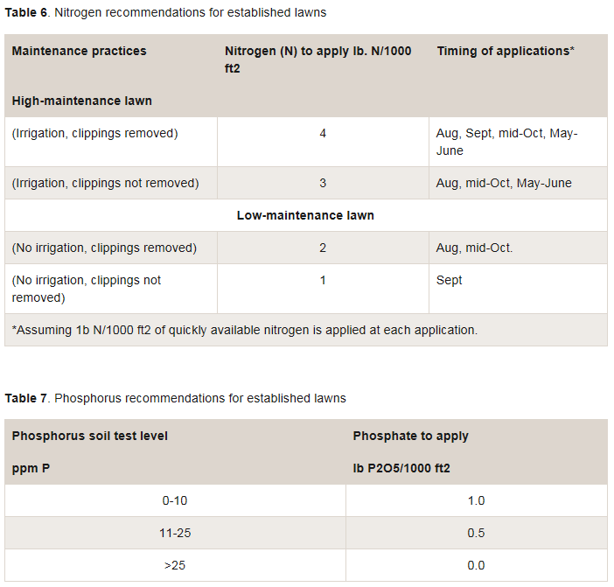
An example: Mycorrhizae and P?
MN (an early zero P state!)

Slide 44
An example: Mycorrhizae and P?
MN (an early zero P state!)
The benefits of mycorrhizae are greatest in P-deficient soils and decrease as soil phosphate levels increase (Schubert & Hayman, 1986).
The benefits of mycorrhizae are greatest when soil phosphorus levels are at or below 50 ppm (50 mg kg -1).

Slide 45
Rethinking Species and Fertilization Practices, “Sustainable Systems”?
Ongoing research with grass and “micro-clover” mixtures???

Slide 46
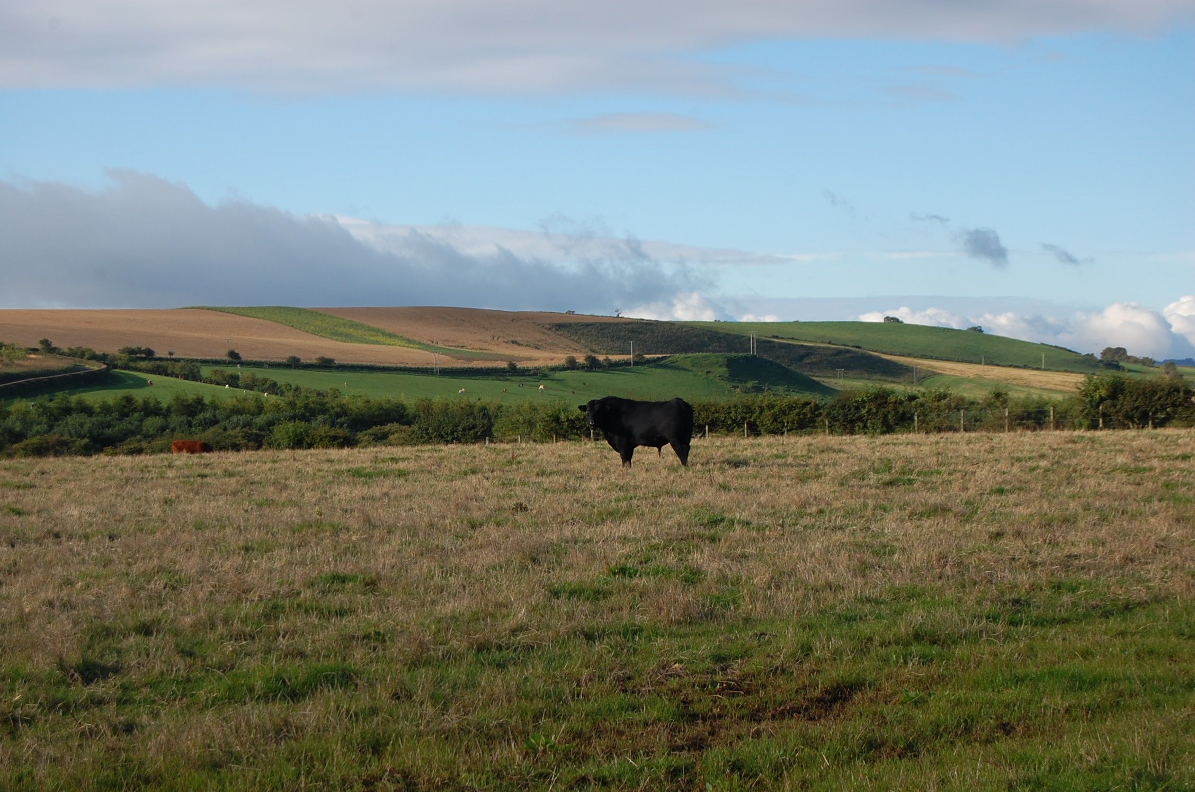
Gratuitous Livestock Image: Black Angus

Slide 47
It’s all about the BASE!

Slide 48
Should you be interested in contacting me to discuss further.
Email: cbigelow@purdue.edu
On “The Twitter”: @BIGTurfTeaching
Thank you….

