Slide 1
Building Your Tree and Shrub
Marketing Campaign

Slide 2
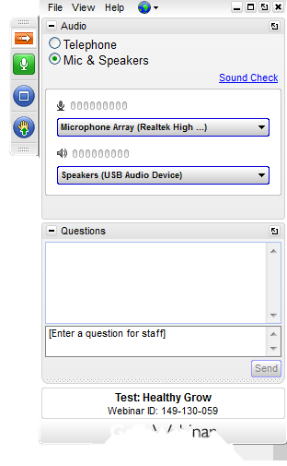
Webinar Semantics
If you have a question, type it here!
Notes:
Insert updated pic

Slide 3
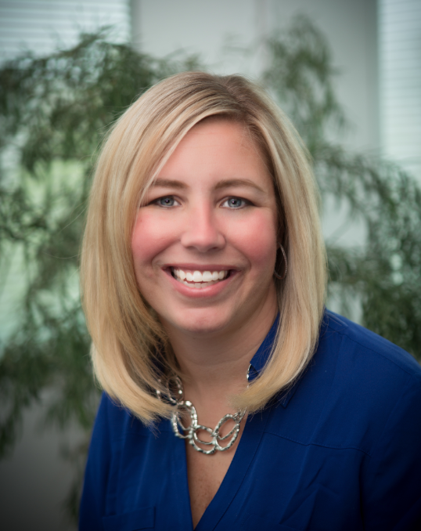
Nicole Wise
Holganix Head of Marketing
Email: Nwise@holganix.com
Phone: 866-56-EARTH ext. 300
Notes:
Insert updated pic

Slide 4
Agenda
Why tree and shrub?
Who’s your audience?
Building your marketing campaign
Marketing campaign timeline
Marketing Tools
Q&A
Audience Polls
Notes:
Insert updated pic

Slide 5
“
Question one: How many of you have attended a marketing webinar?
“
Notes:
These are audience poll questions

Slide 6
“
Question two: How many of you currently offer tree & shrub apps?
“
Notes:
These are audience poll questions

Slide 7
Why
Tree & Shrub?

Slide 8
Average 10 – 30% sign up rate
Notes:
Late spring and early summer is the key time for the Northeast area to market tree and shrub because insects and disease will start to attack! In general, you can expect to have 10 – 30% of your current customers sign up for tree and shrub applications. It’s like new found money!

Slide 9
Who
Is your Audience?
Notes:
Put the logo in

Slide 10
1. Current customers
2. Have they signed up for other services?
Notes:
If they signed up for other services like aeration your know they especially love their lawn

Slide 11
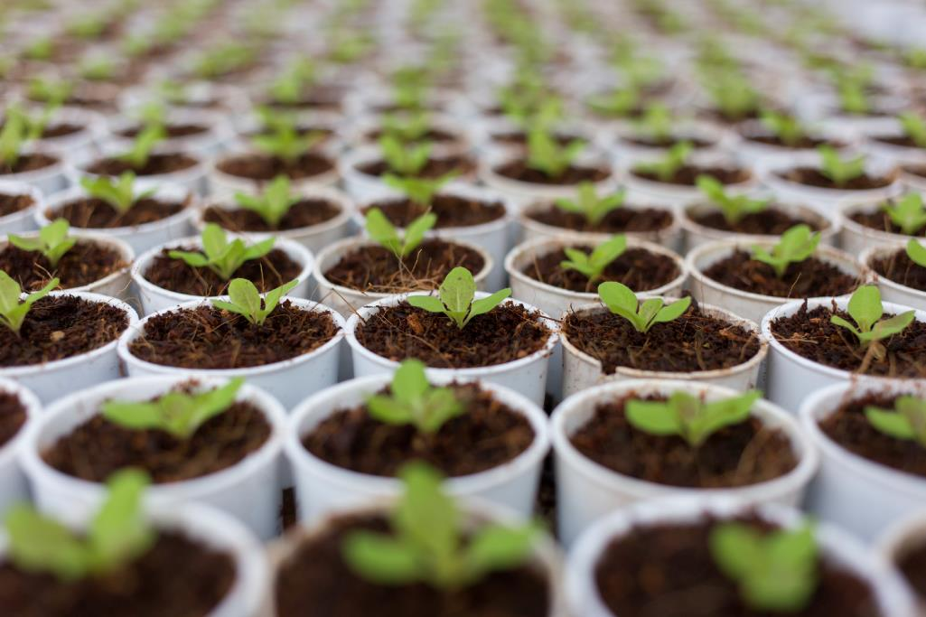
Building a tree & shrub campaign

Slide 12
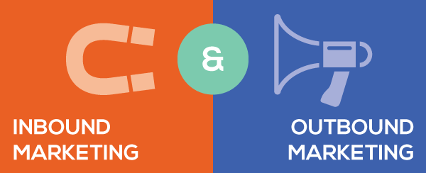
Notes:
The best marketing campaigns include elements of both inbound and outbound marketing campaigns.

Slide 13
Outbound Marketing
Prepays to all customers for remaining balance
Prepays for tree and shrub applications only
Postcard campaign
Personal notes on invoices
Notes:
You can take three different avenues when considering a direct mail route. First, you can send out prepay letters for the remainder of services along with tree and shrub applications to current customers. Another option is to send a prepay letter specifically for tree and shrub applications. And yet a third option is to send out a postcard to current customers.

Slide 14
1. Is your piece remarkable?
2. Keep it simple stupid!
3. Is your offer strong?
Notes:
No matter the direct mail or telemarketing route you decide to pursue, be sure you include an offer to entice your customers to give a tree and shrub program a try. One of our favorite offers is including a free winterizer application.

Slide 15
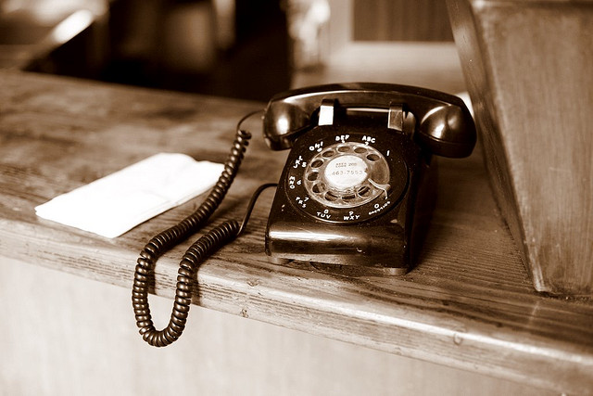
When you follow up with telemarketing, close rates increase.

Slide 16
Inbound Marketing
Email Newsletter
Blog it!
Social Media
Notes:
An ideal marketing campaign for tree and shrub would not just include outbound marketing strategies such as direct mail and telemarketing campaigns, but would contain inbound marketing campaigns as well. Right before mailing your post cards and prepay letters, consider sending an email newsletter or blog post to current customers, highlighting the benefits received from tree and shrub applications. Also consider tweeting and posting two to three times per week, the benefits of tree and shrub applications during your marketing campaign.

Slide 17
“
Question three: Do you have a blog or social media network?
“
Notes:
These are audience poll questions

Slide 18
Educate don’t sell
Act like you’re at a cocktail party

Slide 19
Campaign
Timeline

Slide 20
 | Direct Mail Piece | Telemarket | Email Newsletter | Blog | Social Media
Week 1 | x |  |  |  | x
Week 2 |  | x |  | x | x
Week 3 |  |  | x |  | x
Week 4 | x |  |  | x | x
Week 5 |  | x |  |  | x
Week 6 |  |  |  | x | x
Week 7 |  |  |  |  | x
Notes:
Sample marketing campaign timeline

Slide 21
Marketing
Tools

Slide 22
Recommended Tools
Holganix postcard, video, informational pieces
MyEmma.com
Automated Social Media
Tree and Shrub facts
Notes:
Marketing tools will be mailed out after webinar
Never done an email marketing campaign? Click here for tips then check out MyEmma – an email marketing platform that includes tons of tracking information to help monitor your ROI. Need some inspiration with which to craft your fabulous email newsletter blog or social media post? Check out these key benefits to tree and shrub programs from the x university.
Automated social media: http://www.razorsocial.com/social-media-automation/
Tree and shrub facts: http://www.bachmans.com/Garden-Care/divHomePage.html

Slide 23
Notes:
Marketing tools will be mailed out after webinar
Automated social media: http://www.razorsocial.com/social-media-automation/
Never done an email marketing campaign? Click here for tips then check out MyEmma – an email marketing platform that includes tons of tracking information to help monitor your ROI. Need some inspiration with which to craft your fabulous email newsletter blog or social media post? Check out these key benefits to tree and shrub programs from the x university.
Tree and shrub facts: http://www.bachmans.com/Garden-Care/divHomePage.html

Slide 24
Notes:
Marketing tools will be mailed out after webinar
Automated social media: http://www.razorsocial.com/social-media-automation/
Never done an email marketing campaign? Click here for tips then check out MyEmma – an email marketing platform that includes tons of tracking information to help monitor your ROI. Need some inspiration with which to craft your fabulous email newsletter blog or social media post? Check out these key benefits to tree and shrub programs from the x university.
Tree and shrub facts: http://www.bachmans.com/Garden-Care/divHomePage.html

Slide 25
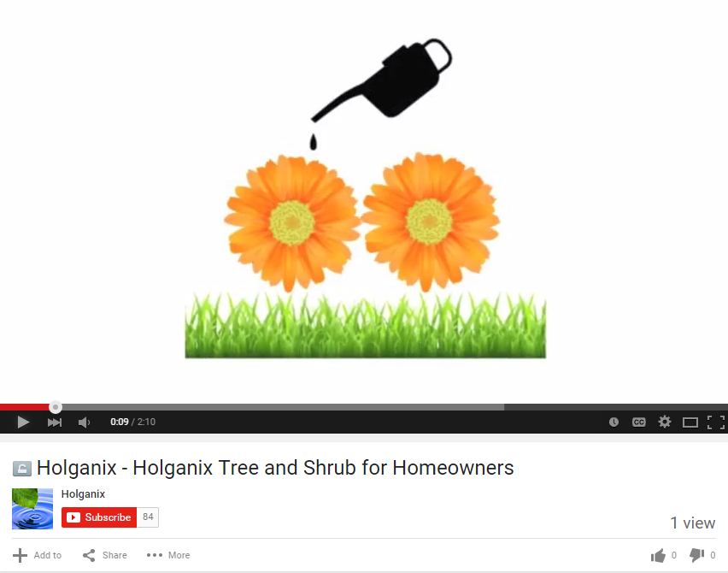

Slide 26
Audience Questions:
Type your questions in the Chat Box!

Slide 27
Conclusion
Please take our survey!
Look for a follow up email with:
A recorded version of this webinar
Resources and information mentioned during the webinar

Slide 28
Nicole Wise
Email: Nwise@holganix.com
Phone: 866-56-EARTH ext. 300
Suzanne Longacre
Email: Slongacre@holganix.com
Phone: 866-56-EARTH ext. 212
Notes:
Insert updated pic

