Slide 1
GeBBS Healthcare Solutions

Slide 2
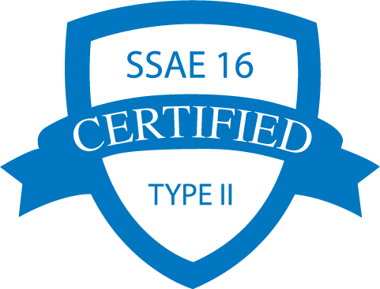
Why is GeBBS Unique?
Comprehensive
Solution
Portfolio
Rigorous
Compliance &
Security
Proprietary
Technology & Analytics
Service Delivery Leadership
Global
Footprint
Deep Domain
Expertise
Code/audit over 5 million charts monthly
Largest pool of AAPC and AHIMA certified coders
HQ in Los Angeles, CA
Global footprint – 6 locations in 3 countries
4,000+ employees
Notes:
What makes GeBBS Healthcare Solutions uniquely positioned to help your organization in the face of these pain points?
Here are several of the GeBBS differentiators in overview, which we will elaborate on during this presentation:
GeBBS delivers a comprehensive solution portfolio with end-to-end customizable Revenue Cycle Management solutions.
Our proprietary workflow and analytic technology solutions are built to industry standards so that we have unique advantages for our
clients.
The global footprint extends not just from our Los Angeles-area headquarters, but also with flexibility from US and global delivery centers
employing over 4,000 professionals.
Our staff has deep domain expertise and service delivery leadership coming from diverse healthcare organizations and specialties. This
includes for example GeBBS investing tens to hundreds of thousands of dollars making sure our coders are and maintain their AAPC
and AHIMA certifications.
We have rigorous compliance and security in place. This includes HIPAA compliance with SSAE 16 Type II security of PHI, data,
network, hardware/software, and physical infrastructure.

Slide 3
Comprehensive RCM Solution Portfolio
Patient Contact
Services
Health
Information
Management
Patient Accounting Services and Call Center Support
FlexCode
Flexible Medical Coding
Self-Pay Soft Collections
Technology
&
People
Insurance & Benefits Eligibility
Coding and Documentation Auditing
Clinical Documentation Improvement
Revenue Cycle
Management
Extended Business Office
Accounts Receivable
Denial Management
Credit Balance Resolution
Notes:
GeBBS has a broad portfolio of capabilities, technology and engagement models. This portfolio spans across the spectrum of hospitals, physicians and specialties delivering an end-to-end portfolio of solutions that offer a breadth of options that provide you a single destination for your RCM needs.
It serves all aspects of HIM, RCM and patient access. Our clients can use all of our solutions or a la carte, which are supported by our proprietary technology and highly-skilled staff of over 4,000 professionals globally.
HIM solutions include coding and coding audit across facility and pro fee settings, along with CDI services.
RCM solutions include medical billing for charge entry, payment posting, accounts receivable, and denial management. We also offer credit balance resolution solutions.
Patient access solutions support our clients’ patients with the ability to increase customer satisfaction and collections simultaneously. The services provided include inbound and outbound call center support and insurance eligibility verification.
With every client engagement, we will assess what the client needs are to our portfolio of solutions, including what tools, technology and human capital deployment model are in place to best support the client needs and budgets. The objective is to curate the best solution for our customers.

Slide 4
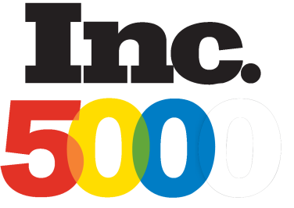
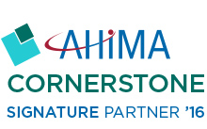
Awards & Memberships
America’s Fastest Growing Private Companies
2009 – 2010 – 2011 – 2012 – 2013 – 2014 – 2015 -- 2016
Ranked in top 20 for outsourced RCM in three categories by Black Book Market Research 2015
Ranked in top 20 for outsourced RCM in three categories
Hospital Managed Systems
Hospitals Over 150 Beds
Hospitals Under 150 Beds
Corporate Membership
Notes:
We have received numerous accolades including being an eight-time Inc. 5000 fastest growing private company, customer rankings in the
top 20 for outsourced RCM in Black Book, and one of 2016’s most respected global outsourcing companies.
We have invested in and are active participants in numerous healthcare organizations, including AHIMA where we are a cornerstone
signature partner – the second highest level partnership possible. We are deeply involved at leadership meetings, CDI activities, billing
and coding meetings, along with over 25 trade shows annually.

Slide 5
Customizable
Coding Audit Software
Compliance Program Management
Claims Data Aggregation
Audit Workflow and Operations Management
Dashboards and Business Analytics
Notes:
Comprehensive SaaS solution for medical code auditing. With in-built workflow, management dashboard, scorecards, and robust reporting, it optimizes and accelerates the coding audit process. For hospitals and providers, it improves overall coding quality and compliance while providing the ability to access audited and scored records for education, review and process improvements. Based on OIG audit methodology and AHIMA’s best practices standards, it supports accurate and compliant coding.

Slide 6
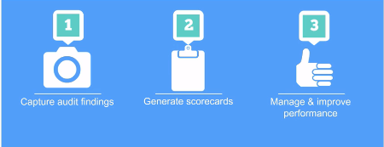
Compliance Program Management
Benefits
Fully customizable
Secure, cloud-based solution
Auto sample selection
Workflow management
Dashboards and reporting
Trend & variance analysis
Notes:
Compliance Program Management
Fully customizable to meet your needs
Secure, cloud-based solution
Audit Review Options
Customized Audit: Selects any records associated with user-defined criteria for a customized review
Focused Audit: Designed to flag and select specific charts that are higher risk for immediate review
Statistically Valid Audit: GeBBS proprietary algorithm provides the optimal method for compliance audits
Comprehensive Audit: Pulls a percentage of charts coded over a selected period of time by chart type, and by coder to get an on-going overview for areas of concern using a more extensive data set.

Slide 7
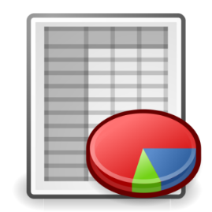
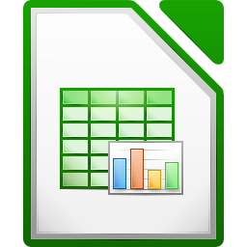
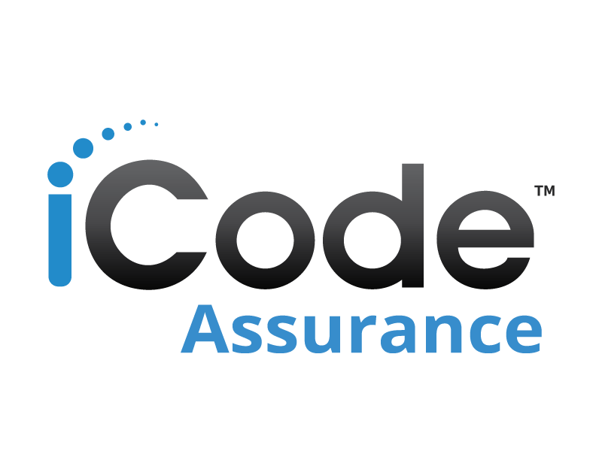
Claims Data Aggregation
Charts
Spreadsheets
NextGen
Allscripts
Greenway
Physician
Cerner
Epic
MEDITECH
Hospital
Clinic
Notes:
Audit Workflow

Slide 8
Audit Workflow & Operations Management
Compliance
Program
Feedback & Education
Sample Selection
Batch Allocation
Auditing
Dashboards & Reporting
Production Monitoring
Notes:
Audit Workflow

Slide 9
Operations Management/Production
Benefits
Manage all of your audits in a single location
Facility Inpatient
Facility Outpatient
Professional Fee
Works with existing EHR and coding platforms
Dashboards and Business Analytics
Benefits
Interactive audit dashboards
Easy-to-view performance reports
Provides revenue impact
Enables benchmarking
Report Options
Provider accuracy
Coder accuracy
Facility accuracy
Revenue variance
Documentation improvement
Notes:
Operations Management/Production

Slide 10
National Healthcare System
System Overview
5 hospitals
75 coders
300 providers
Coding & Documentation Quality Review Program
Coder Quality Reviews
GeBBS conducts monthly coding audits of NHS coders
GeBBS conducts monthly QA on global coding support
Annual Provider Compliance Quality Reviews
GeBBS conducts annual provider audits
Quarterly Focused Audits
Notes:
Operations Management/Production

Slide 11
Customizable set-up
Notes:
Operations Management/Production

Slide 12
Sample Selection & Audit Batch Creation
Notes:
Operations Management/Production

Slide 13
Audit Workflow Management
Notes:
Operations Management/Production

Slide 14
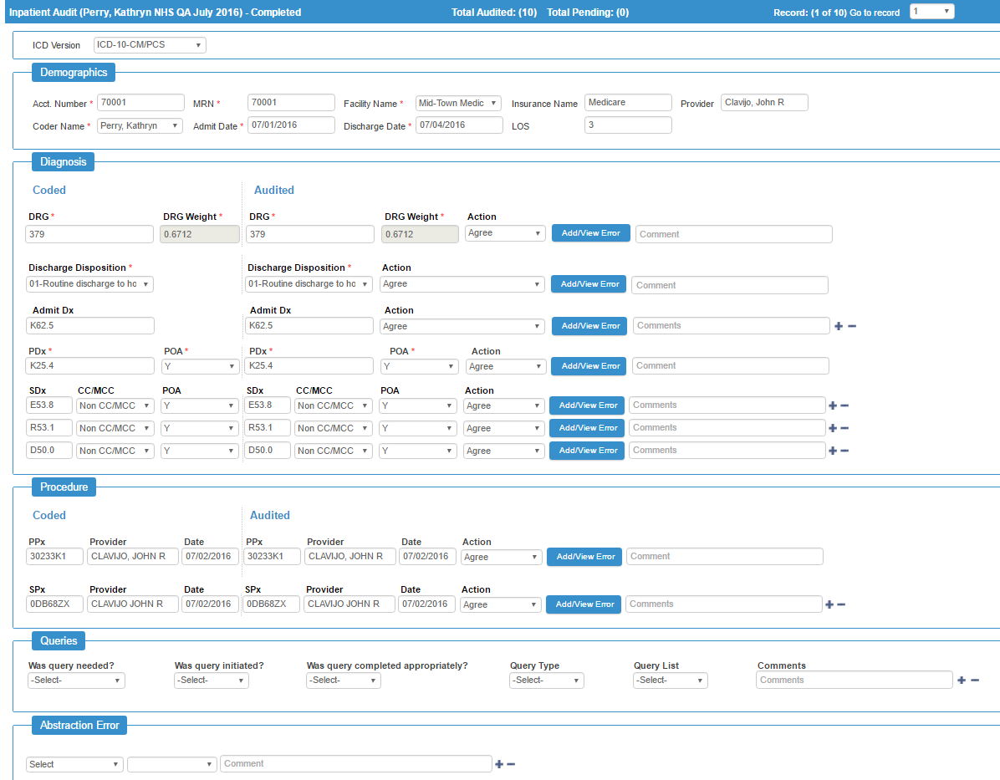

Slide 15
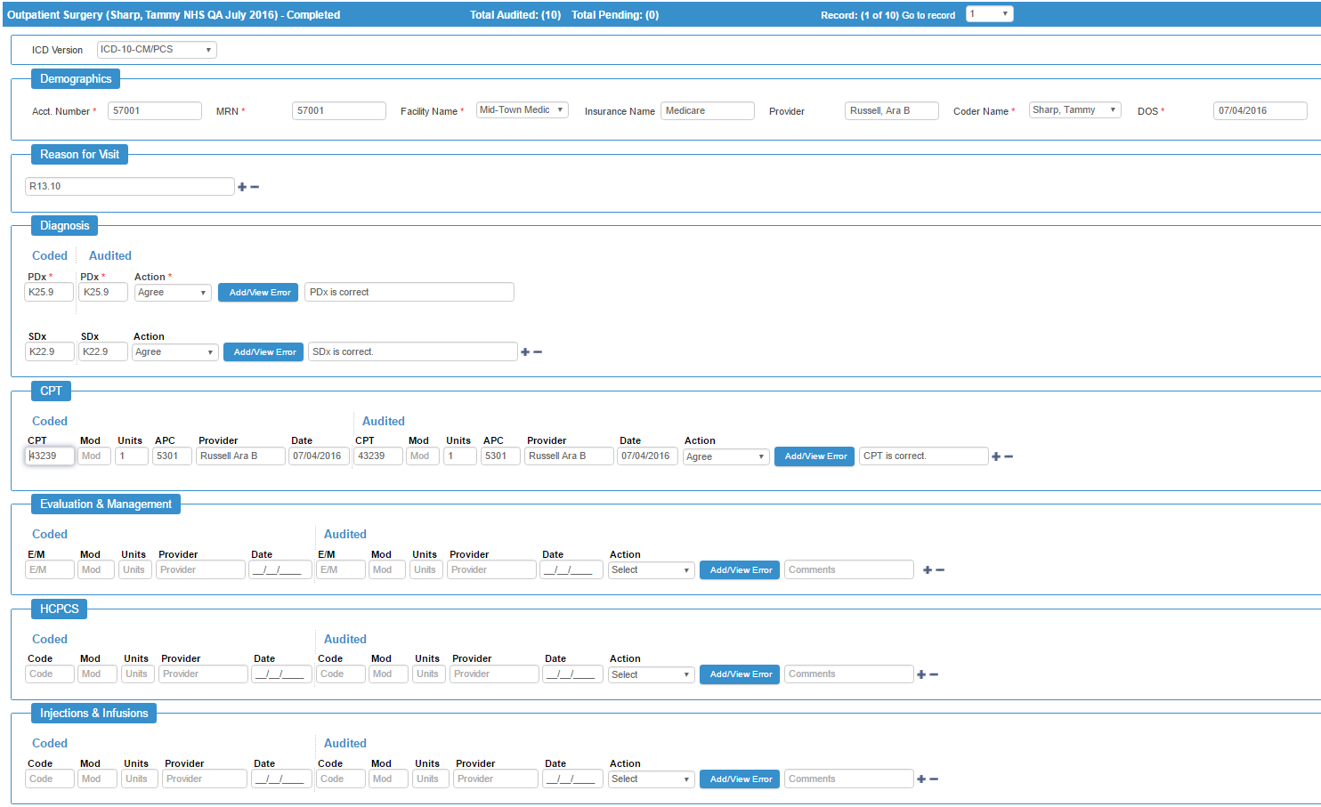

Slide 16
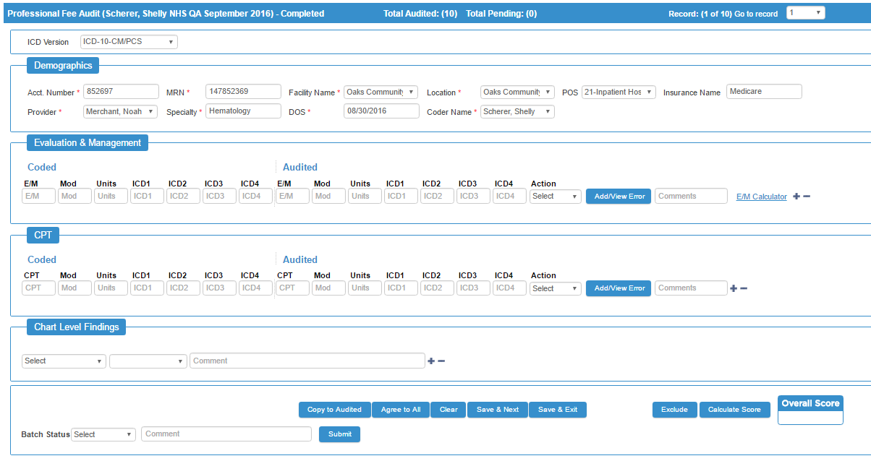

Slide 17
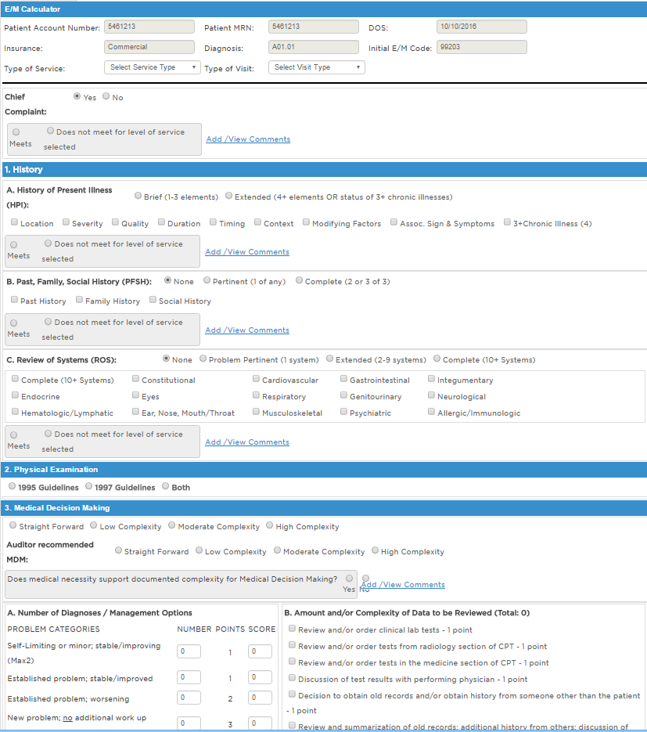
Audit Workflow Management – Professional E/M Calculator
Notes:
Operations Management/Production

Slide 18
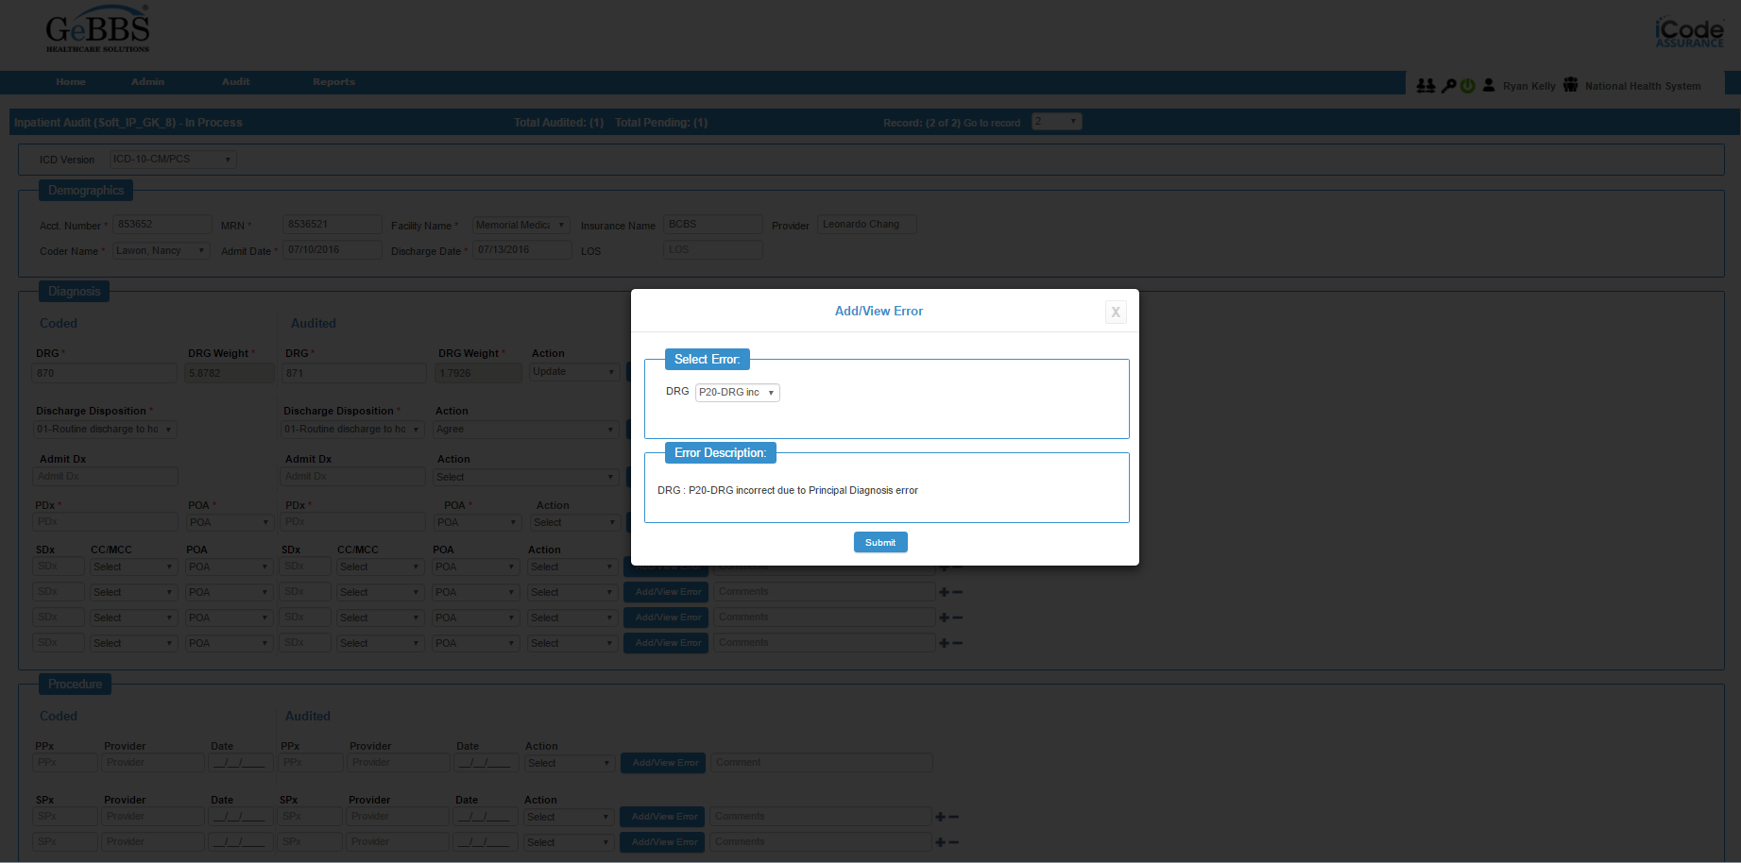
Audit Workflow Management
Standardized Reason Codes
Notes:
Operations Management/Production

Slide 19
Audit Workflow Management – Customizable Reason Codes
Notes:
Operations Management/Production

Slide 20
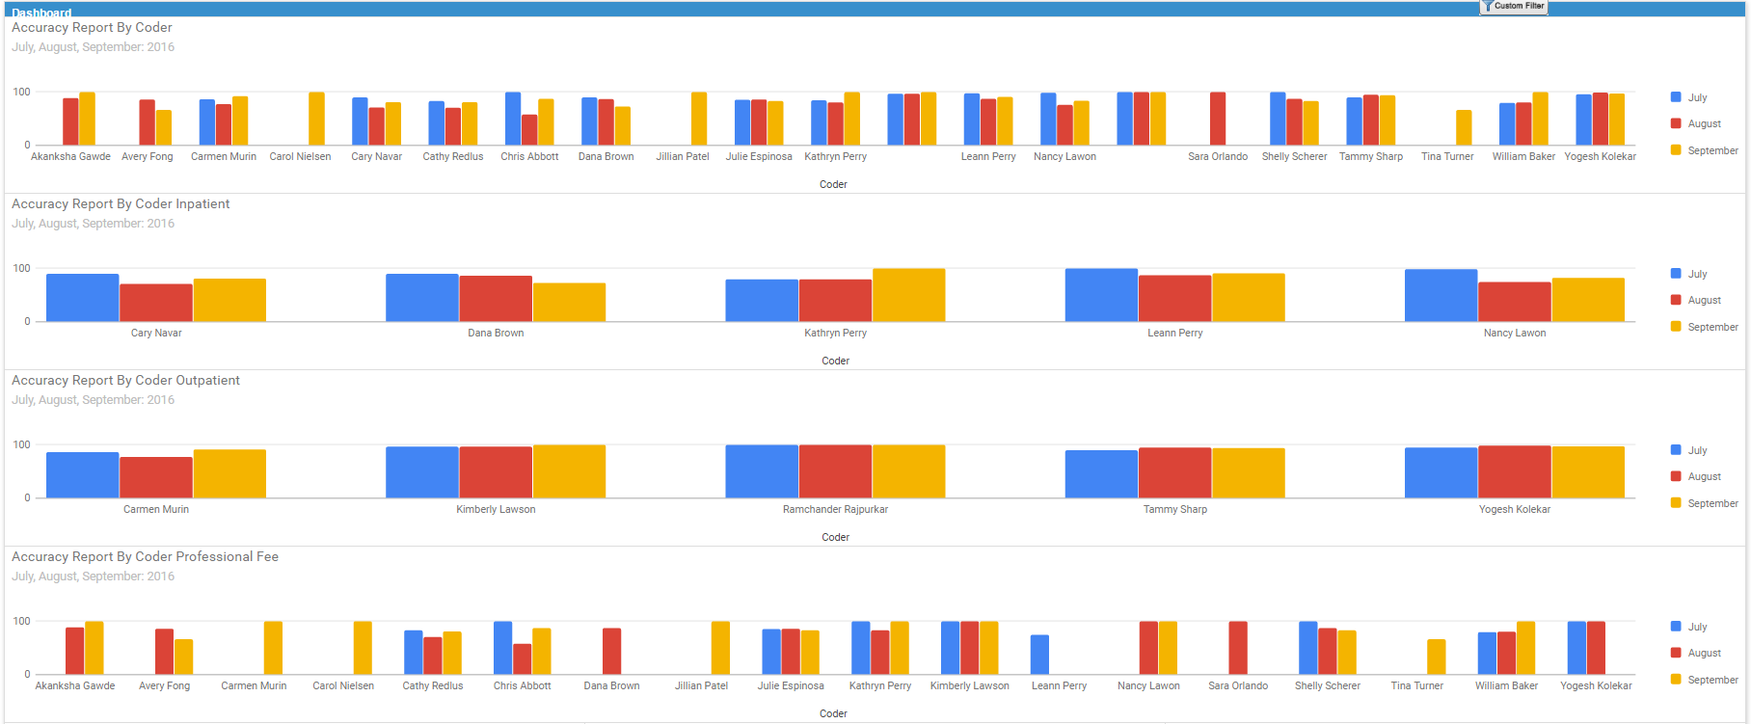
Customizable Dashboards
Notes:
Operations Management/Production

Slide 21
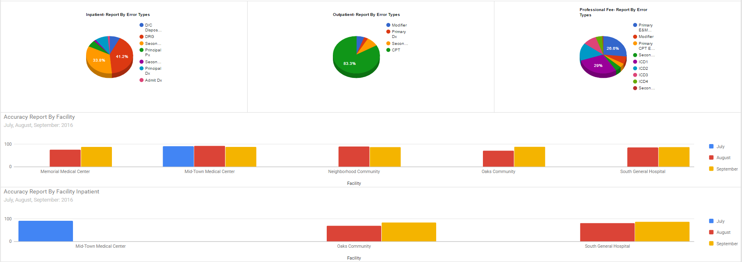
Customizable Dashboards
Notes:
Operations Management/Production

Slide 22
Customizable Reporting
Notes:
Operations Management/Production

Slide 23
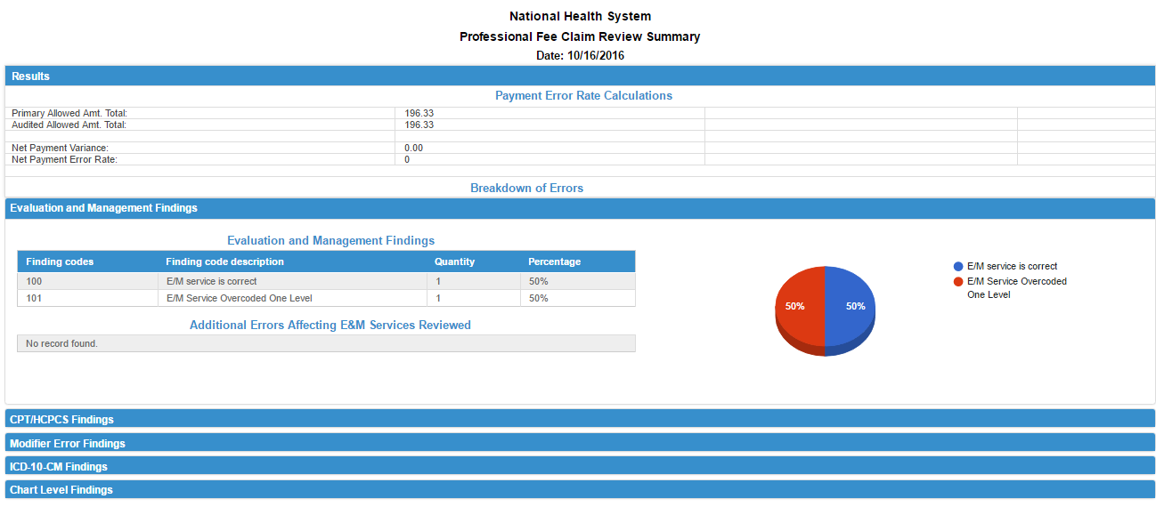
Customizable Reporting
Notes:
Operations Management/Production

Slide 24
Customizable Reporting
Notes:
Operations Management/Production

Slide 25
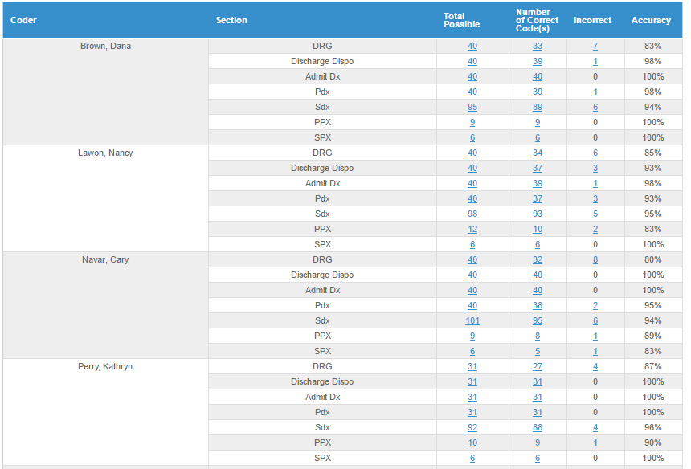
Customizable Reporting
Notes:
Operations Management/Production

Slide 26
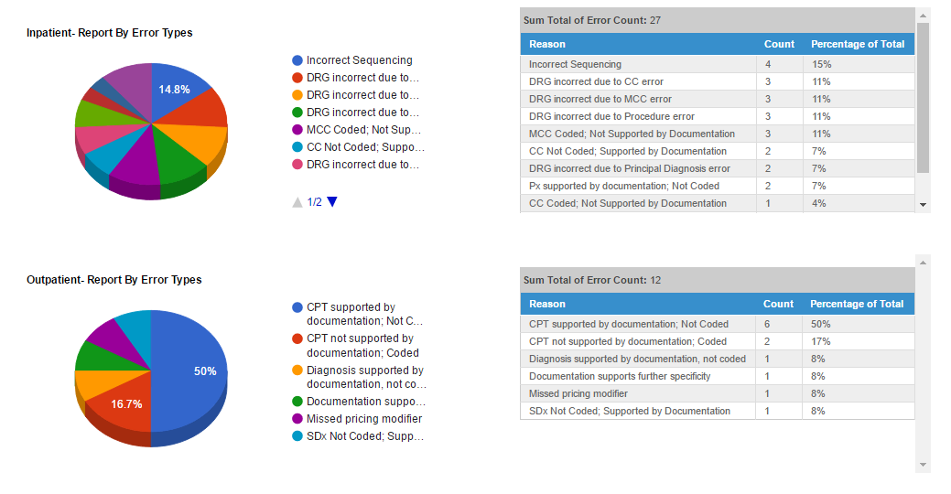
Customizable Reporting
Notes:
Operations Management/Production

Slide 27
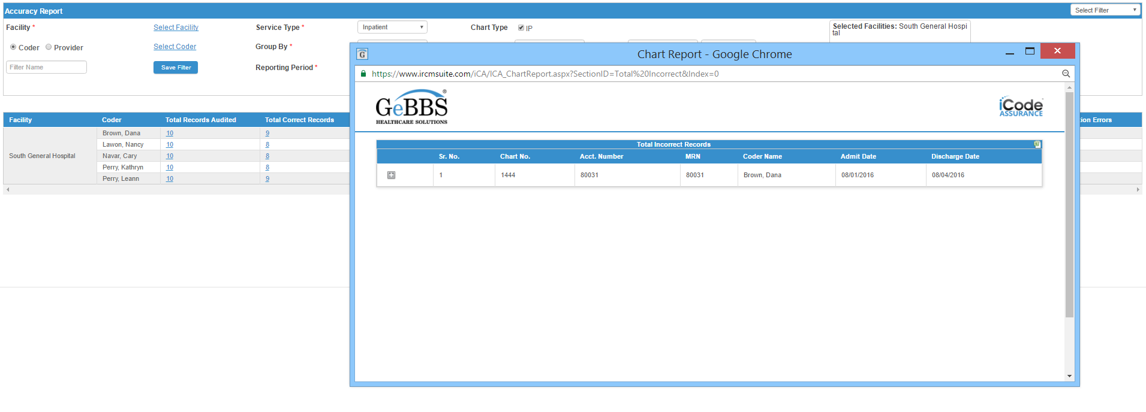
Customizable Reporting
Notes:
Operations Management/Production

Slide 28
Thank You!
sales@gebbs.com

