Slide 1

Presented By: John Friar, Financial Consultant/Director of Corporate Retirement Plans for Hausmann-Johnson Bauch Financial

Slide 2
Retirement readiness is the degree to which a participant is on target for meeting and maintaining income goals throughout retirement.

Slide 3
WHY SHOULD YOU CARE?
WORKERS’ SAVINGS ARE FALLING SHORT.
5-7%
Average deferral rates are 5-7%¹
70%
are behind schedule in saving for retirement²
50%
About 50% have less than $10,000 saved for retirement²
¹The average 401(k) participant saved 6.8% of their salary pre-tax in their 401(k) plan. (PSCA’s 55th Annual Survey of Profit Sharing and 401(k) plans, Oct. 2013.) The average 403(b) participant saved 5.7% of their salary pre-tax in their 403(b) plan. (PSCA’s 5th Benchmarking Survey of 403(b) Plans, 2013.)
² EBRI Retirement Confidence Survey, 2013.

Slide 4
IS YOUR FINANCIAL PROFESSIONAL HAVING THIS CONVERSATION?
2/3 of plan sponsors
“I expect my financial professional to be aggressive in promoting outcomes-focused retirement income planning.”

Slide 5
FORMULA FOR SUCCESS
High Participation & Savings Levels
An Outcomes-Based Investment Strategy
Plan Evaluation

Slide 6
EVALUATE YOUR PLAN
Who can help me?
INCOME REPLACEMENT RATIO: Percentage of income required by a retiree to maintain a desired standard of living during the retirement years; can be calculated at the plan and/or participant level
Financial professional
Third party administrator
Service provider

Slide 7
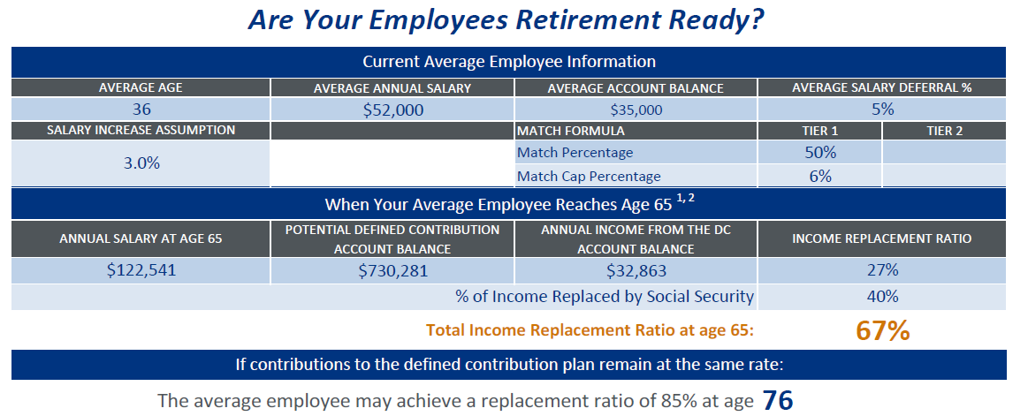
EVALUATE YOUR PLAN
RESULTS AREN’T ALWAYS WHAT THEY MAY APPEAR
Are your employees retirement ready?

Slide 8
DELAYED RETIREMENT HURTS
THE BOTTOM LINE
The impact of employees who can’t retire
due to inadequate savings:
HEALTHCARE/BENEFITS
COST TO RISE:
60% of employers
expect costs to rise.*
FOR EACH
EMPLOYEE
OVER AGE 65
A PLAN SPONSOR COULD
PAY $5,000 MORE PER YEAR FOR HEALTHCARE.
Source: EBRI Estimates
ON PRODUCTIVITY:
? Potentially significant employer costs.

Slide 9
ADEQUATE SAVINGS LEVELS
PUT IT ON AUTO
AUTOMATIC ENROLLMENT
AUTOMATIC ESCALATION
(default FEATURE)
AUTOMATIC ESCALATION
(VOLUNTARY CHOICE)
91%
88%
6%
PARTICIPANTS stayed in
PARTICIPANTS stayed in
PARTICIPANTS OPTED IN
Source: The Principal Financial Group. Data based on a combination of 42,806 participants opting out of Automatic Enrollment or Automatic Increase as of April 25, 2013, and 65,662 opting in to Principal Step Ahead Retirement OptionSM as of April 31, 2013.

Slide 10
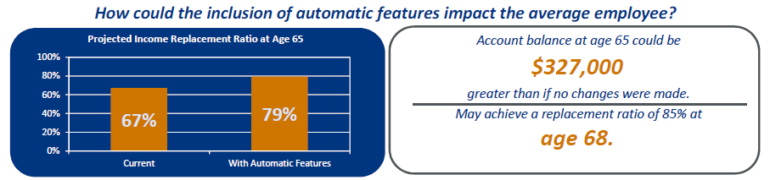
BOOST PARTICIPATION
How could the inclusion of automatic features impact the average employee?
76% of plan sponsors say they are open to consulting with a financial professional on plan design to improve participant outcomes.*
*Source: Brightwork Partners’ Supporting Retirement Savings Survey, September 2013

Slide 11
ADEQUATE SAVINGS LEVELS:
STRETCH THE POWER OF THE MATCH
Match Formula¹
Max. Employer Contribution
Avg. Participant Contribution
Total Contribution
100% UP TO 2% OF PAY
50% UP TO 4% OF PAY
25% UP TO 8% OF PAY
2%
2%
2%
5.3%
5.9%
7.2%
7.3%
7.9%
9.0%²
¹ The Principal Financial Group. Analysis based on 172 contracts that showed a stated match formula. Total contribution percentage includes participant contribution and employer match (as of 12/31/2012).
²The total contribution adds up to 9%, instead of 9.2%, because participants aren’t contributing on average enough to get the full match.

Slide 12
Automatic enrollment at 6%
Positively impacts savings rates
Participant Savings Rate* | 3% Default Rate | 6% Default Rate
11% + | 35% | 50%
6-10% | 65% | 50%
Participant Opt-Out Rate | 9% | 14%
* The Principal®. Data based on 1735 plans with automatic enrollment with
3% and 6% default deferral amounts. Sept. 30, 2013.

Slide 13
CHANGING THE GAME
Outcomes-based investing
Avoid Emotional Decisions
Preserve Purchasing Power
Improve Return Consistency
Manage Volatility
Generate Income
GOAL OF RETIREMENT READINESS

Slide 14
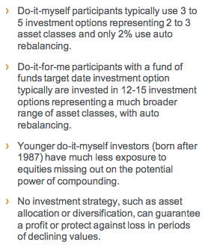
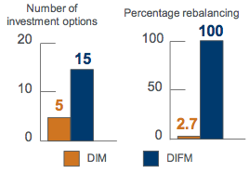
CHANGING THE GAME
Potential Benefits of Target Date Funds
Investing Styles Defined as:
Investors Age 25 or Younger
1. DIM = Do-It-Myself
(no money in target date funds) and
2. DIFM = Do-It-For-Me
(100% target date funds)
38%
DIM % Equity Allocation
62%
Equity
Other
16.1%
DIFM % Equity Allocation
84.0%

Slide 15
SO HOW DOES THIS HELP
Plan Evaluation
Decreased health and benefit expenses.
More engaged, productive employees.
High Participation & Savings Levels
Opportunity for orderly exit.
An Outcomes-Based Investment Strategy
Help employees achieve retirement goals.

Slide 16
OVERCOMING COMMON CONCERNS
“Are my employees prepared to make smart decisions?”
Did you as their employer make education opportunities available? Wouldn’t you rather know that you did everything to help set them up for success?

Slide 17
EDUCATION:
THE FOUNDATION OF YOUR RESULTS
Plan
Create and work from a 12-month plan for best results
Group education and 1:1 meetings
with employees, new hire orientations, segmented education (by age, gender, tenure, retiree status)
IMPLEMENT
MEASURE
Reporting and reality checks, annual plan reviews/wellness reports

Slide 18
PARTICIPANT EDUCATION
RESULTS GENERATED BY 1:1 MEETINGS
Among plan sponsors:
Among employees:
98% agree it increased employee understanding of their benefits¹
Over 58,500 1:1 meetings held; and 40,800 actions taken (new participation, increased deferral, automatic increase election) in 2013²
Participation is 23% higher and Average Deferral
is 15% higher when 1:1 meetings are offered²
More than 96% of participants responded that they were satisfied with the 1:1 meetings in 2013³
¹ Based on data from Retirement and Investor Finance, the Principal Financial Group, December 2013
² Individual Investor Reporting, the Principal Financial Group, January-December 2013
³ Results of the Principal Financial Group Retire Secure Participant Survey , December 2013

Slide 19
OVERCOMING COMMON CONCERNS
“My highly compensated employees are concerned their 401(k) won’t meet their needs.”
Are you providing additional tax-deferred savings vehicles?
Have you considered the retention benefits associated with offering additional savings vehicles for this key employee group?

Slide 20
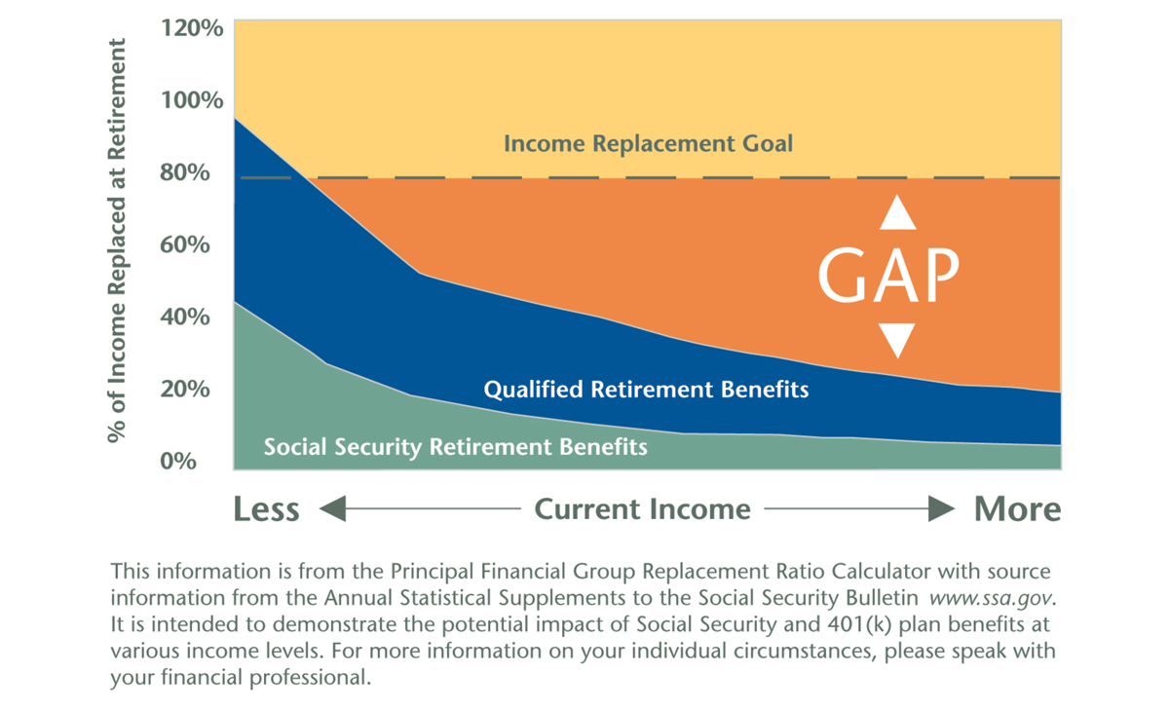
RETIREMENT INCOME GAP
NONQUALIFIED PLAN SOLUTIONS BRIDGE THE INCOME GAP
An employer-sponsored
plan that:
Offers pre-tax deferral of compensation
Is designed for selected
highly compensated employees (HCEs)
Allows saving for retirement and other needs
Allows contributions in excess of qualified plan limits

Slide 21
SUCCESSFUL RETIREMENT PLAN
Three items to do in the next three days
1. Consider “success” as it relates to your plan participants and the role you play in impacting the plan’s success.
2. Work with your financial professional to evaluate your plan and create a strategy.
3. Encourage participants to meet with a financial professional to keep on track.

Slide 22
Thank you!
For More Information Contact:
John Friar
Financial Consultant/ Director of Corporate Retirement Plans
Jfriar@hjbfinancial.com
Direct: 608-252-9634

