Slide 1
ICD-10 CM Training
Obstetrics and Gynecology

Slide 2
ICD-10-CM Compliance Dates
ICD-10-CM will be valid for dates of service on or after October 1, 2015
Outpatient dates of service of October 1, 2015 and beyond.
Inpatient hospital service claims, is effective for dates of discharge after September 30, 2015

Slide 3
Covered and Non-Covered Entities
Covered Entities
Everyone covered by the Health Insurance Portability Accountability Act (HIPAA)
Non-Covered Entities
Worker’s Compensation
Auto Insurance
Non covered HIPAA entities are exempt but are encouraged to adapt the new code set

Slide 4
ICD-10 Code Structure
21 Chapters
Alpha-numeric codes; not case-sensitive
Codes begin with Alpha letter, A-Z, excluding U
Common errors
I verses 1
O verses 0
“x” Placeholder
3 to 7 characters
Decimal following 3rd character

Slide 5
ICD-10 Code Structure
Placeholder “x”
Used for future expansion of a code
Fills in empty characters when a 6th and/or 7th character apply
The placeholder may be used in different scenarios but should never serve as the final character.
Example: W19.XXXA Unspecified fall, Initial Encounter

Slide 6
ICD-10 Code Structure
7th Character
Provides specified information regarding the clinical visit
Is required for certain categories and must be reported in the seventh position
May be alpha or numeric
Has different meanings depending on the coding category

Slide 7
ICD-10 Code Structure
 | 7th Character
1 | Fetus 1
2 | Fetus 2
3 | Fetus 3
4 | Fetus 4
5 | Fetus 5
9 | Other fetus

Slide 8
ICD-10 Code Structure
Laterality
Some ICD-10-CM codes indicate laterality, specifying whether the condition occurs on the left, right or is bilateral.
If no bilateral code is provided and the condition is bilateral, assign separate codes for both the left and right side.
If the side is not identified in the medical record, assign the code for the unspecified side.
OGCR section 1.B.13

Slide 9
ICD-10 Code Structure
“Other” Codes
Codes titled “other” or “other specified” are for use when the information in the medical record provides detail for which a specific code does not exist.
“Unspecified” Codes
Codes titled “unspecified” are for use when the information in the medical record is insufficient to assign a more specific code.
OGCR section 1.A.9.a.b

Slide 10
ICD-10 Structure
Excludes Notes
Excludes1
A type 1 Excludes note is a pure excludes note
It means “NOT CODED HERE”
The code excluded should never be used at the same time
When two conditions cannot occur together
Excludes2
Represents “Not included here”
The condition excluded is not part of the condition represented by the code
It is acceptable to use both the code and the excluded code together, when appropriate
OGCR section 1.A.12.a.b

Slide 11
ICD-10 Code Structure
“Code First” and “Use Additional Code”
ICD-10 has a coding convention that requires the underlying condition be sequenced first followed by the manifestation.
These instructional notes indicate the proper sequencing order of the codes.
OGCR section 1.A.13
The “-” indicates there are additional reporting options

Slide 12
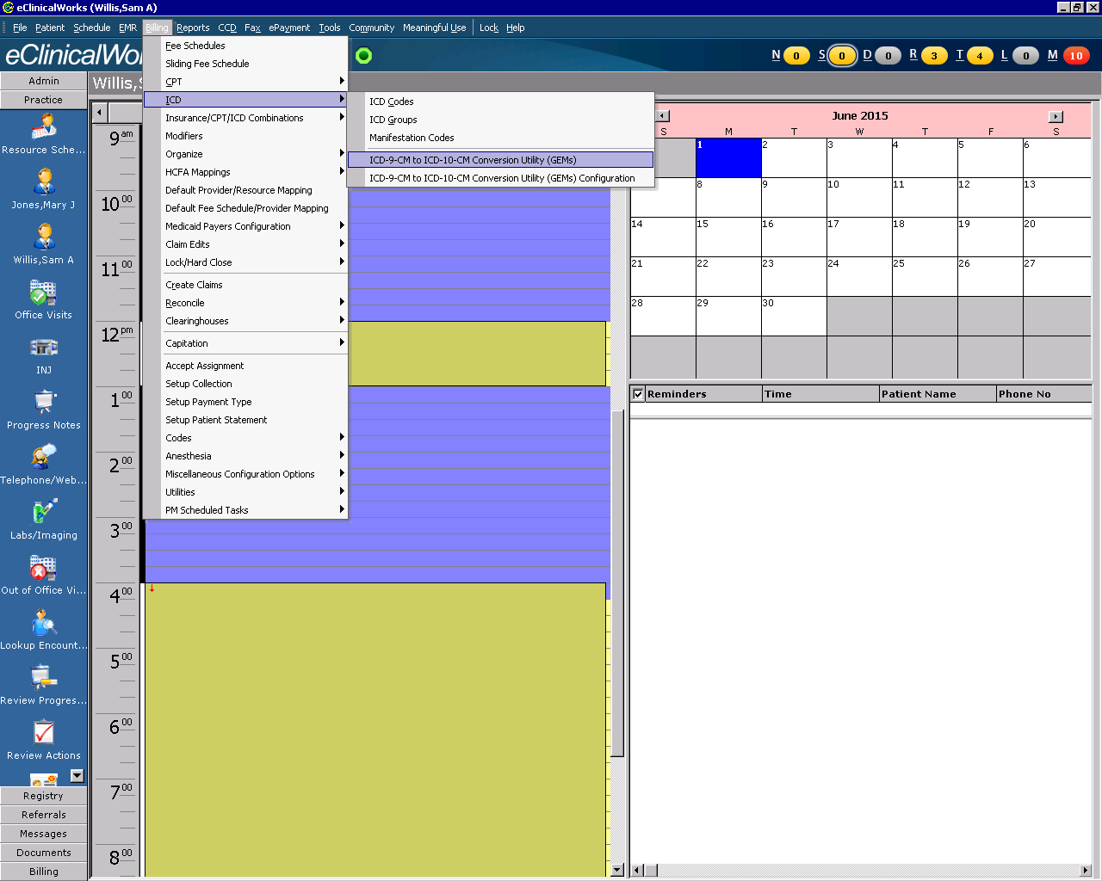
ICD-9-CM to ICD-10-CM Conversion Utility (GEMs) in eCW
From top tool bar
Billing
ICD
ICD-9-CM to ICD-10-CM
Conversion Utility (GEMs)

Slide 13
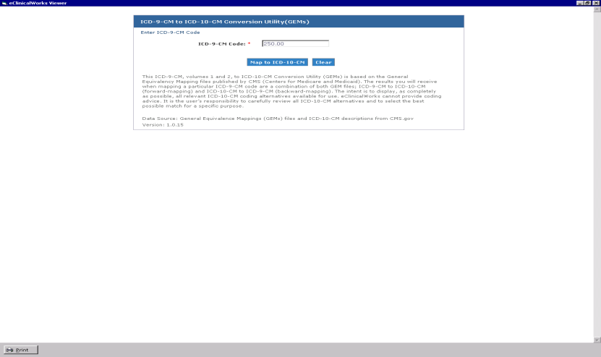
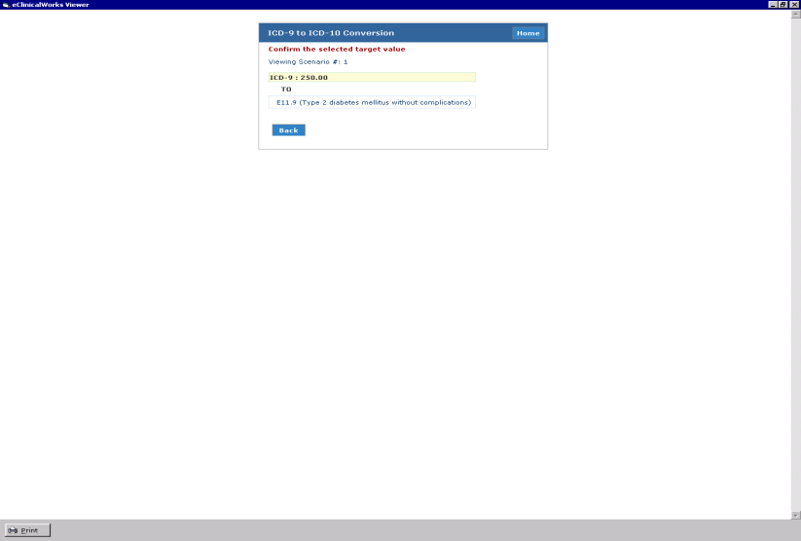
ICD-9-CM to ICD-10-CM Conversion Utility (GEMs) in eCW
Type in ICD-9-CM Code
Select- Map to ICD-10-CM
ICD-10-CM Code will appear
IF code is not a one-to-to
conversion, modifier selections
will appear to narrow search.
Notes:
This is a good feature for staff needing the ICD-10 codes for tests, orders, referrals, prior auths. etc.

Slide 14
IMO/Smart Search
IMO is a registered trademark for Intelligent Medical Objects.
Integrates software in the practice management systems to allow for a quick search of medical terms and codes.
Allows for a search using physician verbiage, partial terms or ICD codes.
System integrates with eCW
Smart Search is the result of IMO functionality within a practice management system.
Is available at no cost
Is found in the assessment section of the progress note
Allows easier search of codes (ICD-9 to ICD-10)
Notes:
IMO is turned on for all clients. If you are unable to see need to contact G1 support. This cost has been absorbed by GroupOne for most clients.

Slide 15
Most Common Diagnosis Codes

Slide 16
Weeks of Gestation
Codes from category Z3A are for use, only on the maternal record, to indicate the weeks of gestation of the pregnancy.
Code first complications of pregnancy, childbirth and the puerperium (O00-O9A)
Weeks of Gestation – 2nd Trimester
Z3A.14 | 14 weeks gestation
Z3A.15 | 15 weeks gestation
Z3A.16 | 16 weeks gestation
Z3A.17 | 17 weeks gestation
Z3A.18 | 18 weeks gestation
Z3A.19 | 19 weeks gestation
Z3A.20 | 20 weeks gestation
Z3A.21 | 21 weeks gestation
Z3A.22 | 22 weeks gestation
Z3A.23 | 23 weeks gestation
Z3A.24 | 24 weeks gestation
Z3A.25 | 25 weeks gestation
Z3A.26 | 26 weeks gestation
Z3A.27 | 27 weeks gestation
Weeks of Gestation – 1st Trimester
Z3A.00 | Weeks of gestation, not specified
Z3A.01 | Less than 8 weeks gestation
Z3A.08 | 8 weeks gestation
Z3A.09 | 9 weeks gestation
Z3A.10 | 10 weeks gestation
Z3A.11 | 11 weeks gestation
Z3A.12 | 12 weeks gestation
Z3A.13 | 13 weeks gestation

Slide 17
Weeks of Gestation – 3rd Trimester
Z3A.28 | 28 weeks gestation
Z3A.29 | 29 weeks gestation
Z3A.30 | 30 weeks gestation
Z3A.31 | 31 weeks gestation
Z3A.32 | 32 weeks gestation
Z3A.33 | 33 weeks gestation
Z3A.34 | 34 weeks gestation
Z3A.35 | 35 weeks gestation
Z3A.36 | 36 weeks gestation
Z3A.37 | 37 weeks gestation
Z3A.38 | 38 weeks gestation
Z3A.39 | 39 weeks gestation
Z3A.40 | 40 weeks gestation
Z3A.41 | 41 weeks gestation
Z3A.42 | 42 weeks gestation
Z3A.49 | Greater than 42 weeks

Slide 18
Encounter for gynecological examination
ICD-9 Code | ICD-10 Code | Description | Excludes1 | Excludes2
V72.31 | Z01.411 | Encounter for gynecological examination (general) (routine) with abnormal findings | encounter for examination for administrative purposes (Z02.-) encounter for examination for suspected conditions, proven not to exist (Z03.-) encounter for laboratory and radiologic examinations as a component of general medical examinations(Z00.0-) encounter for laboratory, radiologic and imaging examinations for sign(s) and symptom(s) - code to the sign(s) or symptom(s) | screening examinations (Z11-Z13) pregnancy examination or test (Z32.0-) routine examination for contraceptive maintenance (Z30.4-)
V72.31 | Z01.419 | Encounter for gynecological examination (general) (routine) without abnormal findings

Slide 19
Documentation Tips
Use additional code:
for screening for human papillomavirus, if applicable, (Z11.51)
for screening vaginal pap smear, if applicable (Z12.72)
to identify acquired absence of uterus, if applicable (Z90.71-)

Slide 20
Circumscribed scleroderma
ICD-9 Code | ICD-10 Code |  | Description |  | Excludes1 | Excludes2
701.1 | L94.0 |  | Localized scleroderma [morphea] Applicable To: Circumscribed scleroderma |  | systemic connective tissue disorders (M30-M36) | lichen sclerosus of external female genital organs (N90.4) lichen sclerosus of external male genital organs (N48.0)
There are more specific code choice selections below:
 |  | L90.0 |  | Lichen sclerosus et atrophicus
 |  | L94.1 |  | Linear scleroderma
 |  | L94.3 |  | Sclerodactyly

Slide 21
Noninflammatory disorder of vulva and perineum, unspecified
ICD-9 Code | ICD-10 Code |  | Description |  | Excludes1 | Excludes2
624.9 | N90.9 |  | Noninflammatory disorder of vulva and perineum, unspecified |  | anogenital (venereal) warts (A63.0) carcinoma in situ of vulva (D07.1) condyloma acuminatum (A63.0) current obstetric trauma (O70.-, O71.7-O71.8) inflammation of vulva (N76.-) severe dysplasia of vulva (D07.1) vulvar intraepithelial neoplasm III [VIN III] (D07.1) | N/A

Slide 22
Documentation Tips
Identify:
Atrophies
Dysplasia
Hypertrophy
Mutilations
Status
Cyst

Slide 23
Postmenopausal bleeding
ICD-9 Code | ICD-10 Code |  | Description |  | Excludes1 | Excludes2
627.1 | N95.0 |  | Postmenopausal bleeding |  | excessive bleeding in the premenopausal period (N92.4) menopausal and perimenopausal disorders due to artificial or premature menopause (E89.4-, E28.31-) premature menopause (E28.31-) | postmenopausal osteoporosis (M81.0-) postmenopausal osteoporosis with current pathological fracture (M80.0-) postmenopausal urethritis (N34.2)

Slide 24
Other specified conditions associated with female genital organs and menstrual cycle
ICD-9 Code | ICD-10 Code | Description | Excludes1 | Excludes2
625.9 | N94.89 | Other specified conditions associated with female genital organs and menstrual cycle | N/A | N/A
625.9 | R10.2 | Pelvic and perineal pain | Vulvodynia (N94.81)
There are more specific code choice selections below:
 | N94.9 | Unspecified condition associated with female genital organs and menstrual cycle
 | R19.8 | Other specified symptoms and signs involving the digestive system and abdomen
 | R39.9 | Unspecified symptoms and signs involving the genitourinary system

Slide 25
Documentation Tips
Use of symptom codes
R00-R99 codes that describe symptoms and signs are acceptable for reporting purposes when a related definitive diagnosis has not been established (confirmed) by the provider.
Use of a symptom code with a definitive diagnosis code
R00-R99 codes for signs and symptoms may be reported in addition to a related definitive diagnosis when the sign or symptom is not routinely associated with that diagnosis, such as the various signs and symptoms associated with complex syndromes. The definitive diagnosis code should be sequenced before the symptom code..

Slide 26
Threatedned preterm labor without delivery
ICD-9 Code | ICD-10 Code | Description | Excludes1 | Excludes2
644.03 | O47.00 | False labor before 37 completed weeks of gestation, unspecified trimester | preterm labor (O60.-) | N/A
 | O47.02 | False labor before 37 completed weeks of gestation, second trimester
 | O47.03 | False labor before 37 completed weeks of gestation, third trimester
 | O47.1 | False labor at or after 37 completed weeks of gestation
 | O47.9 | False labor, unspecified

Slide 27
Documentation Tips
Identify:
Gestation week
Trimester

Slide 28
Documentation Tips
O60 codes are for onset (spontaneous) of labor before 37 completed weeks of gestation
In instances when a patient is admitted to a hospital for complications of pregnancy during one trimester and remains in the hospital into a subsequent trimester, the trimester character for the antepartum complication code should be assigned on the basis of the trimester when the complication developed, not the trimester of the discharge. If the condition developed prior to the current admission/encounter or represents a pre-existing condition, the trimester character for the trimester at the time of the admission/encounter should be assigned.

Slide 29
Documentation Tips
In episodes when no delivery occurs, the principal diagnosis should correspond to the principal complication of the pregnancy which necessitated the encounter. Should more than one complication exist, all of which are treated or monitored, any of the complications codes may be sequenced first.
For suspected or confirmed cases of abuse of a pregnant patient, a code(s) from subcategories O9A.3, Physical abuse complicating pregnancy, childbirth, and the puerperium, O9A.4, Sexual abuse complicating pregnancy, childbirth, and the puerperium, and O9A.5, Psychological abuse complicating pregnancy, childbirth, and the puerperium, should be sequenced first, followed by the appropriate codes (if applicable) to identify any associated current injury due to physical abuse, sexual abuse, and the perpetrator of abuse.

Slide 30
Cystocele, midline
ICD-9 Code | ICD-10 Code |  | Description |  | Excludes1 | Excludes2
618.01 | N81.11 |  | Cystocele, midline |  | genital prolapse complicating pregnancy, labor or delivery (O34.5-) prolapse and hernia of ovary and fallopian tube (N83.4) prolapse of vaginal vault after hysterectomy (N99.3) cystocele with prolapse of uterus (N81.2-N81.4) | abnormal findings on antenatal screening of mother (O28.-) certain conditions originating in the perinatal period (P04-P96) signs and symptoms classified in the body system chapters signs and symptoms of breast (N63, N64.5)
There are more specific code choice selections below:
 |  | N81.10 |  | Cystocele, unspecified Prolapse of (anterior) vaginal wall NOS
 |  | N81.12 |  | Cystocele, lateral Paravaginal cystocele

Slide 31
Documentation Tips
Identify:
location

Slide 32
Excessive and frequent menstruation with regular cycle
ICD-9 Code | ICD-10 Code |  | Description |  | Excludes1 | Excludes2
626.2 | N92.0 |  | Excessive and frequent menstruation with regular cycle |  | postmenopausal bleeding (N95.0) precocious puberty (menstruation) (E30.1) | N/A
There are more specific code choice selections below:
 |  | N92.1 |  | Excessive and frequent menstruation with irregular cycle
 |  | N92.2 |  | Excessive menstruation at puberty
 |  | N92.3 |  | Ovulation bleeding
 |  | N92.4 |  | Excessive bleeding in the premenopausal period
 |  | N92.5 |  | Other specified irregular menstruation
 |  | N92.6 |  | Irregular menstruation, unspecified

Slide 33
Documentation Tips
Identify:
Type of bleeding
Menstruation
Ovulation
Puberty

Slide 34
Drug use complicating pregnancy, childbirth, and the puerperium
ICD-9 Code | ICD-10 Code |  | Description |  | Excludes1 | Excludes2
648.33 | O99.320 |  | Drug use complicating pregnancy, unspecified trimester |  | when the reason for maternal care is that the condition is known or suspected to have affected the fetus(O35-O36) | N/A
Use additional code to identify specific condition Use additional code(s) from F11-F16 and F18-F19 to identify manifestations of the drug use
There are more specific code choice selections below:
 |  | O99.321 |  | Drug use complicating pregnancy, first trimester
 |  | O99.322 |  | Drug use complicating pregnancy, second trimester
 |  | O99.323 |  | Drug use complicating pregnancy, third trimester
 |  | O99.324 |  | Drug use complicating childbirth
 |  | O99.325 |  | Drug use complicating the puerperium

Slide 35
Documentation Tips
Identify:
Gestation week
Trimester
Manifestations of alcohol use
Conditions which complicate the pregnant state, are aggravated by the pregnancy or are a main reason for obstetric care

Slide 36
Documentation Tips
Alcohol use during pregnancy, childbirth and the puerperium
Codes under subcategory O99.31, Alcohol use complicating pregnancy, childbirth, and the puerperium, should be assigned for any pregnancy case when a mother uses alcohol during the pregnancy or postpartum. A secondary code from category F10, Alcohol related disorders, should also be assigned to identify manifestations of the alcohol use.

Slide 37
Postmenopausal atrophic vaginitis
ICD-9 Code | ICD-10 Code |  | Description |  | Excludes1 | Excludes2
627.1 | N95.2 |  | Postmenopausal atrophic vaginitis Applicable to: Senile (atrophic) vaginitis |  | excessive bleeding in the premenopausal period (N92.4) menopausal and perimenopausal disorders due to artificial or premature menopause (E89.4-, E28.31-) premature menopause (E28.31-) | postmenopausal osteoporosis (M81.0-) postmenopausal osteoporosis with current pathological fracture (M80.0-) postmenopausal urethritis (N34.2)

Slide 38
Documentation Tips
Identify:
Current
History of

Slide 39
Other specified pregnancy related conditions
ICD-9 Code | ICD-10 Code |  | Description |  | Excludes1 | Excludes2
646.83 | O26.899 |  | Other specified pregnancy related conditions, unspecified trimester |  | N/A | N/A
There are more specific code choice selections below:
 |  | O26.891 |  | Other specified pregnancy related conditions, first trimester
 |  | O26.892 |  | Other specified pregnancy related conditions, second trimester
 |  | O26.893 |  | Other specified pregnancy related conditions, third trimester

Slide 40
Documentation Tips
Identify:
Gestation week
Trimester
Complication

Slide 41
Missed abortion
ICD-9 Code | ICD-10 Code | Description | Excludes1 | Excludes2
632 | O02.1 | Missed abortion | papyraceous fetus (O31.0-) failed induced abortion (O07.-) fetal death (intrauterine) (late) (O36.4) missed abortion with blighted ovum (O02.0) missed abortion with hydatidiform mole (O01.-) missed abortion with nonhydatidiform (O02.0) missed abortion with other abnormal products of conception (O02.8-) missed delivery (O36.4) stillbirth (P95) | N/A
Use additional code from category O08 to identify any associated complication.

Slide 42
Documentation Tips
Early fetal death, before completion of 20 weeks of gestation, with retention of dead fetus
Identify:
Week of gestation
Associated complications

Slide 43
Vaginitis and Vulvitis
ICD-9 Code | ICD-10 Code |  | Description |  | Excludes1 | Excludes2
626.10 | N76.0 |  | Acute vaginitis |  | N/A | senile (atrophic) vaginitis (N95.2) vulvar vestibulitis (N94.810)
Use additional code (B95-B97), to identify infectious agent
There are more specific code choice selections below:
 |  | N76.1 |  | Subacute and chronic vaginitis
 |  | N76.2 |  | Acute vulvitis
 |  | N76.3 |  | Subacute and chronic vulvitis
 |  | N76.4 |  | Abscess of vulva
 |  | N76.5 |  | Ulceration of vagina
 |  | N76.6 |  | Ulceration of vulva
 |  | N76.81 |  | Mucositis (ulcerative) of vagina and vulva
 |  | N76.89 |  | Other specified inflammation of vagina and vulva

Slide 44
Documentation Tips
Identify:
Acute or subacute
Abscess or ulceration
Infectious agent

Slide 45
Prolapse of vaginal walls
ICD-9 Code | ICD-10 Code |  | Description |  | Excludes1 | Excludes2
618.01 | N81.11 |  | Cystocele, midline |  | genital prolapse complicating pregnancy, labor or delivery (O34.5-) prolapse and hernia of ovary and fallopian tube (N83.4) prolapse of vaginal vault after hysterectomy (N99.3) cystocele with prolapse of uterus (N81.2-N81.4) | N/A
618.00 | N81.9 |  | Female genital prolapse, unspecified
There are more specific code choice selections below:
 |  | N81.0 |  | Cystocele, unspecified Prolapse of (anterior) vaginal wall NOS
 |  | N81.1- |  | Cystocele
 |  | N81.2 |  | Incomplete uterovaginal prolapse
 |  | N81.3 |  | Complete uterovaginal prolapse
 |  | N81.4 |  | Uterovaginal prolapse, unspecified
 |  | N81.5 |  | Vaginal enterocele
 |  | N81.6 |  | Rectocele
 |  | N81.8- |  | Other female genital prolapse

Slide 46
Documentation Tips
Identify:
Location
Complete or incomplete
Incompetent or weakening

Slide 47
Ovarian cyst
ICD-9 Code | ICD-10 Code |  | Description |  | Excludes1 | Excludes2
620.2 | N83.20 |  | Other and unspecified ovarian cysts |  | developmental ovarian cyst (Q50.1) neoplastic ovarian cyst (D27.-) polycystic ovarian syndrome (E28.2) Stein-Leventhal syndrome (E28.2) | hydrosalpinx (N70.1-)
 | N83.29 |  | Other ovarian cysts Retention cyst of ovary Simple cyst of ovary
There are more specific code choice selections below:
 |  | N83.1 |  | Corpus luteum cyst Hemorrhagic corpus luteum cyst
 |  | N83.0 |  | Follicular cyst of ovary Cyst of graafian follicle Hemorrhagic follicular cyst (of ovary)

Slide 48
Documentation Tips
Identify:
Cyst type

Slide 49
Clearinghouse Testing
GroupOne will submit ICD-10 CM test batch to Clearinghouse prior to October 1, 2015
Update all eCW ICD-10 settings to be effective on October 1, 2015

Slide 50
Monitor Claims
On October 01, 2015 we will monitor claims for date of service rules
Outpatient claims cannot have crossover dates
Outpatient claims will be coded according to date of service
Inpatient facility claims will be coded per date of discharge
We will monitor claims to resolve any unanticipated problems with the submission process

Slide 51
Claim Denial and Management
We will monitor for claim denials
We will monitor editing trends for ICD-10 Coding guidelines
We will provide feedback to the physicians regarding supporting documentation requirements
We will monitor WC or Liability carriers for published rules on use of ICD-9 or ICD-10 code sets

Slide 52
Client Responsibilities
Client will need to update in eCW
Templates
Order Sets
Superbills
Favorites
Future Orders in eCW
Remove ICD-9 code add ICD-10 code

Slide 53
https://my.eclinicalworks.com/eCRM/jsp/index.jsp
Knowledge
Documents & Videos
ICD-10 Information
ICD-10 Videos
View videos
ICD-10-01 Overview and Setup
ICD-10 -02 Assessment Search
ICD-10-03 Order Sets and Templates
ICD-10-04 ICD and CPT Associations and ICD Groups
ICD-10-05 Lab Req Forms and Superbills
ICD-10-06 Future Labs and Standing Orders

Slide 54
Documentation – Start Now
All Conditions treated or assessed must be documented in the medical record. In addition to the documentation tips reviewed, below are more areas to document that will ensure proper ICD-10-CM code selection.
Site specificity
Document notation of qualifiers
Exacerbation
Manifestations
Relapse
Status
Stages
Indicate acute or chronic
Indicate underlying or external cause factors
Medication
Smoke
Accidents
Mechanical failure
Laterality
Bilateral
Right
Left

Slide 55
Documentation – Start Now
Episode of Care for injuries, poisoning, external causes and other conditions
Initial Encounter
Use while the patient is receiving active treatment of the condition
Active treatment includes surgical treatment, an emergency encounter, and evaluation and treatment by a new physician
Subsequent Encounter
Used on encounter after the patient has received active treatment of the condition and is receiving routine care for the condition during the healing or recovery phase.
Medication adjustments, aftercare, device adjustments, cast change
Sequela
Used for complications or conditions that arise as a direct result of a condition, late effect

Slide 56
Documentation – Start Now
Combination codes that capture
Etiology and manifestation
Related conditions
Disease, injury or other medical condition and complications
Disease or other medical conditions and common signs or symptoms

Slide 57
Official Guidelines for Coding and Reporting
Underdosing
Underdosing refers to taking less of a medication than is prescribed by a provider or a manufacturer’s instruction. For underdosing, assign the code from categories T36-T50 (fifth or sixth character “6”).
Codes for underdosing should never be assigned as principal or first-listed codes. If a patient has a relapse or exacerbation of the medical condition for which the drug is prescribed because of the reduction in dose, then the medical condition itself should be coded.
Noncompliance (Z91.12-, Z91.13-) or complication of care (Y63.6-Y63.9) codes are to be used with an underdosing code to indicate intent, if known.
OGCR Section 1.C.19.e.5.c

Slide 58
V00- Z99 Codes External Causes of Morbidity
V-codes
Transport Accidents
W00-X58 codes
Other External Causes of Accidental Injury
X71-X99.9 codes
Intentional Self-Harm
Y00-Y99.9 Other External Causes of Morbidity
Z00-Z99 Factors influencing health status and contact with health services

Slide 59
V00-V99 Codes Other External Causes of Accidental Injury
Code Range | Description
V00-V09 | Pedestrian injured
V10-V19 | Pedal cycle injured in transport accident
V20-V29 | Motorcycle rider injured in
V30-V39 | Occupant of three-wheeled motor vehicle injured in transport accident
V40-V49 | Car occupant injured in transport accident
V50-V59 | Occupant of pick-up truck or van injured in transport accident
V60-V69 | Occupant of heavy transport vehicle injured in transport accident
V70-V79 | Bus occupant injured in transport accident
V80-V89 | Other land transport accidents
V90-V94 | Water transport accidents
V95-V97 | Air and space transport accidents
V98 | Other and unspecified transport accidents
V99 | Unspecified transport accidents

Slide 60
W00-W99 Codes Other External Causes of Accidental Injury
Code Range | Description
W00-W19 | Slipping, Tripping, Stumbling, and Falls
W20-W49 | Exposure to Inanimate Mechanical Forces Struck by object due to collapse of building
W50-W64 | Exposure to Animate Mechanical Forces Struck by another person
W65-W74 | Accidental non-transport drowning and submersion
W85-W99 | Exposure to Electric Current, Radiation and Extreme Ambient Air Temperature and Pressure

Slide 61
X00-X99 Codes Other External Causes of Accidental Injury
Code Range | Description
X00-X08 | Exposure to Smoke, Fire and Flames
X10-X19 | Contact with Heat and Hot Substances
X30-X39 | Exposure to Forces of Nature
X52, X59 | Accidental Exposure to Other Specified Factors
X71-X83 | Intentional Self-Harm
X92-Y09 | Assault

Slide 62
Y00-Y99.9 Codes Other External Causes of Morbidity
Code Range | Description
Y00-Y09 | Assault Maltreatment and neglect
Y21-Y33 | Event of undetermined intent
Y35-Y38 | Legal Intervention, Operations of War, Military Operations, and Terrorism
Y62-Y69 | Misadventures to Patients During Surgical and Medical Care
Y70-Y82 | Medical Devices Associated with Adverse Incidents in Diagnostic and Therapeutic Use
Y83-Y84 | Surgical and other Medical Procedures as the Cause of Abnormal Reaction
Y92 | Place of occurrence of the external cause
Y93 | Activity codes
Y95 | Nosocomial condition
Y99 | External cause status

Slide 63
Z00-Z99 Factors influencing health status and contact with health services
Code Range | Description
Z00-Z13 | Persons encountering health services for examination and investigation
Z14-Z15 | Genetic carrier and genetic susceptibility to disease
Z16 | Infection with drug-resistant microorganisms
Z17 | Estrogen receptor status
Z18 | Retained foreign body fragments
Z20-Z28 | Persons with potential health hazards related to communicable disease
Z30-Z39 | Persons encountering health services in circumstances related to reproduction
Z40-Z53 | Persons encountering health services for specific procedures and health care

Slide 64
Z00-Z99 (Continue)
Code Range | Description
Z40-Z53 | Persons encountering health services for specific procedures and health care
Z55-Z65 | Persons with potential health hazards related to socioeconomic and psychosocial circumstance
Z66 | Do Not Resuscitate (DNR) status
Z67 | Blood type
Z68 | Body mass index (BMI)
Z69-Z76 | Persons encountering health services in other circumstances
Z79-Z99 | Persons with potential health hazards related to family and personal history and certain conditions influencing health status

Slide 65
Questions
codingresource@g1hs.com

