Slide 1
Maximo 7.5 Product Update July 8, 2011

Slide 2
Presenting today
Matt Logsdon General Maximo 7.5 Enhancements
Arden Juby Supply Chain Management
Lance Morris Work & Asset Management

Slide 3
Maximo 7.5 – 3 Major Areas of Focus
Usability & Performance
New & Enhanced Supply Chain Management Features
New & Enhanced Work & Asset Management Features
IBM Released Maximo 7.5 on April 29, 2011

Slide 4
Maximo 7.5– Expanded Footprint
Asset
Management
Work
Management
Materials
Management
Purchasing
Contract
Management
Service
Management
Locations
Repair Facilities
Asset
Asset Templates
Failure Codes
Linear Assets
Visual Control
Condition Monitoring
Meters
Meter Groups
Job Plans
Revisioning
Routes
Service Requests
Work Order Tracking
Assignment Tab
Hard/Soft Reservations
Repair Facilities
Safety
Quick Reporting
Labor/Crafts
Tools
Preventive Maintenance
PM Forecasting
Master PM
Assignment Manager
Item Master
Storerooms
Inventory
Inventory Usage
LIFO/FIFO Costing
Consigment
Transfer via Shipment
Default Costing
Condition Codes
Stocked Tools
Service Items
Request for Quotation
Receiving
Receiving Inspections
Shipment Receiving
Purchase Requisitions
Invoices
Invoice Reversals
Purchase Orders
Revisioning
Receipt Tolerance
Desktop Requisitions
Purchase Contracts
Master Contracts
Warranty Contracts
Lease/Rental Contracts
Labor Rate Contracts
Premium Pay Rates
Payment Schedules
Service Groups
SLA Management
Change Management
Incidents
Problems
Changes
Releases
Solutions
Enhanced Workflow – Event Driven, Context-based / Escalation Manager
KPIs / Reporting/ Ad-hoc Reporting / Cognos Integration
Security/Administration/Configuration – Automation Scripts, Migration Manager
Integration/Web Services – Import & Export direct from applications

Slide 5
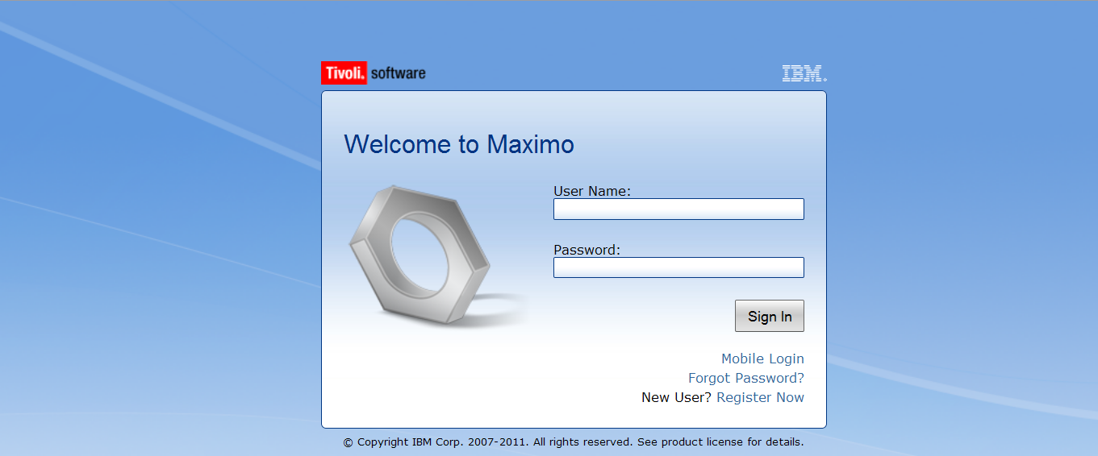
Maximo 7.5 Highlights
Mobile User
Login Option

Slide 6
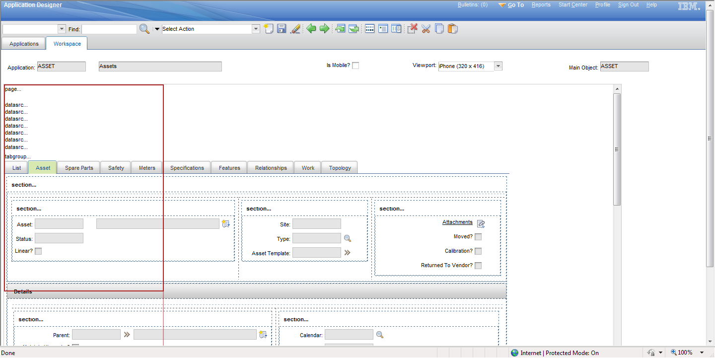
Application Designer
View Size
Example: iPhone
Red Border shows screen size

Slide 7
Usability & Performance Enhancements
The user spends lots of time in Maximo and does a lot of data entry, they asked:
“Anticipate what I will need next and present it to me (don’t make me hunt for it)”
“Don’t let me make avoidable errors”
“Help me to complete my tasks in as few steps as possible”
“Don’t slow me down when I’m on a roll”
“My eyes are bad, sometimes I can’t read the screen”
Maximo 7.5 offers:
Improved Table window refresh behavior
Enabled ‘heads down’ data entry (asynchronous validation)
Browser zoom enabled, users can zoom in (ctrl+) or zoom out (ctrl-) of application screens
Faster date/time look up (new calendar control)
Rich-text editor (can format text the way they want to see it)

Slide 8
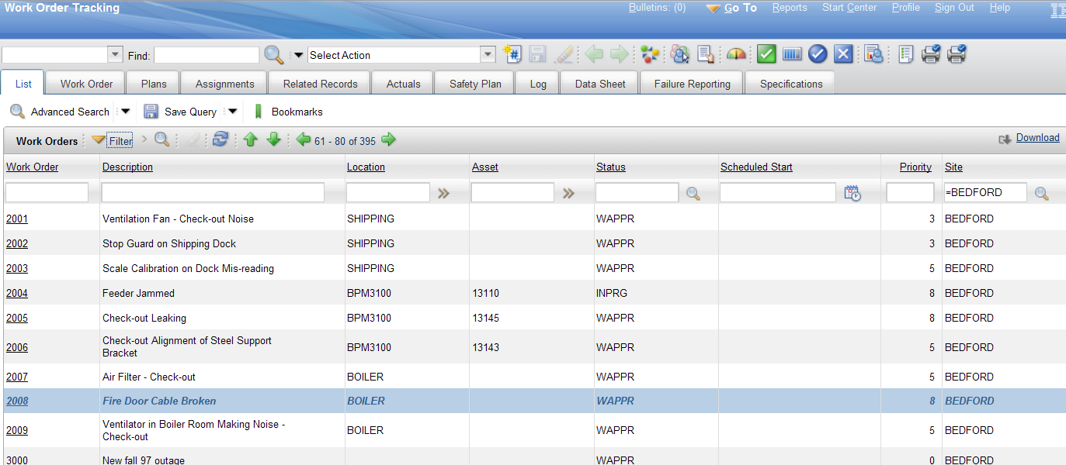
Table Windows / List Screens
When I save a record and go back to the List, the result set is still in the state I left it until I hit refresh.
Records that have been touched are Italicized to indicate they have changed

Slide 9
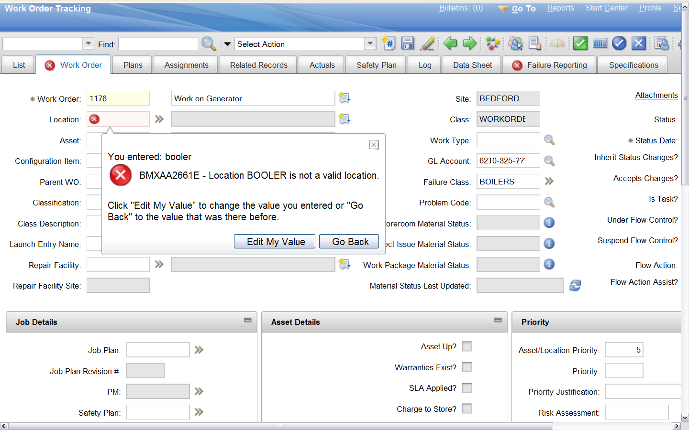
‘Heads down data entry’ (Asynchronous Validation)
I can enter data at my own pace, and address errors and warnings when I want to

Slide 10
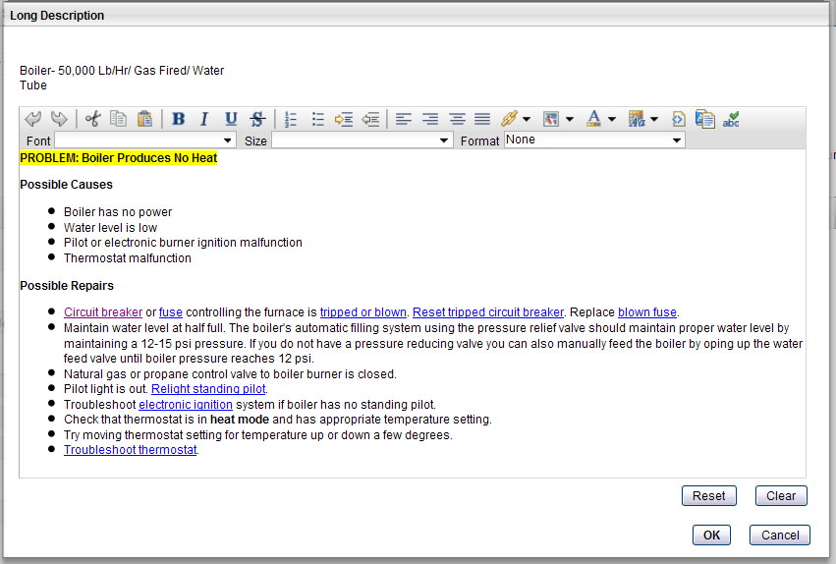
Rich Text Formatting
Long Descriptions, Communication Templates and Displays in BIRT reports
Flexible Fonts
Bold, Italics, Underline, etc.
Character Sizes
Bullets
Colors and Highlighting
URL links
Supports copy/paste from Word, etc.

Slide 11
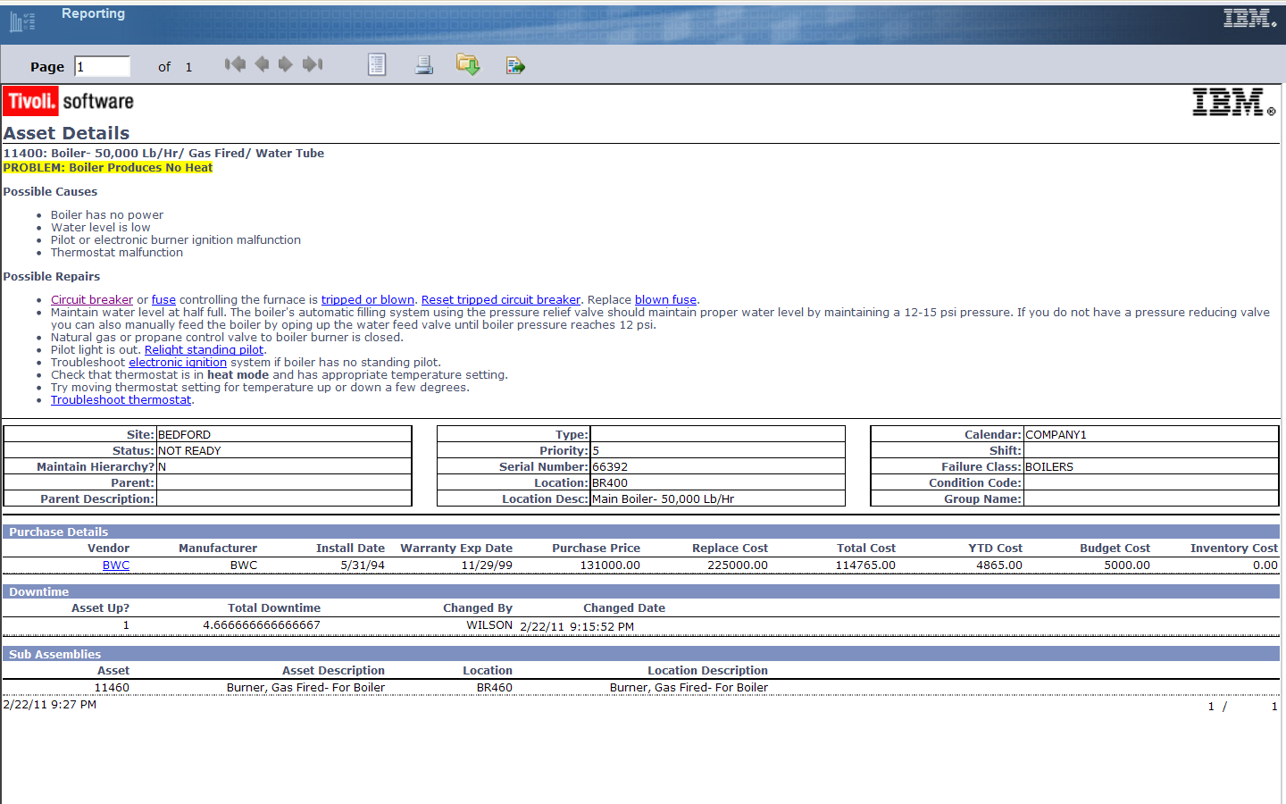
Displays in reports
Enabled Rich Text Formats to display in BIRT Reports

Slide 12
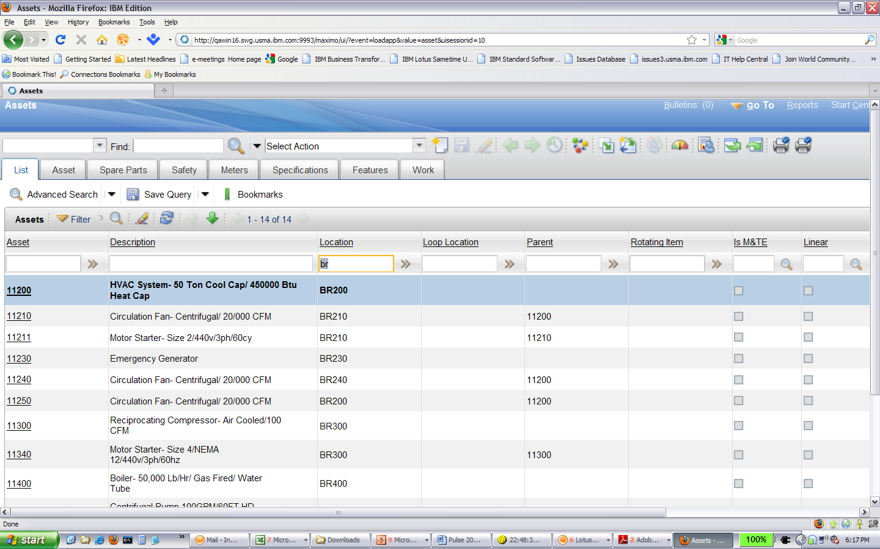
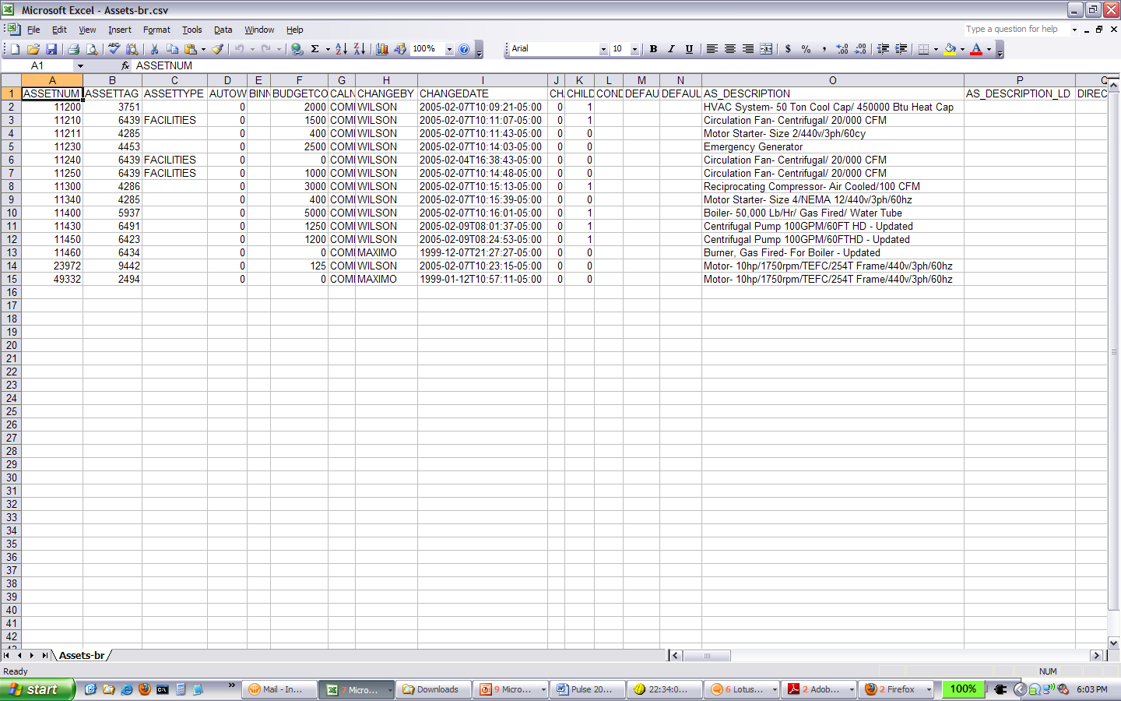
Application Export/Import
Export/Import toolbar buttons
Added through Object structures
Controlled through Security
Imported data is validated through business logic
Able to run in Preview mode
Export .csv
Import

Slide 13
Enhancements to Help
The overall objective toward the enhancements to Help is to allow the user to accomplish their work while staying in the product
Feature | Benefit
Technical content of the product is now in one information center and installed on the customer network | Permits better access to a more complete library of information.
A single search for all products | All help for all Service Management products available in one place!

Slide 14
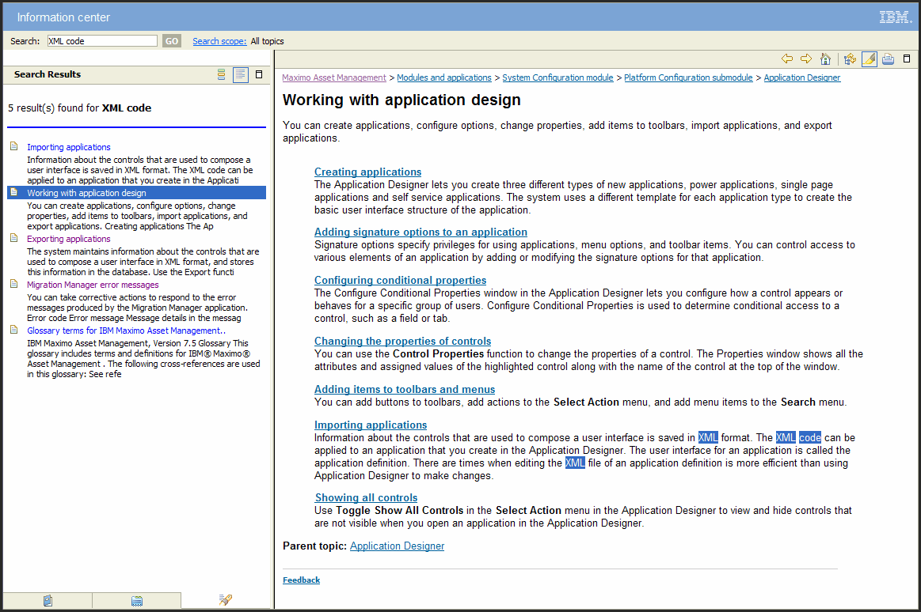
Search with highlighting

Slide 15
Maximo 7. 5
Supply Chain Enhancements
Arden Juby

Slide 16
Item Master
Receipt Tolerance percent can now be set at Item Master.

Slide 17
Item Master
STK or NS is now set at the organizational level.
Consignment is now set at the inventory record (Outside? Checkbox has been removed).

Slide 18
Item Master
Adding items to a Stockroom allows for selection of Cost Type (Average, FIFO,LIFO).

Slide 19
Inventory
Create hard reservations or soft reservations of inventory items and tools, based on the availability of the inventory requirement.
You can create reservations for inventory items and tools to ensure that they are replenished in the inventory stock on time. You can create hard reservations or soft reservations, based on the importance of the inventory requirement.
A hard reservation is a request for materials that is defined by the need for an item within a specific timeframe. You can specify that the reorder process includes only hard reservations. You can also specify that inventory items can be issued from a storeroom only when they are associated with a hard reservation. Hard reservations of inventory items are prioritized so that they cannot be superseded by other requests.
A soft reservation is a request for materials that is not subject to a timeframe. You can create a soft reservation to ensure that the item or tool is available for issue at any time that it is needed.
Hard and soft reservation types can be set automatically. You can apply automatic processing to determine hard or soft reservations, based on the date that the materials are required. You select automatic processing for reservation types in the Purchase Orders, Purchase Requisitions, and Desktop Requisitions applications.
The backorder reservation type can also be applied using automatic processing. Backorder indicates that an inventory item or tool can have only hard reservations, and that the reservation quantity must be satisfied by the available balance on the inventory record. An organization must disallow negative availability to use the Backorder reservation type.

Slide 20
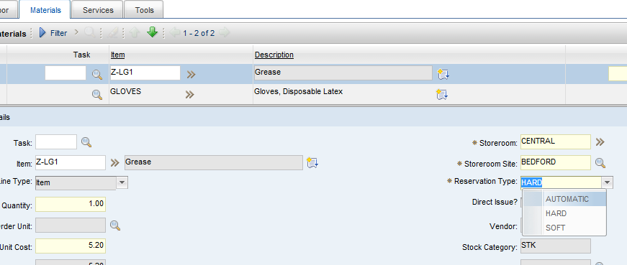
Inventory
Reservations can be set as Automatic, Hard or Soft on the Work Order Plans Tab.
They can also be changed from the Inventory Record, Add/Modify Reservations.

Slide 21
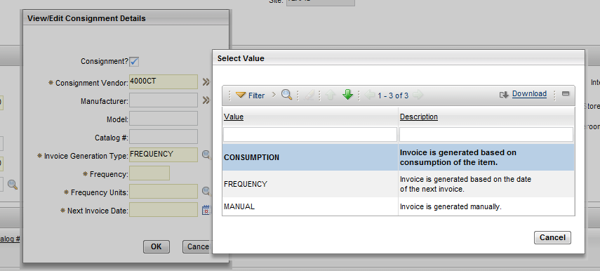
Inventory
Consignment items can now be identified from the ‘Select Action’ on the inventory record.
You will also set the invoice method at this item level.

Slide 22
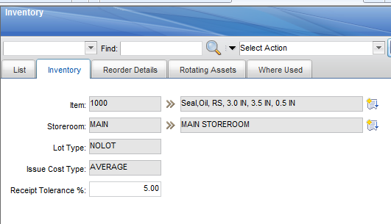
Inventory
Receipt tolerances
Inventory records will only contain STK items. NS and SP are no longer inventory types.

Slide 23
Inventory Usage
The new Inventory Usage application replaces the Issues and Transfers application. Create inventory usage records to track the issue, transfer, and return of inventory items within and across organizations.
Issues and Transfers application can still be used if desired.
Monitor the balances of inventory items and tools in storerooms and bins.
Transfer inventory items or tools between storerooms within an organization by creating shipment records.

Slide 24
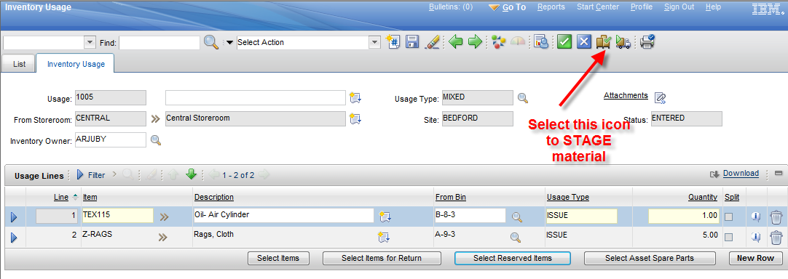
Inventory Usage
Staged Bins. Items will be identified from the Inventory Usage, Reserved items.

Slide 25
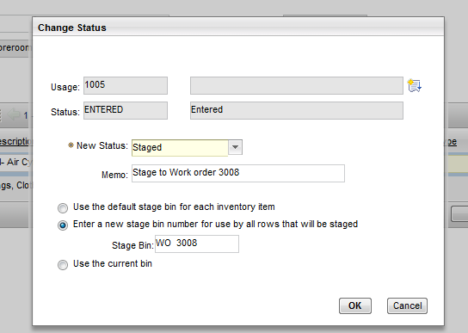
Inventory Usage
Identify the Staging Bin.

Slide 26
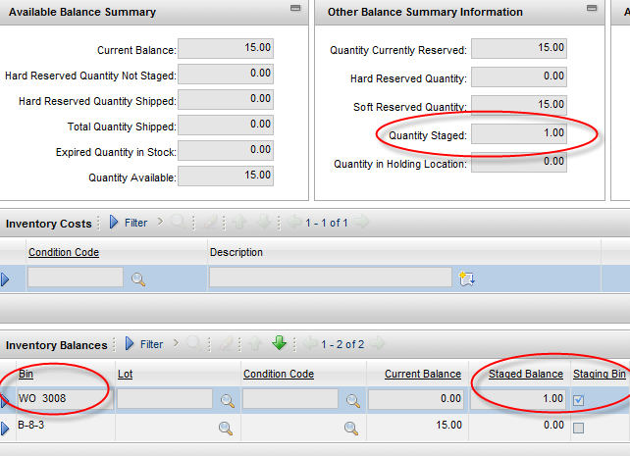
Inventory Usage
Staged Bins. Will be reflected on the inventory record.

Slide 27
Inventory Usage
Staged Materials will be issued by selecting “Complete” against the Usage record.

Slide 28
Shipment Receiving
The new Shipment Receiving application is in the Inventory module and the Purchasing module. Create shipment receipt records to log the receipt of transferred inventory items at the destination storeroom.
Monitor the balance of items received and adjust the totals and status in inventory usage records.
Specify that an inspection is required when inventory items are received. You can specify an inspection status for shipment receipt records.
Void shipment receipt records.

Slide 29
Shipment Receiving

Slide 30
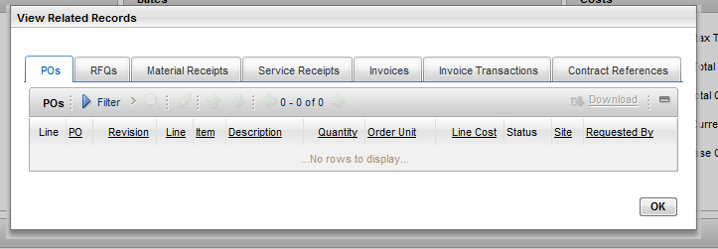
Purchase Requisitions
Ability to View Related Records.

Slide 31
Request for Quotation
Quotation lines will be entered in Vendors currency and converted to Base currency.
You can then compare the cost of the item in the base currency from all vendors from whom you received quotations.

Slide 32
Receiving
You now can VOID receipts transactions entered in error.

Slide 33
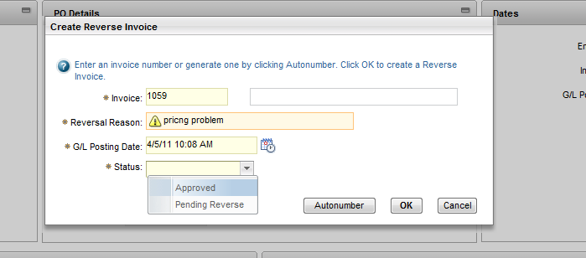
Invoices
Invoicing now allows for reversing invoices approved in error.

Slide 34
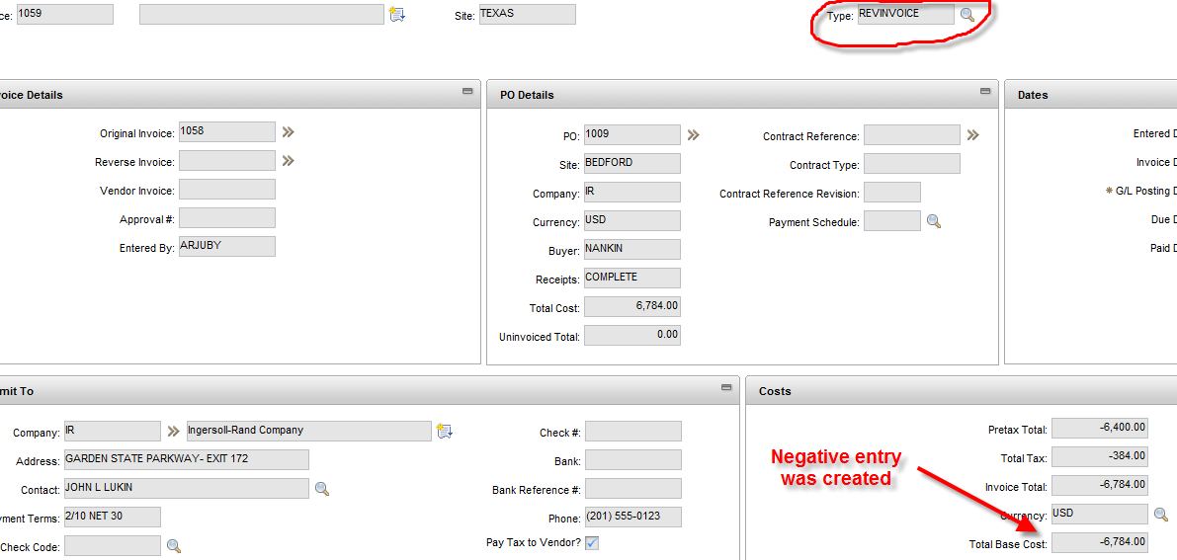
Invoices
Invoicing now creates negative entry referencing the original invoice.

Slide 35
Invoices
Invoicing now reflects a new Status for the original invoice, with a reference to the reversed invoice.

Slide 36
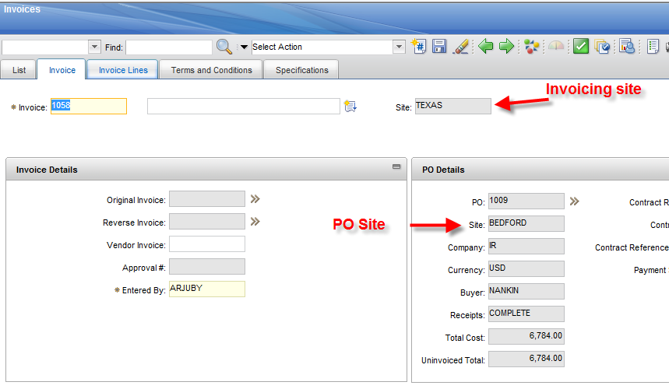
Invoices
Invoicing now supports central AP entries by allowing invoicing against any site in the organization.

Slide 37
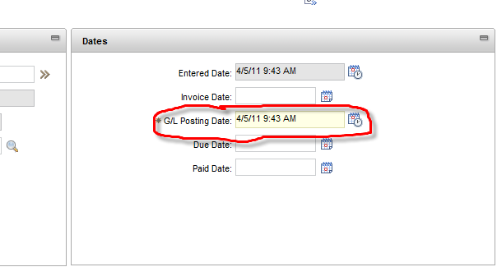
Invoices
Determine the financial period by using the new G/L Posting date.

Slide 38
Invoices
Consignment invoices can be generated Automatically or Manually based on predetermined frequency of usage.
Set at the Inventory Record.

Slide 39
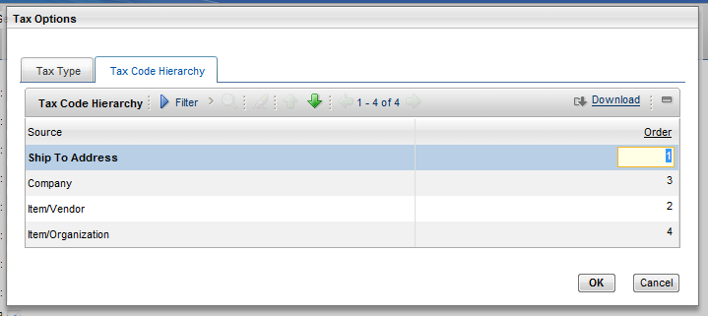
Tax Application
Taxes can now be applied based on various criteria.

Slide 40
Tax Application
Tax to Item/Vendor

Slide 41
Tax Application
Tax to Item/Organization

Slide 42
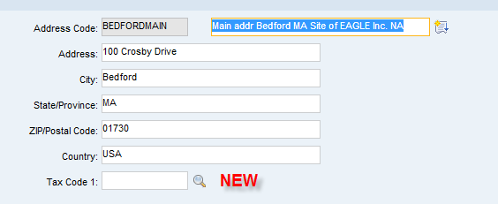
Tax Application
Tax codes can be assigned to Addresses.
Tax can be applied to purchases based on the Delivery address.

Slide 43
Export/ Import
Using the Export/Import Functions
Update records
Add records through the front end
Create Excel files to evaluate data and return results.
Create Excel files for Vendors to update delivery dates.
Make mass changes to objects such as personnel department or supervisor changes.
Can be configured for any Object

Slide 44
Export/ Import
EXAMPLE OF - Using the Export/Import Functions for Expediting
Select a list of Approved Vendor POs which are past due.
Set status to Expediting.
Export the data to an Excel file.
Vendor updates header and/or item details on the Excel file.
Import file back to Maximo PO.
Records updated with Vendor information
From list, reapprove POs.

Slide 45
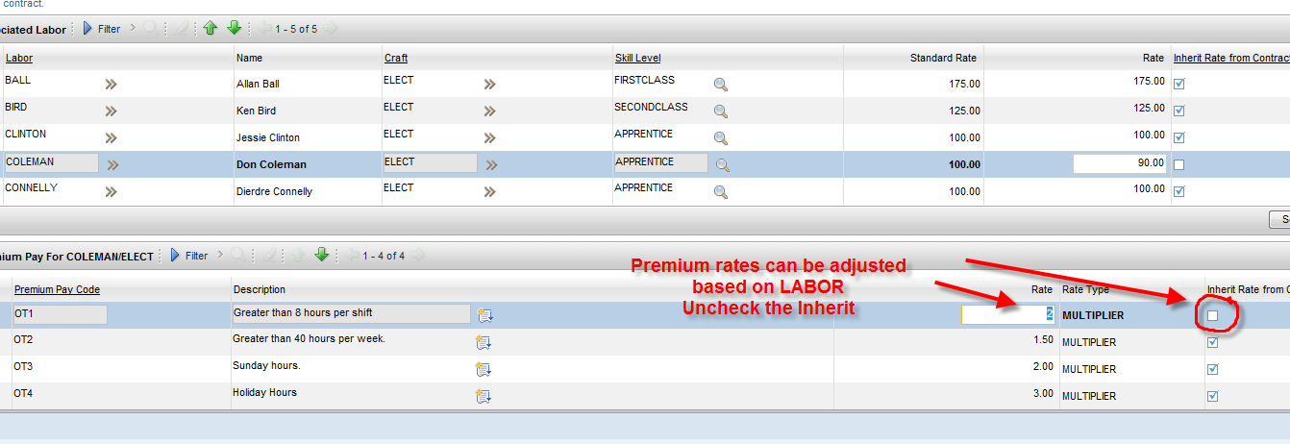
Labor Contracts
Ability to specify premium pay rate codes by LABOR.

Slide 46
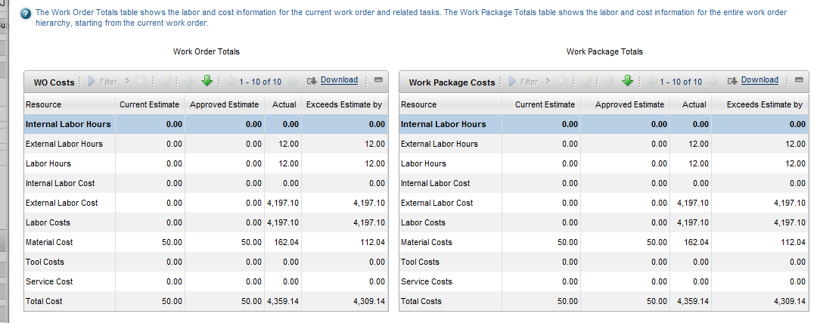
Work Order Tracking
Now Work Order cost view shows External and Internal Labor hours and costs.

Slide 47
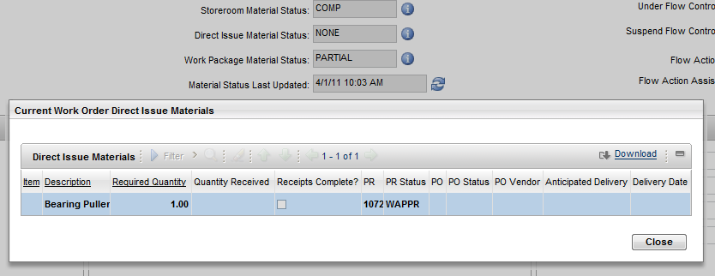
Work Order Tracking
Work order shows Direct and Stock Material availability Status.

Slide 48
Related Records
PR, PO, Receiving, Invoice, all have ability to “View Related Records”

Slide 49
Related Records

Slide 50
Maximo 7. 5
Work & Asset Management Enhancements
Lance Morris

Slide 51
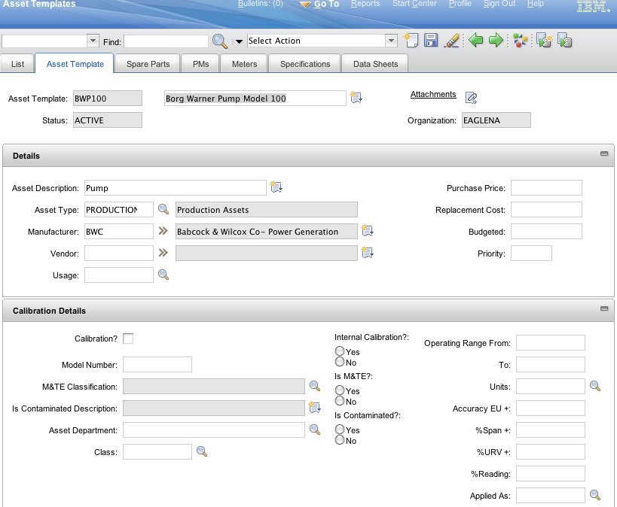
Asset Templates
Standard Template for maintaining like equipment

Slide 52
Asset Template
Details including Calibration/Data Sheets
Spare Parts
PM’s managed from Master PM’s
Meters
Specifications

Slide 53
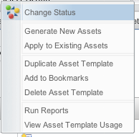
Asset Template
Status Controlled
Generate New Assets
Apply to Update Existing Assets
View Assets linked to template

Slide 54
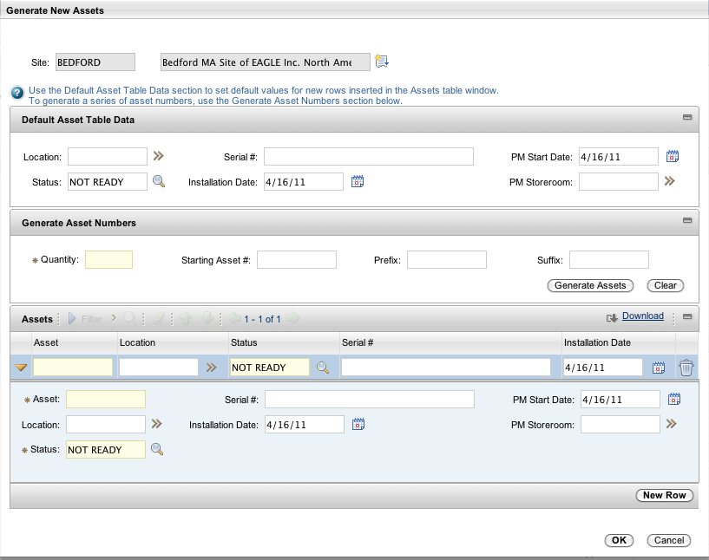
Asset Template
Default Table Date
Generate series of Numbers or manually number
Set PM Start Date and Storeroom

Slide 55
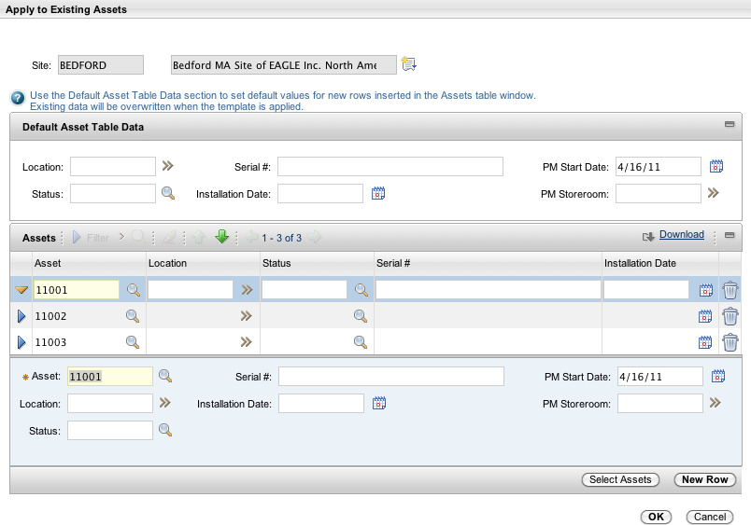
Asset Template
Selectively Update
Could update assets already tied to the template
Also tie other existing assets to the template

Slide 56
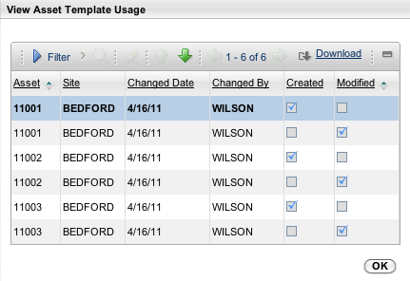
Asset Template
Usage Tracks application, creation and updates

Slide 57
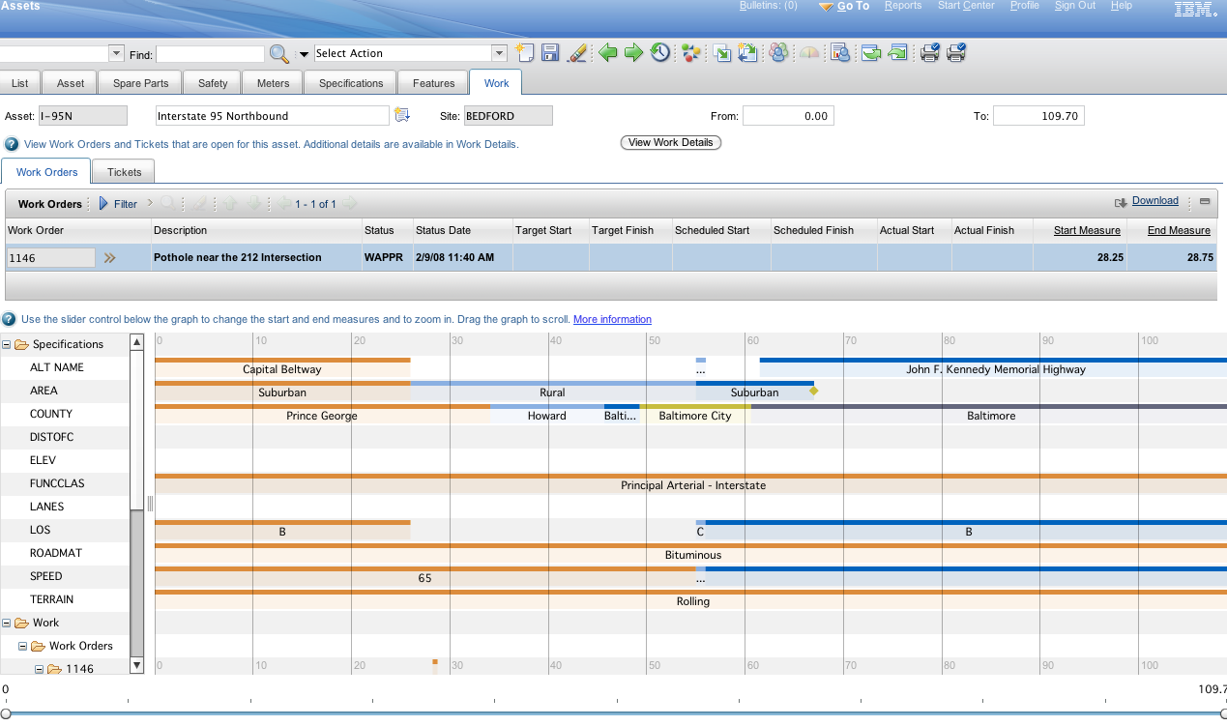
Linear Asset Visual Control
Specifications with hover help
Control Resolution with Slider Bar at Bottom

Slide 58
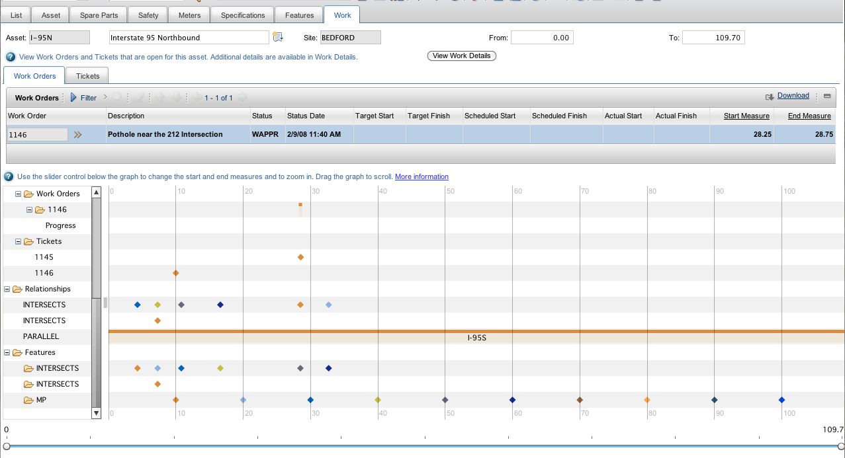
Linear Asset Visual Control
Visual representation of Work Orders and Tickets
Visual Representation of Relationships and Features

Slide 59
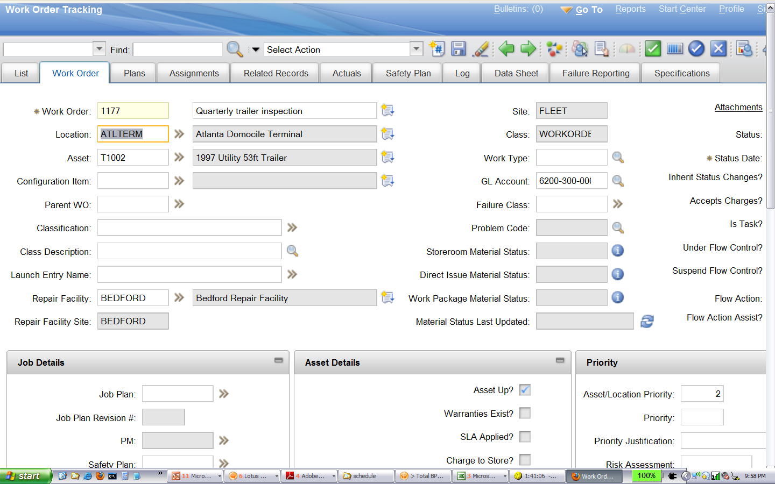
Work Order Repair Facility
Repair Facility where work is performed
Can be a different site than Work Order

Slide 60
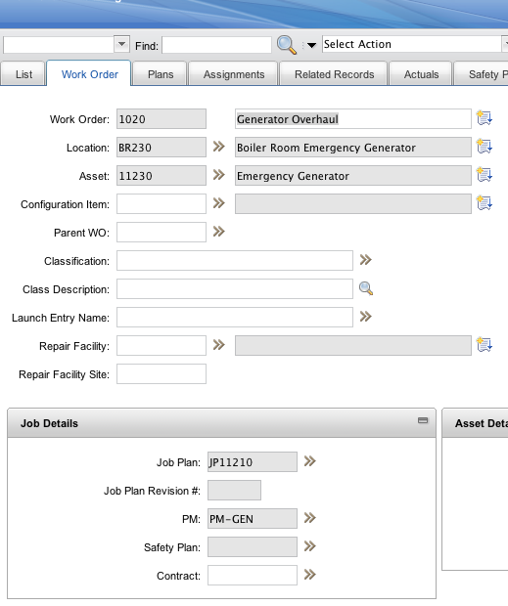
Job Plan Revisions
Standard Calibration Functionality becomes base

Slide 61
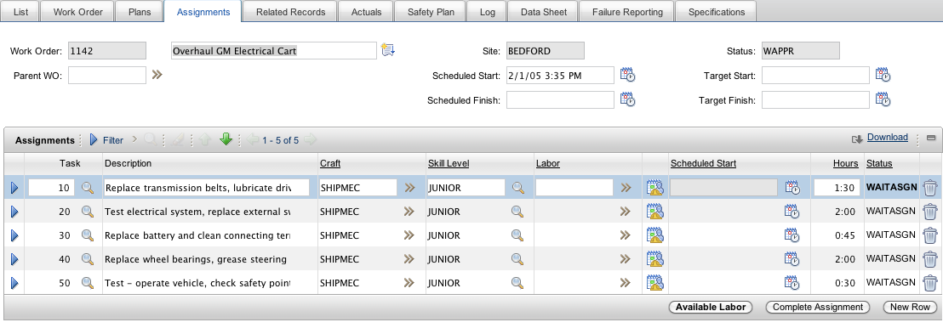
Work Order Assignments
Assignment Manager Assignments made directly from the Work Order

Slide 62
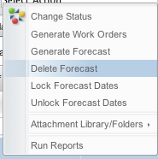
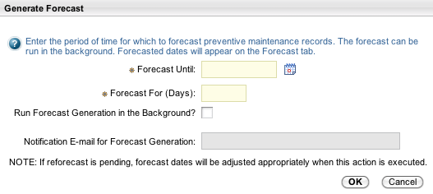
PM Forecasting
Generation of Forecast similar to generating Work Orders
Select Action to lock, unlock or delete forecast

Slide 63
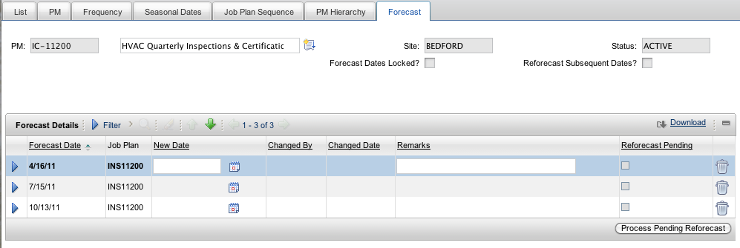
PM Forecasting
Make Adjustments to Dates
View Forecast in Scheduling Tool for Manpower review

Slide 64
IBM’s 2011 Asset Management Product Roadmap
Maximo Asset Management 7.5.0.0
Maximo Spatial Asset Management 7.5.0.0
Maximo Industry Solutions 7.5.0.0
Oil & Gas
Transportation
Utilities
Life Sciences
Nuclear Power
Government
TRIRIGA Portfolio - TBD
IBM Real Time Asset Locator for Healthcare 7.5.0.0
Maximo Asset Mgmt 7.5.1.0
Industry Solutions
Add-on’s
Maximo Asset Configuration Manager 7.5.0.0
Maximo Asset Mgmt. Essentials 7.5.0.0
IBM Real Time Asset Locator 7.5.0.0
Maximo for Service Providers 7.5.0.0
Maximo Archiving with Optim Data Growth Solution 7.5.0.0
TRIRIGA Portfolio - TBD
Maximo DCIM 7.5.1.0
Maximo Adapter for Oracle 7.5.0.0
Maximo Mobile Suite 7.5.0.0
Maximo for Internal Service Providers 7.5.0.0
Maximo Adapter for SAP 7.5.0.0
Maximo for Safety, Risk & Compliance 7.5.0.0
Intelligent Building management Solution 1.x
Maximo Everyplace 7.5.0.0
Q2 2011
Q3 2011
Q4 2011
2012
Maximo for Data Center Infrastructure Mgmt 7.5.0.0
Maximo Scheduler 7.5.0.0
Fix-pack 6.2.8
Fix-pack 7.1.1.9
Fix-pack 7.5.0.1
Maximo Mobile 7.5.1.0
Maximo Adapter for Primavera 7.5.0.0
Fix-pack 7.1.1.10
Maximo Everyplace 7.5.1.0
Maximo for Energy Optimization 7.5.0.0
Intelligent Building Management Solution 1.x.0.0
Maximo Adapter for Microsoft Project 7.5.0.0
TAMIT 7.5.0.0
Fix-Packs
Maximo adapter for ITM 7.5.0.0
TSRM 7.5.0.0
7.x.0.0 Releases
CCMDB 7.5.0.0
New Products
Planned Releases
Notes:
* Shoul

Slide 65
Questions ?

Slide 66
For More Information Visit: www.cohesivesolutions.com or Matt Logsdon 770-378-5402 mlogsdon@cohesivesolutions.com

