Slide 1
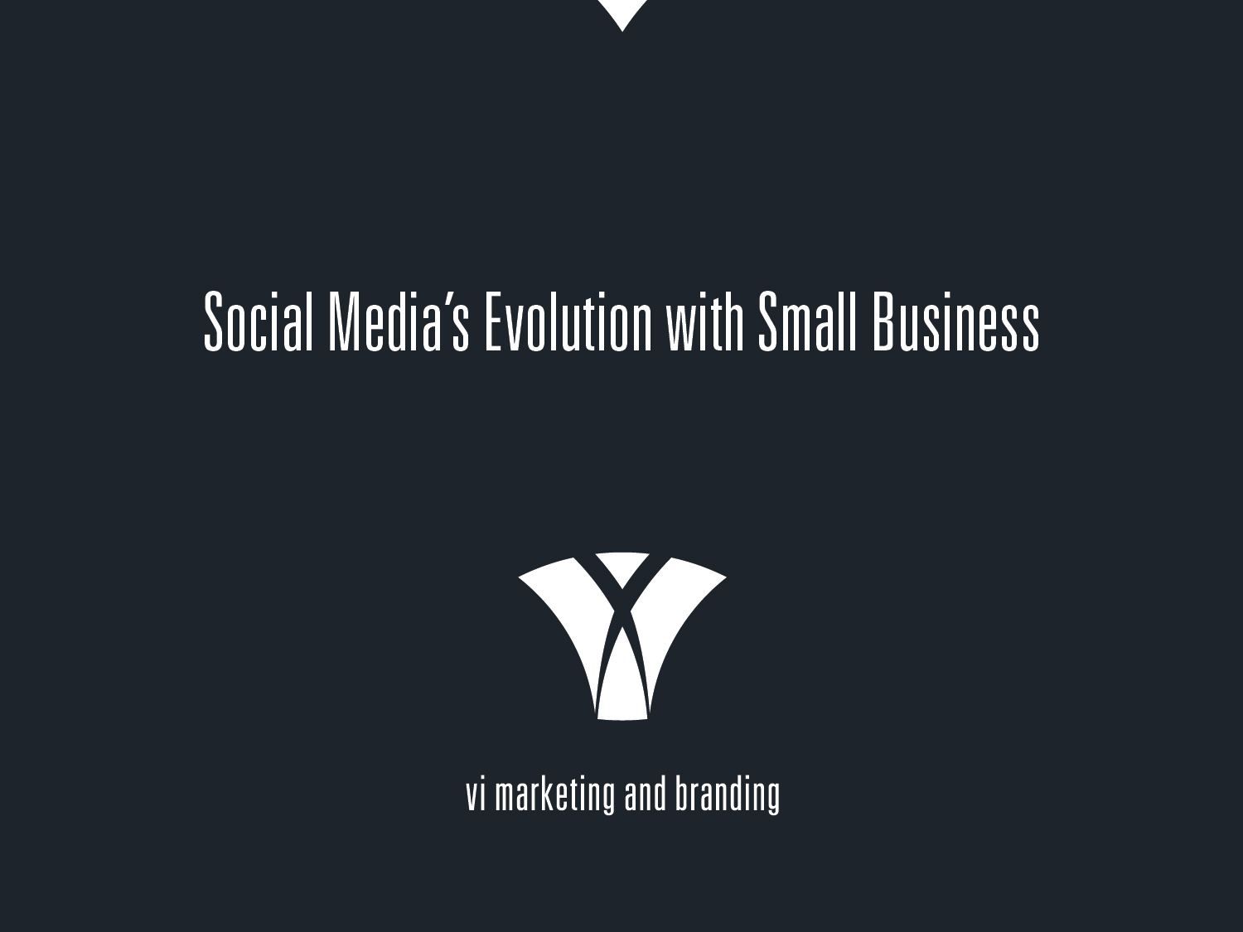
Notes:
1. VI Marketing and Branding: 65-person agency headquartered in Oklahoma City with offices in Kansas City and Colorado Springs with specialists in 20+ different marketing disciplines including: PPC, Display, SEO, Social Media, Public Relations, In-House Film, Motion Graphics, Media Buyers, Web Design, Graphic Design and more.

Slide 2
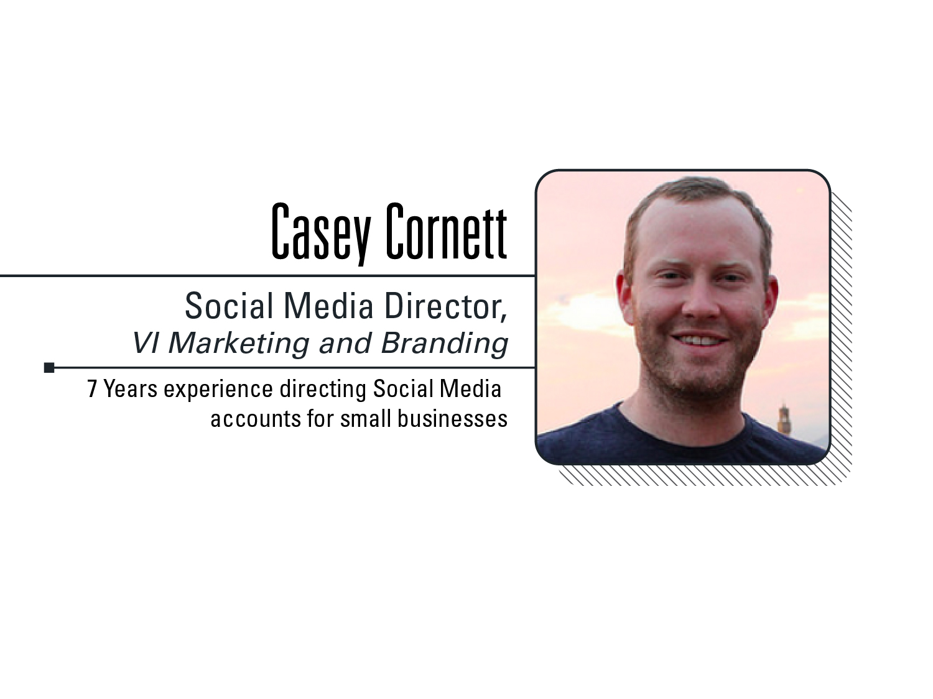
Notes:
2. My name is Casey Cornett and I have been the Social Media Director at VI Marketing and Branding for the past four years. I lead a team of incredibly smart social media strategists who develop and execute social media campaigns and brand development for local, regional and national clients. My background is in Public Relations which I believe is a perfect fit for anyone who has control over public messaging for a brand. I often speak on social media strategies at universities and non-profits in the area. While this is my first presentation at Confluence Conference, speaking today on social media is “not my first rodeo.”

Slide 3
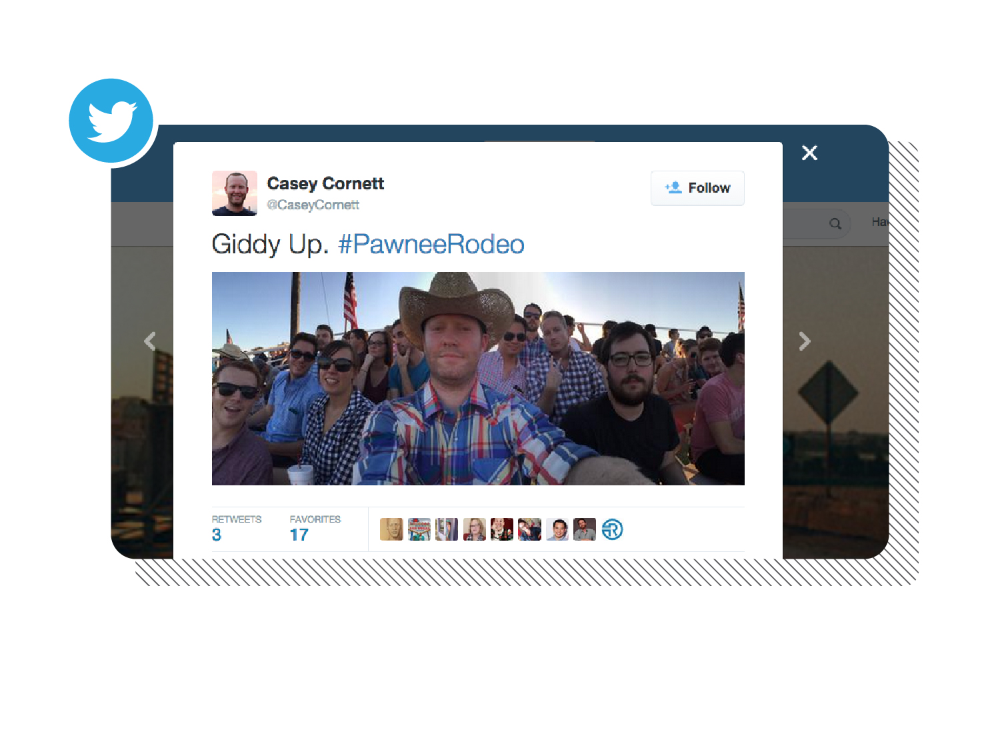
Notes:
3. In the literal sense, August 8, 2015 WAS my first rodeo. This is a panoramic selfie I took with a group of friends when we went to Pawnee, Oklahoma for the weekend and went to the Pawnee Bill Memorial Rodeo. I loved this photo and tweeted it out.

Slide 4
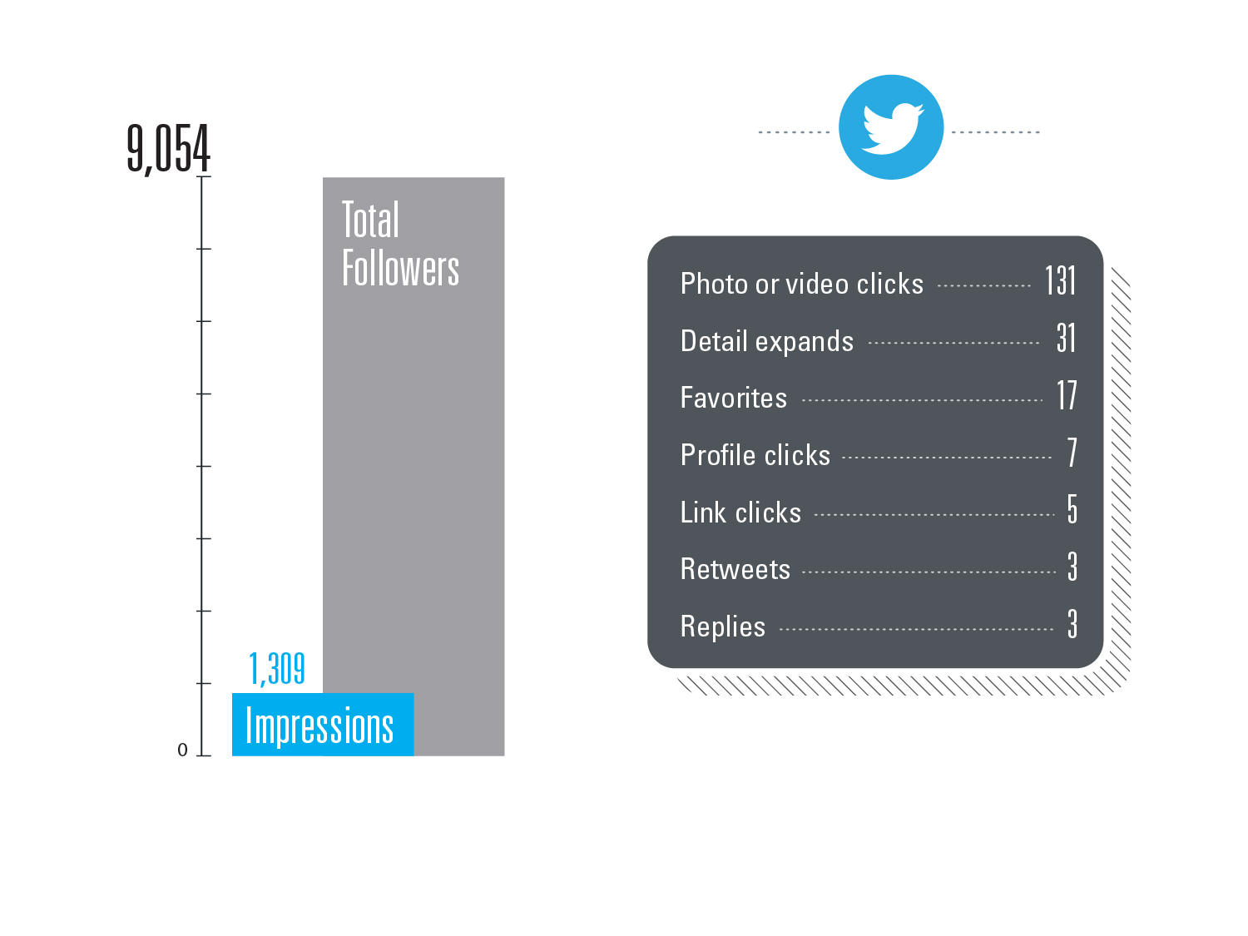
Notes:
4. My followers along with all the followers of those three people who retweeted it allowed for a possible reach of 9,054 Twitter users, yet only 1,309 impressions were actually made. Only 14% of the total.

Slide 5
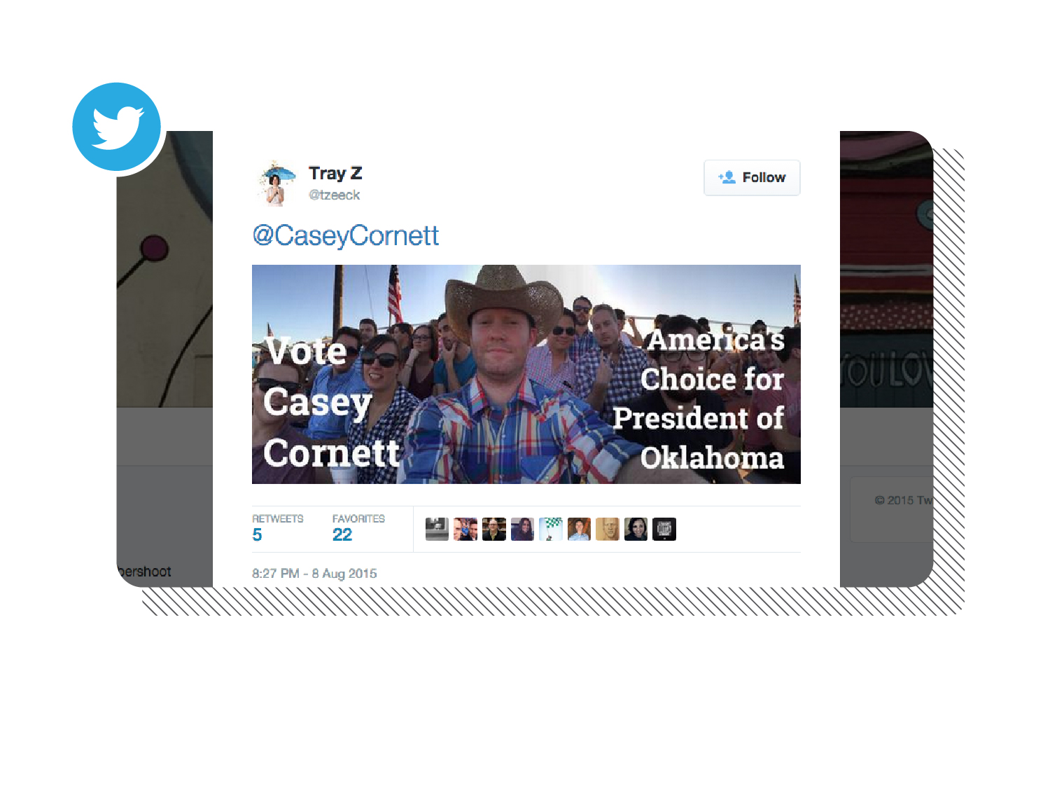
Notes:
5. Minutes later my friend Tracey Zeeck (@tzeeck) tweeted this out. She edited my photo to include “Vote Casey Cornett America’s Choice for President of Oklahoma.” Her tweet was obviously an improvement to mine.

Slide 6
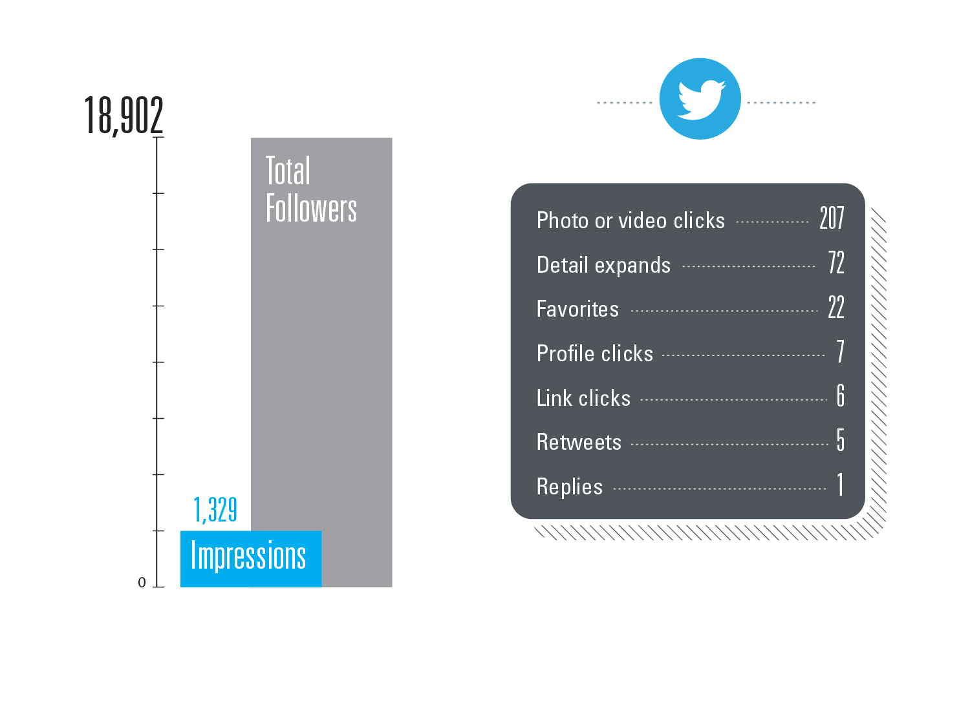
Notes:
6. Her followers, along with the followers of those five people who retweeted her had a potential reach of 18,902 yet only had 1,329 impressions. 7.2% of the total.

Slide 7
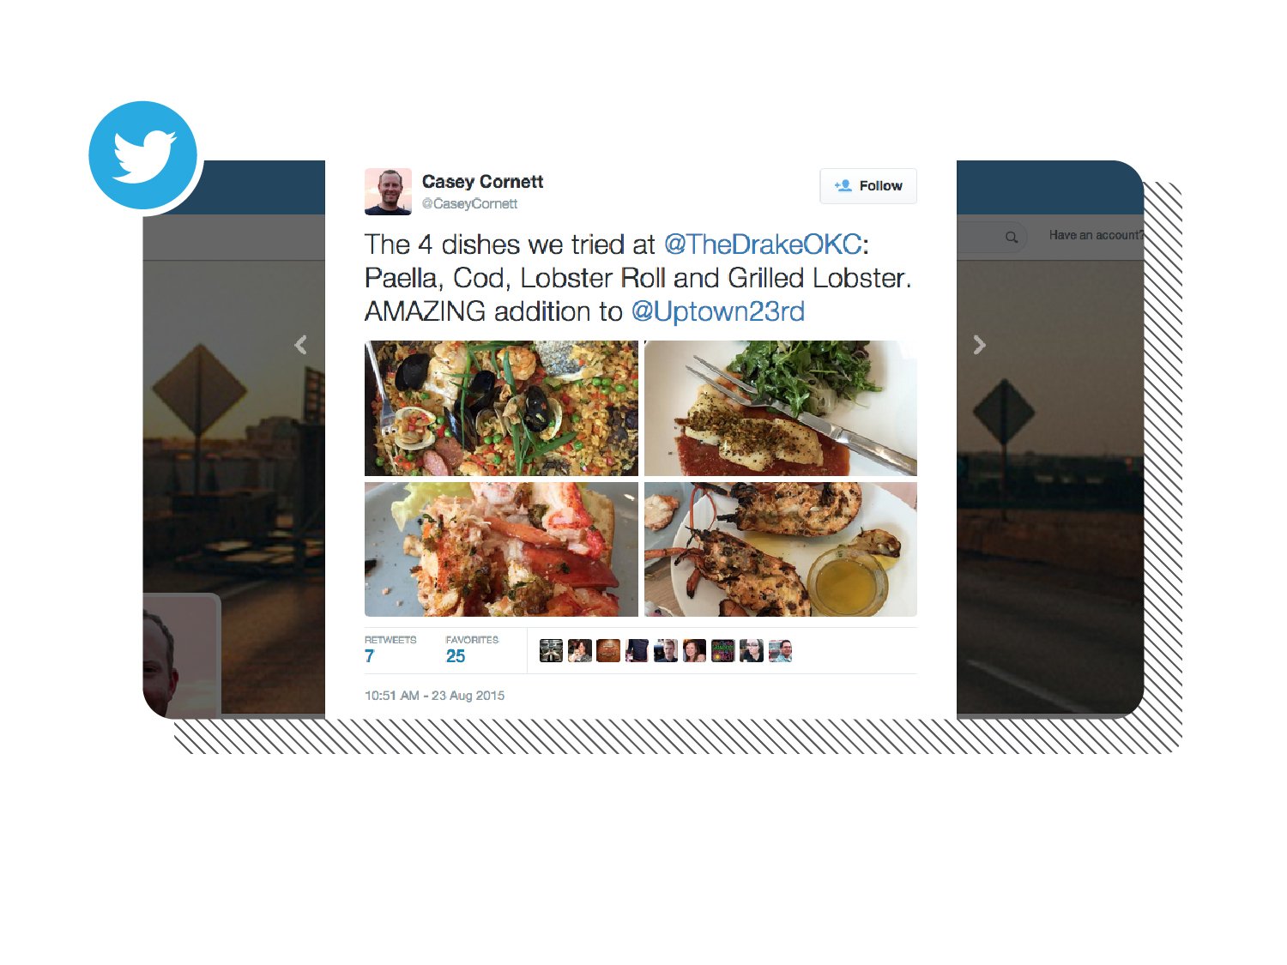
Notes:
7. One more example. This was a tweet I posted after my visit to The Drake, the new oyster bar for A Good Egg Dining Group.

Slide 8
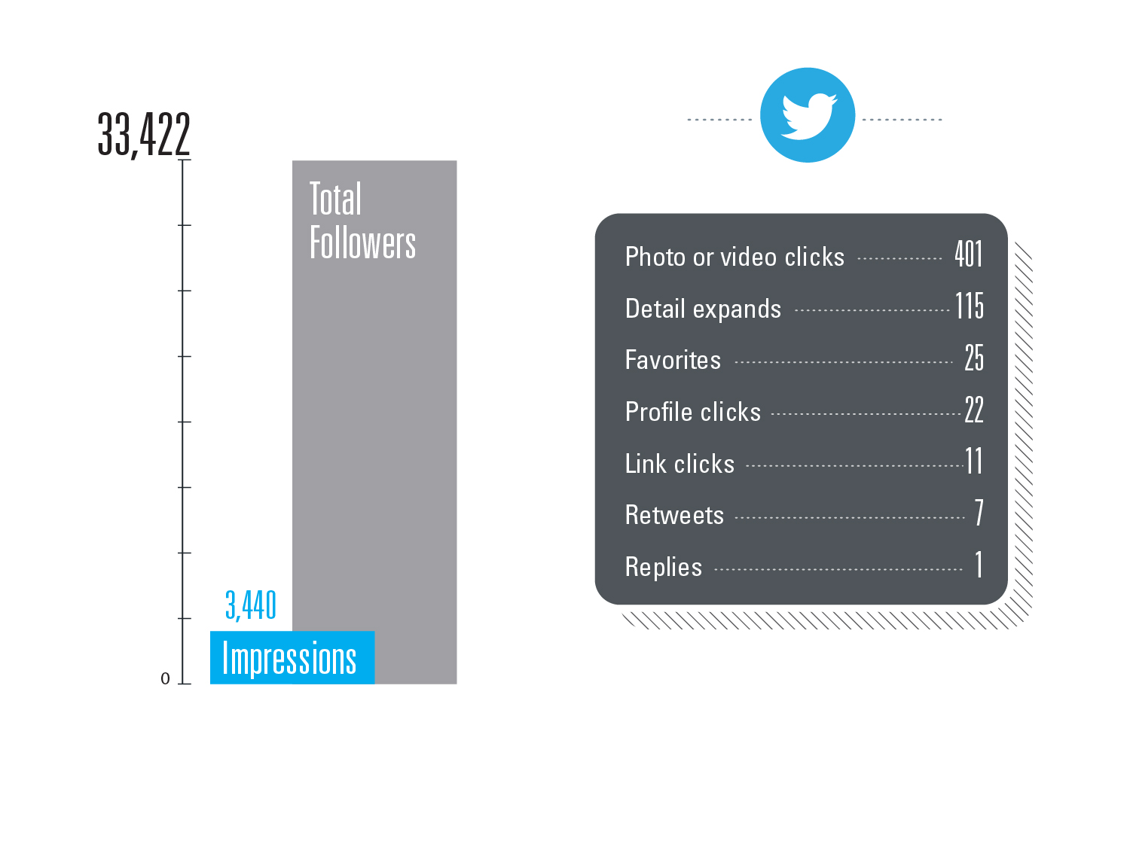
Notes:
8. My followers and the followers of the seven people who retweeted it had a potential reach of 33,422 but only had 3,440 impressions. Reaching only 10% of the possible audience. If you think these numbers and percentages are bad…

Slide 9
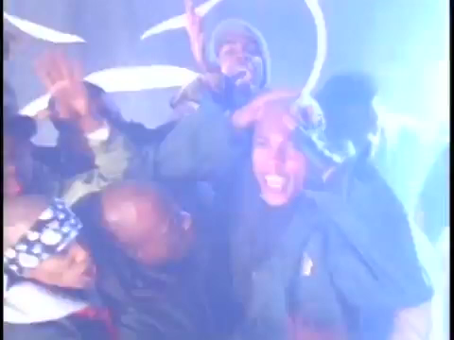
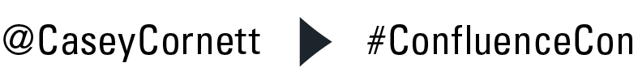
Notes:
9. (Video with sound here) “BU BU BU BU BU BUT WAIT IT GETS WORSE!”

Slide 10

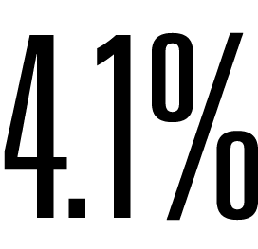
Notes:
10. Facebook. The evil empire of social media. Studies show that a small business with a Facebook page of 1,000 LIKES will get on average a 4.1% reach organically on its posts…meaning only 41 out of the 1,000 fans will actually see your post. And of those 41, they are the most engaged fans which means it will be the same 41 over and over most likely including: co-workers, and employees’ families; hardly the audience you are trying to reach. But how did we get to this point in 2015 social media? Considering engagement is what drives that % up or down, let’s take a look at the average Facebook users timeline to see why brands are not getting the engagement they want (on Facebook).

Slide 11
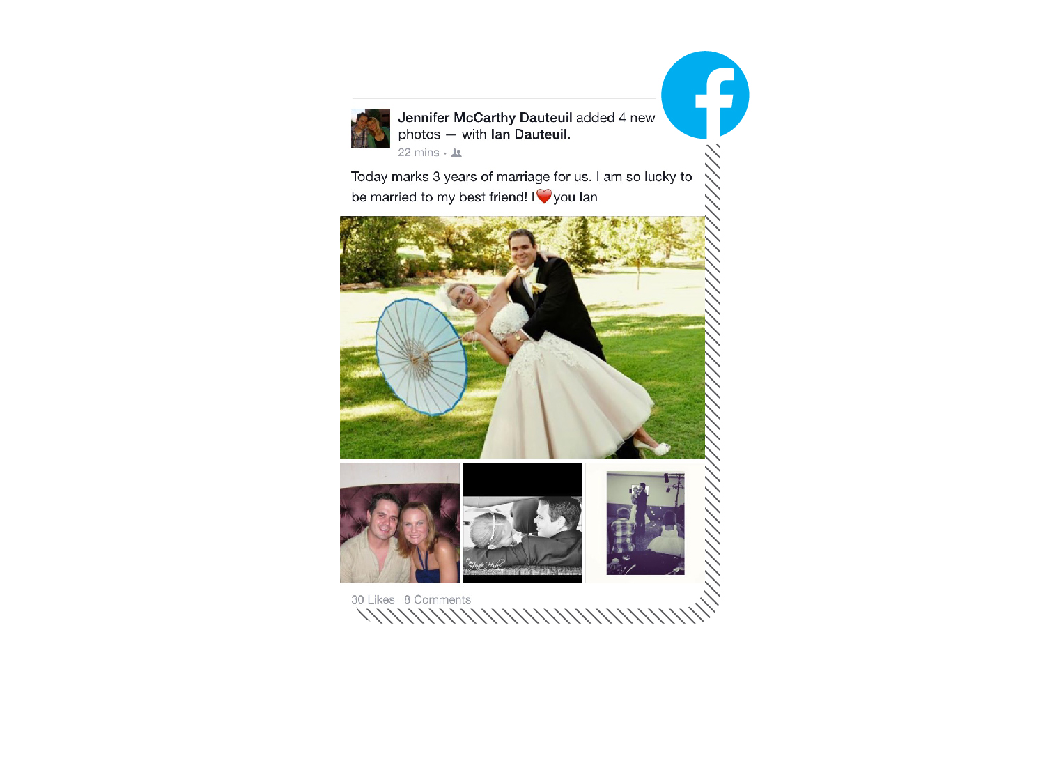
Notes:
11. First, you turn on your app and see photos from your friend’s wedding. That’s nice.

Slide 12
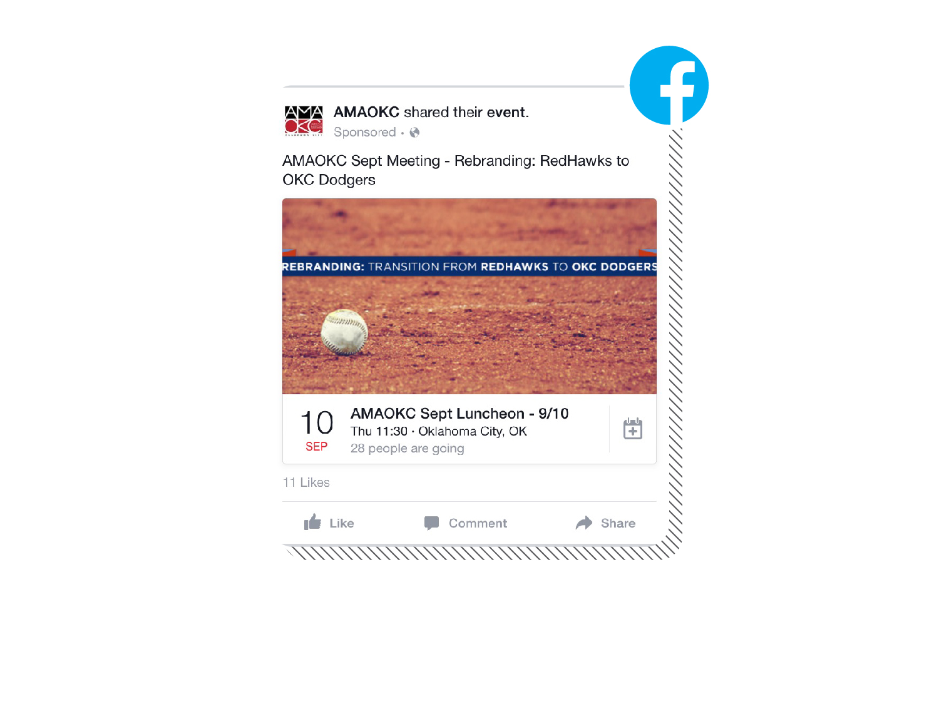
Notes:
12. Scroll down and you see an event from a brand you follow (or possibly it’s an ad they served you with).

Slide 13
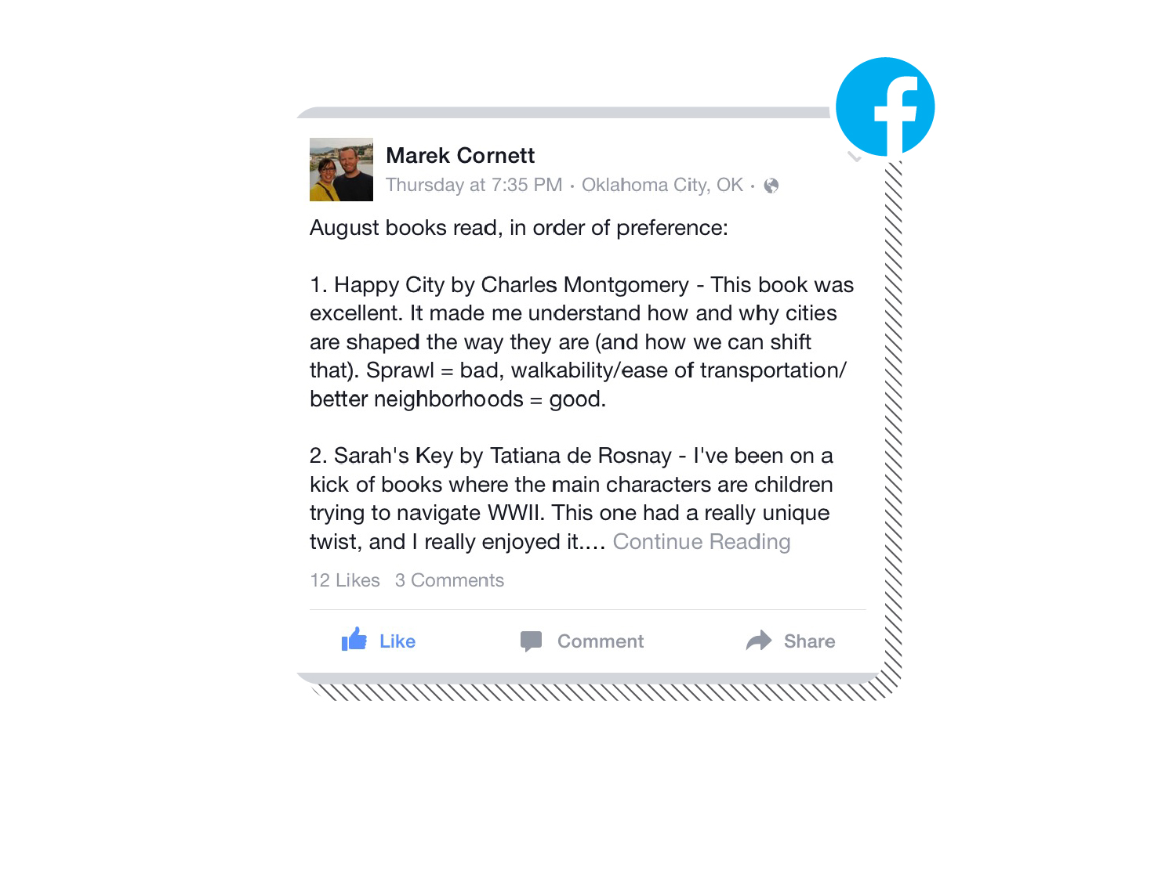
Notes:
13. Scroll down more and it’s a post form the user’s wife or best friend (my wife in this case). “Like”

Slide 14
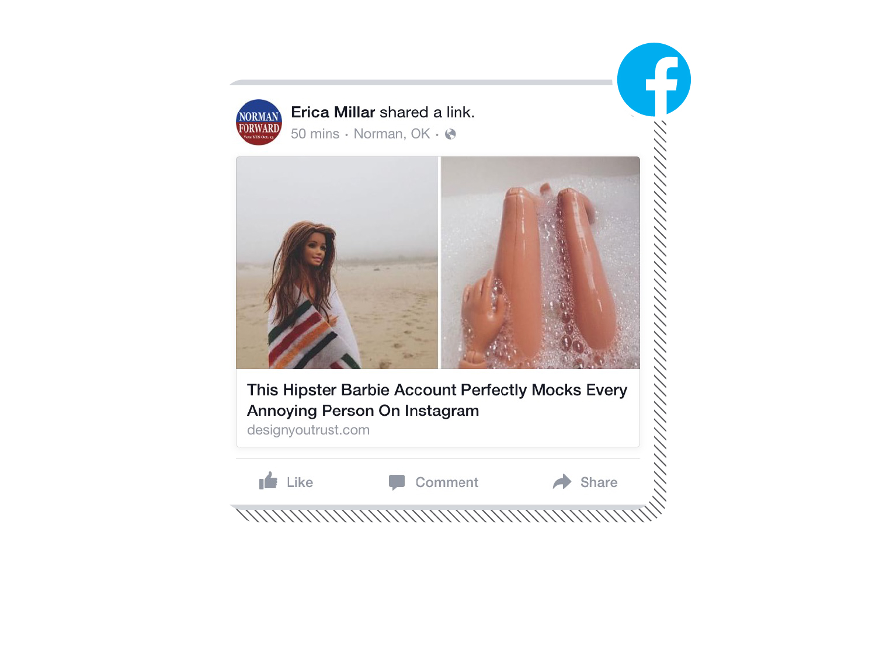
Notes:
14. Another scroll and we see some click bait of Barbie in the bathtub. A little outlandish but it’s attention-grabbing none the less.

Slide 15
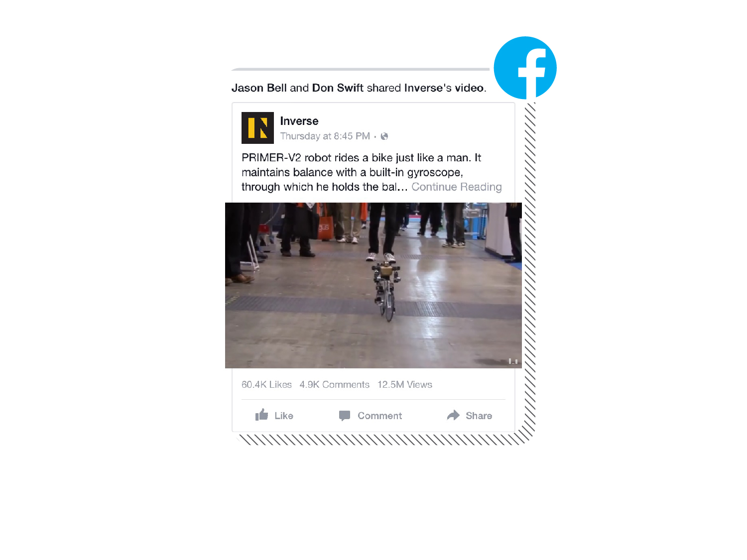
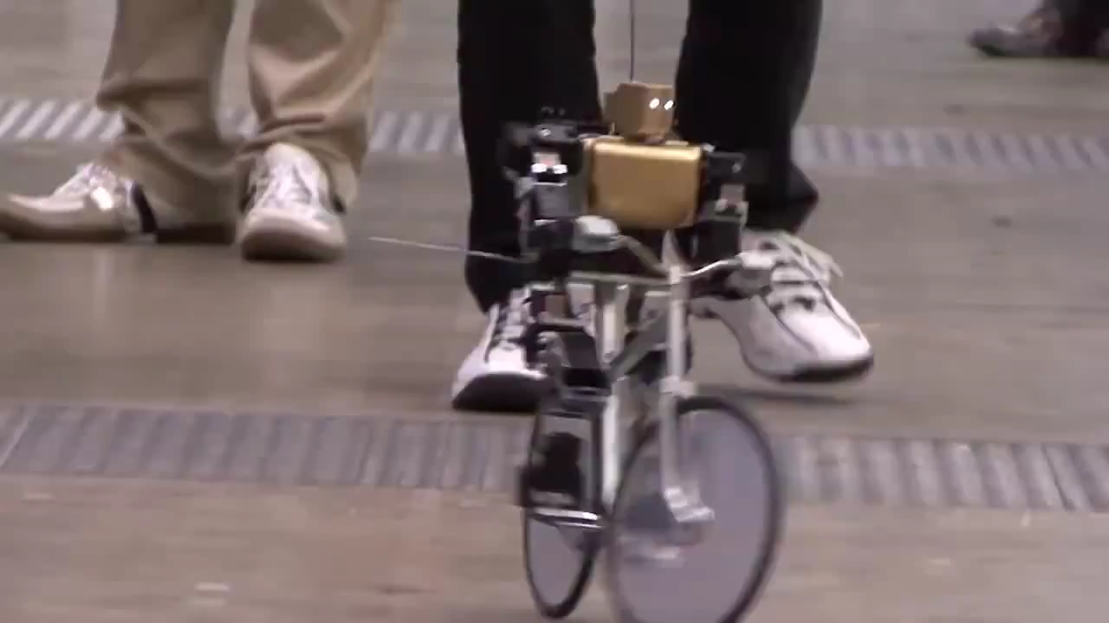
Notes:
15. And finally we scroll down to a 5th post and it’s a video auto-playing of a robot riding a bike. A robot on a bike video! You see, your competitors in the real world are not your competitors on social media. In social media your competitors are the users friends, family, barbie and even a robot riding a bike! As a small business, your content needs to be as captivating as a robot on a bike to keep me from scrolling on to the next post. Get creative! Stop me from scrolling.

Slide 16

Notes:
16. A small business has a lot of good things going for it. Easy approval processes. A “Go get ‘em” attitude. But unfortunately, it usually means that the few employees that work for a small business are usually wearing many different hats at the same time. Meaning, it is likely the youngest in the office who is in charge of social or maybe it’s someone who only knows that “engage” is a priority. They often fall into a pattern of using social the way they first learned to use it years ago as a personal profile (not as a business). They have missed the evolution and all of its advantages. Before we jump into all the advantages, let’s take a look at where we came from in the social media world as it pertains to a small business.

Slide 17
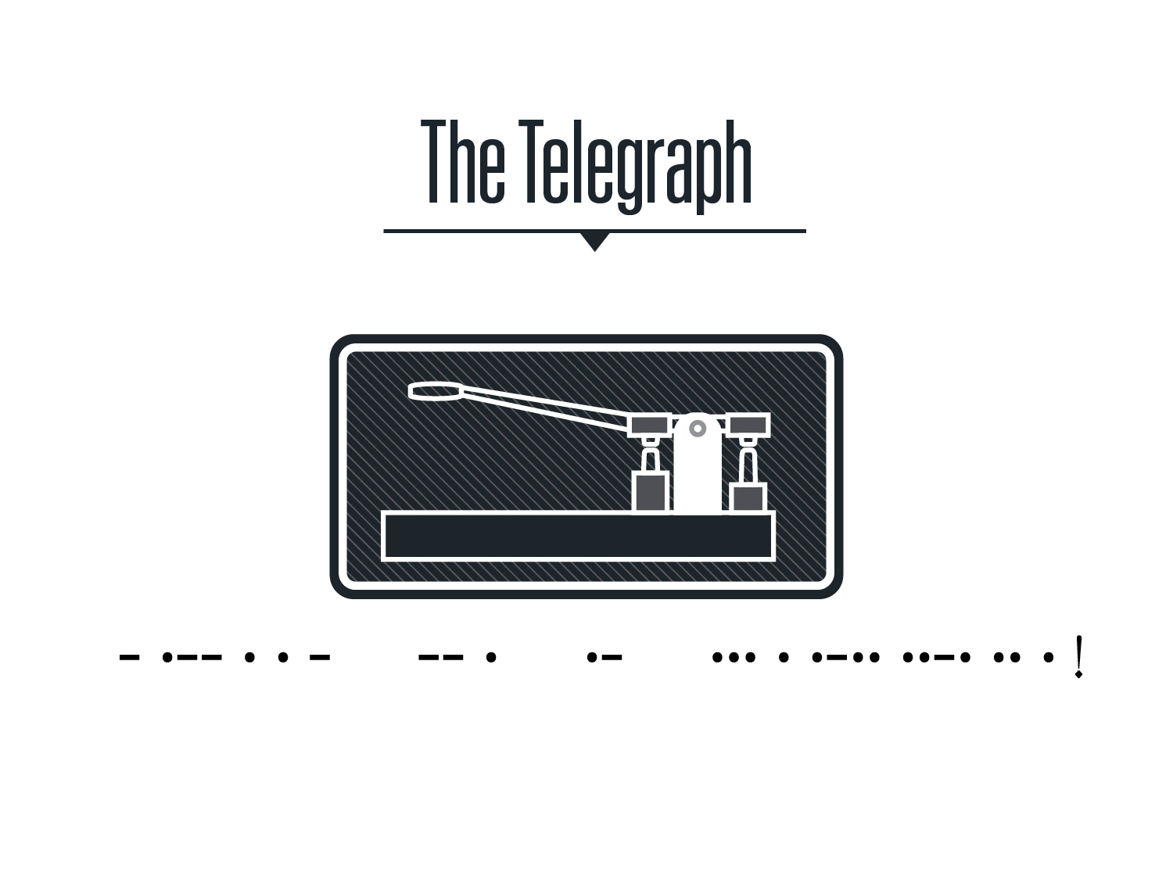
Notes:
17. The telegraph. I have heard many presentations use the telegraph as the launching pad for the first social media “network.” As a small business, you must be asking yourself, “Who cares?” Good point. This presentation isn’t a history lesson. It’s a look in how social media has evolved with small business. And social for a small business didn’t start with the telegraph. It started on a morning much more recent. Can you guess what morning that was?

Slide 18
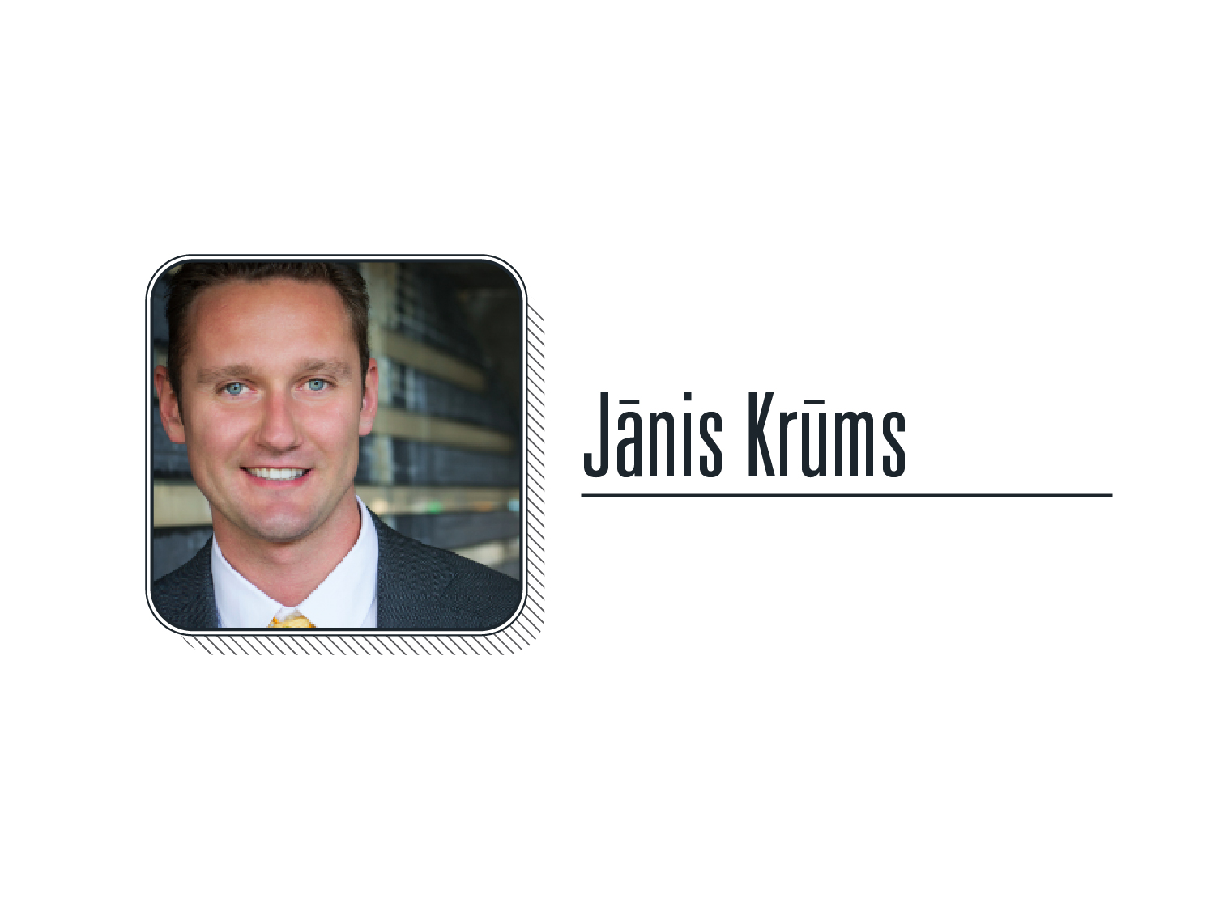
Notes:
18. Does this help? Janis (pronounced yanis) was in my opinion a crucial figure in social media for small businesses. Before Janis’s famous tweet, small businesses saw social as an after thought. No strategy except to maybe secure an account and occasionally check it for bad reviews on your brand or product. But what was it that Janis posted that changed the social media industry for small businesses so much?

Slide 19
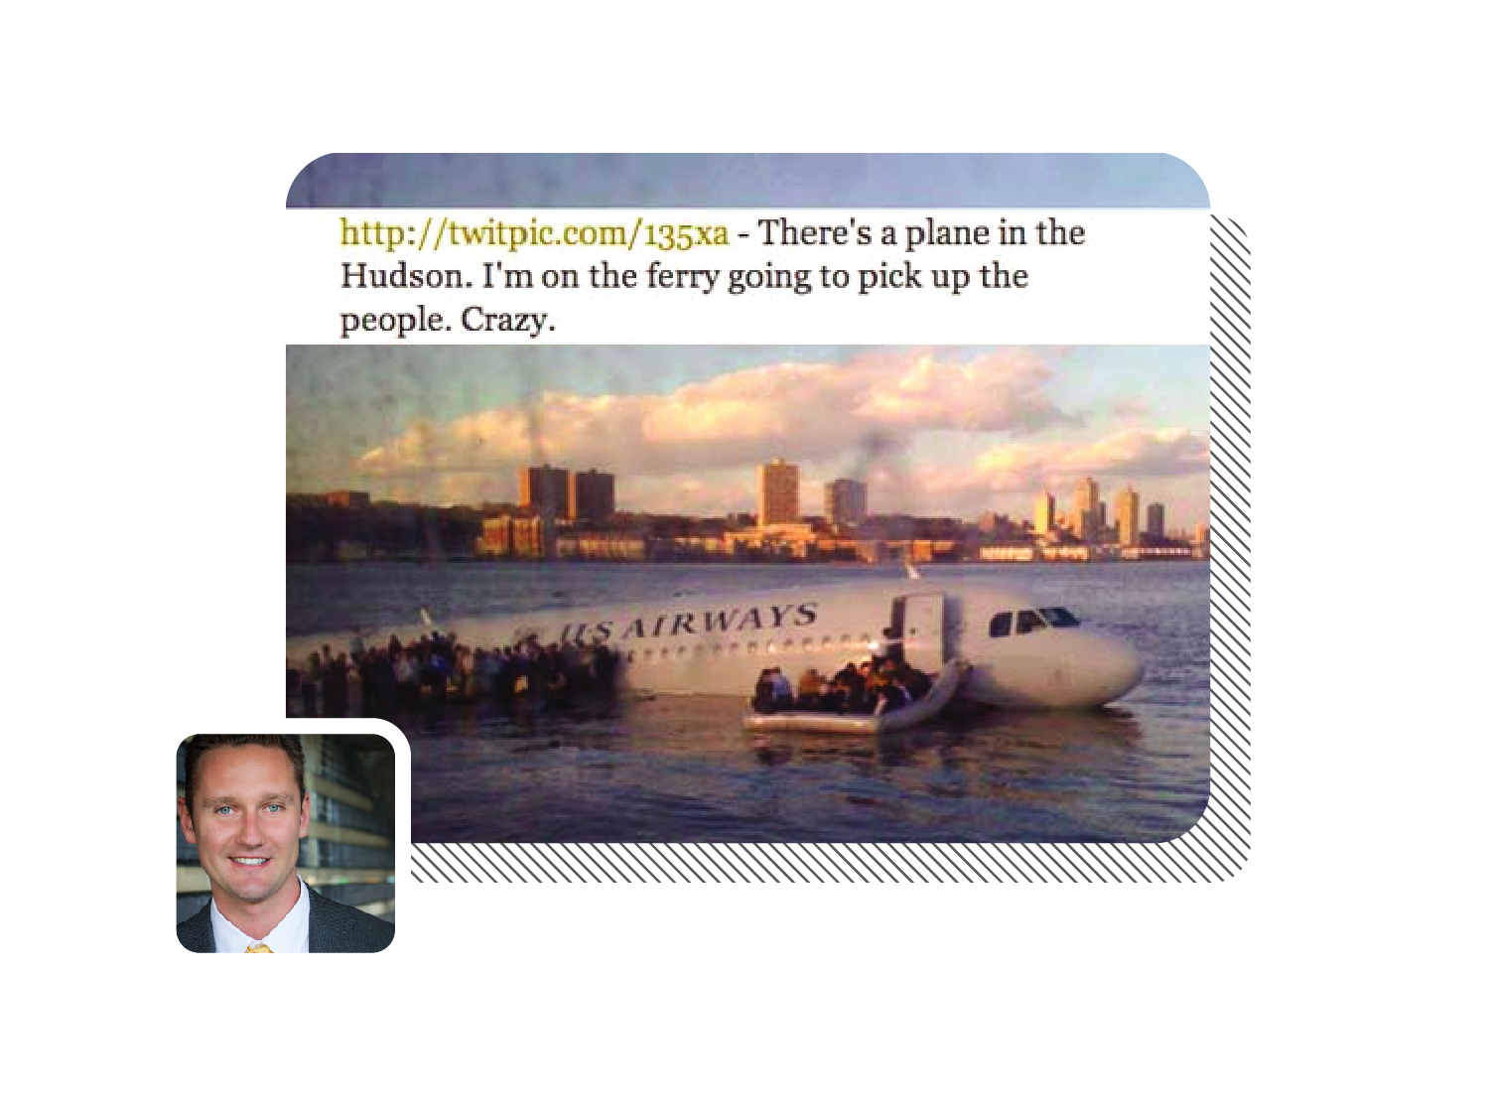
Notes:
19. This. A plane landed in the Hudson and the world lost its mind. For the first time a “Regular Joe” became a worldwide citizen journalist and photographer. Every media outlet around the world was using this photo and Janis’s “quote” for their leads and source. It wasn’t waiting for the 10:00pm news or tomorrow’s newspapers. The world wanted it NOW, and through Twitter they received it. The business in the photo is obviously not a small business, but that is not the point. The point is that this single tweet made Twitter explode. It gave precedence to the notion that one singe user (read “small business”) could get their message to the masses. It was possible, and to a small business sometimes that all you need to hear.

Slide 20
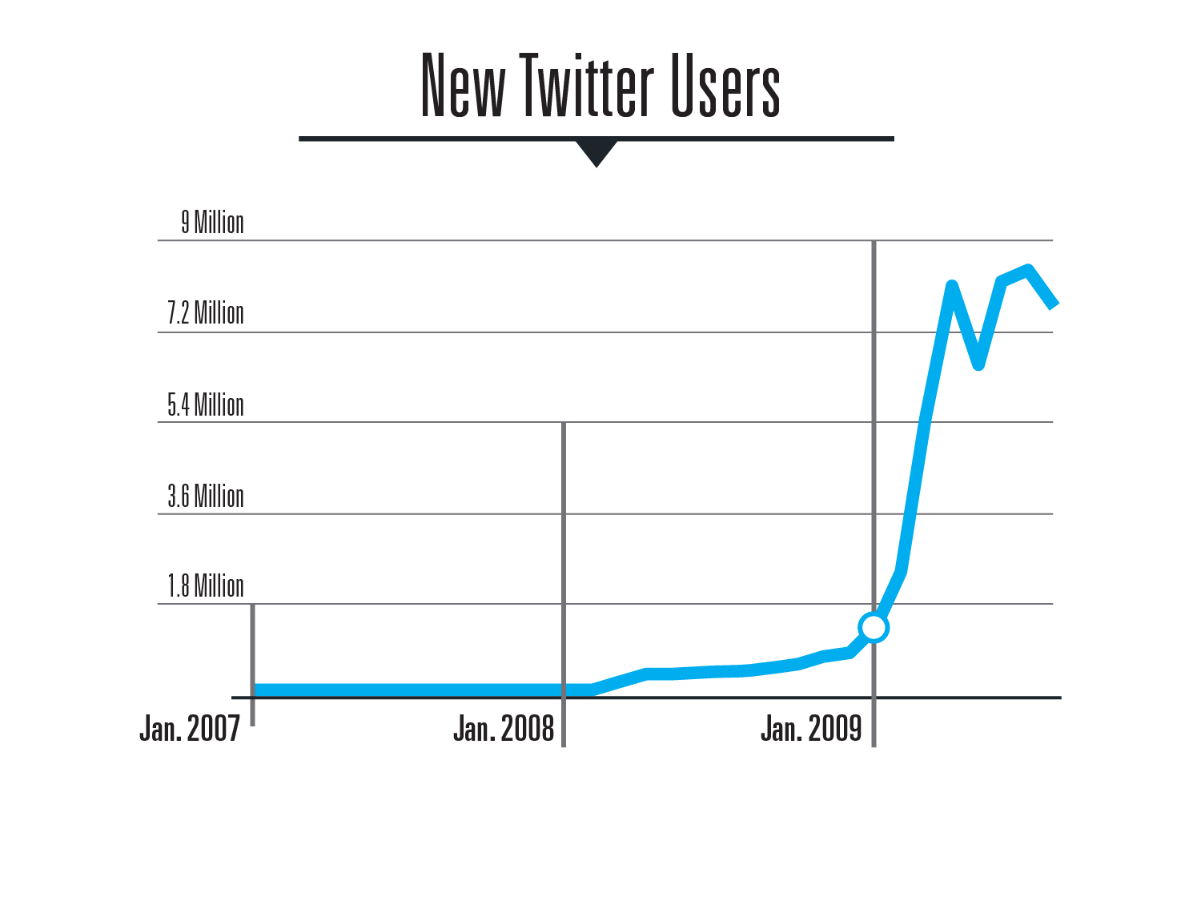
Notes:
20. You want proof that this moment was big for social? How does this chart satisfy that need? Accounts and individual users began jumping onboard at a ridiculous pace. Before this, that flat little line was basically just me and some friends. Now, Twitter was a behemoth. So, what did small businesses do in their infancy?

Slide 21
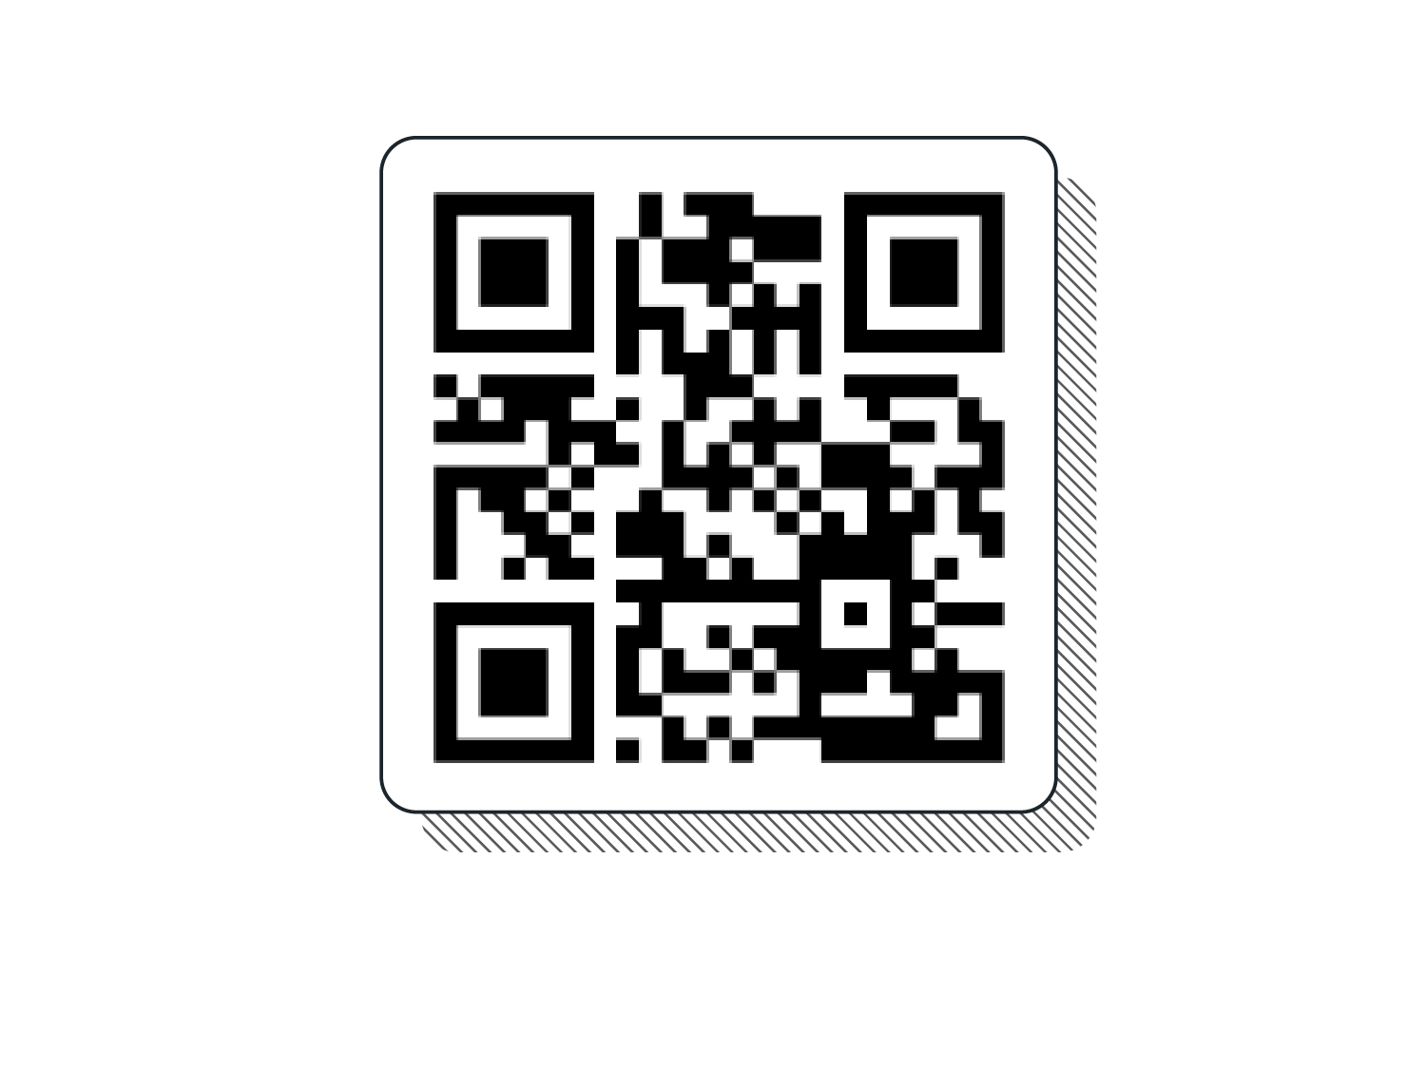
Notes:
21. They put this on EVERYTHING. Didn’t matter what it was. Roadside billboard? Sure! Problem solved. What else?

Slide 22
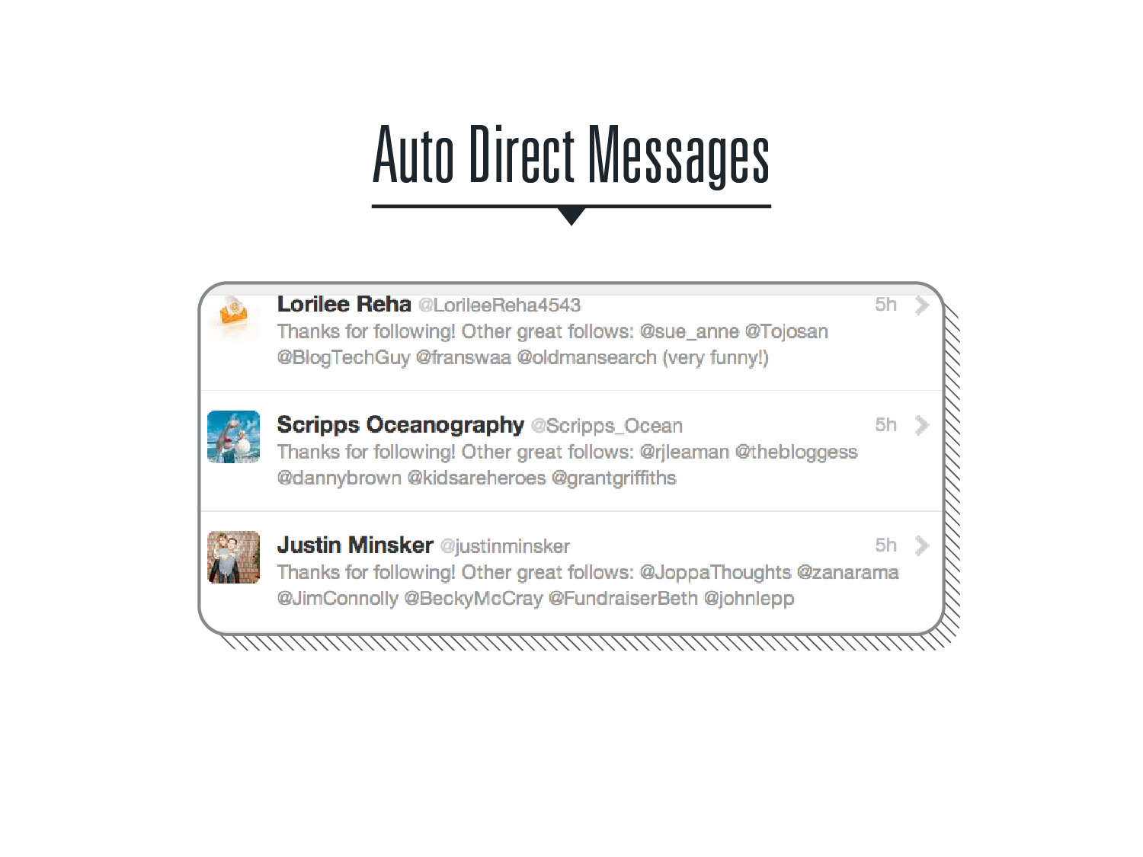
Notes:
22. They auto-messaged everyone, seemingly saying, “Thanks for allowing our messages into your feed! Now, as our first communication together, click on this random crappy link!”

Slide 23

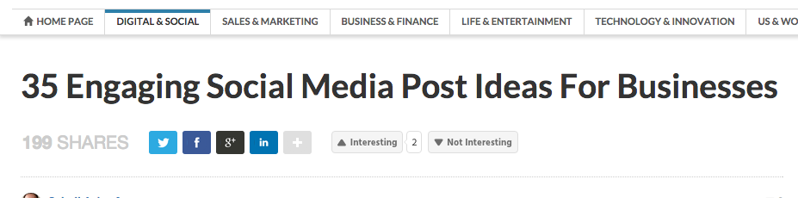
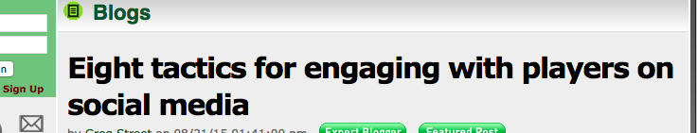
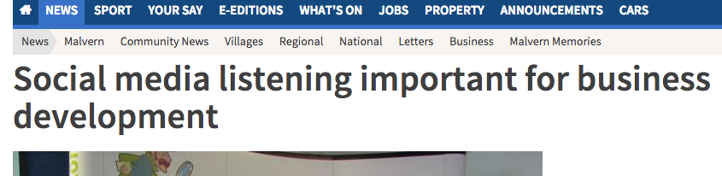
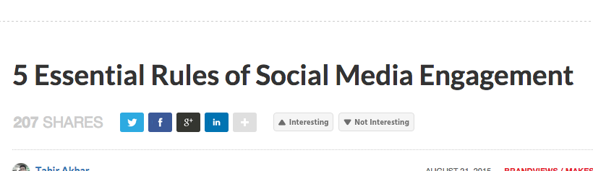
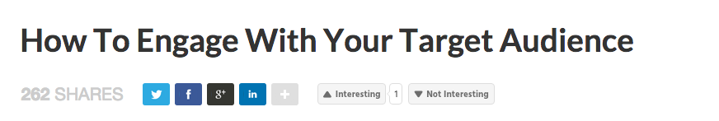
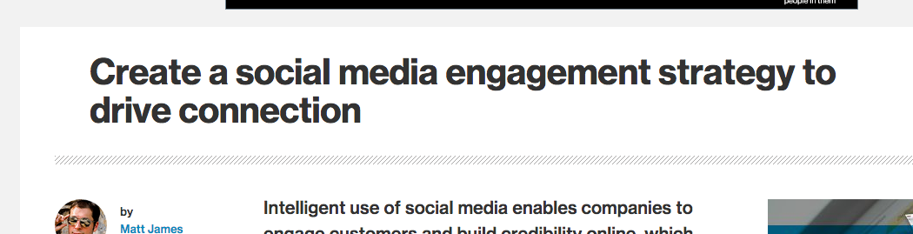
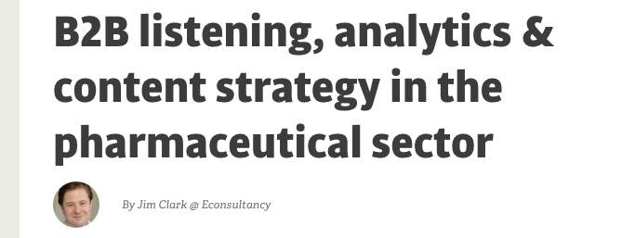
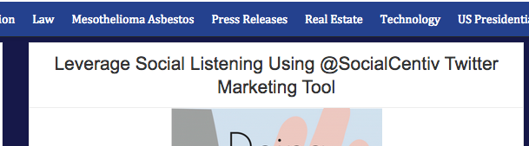
Notes:
23. But small businesses knew to “engage.” How could they not know it? It was the headline everywhere. “ENGAGE WITH CUSTOMERS!” “”ENGAGE NOW” “WAYS TO ENGAGE!” ENGAGE! ENGAGE! ENGAGE!

Slide 24
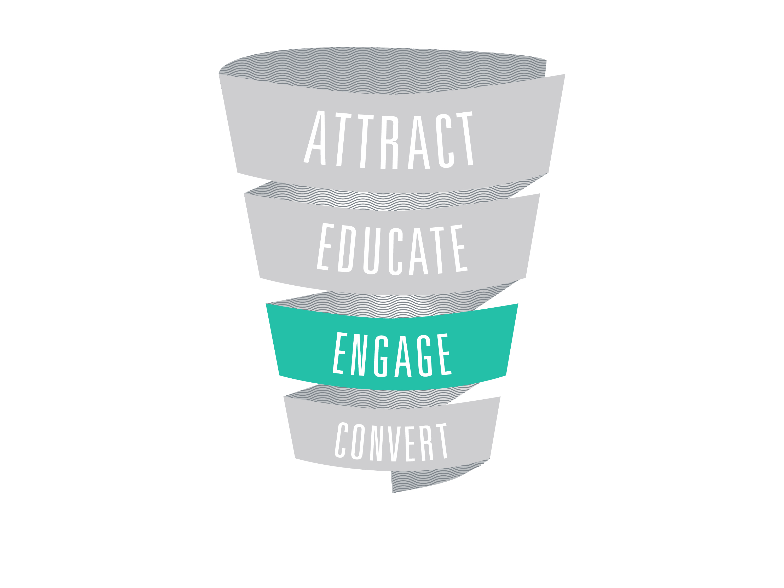
Notes:
24. Small businesses were stuck. They found a way in (by engaging), and they held on too tight. They boxed themselves in and put up blinders as the social media evolution truly took place. They knew the marketing funnel called for four different sections for growing their business: Attract, Educate, Engage and Convert. They knew social was perfect for the Engage section. A few advanced small business owners even took advantage of some ways to (on a small scale) use social media for other parts of the funnel but it wasn’t very rewarding for the time it took to complete. But as time went on, social media for small businesses began taking HUGE steps forward (for those who were paying attention). The social media industry made HUGE steps forward allowing for the other sections of the funnel to become equally worth it.

Slide 25
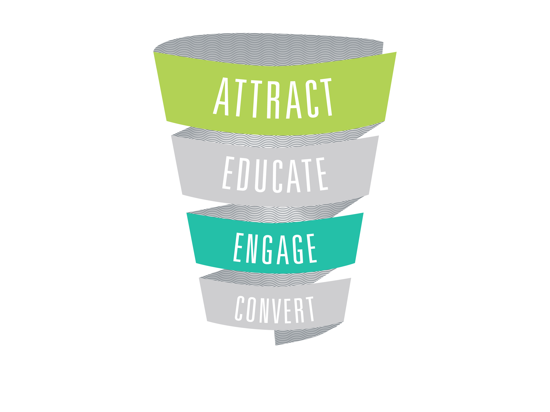
Notes:
25. Over time you were allowed (and encouraged) to use social media as a small business to Attract.

Slide 26
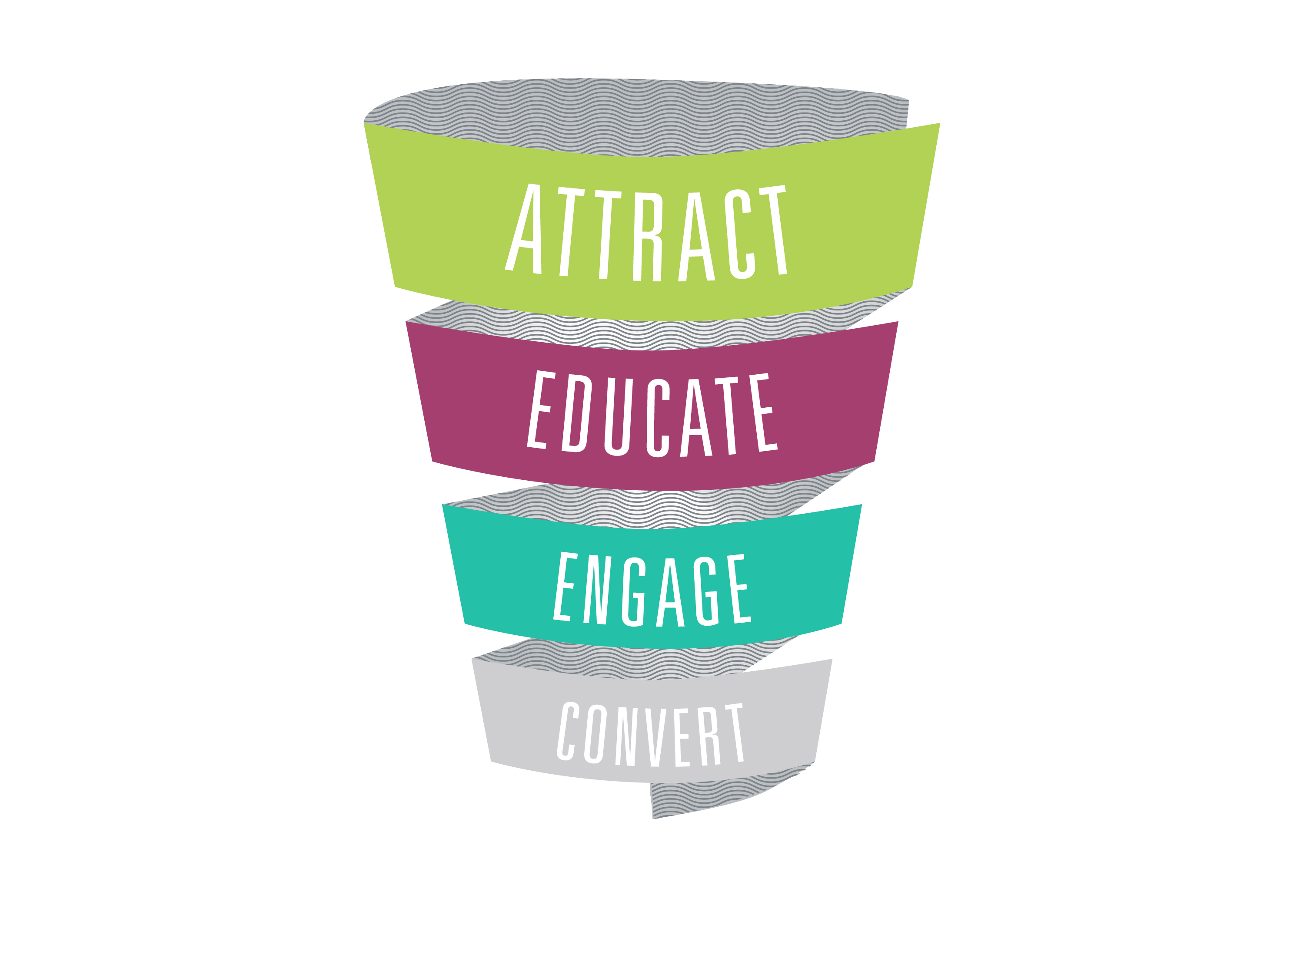
Notes:
26. To Educate. To Engage.

Slide 27
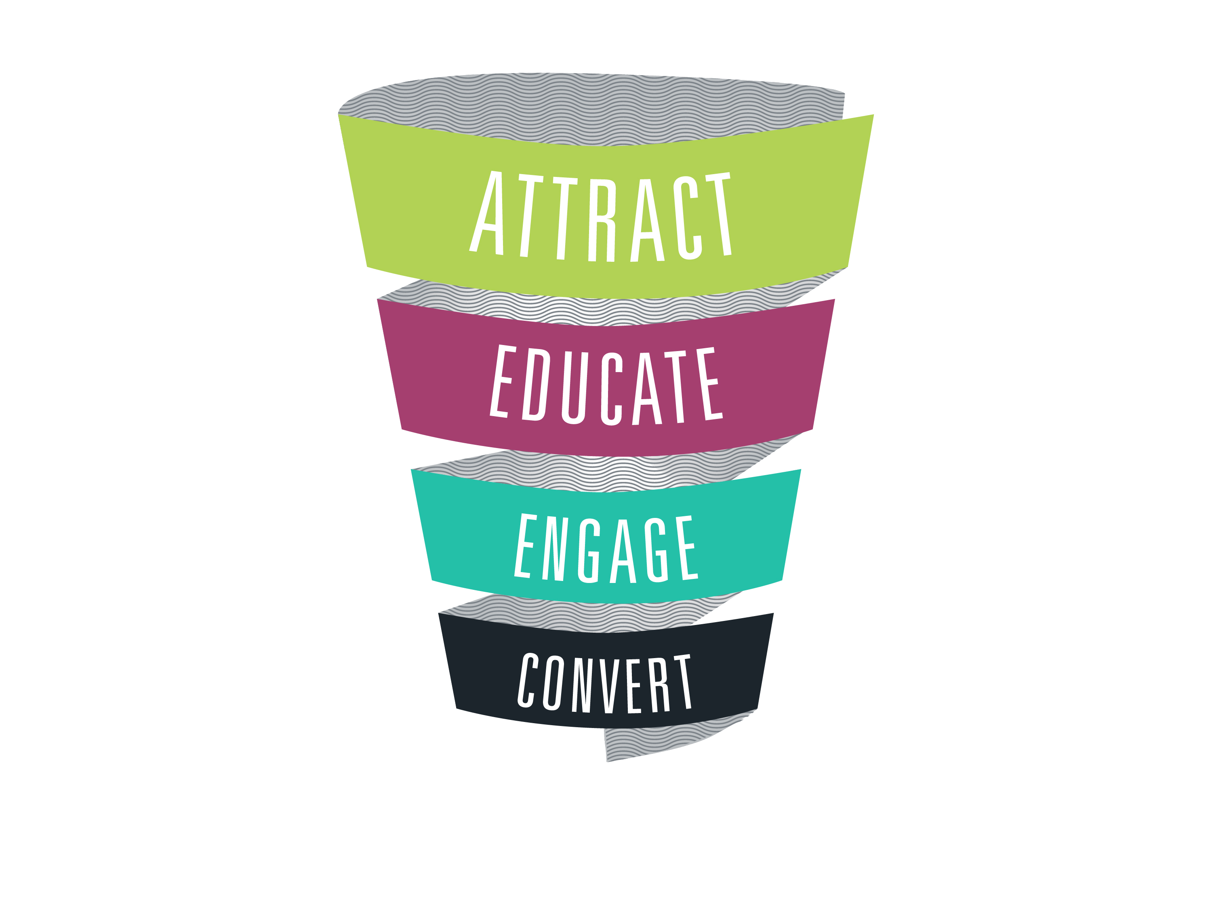
Notes:
27. And to Convert.

Slide 28
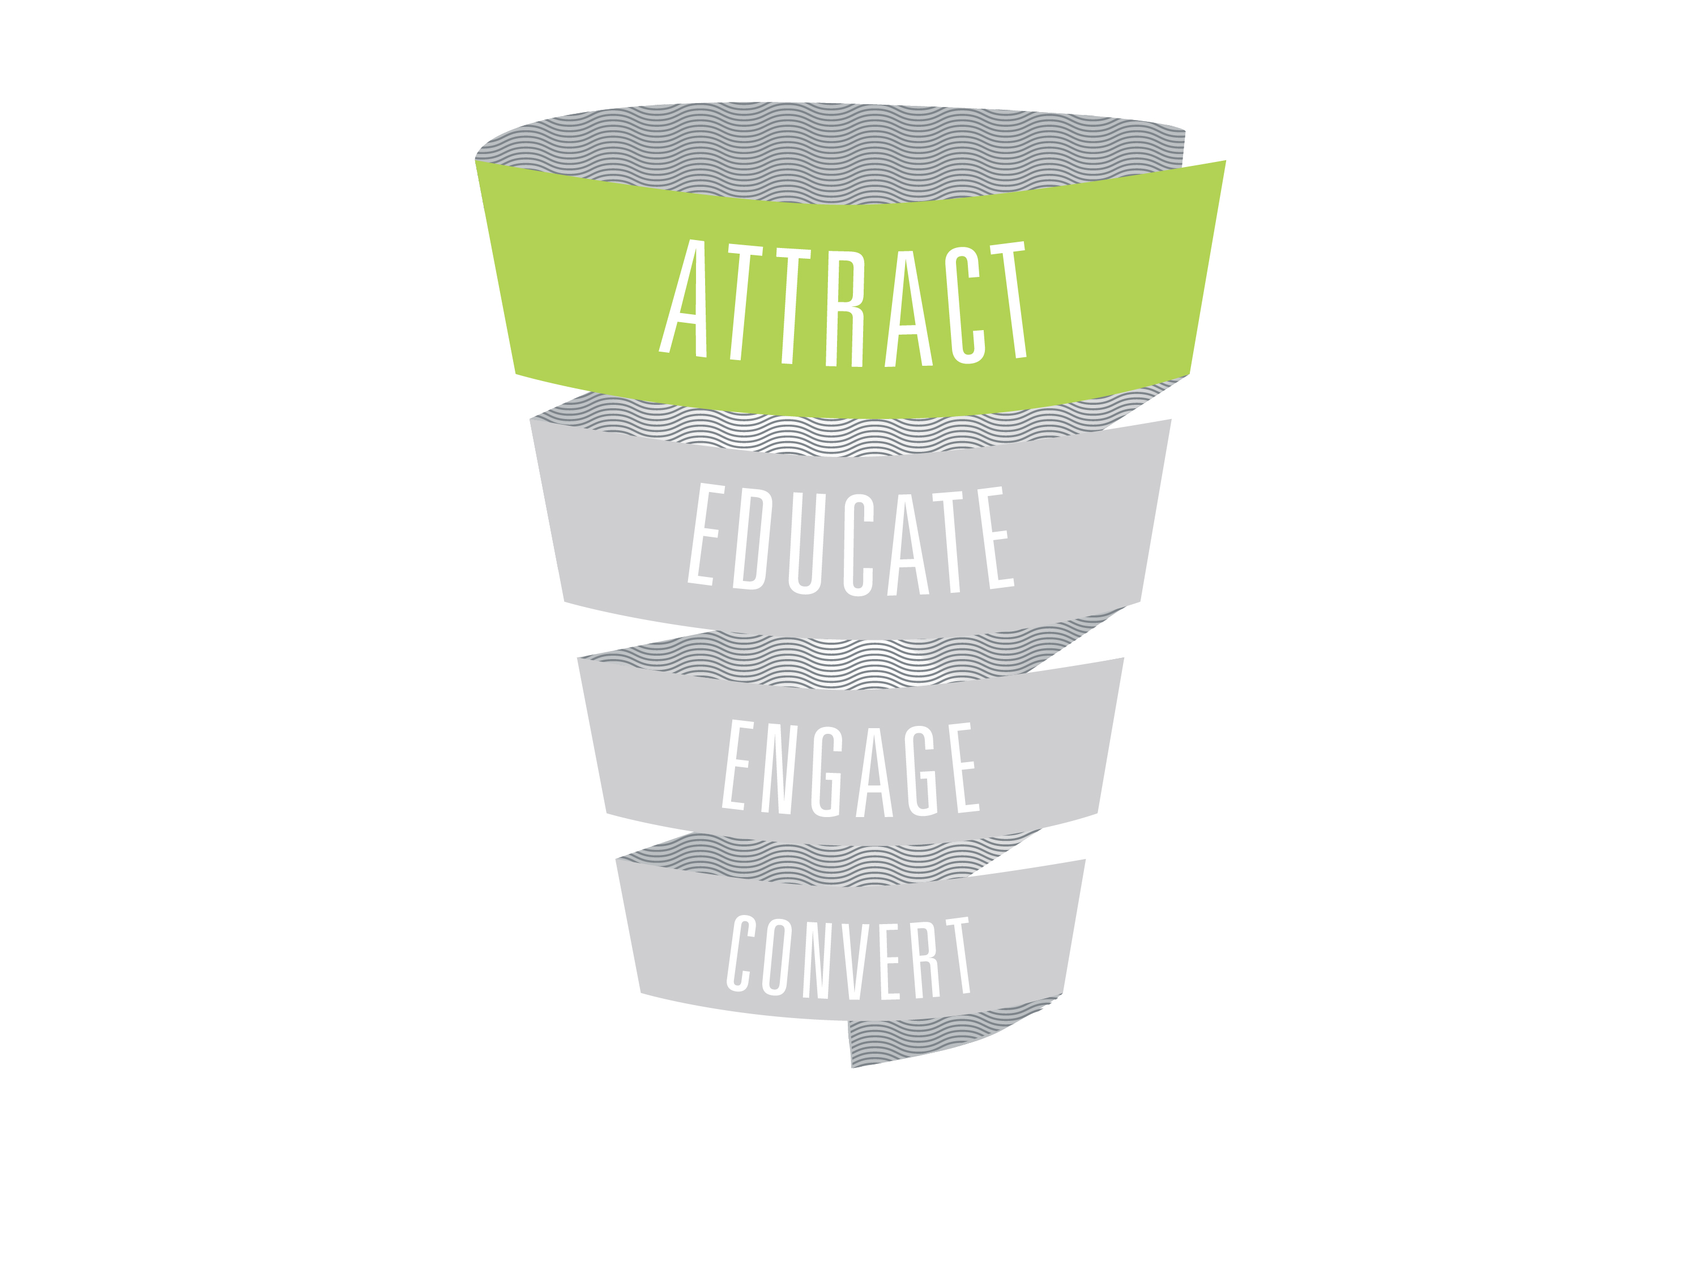
Notes:
28. Attract. What does this mean for small businesses who have fought so hard to evolve with the ever-changing industry? It means your efforts are finally being rewarded.

Slide 29
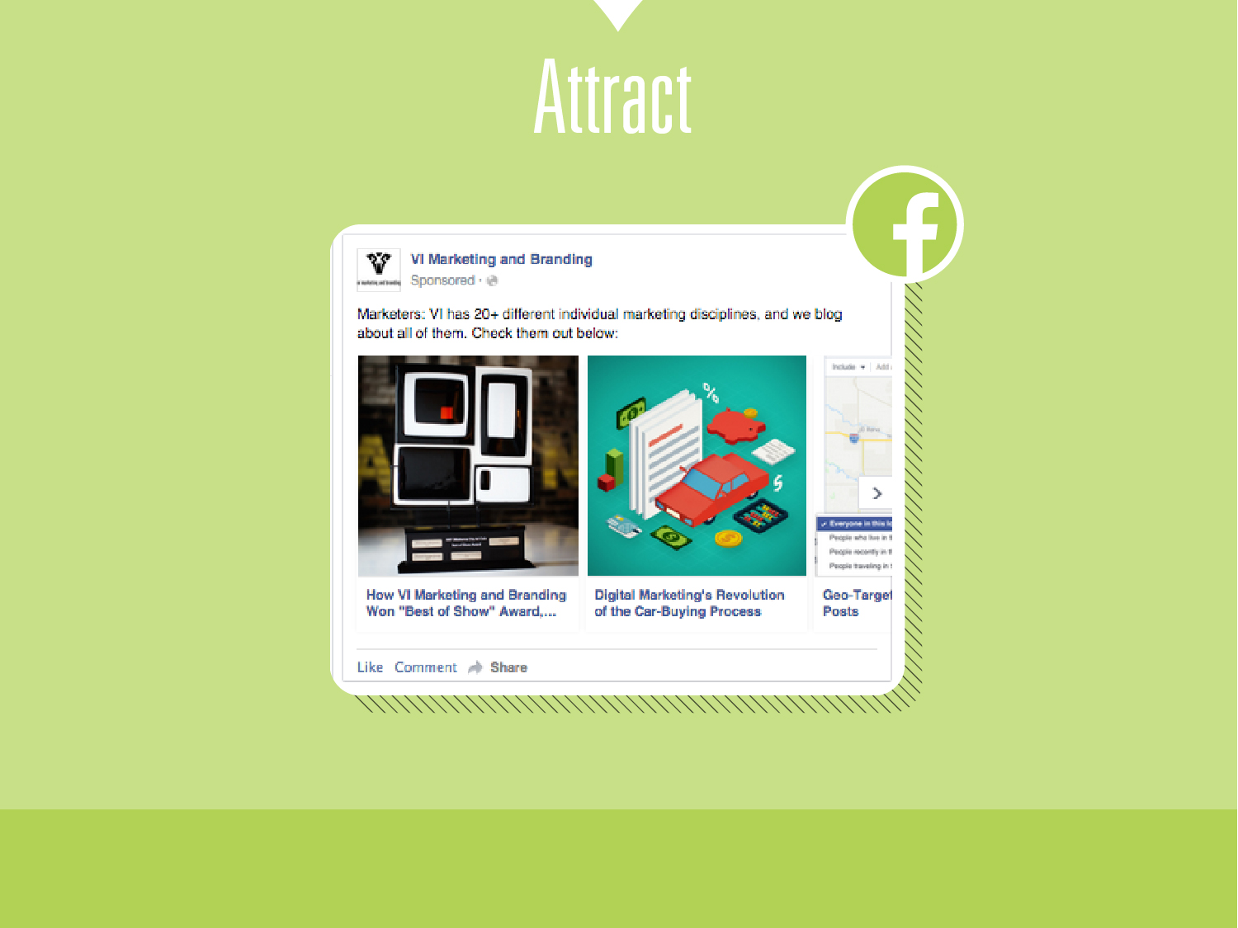
Notes:
29. Saving up all your money to make/produce and run a TV ad to reach the 18 to 54 year old market is a thing of the past for small business. Now, you can reach them based on interests, income, keywords in posts, job title, websites they’ve visited, email lists and even specific types of “Mom” (soccer mom, stay-at-home mom, etc). Ever logged-in to an app on your iphone using your Facebook login? I mean who wants to have a completely new login for every app and service you use? Exactly. You use the easy “Login through Facebook” option, and when you begin using that app (maybe it’s Yahoo Sports or New York Times) you are now seeing ads that were created from Facebook, but targeting you in a completely different app/site. Facebook is now bigger than itself, serving/targeting its users even when they aren’t even using the Facebook product. The possibilities are all at your finger tips. Open the “Ads manager” on Facebook and poke around.

Slide 30
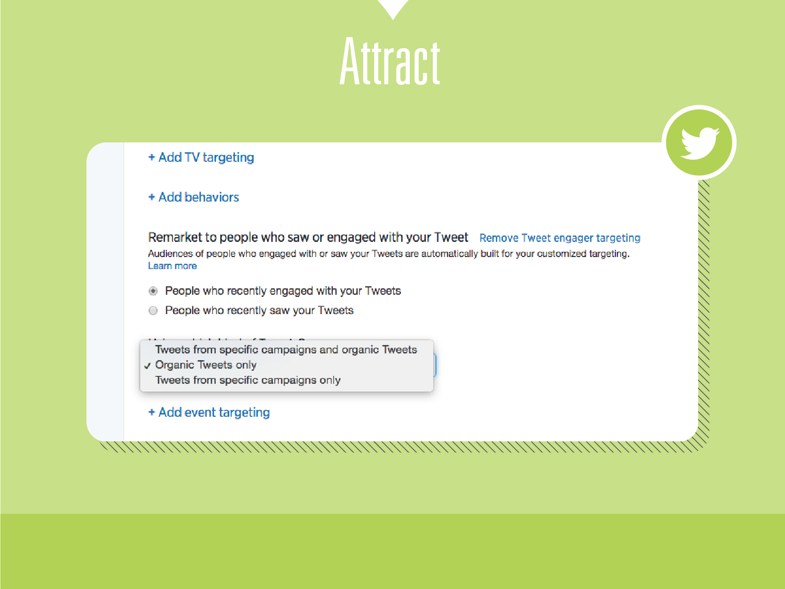
Notes:
30. How about Twitter? Show a specific tweet to someone watching a TV show in real-time on their 2nd device. Or perhaps show a CTA-tweet to someone who has already interacted with your Twitter account – proving they are ready to move further down the funnel.

Slide 31
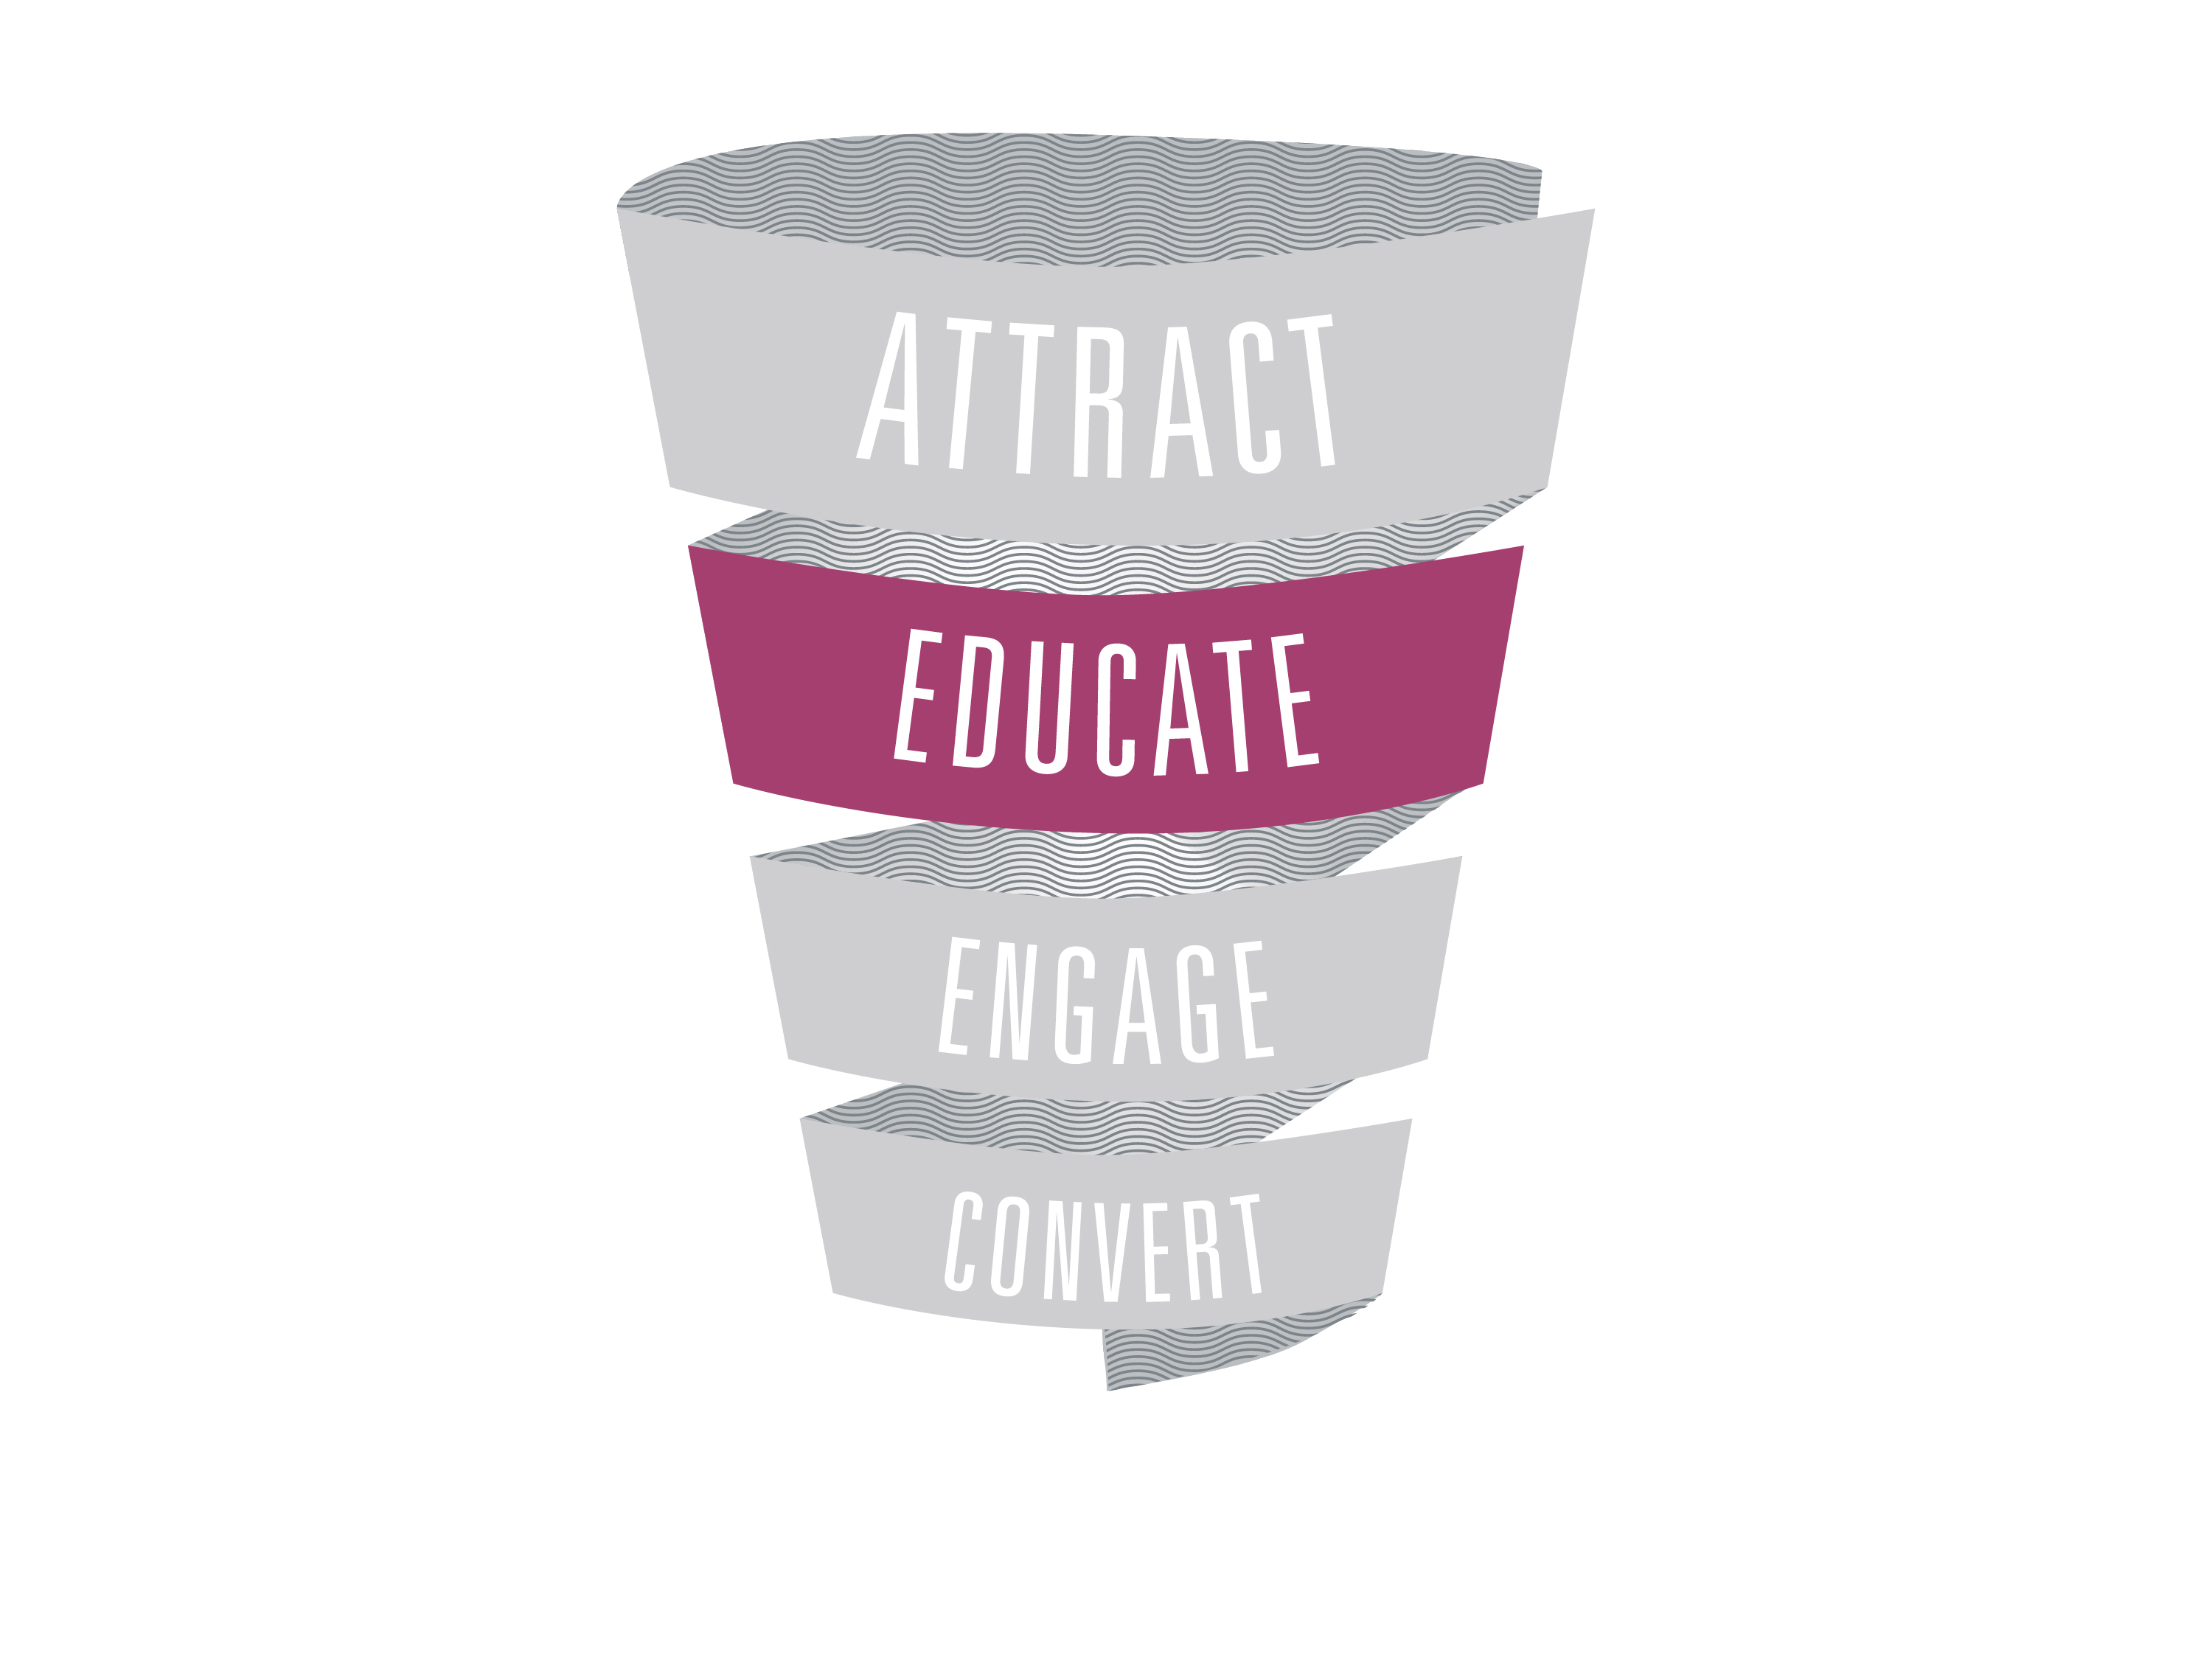
Notes:
31. Educate your audience with social media

Slide 32
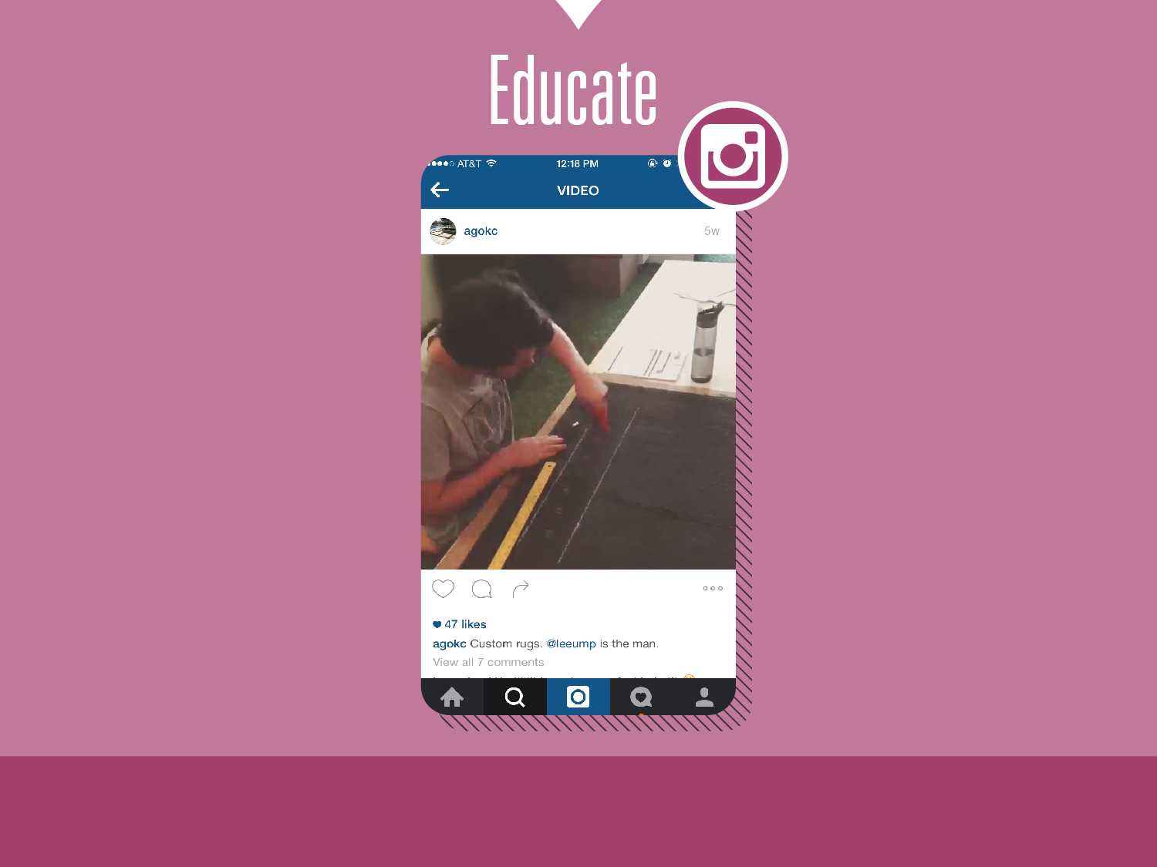
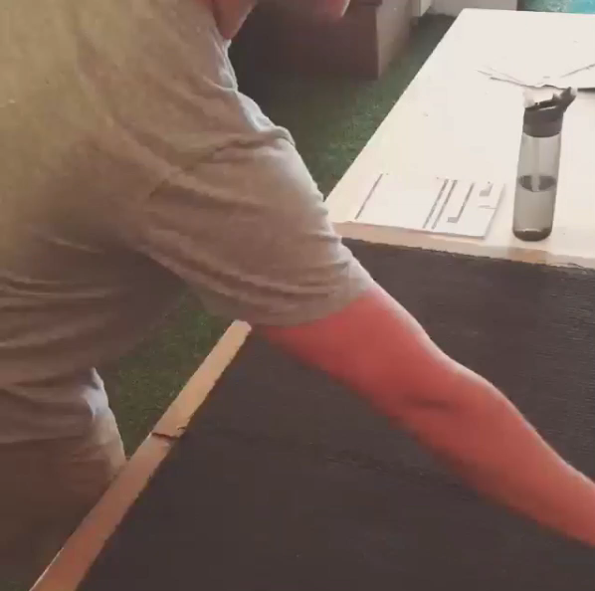
Notes:
32. (Video here) Probably the biggest evolutionary change in social media as it relates to educating your audience is through the use of video. Just about everyone has a full video studio tucked away neatly in their pocket = Smartphone. Make your brand interesting to the “scroller”/potential customer using video and they’re more likely to stop and be Educated on how you can benefit their life using your product/service.

Slide 33
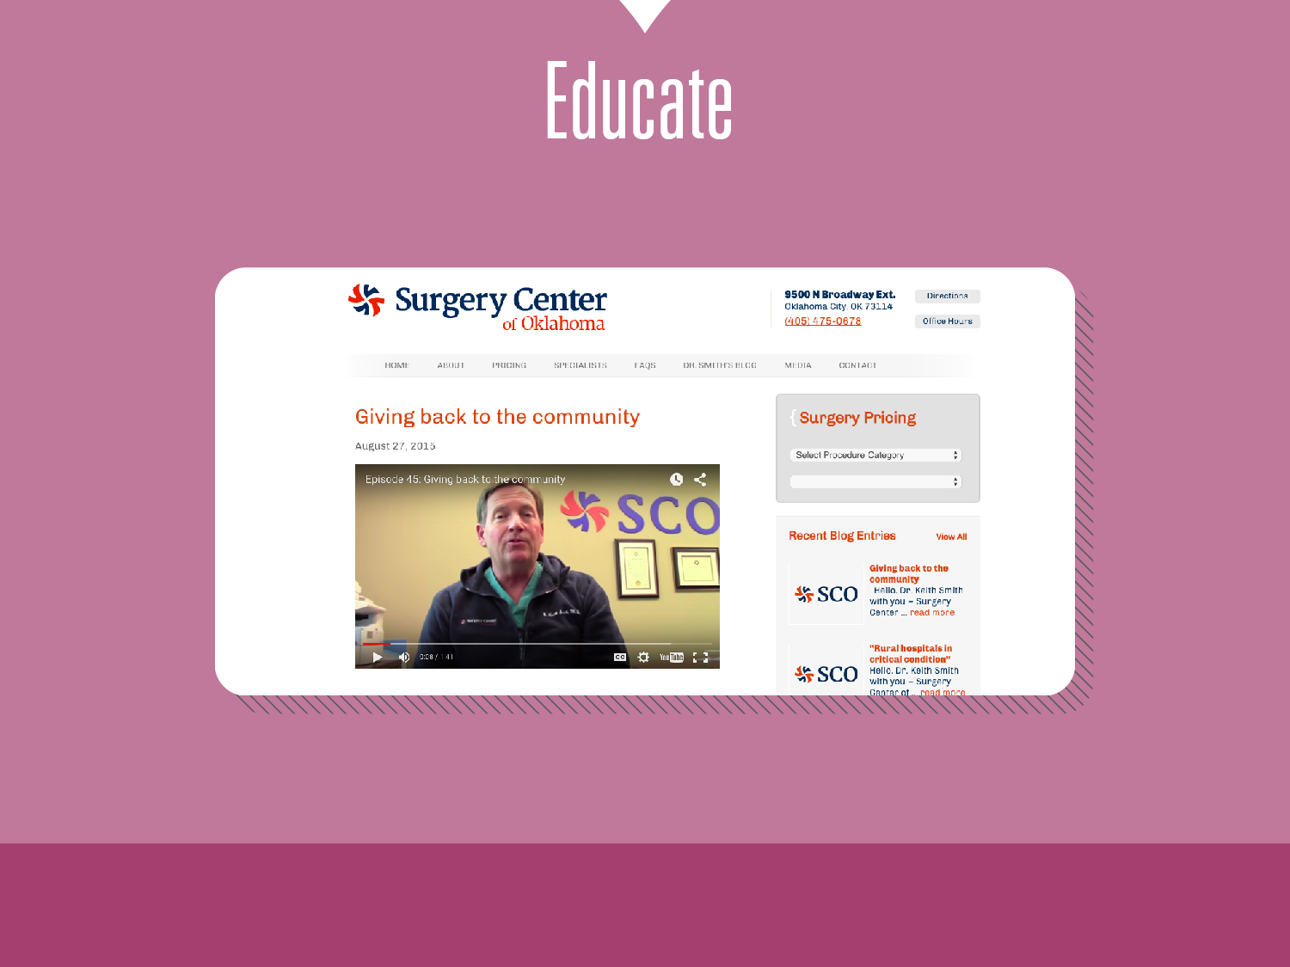
Notes:
33. Another reason we push for video is because everyone is different. Some people like to learn/be educated by reading, some like to watch and some like to listen. Take your video and get the most out of it. The Surgery Center of Oklahoma for years was a written blog only. In the past 9 months they have begun shooting video blogs to educate the public on their free market principles in the healthcare industry (pretty groundbreaking stuff with surgery prices listed right on their website). They don’t stop there – they take they video and place it in a couple strategic places, then they transcribe the video into written form (appeasing their long-time loyal following) and then they strip the audio for podcast/soundcloud upload. They take one piece of content and make it stretch so that they can educate the public where and how THEY want to be educated.

Slide 34
Notes:
34. Engage.

Slide 35
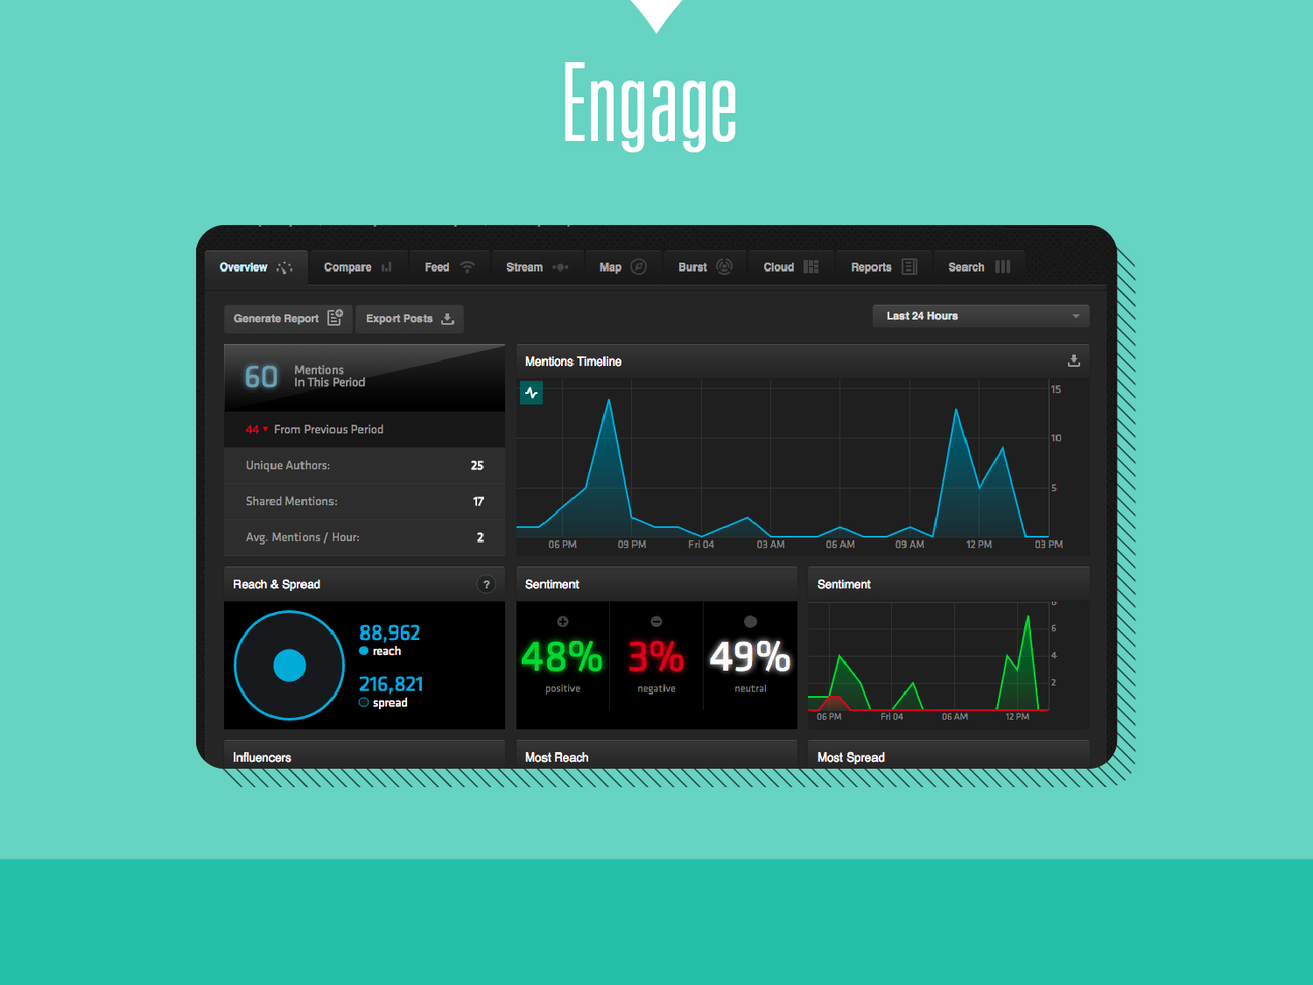
Notes:
35. Remember when engagement meant setting up notifications so that when someone tagged your business you would know about it and then go engage? That was 2009. In 2015, engaging looks something like this screenshot. I call this active engagement, and I call that 2009 version passive engagement. Active = looking for the conversation to engage. Passive = sitting back waiting to be talked to. On the slide, what you are looking at is a monitoring software that is tracking a dozen+ different social media platforms (Facebook, Twitter, Instagram, etc.). We tell it what to look for – and we think much broader than just our name. What kind of conversations should you be engaging with? Just people ready to buy? Just people doing research? Just people talking about your industry or even your community? All the above. Don’t be afraid to show off your brand’s voice and personality.

Slide 36
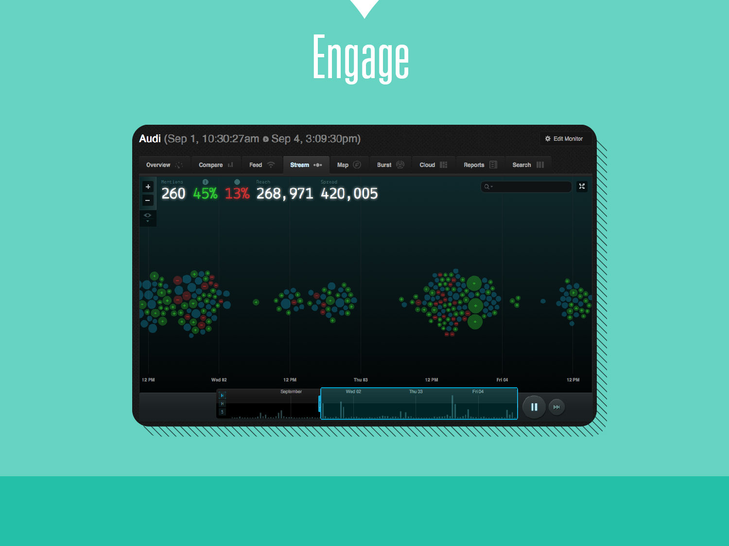
Notes:
36. Don’t have all the time in the world to get back to everyone who mentions something you are tracking? No biggie. Engagement in 2015 will sort it all out for you. Sure, all potential new customers are equal to some degree, but let’s be honest…talking with someone on Twitter with 4,500 followers is likely different than talking to someone with 45. Engagement tools now help you know (and alert you) to which conversations/mentions you are tracking potentially come with a bigger social return. See the bigger bubbles in the slide? Those are posts from users with large audience sizes…likely, you’ll want to check those out first.

Slide 37
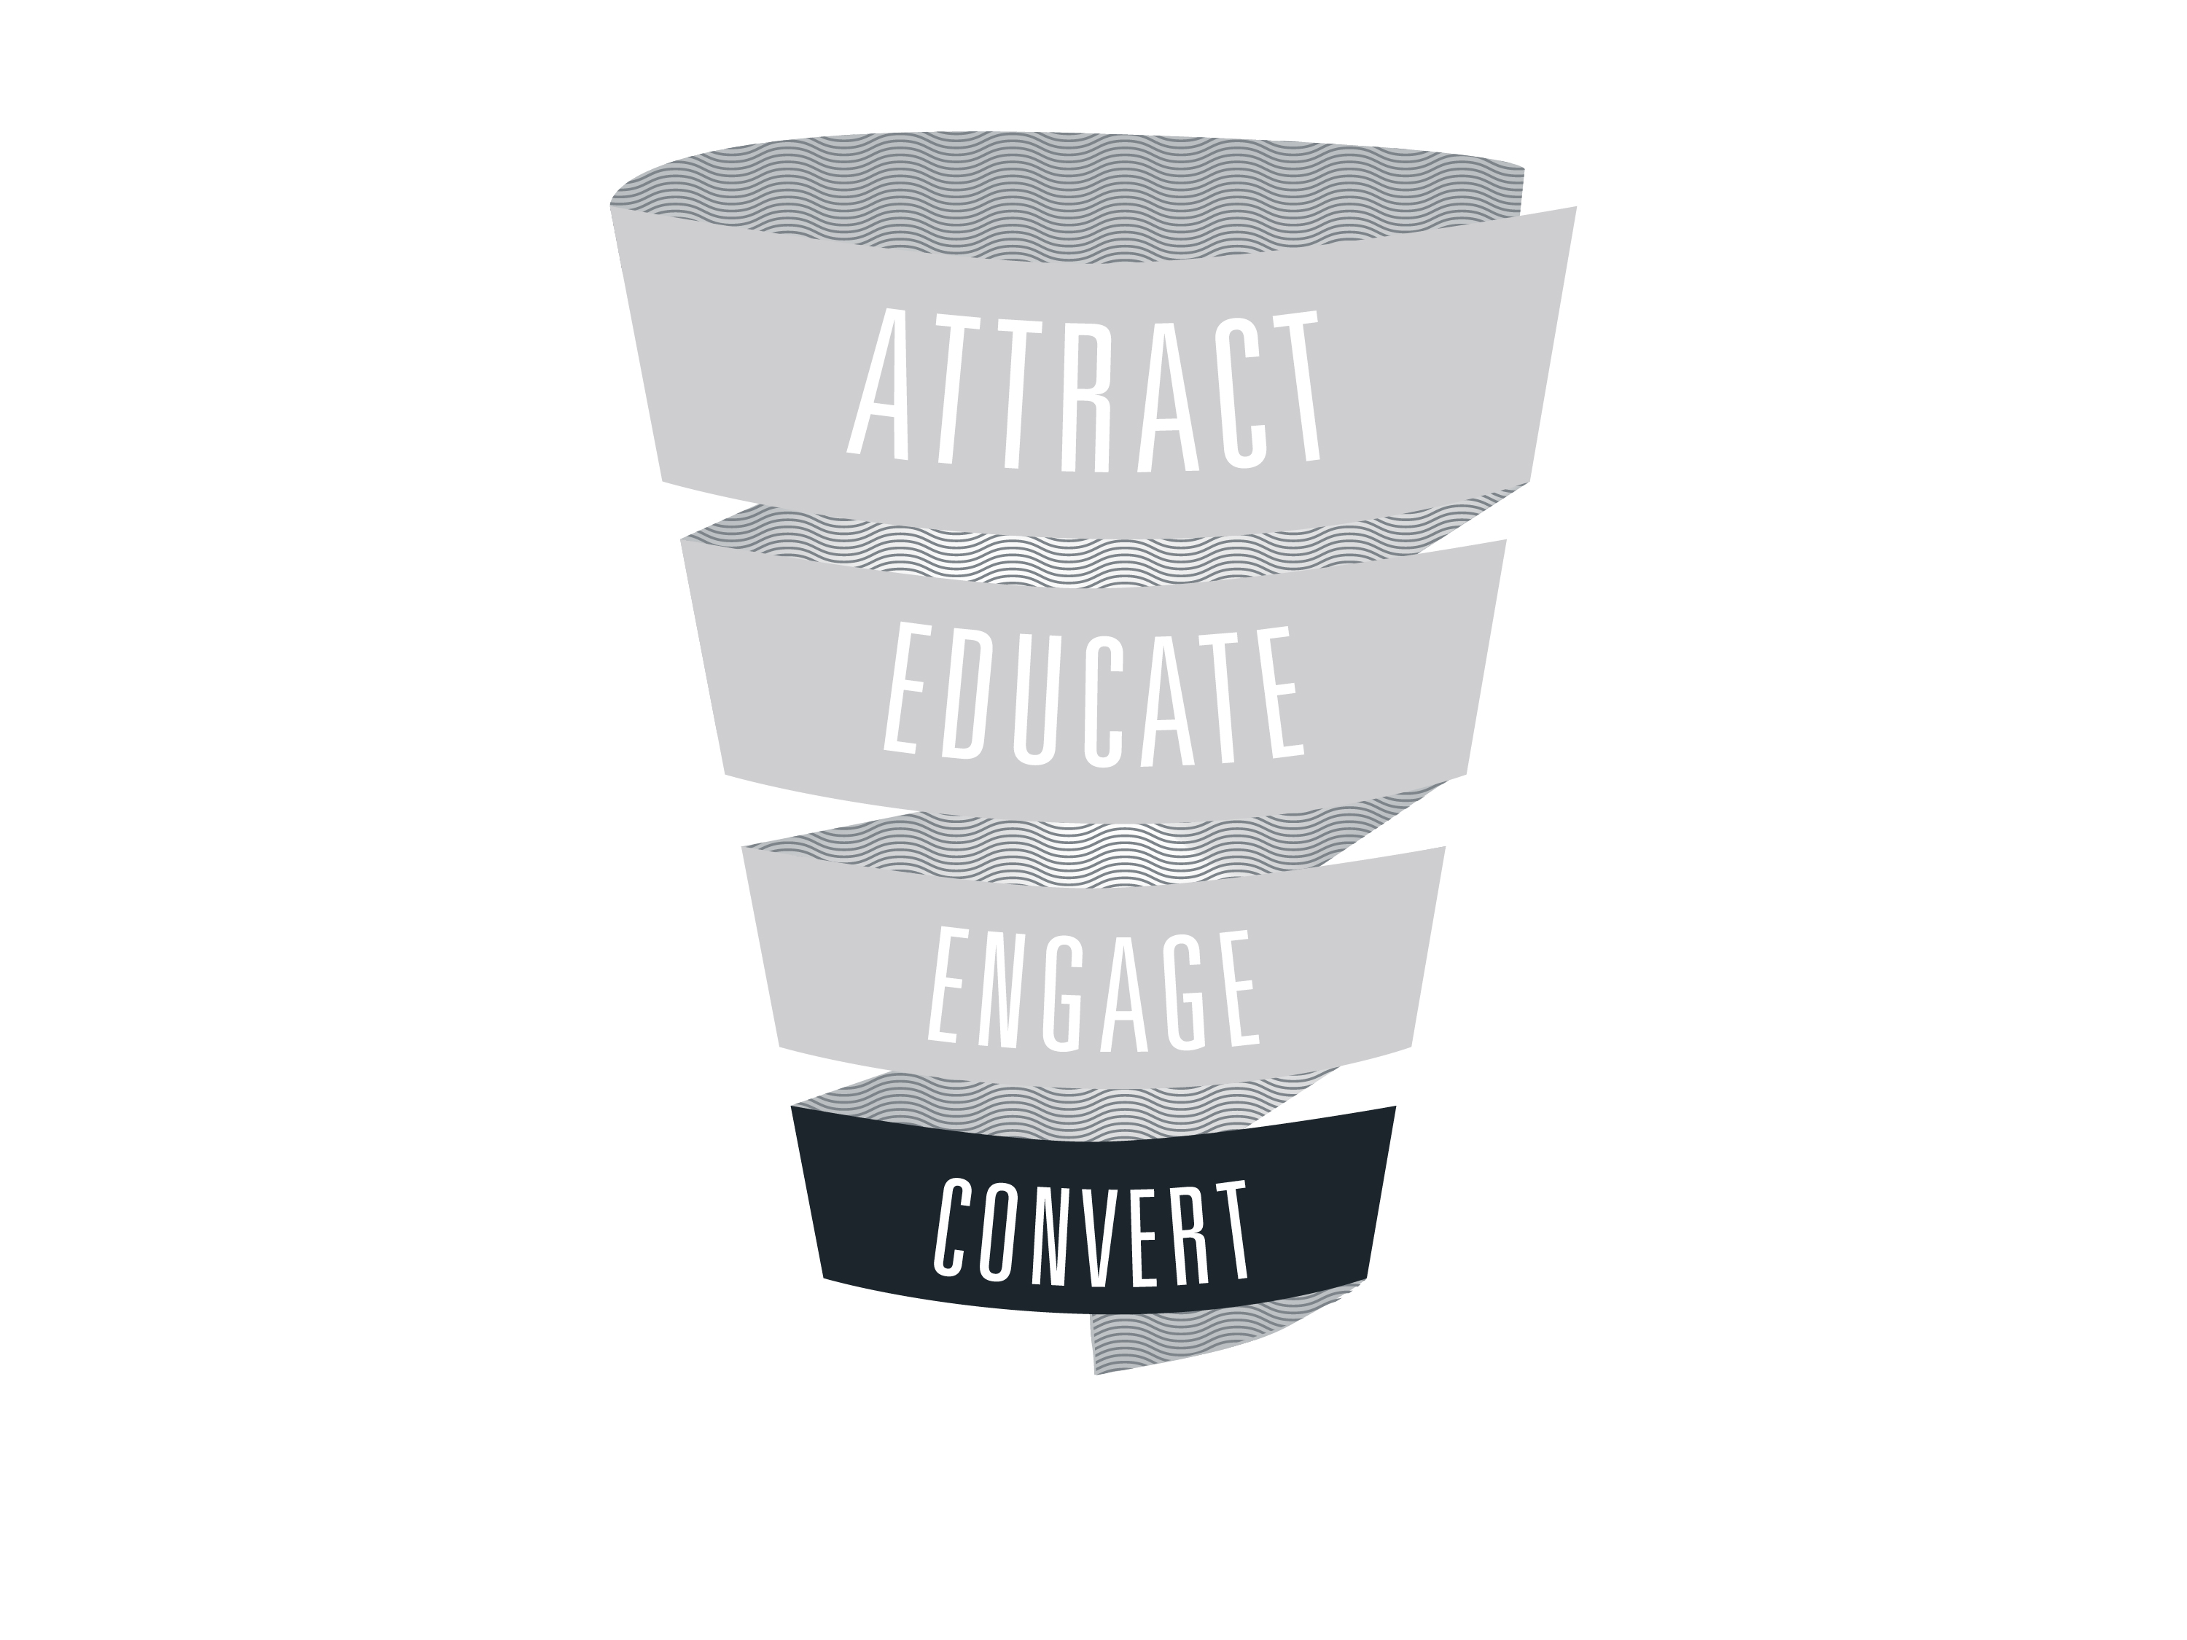
Notes:
37. Here we are at the bottom of the funnel. Convert. The grand unicorn of social media. What once was debatable is now trackable.

Slide 38
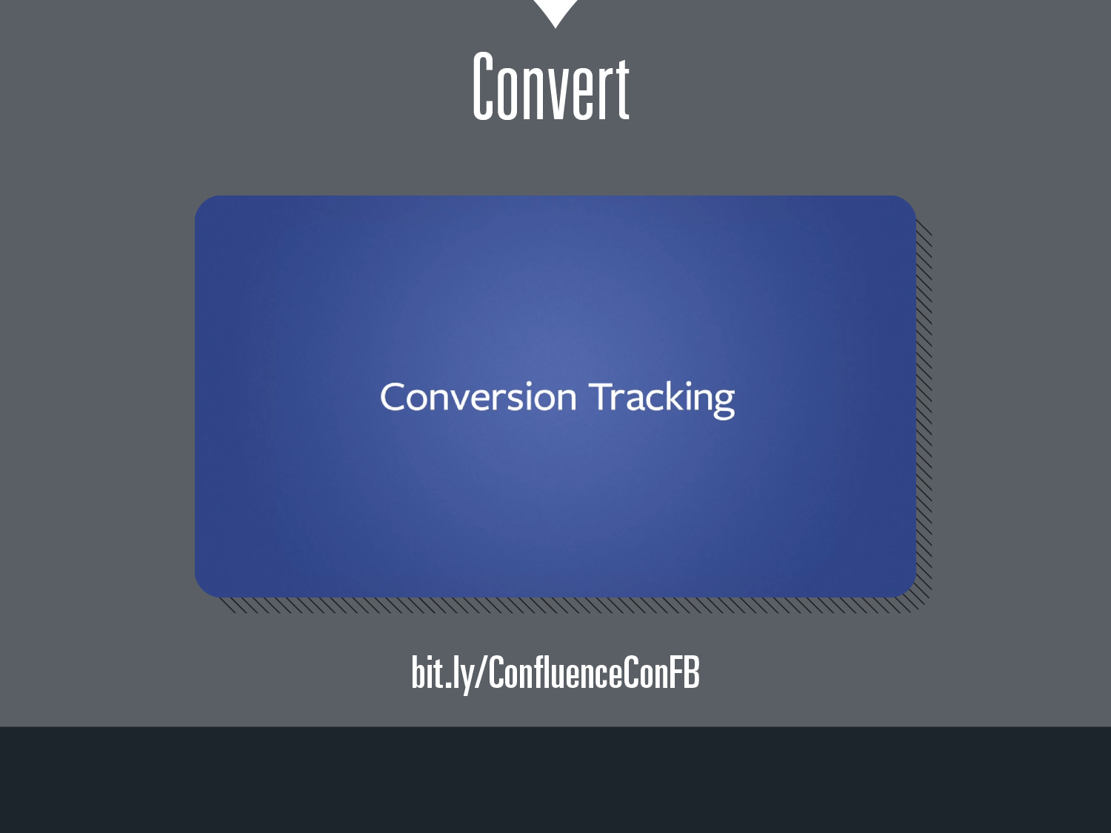
Notes:
38. You can now easily track social media conversions based on tracking pixels (as you would with a Google PPC or display campaign). Facebook explains their version of conversion tracking in a simple 2 minute video. Here’s the link to their video: bit.ly/ConfluenceConFB

Slide 39
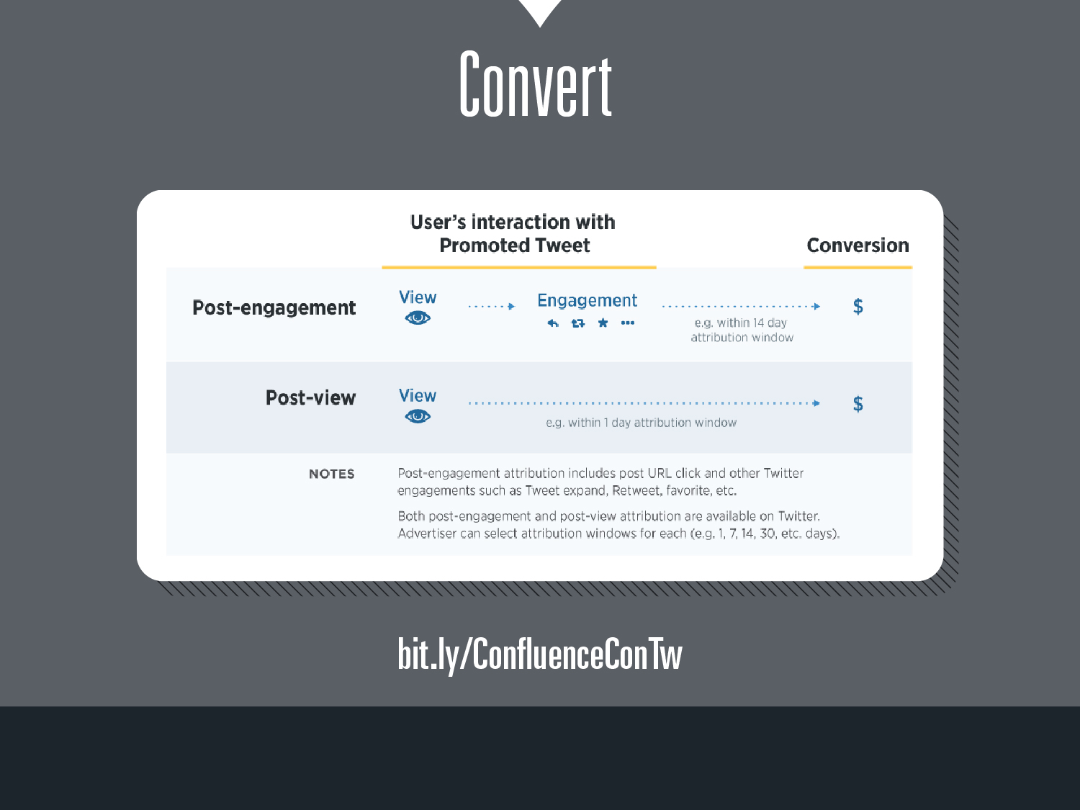
Notes:
39. Where Facebook will tell you which purchasers form your website bought something/filled out a form/became a contact based on seeing your Facebook ad, Twitter does the same. Twitter will even go so far as to tell you if they happened to see it weeks prior – helping you to fuel that multi-channel attribution list. Here is the link to read about how to do it on Twitter: bit.ly/ConfluenceConTw

Slide 40
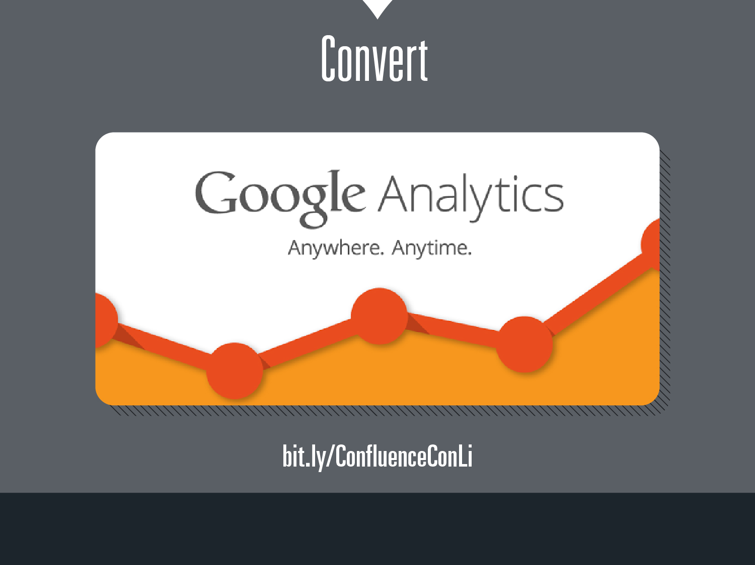
Notes:
40. We discussed how to measure conversions on Facebook and Twitter, and the reality is that there are hundreds of social media platforms. Maybe you don’t use Facebook or Twitter, but you use other platforms like Pinterest or Linkedin, etc. Hope is on the way. Google Analytics is about to become your best friend, and it’s completely free. Study it. Test it. Setup goals and optimize. This link: “bit.ly/ConfluenceConLi” will explain how to use Google Analytics specifically for Linkedin conversion tracking, but this method for Linkedin will likely apply to many other social platforms your brand uses.

Slide 41
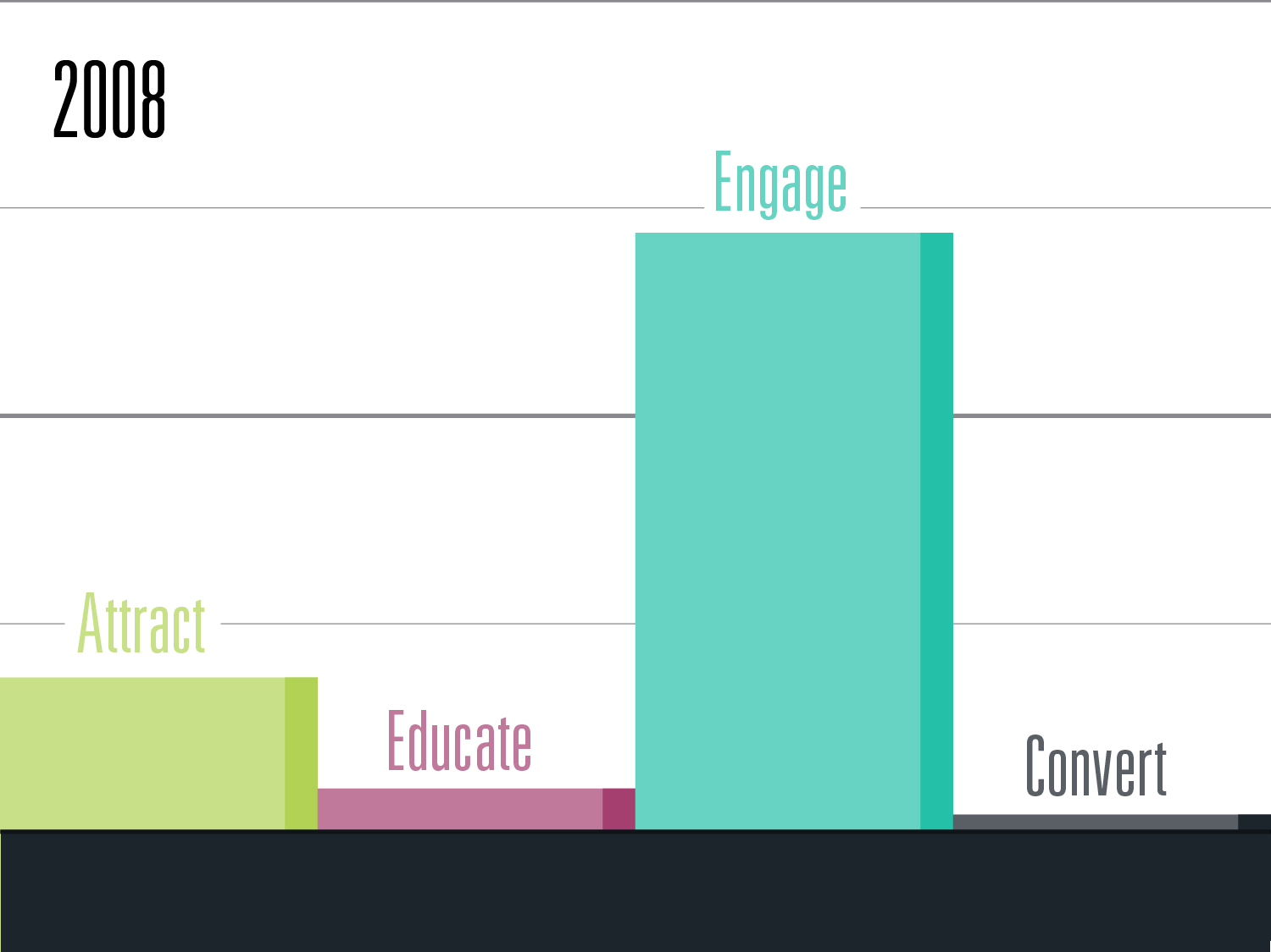
Notes:
41. So to recap, or to try and sum up the presentation, we need to look at how social media has evolved over the past few years. This graphic is my own interpretation of the sales funnel in 2008, but you’ll likely agree that in 2008 brands that were using social media primarily used it to “engage.” Some would try to “Attract” customers, and even fewer would try to educate or even attempt to convert. Were all parts of the funnel possible? Yes. But it took much more time and effort, and much of it was not trackable, meaning it was subjective and difficult to explain the successes and failures. But as time went on…

Slide 42
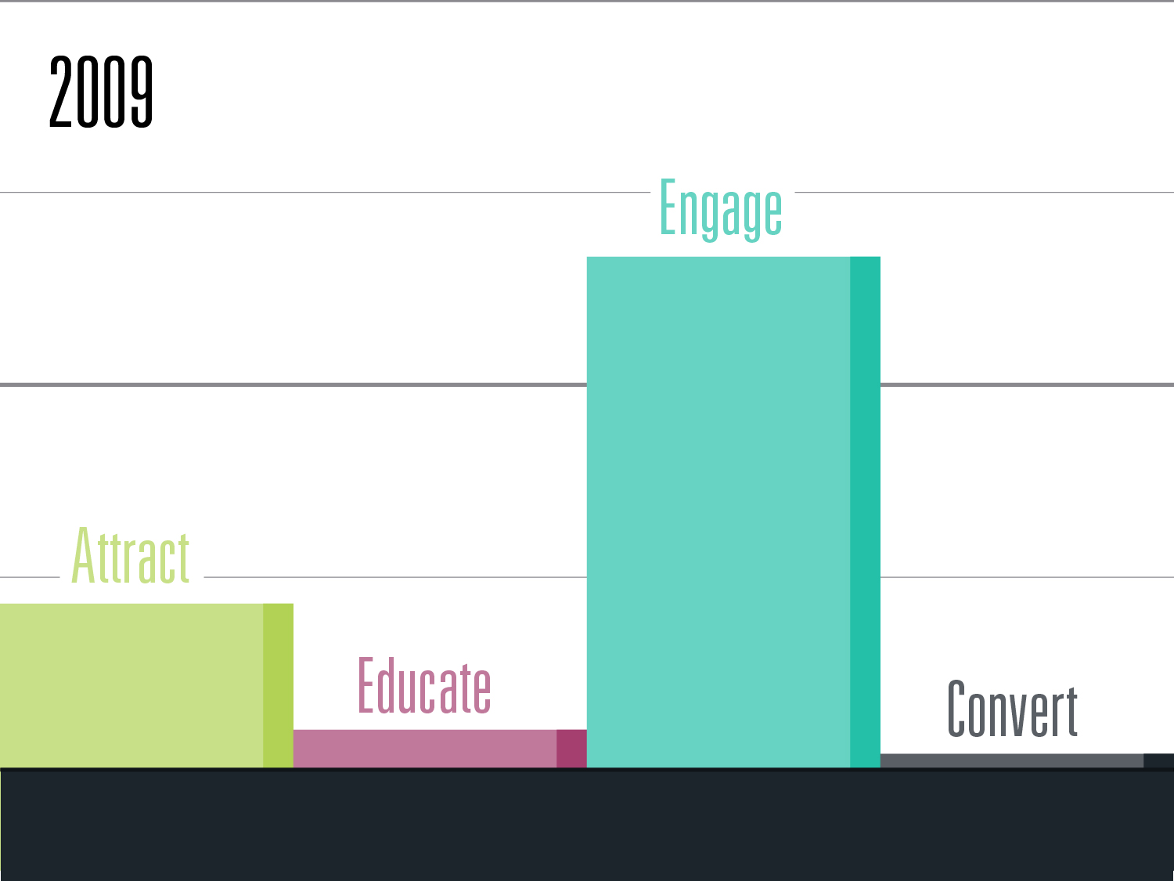
Notes:
42. More options became available.

Slide 43

Notes:
43. And we began to see shifts in how small businesses were using social media, especially as it related to the marketing funnel.

Slide 44

Notes:
44. Engagement was still a monster portion of social media, but as organic reach began to drop, and advertising began to take hold on the industry, the other parts of the marketing funnel began to rise as Engagement’s stronghold on the #1 priority began to drop.

Slide 45

Notes:
45. We began to see what was about to happen…

Slide 46

Notes:
46. That social media, if used by a small business properly…

Slide 47

Notes:
47. Could honestly become…

Slide 48

Notes:
48. A full marketing funnel tool. Attract. Educate. Engage. Convert. In 2015, a small business has more control over the marketing funnel than ever before. Take advantage of it, and prosper.

Slide 49

Notes:
49. Contact info and Links

