Slide 1
Notes:
Welcome to the Young Scholars Program Webinar. We will begin the presentation shortly.

Slide 2
Young Scholars Program
For high-achieving 7th graders who demonstrate financial need
Notes:
Good afternoon and welcome to the Cooke Young Scholars Webinar. My name is Nara Lee and I’m joined by two of my colleagues, Larry Thi, Alumni and Outreach Associate for the Foundation our Recruitment Program Coordinator Amber Styles. We will be sending out a printer-friendly version of the PowerPoint following the webinar today. If there are questions during the presentation, please feel free to use the chat or Q&A functions. We will open it up for live questions at the end so that we can get through the information for everyone.

Slide 3
Introduction
What is the Young Scholars Program?
A selective pre-college scholarship for high-performing middle school students with financial need
The scholarship includes:
Individualized academic advising
Financial support
Pathway to the Foundation’s $40,000 per year
College Scholarship
Application Open Now
Deadline is April 14th, 2016
Notes:
In this webinar, we will introduce you to the Young Scholars Program and tell you about the application process. Our application this year will open at the end of this month. The deadline is April 14th, 2016
Many of you may be learning about our program for the first time. The Young Scholars Program is a selective scholarship program for high-performing middle school students who also demonstrate financial need.
The scholarship provides academic advising, financial support, and a pathway to the Foundation’s college scholarship.

Slide 4
Eligibility
Students who meet the following criteria may apply:
Be a current 7th grader (will enter 8th grade in Fall 2016)
Have earned grades of all or mostly A’s, with no C’s in core academic subjects since 6th grade
State standardized test scores and/or SAT/ ACT
Family income does not exceed $95,000.
Attend school in the United States
Notes:
A few specifics before we move on. If a student meets the following criteria, they are eligible to apply for the Young Scholars Program. They must be a current 7th grader entering 8th grade in the Fall of 2016. They must have earned mostly As with no Cs in core subjects since 6th grade. Applicants must have state standardized test scores, demonstrate financial need and attend school in the United States.

Slide 5
Program Goals
• Enable Young Scholars to take advantage of academic and extracurricular opportunities in high school
• Prepare Young Scholars for competitive four-year colleges and universities
• Help Young Scholars develop skills that will enable them to be successful contributors to society
Notes:
The goals of the Young Scholars Program are threefold. One is to enable our scholars to make the most of academic and extracurricular activities during school. We do this so that our Young Scholars will be prepared to attend the most competitive and selective four-year colleges and universities. From our research and experience, we know that graduation rates and long-term career benefits for low-income and first generation students are much better for students who attend more schools where there is considerable financial, academic and community support.
Finally, our goal is that scholars will develop the necessary skills and knowledge to be successful in college and beyond. The students who comprise the Cooke community of scholars are students who are looking to give back to their homes, communities and beyond with their talents and compassion for society.

Slide 6
Notes:
Our goals lead us to have a three-fold support system for each Young Scholar. Each Young Scholar receives a personal educational adviser, an individualized learning plan which includes generous financial support and goal-setting, and access to a large scholar community.

Slide 7
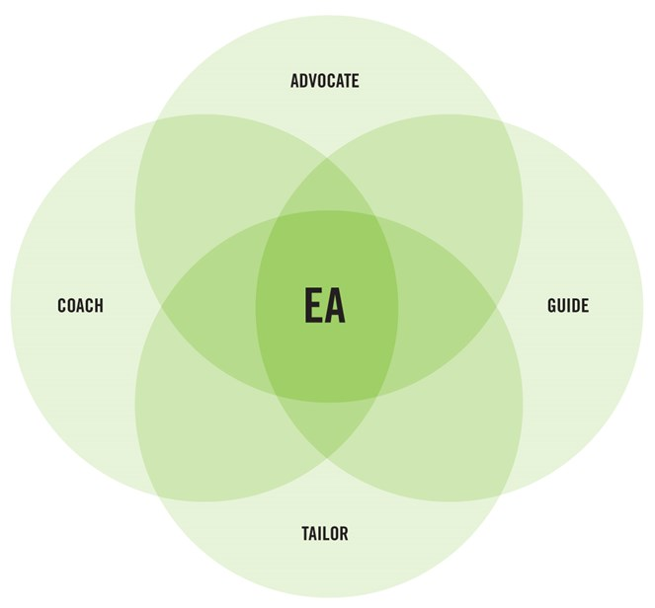
Educational Adviser (EA)
Notes:
The adviser or (EA) plays a number of roles to the student, as an advocate, coach, guide, and tailor of resources for the scholar.

Slide 8
Role of the Educational Adviser (EA)
Plan a challenging four-year academic course load
Research enrichment opportunities
Learn to take appropriate educational risks
Help make educational decisions
Develop yearly academic and extracurricular goals
Construct a yearly Individualized Learning Plan (ILP)
Notes:
Here are few examples of ways an EA supports a scholar. An EA might help with the high school search which is why we accept students in middle school. EAs also serve as strong advocates for scholars at school and beyond helping choose classes and prepare for important milestones like internship and research opportunities. Scholars and their parents also rely on EAs to help navigate the Young Scholars Program and its resources. The EA helps with planning for summer programs and setting goals which lead to the Individualized Learning Plan.

Slide 9
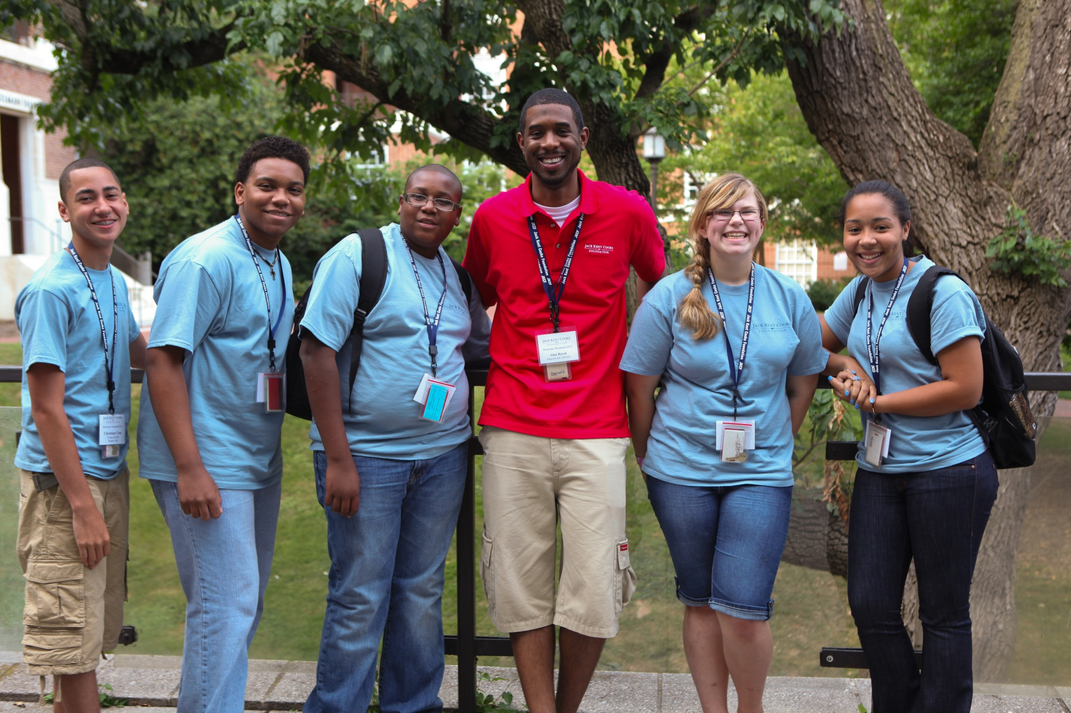
Notes:
All of our EAs are full-time Foundation staff members who have a student case load of about 25-30 across the country. EAs are experts in navigating educational resources and they make personal visits to scholars throughout middle and high school. Young Scholars benefit from having close relationships with their EAs and the early exposure to communicating regularly with a mentor and educator helps students develop strong skills in communication.

Slide 10
Individualized Learning Plan (ILP)
Each scholar’s ILP serves to help the scholar to:
• Develop and nurture academic skills
• Explore passions and interests
• Stretch outside their comfort zone
Notes:
EAs get to know the scholars on an individual level so that they can help design each scholar’s individualized learning plan or the ILP. An ILP is used to develop and nurture academic skills; explore passions and interests, and stretch the scholar out of their comfort zone.

Slide 11
Individualized Learning Plan (ILP) Opportunities
A few examples include:
Summer academic programs
Online courses
Music lessons
Books and magazine subscriptions
Software and technology
Conferences and Competitions
Internships
Notes:
ILP opportunities are individualized so each scholar participates in different activities. Some examples of ILP opportunities include summer programs, books and magazine subscriptions, software and technology, conference and competition fees, internships, and travel.

Slide 12
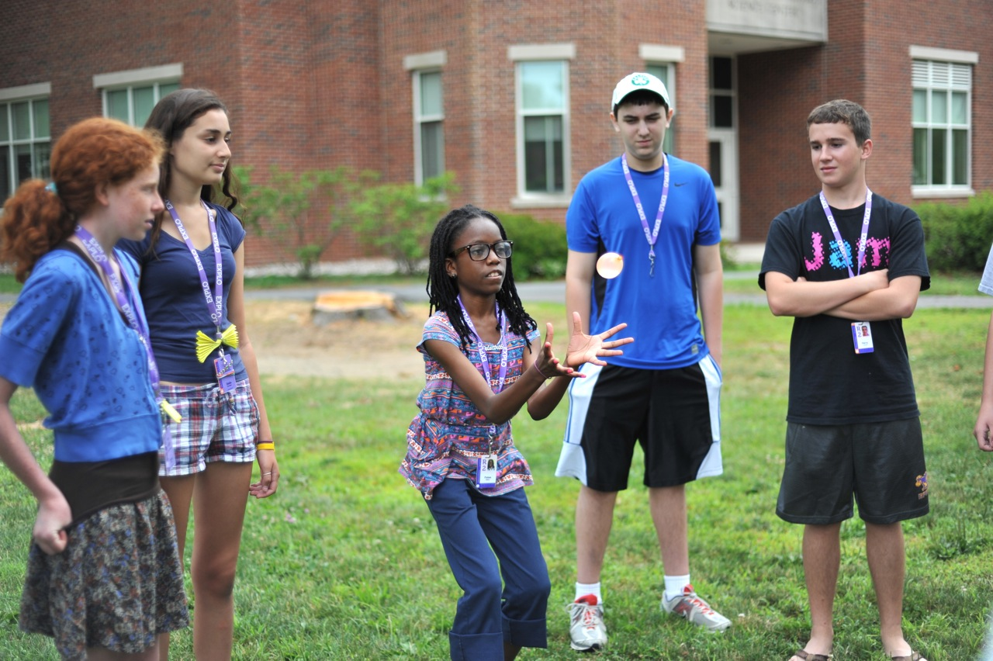
Notes:
Summer programs is one of the biggest benefits of the Young Scholars Program. It’s important for high achieving students to spend quality time learning in a setting that is supportive and full of like-minded peers. Here’s one of our Young Scholars attending her first summer program at EXPLO in Wellesley. She was learning about physics through a hands-on approach and it was her first time attending an intensive program.

Slide 13
Welcome Weekend
Four-day residential experience that orients each Young Scholar and a parent or guardian to the program.
CivicWeek
One-week residential experience that immerses Young Scholars in service learning during the summer between freshman and sophomore year.
Scholars Weekend
Four-day residential experience for Young Scholars about to enter their senior year of high school. Focuses on the college search and application process, as well as scholarship opportunities.
Young Scholars Community
Notes:
Because we believe that scholars benefit from being surrounded by their peers whenever possible, the Young Scholars Program organizes opportunities for scholars to meet and see each other.
As rising 9th graders, all new scholars and a parent or guardian attend Welcome Weekend to learn more about the Young Scholars Program and do many fun activities together to prepare for high school. This is our big orientation weekend where we welcome the new scholars and their families to the Cooke Foundation family.
As rising 10th graders, all scholars attend CivicWeek in Washington D.C. to engage in robust service learning.
And as rising 12th graders, all scholars come together again to participate in college-preparatory programming at Scholars Weekend. A college tour follows the weekend to several top schools on the East Coast.

Slide 14
Young Scholars Community
Notes:
The Young Scholars Community is close-knit and integral to the growth of our talented students. Each year, we look to add to this wonderful community of scholars by admitting a new group or cohort of students.

Slide 15
Active Scholars in Young Scholars Program
292 8th - 12th graders
Number of Scholars in Cohort 15 (2015)
70
Think Big. Work Hard. Achieve.
Young Scholars Community
Notes:
Currently we have 292 students in the Young Scholars Program. This year, we will admit up to 80 students to our 16th Cohort. We are looking for students who are ready to live the Foundation’s motto and “Think big. Work hard. Achieve”

Slide 16
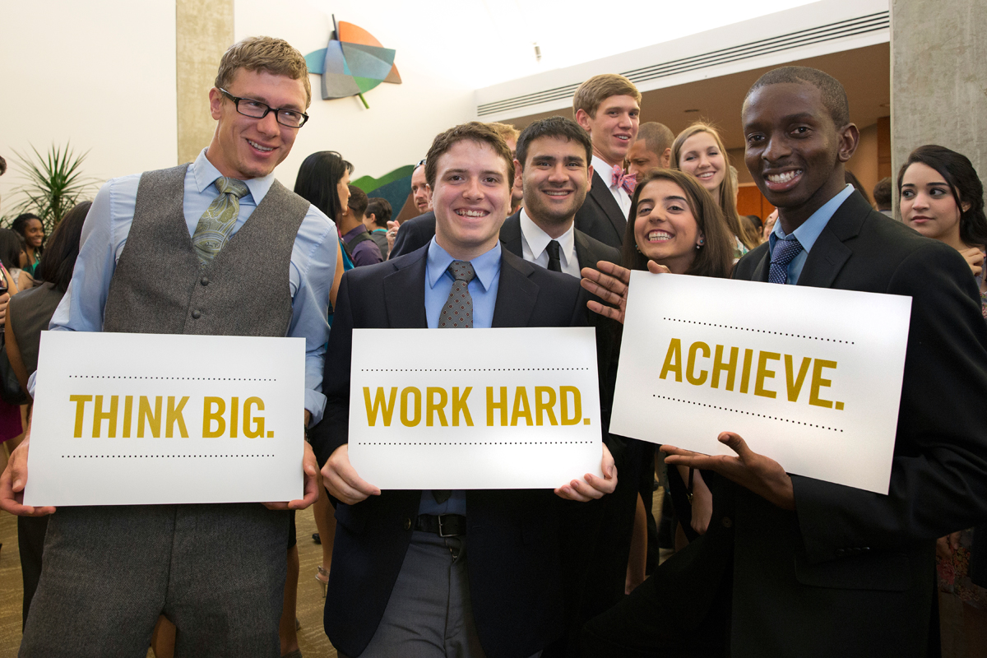
Notes:
We thank you for your interest and help in finding our next cohort of scholars. We’ve talked about what the program is. We want to tell you briefly more about who our scholars are, and who might be good candidates for the Young Scholars Program.
Our motto at the Foundation is “Think Big. Work Hard. Achieve.”

Slide 17
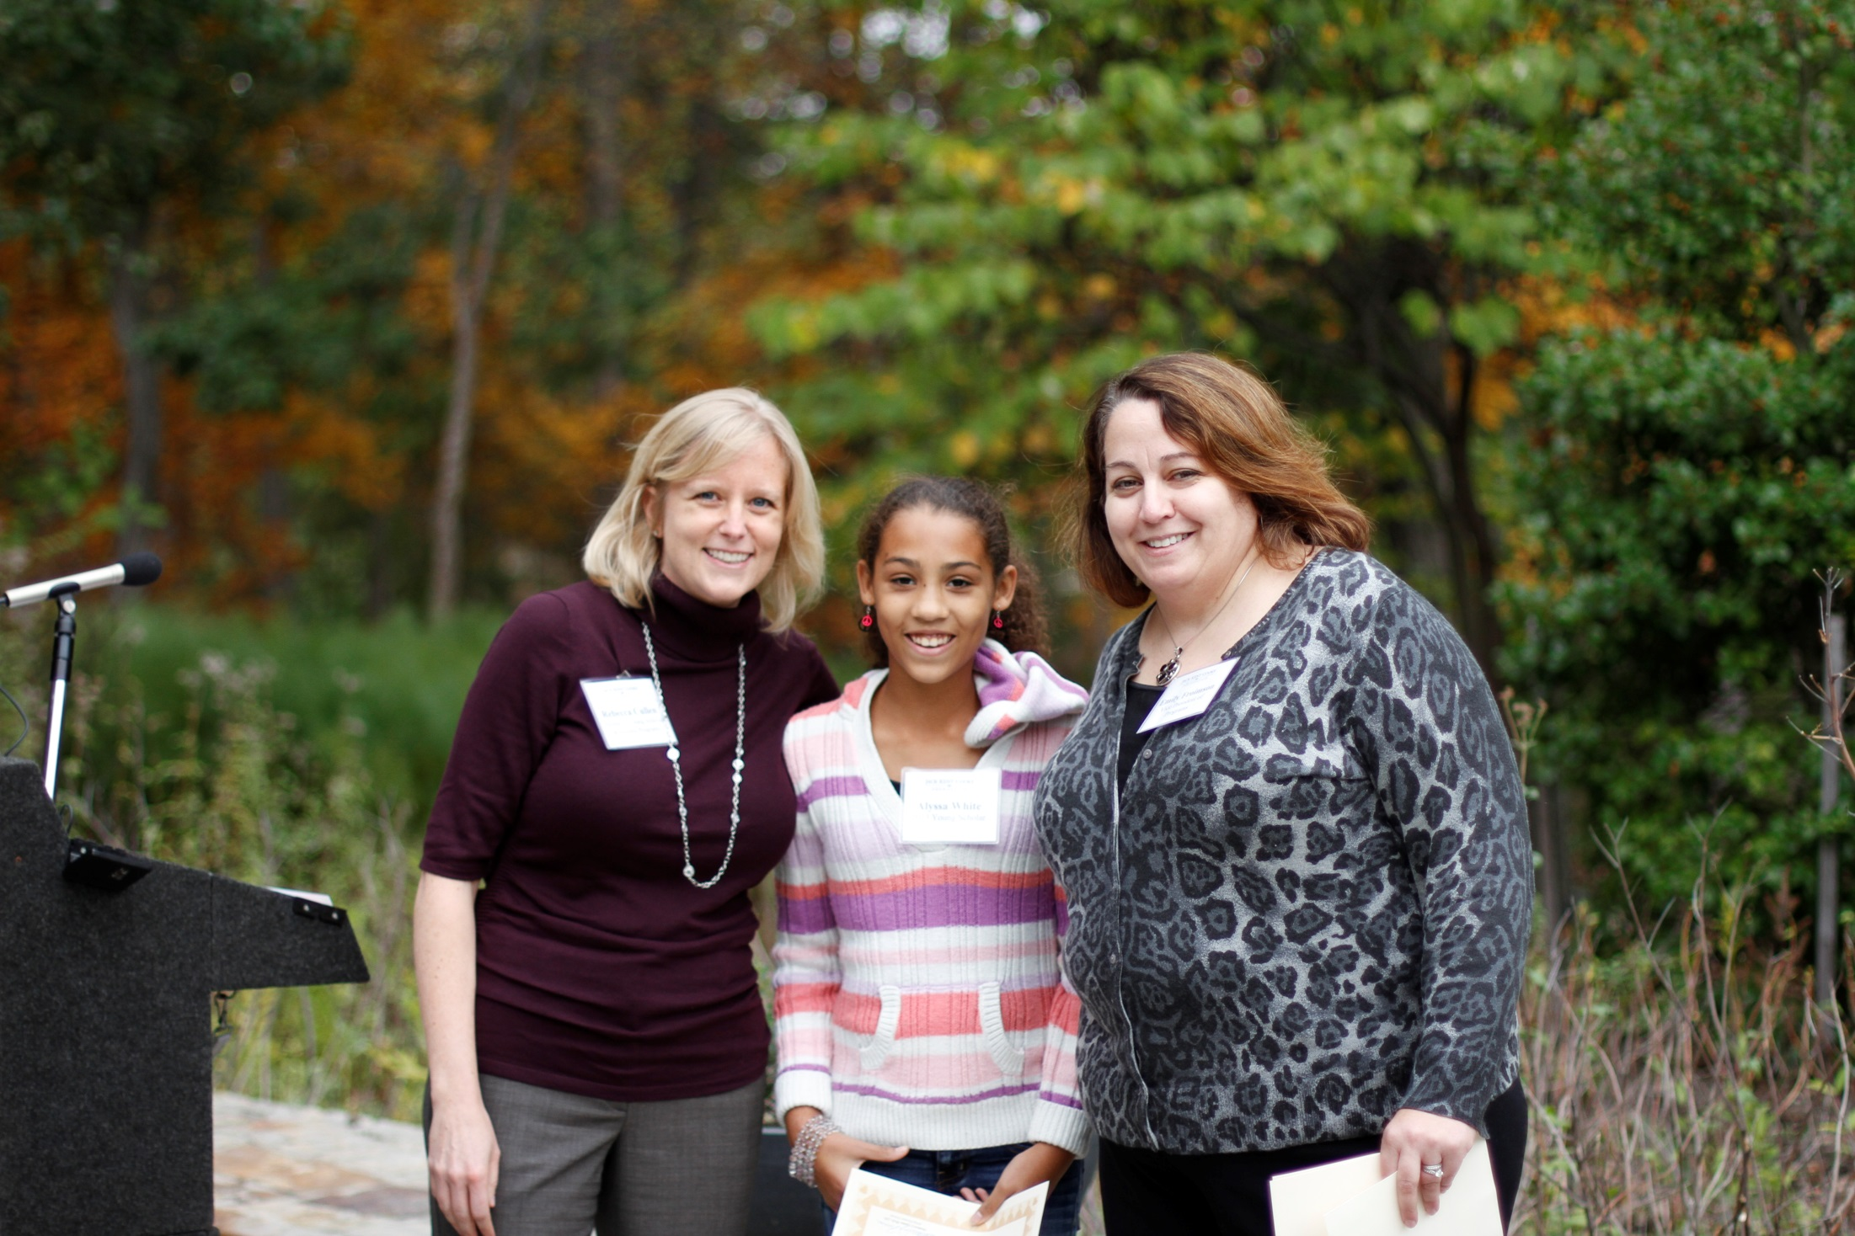
Notes:
Thinking big is not just about studying and doing well. Young Scholars are leaders in their schools and communities, and problem-solvers.
Certainly we are looking for students who have already achieved and demonstrated high academic ability. They will have strong grades and recommendations from their teachers. We are also looking for students who have passion and drive for their interests. They may be interested in speech and debate…or computer science and robotics.

Slide 18
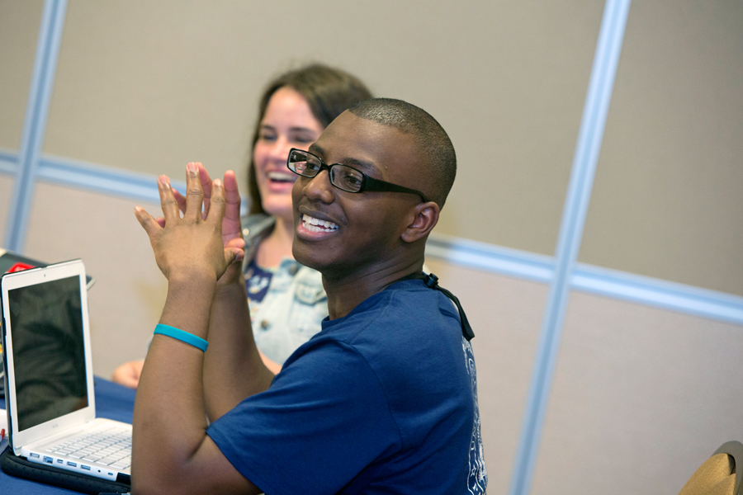
Notes:
They may be interested in psychology, business, looking to change communities.

Slide 19
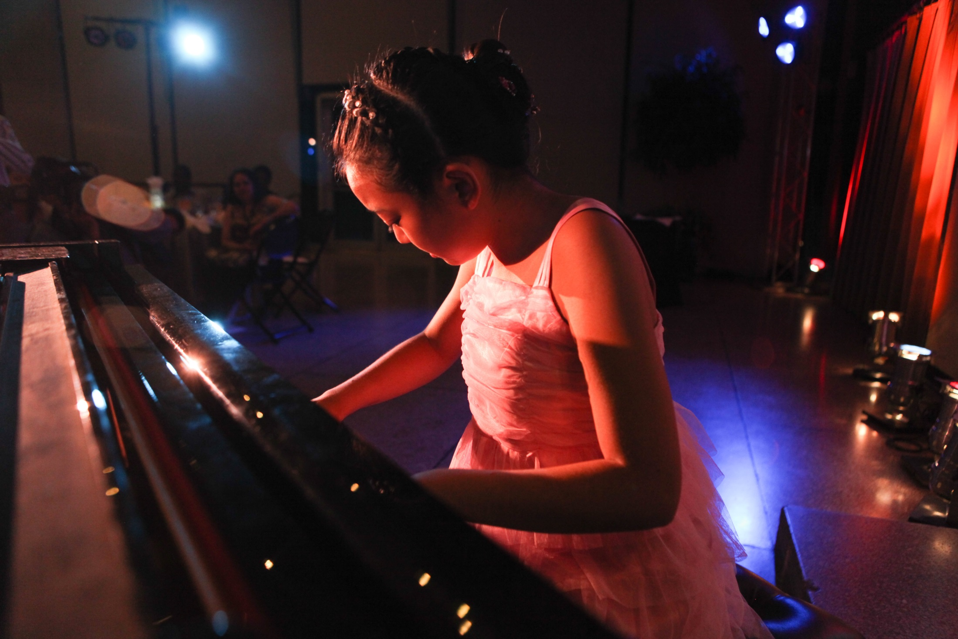
Notes:
Or they may be an excellent musician, artist, or poet.

Slide 20
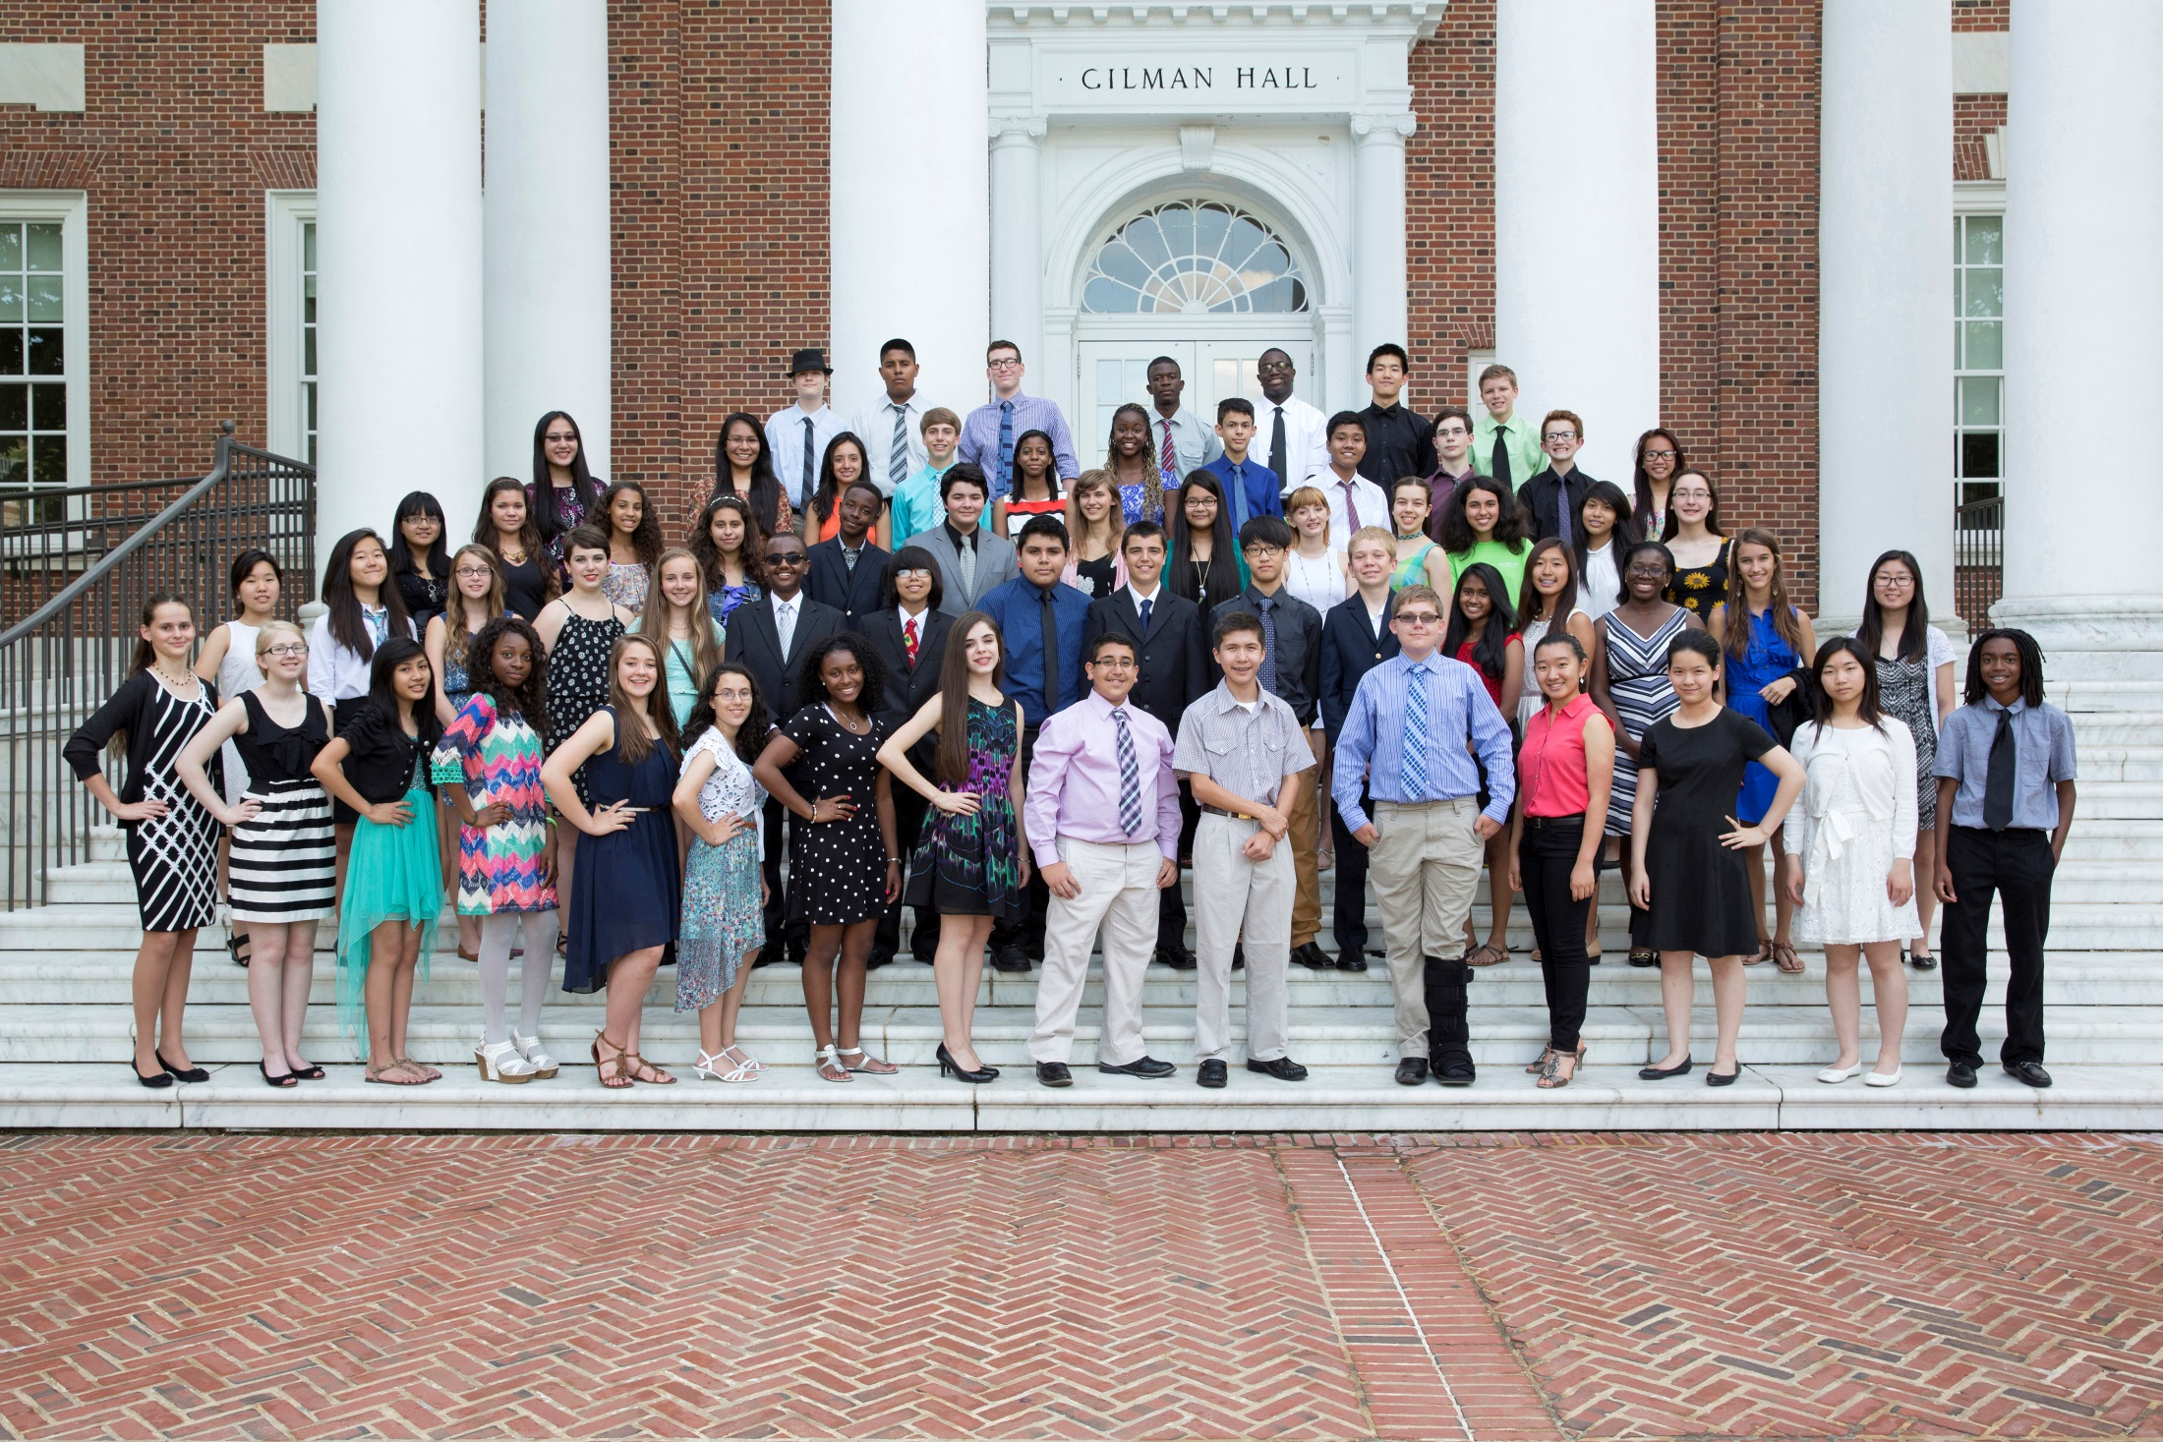
Notes:
There are many talented students who have financial need. You know one, two, or a whole classroom full. Regardless of the number, we encourage you tell prospective applicants to learn more about the Young Scholars Program. This is last year’s cohort of Young Scholars. We look forward to welcoming a new group of students this year.

Slide 21
Notes:
If you know a student who is already showing strong signs of thinking big, working hard, and achieving,
If you know a student who is Hardworking, Creative, Motivated, Curious, Responsible, Driven, and Compassionate,
If you know a student who is hungry to learn,
here is what is needed for their application.

Slide 22
Application Components
Grades, GPA, Test Scores, and Awards
English and Math Teacher Recommendations
Personal Recommendation
Short Answers and Long Essay (500 words)
Parent/Guardian information and financial information comprising of the last three years (including copies of family’s tax forms)
Notes:
The application is comprised of several parts. Grades, GPA, test scores, and awards are one. We also request three recommendations. One from an English or language arts teacher, one from a math teacher and one personal recommendation. The personal recommendation can be from another teacher who knows a student particularly well, a community leader, pastor, rabbi, coach, music teacher, among other possibilities. Students also must submit short answers and a long essay based on the application prompts. Parents/Guardians must submit financial information to be considered for the scholarship. We ask for financial info for the last three years.

Slide 23
Selection Criteria
High academic ability
Financial Need
Persistence
Leadership
Service to others
Notes:
The application components are weighed holistically and we look for the following in the selection process: high academic ability, financial need, persistence, leadership, and service to others.

Slide 24
Next Steps & Tips for Parents and Students
Start early!
Start the student account, parent account, and add recommenders to your application right away. Automatic reminders will be sent throughout the application period.
Visit www.jkcf.org/ysp for more information or contact scholarships@jkcf.org with specific questions about your eligibility and application
Notes:
Starting the application process early provides the student the opportunity to strengthen their application, troubleshoot any challenges and difficulties, and receive support as necessary.
Although students will be completing the bulk of the application, students may seek support from a teacher or counselor to help strengthen their application. In addition, applicants will find themselves seeking support from an adult through the application process to obtain school documents, recommendations, and financial information.
Most information required to successfully complete the application can be found online at www.jkcf.org/ysp. However, you may have questions regarding different components of the application, need of technical support, and other assistance. Please send all inquiries to outreach@jkcf.org.

Slide 25
Important Dates
January
Application Opens
www.jkcf.org/ysp
April 14, 2016
Application Deadline
Early Fall 2016
The Foundation makes finalist and semifinalist announcements
Notes:
The application will launch online by the end of this month. The application will be available on our website: www.jkcf.org
Applications must be received by April 14th, 2016 for consideration.
We anticipate informing applicants of the results in early Fall 2016

Slide 26
More Information
Please visit us at www.jkcf.org/ysp
For questions about the recruitment and outreach: outreach@jkcf.org
For individual questions regarding your eligibility and application:
scholarships@jkcf.org
Notes:
At this time if you have a general or specific question about the program or the application, we’d love to hear from you. Please use the Q&A feature in GoToMeeting or the chatbox.

Slide 27
Questions
Please use the chat box or question feature in GoToWebinar to submit your questions.
If we don’t get to your individual question, please email scholarships@jkcf.org for specific inquiries about student eligibility.
For other questions about the program and outreach opportunities, please email outreach@jkcf.org

