Slide 1
Authentication in the information industry: the challenges
Rob Scaysbrook, International Sales Manager
robert.scaysbrook@eduserv.org.uk

Slide 2
The next 30 minutes
Why we care about the seamless user journey
What are the challenges
What are the first steps to delivering a seamless user journey

Slide 3
Our purpose
We help organisations connect their communities with the content and resources they need to develop their ideas and make the best possible decisions

Slide 4
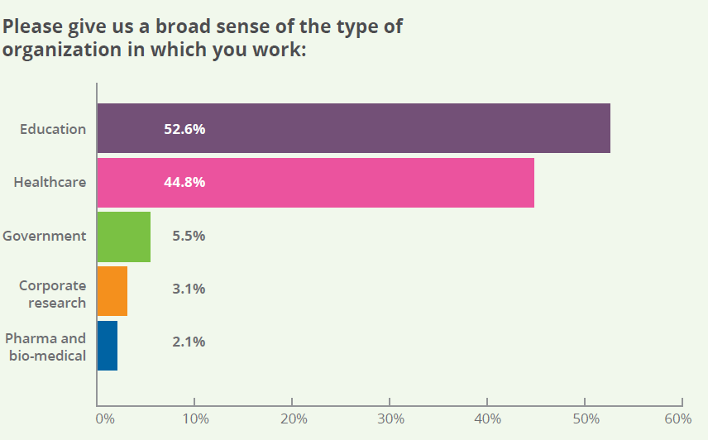
Librarians’ experiences and perceptions of Identity and Access Management – January 2015

Slide 5
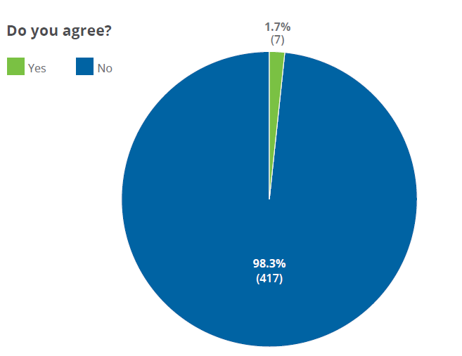
Access management is critical
Yes
No
Notes:
98.3% (n = 424) of respondents agreed that access management is critical to meeting users’ needs and maximizing investment in resources.
Those who didn’t agree made good points, for example, that access management is critical to providers but can in some respects be a barrier to meeting end users’ needs; what is critical to them is access provision. This may be considered a semantic point but it reminds us to remain focused on the end rather than the means.

Slide 6
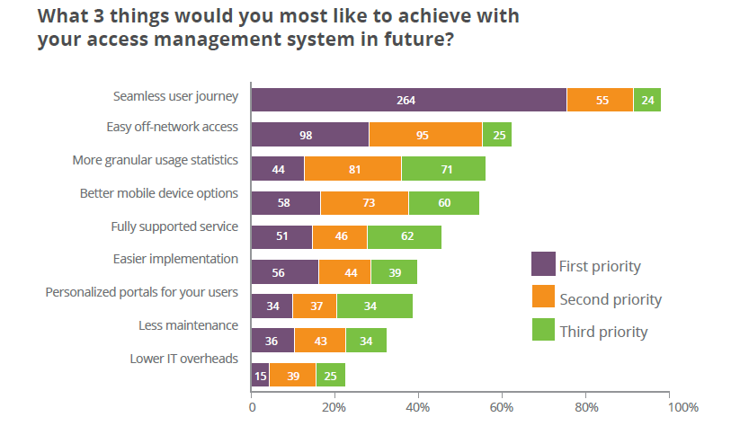
Aspirations
Notes:
Respondents’ clear priority is a seamless user journey, with 66.5% (n = 397) choosing this as their top priority. Easy off-network access and more granular usage statistics were also popular choices. Better mobile device options was a high priority for respondents in healthcare and education, but less so for respondents in other groups.

Slide 7
.
The expectation

Slide 8
.
Libraries
Speed of access
Device support
No subscription
.
Network
access
Site
experience
?
Login
credentials
User not
recognized
404
Location
Usability &
training
Link rot
Device pairing
Publishers
The reality

Slide 9
Considerations for libraries..

Slide 10
Network Access
Users expect consistent wifi connectivity across devices and locations
Technology needs to be updated regularly to meet users’ evolving device requirements

Slide 11
Device Support
Incorporate device-agnostic design into institutional network pages
Redevelop library portals with responsive design and mobile usability in mind

Slide 12
Usability & training
Users are not always familiar with the resources they need to use
Provide training videos to understand library portals, discovery services, and publisher’s platforms
Provide users with training on how to transition from search engine results to the appropriate library resources

Slide 13
User credentials
It’s not always clear which credentials are required to sign into a service
Single Sign-On supported on institutional network, regardless of device

Slide 14
Can OpenAthens help?
Consistent set of user credentials for all e-resources
Integration with institutions’ portals to improve the end-user experience
OpenAthens authentication available irrespective of device or location

Slide 15
Considerations for publishers..

Slide 16
Speed of access
Publisher’s sites can be slow to respond and deliver search results, leading to user frustration
Set a target for page speed and search results to improve performance

Slide 17
Device pairing
The procedure for pairing an app with a web service is sometimes unclear
Focus on user experience to develop a more friendly pathway
User confusion regarding expiration of paired accounts
Ensure user-facing messages are clear about expiry, and provide reminders

Slide 18
User recognition
Publishers’ systems don’t always recognize user’s credentials
Improve clarity of why users are asked to log in, and the resources available
Ensure the user journey meets expectations

Slide 19
Link rot
Libraries often only notice a resource is unavailable when notified by users
Put better procedures in place to alert libraries when resource URLs are changed
Make it easier for librarians to connect with technical staff and address Identity / Service Provider issues quickly

Slide 20
User experience
Users’ login experience lacks consistency
Collaborate to develop shared terminology and standards
Establish a clear and consistent user journey

Slide 21
No subscription
It’s not always clear to users what their institution holds a subscription to
Incorporate clear resource availability indicators based on users’ current sign-in status

Slide 22
Can OpenAthens help?
We have developed our authentication process to be light, responsive and improve organisation discovery
We can now pass more end-user attributes to the publisher to improve the user experience and support personalisation
Our statistics can show which resources end users engage with most frequently

Slide 23
Next steps
Enable access with local directories to manage local accounts within the OpenAthens dashboard
Improve the integration with our products and other applications
Increase collaboration with all our customers to create a seamless end user experience

Slide 24
What our customers say
“It's a great convenience to be able to access our resources from any computer outside of work. That kind of access is indispensable for students and researchers.”
OpenAthens healthcare customer, NPS survey feedback, Spring 2015

Slide 25
Questions?

