Slide 1
Content, Access and Discoverability
Lenerl Sharp
20th & 22nd October

Slide 2
About SpringerNature
The leading global research, educational and professional publisher. Home to an array of respected and trusted brands providing quality content through a range of innovative products and services.
The world’s largest academic book publisher, publisher of the world’s highest impact journals and a pioneer in the field of open research.
Almost 13,000 staff in over 50 countries with a turnover of approximately € 1.5 billion
Formed in 2015 through the merger of Nature Publishing Group, Palgrave Macmillan, Macmillan Education and Springer Science+Business Media.
Every day, around the globe, our imprints, books, journals and resources reach millions of people, helping researchers and scientists to discover, students to learn and professionals to achieve their goals and ambitions.

Slide 3
How we look at research
As the world’s largest academic book publisher, publisher of the world’s highest impact journals and a pioneer in the field of open research, we understand that we are in a unique position to think differently about what publishing should mean today.
By using our combined expertise, scale and the reach of our brands, we aim to grow and innovate in order to better serve academic researchers, corporations and the wider public by helping them to access, share, use and apply the very best research and information available.

Slide 4
Vision for the future
At SpringerNature we continuously build on the reputation for being proactive partners. We combine the best approaches to all relationships:
Quality of our products, the physical appearance of our books and the service we give to our customers: authors, agents, booksellers and teachers.
Focused on remaining industry pioneers, new developments, new products and new systems. Lead the way in innovation.
Key examples:
Both founding members of CrossRef – an initiative from the industry that benefits all, including researchers.
Springer has been leading the way with Open Access and eBooks.
At Nature, content sharing has been very important and we are working on a number of new initiatives, like TDM, Aggregators, Papers.

Slide 5
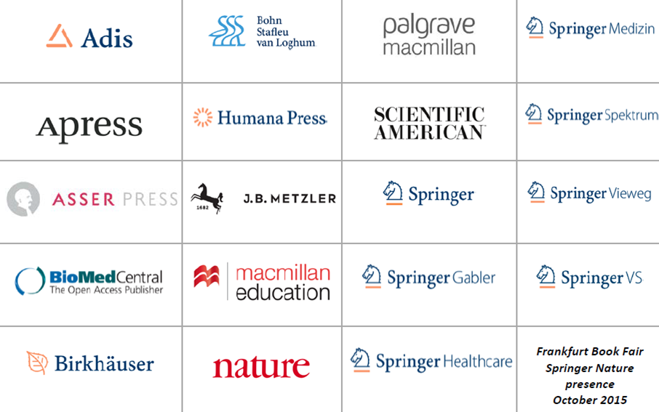
Our accessible imprints

Slide 6
Content - The Research Cycle
Idea discovery, generate hypothesis
Idea discovery, generate hypothesis (awareness, literature review, informal)
Funding/approval (literature review)
Conduct research (awareness)
Disseminate results (formal publication, informal dissemination)
Disseminate results
Funding / Approval
Conduct research

Slide 7
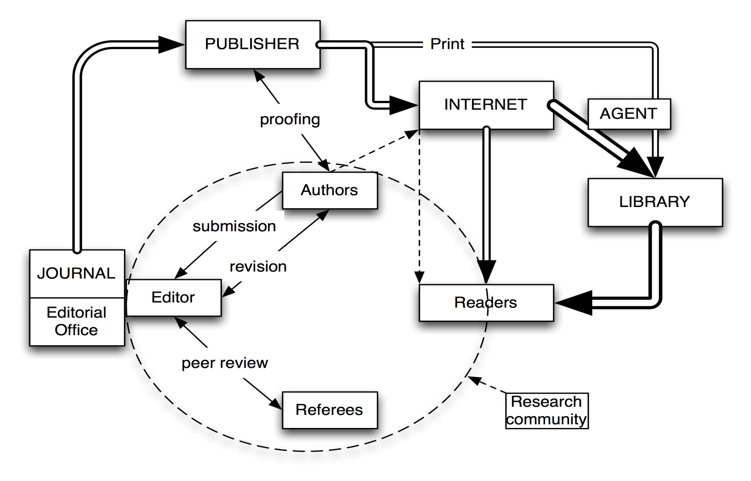
Content - The Publishing Cycle
Morgan, Campbell, & Teleen, 2012

Slide 8

The Research Cycle and the Role of the Scientist
Develop research idea
Funding
Conduct research
Publish research results
Scientist as creator of scientific information
Scientist as user of scientific information
Registration,
dissemination,
certification and
archival of scientific research
Access to content precondition
Awareness
Literature review
Not redoing existing research

Slide 9
Content - The Publisher
Identify new niche markets for content
Expanding or closing existing journals
Meet demand for new journals
Creation of new disciplines – new starts
Manufacturer/electronic service provider – type setting tagging, etc.
Marketing – Attracting the papers (authors), increasing readership and subscribers
Distributor – Fulfilment system
Electronic host – for journals, books, databases

Slide 10
Content – Changing…
Changes to the publishing market (e.g. new business models like open access; new sales models such as consortia licensing; user centered collection models, globalization and the growth of emerging regions)
Changes to the way research is conducted (e.g. use of networks; growth of data intensive and data-driven science; globalization of research)
Changes to public policy (e.g. research funder self-archiving mandates; changes to copyright)
Source: STM Assoc. 2015 Report

Slide 11
Drivers
Delivery
Innovation
Collaboration
Discoverability
Technology

Slide 12

How big is the STM market?
STM Market Size
Total Market Volume:
$12.4 billion
(Source: Springer, SIMBA Information)

Slide 13
Content – STM literature at a glance
350 Years of Journal Publishing - $$$$ invested in Online Publishing
About 28,500 Journals Published (11,500 English Language)
2.3 Million Journal Articles
10,000 Open Access Journals
eBooks 50,000 per year
5,000 – 10,000 Publishers
Protocols
Reference Works
Databases – (Internal/External)
Virtually all Available On Line
Researchers Average reading 270 articles per year
Source: STM Assoc. 2015 Report, SIMBA

Slide 14
SpringerNature is the leading book publisher
Number of English-Language Titles Published in 2014
Data from www.puballey.com; only books available through YBP approval plans; if a book is published simultaneously in hard- and paperback editions, only the hardback edition was included

Slide 15
But it is not just about the number of available books
High demand
High downloads
Available on any device
No DRM, no limitations on copying, printing, simultaneous use or downloading
Continuous access business model
More than 180k books
Usage growth year on year
You think books are less key
than journals?
Let us prove you wrong!
eBooks
Great value for money
Including all book types, series & MRWs
Affordable business models for every organization
After sales support

Slide 16
Access - Multiple options available
Publishers Platforms
Third Parties
Aggregators
Doc-Delivery
Pay Per View
Archives
Milestones in E-Book Content
Technology – E-Readers, Tablets
Available Anytime, Anywhere

Slide 17
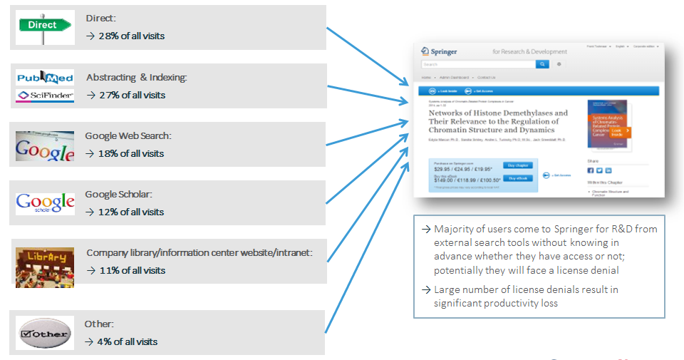
How corporate researchers access Springer content
Based on an analysis of the Top 50 Corporate & Health customers; direct includes every visit for which no referrer information was passed on, such as bookmark traffic, typed URLs, and word-of-mouth initiated traffic such as links in e-mails or instant messaging programs

Slide 18
Find and access our content through 3rd parties
  Two-thirds of users started their search on Google web search or Google Scholar
  Other important referrers include library websites, A&I databases, CrossRef links, recommendations from peers, and TOC alerts
  Results are very much in line with data from the Springer Link web analytics tool
Source: Market Intelligence & Web Analytics

Slide 19
Discoverability
Indexing
Third Parties – discovery tools
Aggregators
Doc-Delivery
Pay Per View
Technology (Social Media)
Databases
Text Data Mining initiatives
Copyright
Platform development
API’s

Slide 20

Scientists spend almost 12 hours per week on information tasks
11.7
Median hours per week
Source: Outsell Information markets & Users Database; N=2,070 Faculty, Graduate Students and R&D/Science professionals

Slide 21
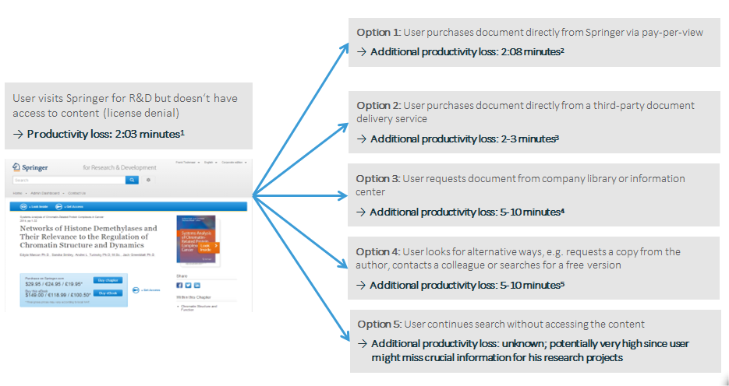
The hidden costs of denied access
1 = Average time per session with a license denial; only sessions from registered institutions
2= Average time of the pay-per-view order process; productivity loss potentially higher if pay-per-view costs are reimbursed by the employer (additional paper work)
3 = Estimate; productivity loss potentially higher if pay-per-view costs are reimbursed by the employer (additional paper work)
4= Estimate, includes time of user as well as librarian/information specialist
5= Estimate

Slide 22










Discovery tools
These third parties are used by our customers to search for content. PubMed, PubChem & Chemspider are well known free resource databases
Scopus and CAS are abstraction and citation databases. Reaxys is a chemistry database and also used as a discovery tool
EBSCO is a discovery tool used by our customers
Google Scholar/Google Web is a search engine crawling our content
FREE
PAID

Slide 23
Risks associated with unleveraged discoverability opportunities?
Springer is isolated from indexing process
    Limited knowledge and participation in third party indexing processes
Poor renewal rate of sales‘ contracts
    Impact on discoverability and downstream usage of our content by our customers
Failure to remain competitive
    Competitors are participating in third party indexing e.g. Reprints Desk, Scopus, etc.
    Springer Nature is working closely with Google to manage and insure that our content is discoverable.
    Keeping up to date with trends in indexing and participating.

Slide 24
What is SpringerNature doing about discoverability?
Partnering with third parties and our customers to better index our content through their channels
Communicating to our customers about how our content is indexed
Formalising ownership for discoverability within Springer
Formalising ownership for third party relationships with focus on indexing

Slide 25
Account development & discovery
Account Development collaborates with Springer clients to optimize usage of licensed electronic resources
Account development tracks e-resource usage to spot issues
Increasingly necessary to marry up what we do with metadata and full text provision for discovery services, with what those services deliver
The costs in IT time to match search engine optimization on Springer web sites with the nuances of public search engines is considerable
The costs to provide content for indexing by web-scale library tools, and client support around these tools is also considerable
Consequently, we need to know how tools really perform
One way to determine performance is by conducting discovery audit

Slide 26
Library Advisory Boards concludes
“that if usage had been good, and then goes bad, they look for technical reasons”
Has the publisher set up all the proper access?
Has the Org. set up all the finding tools?
Has the Org. recently made system changes, lost staff, etc.?
Has something changed in the intermediary discovery layer?
Did Google change the way it does ranking?
If usage has never been good, you can check the discovery layer, but it may be a marketing/visibility issue. Either that our content is a poor match for the client ☹
If usage had been good and it goes bad, and no technical reason can be found, it must be a marketing/visibility issue
It is never the case that researchers who one year liked our content, wake up and decide one day that they do not like it

Slide 27
The technical side - Discovery tools
Discovery is a shared effort between publishers, search tool providers, and libraries
Springer maximizes the content it gives to search tool providers
    Each word, name, image caption, subject class is an access point
    Not just metadata, full text
Search tools work to maximum effect if they index everything Springer gives them
Google can index every word on SpringerLink, but we also give this content to library web-scale discovery services like the following:
    EBSCO Discovery Service
    Ex Libris Primo and Primo Central
    OCLC WorldCat and WorldCat Local
    Serials Solutions Summon by ProQuest
One of the most important disciplinary index is PubMed for medical content – daily feeds…

Slide 28

SpringerNature - Metadata mission statement
1
We understand metadata as the gateway to our content
2
We provide best quality metadata with state-of-the-art enrichment in all key formats and flavors, available in all relevant delivery models
3
Our bibliographic metadata is free, open and re-usable

Slide 29
The Golden Rules of STM Publishing in Today’s Environment
1. Your content has to be online
All new articles (250,000/yr)
Backfiles
(2.4 million articles)
All new books (7,000/yr)
Book Archive
(100,000 books)
2. Your content has to be “findable”
SEO
A&I services
Library portals
Book search programs / eRetail
Social Media
Push marketing

Slide 30
How are we addressing content, access & discoverability?
Flexible Pricing Models
New and Improved Pricing Models
Adaptability
Innovation
Collaboration
Auditing
Participation in Initiatives
Technology – API’s
Acquiring Content/Acquisitions
Lowering Barriers for Access
New and Improved Databases
Better ROI – Lower Cost Per Access

Slide 31

Building relationships with Reprints Desk
Including Proper Indexing of All Content
Working together with Clients
Offering Additional Value – with Tokens
Token Rates to be charged to shared Customers
Invoice the Customer via Reprints Desk
Springer initiates the Contract
Customer’s current token Agreements still valid

Slide 32
Thank you!
For more information, contact your Springer Licensing Manager

