Slide 1
RICHMOND HUG
9.30.15

Slide 2
Agenda
HUG Updates
Why Personas?
Instructions
Group Workshop
Wrap-Up - What Next?
#RVAHUG

Slide 3
HUG Updates
Most RSVPs EVER! to a RVA HUG event
…out of 2
Let’s make the HUG a great resource for meeting other inbound marketers & sharing best practices
Quarterly meetings
Despite all of the sprockets…
…we're not paid by HubSpot to do this
#RVAHUG

Slide 4
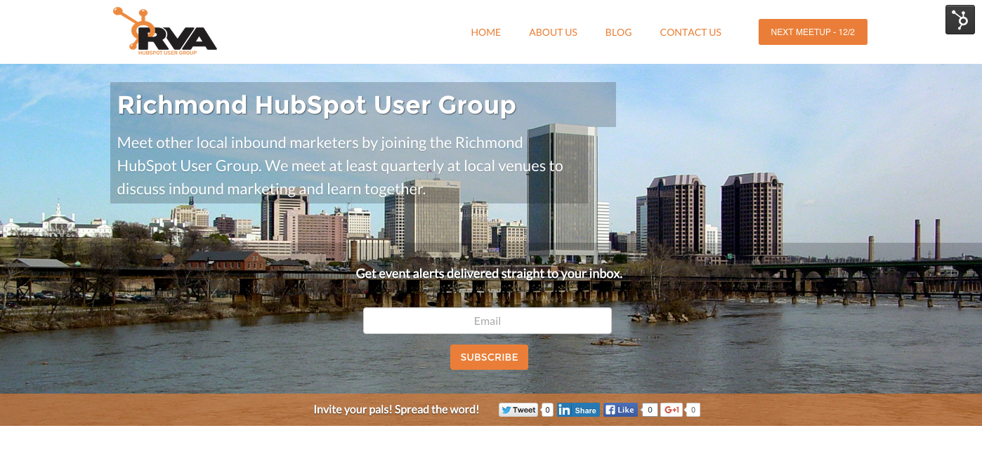
HUG Updates
New website!
richmond.hubspotusergroups.com
#RVAHUG

Slide 5
HUG Updates
Mark your calendar
Next Event: Wednesday, December 2, 2015
Topic TBD
It will be in between Thanksgiving and Christmas.
There will be beer.
#RVAHUG

Slide 6
Why Personas?
“By creating content specifically designed to appeal to your dream customers, inbound attracts qualified prospects to your business and keeps them coming back for more.” -HubSpot
#RVAHUG

Slide 7
Your customers are more than just numbers, they’re people
People have problems that they need solve
To position your content and your solution correctly, you need to fully understand your customers and their problems
Everyone needs to be on the same page
All marketing efforts should speak the same language
#RVAHUG

Slide 8
Persona Guidelines
How many?
Enough to cover your primary customer groups
Not too many to where they become unwieldy
How detailed?
Detailed enough to be useable but not too detailed to be overwhelming
Keep each persona to one page
Where do I get customer info?
From your customers!
Employees that interact with customers
#RVAHUG

Slide 9
Persona Components
Name and Photo Use an alliterative name and a representative photo
Background
Demographics
Identifiers
Buzzwords
Goals
Challenges
How we help
Quotes Get creative and think of quotes your persona might actually say
Common Objections
Marketing Message
Elevator Pitch

Slide 10
How To Use Personas
Serve as the cornerstone for all of your online efforts
Site design
Design your site so that your persona can easily identify next steps and navigate intuitively
Site content
Create content that’s relevant to their needs/challenges. Does the content on the page resonate with them?
Make sure you’re speaking your persona’s language.
Blog topics
Use personas to guide your blog content strategy. Are the posts addressing their questions?
Divide content by persona based on business objectives
Whitepapers
What topics does your persona need in-depth information on?
Is the content something they would exchange an email for?
#RVAHUG

Slide 11
How To Use Personas
Offline
Sales and support teams can better understand who they’re speaking to.
Eliminate tire kickers and lengthy, uneventful sales calls.
Reference personas when developing trade show collateral, ad strategies, and other offline marketing efforts.
#RVAHUG

Slide 12
Group Workshop
Split into groups
Complete worksheet for your company’s primary buyer persona
We’ll have folks walking around
Feel free to run ideas by others
Break!
#RVAHUG

Slide 13
Next Steps
Promote personas internally
Get people on board. Show them why it’s important
Tools for building detailed personas
Google forms
Request a specific number in questions, be detailed with instructions
Customer surveys
SurveyMonkey
Interviews
Structure the interview in same format as persona worksheet
#RVAHUG

Slide 14
Next Steps
Document
Powerpoint is easy
One pager is useful
Canva is great for this or just use Word
Refine
Ask for feedback from others
Only as useful as they are accurate
Share
Post them on the wall
Spread throughout the organization
#RVAHUG

Slide 15
Next Steps
USE THEM!
Reference them in projects
Target content
Refine ad targeting
Use them to make informed decisions
Add to HubSpot
Use form criteria to segment lists
Add personas to HubSpot
#RVAHUG

Slide 16
Recap
Email follow-up to come
Helpful links
Deck
Worksheet
Link to next HUG, new website and more

Slide 17
Thanks for coming!

