Slide 1

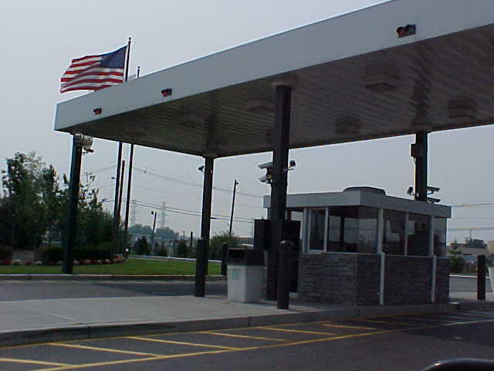
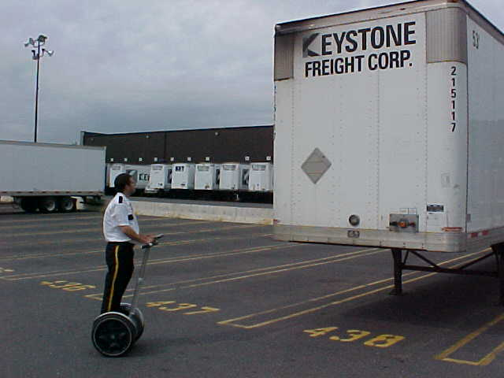
Inside a Facility
Main entrance
One exit / entrance
Access control
Perimeter alarms
Electric fence
ID cards
Generators
Segways
CCTV

