Slide 1
The Sellability Tracker
Prepared for
www.ValueBuilderSystem.com
The Value Builder SystemTM is a statistically proven method for increasing the value of a company by 71%.

Slide 2
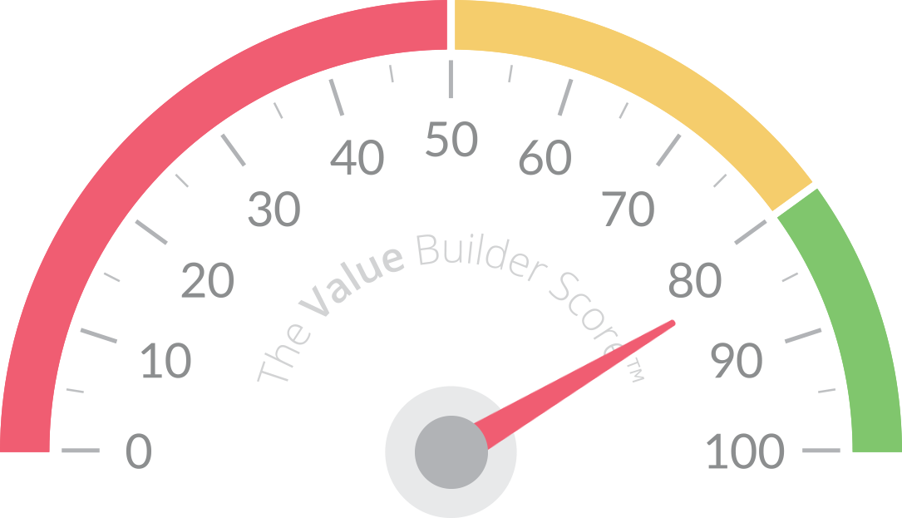
The Sellability Tracker
www.ValueBuilderSystem.com
The Value Builder SystemTM is a statistically proven method for increasing the value of a company by 71%.

Slide 3
Objectives & Methodology
The Sellability Tracker is a quarterly study designed to track worldwide trends in the liquidity of privately held businesses.
This study was conducted by the team at The Value Builder System™— a cloud-based software application that allows business owners to evaluate the “sellability” of their company.
We analyzed data from over 20,000 users of The Value Builder Score from around the world between July 1, 2012 and March 31, 2016. The majority of participants were from the United States, the United Kingdom, Canada and Australia.
96.4% of business owners surveyed had revenue (annual turnover) of less than $20,000,000; 3.6% had revenue in excess of $20,000,000.
Findings are considered accurate +/-0.81% 19 times out of 20.
www.ValueBuilderSystem.com
Sellability Tracker Q2 2015. Copyright 2015 ValueBuilderSystem.com
Sellability Tracker Q1 2016. Copyright 2016 - Presented by The Value Builder SystemTM

Slide 4
Slight decrease in owner optimism, except in the U.S.
Q
“In the next 12 months, do you expect your revenue to…”
% who expect their revenue to increase next year
www.ValueBuilderSystem.com
Sellability Tracker Q2 2015. Copyright 2015 ValueBuilderSystem.com
Sellability Tracker Q1 2016. Copyright 2016 - Presented by The Value Builder SystemTM

Slide 5
Industry optimism varies by region
Q
Q
“Would you say your industry is…”
% who say their industry is growing
www.ValueBuilderSystem.com
Sellability Tracker Q1 2015. Copyright 2015 www.SellabilityScore.com
Sellability Tracker Q1 2016. Copyright 2016 - Presented by The Value Builder SystemTM

Slide 6
Business Liquidity Index (BLI) has dropped to its lowest point on record
Q
“Have you received a written offer to buy your business in the last year?”
BLI = (%receiving an offer in quarter X / benchmark %)*100
www.ValueBuilderSystem.com
Sellability Tracker Q2 2015. Copyright 2015 ValueBuilderSystem.com
Sellability Tracker Q1 2016. Copyright 2016 - Presented by The Value Builder SystemTM
Notes:
The Business Liquidity Index (BLI) uses the percentage of respondents who have received an offer in the last quarter as a proxy for the liquidity in the private business market

Slide 7
Average multiples down slightly from Q4 2015
Q
“What multiple of your earnings did the offer represent? Please estimate the multiple using the money (or other currency like stock) that was being offered at closing. Please do not include any money being offered in the form of an ‘earn out’, or management contract that was contingent on your future performance.”
Multiple of earnings the offer represents
www.ValueBuilderSystem.com
Sellability Tracker Q2 2015. Copyright 2015 ValueBuilderSystem.com
Sellability Tracker Q1 2016. Copyright 2016 - Presented by The Value Builder SystemTM

Slide 8
Trends since inception: Demographics
www.ValueBuilderSystem.com
Sellability Tracker Q1 2016. Copyright 2016 - Presented by The Value Builder SystemTM

Slide 9
Age
www.ValueBuilderSystem.com
Sellability Tracker Q1 2016. Copyright 2016 - Presented by The Value Builder SystemTM

Slide 10
Younger owners most likely to receive an offer…
Q
“Have you received a written offer to buy your business in the last year?”
% of respondents who had received an offer in the last year
www.ValueBuilderSystem.com
Sellability Tracker Q2 2015. Copyright 2015 ValueBuilderSystem.com
Sellability Tracker Q1 2016. Copyright 2016 - Presented by The Value Builder SystemTM

Slide 11
…but the value offered to younger owners is lower
Q
“What multiple of your earnings did the offer represent? ”
Comparing average multiple offered
www.ValueBuilderSystem.com
Sellability Tracker Q2 2015. Copyright 2015 ValueBuilderSystem.com
Sellability Tracker Q1 2016. Copyright 2016 - Presented by The Value Builder SystemTM

Slide 12
The Long View
www.ValueBuilderSystem.com
Sellability Tracker Q1 2016. Copyright 2016 - Presented by The Value Builder SystemTM

Slide 13
Owners in it for the long haul
twice as likely to receive an offer
Q
“Have you received a written offer to buy your business in the last year?”
% of respondents who received an offer in the last year
www.ValueBuilderSystem.com
Sellability Tracker Q2 2015. Copyright 2015 ValueBuilderSystem.com
Sellability Tracker Q1 2016. Copyright 2016 - Presented by The Value Builder SystemTM

Slide 14
Long view owners get better offers too
Q
“What multiple of your earnings did the offer represent?
Comparing average multiple offered
www.ValueBuilderSystem.com
Sellability Tracker Q2 2015. Copyright 2015 ValueBuilderSystem.com
Sellability Tracker Q1 2016. Copyright 2016 - Presented by The Value Builder SystemTM

Slide 15
Trends since inception: Drivers of Value
www.ValueBuilderSystem.com
Sellability Tracker Q1 2016. Copyright 2016 - Presented by The Value Builder SystemTM

Slide 16
Rising Tide
www.ValueBuilderSystem.com
Sellability Tracker Q1 2016. Copyright 2016 - Presented by The Value Builder SystemTM

Slide 17
Companies in a growing industry typically get slightly
higher average offers (especially in the UK)
Q
“What multiple of your earnings did the offer represent?
Comparing average multiple offered
www.ValueBuilderSystem.com
Sellability Tracker Q2 2015. Copyright 2015 ValueBuilderSystem.com
Sellability Tracker Q1 2016. Copyright 2016 - Presented by The Value Builder SystemTM

Slide 18
Geo-scalable
www.ValueBuilderSystem.com
Sellability Tracker Q1 2016. Copyright 2016 - Presented by The Value Builder SystemTM

Slide 19
Companies with the potential to scale geographically typically get slightly higher offers… Less relevant in Down Under
Q
“What multiple of your earnings did the offer represent?
Comparing average multiple offered
www.ValueBuilderSystem.com
Sellability Tracker Q2 2015. Copyright 2015 ValueBuilderSystem.com
Sellability Tracker Q1 2016. Copyright 2016 - Presented by The Value Builder SystemTM

Slide 20
Custom vs. Standard
www.ValueBuilderSystem.com
Sellability Tracker Q1 2016. Copyright 2016 - Presented by The Value Builder SystemTM

Slide 21
Companies that offer little or no customization to their product or service get somewhat higher offers
Q
“What multiple of your earnings did the offer represent?
Comparing average multiple offered
www.ValueBuilderSystem.com
Sellability Tracker Q2 2015. Copyright 2015 ValueBuilderSystem.com
Sellability Tracker Q1 2016. Copyright 2016 - Presented by The Value Builder SystemTM

Slide 22
Customer Relationship
www.ValueBuilderSystem.com
Sellability Tracker Q1 2016. Copyright 2016 - Presented by The Value Builder SystemTM

Slide 23
Owner relationship with customer
Q
“What multiple of your earnings did the offer represent?
Comparing average multiple offered
www.ValueBuilderSystem.com
Sellability Tracker Q2 2015. Copyright 2015 ValueBuilderSystem.com
Sellability Tracker Q1 2016. Copyright 2016 - Presented by The Value Builder SystemTM

Slide 24
Scalability
www.ValueBuilderSystem.com
Sellability Tracker Q1 2016. Copyright 2016 - Presented by The Value Builder SystemTM

Slide 25
How Easy Would It Be To Accommodate 5 X Demand?
Q
“What multiple of your earnings did the offer represent?
Comparing average multiple offered
www.ValueBuilderSystem.com
Sellability Tracker Q2 2015. Copyright 2015 ValueBuilderSystem.com
Sellability Tracker Q1 2016. Copyright 2016 - Presented by The Value Builder SystemTM

Slide 26
Opt Ins
www.ValueBuilderSystem.com
Sellability Tracker Q1 2016. Copyright 2016 - Presented by The Value Builder SystemTM

Slide 27
Total Number of “Opt Ins” including email subscribers, Twitter “Followers”, Facebook Fan Page “Likes” etc.
Q
“What multiple of your earnings did the offer represent?
Comparing average multiple offered
www.ValueBuilderSystem.com
Sellability Tracker Q2 2015. Copyright 2015 ValueBuilderSystem.com
Sellability Tracker Q1 2016. Copyright 2016 - Presented by The Value Builder SystemTM

Slide 28
Market Share
www.ValueBuilderSystem.com
Sellability Tracker Q1 2016. Copyright 2016 - Presented by The Value Builder SystemTM

Slide 29
Market Share
Q
“What multiple of your earnings did the offer represent?
Comparing average multiple offered
www.ValueBuilderSystem.com
Sellability Tracker Q2 2015. Copyright 2015 ValueBuilderSystem.com
Sellability Tracker Q1 2016. Copyright 2016 - Presented by The Value Builder SystemTM

Slide 30
Recurring Revenue
www.ValueBuilderSystem.com
Sellability Tracker Q1 2016. Copyright 2016 - Presented by The Value Builder SystemTM

Slide 31
Businesses with recurring revenue get more offers …
Q
“Have you received a written offer to buy your business in the last year?”
12.29%
Comparing average multiple offered
17.56%
www.ValueBuilderSystem.com
Sellability Tracker Q2 2015. Copyright 2015 ValueBuilderSystem.com
Sellability Tracker Q1 2016. Copyright 2016 - Presented by The Value Builder SystemTM

Slide 32
… And Better Offers
Q
“What multiple of your earnings did the offer represent?
3.76
Comparing average multiple offered
4.14
www.ValueBuilderSystem.com
Sellability Tracker Q2 2015. Copyright 2015 ValueBuilderSystem.com
Sellability Tracker Q1 2016. Copyright 2016 - Presented by The Value Builder SystemTM

Slide 33
Size
www.ValueBuilderSystem.com
Sellability Tracker Q1 2016. Copyright 2016 - Presented by The Value Builder SystemTM

Slide 34
Size matters…
Q
“What multiple of your earnings did the offer represent?
Comparing average multiple offered
www.ValueBuilderSystem.com
Sellability Tracker Q2 2015. Copyright 2015 ValueBuilderSystem.com
Sellability Tracker Q1 2016. Copyright 2016 - Presented by The Value Builder SystemTM

Slide 35
Multiple goes up in lock step with size
Q
“What multiple of your earnings did the offer represent?
Comparing average multiple offered
www.ValueBuilderSystem.com
Sellability Tracker Q2 2015. Copyright 2015 ValueBuilderSystem.com
Sellability Tracker Q1 2016. Copyright 2016 - Presented by The Value Builder SystemTM

Slide 36
Record Keeping
www.ValueBuilderSystem.com
Sellability Tracker Q1 2016. Copyright 2016 - Presented by The Value Builder SystemTM

Slide 37
Record keeping approach
Q
“What multiple of your earnings did the offer represent?
Comparing average multiple offered
www.ValueBuilderSystem.com
Sellability Tracker Q2 2015. Copyright 2015 ValueBuilderSystem.com
Sellability Tracker Q1 2016. Copyright 2016 - Presented by The Value Builder SystemTM

Slide 38
Growth
www.ValueBuilderSystem.com
Sellability Tracker Q1 2016. Copyright 2016 - Presented by The Value Builder SystemTM

Slide 39
Growing companies get much higher offers
Q
“What multiple of your earnings did the offer represent?
Comparing average multiple offered
www.ValueBuilderSystem.com
Sellability Tracker Q2 2015. Copyright 2015 ValueBuilderSystem.com
Sellability Tracker Q1 2016. Copyright 2016 - Presented by The Value Builder SystemTM

Slide 40
Differentiation
www.ValueBuilderSystem.com
Sellability Tracker Q1 2016. Copyright 2016 - Presented by The Value Builder SystemTM

Slide 41
Companies with a monopoly in their market get
50% higher offers
Q
“What multiple of your earnings did the offer represent?
Comparing average multiple offered
www.ValueBuilderSystem.com
Sellability Tracker Q2 2015. Copyright 2015 ValueBuilderSystem.com
Sellability Tracker Q1 2016. Copyright 2016 - Presented by The Value Builder SystemTM

Slide 42
Industry
www.ValueBuilderSystem.com
Sellability Tracker Q1 2016. Copyright 2016 - Presented by The Value Builder SystemTM

Slide 43
Proportion of owners receiving offers by industry
Q
“Have you received a written offer to buy your business in the last year?”
% of respondents who had received an offer in the last year
www.ValueBuilderSystem.com
* Caution: small sample
Sellability Tracker Q2 2015. Copyright 2015 ValueBuilderSystem.com
Sellability Tracker Q1 2016. Copyright 2016 - Presented by The Value Builder SystemTM

Slide 44
Industry average offers
Q
“What multiple of your earnings did the offer represent? ”
Comparing average multiple offered
*
*
*
*
* Caution: small sample
www.ValueBuilderSystem.com
Sellability Tracker Q2 2015. Copyright 2015 ValueBuilderSystem.com
Sellability Tracker Q1 2016. Copyright 2016 - Presented by The Value Builder SystemTM

Slide 45
Industry average offers for businesses with greater than $3 million annual revenue
Q
“What multiple of your earnings did the offer represent? ”
Comparing average multiple offered
www.ValueBuilderSystem.com
Sellability Tracker Q2 2015. Copyright 2015 ValueBuilderSystem.com
Sellability Tracker Q1 2016. Copyright 2016 - Presented by The Value Builder SystemTM

Slide 46
Value Builder Score
www.ValueBuilderSystem.com
Sellability Tracker Q1 2016. Copyright 2016 - Presented by The Value Builder SystemTM

Slide 47
Company Value Builder Score by offer multiple
Q
“What multiple of your earnings did the offer represent?
Comparing average multiple offered
Average Value Builder Score: 59.1
www.ValueBuilderSystem.com
Sellability Tracker Q2 2015. Copyright 2015 ValueBuilderSystem.com
Sellability Tracker Q1 2016. Copyright 2016 - Presented by The Value Builder SystemTM

Slide 48
www.ValueBuilderSystem.com
Sellability Tracker Q1 2016. Copyright 2016 - Presented by The Value Builder SystemTM

Slide 49
www.ValueBuilderSystem.com
Sellability Tracker Q1 2016. Copyright 2016 - Presented by The Value Builder SystemTM

Slide 50
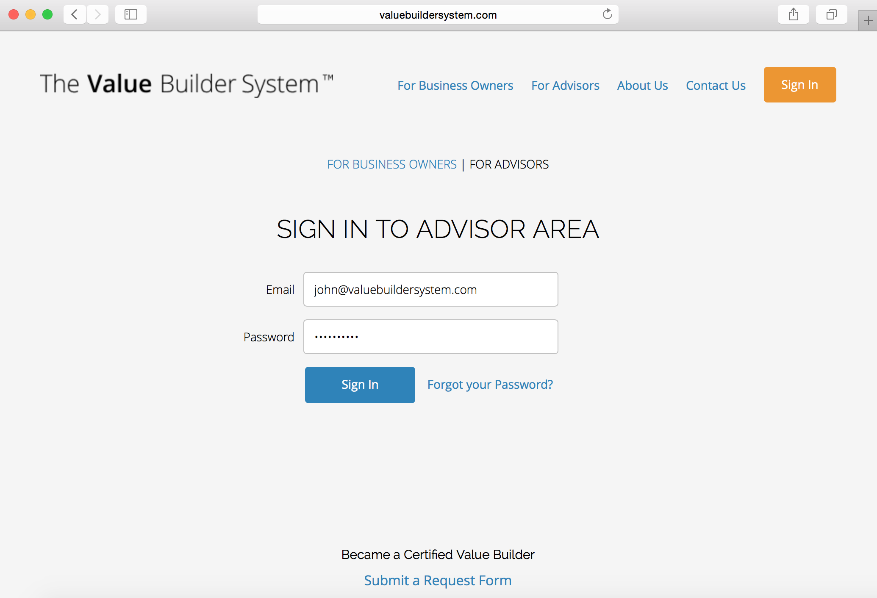
www.ValueBuilderSystem.com
Sellability Tracker Q1 2016. Copyright 2016 - Presented by The Value Builder SystemTM

Slide 51
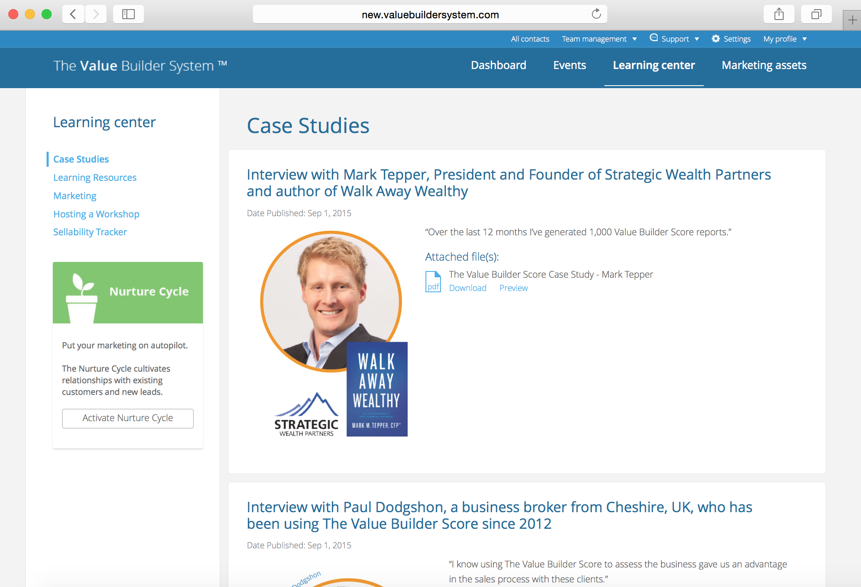
www.ValueBuilderSystem.com
Sellability Tracker Q1 2016. Copyright 2016 - Presented by The Value Builder SystemTM

Slide 52
www.ValueBuilderSystem.com
Sellability Tracker Q1 2016. Copyright 2016 - Presented by The Value Builder SystemTM

Slide 53
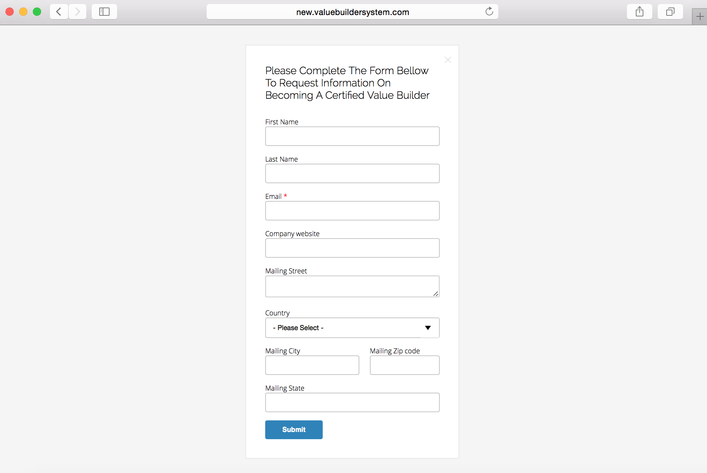
www.ValueBuilderSystem.com
Sellability Tracker Q1 2016. Copyright 2016 - Presented by The Value Builder SystemTM

Slide 54
ValueBuilderSystem.com
www.ValueBuilderSystem.com
Sellability Tracker Q1 2016. Copyright 2016 - Presented by The Value Builder SystemTM

