Slide 1


B8512G/B9512G Introduction
March 2015
Security Systems
ST-IN/MKP | #/$.2105 | © 2013 Robert Bosch LLC and affiliates. All rights reserved.

Slide 2
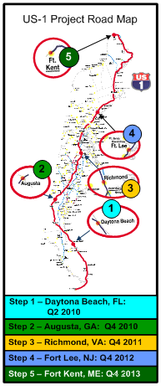
B8512G/B9512G Introduction
✓
✓
3 Hardware Upgrade
Performance:
HS bus (SDI2)
New SDI2 Peripherals
(IP, 8-In, 8-Out, RF Interface)
Capacity:
More Users
Operations:
Panel FW Update (via RPS)
5 New Platform (High-End)
SW grade (Mid-Range)
Performance and UI:
SDI2 Access Control
SDI2 POPEX, Retrofit Module
Communications:
Modular – Future Proof
Family:
Common peripherals
1 Hardware Upgrade
Performance:
New 32 bit processor
Communications:
New modem section (CID, faster)
Cellular reporting/programming
Dual IP path support
Operations:
Local flash update (ROM Key)
No more coin-cell battery
5 New Platform (High-End)
SW upgrade (Mid-Range)
Performance and UI:
SDI2 Access Control
SDI2 POPEX, Retrofit Module
Communications:
Modular – Future Proof
Family:
Common peripherals
✓
✓
2 Software Upgrade
Capacity:
More Areas
More Keypads
Communications:
IP & RPS configuration from keypad
SDI Automation Update
4 New Platform (Mid-Range)
Performance and UI:
SDI2 Devices (B920, B930, B520)
SDI2 RADION Wireless
Communications:
IP, Modular – Future Proof
Family:
Common peripherals
D9412GV3
D7412GV3
D7212GV3
D9412GV3
D7412GV3
D7212GV3
D9412GV4
D7412GV4
D7212GV4
B5512
B4512
GV4 v2
B9512G
B8512G
Step 3 – Richmond, VA: Q4 2011
Step 4 – Fort Lee, NJ: Q4 2012
2010
2011
2012
2013
2015
Step 5 – Fort Kent, ME: Q1 2015
Introduce new technology elements in a phased and controlled approach
Maintain forward and backwards compatibility
Security Systems
ST-IN/MKP | #/$.2105 | © 2013 Robert Bosch LLC and affiliates. All rights reserved.

Slide 3
B8512G/B9512G Introduction
Features and Capacities | B3512 | B4512 | B5512 | D7212GV4 | D7412GV4 | D9412GV4 | B8512G | B9512G
Users | 10 + Service | 32 + Service | 50 + Service | 99 + Service | 399 + Service | 999 + Service | 500 | 2000
Areas | 1 | 2 | 4 | 4 | 8 | 32 | 8 | 32
Points | 16 | 28 | 48 | 40 | 75 | 246 | 108 | 599
Point Indexes | 20 | 20 | 20 | 31 | 31 | 31 | 31 | 64
Outputs | 3 | 27 | 43 | 27 | 67 | 131 | 67 | 599
Doors | - | - | - | - | 2 | 8 | 8 | 32
IP cameras | - | 2 | 4 | - | - | - | 8 | 16
Supervised Keypads | 4 | 8 | 8 | 8 | 16 | 16 | 16 | 32
Log Events | 128 | 128 | 256 | 1000 | 1000 | 1000 | 2048 | 10192
Custom Functions | 1 | 2 | 4 | 4 | 4 | 16 | 8 | 32
SKEDS | 1 | 5 | 5 | 40 | 40 | 40 | 40 | 80
O/C Windows and User Groups | 2 | 2 | 4 | 8 | 8 | 8 | 8 | 32
Commercial Fire | No | No | No | No | Yes | Yes | Yes | Yes
Security Systems
ST-IN/MKP | #/$.2105 | © 2013 Robert Bosch LLC and affiliates. All rights reserved.

Slide 4
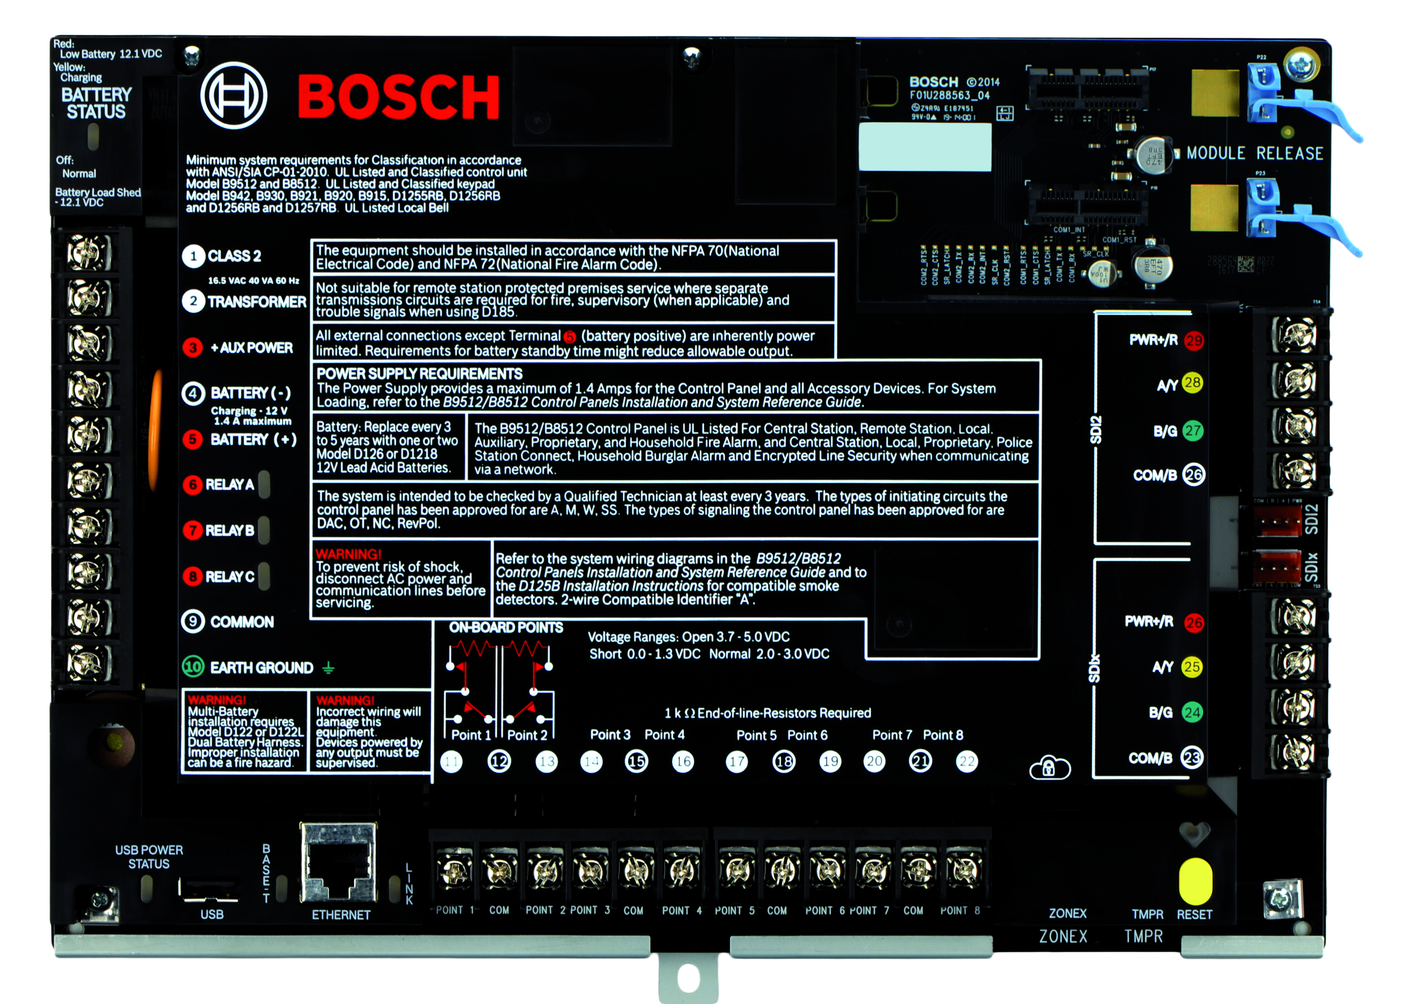
Greater familiarity
B8512G/B9512G Introduction
Familiar Footprint for easy retrofit
  Drop-in replacement for G, GV2, GV3 and GV4 and other
  Same plug-in terminal strips for most wire connections
Security Systems
ST-IN/MKP | #/$.2105 | © 2013 Robert Bosch LLC and affiliates. All rights reserved.

Slide 5
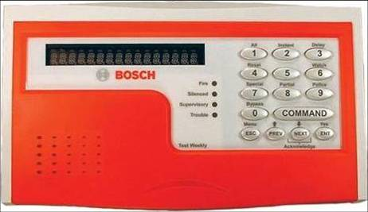
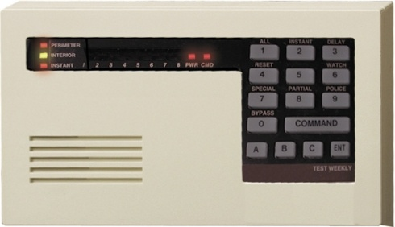
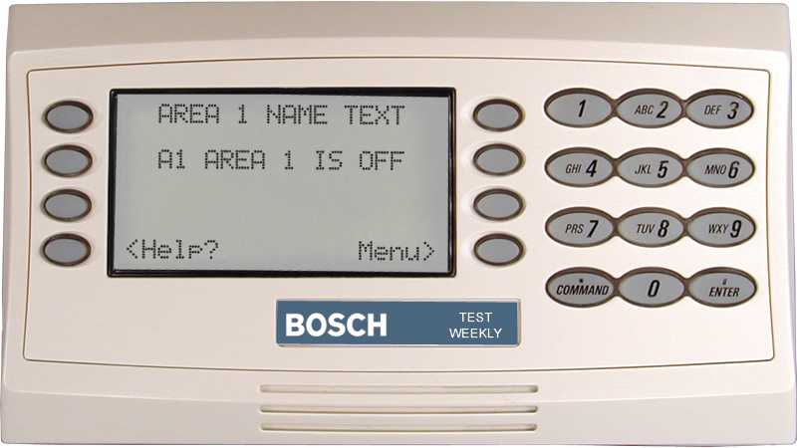
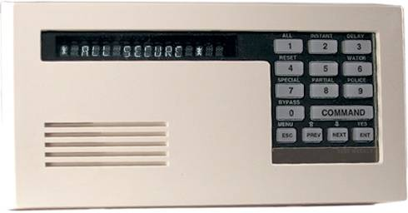
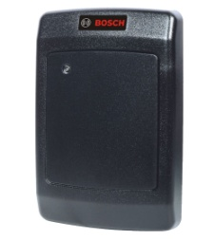
B8512G/B9512G Introduction
Greater compatibility
B9512G, B8512G
Supported Devices
Fully Backwards compatible with:
  SDI keypads
  Zonex devices
  POPITs
  D9210C Access Control
Security Systems
ST-IN/MKP | #/$.2105 | © 2013 Robert Bosch LLC and affiliates. All rights reserved.

Slide 6
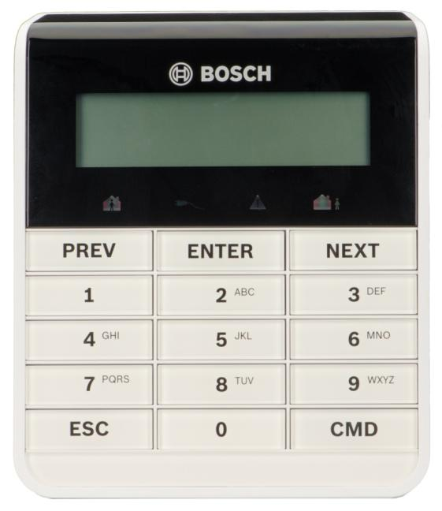
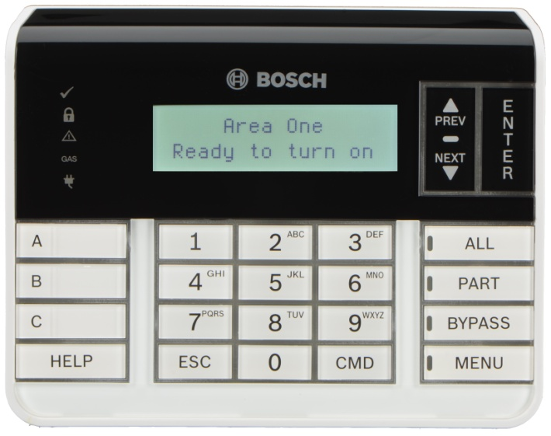
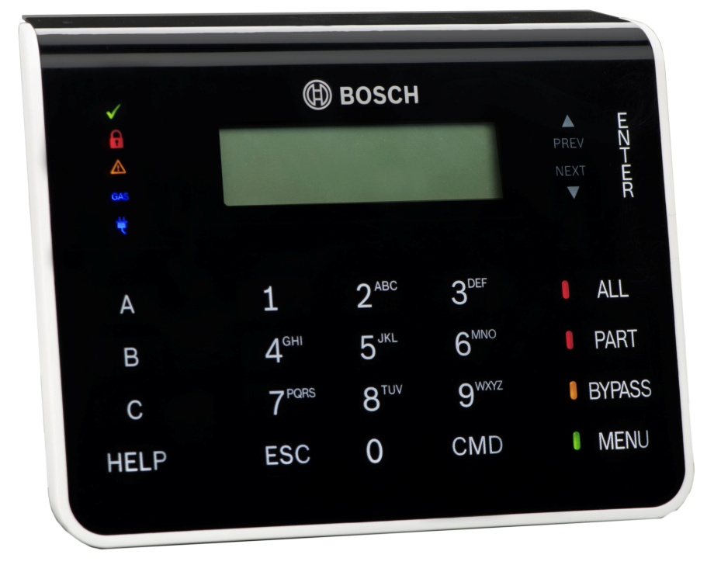
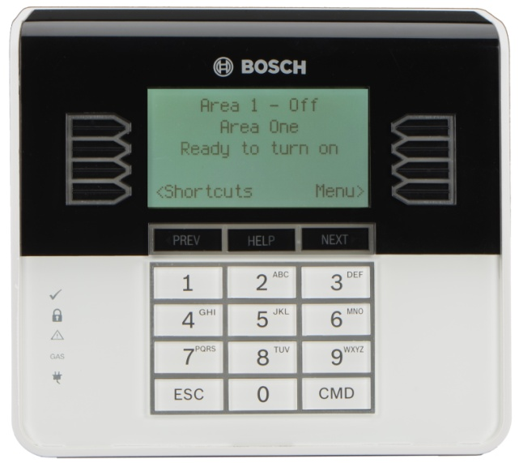
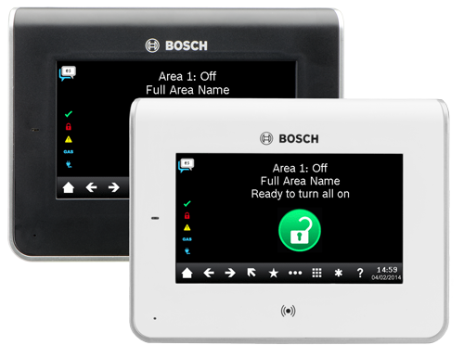
Greater flexibility
B8512G/B9512G Introduction
B Series Keypads
  B915 Basic Text
  B920 2-line LCD display
  B921C Capacitive Touch
  B930 Deluxe ATM Style
  B942(W) Color Graphic Touch Screen
Security Systems
ST-IN/MKP | #/$.2105 | © 2013 Robert Bosch LLC and affiliates. All rights reserved.

Slide 7
B8512G/B9512G Introduction
B:more:flexible
B942 Touch Screen Keypad
  Full color Graphic display, housed in a sleek design
  Simple symbol-based user interface
  4 inputs, 1 relay output
  Built-in proximity (RFID) reader
  Built-in presence detector
  B942 Black Face, Silver Base
  B942W White Face, Silver Base
  In B Series, and GV4, v2.03
Security Systems
ST-IN/MKP | #/$.2105 | © 2013 Robert Bosch LLC and affiliates. All rights reserved.

Slide 8
B:more:flexible
B8512G/B9512G Introduction
B920 Standard Keypad
  2-line LCD display
  32 character point, user and area names
  Simple menu-style user interface
  Dedicated function buttons for common commands including status indication
  Situation sensitive on-screen help
  Arm/alarm, ready to arm, power and gas alarm indicators
  Simple installation with self locking base and chassis design plus built-in bubble level
  Installer Service and Programming menu
Security Systems
ST-IN/MKP | #/$.2105 | © 2013 Robert Bosch LLC and affiliates. All rights reserved.

Slide 9
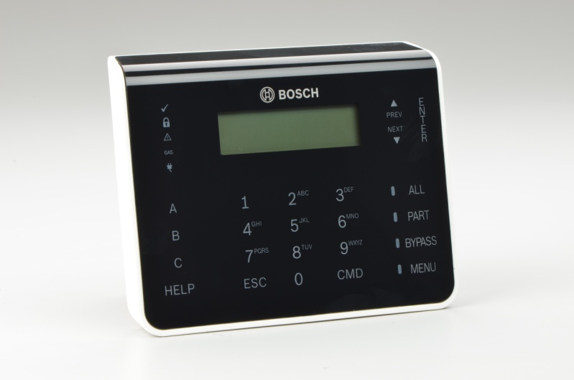
B:more:flexible
B8512G/B9512G Introduction
B921C Capacitive Touch Keypad
  Capacitive touch technology –no buttons
  2-line LCD display
  4 input points
  32 character point, user and area names
  Simple menu-style user interface
  Dedicated function buttons for common commands including status indication
  Situation sensitive on-screen help
  Arm/alarm, ready to arm, power and gas alarm indicators
  Simple installation with self locking base and chassis design plus built-in bubble level
  Installer Service and Programming menu
Security Systems
ST-IN/PRM | #/$.2105 | © 2013 Robert Bosch LLC and affiliates. All rights reserved.

Slide 10
B:more:flexible
B8512G/B9512G Introduction
B930 Deluxe Keypad
  5-line ATM style LCD display
  32 character point, user and area names
  Simple menu-style user interface
  Programmable function buttons for common commands
  Programmable keypad short cuts and situation sensitive on-screen help
  Arm/alarm, ready to arm, power and gas alarm indicators
  Simple installation with self locking base and chassis design plus built-in bubble level
  Installer Service and Programming menu
Security Systems
ST-IN/MKP | #/$.2105 | © 2013 Robert Bosch LLC and affiliates. All rights reserved.

Slide 11
B8512G/B9512G Introduction
B:more:flexible
B915 Text Keypad
  B920 style, text, keypad
  No A, B, C keys, or dedicated function keys
  Modified LEDs provide symbolic status indications
  Lower cost, simple arming station, solutions
  Supported in both B Series, and GV4, v2.03
B915
Security Systems
ST-IN/MKP | #/$.2105 | © 2013 Robert Bosch LLC and affiliates. All rights reserved.

Slide 12
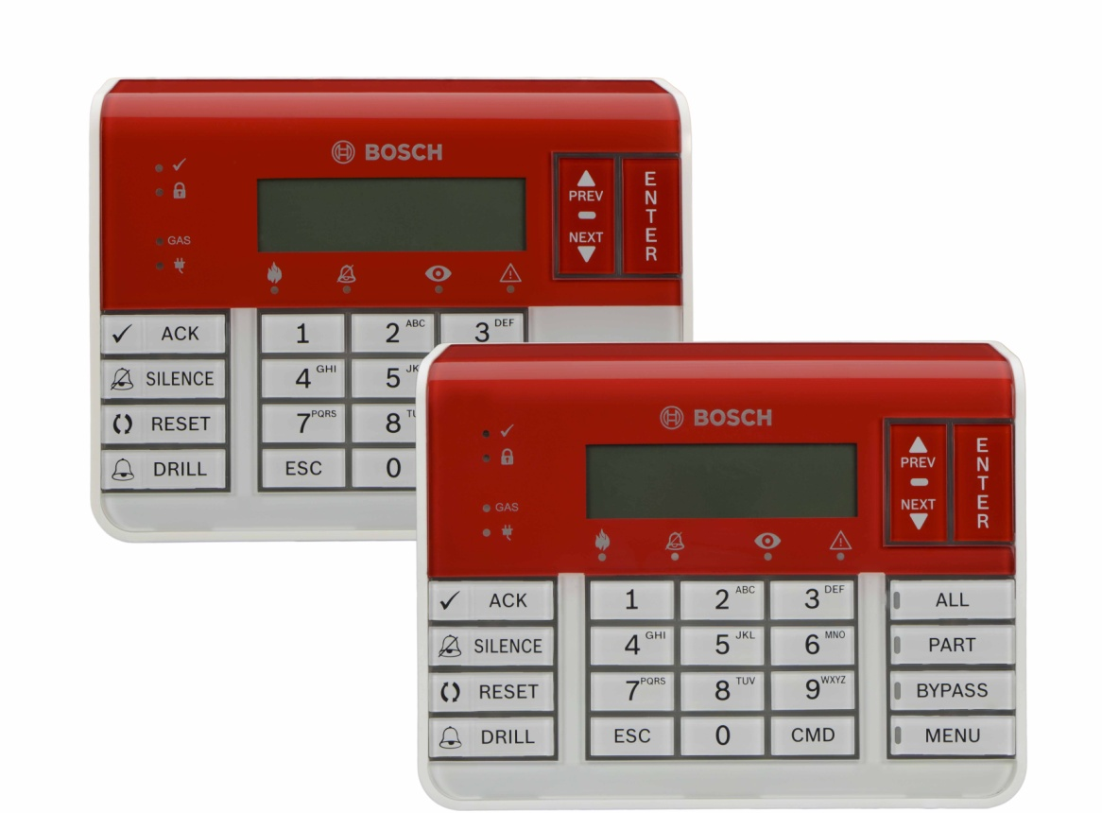
B8512G/B9512G Introduction
Greater flexibility
Fire Keypads
SDI2 Bus compatible
Dedicated Fire LEDs
  Fire Alarm
  Alarm Silenced
  Supervisory
  Trouble
Dedicated Function Buttons
  Acknowledge
  Silence
  Reset
  Drill
B926F
  Fire only
B925F
  Intrusion and Fire
Security Systems
ST-IN/MKP | #/$.2105 | © 2013 Robert Bosch LLC and affiliates. All rights reserved.

Slide 13
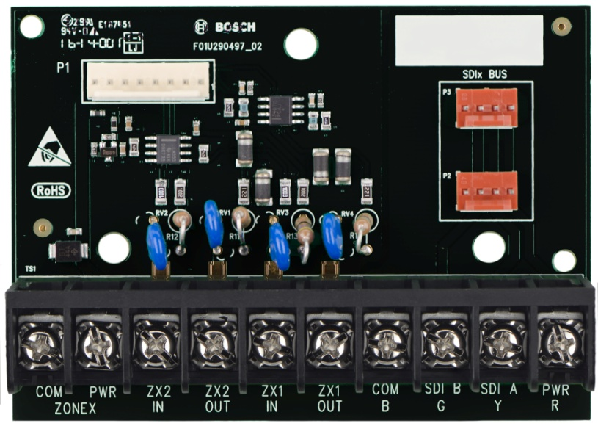
B8512G/B9512G Introduction
Greater compatibility
B600 Zonex Module
Fully Backwards compatible with:
  D8125 – POPEX driver
  D8128 - OctoPOPIT
  D8129 – OctoRelay
Ribbon cable connection to B9512G and B8512G panels.
Uses 3-hole mounting pattern.
ZONEX/SDI removable terminal block for retrofitting.
Security Systems
ST-IN/MKP | #/$.2105 | © 2013 Robert Bosch LLC and affiliates. All rights reserved.

Slide 14
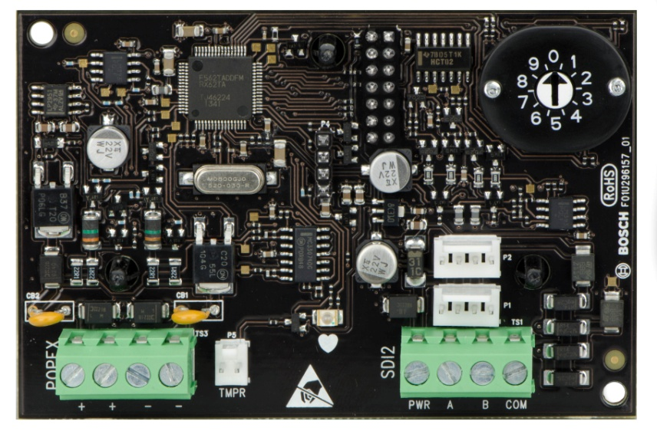
B8512G/B9512G Introduction
Greater compatibility
B299 POPEX Module
Provides point identification for up to 100 connected POPITs
  B8512G = 1 B299
  B9512G = 6 B299s
SDI2 supports remote mounting
Uses 3-hole mounting pattern
Interconnect wiring connectors for easy installation
Security Systems
ST-IN/MKP | #/$.2105 | © 2013 Robert Bosch LLC and affiliates. All rights reserved.

Slide 15
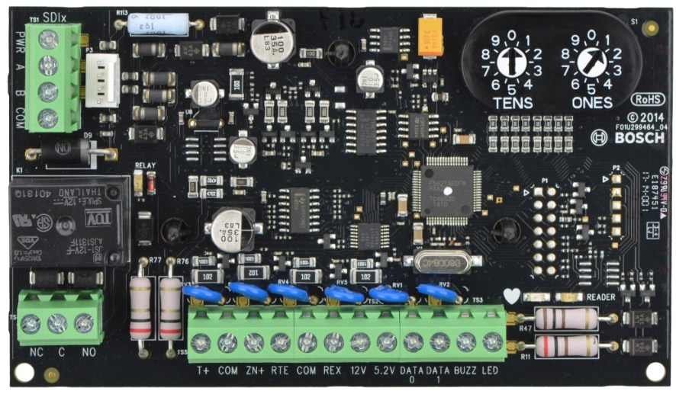
B8512G/B9512G Introduction
Greater compatibility
B901 Access Control Module
Dual Bus (SDI2/SDI) Access Control Interface Module
Backward Compatible with D9210C
SDI2/SDI Quick-connect, Tamper
Rotary Switch Addressing
Security Systems
ST-IN/MKP | #/$.2105 | © 2013 Robert Bosch LLC and affiliates. All rights reserved.

Slide 16
B8512G/B9512G Introduction
System Architecture, D9412GV3 (and older)
Security Systems
ST-IN/MKP | #/$.2105 | © 2013 Robert Bosch LLC and affiliates. All rights reserved.

Slide 17
B8512G/B9512G Introduction
System Architecture, D9412GV4
Security Systems
ST-IN/MKP | #/$.2105 | © 2013 Robert Bosch LLC and affiliates. All rights reserved.

Slide 18
B8512G/B9512G Introduction
System Architecture, B9512G
Security Systems
ST-IN/MKP | #/$.2105 | © 2013 Robert Bosch LLC and affiliates. All rights reserved.

Slide 19

B8512G/B9512G Introduction
Retrofitting with a B600
Hardware (Old)
  Remove Panel Power
  Unplug Terminal Strips
  Remove Old Panel (1 screw)
Hardware (New)
  Install Bx512G Panel (1 screw)
  Plug-in Terminal Strips
  Apply Power
Programming
  RPS Account Upgrade Path
Security Systems
ST-IN/MKP | #/$.2105 | © 2013 Robert Bosch LLC and affiliates. All rights reserved.

Slide 20
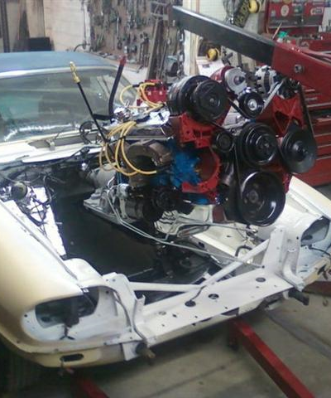
Intrusion Controls Roadmap Update
B8512G/B9512G Introduction
B:more:compatible
B600 Retrofit (ZONEX) Module
Backward Compatibility
Hardware
  Drop-in Replacement for older Bosch (Radionics) Control Panels
  Works with Removable Terminal Strip Panels
Programming
  RPS Account Upgrade Feature
  RPS Account Upgrades from D7212B1/D9112B1
Security Systems
ST-IN/MKP | #/$.2105 | © 2013 Robert Bosch LLC and affiliates. All rights reserved.

Slide 21
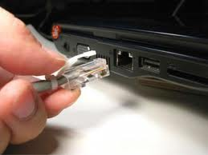
Greater innovation
B8512G/B9512G Introduction
On-Board Ethernet
  Conettix IP reporting
    Modem4 or CID (new)
  RPS programming and service
  Remote Security Control
  Bosch IP camera Integration
  Z-Wave Module Interface
  Third Party Automation
  Modern IP Features
    IPv6 Support
    DNS Reporting and RPS
    Universal Plug and Play
    AutoIP
    256 bit encryption
Security Systems
ST-IN/MKP | #/$.2105 | © 2013 Robert Bosch LLC and affiliates. All rights reserved.

Slide 22
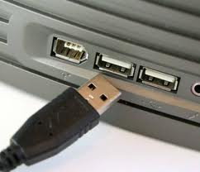
Greater innovation
B8512G/B9512G Introduction
Built-in USB Port
  Direct Connect for RPS Programming and Service
  Provides USB power
    Wifi adapter (when used with Ethernet)
  No extra module
  RPS automatically configures PC
    No special settings required
Security Systems
ST-IN/MKP | #/$.2105 | © 2013 Robert Bosch LLC and affiliates. All rights reserved.

Slide 23

B8512G/B9512G Introduction
Greater integration
BVMS
Integration with Bosch Video Management System
Command and Control
Head-end display
Event Interaction
Security Systems
ST-IN/MKP | #/$.2105 | © 2013 Robert Bosch LLC and affiliates. All rights reserved.

Slide 24
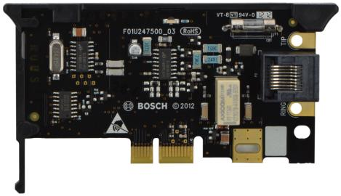
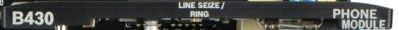
Greater flexibility
B8512G/B9512G Introduction
Plug-In communication modules
  PSTN
  Cellular
Simple installation
Future-proof upgrades
Dual slots
  PSTN plus cellular
  Two PSTN
Security Systems
ST-IN/PRM | #/$.2105 | © 2013 Robert Bosch LLC and affiliates. All rights reserved.

Slide 25
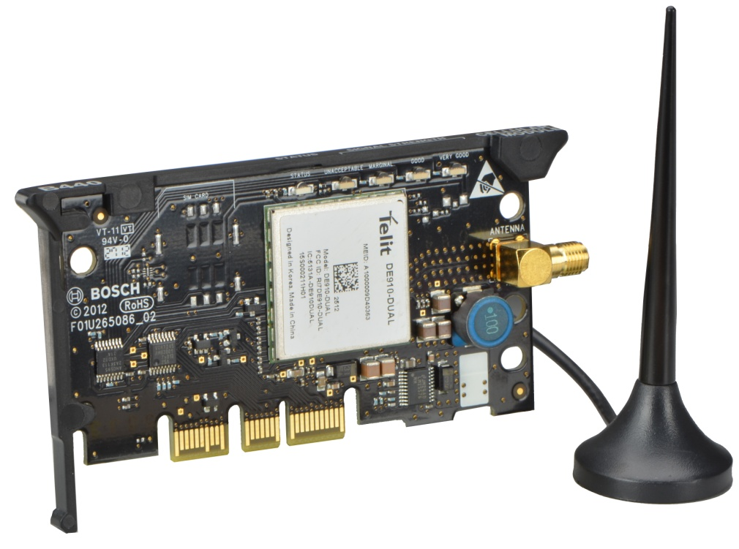
Greater flexibility
B8512G/B9512G Introduction
B430 PSTN Module
  2400 Baud RPS Support
  Tip and Ring Tabs
  Modem4 and Contact ID Reporting
B440/B441 Cellular Modules
  CDMA (Verizon) Network
  Conettix IP Alarm reporting
    Modem4 or CID (new)
  RPS
  Remote Security Control
  Text Messaging
  B443 GSM/GPRS module available for outside USA and for select USA customers
Security Systems
ST-IN/MKP | #/$.2105 | © 2013 Robert Bosch LLC and affiliates. All rights reserved.

Slide 26
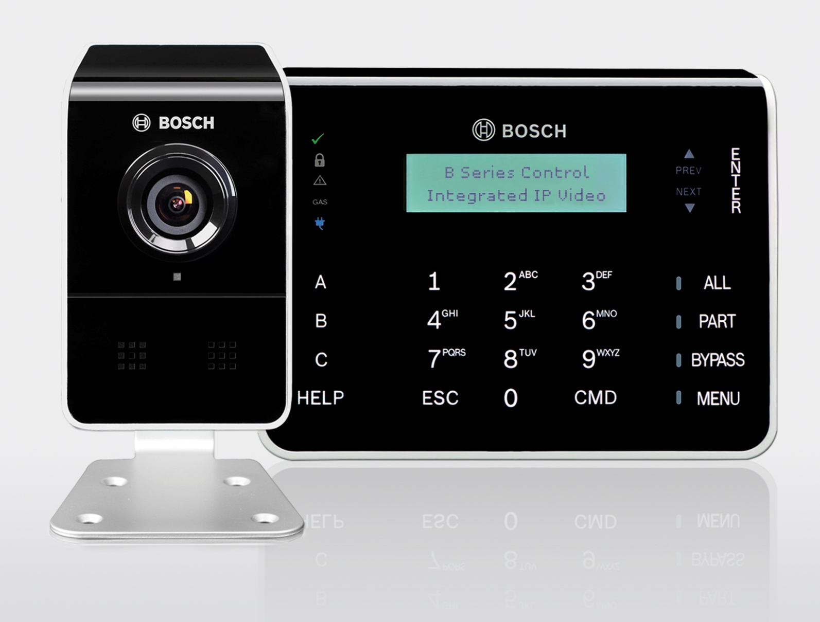
B8512G/B9512G Introduction
Greater visibility
IP Camera integration
Integrates IP alarm panel with up to 16 Bosch IP cameras
Direct machine to machine connection (no third party server)
Camera Events can be reported by alarm panel
  Video Motion Detection
  Video Content Analysis Events
  Camera Health Monitor
    No video/scene too dark
Alarm panel events cause video actions
  Alarms
  Arm/Disarm
  Environmental
Security Systems
ST-IN/PRM | #/$.2105 | © 2013 Robert Bosch LLC and affiliates. All rights reserved.

Slide 27
Greater ease of use
B8512G/B9512G Introduction
Hello
Dynamic Language Selection by User
  Automatically switches between two languages:
    English
    Spanish
    French
    Portuguese
  Can be fixed in either language
  Switch by passcode or hold the HELP key
  User preferred language in personal notification
    Texts, e-mails
Hola
Bonjour
Olá
Security Systems
ST-IN/MKP | #/$.2105 | © 2013 Robert Bosch LLC and affiliates. All rights reserved.

Slide 28
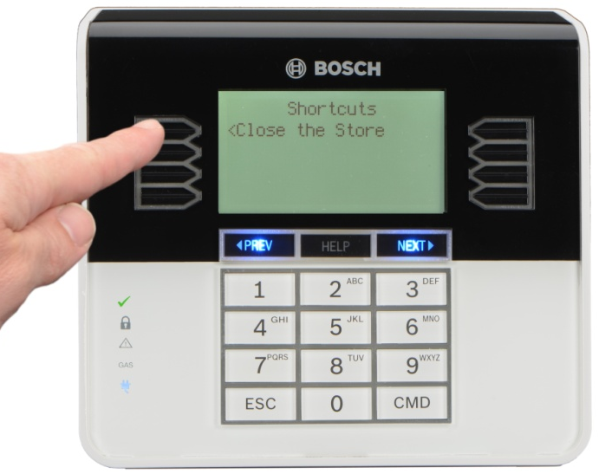
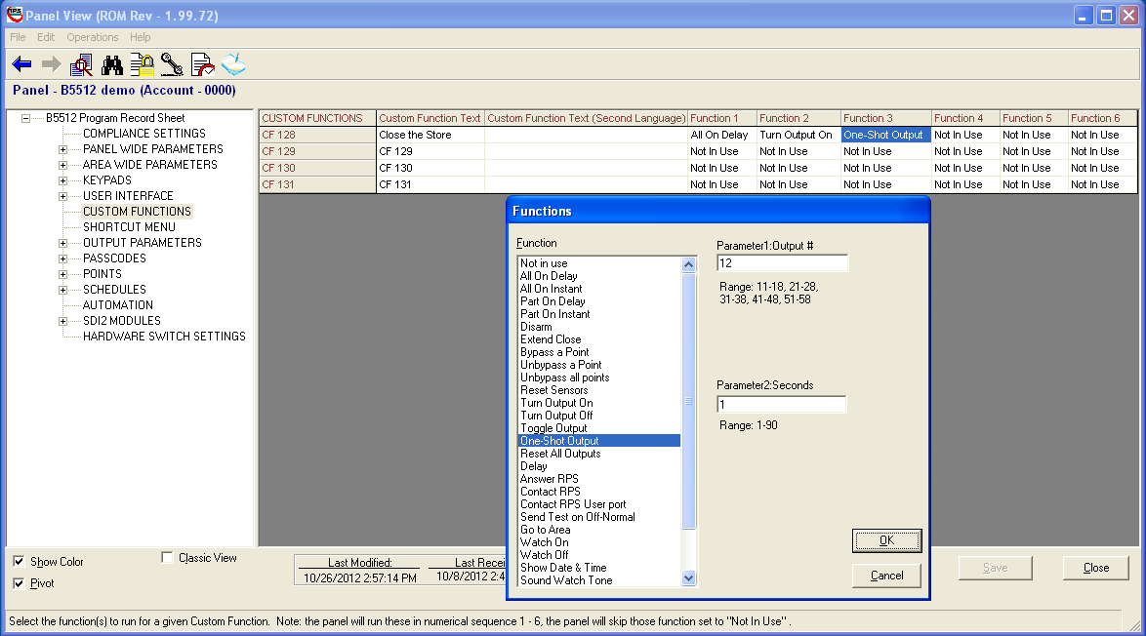
Greater ease of use
B8512G/B9512G Introduction
Programmable Custom Functions
“New” Programming method
  Simple drop-down menus
Stack up to 6 commands into one button
Activate from:
  Keypad command
  Keyfob button
  Point
  SKED
  Keypad function button
Security Systems
ST-IN/MKP | #/$.2105 | © 2013 Robert Bosch LLC and affiliates. All rights reserved.

Slide 29
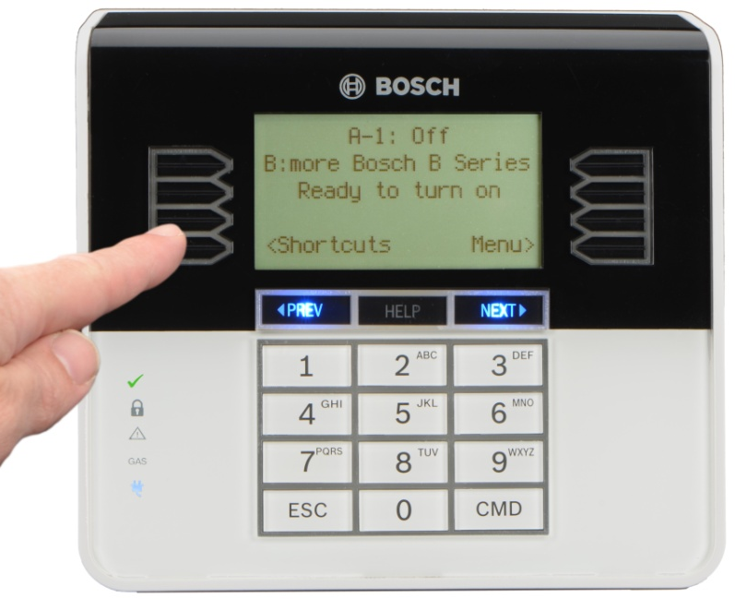
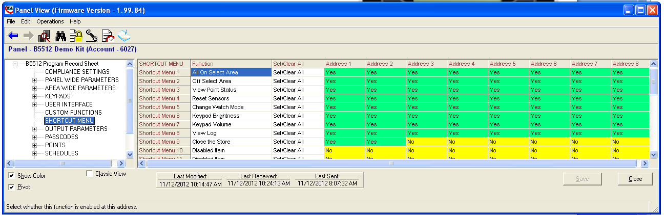
Greater ease of use
B8512G/B9512G Introduction
Up to 32 Programmable Keypad Shortcuts
  One-button selection of common functions
  Can also include custom functions
  Configurable by keypad address
Security Systems
ST-IN/MKP | #/$.2105 | © 2013 Robert Bosch LLC and affiliates. All rights reserved.

Slide 30

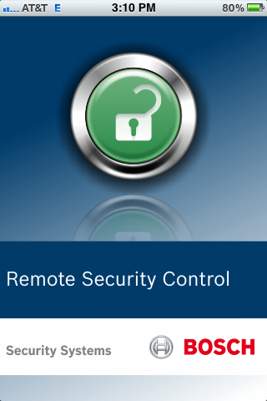
Remote Security Control
B8512G/B9512G Introduction
Greater connectivity
Remote Control App now Available from the iTunes Store and Google Play Store
Compatible with iPhone, iPAD, iPod Touch and Android
Connects using Internet or Wi-Fi
  No Third-Party Server
Connects to using IP Network or cellular module
New – Now supports easier codes management
  Create one certificate for multiple passcodes
  Change passcodes without new certificate
  Part arming
Security Systems
ST-IN/MKP | #/$.2105 | © 2013 Robert Bosch LLC and affiliates. All rights reserved.

Slide 31

B8512G/B9512G Introduction
Greater connectivity
Remote Security Control APP now supports connected cameras
  See live video
  Request video snap shots
  Check Camera Status
  Arm/Disarm Security System
  Operate Outputs
Security Systems
ST-IN/MKP | #/$.2105 | © 2013 Robert Bosch LLC and affiliates. All rights reserved.

Slide 32
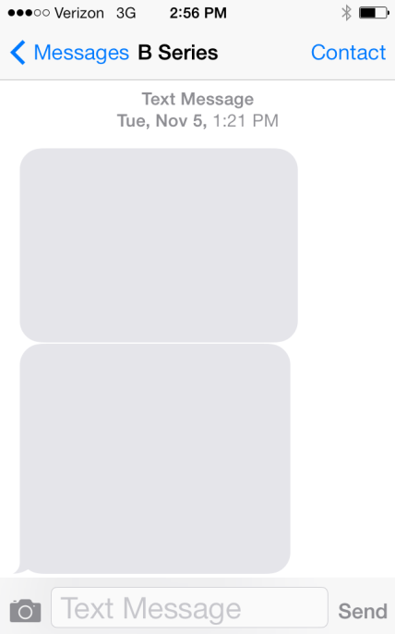
Personal Notification
B8512G/B9512G Introduction
Greater connectivity
Event driven E-Mail and Text messages
Up to 32 different recipients (new)
Language Selectable
Uses Plug-in Cellular Module or built-in Ethernet
11/04/13 9:15P
1234 Area Closing,
Main St. Branch,
John Smith
11/05/13 7:45A
1234 Area Opening,
Main St. Branch,
John Smith
Security Systems
ST-IN/PRM | #/$.2105 | © 2013 Robert Bosch LLC and affiliates. All rights reserved.

Slide 33
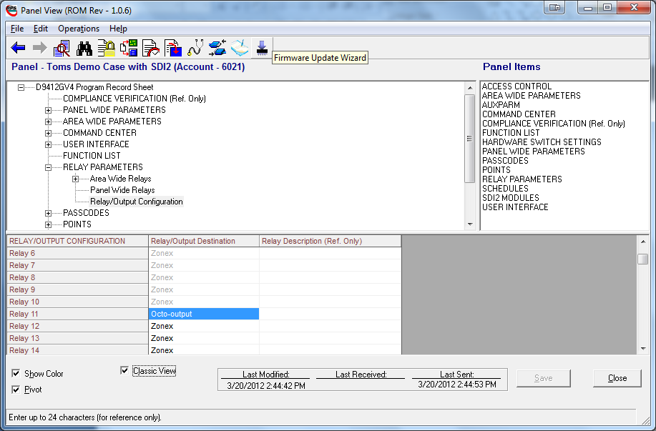
B8512G/B9512G Introduction
Greater service and upgrades
Firmware Update Wizard
  Update firmware locally or remote
  USB
  Ethernet
  Cellular
Also for SDI2 Module Firmware
Security Systems
ST-IN/MKP | #/$.2105 | © 2013 Robert Bosch LLC and affiliates. All rights reserved.

Slide 34



Z-Wave Solutions
B8512G/B9512G Introduction
Greater integration
Network Gateway
  Solution offering…
    Security
    Lighting
    Locks (Doors)
    Thermostat
    Cameras
    App
    Web Portal
Security Systems
ST-IN/MKP | #/$.2105 | © 2013 Robert Bosch LLC and affiliates. All rights reserved.

Slide 35

B8512G/B9512G Introduction
Local Bosch Intrusion and Video Sales and Design Support
www.MidChes.com
support@MidChes.com
(410) 612-9640 | (610) 361-0500
Security Systems
ST-IN/MKR-NA | #/$.2105 | © 2013 Robert Bosch LLC and affiliates. All rights reserved.

