Slide 1
AUTOMATION & CONTROLS
JUNE 2015
Notes:
Why do this presentation?

Slide 2
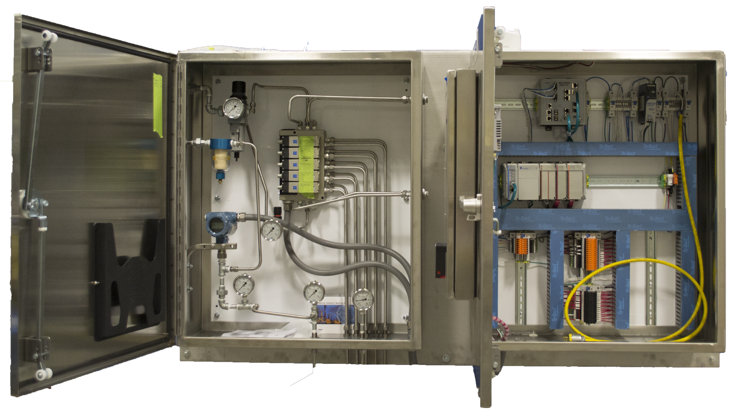
AGENDA
WHAT IS AUTOMATION
WHY AUTOMATION?
WHAT WE DO
REVIEWING AN APPLICATION
TOOLS & BENEFITS
BASIC OFFERING
FINAL THOUGHTS
APPENDIX
Notes:
Introduction

Slide 3
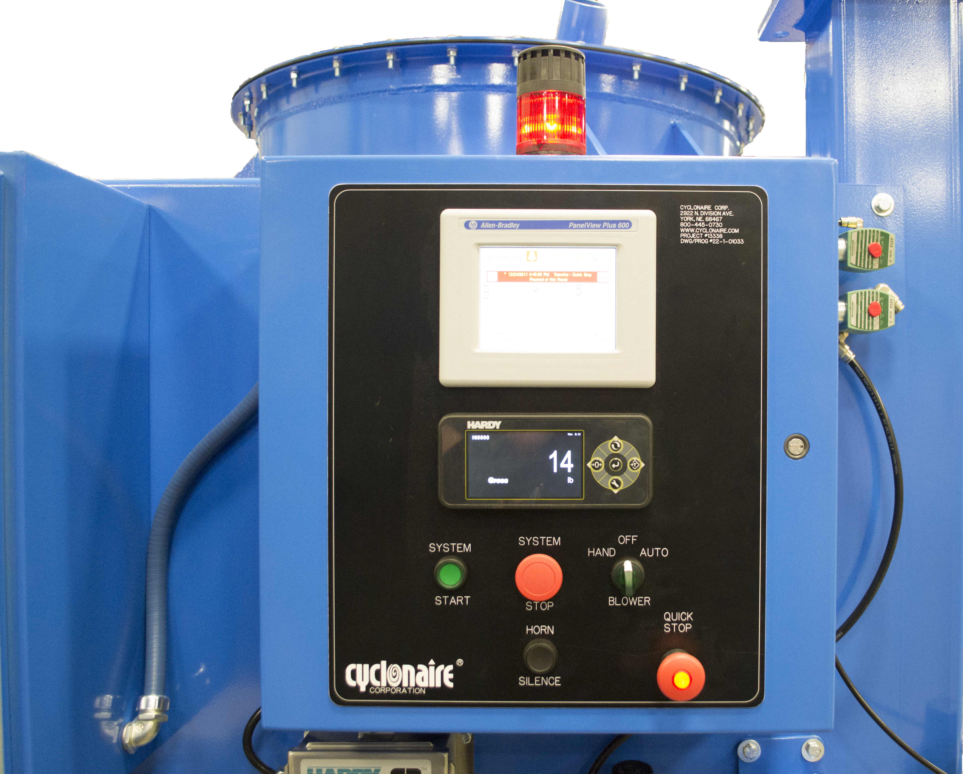
WHAT IS AUTOMATION?
DEFINITION
“Automatically controlled operation of an apparatus, process, or system by mechanical or electronic devices that take the place of human labor.”
AUTOMATION CONSISTS OF TWO PARTS
Hardware
Software

Slide 4
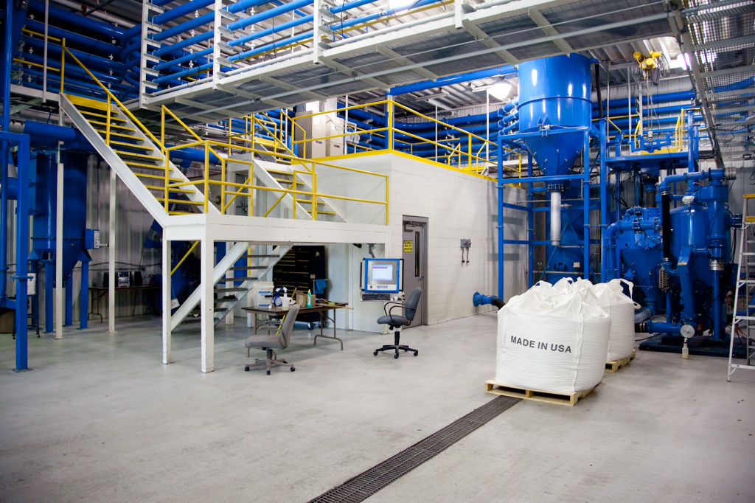
WHY AUTOMATION?
Increased Efficiency
Reduced Cost
Ease of Operation
Reduced Inventory
Increased response time
Improved Quality

Slide 5
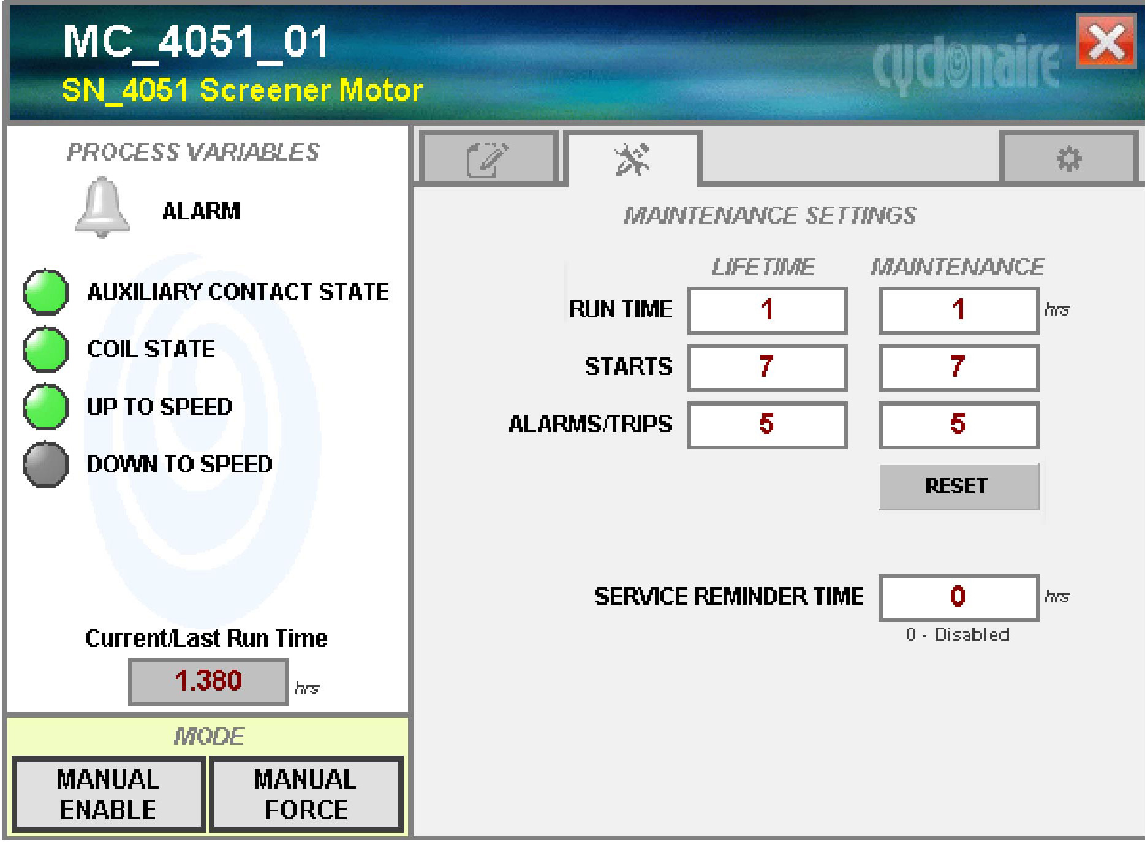
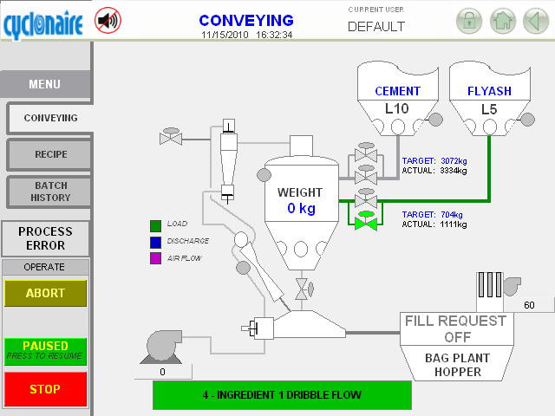
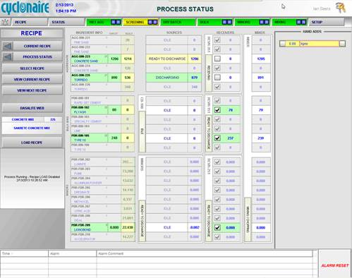
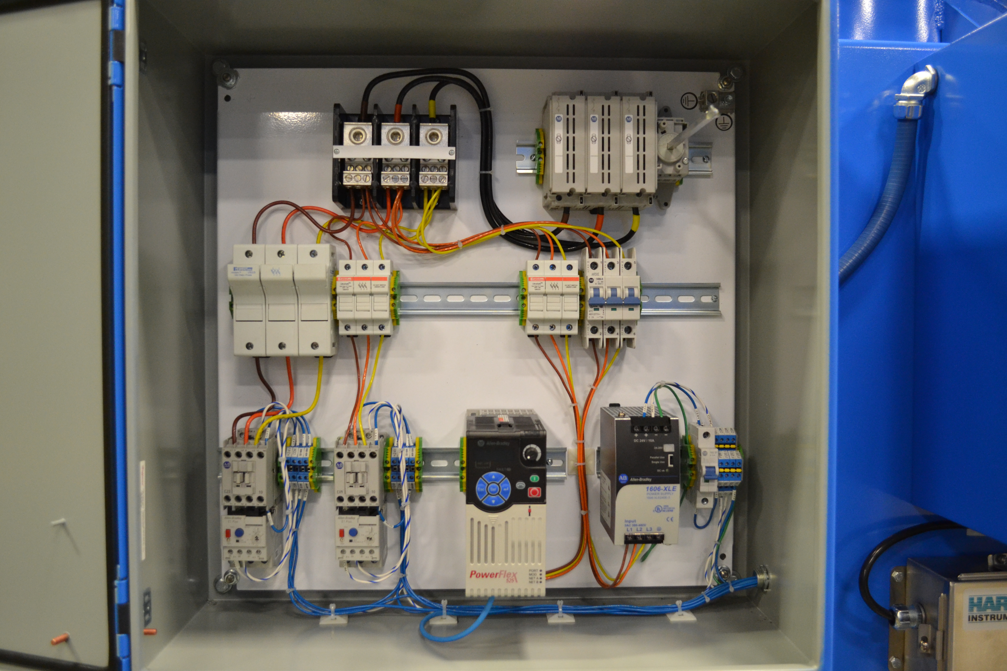
WHAT WE DO
PANEL FABRICATION
ENGINEERING
Single machine or system/process designs
Full plant control (brains of the operation)
Standard or custom automation package for all equipment
Detailed manuals
Designed for:
  Facility expansions
  New equipment
  Process evolution
PANEL FABRICATION
UL 508A listed panel builder
  UL 508A has tested samples of our product for safety
Intuitive controls
Custom face panels built in house
  Weather and UV resistant
ENGINEERING
PROGRAMMING
PROGRAMMING
  Structured code
Operators have complete control at plant, system, machine, and device level.
Abnormal situation management
  User interface will draw attention to issues
DATABASE & DATA STORAGE SOLUTIONS
Recipe management / history
Production history
DATABASE & STORAGE SOLUTIONS
INSTALLATION & COMMISSIONING
System commissioning
  Wiring and instrumentation verification
    Ensures a smooth and successful startup
System start up
    Don’t waste time & resources
REMOTE CONNECTION ACCESS
We can patch in remotely
  We will respond to emergencies without the need to travel
  Live screen sharing eliminates frustrating phone support calls.
Additional field service available
Notifications to personnel when issues arise
INSTALLATION & COMMISSIONING
REMOTE CONNECTION ACCESS
DEVICE LEVEL DATA
Tracks cycles and time for upcoming maintenance
DEVICE LEVEL DATA

Slide 6
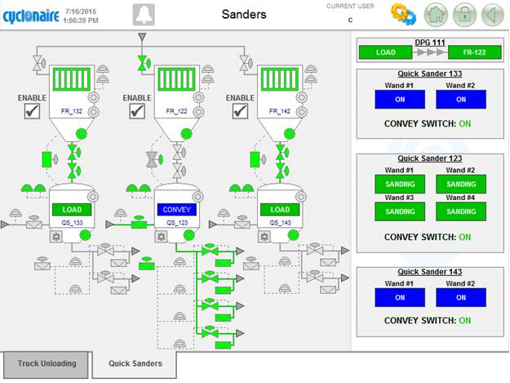
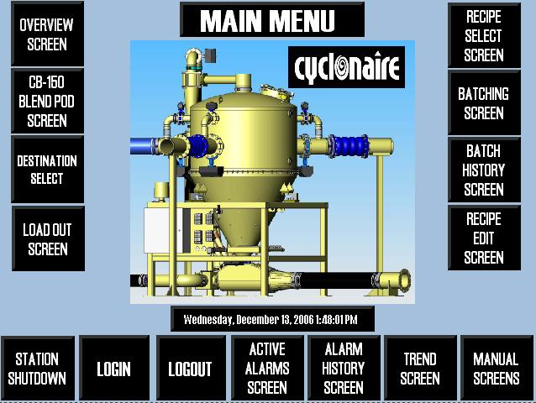
REVIEWING AN APPLICATION
Questions to Consider
Does customers have a control specification?
Supply Voltage
Area Classification
Instrumentation Voltage
Enclosure Type
PLC & HMI Platform
Destination Devices? Type?

Slide 7
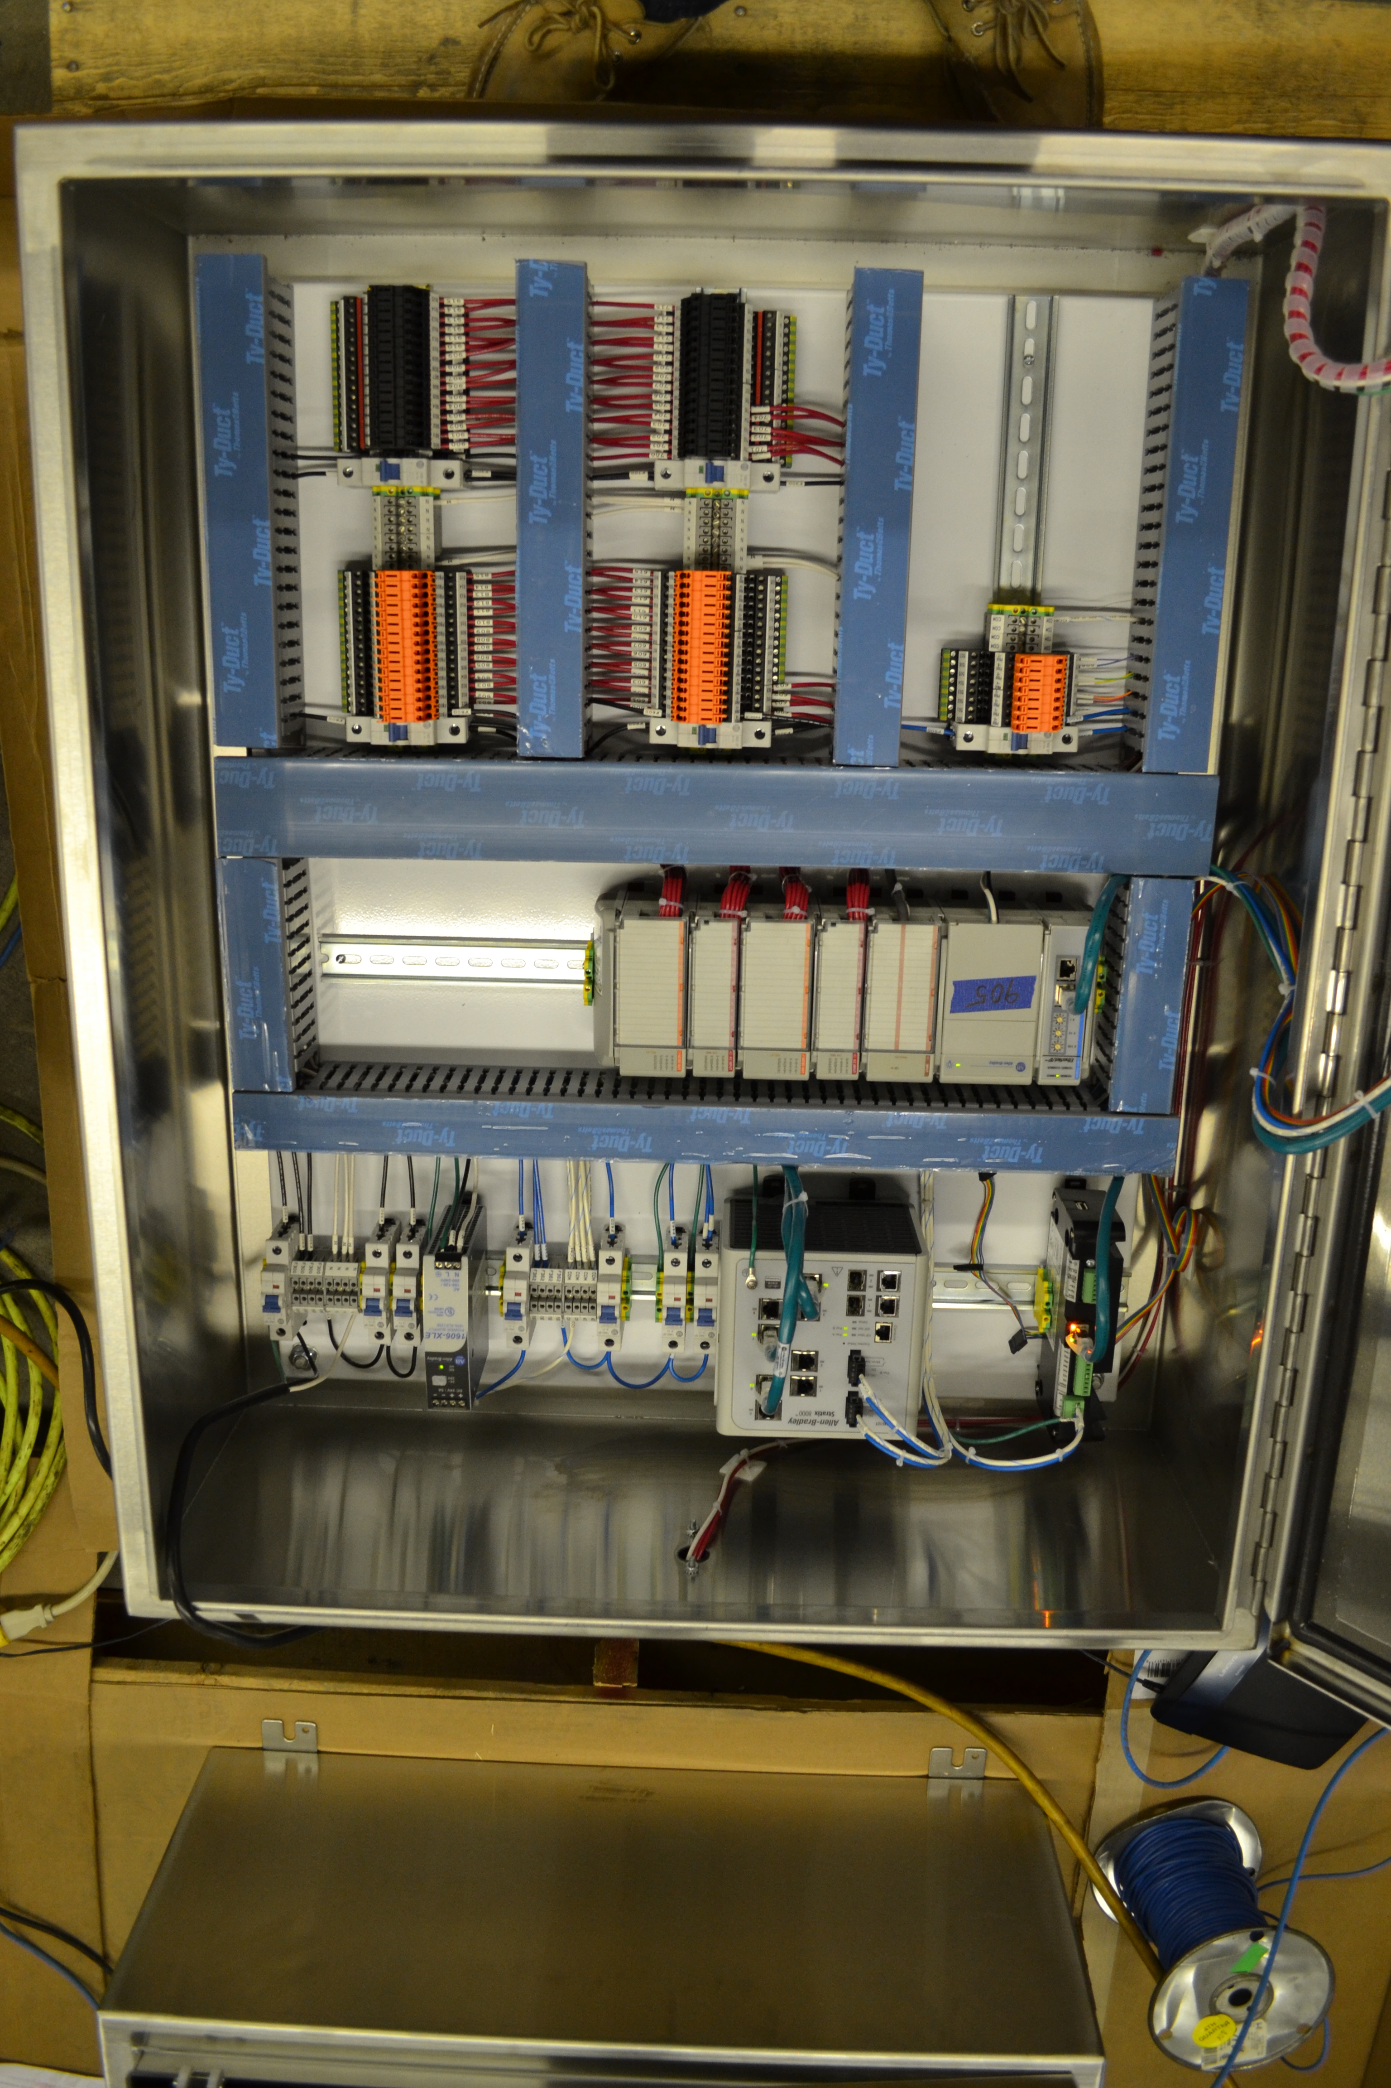
TOOLS & BENEFITS
Cyclonaire standardized quotes
More Information
Less questions asked from us- eliminating time spent back and forth
More Accurate Quotes
The more information we have, the more accurate Cyclonaire is.
Faster Turnaround
Reps receive quotes faster
Eliminates future problems

Slide 8
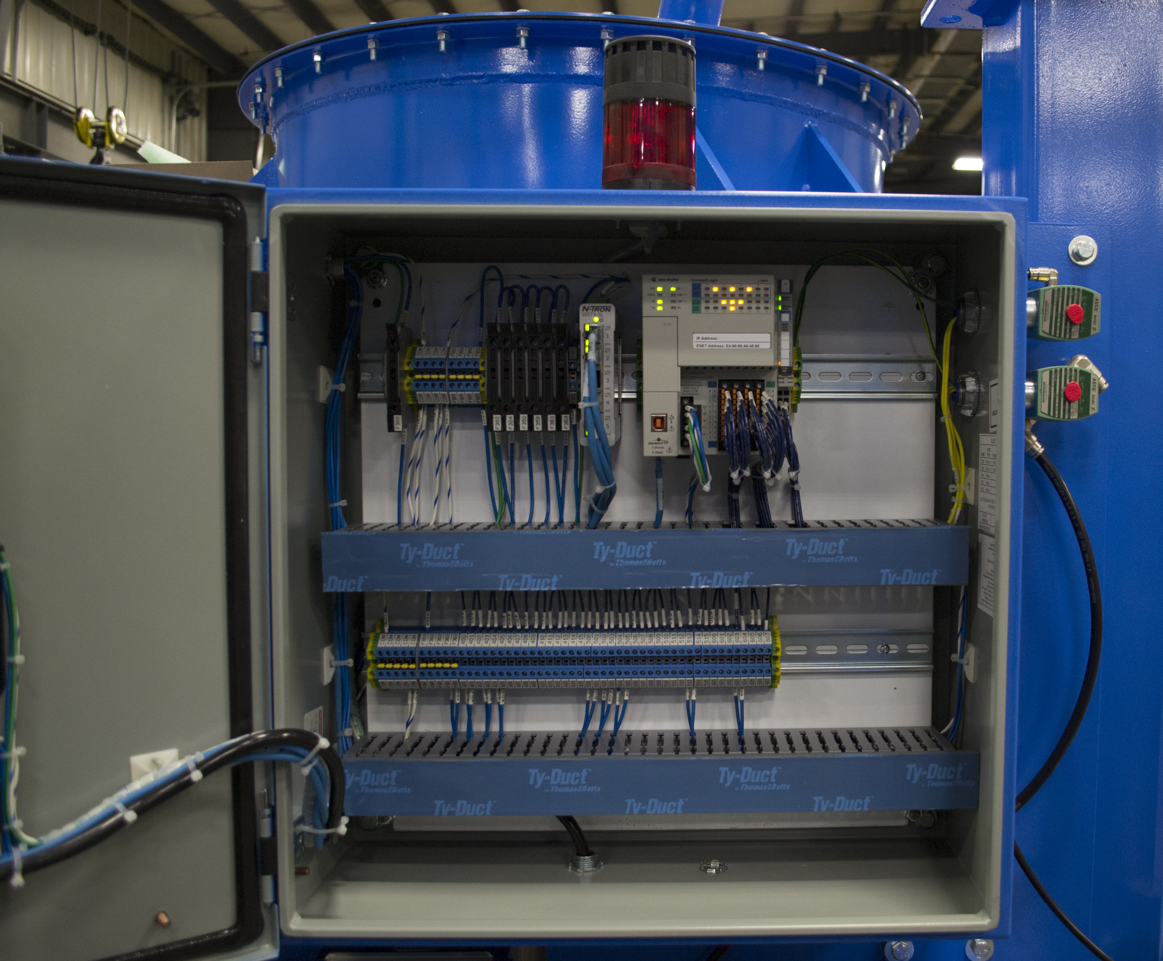
BASIC OFFERING
24 Volt Allen Bradley Hardware (PLC/HMI)
Non-Hazardous Classification
NEMA 4 Outdoor Rated
Quote will reflect basic package
Notes:
What to offer when customer doesn’t know what they want?

Slide 9
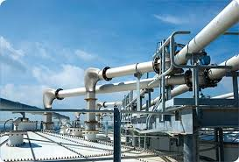
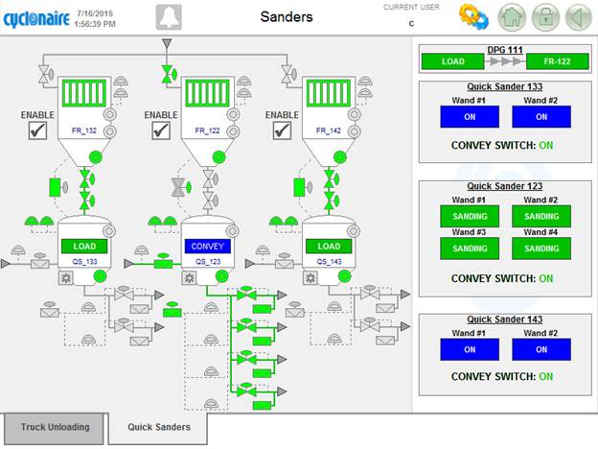
FINAL THOUGHTS
Cyclonaire recommends commissioning
Be aware of application and how the equipment will tie together
Do not be afraid to ask questions
Our automation capabilities can and do set us apart.
  Important upsell

Slide 10
APPENDIX
HMI / OIC / SCADA
HMI = Human Machine Interface | HMI is the apparatus which presents process data to a human operator, and through which the human operator controls the process. At Cyclonaire, we are usually referring to a touch panel (Panel View Plus)
OIC = Operator Interface Control | OIC refers to small stations that are used for local machine control, and are usually very limited in there abilities. At Cyclonaire, we are usually referring to a panel with just lights and buttons.
SCADA = Supervisory Computer And Data Acquisition | SCADA is a standalone computer that gathers and stores data. This usually seen in process systems such as refineries, ethanol, etc.

Slide 11
APPENDIX
I/O | Input and Outputs
Remote I/O | I/O that is communicated to the PLC via some sort of network (Ethernet, Profibus, Modbus, DH+, and many more). Cyclonaire's preferred communication method is Ethernet TCP/IP.
Discrete I/O | Inputs and outputs that are on or off. These can be 120VAC or 24VDC.
Analog I/O | Inputs and outputs that are variable. Usually 4-20ma or 0-10V. Ex: Pressure Transmitter, Level Transmitter, Variable Position Valve, Etc.

Slide 12
APPENDIX
DCS / RTU / PLC
DCS = Distributed Control System | Distributed Control Systems (DCSs) are dedicated systems used to control manufacturing processes that are continuous or batch-oriented, such as oil refining, petrochemicals, central station power generation, pharmaceuticals, food & beverage manufacturing, cement production, steelmaking, and papermaking. Allen Bradley's version of a DCS is called PAX (Plant Automation Controller).
PLC = Programmable Logic Controller | PLC's are a digital computer used for automation of electromechanical processes, such as control of machinery on factory assembly lines, amusement rides, or lighting fixtures. PLC's were created to replace relay logic panels in the automotive industry, but have since evolved into very sophisticated computers that are merging into the DCS world.

Slide 13
APPENDIX
INSTRUMENTATION | Field devices that move, actuate, or return feedback.
VFD | Variable Frequency Drive. These control the speed of a motor by varying the frequency from 0 to 60Hz (and above). This is usually controlled by a PLC via Ethernet IP, but they can be stand alone also.
PIT | Pressure Indication Transmitter
PS | Pressure Switch
XV | Electrically actuated valve. Usually a solenoid valve that controls another device such as a butterfly valve, ball valve, pinch valve, etc.
ZSC | Position Switch Closed
ZSO | Position Switch Opened
AUX | Auxiliary feedback (usually in reference to a motor contactor pulled in, indicating that a motor is running).
KC | Timer Controller. (usually a filter timer board for reverse pulse jet cleaning of filters)

