Slide 1
AUTOMATION & CONTROLS
JUNE 2015

Slide 2
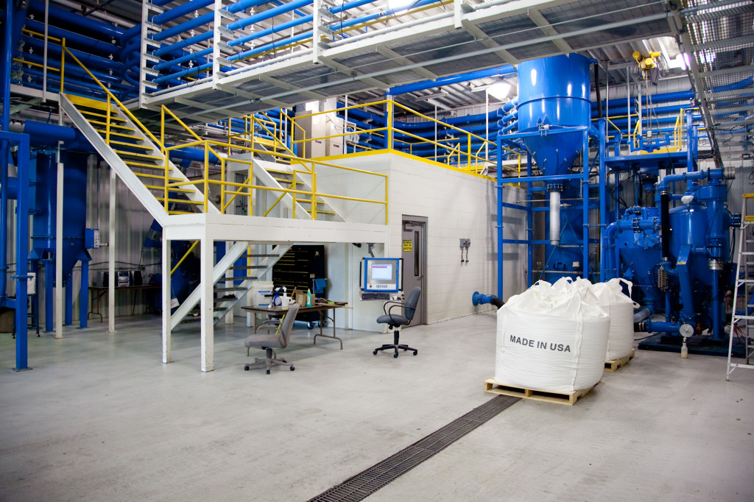
WHAT WE OFFER
BRAINS OF THE OPERATION
Just push start
Maintenance tracking
Alarms
Security level access
INSTRUMENTATION / DEVICES
All devices are configurable
Every device has potential to monitor itself.
Networked devices (control via ethernet)
RECIPE CONTROL & HISTORY
Campaign and/or batch mode
Tracks your material usage
Material inventory
Order materials far in advance
Autocorrecting batches and set points
Increases accuracy
CUT DOWN ON COSTS
Employees can spend more time on other tasks
Tracks cycles and can anticipate when new maintenance is required
Notified immediately when failures arise

Slide 3
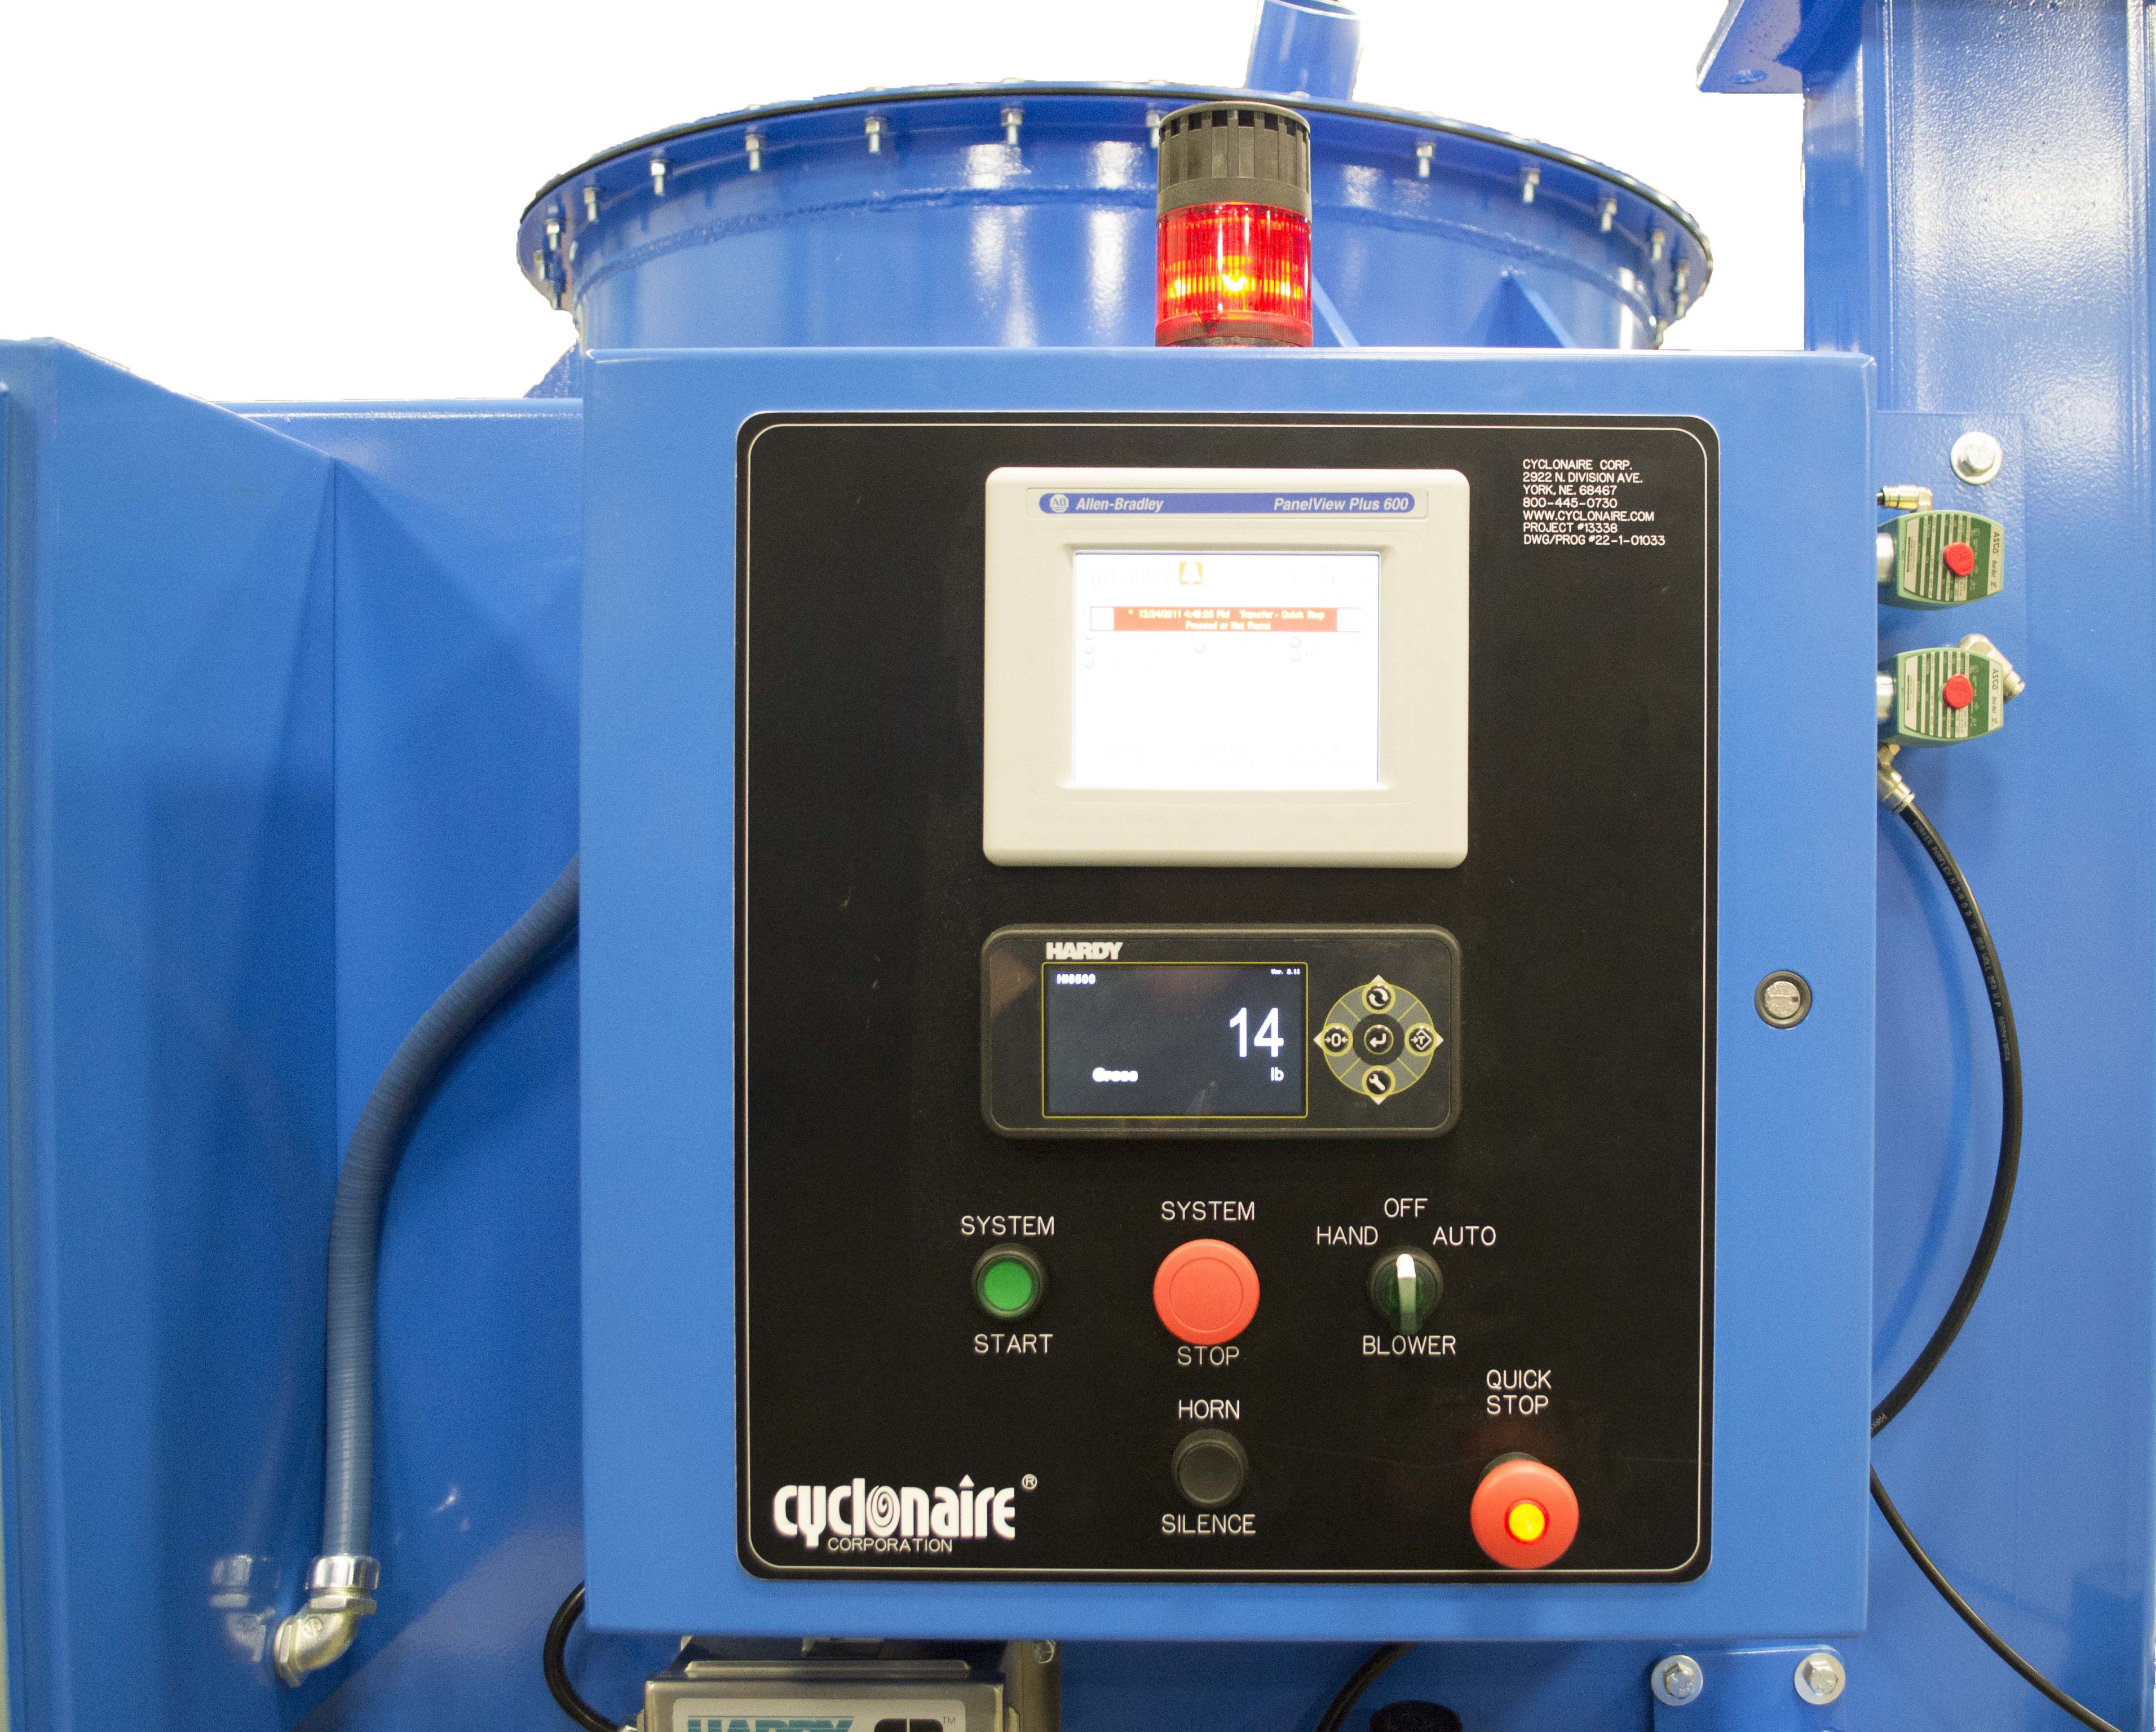
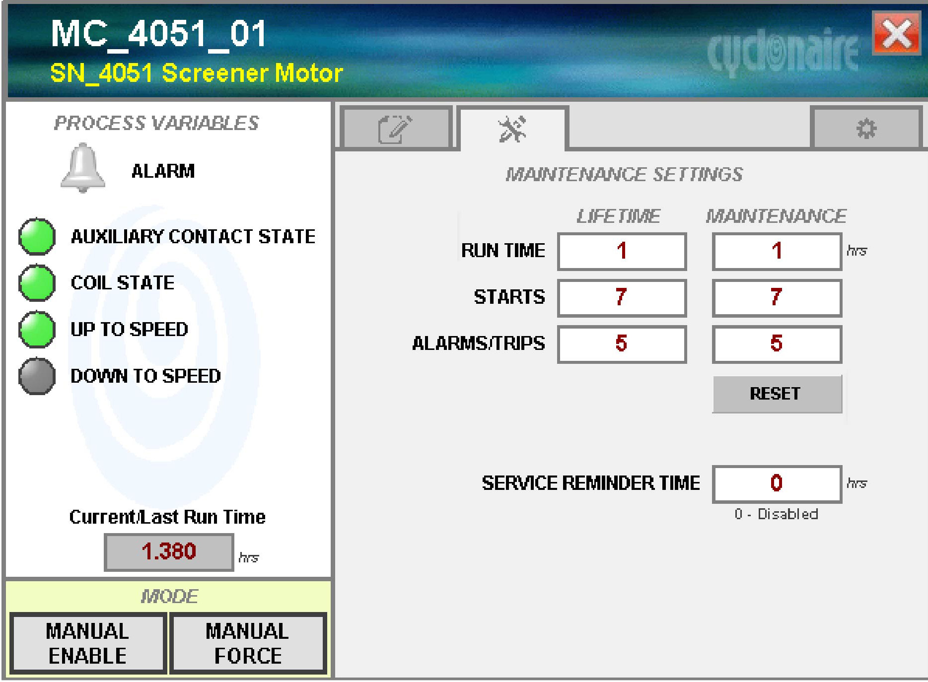
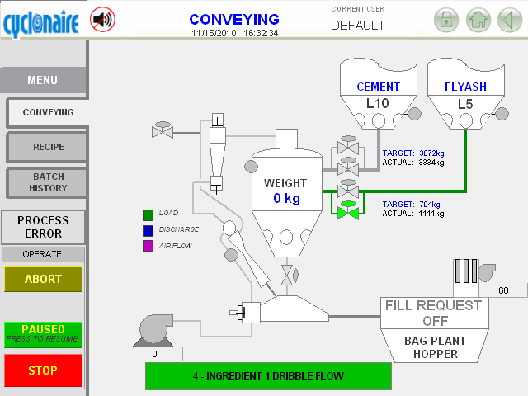
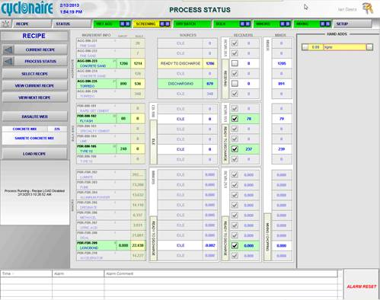
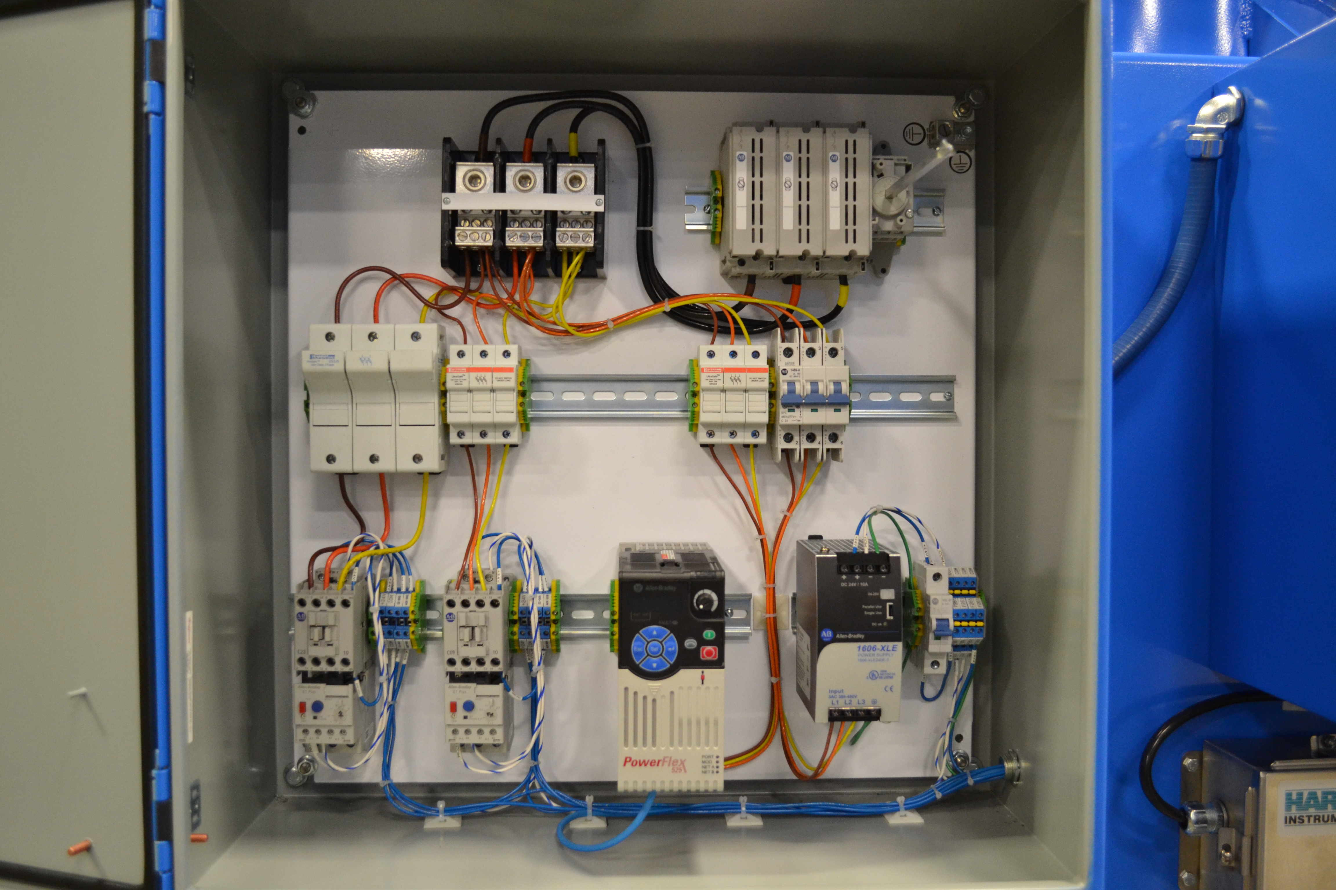
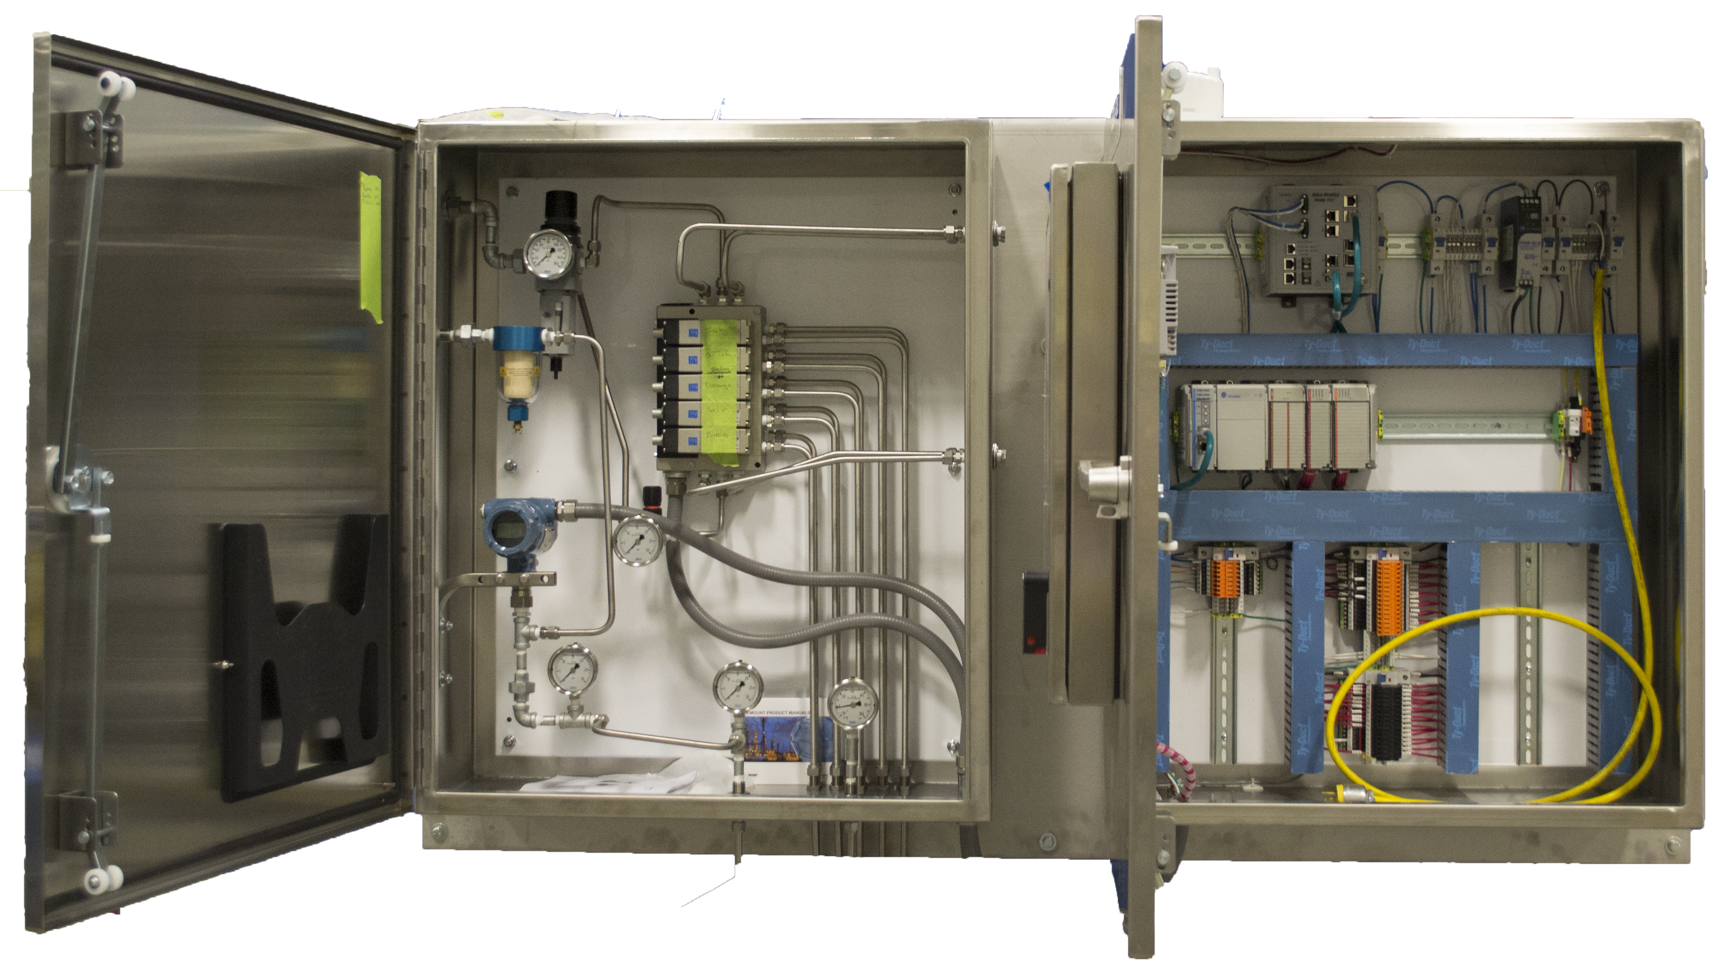
WHAT WE DO
PANEL FABRICATION
ENGINERRING
Single machine or system/process designs
Full plant control (brains of the operation)
Standard or custom automation package for all equipment
Detailed manuals
Designed for:
Facility expansions
New equipment
Process evolution
PANEL FABRICATION
UL 508A listed panel builder
UL 508A has tested samples of our product for safety
Intuitive controls
Custom face panels built in house
Weather and UV resistant
ENGINEERING
PROGRAMMING
PROGRAMMING
We don’t expect you to know how to program
Operators have complete control at plant, system, machine, and device level.
Abnormal situation management
User interface will draw attention to issues
DATABASE & DATA STORAGE SOLUTIONS
Recipe management / history
Production history
DATABASE & STORAGE SOLUTIONS
INSTALLATION & COMMISSIONING
System commissioning
Wiring and instrumentation verification
Ensures a smooth and successful startup
System start up
Don’t waste time & resources
REMOTE CONNECTION ACCESS
We can patch in remotely
We will respond to emergencies without the need to travel
Live screen sharing eliminates frustrating phone support calls.
Additional field service available
Notifications to personnel when issues arise
INSTALLATION & COMMISSIONING
REMOTE CONNECTION ACCESS
DATA GATHERING
Tracks material usage and inventory
Tracks cycles and time for upcoming maintenance
Batch and campaign history
DATA GATHERING

Slide 4
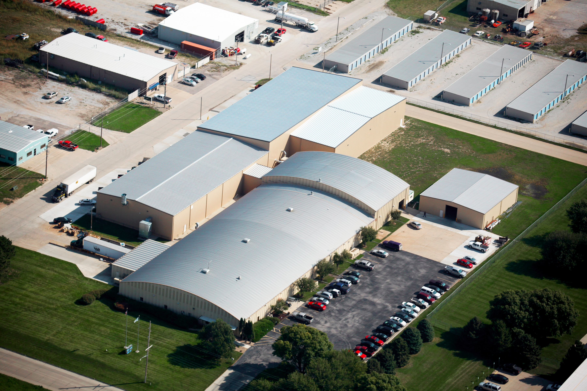
OUR MISSION
Cyclonaire will aggressively strive to enhance its position as a leader in technology and service in the markets we serve. We will focus our resources to build long-standing and meaningful relationships with our customers, employees, sales organizations, and suppliers.

