Slide 1
BATTERY INDUSTRY OVERVIEW
September 25, 2015

Slide 2
AGENDA
INTRODUCTION
BATTERY MANUFACTURING PROCESS
INDUSTRY OVERVIEW
THINGS TO CONSIDER
CONCLUSION & DISCUSSION

Slide 3
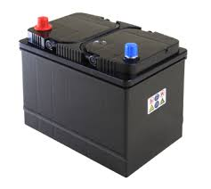
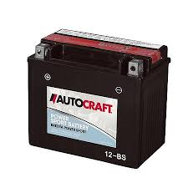
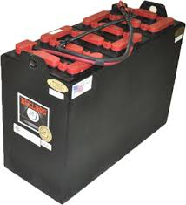
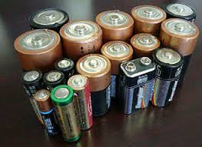
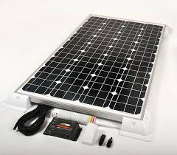
INDUSTRY OVERVIEW
POTENTIAL SALES
Battery Types
Automotive
Power Sports
Marine
Industrial
Household
Mass Storage (wind farms, solar)
Battery Market Segments
Lead Acid
Lithium Ion
Nickel
Alkaline

Slide 4
INDUSTRY OVERVIEW
CUSTOMER LIST
Potential Customer List
Johnson Controls Inc.
All Power Battery
Atlantic Battery
Battery Builders
Braille Battery
Bulldog Battery
EnerSys Energy Products
Exide Technologies
EBCO Battery
Saft America
U.S. Battery Manufacturing
Stats

Slide 5
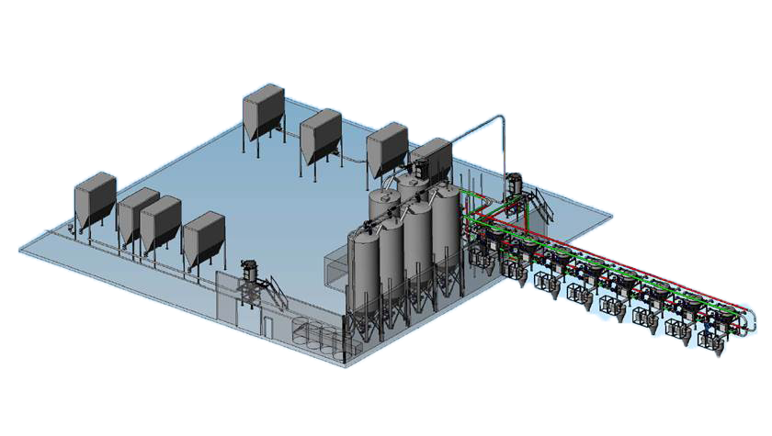
CORE COMPETENCY: LEAD ACID
Understanding how Cyclonaire’s product fits into the material handling portion.
Milling/ Bulk Receiving
Batch Metering/ Mixing
Storage

Slide 6
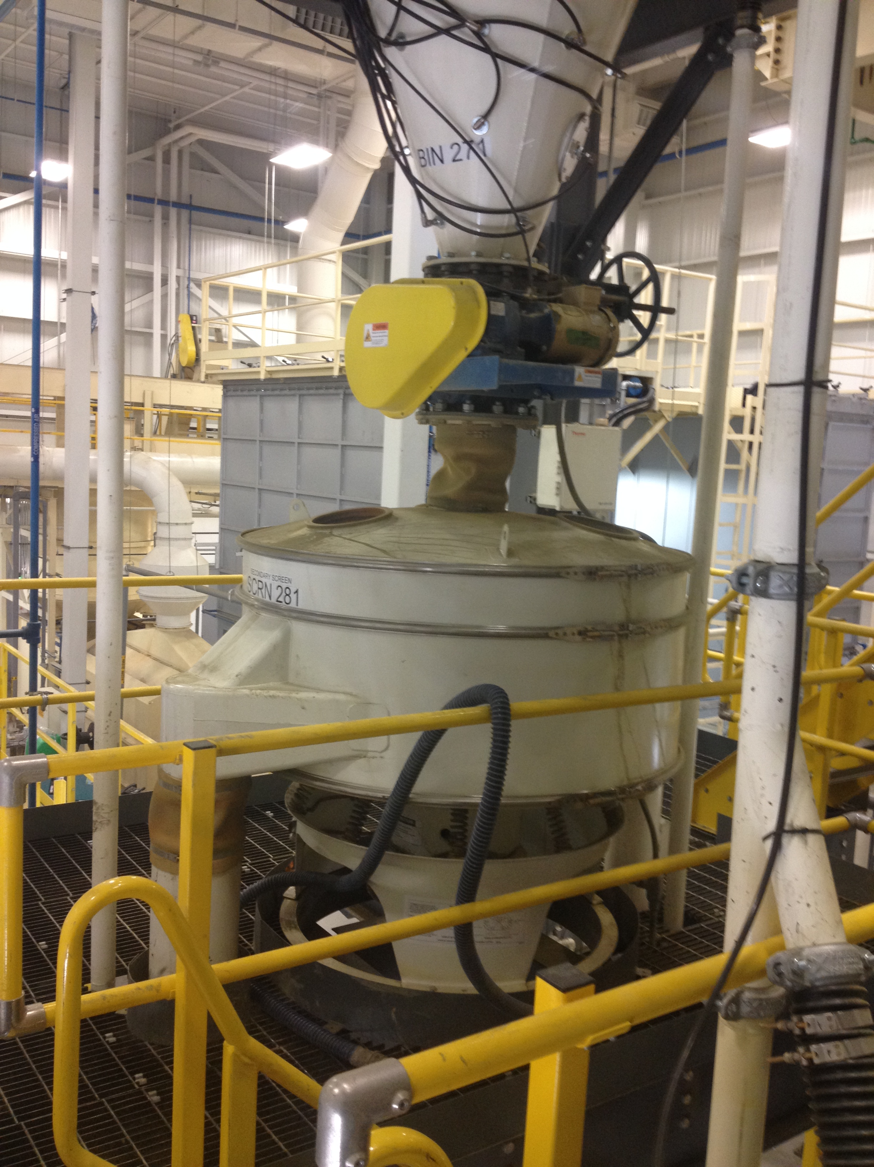
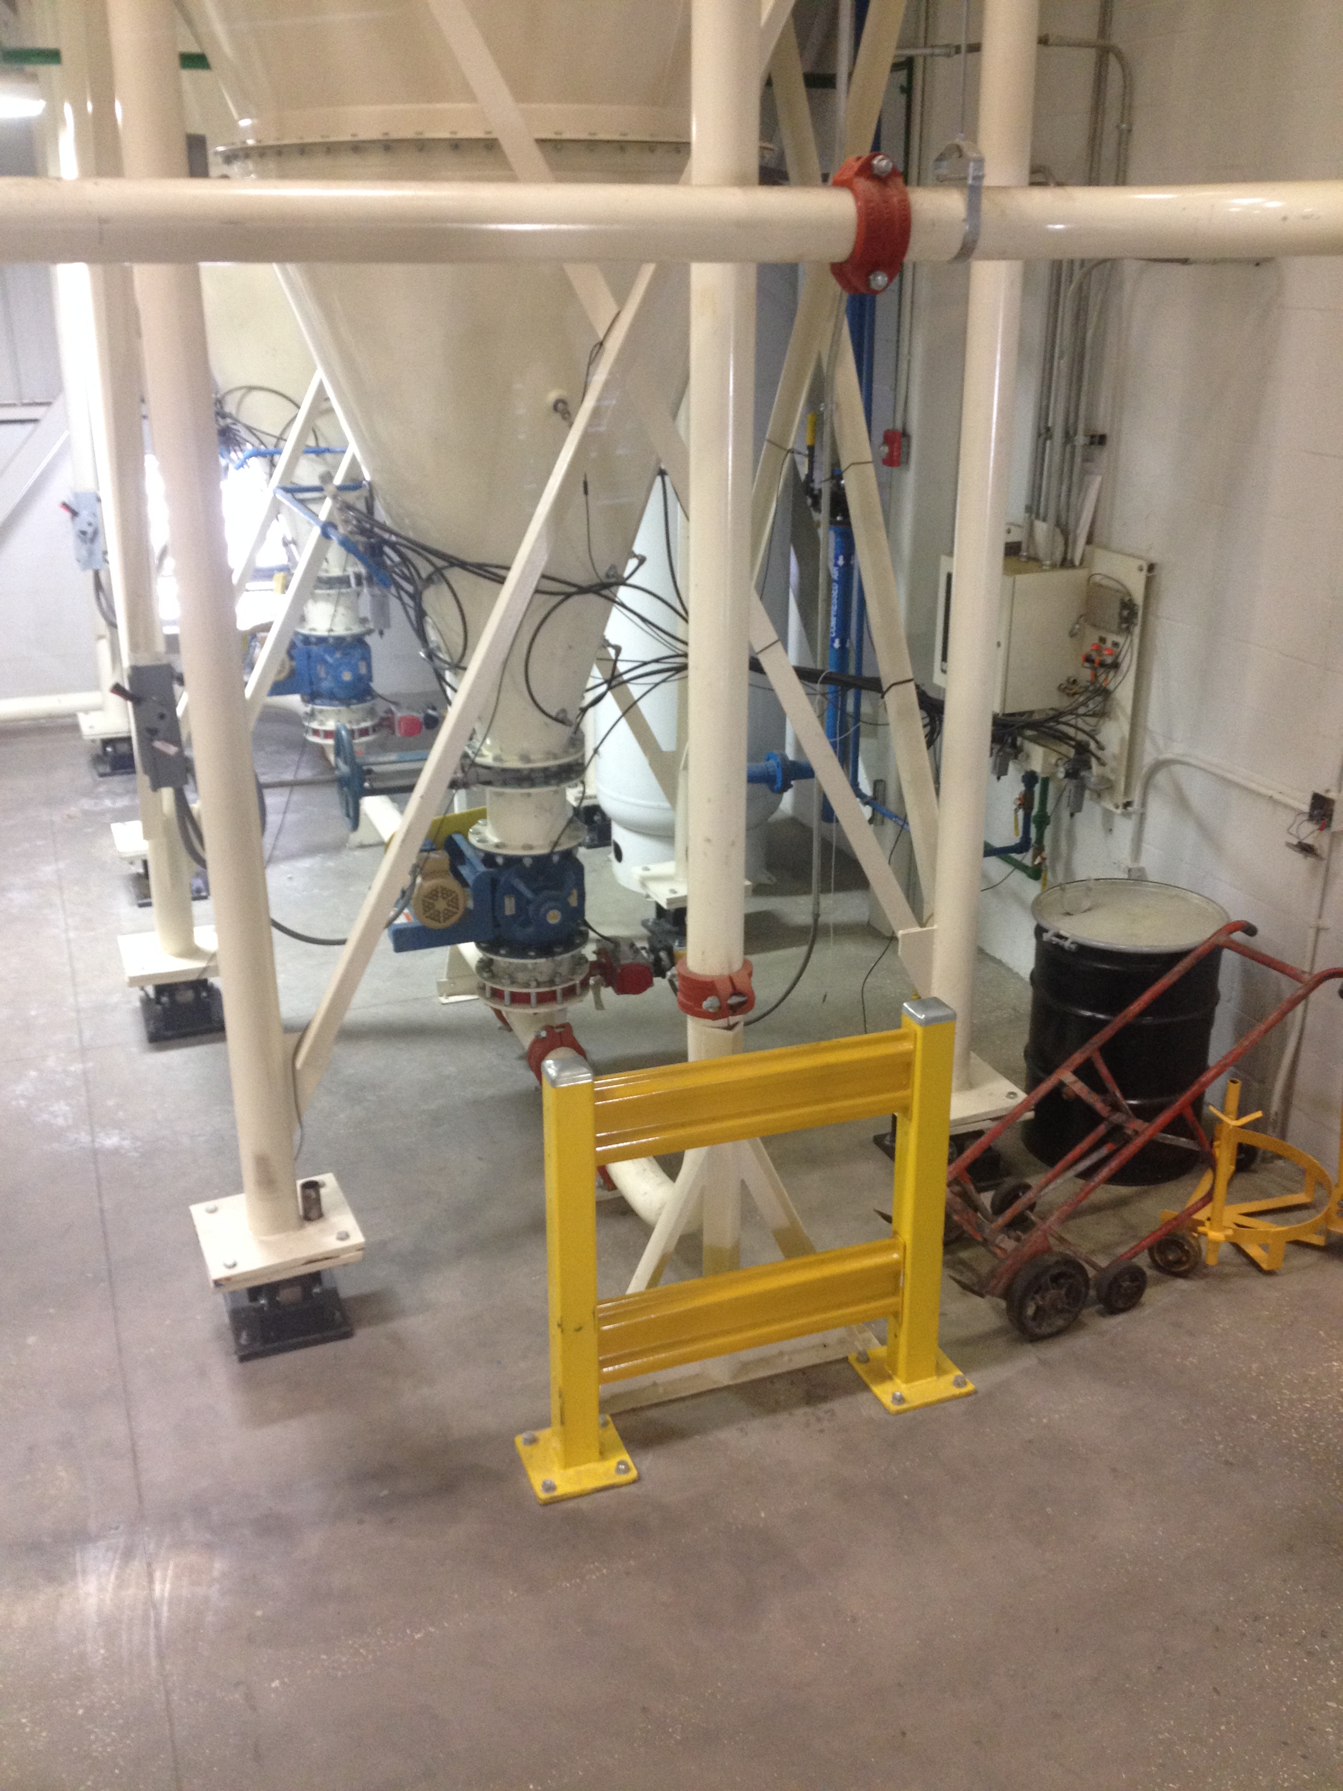
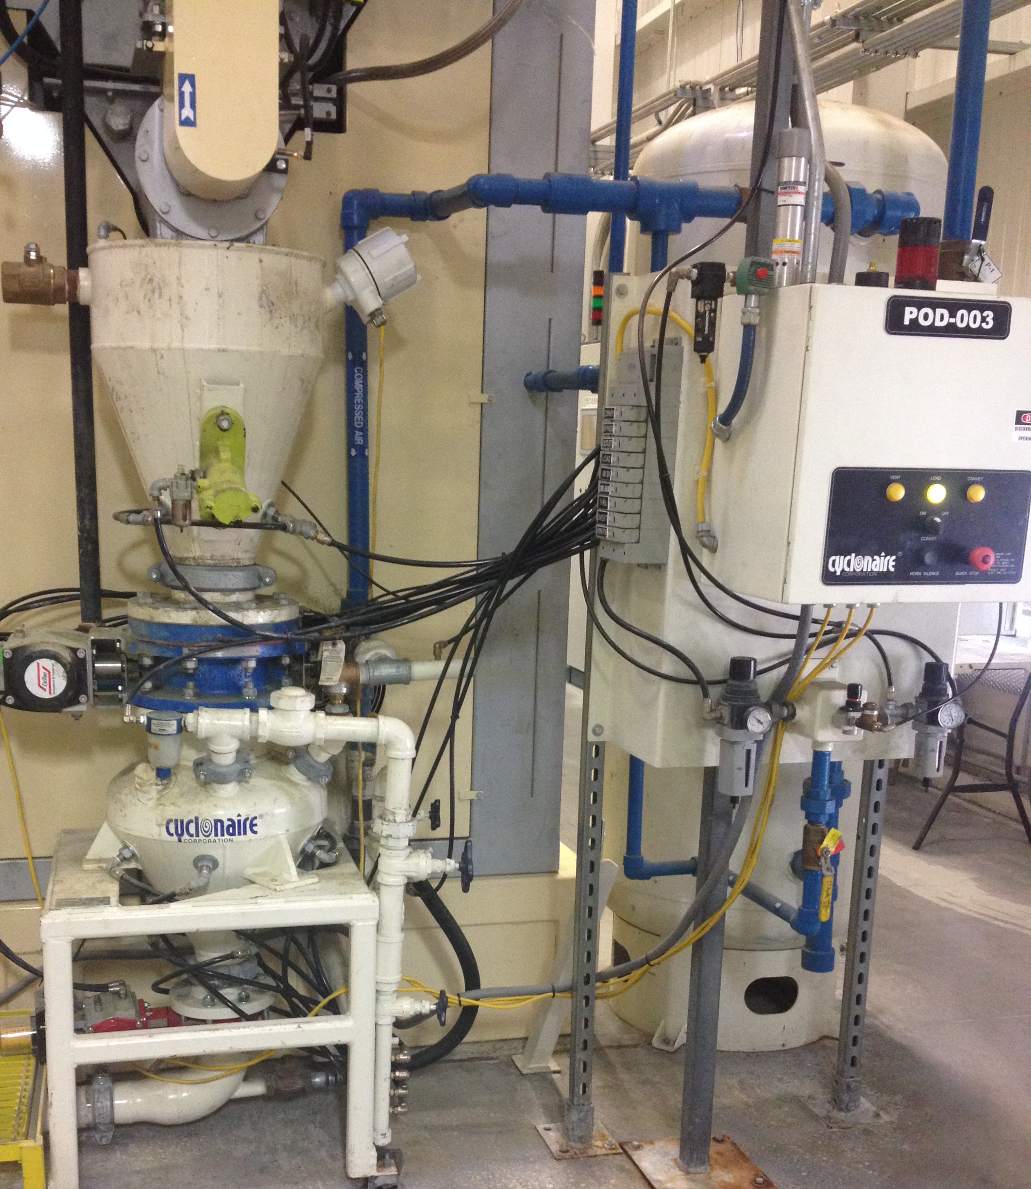
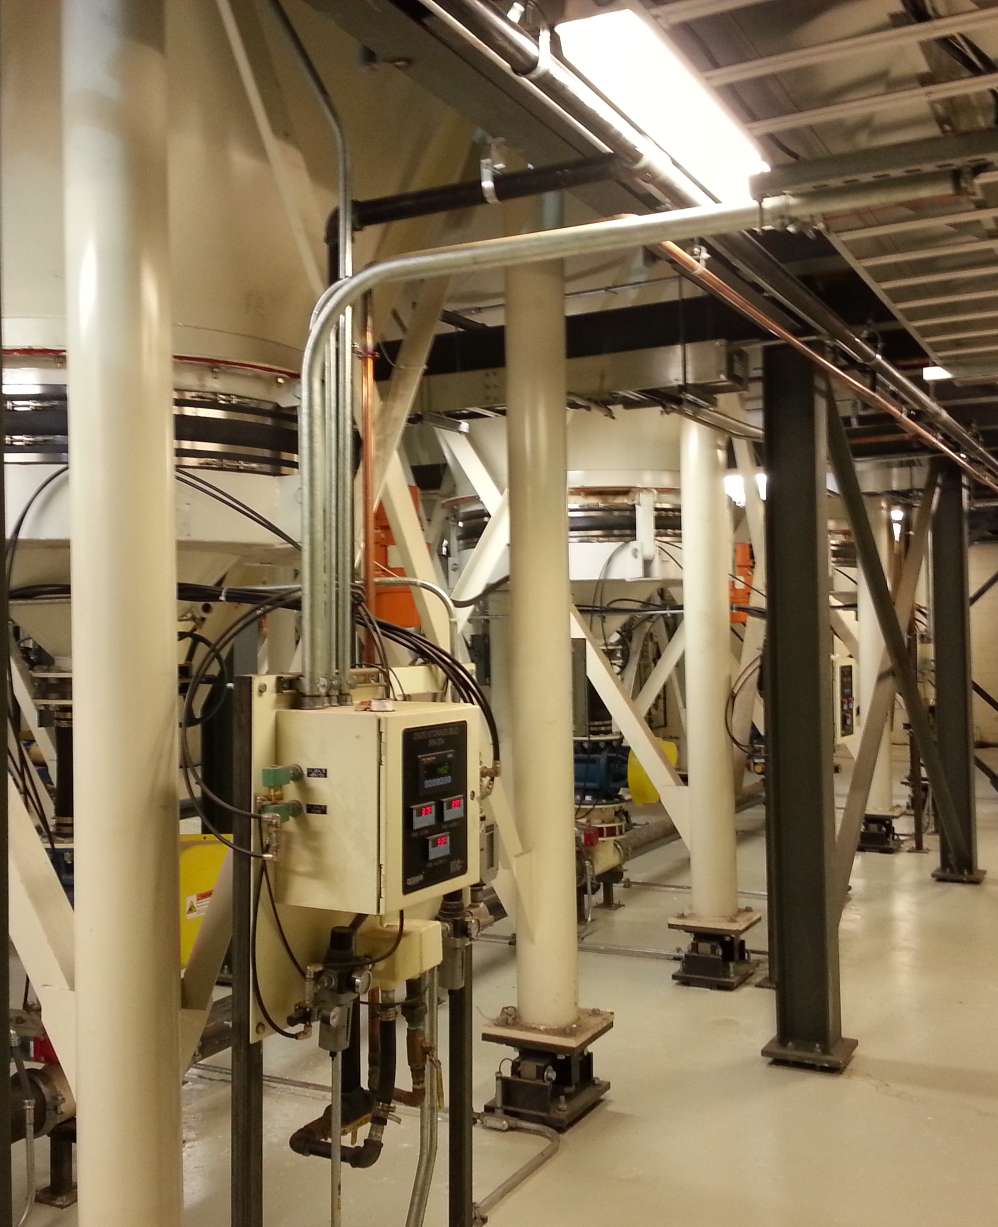
OUR COMPETITIVE ADVANTANGE: LEAD ACID
Experience/ Process Knowledge
Material Reactivity/Storage Issues
Poor Flow Characteristics
Bin Design
System Sizing
Material Cohesiveness
Understanding Critical Nature of Operation to Plant (Assembly Line)
Reliability
Redundancy
Flexibility
Visibility
Notes:
Lead Oxide is its own industry

Slide 7
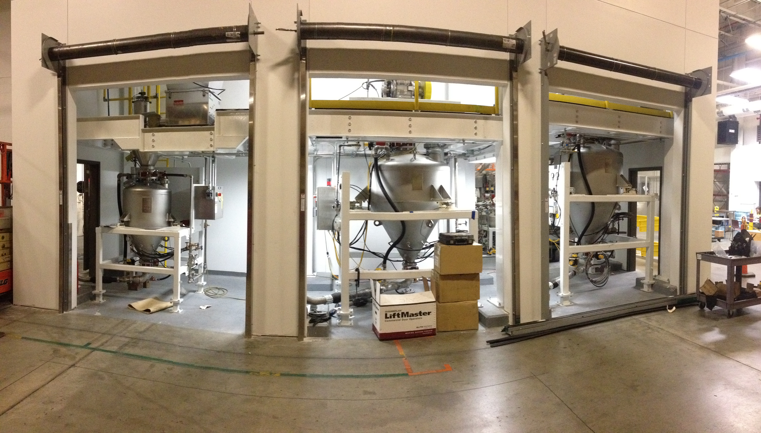
OUR COMPETITIVE ADVANTAGE: LITHIUM ION
Cleanliness Requirements
Vacuum Technology
Precision Batching
Advanced Automation/ Plant Integration
Notes:
Lead Oxide is its own industry

Slide 8
WHAT TO CONSIDER
Typical Questions – New Systems
Typical Questions – New Systems
Goals of the project?
What are they trying to achieve?
Types of material they’re handling
Convey rate
Site specifications
See application date sheet for all questions
Does the customer screen or not?
Material temperature in process
Typical Questions – Existing Systems
Components
Sample Parts List

Slide 9
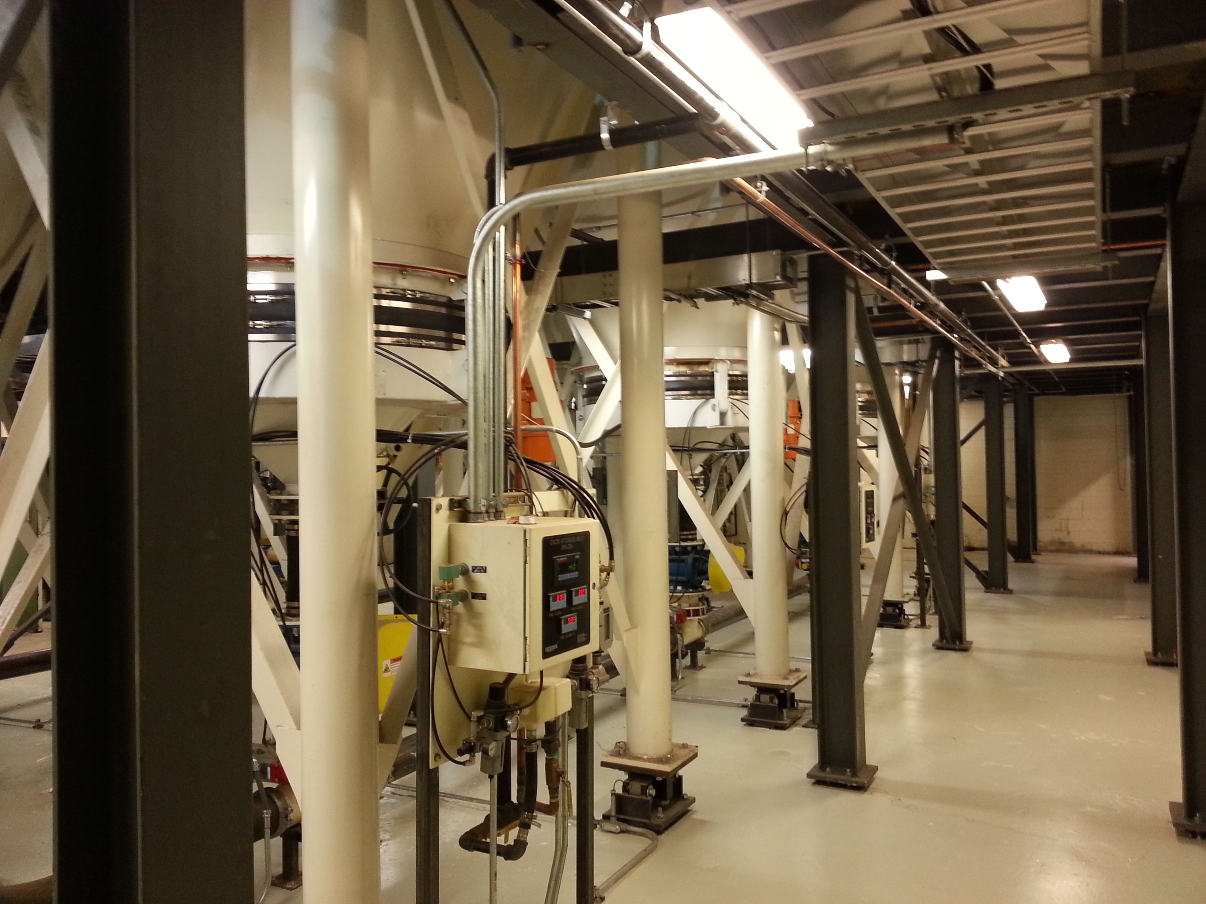
WHAT TO CONSIDER
Typical Questions – New Systems
Typical Questions – Existing Systems
Typical Questions – Existing Systems
How is the system performing?
Are there any major concerns?
Is there anything broken?
Are there high wear parts?
Do they have adequate automation and instrumentation to measure performance?
Are they screening their product? Problems?
Are leaks in the system affecting air quality?
Components
Sample Parts List

Slide 10
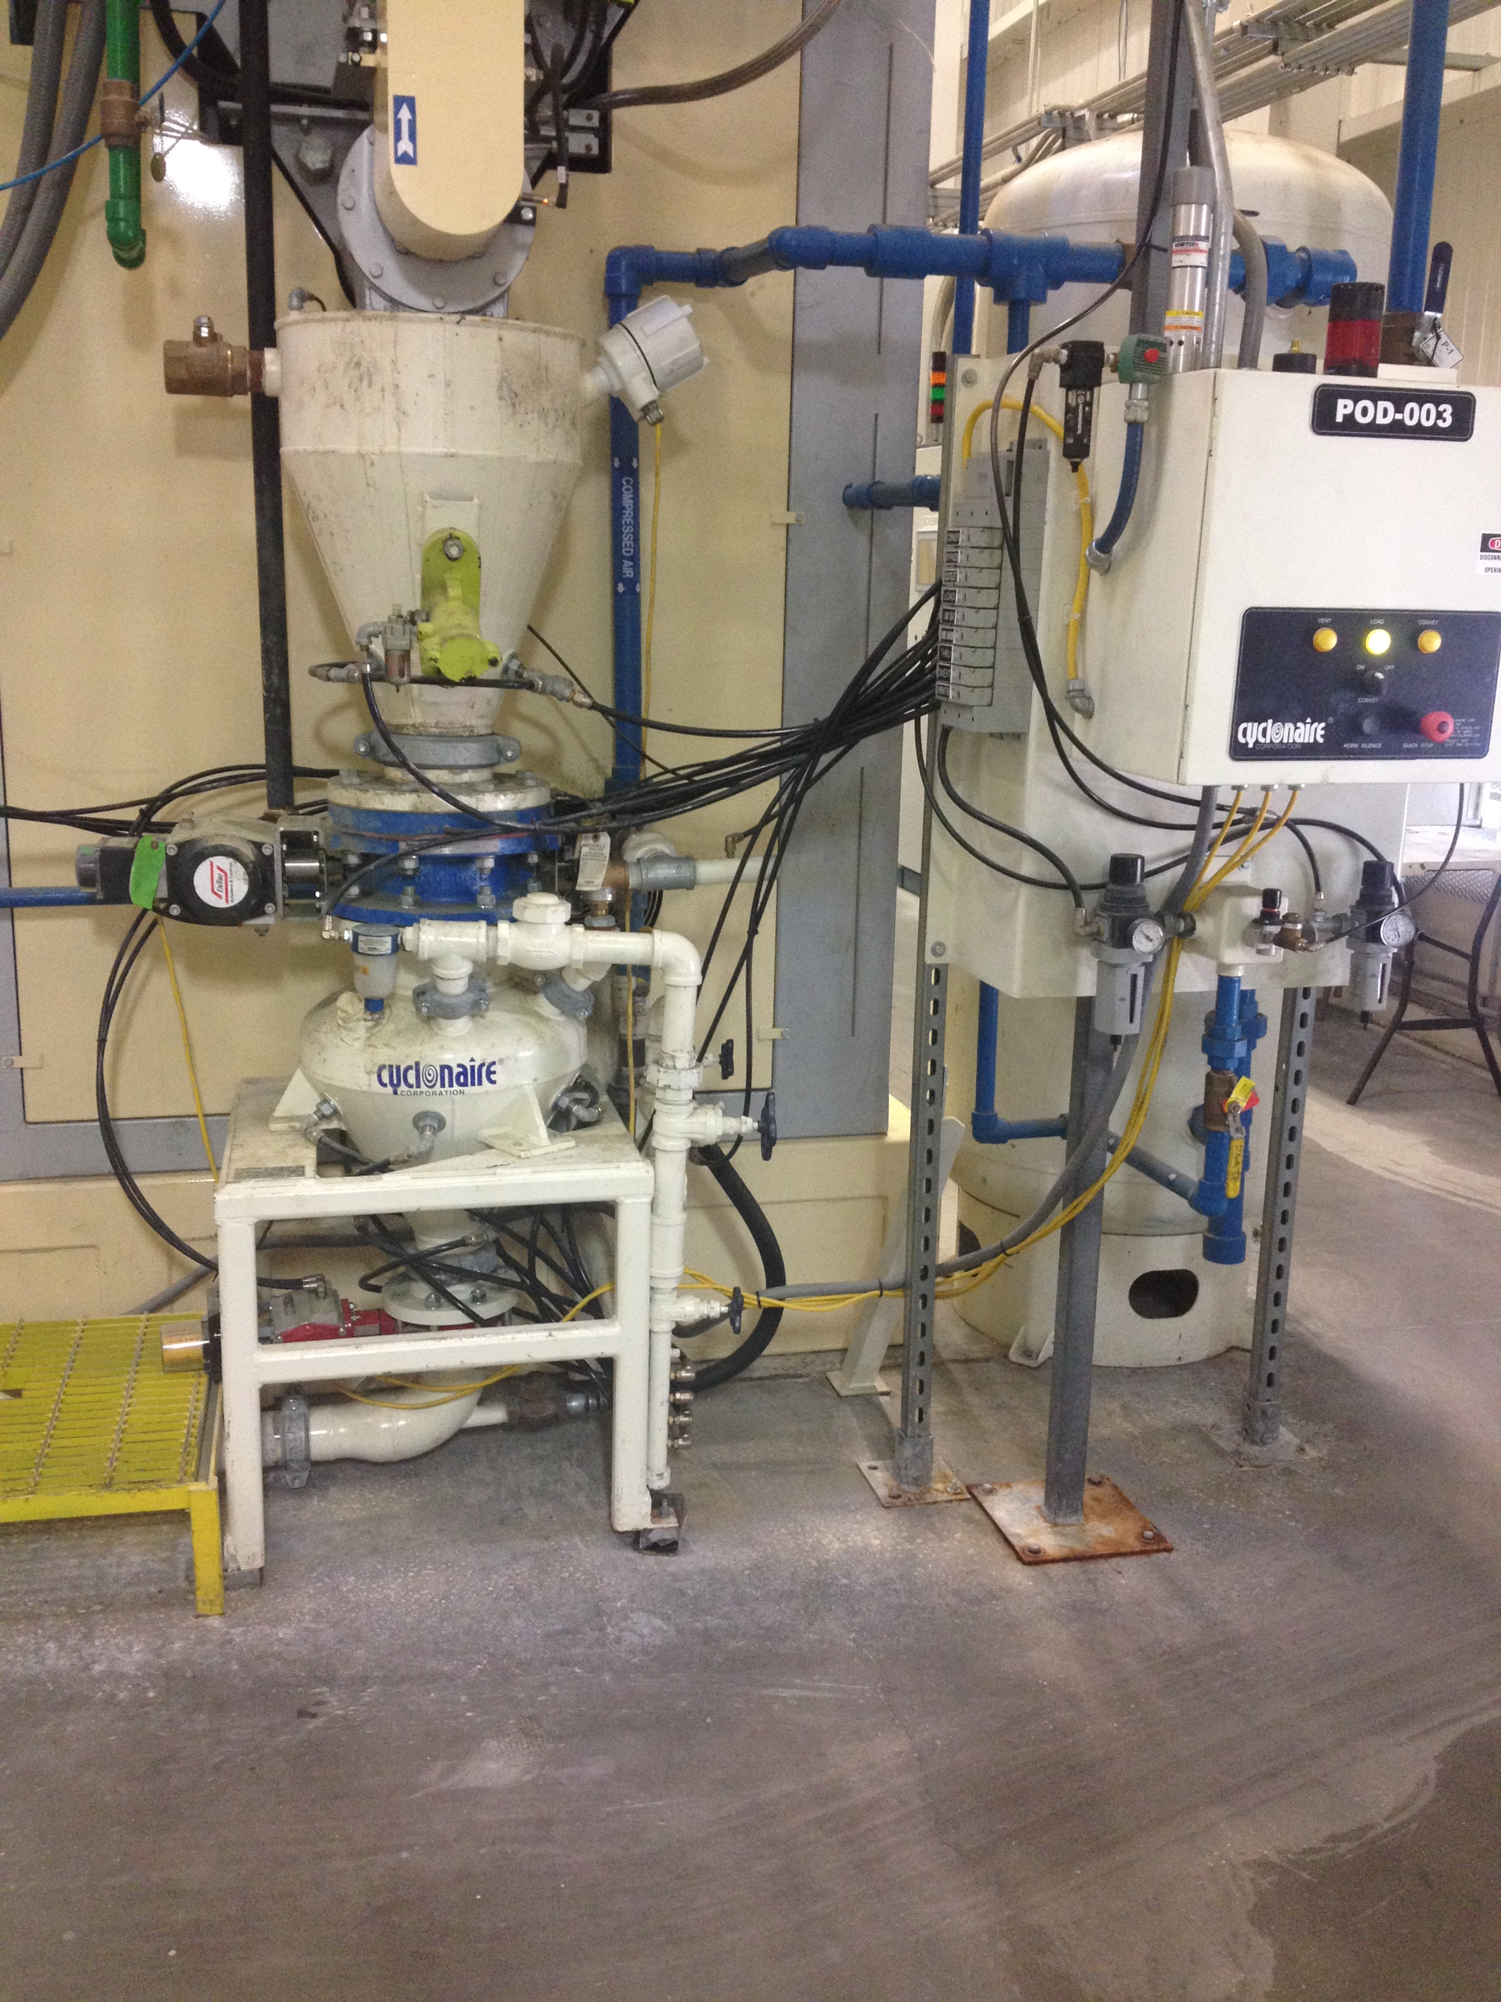
WHAT TO CONSIDER
Typical Questions – New Systems
Typical Questions – Existing Systems
Components in battery plants
Fix and replace competitor’s equipment
Diverters
Bin Vents
Blower Packages
Turbo Inductors
Components
Sample Parts List

Slide 11
WHAT TO CONSIDER
Typical Questions – New Systems
SPARE PARTS LIST
Suggested Qty | Description | Part Number
1 | 6" Pinch Valve | 905-01925
1 | 6" Sleeve | 905-11246
1 | 4" Pinch Valve | 905-01919
0 | 4" Sleeve | 905-11242
2 | Level Sensor | 904-02984A
30 | Filter | 904-01442
6 | 1/8" Asco | 905-01369
6 | 1" Diaphragm | 905-01496A
3 | 3/4" Filter Reg | 905-01255
3 | 1/2" Reg | 905-09266
3 | 1/4" Reg | 905-09249
2 | DP Transmitter | 904-02150B
1 | DP Switch | 904-02767
1 | Rotary Valve | 905-01329B
1 | 10" BFV | 905-01163B
Typical Questions – Existing Systems
Components
Sample Parts List

Slide 12
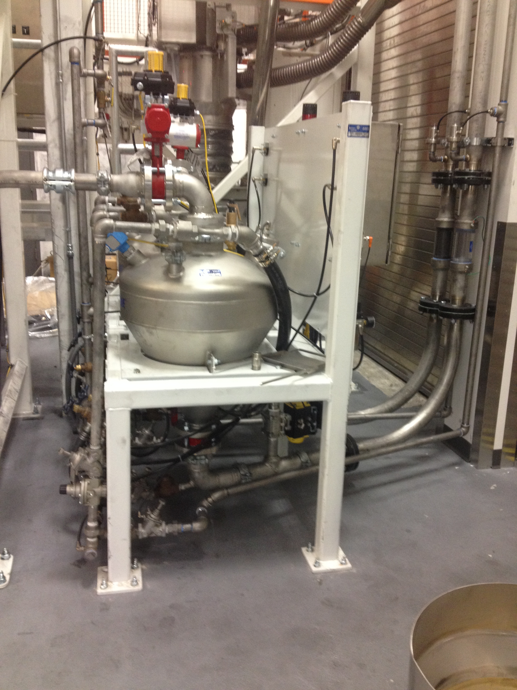
CYCLONAIRE EFFORTS
Cyclonaire Efforts
Dedicated Resource - Mike
Battery industry overview line sheet
Prospecting efforts
Direct Mail campaign
Web content and SEO (search engine optimization)

Slide 13
DISCUSSION
QUESTIONS

