Slide 1
PCI Rapid Comply Questionnaire
Hello Valued Paperless Client,
This step-by-step presentation will show you
how to answer the specific questions on the PCI
Rapid Comply Website.
The responses listed here are intended solely for
non-profit/church clients that DO NOT directly handle
credit cards. If you have any questions please contact
Support: support@paperlesstrans.com

Slide 2
If status is “incomplete” select “continue” to begin questionnaire.

Slide 3
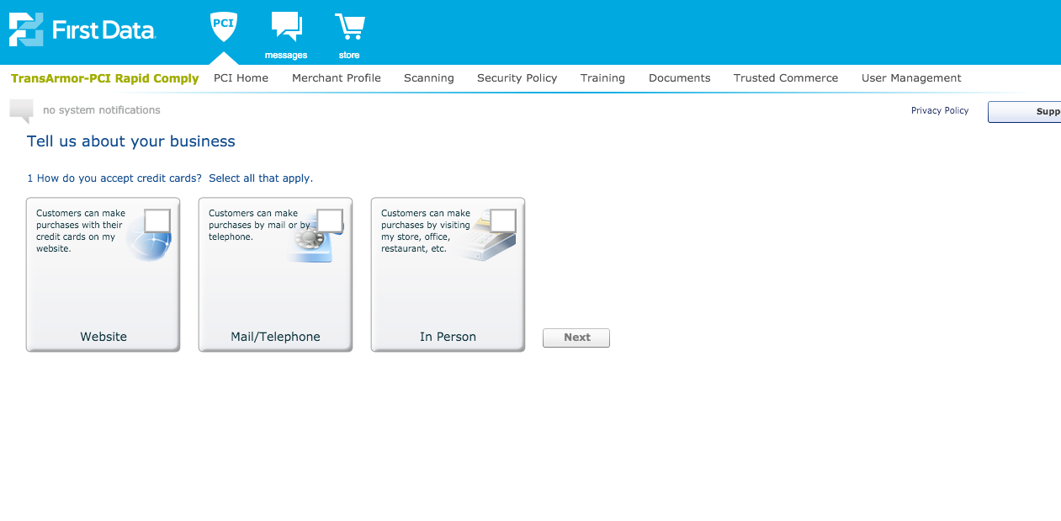
Choose “Website”

Slide 4
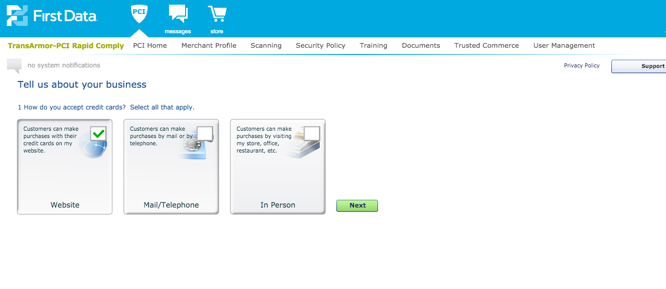
Once Website is checked,
click “Next”

Slide 5
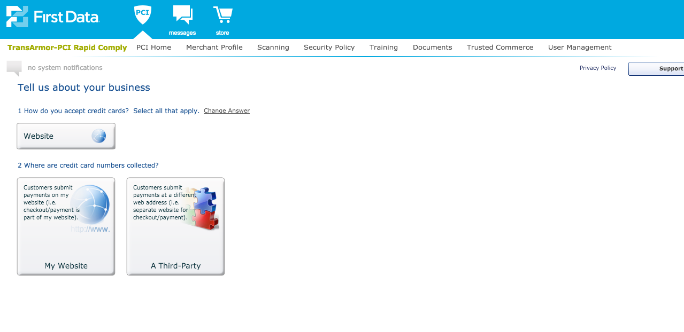
Click “A Third-Party”

Slide 6
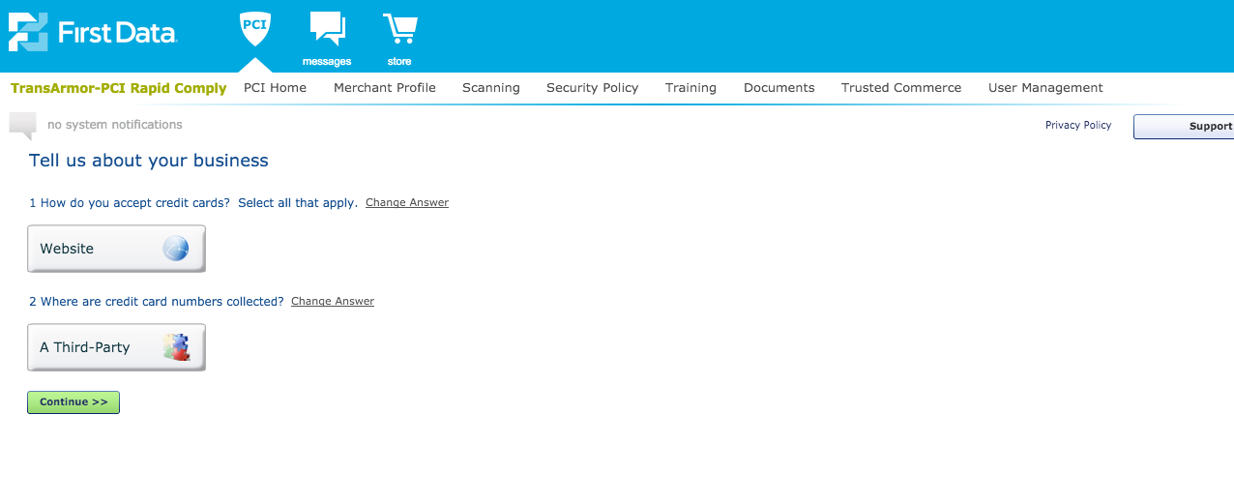
Click “Continue”

Slide 7
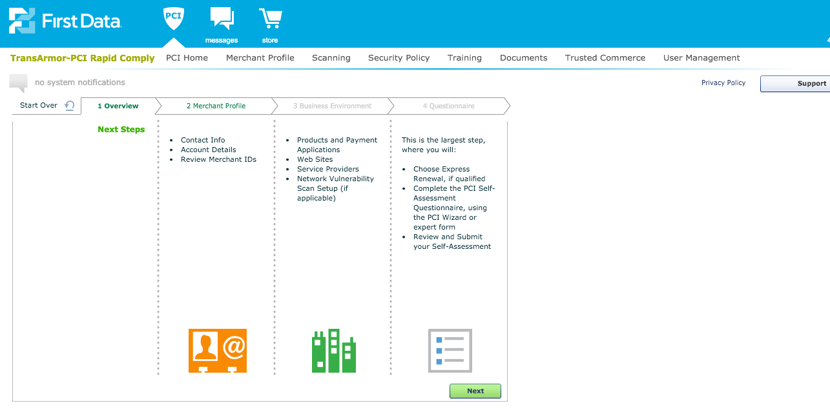
Click “Next”

Slide 8
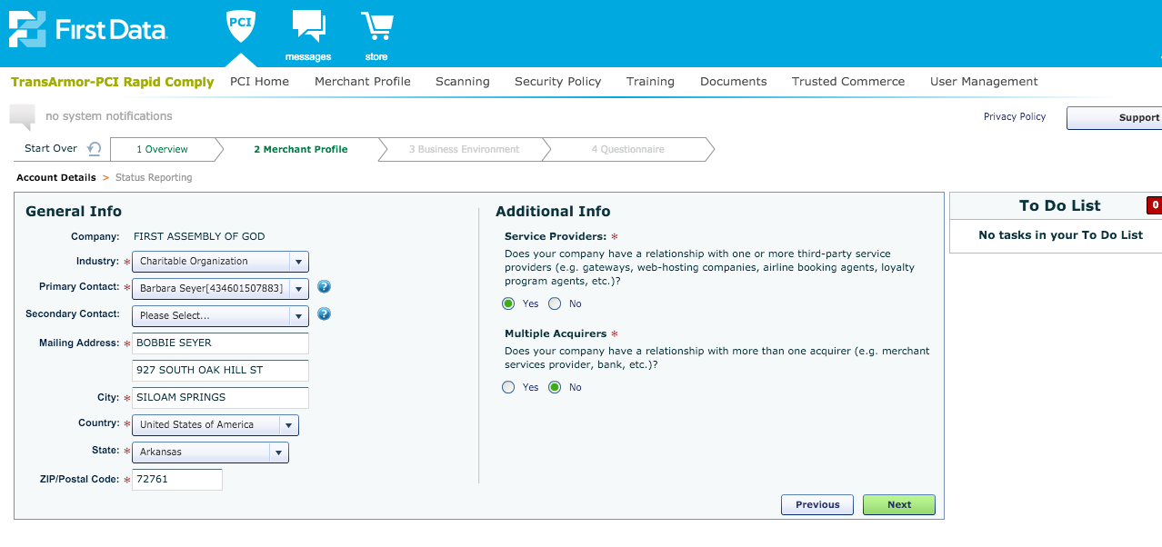
Verify Merchant “General Info”
Then click “Next”

Slide 9
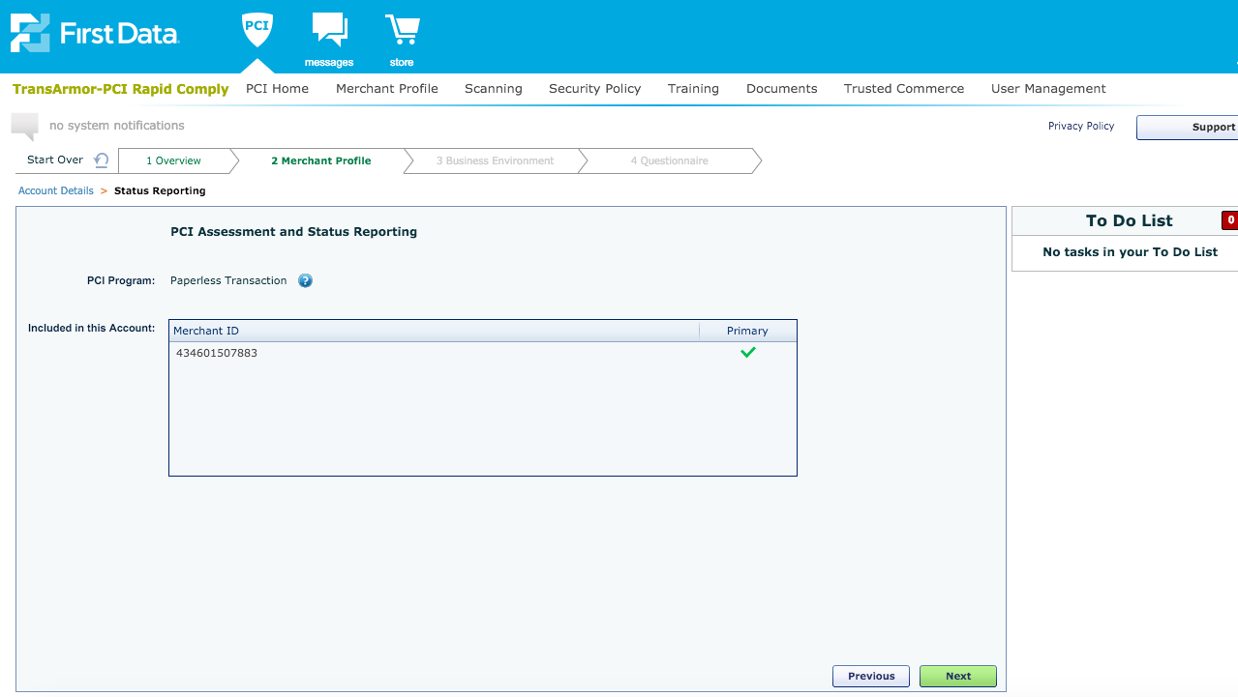
xxxxxxxx
Verify Merchant ID
Then click “Next”

Slide 10
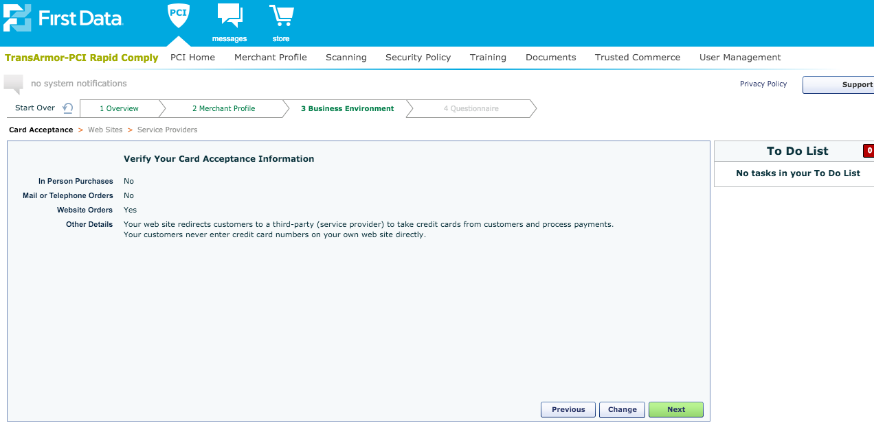
Click “Next”

Slide 11
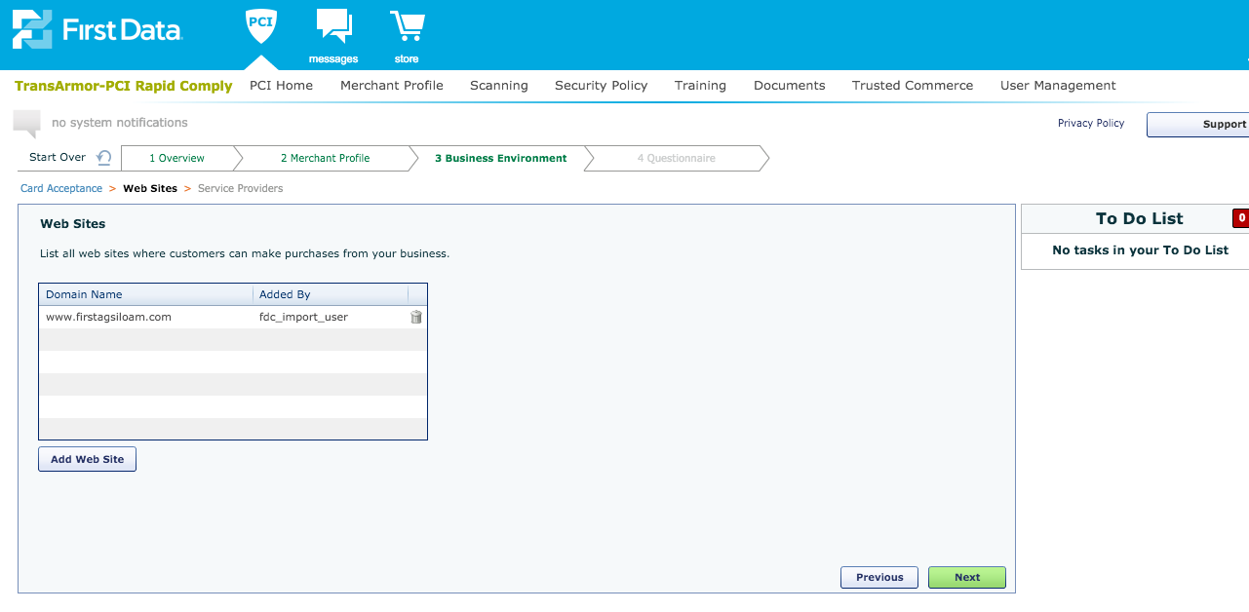
Yourwebsite.com
Add your organizations MAIN website to
The list of Domain Names if it is not listed.
Then click “Next”

Slide 12
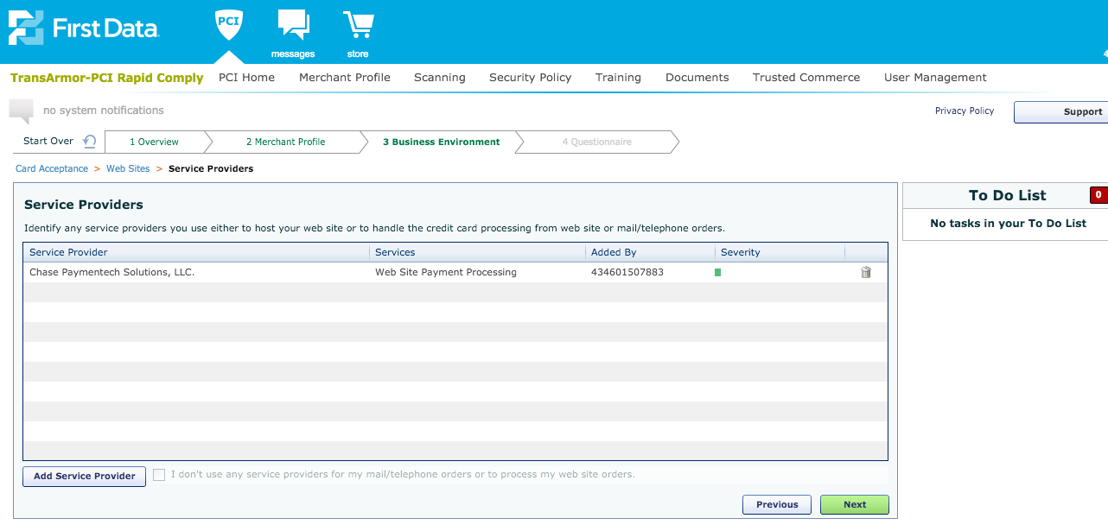
Make sure your service providers are listed. There may be more than one.
If Paperless Transaction Corporation is not listed, click “Add Service Provider”

Slide 13
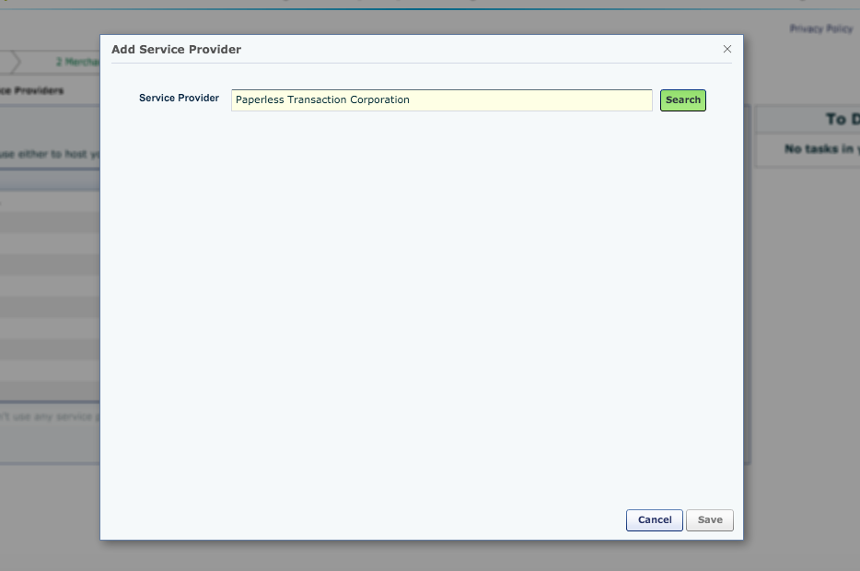
“Search” for Paperless Transaction Corporation

Slide 14
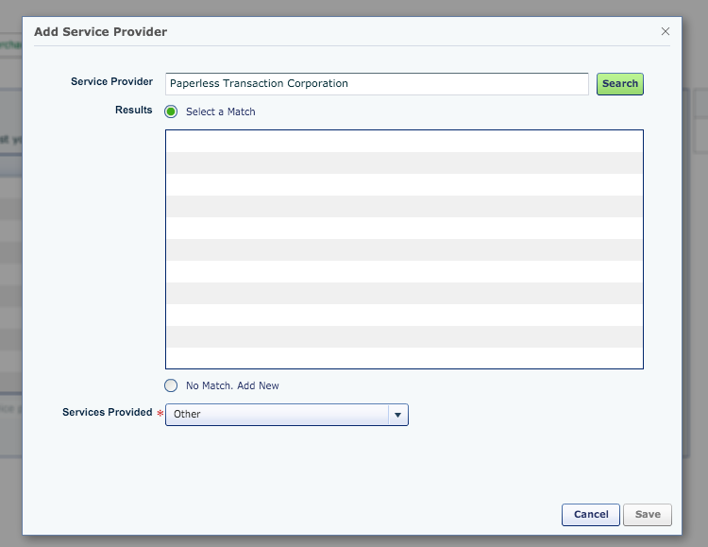
Add Paperless as a New Service Provider

Slide 15
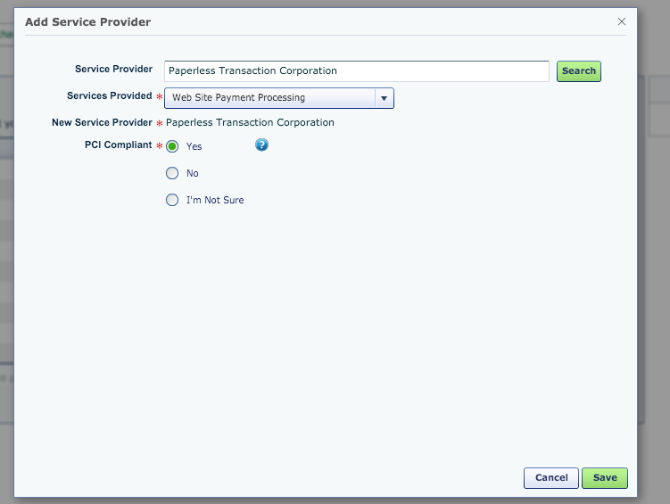
List Paperless as your Website Payment Processor
Paperless IS PCI Compliant
Click “Save”

Slide 16
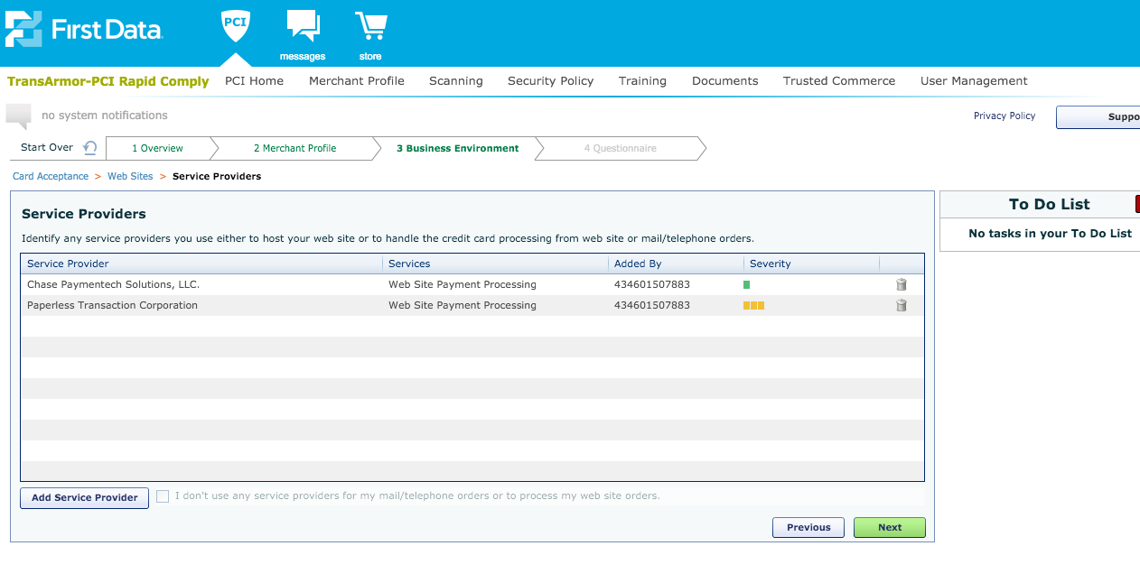
Verify Paperless was added
Then click “Next”

Slide 17
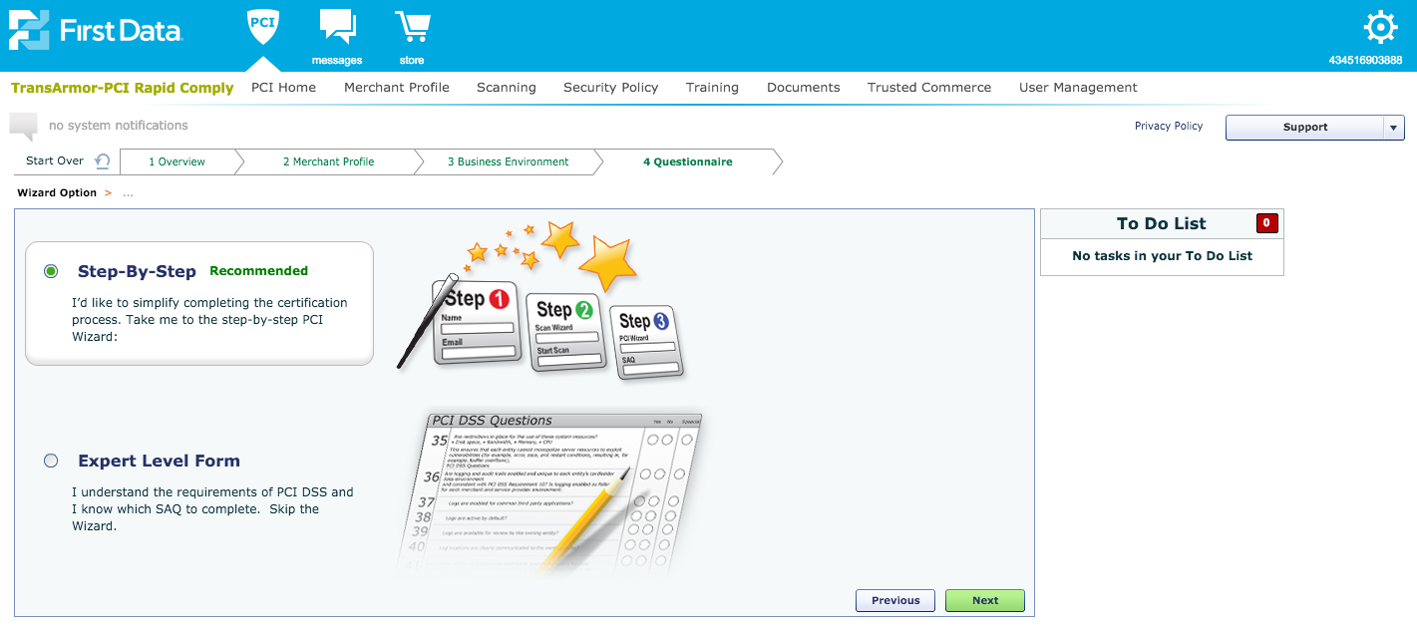
Select “Step-By-Step”
Then Select “Next”

Slide 18
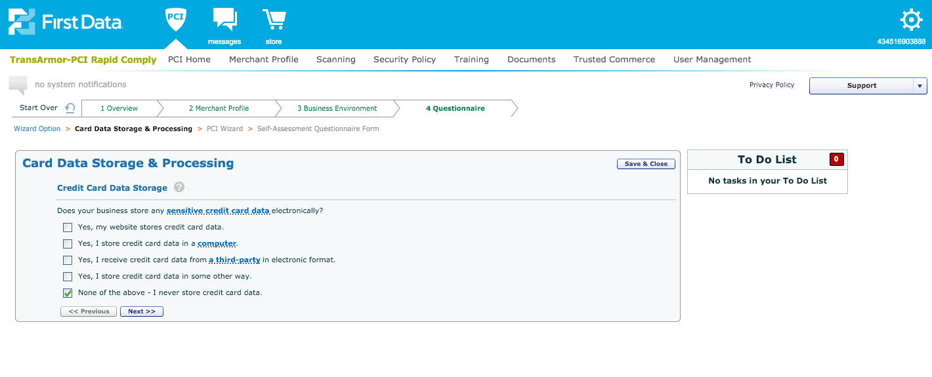
Select “None of the above- I never store credit card data.”
Select “Next”

Slide 19
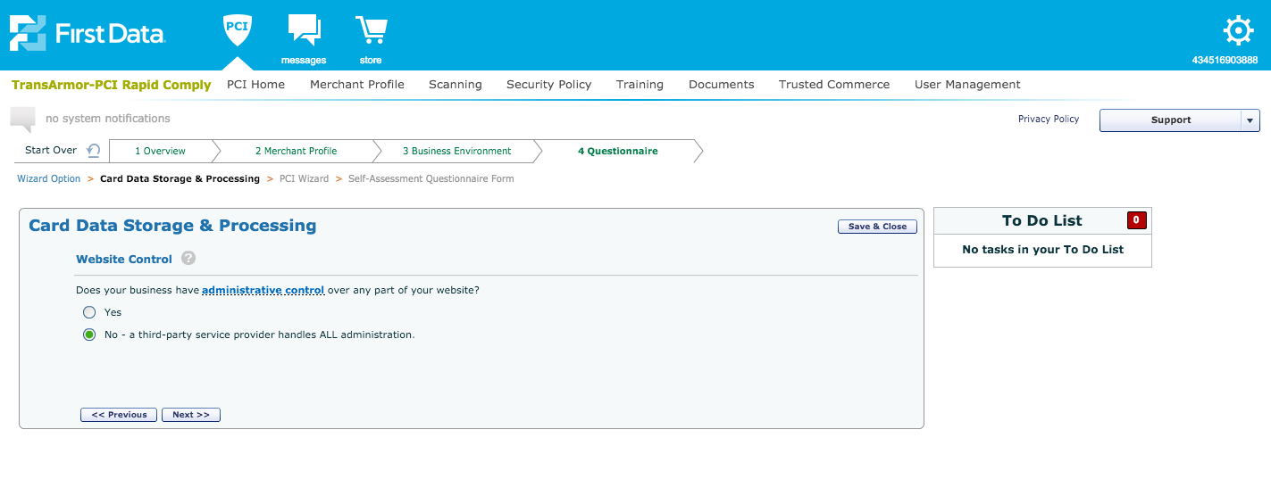
Select “No- a third-party service provider handles ALL administration”
Click “Next”

Slide 20
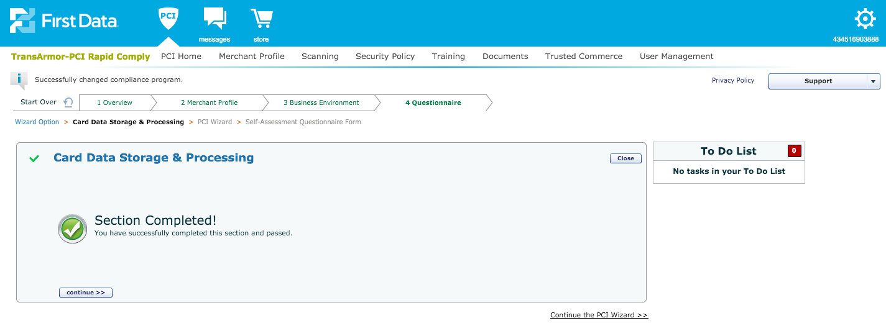
Click “Continue”

Slide 21
Select “Begin” Physical Security

Slide 22
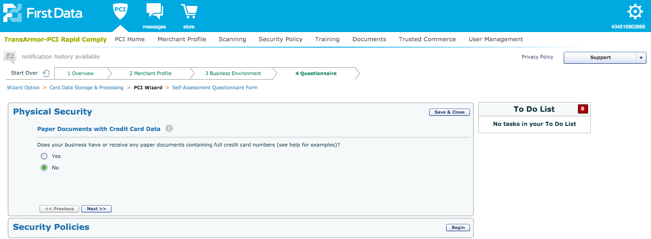
Select “No”
Select “Next”

Slide 23
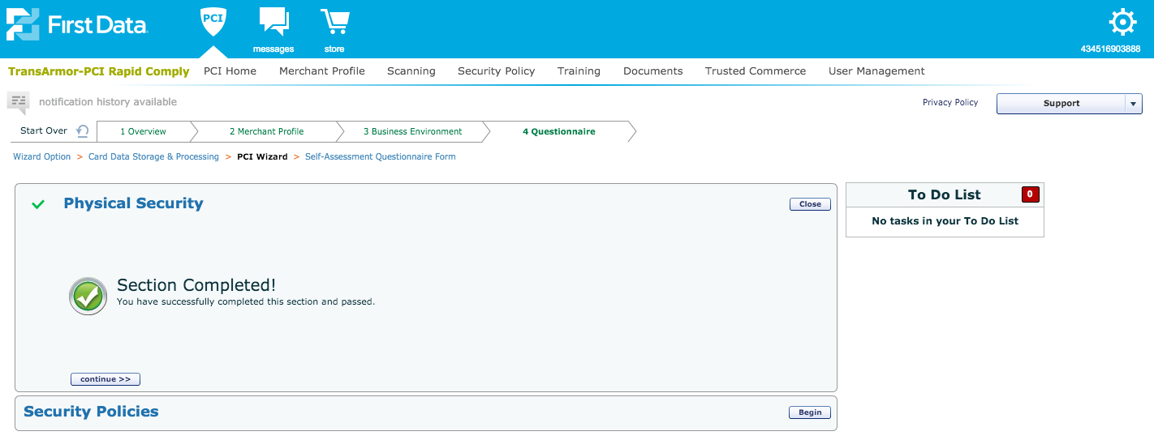
Select “Continue”

Slide 24
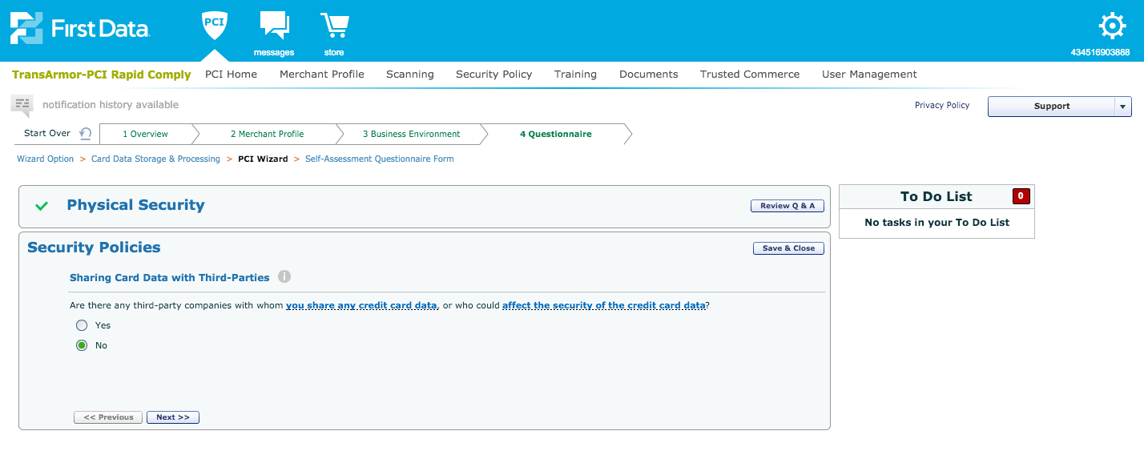
Select “No” Select “Next”

Slide 25
Select “Yes, I use the security policies included in my subscription”
Select “Next”

Slide 26
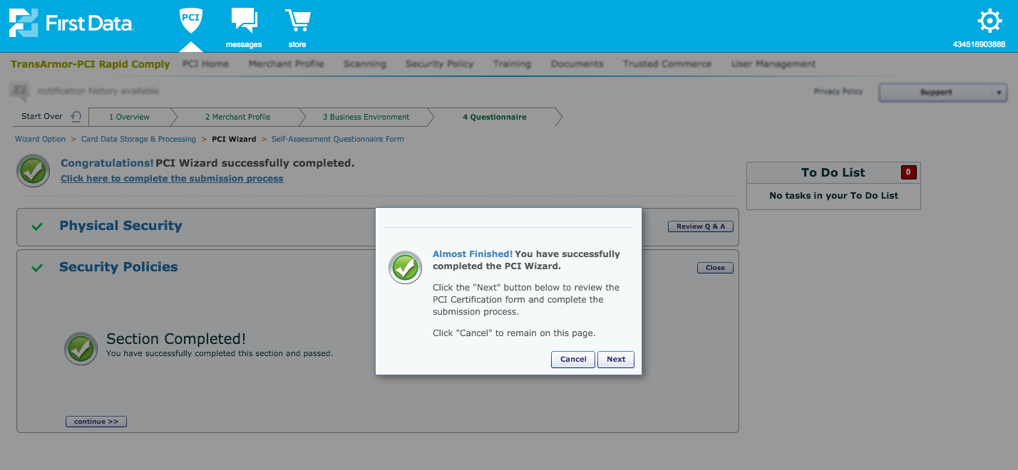
Select “Next”

Slide 27
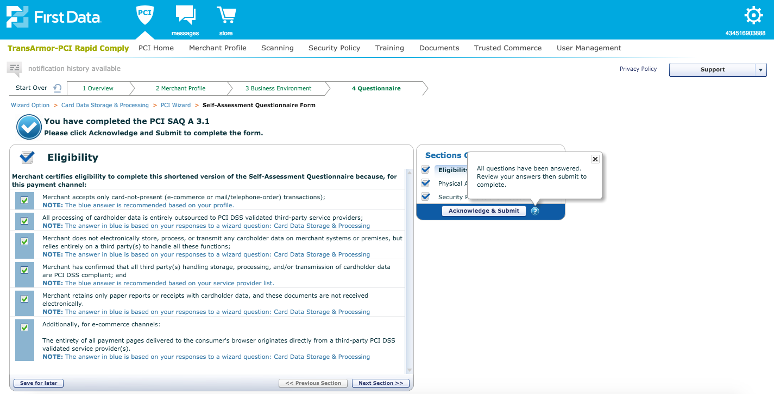
Select “Next”

Slide 28
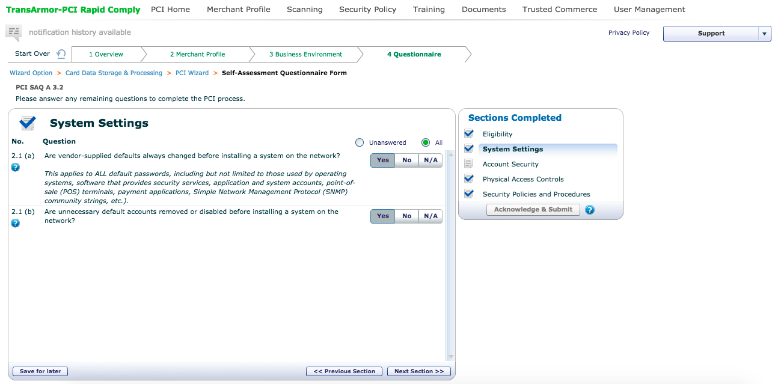
Select “Yes” to both questions Select “Next Section”

Slide 29
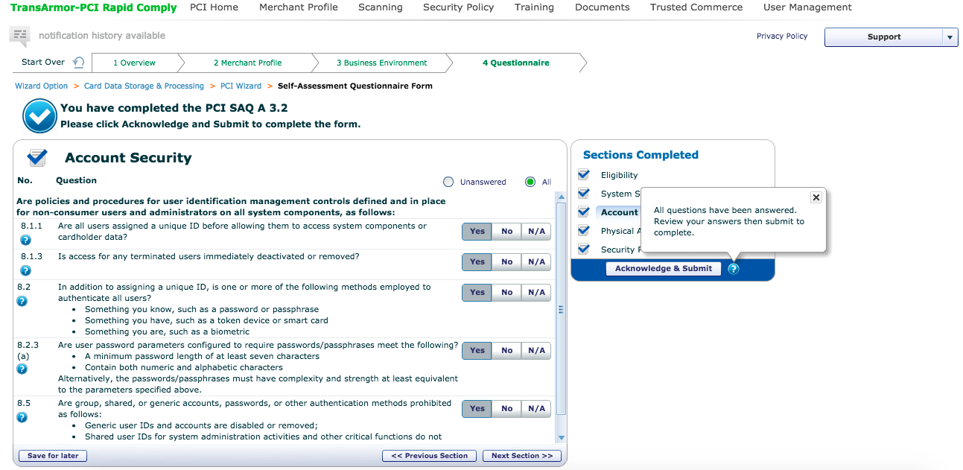
Select “Yes” to all questions
Select “Next Section”

Slide 30
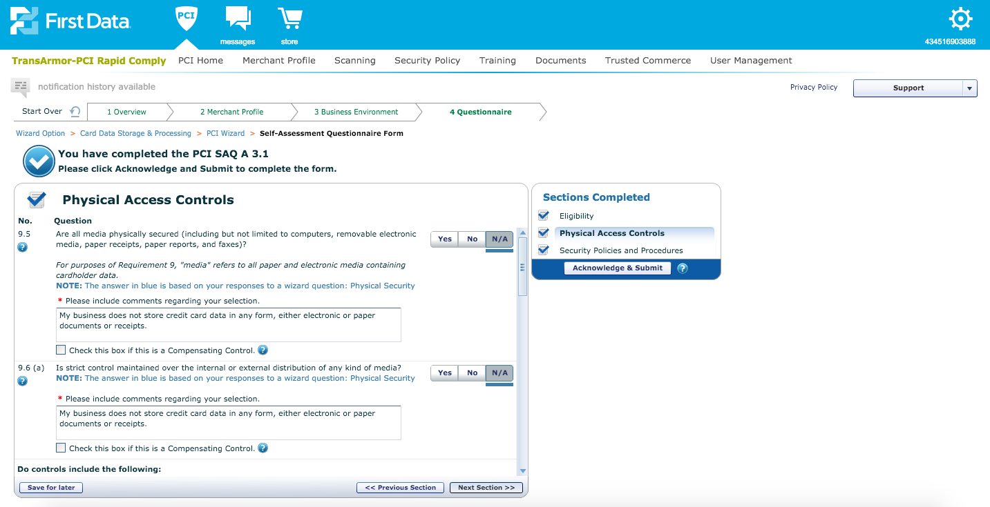
Select “Next Section”

Slide 31
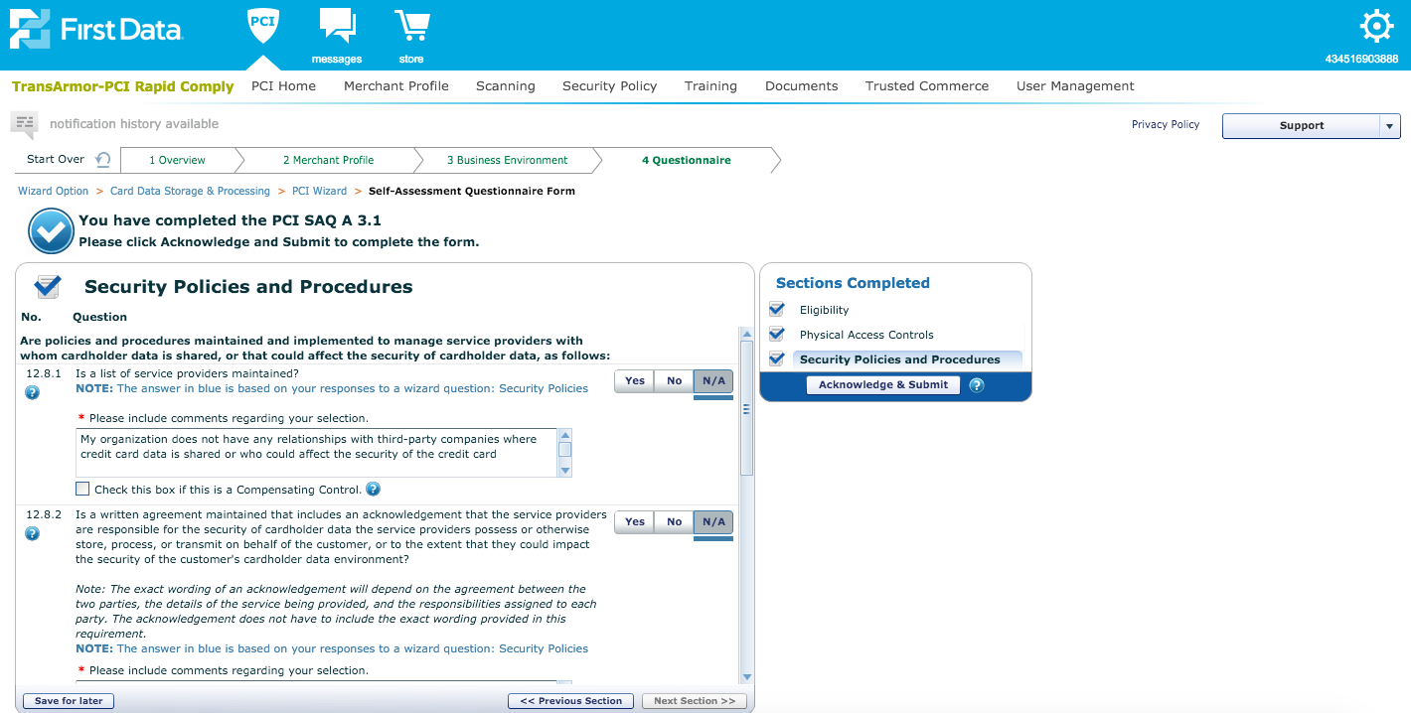
Select “Acknowledge
& Submit”

Slide 32
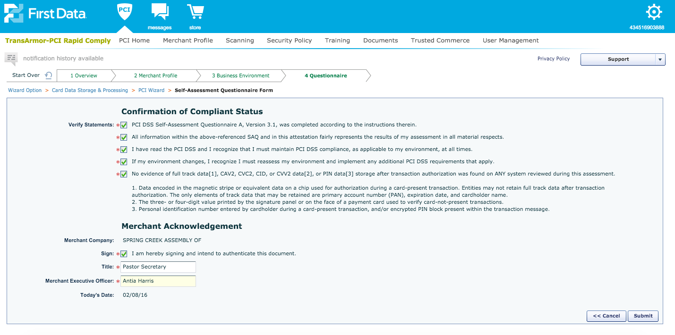
XXXXXXXXXXXXXX
XXXXXXXXXXXXXX
Click ALL checkboxes and fill in Title and Name

Slide 34
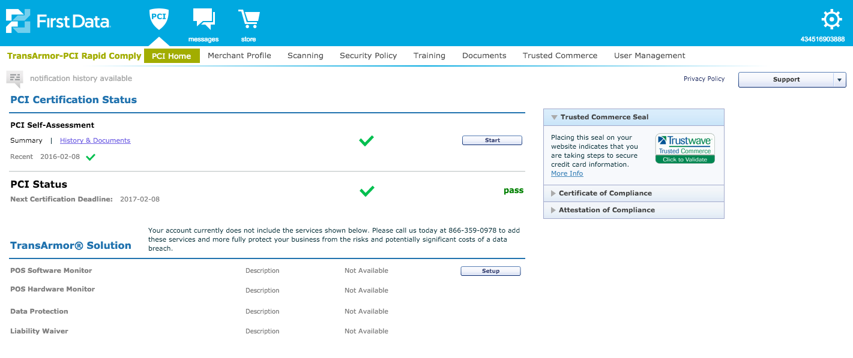
Verify “PASS” Status

Slide 35
If you have any questions about completing your PCI Rapid Comply Questionnaire, please contact Paperless Support: support@paperlesstrans.com

