Slide 1
Performance with Convenience
The ExiCheck Gas Exchange Accessory

Slide 2
Teledyne CETAC Technologies
Headquarters in Omaha, Nebraska
Specialize in Sample Introduction for Analytical Chemistry
Laser R&D Facility in Bozeman, Montana

Slide 3
Teledyne, CETAC and Photon Machines

Slide 4
Excimer Lasers
Pre-Ionization
System
Metal Electrodes
Mirror
Output Coupler
High Voltage Switching System

Slide 5

Passivation
F₂ reacts with inner surfaces
Over time, a layer of fluorine is present on the surfaces
  Adsorption plays a role
When the surfaces are full of fluorine, new fills see only fluorine and not metal or ceramic parts
Surfaces are ‘Passive’ to fluorine reactions

Slide 6
Passivation
Well passivated system is essential to peak operation
  Affects Static and Dynamic Gas Lifetime
If left alone, the passivation layer is lost over time
  Re-passivation requires multiple fills and significant effort

Slide 7
Normal Operation
Energetic F is formed, increasing fluorine reactions
  F is lost from Excimer gas: need to replenish premix for optimum energy
Electrodes burn-off with each shot
  Metal vapor that coats internal surfaces and reacts with F in premix : needs to be flushed from the cavity regularly
As F content decreases, energy required from electrodes increases; therefore electrode burn-off rate increases

Slide 8
Static Gas Lifetime
Time in which a non-running laser has effective gas
  Fluorine adsorbs and reacts to the internal surfaces
Typically 1 – 2 weeks for a well passivated system
  Shorter for less passivation as more ‘fresh’ surface available to the fluorine
After 2 weeks, fluorine starts to depassivate
  Reacted fluorine; therefore, unavailable to laser generation

Slide 9
Dynamic Gas Lifetime
Defined as a number of shots
Energy and Rep-Rate Dependent
  Laser run at 9 mJ has roughly half the lifetime of one run at 5 mJ
Linked to Static Gas Lifetime
  Shorter static lifetime correlates to shorter dynamic lifetime
More energy required at end of dynamic lifetime to produce the laser
  Increased electrode burn-off

Slide 10
Gas Exchanges
Replenish fluorine content in the cavity
  Optimum lasing conditions
Flush electrode burn-off
  Prevents it coating the cavity and mirrors
Important part of regular maintenance
  Must be performed every 2 weeks for a well passivated system, even when the system is not is use

Slide 11
Missing a Gas Exchange
Regular maintenance can be overlooked
  Hectic Schedules
  Field Trips – have to ensure maintenance backup
    Storage mode means repassivation will be required!
    Reliance on personnel not aware of the importance
Dynamic Gas Lifetime is quickly degraded
Repassivation requires a lot of gas exchanges
  Low energy systems need longer periods of higher voltages to run

Slide 12
ExiCheck
The Solution!
An automated gas exchange device integrated into the laser system. No user interaction required!

Slide 13
Operation Modes
Manual Gas Exchange
  As requested
Automated Gas Exchange at Scheduled Interval
  Minimum interval 1 day
    If manual exchange performed, automated will run the next day
  Maximum interval 14 days
Progressive Gas Exchange
  Long runs
  Set through Chromium (Stability Mode = Energy w/PGE)
Will not operate when Chromium is Running – prevents accidental activation during an overnight run.

Slide 14
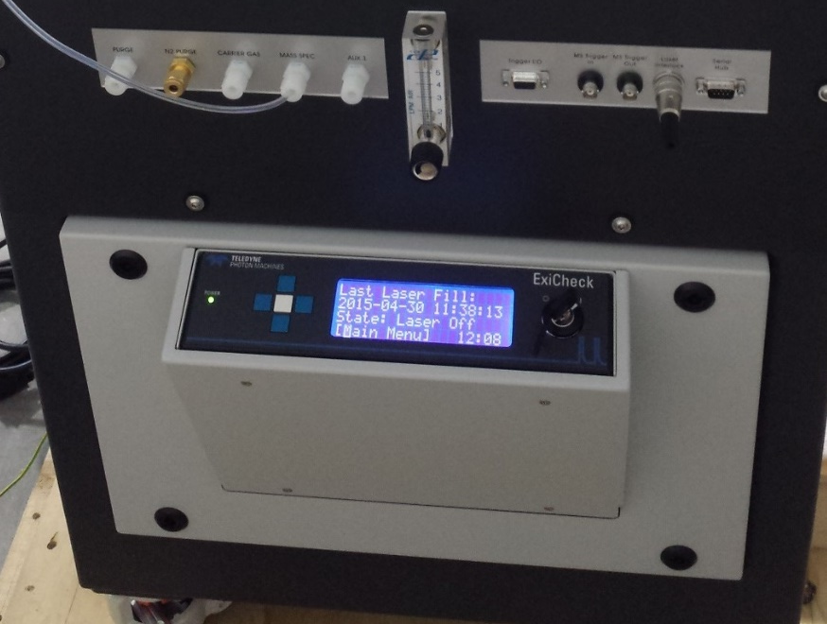
Features and Benefits
UNATTENDED
Performs Gas Exchanges on a scheduled basis or manually
  Maintains Passivation and Peak Performance of laser cavity
  Reduced strain on HV components
  Optimum Performance when you need it

Slide 15
Features and Benefits
Fully integrated into Excimer Chassis
  Clean
  Safe: no human interaction with ArF cylinder
Transparent to ATL Software and Chromium
  No further user training required
Easy Updates

Slide 16
A Customer Comment
“The ExiCheck works well and we are very happy to have such an automated device. It supports us with the daily routine and we can concentrate on all the other challenges we have.”

Slide 17
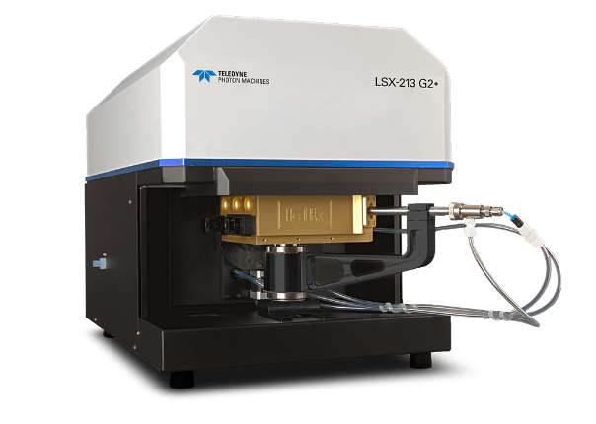
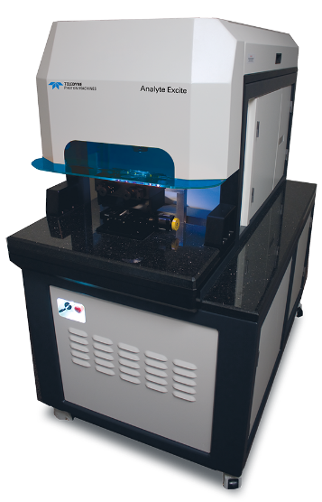
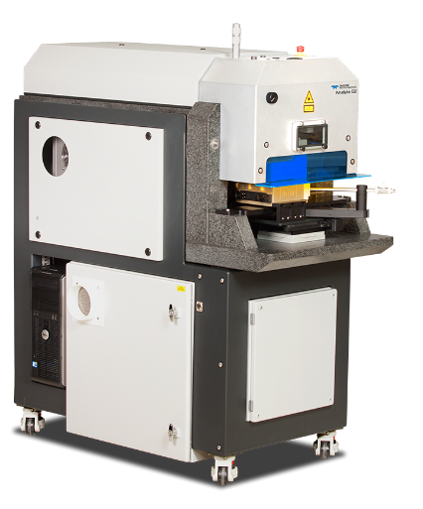
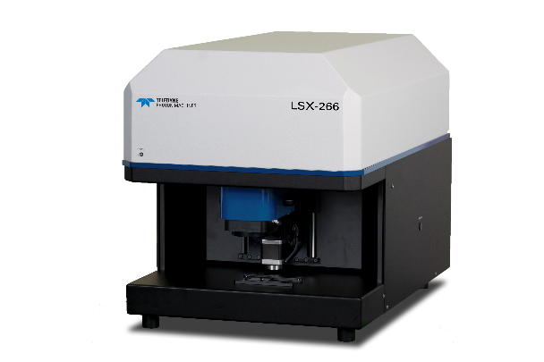
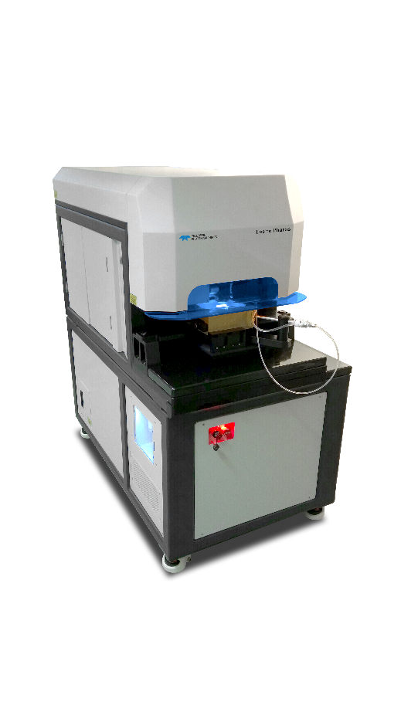
Laser Ablation Range
ArF Excimer Lasers
Nd:YAG Solid State Lasers
Stepped Heating Lasers
Turn-Key Femtosecond Lasers

Slide 18
The ExiCheck Gas Exchange Accessory
Performance with Convenience!
CETACsales@Teledyne.com

