Slide 1
Discovering a New Choice in ICP-MS Low Volume Handling
MVX-7100 µL Workstation

Slide 2
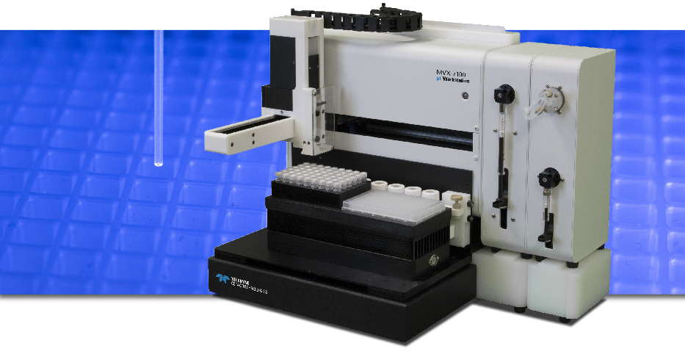
MVX-7100 Overview

Slide 3
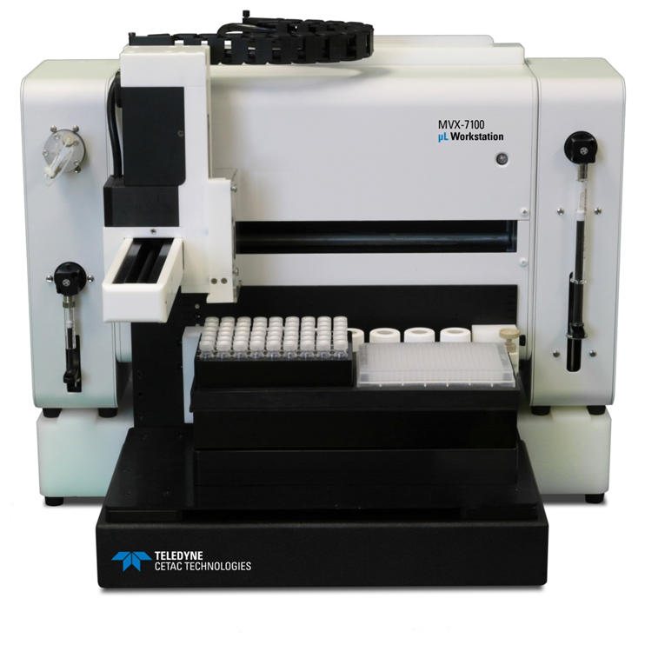
MVX-7100
Overview
  Reduced reagent and sample usage
  Well plate compatibility
  Sample Mixing
  Internal standard addition
  Septum piercing
  Syringe performance
  Sample control

Slide 4
How did we get here?
The Problem → what can I do with a sample of small size with elements already at trace levels?
Dilution? → lose sensitivity
Low flow neb? → matrix match for self aspirate
Automation?→ does not exist in non-metallic form

Slide 5
Not the First to Ask
Review paper by Todoli & Mermet (2006) as well as other papers
There are ‘many fields in which the available sample volume is the limiting factor in elemental analysis’
Sample Type | Amount Available
Cells | 20 μL
Suspended Nanoparticles | 100 μL
Brain | 1 mg
Metalloproteins | 50 μL
Dust | 5 mg

Slide 6
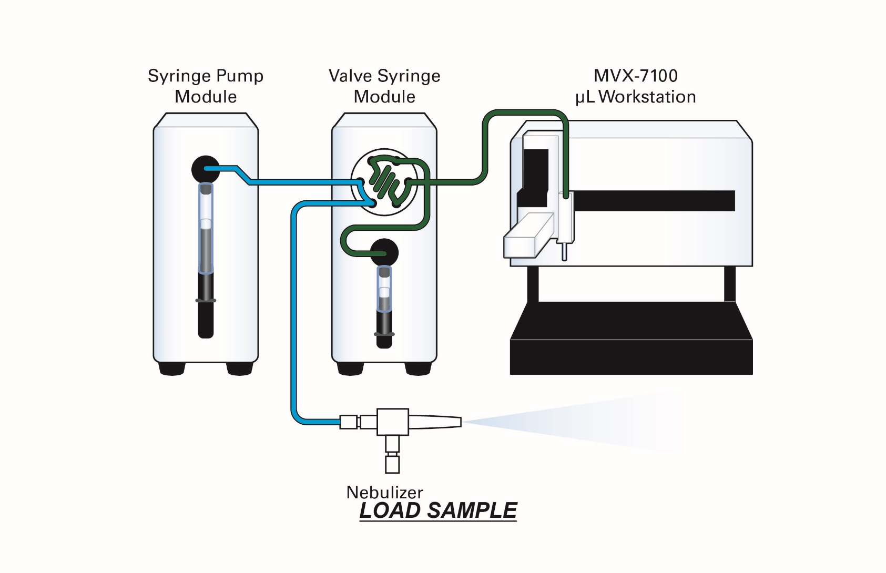
MVX – 7100 Load

Slide 7
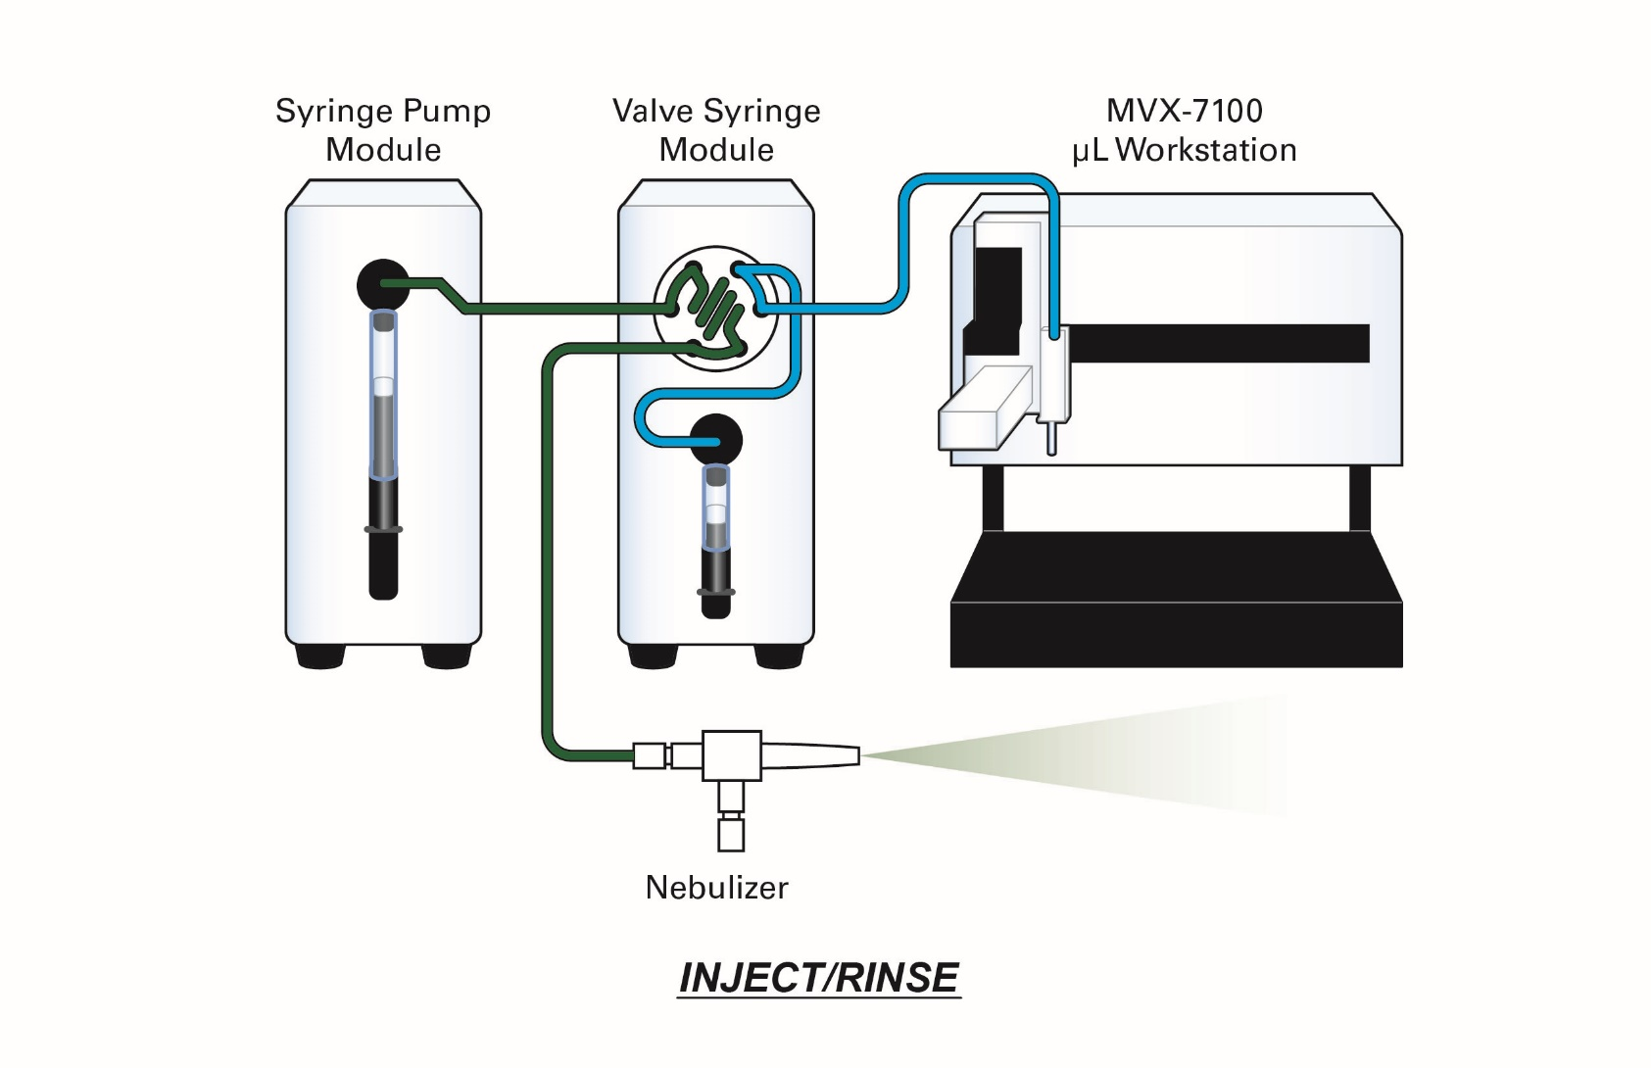
MVX-7100 Inject

Slide 8
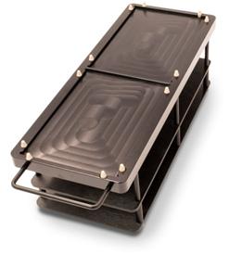
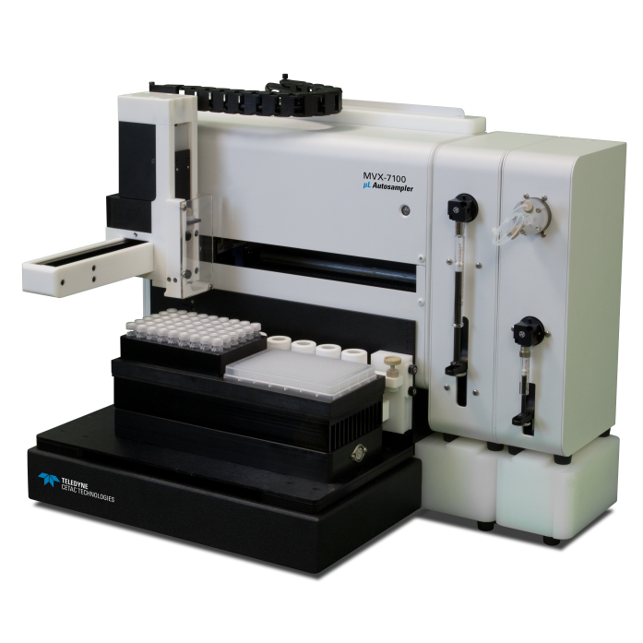
MVX-7100 Automation
MVX-7100 automation
  96 and 384 well compatible
  Septum piercing
  Two trays
  Encoder feedback for precision control
  Stepper motor control for X,Y, and Z axis
  Modular design
  Right or left handed instrument setup
  Dual flowing rinse plus internal syringe rinse control

Slide 9
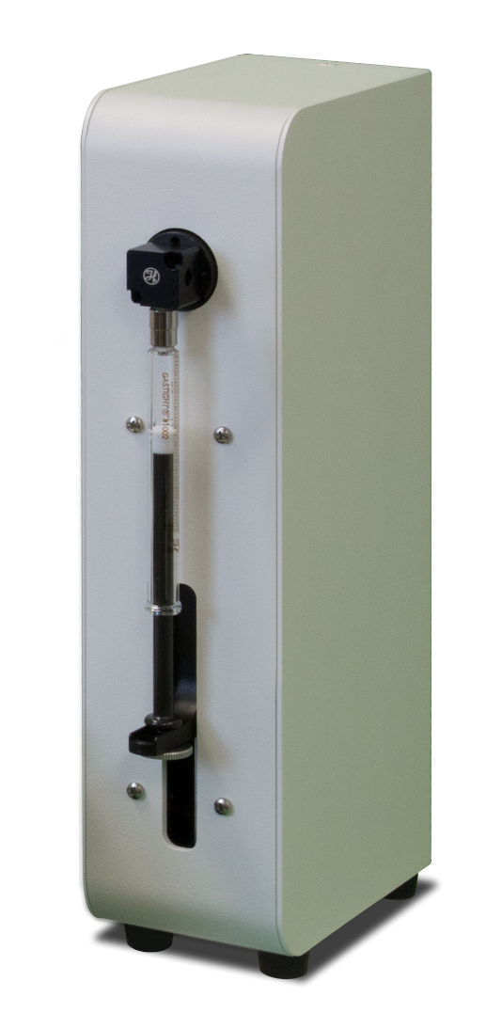
SPM-700+ Module
Precision Syringe Control
Full height syringe
  Peristaltic pump replacement
  Smooth stable baseline even at low flows
  Flow rates <5µL/min - >1mL/min
  Expandable to include multiple syringes
  Includes 2.5 mL barrel

Slide 10
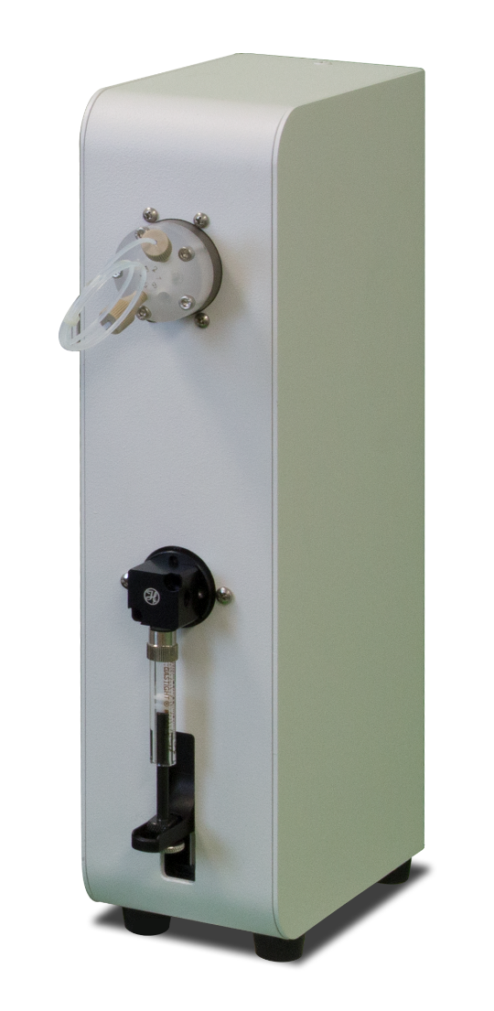
VSM-700 Module
Flow injection
Flow injection valve
  Inert material
    PFA and PEEK
  6 port valve
  Loop between valve and syringe
Half height syringe
  Precise aliquot control
    5µl – 1.0mL
  Sandwich loop loading
  Includes 1.25 mL barrel

Slide 11
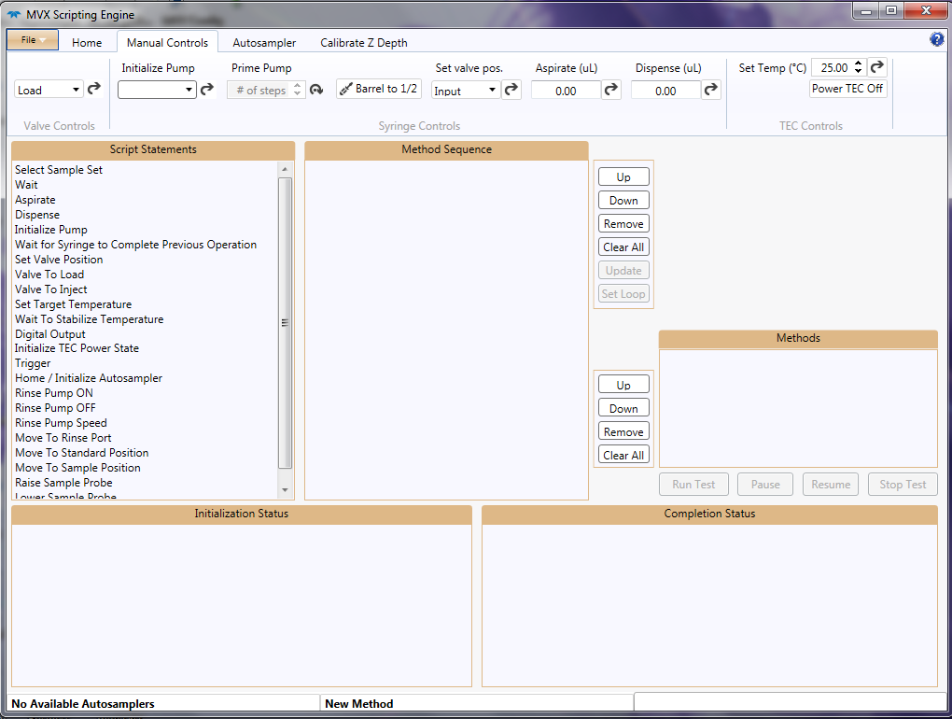
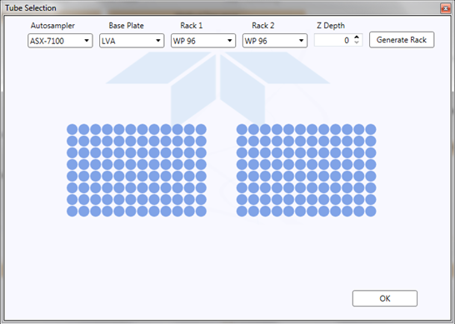
MVX-7100 Software
Flexible Software
  Instrument Triggering
  Full / Partial Loop
  In-vial reagent addition
  Complete control
  Sophisticated Rinse

Slide 12
Improved Efficiency
Sample reduction
Performance
Lab A Before
  Before
    100 µL sample
    4.9 mL of diluent
    80 samples in 8 hours
  After
    20 µL sample
    0.98 mL of diluent
    192 samples in 5.5 hours
5 times less sample volume
5 times less reagent volume
Greater than 2 times capacity in 2.5 hours less time
Reduced autosampler footprint

Slide 13
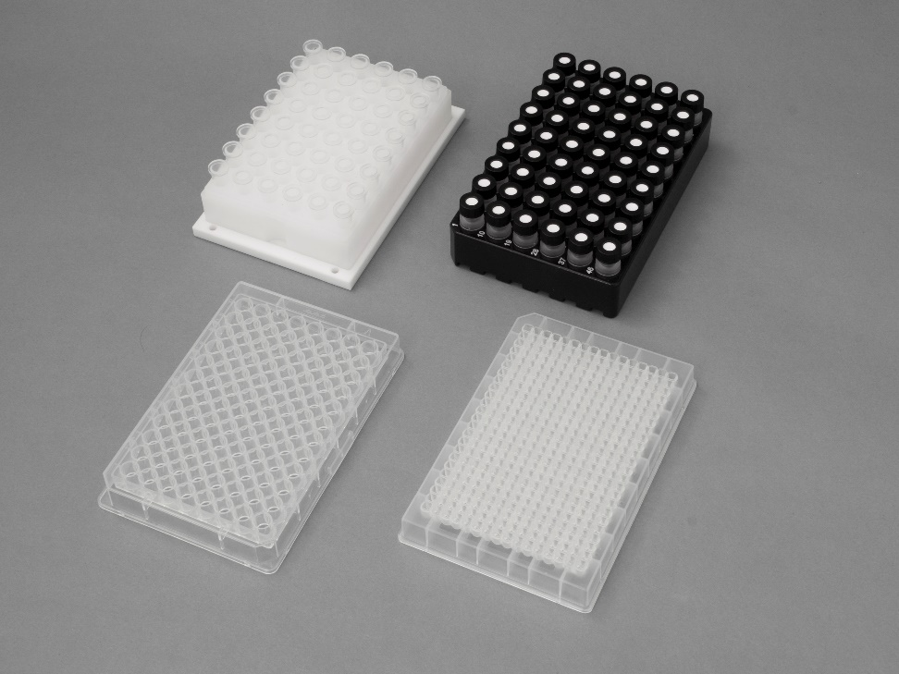
Supported Racks
Vials Racks
  48 positions 1.5 ml vial
    PFA vials
    Adapted from ASX-110/112
  VT-54
    2 mL polypropylene vials
    54 positions per rack
  96 Well Plate
    Up to 1.5 mL per well
  384 Well Plate
    Up to 400 µL per well

Slide 14
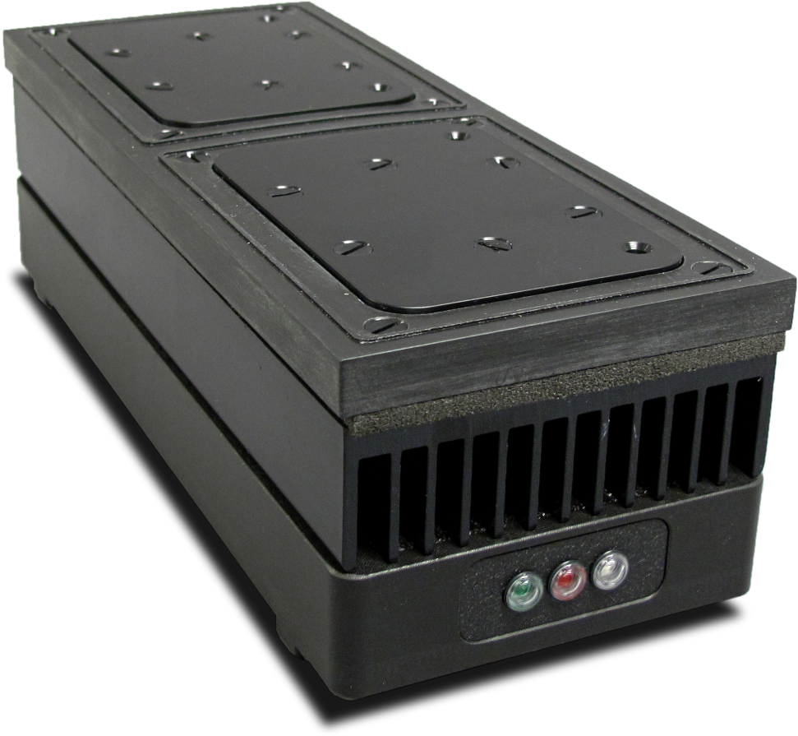
Tempering Module
Rack compatibility
  48 position PFA
  VT-54
  96 well
  384 well
5°C - 40°C
Volatile samples
Metal tagged proteins
Optional accessory

Slide 15
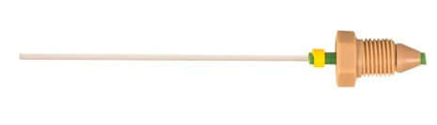
Non Metallic Flow Path
Quartz Needle
PFA tubing
CTFE 6 port valve
PEEK rotor
CTFE Syringe Valve
Borosilicate Glass syringe

Slide 16
Features
Syringe rinse more stable than self aspiration
Maximize data with limited volume
Segmented sample loading
Syringe driven internal standard
Septum piercing for sensitive samples
Temperature control option

Slide 17
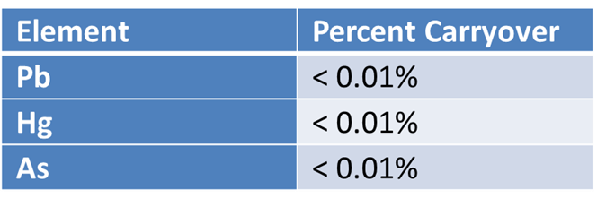
Sample Performance
<1% RSD 100 µL without internal standard correction
Low carryover

Slide 18
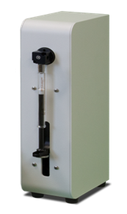
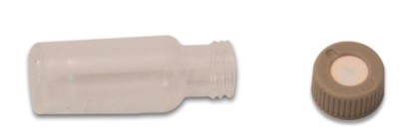
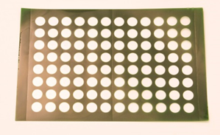
Sample Performance
Internal Standard
  Tee in with second full height syringe
  Diluent
  ICP-MS peristaltic pump
Septum Piercing
  Silicon with PTFE lining
  Teflon Film
  2 mL vials, 96 and 384 well plate

Slide 19
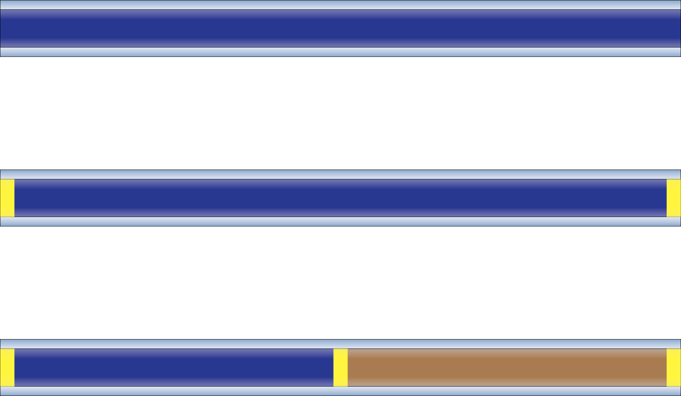
Sample Handling
Full Loop, Sample and Air, Sample and Reagent

Slide 20
Sample Handling
Full Loop injections
  Overfill loop
  Improved speed
  Some sample waste
Sample with air
  Improved washout
  No sample waste
Sample with reagent
  In loop chemistry
  Clean out lines

Slide 21
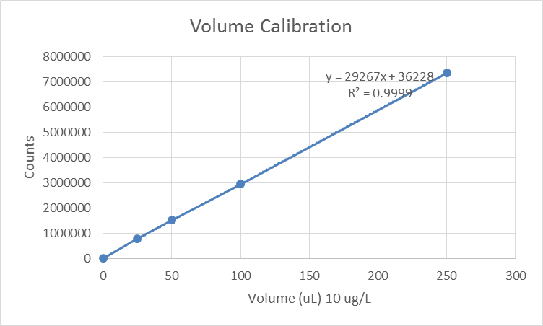
Aliquot Control
Variable volume from one 10 µg/L solution
Cobalt shown
  1 µg/L reads 1.04
  5 µg/L reads 5.06
  10 µg/L reads 9.95
Area vs height
Rinse for makeup volume

Slide 22
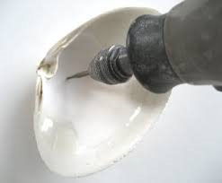
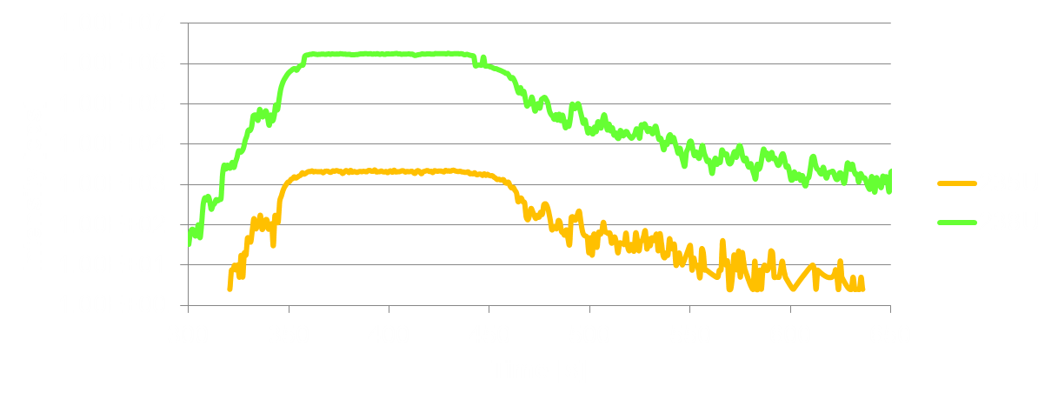
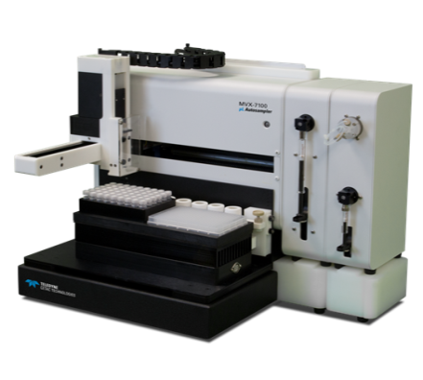
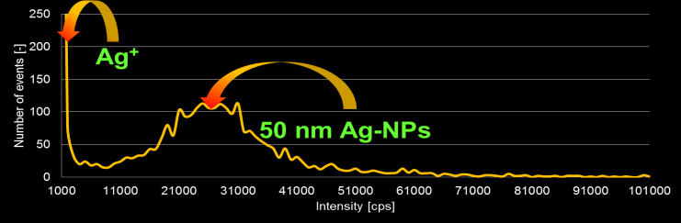
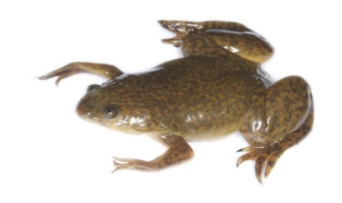
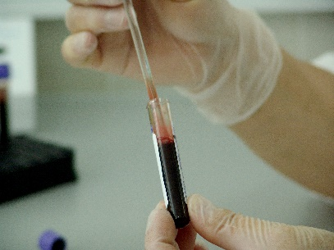
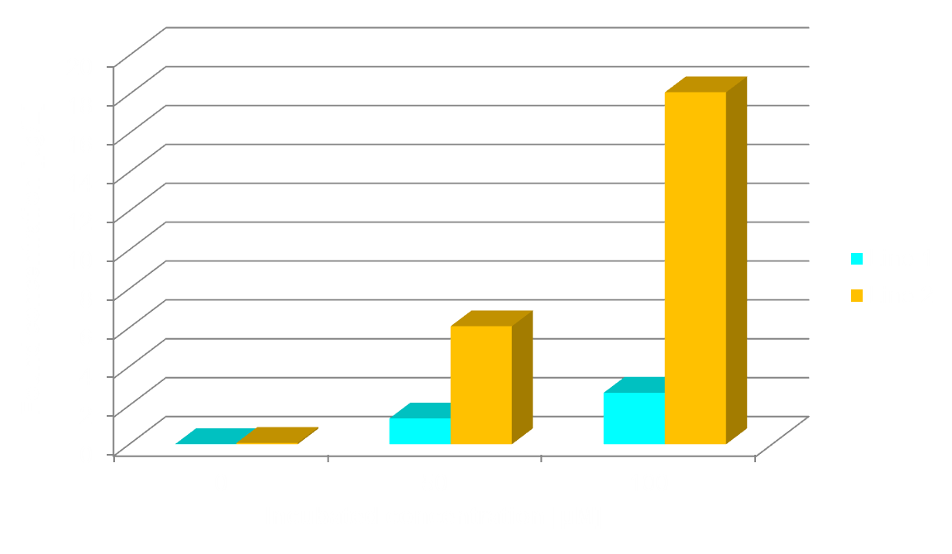
Applications
Micro drilling
Isotope Ratios (20 μL injection)
Ag Nanoparticles in Cell Culture Media
Zn in Protein Isolates
Whole Blood
CISPLATIN in Cell Lysates

Slide 23
Applications
Isotopic Ratios
  Steady state signal
  Syringe rinse works across varied matrices
  20 µL sample
Zinc in protein isolates
  Xenopus Laevis, South African Clawed Frog,
  50 µL sample before digest

Slide 24
Applications
Cisplatin
  Used for cancer treatment
  Improved washout with flow injection valve
  <100 µL sample
Nanoparticles in Cell Culture Media
  Ag at different dilutions
  Steady state signal
  Size distribution

Slide 25
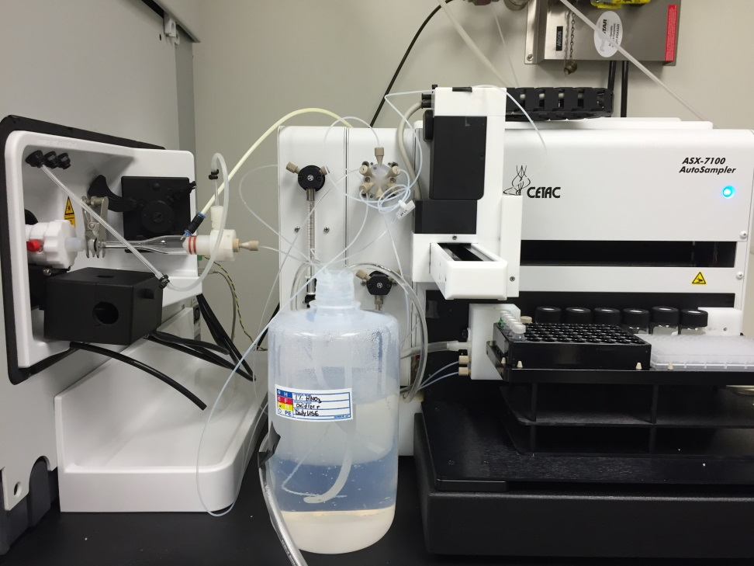
Optimization of Micro Samples for ICP-MS
Combining discrete aliquot sampling with total consumption Nebulizer
Neb. Flow rate : 8 μL/min

Slide 26
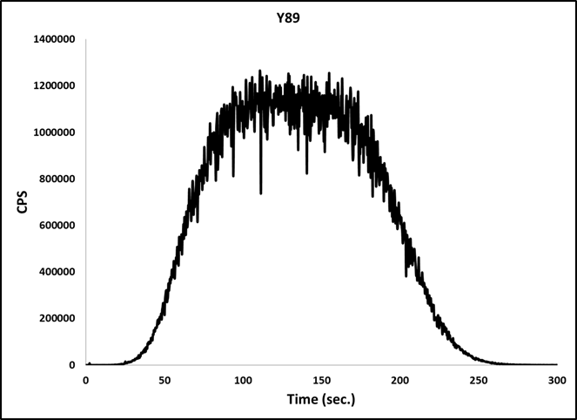
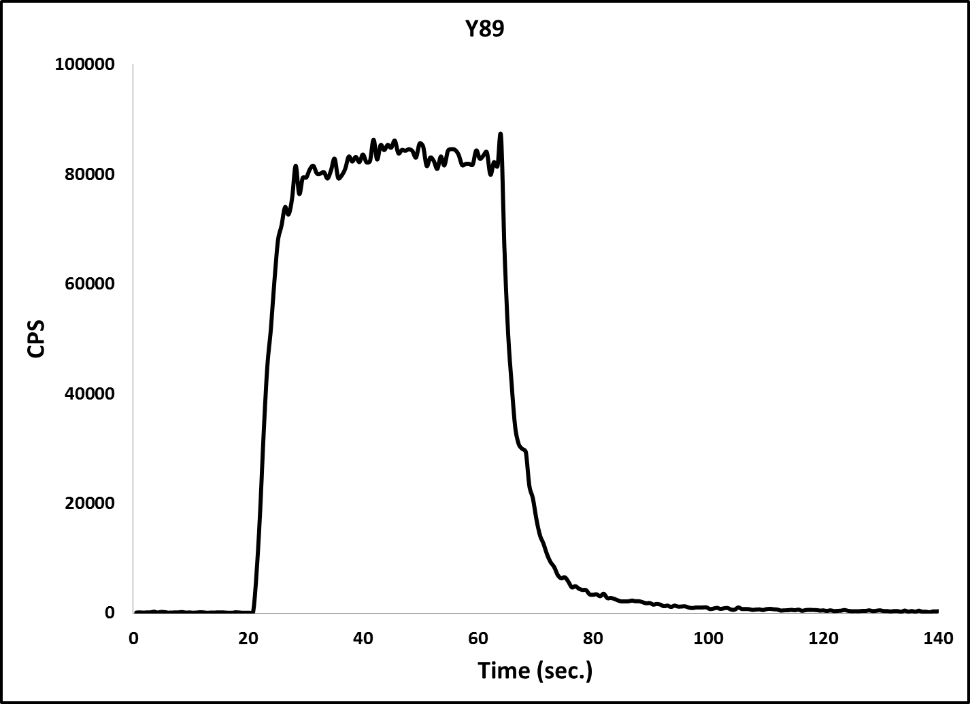
Optimization of Micro Samples for ICP-MS
20 μL Injection, DS-5 Total Consumption Nebulizer
100 μL Injection, standard nebulizer & Spray Chamber

Slide 27
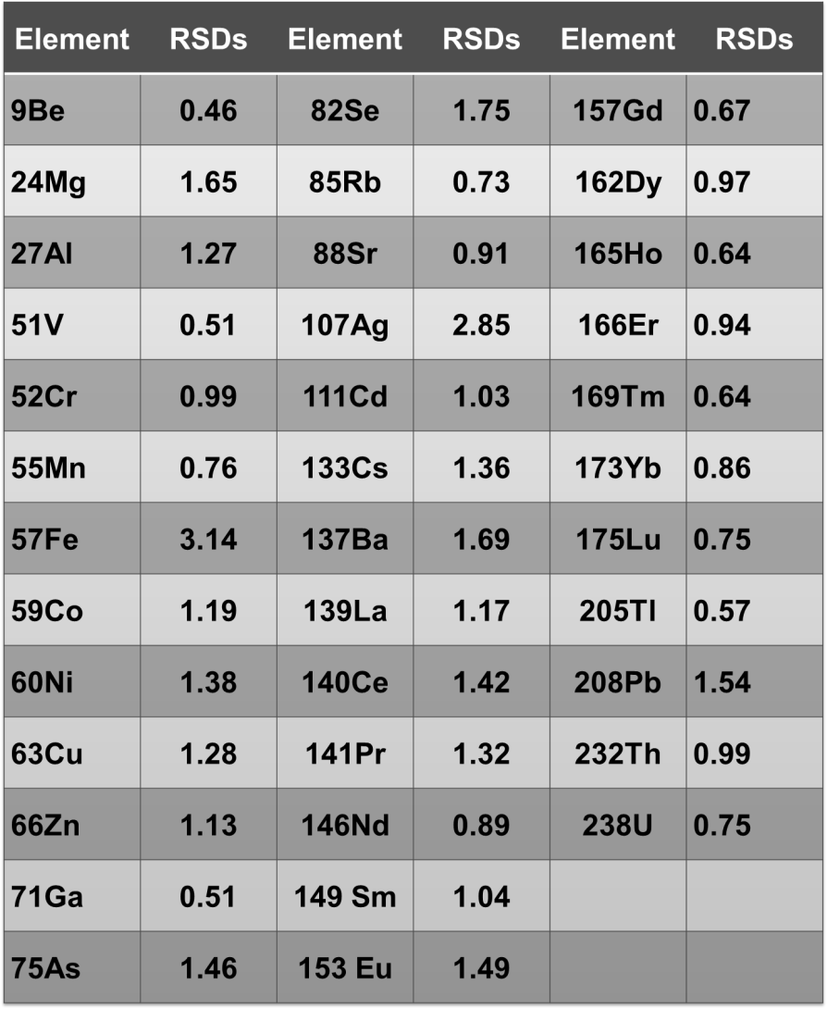
Optimization of Micro Samples for ICP-MS
Repeatability of seven replicates with MVX-7100 and DS-5 total consumption nebulizer

Slide 28
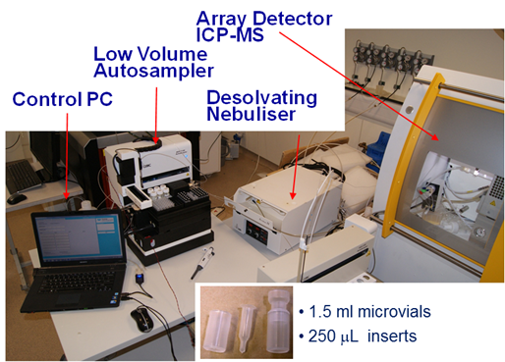
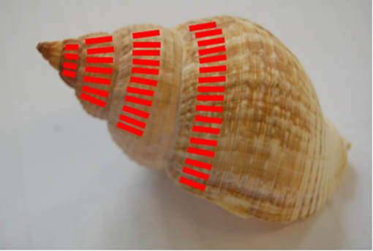
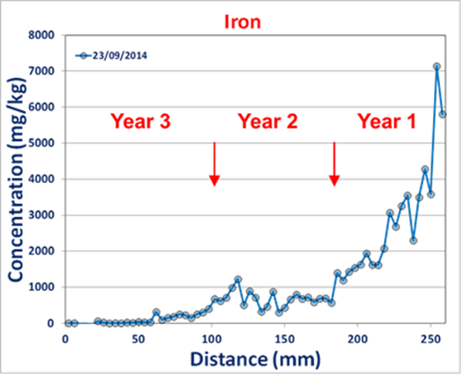
Geochemistry
Limited Sample (100µg)
No sample volume wasted
Fe, Mn, U
Used with Aridus II

Slide 29
Blood Applications
Lead, Mercury, and Arsenic in Blood
  Increased throughput
  Reduced sample and reagent
  Standard flow rate ~ 400 µL/min
Titanium
  Used in implants and prosthetics

Slide 30


Applications
Clinical
  Blood, Urine, biological samples
  Limited volumes
Geological
  Shellfish, Microdrilling
  Precious samples

Slide 31
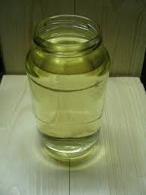
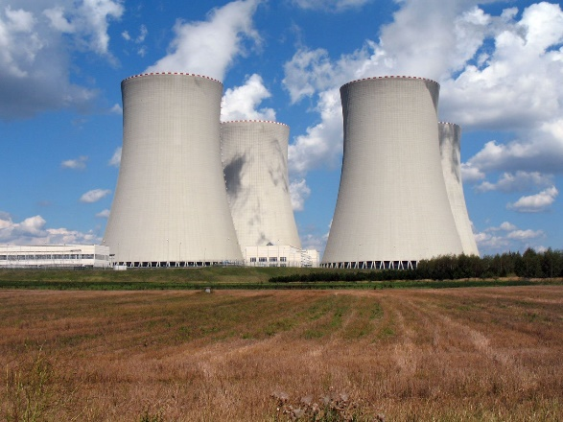
Applications
Academic Research
  Analytical, Environmental, Geology, Medical, Toxicology
Industry
  Fuels, Nuclear, Semiconductor
Anybody with limited sample volumes

Slide 32
Resources
MVX-7100 Brochure
  http://www.cetac.com/Product/mvx-7100.htm
Application Notes
  http://www.cetac.com/resource_center/page/application-notes.htm#mvx
Sales Questions
  http://www.cetac.com/contact/page/sales-contacts.htm
Brian Cook Product Manager
  Brian.cook@Teledyne.com

Slide 33
MVX-7100
Questions???

