Slide 1
LegalShield Business Solutions Sales opportunity Briefing
USA – Benefit brokers
Notes:
Thank you for your interest in learning more about selling LegalShield Business Solutions voluntary benefits and business services.

Slide 2
agenda
WHO we are
WHAT we sell and WHO buys it
WHY you should consider selling LegalShield
WHAT the LegalShield opportunity can mean for you
Notes:
During this presentation, we will cover the following points:
WHO is LegalShield
WHAT do we sell and WHO buys it
WHY you should consider selling LegalShield
And lastly WHAT the LegalShield opportunity can mean for you.

Slide 3
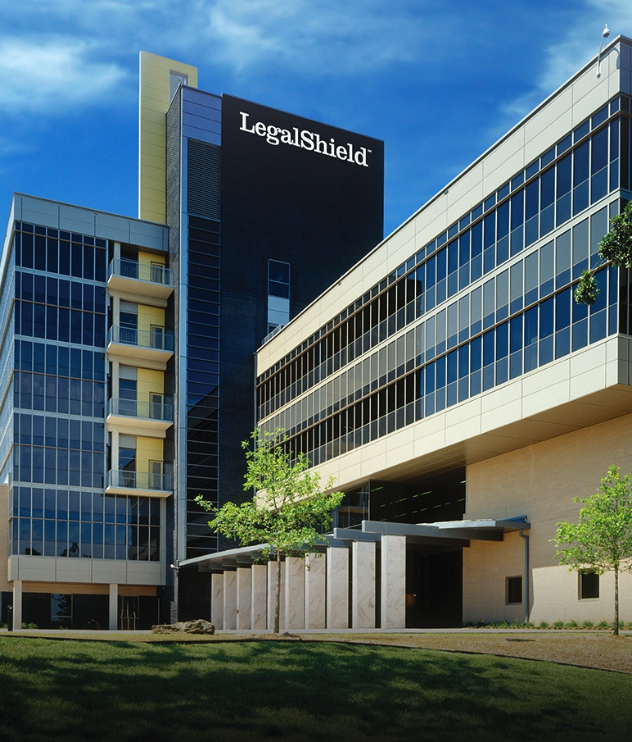
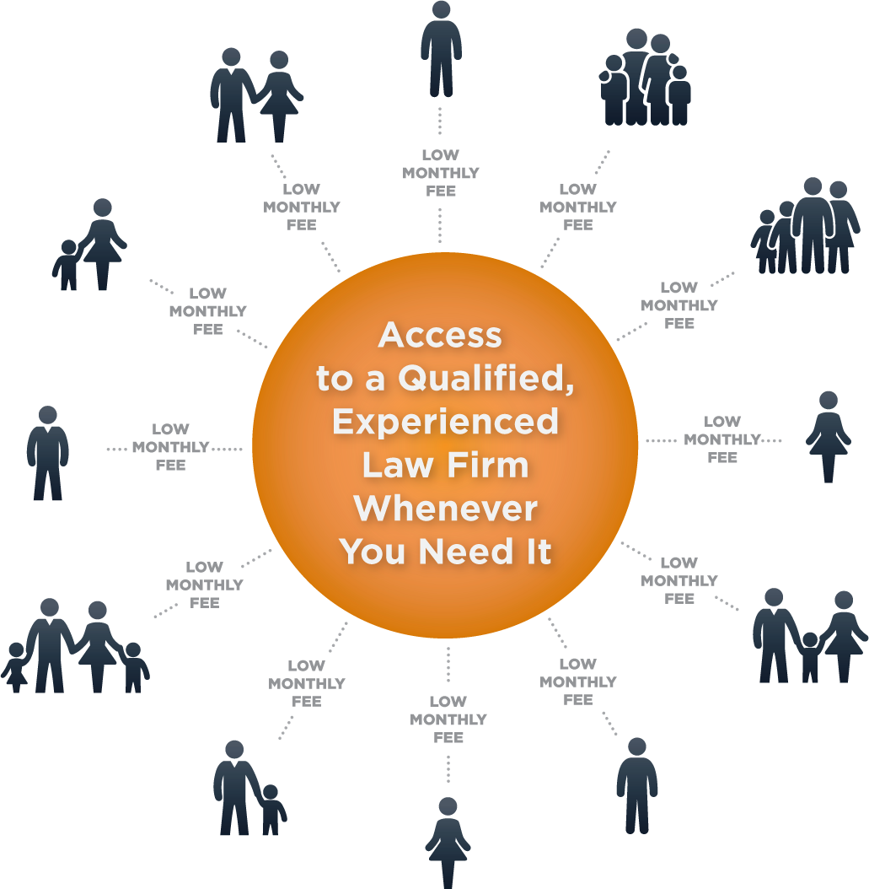
40+ YEARS IN BUSINESS
OVER 3.7 MILLION LIVES
Notes:
So, who is LegalShield?
X Established in 1972, LegalShield pioneered the concept of making legal services available and affordable to individuals, families and small businesses by using the
x “shared economy” approach. Lots of members pay a low monthly fee, which allows every member access to a qualified, experienced lawyer whenever they need one—even for just a quick question or consultation. No more worrying about high hourly rates.
X Our Legal Plans cover more than 3.7 million lives

Slide 4
1.7 MILLION LIVES
Notes:
For the past 16 years, we have provided peace of mind and comprehensive restoration to individuals and families through our identity theft protection service, IDShield.
xIDShield covers more than 1.7 million lives.

Slide 5
Specialized focus on B2B accounts
70,000 Business Accounts
Voluntary Benefit
Small Business
Independent Sales Associates
Insurance Agencies
Benefit Brokers
Notes:
LegalShield Business Solutions serve more than 70,000 businesses. All sizes of businesses offer LegalShield and IDShield to their employees as a
xvoluntary benefit.
xSmall Businesses with 100 employees or less also benefit from a Legal Plan designed just for them.
We sell our services as a voluntary benefit through
X independent sales associates,
X insurance agencies and
X benefit brokers.

Slide 6
Notes:
Another important aspect of the LegalShield business model is our direct sales organization.
Our direct sales force focuses on recruiting new sellers, as well as selling plans on a one-to-one basis to members who are not part of an employee group.

Slide 7
Specialized focus on B2B accounts
Notes:
Today, we are going to focus on opportunities within our business-to-business organization, LegalShield Business Solutions, and specifically to you as a Benefit Broker.

Slide 8
Benefit brokers
Notes:
LegalShield sells through hundreds of benefit brokers across the US and Canada including Lockton Companies, Inc., HUB International, Mercer and Arthur J Gallagher & Co to name a few.
Our brokers use LegalShield and IDShield to expand their product offerings, helping them stay front and center with customers.
We recognize how important your clients are. Let us help you be their trusted advisor by providing them products that protect not only their employees but also their bottom line.
Now Let’s learn a little more about the services

Slide 9
Legal plans
Traffic-related issues
Estate planning
Contract Review
Legal advice on unlimited number of personal issues
Group plans start at $15.95/month
Exclusions and limitations apply. Services and benefits vary by state/province. See www.legalshield.com/fullplandetails and select your state/province for specifics.
Please review plan details for complete terms, conditions and exclusions before purchase.
9
Notes:
There are many reasons individuals and families should use a lawyer in their day to day lives.
Some of the most common uses of the LegalShield plan include consultation on:
X traffic related issues,
X estate planning-- including your will, living will and health care power of attorney--, and
X contract review. Additionally, members can call their provider firm for
X legal advice on an unlimited number of personal issues!
With LegalShield, members receive timely advice at a fraction of the cost of a lawyer’s hourly rate for covered services.
X LegalShield group legal plans start at $15.95 per month.

Slide 10
idshield
Comprehensive identity monitoring
Credit monitoring and alerts
Identity theft prevention consultation
Licensed Private Investigators
Identity restoration to pre-theft status
Group plans start at $8.45/month
Exclusions and limitations apply. Services and benefits vary in US/Canada. See www.idshield.com/plans-and-pricing for specifics. Please review plan details for complete terms, conditions and exclusions before purchase.
10
Notes:
IDShield gives members comprehensive monitoring of many aspects of their identity, including: Social Security number, driver’s license, passport,
credit cards, bank accounts and more. Similar to our legal plan, this benefit also provides
unlimited consultation for identity theft prevention.In the event the member’s identity is compromised, a
licensed private investigator will work to uncover evidence, restore the member’s identity, and
clear the record back to its pre-theft status.
IDShield Group Plans start at $8.45 a month

Slide 11
Small business plans
Consultation on day-to-day matters
Debt collection and vendor disputes
Contract Review
Worker’s compensation issues
Employee hiring and firing
Starts at $39/month
Exclusions and limitations apply. Services and benefits vary by state/province. See www.legalshield.com/business/plans-and-pricing and select your state/province for specifics.
Please review plan details for complete terms, conditions and exclusions before purchase.
11
Notes:
Companies with 100 or fewer employees run their businesses more efficiently with our Small Business Legal plan.
As part of the membership, business owners with up to 5 authorized users can access timely legal advice on everyday matters. Small Businesses appreciate that they can pick up the phone, call their provider firm, and ask questions without worrying about an outrageous bill at the end.
Debt collection letters, vendor disputes,
contract review and
consultation on human resource matters such as worker’s compensation issues, and
employee hiring and firing are just part of what’s covered. This gives small businesses legal tools they need to manage their finances and employees with confidence.
LegalShield offers a suite of small business plans ranging from $39 to $149 per month

Slide 12
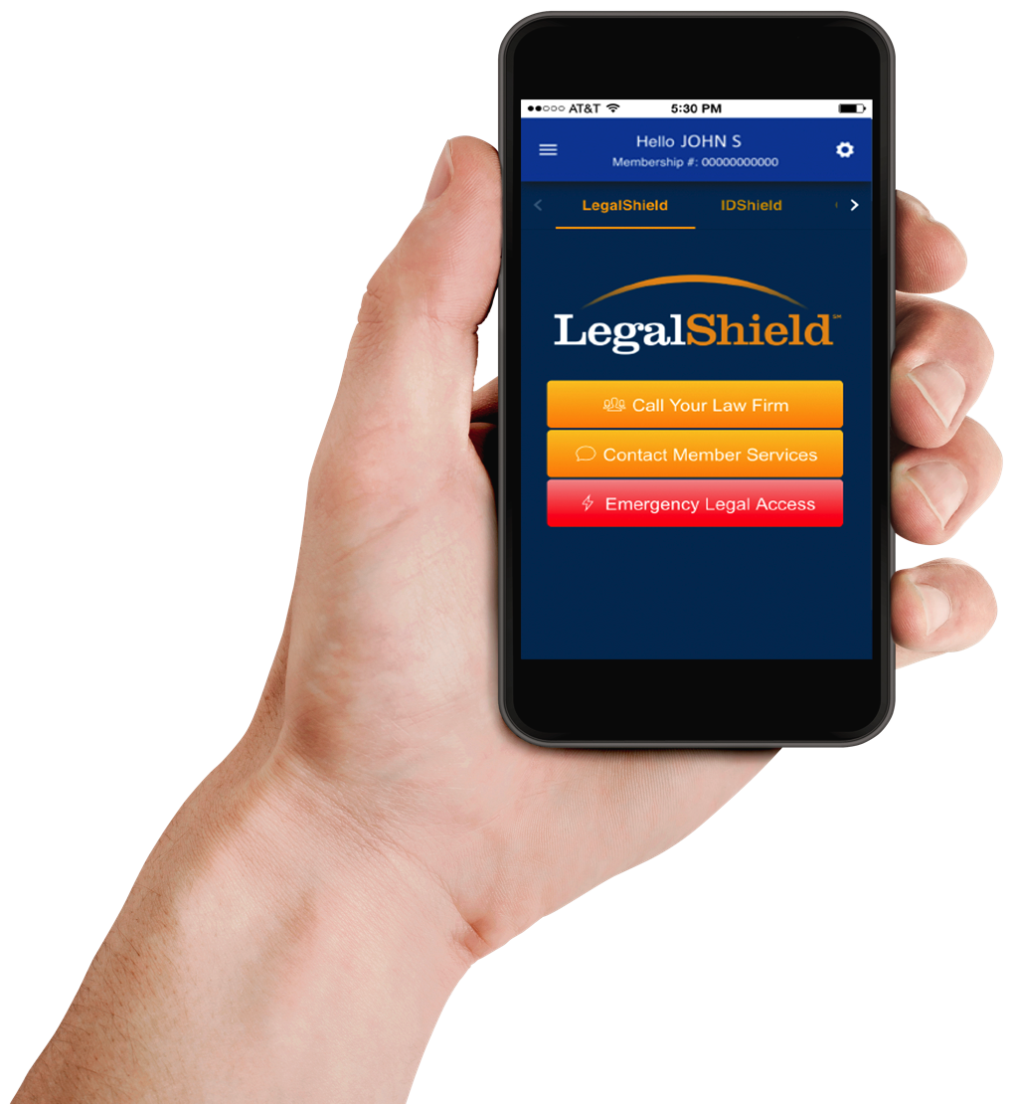
Definitively different
Nationwide system of dedicated law firms
Quality Assurance
Service level monitoring of law firm performance
Notes:
What makes us different? LegalShield is unlike any other legal service plan provider. We are not a referral service nor a directory of lawyers. We take the guess work out of finding the right attorney to fit our members’ legal needs.
Our members have access to an unmatched network of dedicated law firms in 49 states and four Canadian provinces, and through our collective purchasing power, we are these law firms’ biggest client.
Our dedicated network of seasoned lawyers, with an average of 21 years experience, is carefully vetted and monitored to ensure
quality, outstanding service is provided to our members. Our plans provide a wide spectrum of legal services to help our members traverse their legal needs, from the trivial to the traumatic.

Slide 13
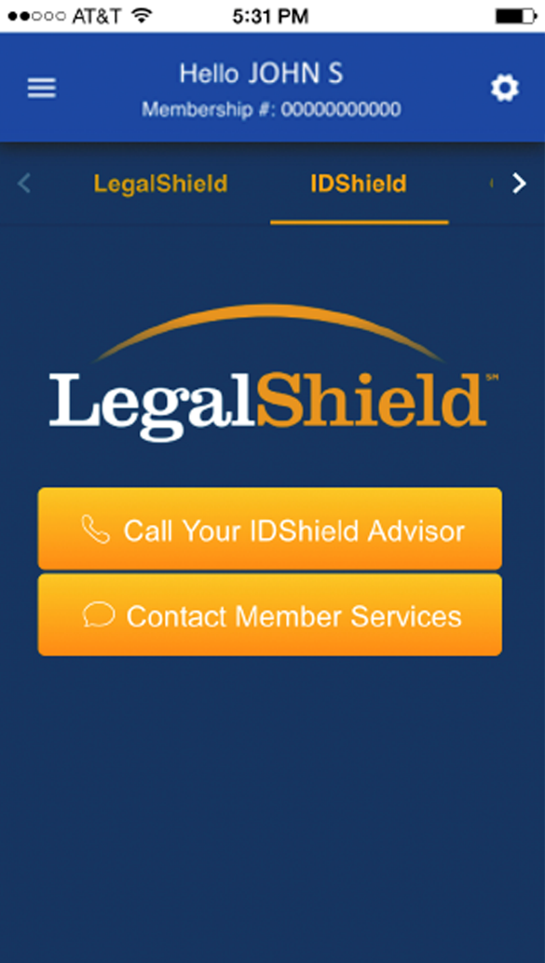
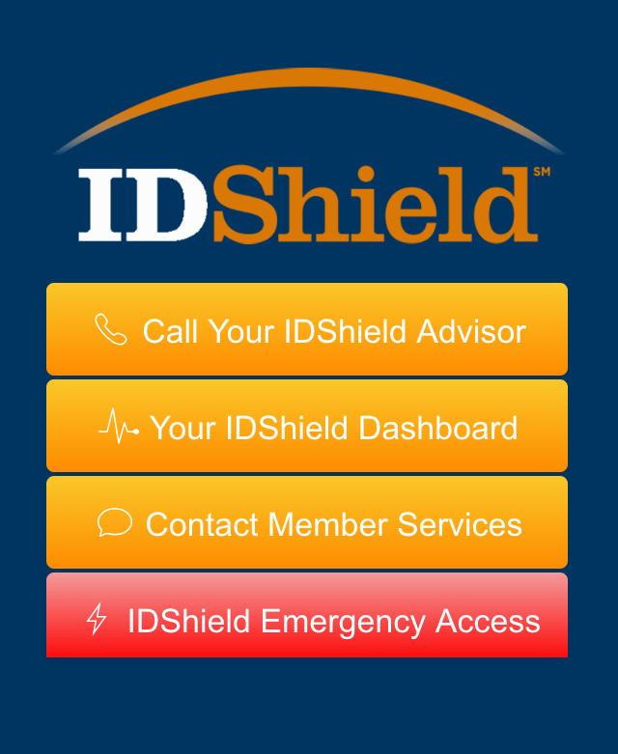
Definitively different
Highest identity theft service guarantee available
Identity theft services conducted by licensed private investigators
24/7 emergency hotline for covered legal and ID theft issues
Easy access via mobile app
Notes:
Our identity theft protection has a $5 million service guarantee—the highest guarantee available in the industry.
In addition, our identity theft services and consultations are conducted by licensed private investigators.
Our legal and identity theft services provide 24/7 emergency hotlines for covered issues.
And, you can Use the apps for easy access to your Provider Law Firm and Licensed private investigator!

Slide 14
The need
Nearly 90% of Americans say they do not have any form of legal insurance or legal protection service
More than 60% reported they would be interested in purchasing legal protection
Identity theft has topped the FTC ranking of complaints for 15 years
Legal Source: The Legal Needs of American Families. A Research Study Conducted by Decision Analyst, Inc. Commissioned by LegalShield
ID Theft source: CNN Money. “Identity Fraud Hits New Victim Every Two Seconds.” Ellis, Blake. 2014. (http://money.cnn.com/2014/02/06/pf/identity-fraud/)
14
Notes:
You may wonder, is there a market for these services?.
Studies show that Nearly 90% of Americans say they do not have any form of legal insurance or legal protection service. However, more than
60% reported they would be interested in purchasing legal protection.
In addition, identity theft has topped the Federal Trade Commission ranking of complaints for 15 years.
That means… a lot of opportunity!

Slide 15
Legalshield broker contract requirements
Producers must hold an active insurance license
Cover a minimum of 500 lives*
Selling Agent must be licensed to sell LegalShield in the state where the benefit or plan is sold if required
*For Brokers with less than 500 lives, please see the Commission Sales compensation plan
Notes:
If you are interested in selling LegalShield through a broker contract, please note the following requirements:
Your organization must have producers who hold active insurance licenses and your
brokerage or agency must cover at least 500 lives.
Different states may require additional licensing to sell LegalShield.
If this is the case in your area, you will be responsible for ensuring the selling agent has the appropriate license.

Slide 16
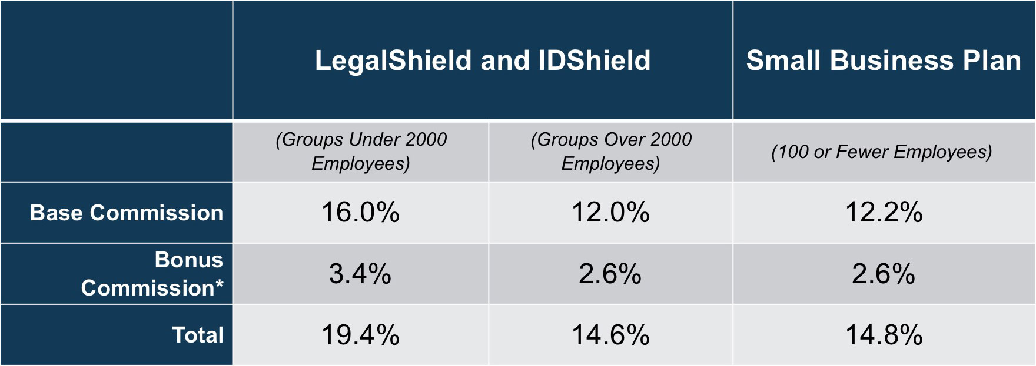
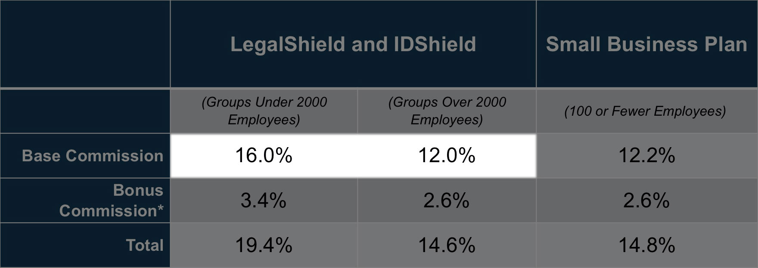
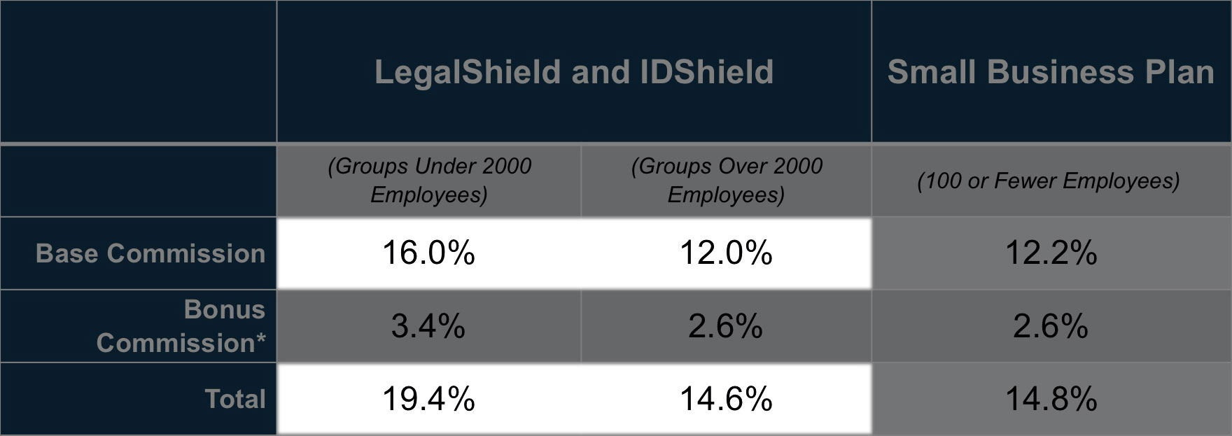
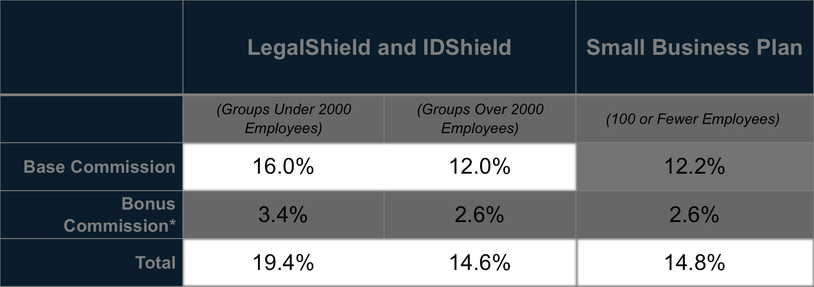
Level compensation plan 16%
First year and renewal commissions represented. First year commissions are paid as a percentage of the membership fee, ranging from 12% to 16%. This program provides an additional 2.6% to 3.4% bonus commission for reaching 1,000 active members and maintaining at least 750 active members at all times. In the level compensation plan, renewals are paid at the same rate as in the first year.
*Reach 1000 active members and maintain a minimum of 750 active members.
Notes:
You’re probably wondering what sort of commission and bonus options are available to brokers. There are two commission plans available to you.
The first commission option is the Level compensation plan. Based on the number of lives within the group the broker earns a flat 16% or 12% commission for the first year and for renewals.
By reaching 1000 members and maintaining 750 active members, Brokers earn up to 19.4% or 14.6% for the life of the membership.
Brokers may also sell the Small Business legal plan to Businesses with 100 or fewer employees and can earn up to 14.8% commissions.

Slide 17
Level compensation plan case study
A large manufacturing firm in Texas with 8,400 Employees
Nearly 18% enrolled in IDShield
Generating premiums of $200,000
And commissions of $29,200 per year
Actual case history. Not all Brokers will experience this enrollment rate or commission amount.
Notes:
We’ve seen a number of brokers choose our company and open cases. As an example,
last year we opened a group with 8,400 eligible employees through their broker,
enrolling nearly 18% of the employee base, and yielding over
$200,000 in premiums and
$29,000 in 1st year commissions alone.

Slide 18
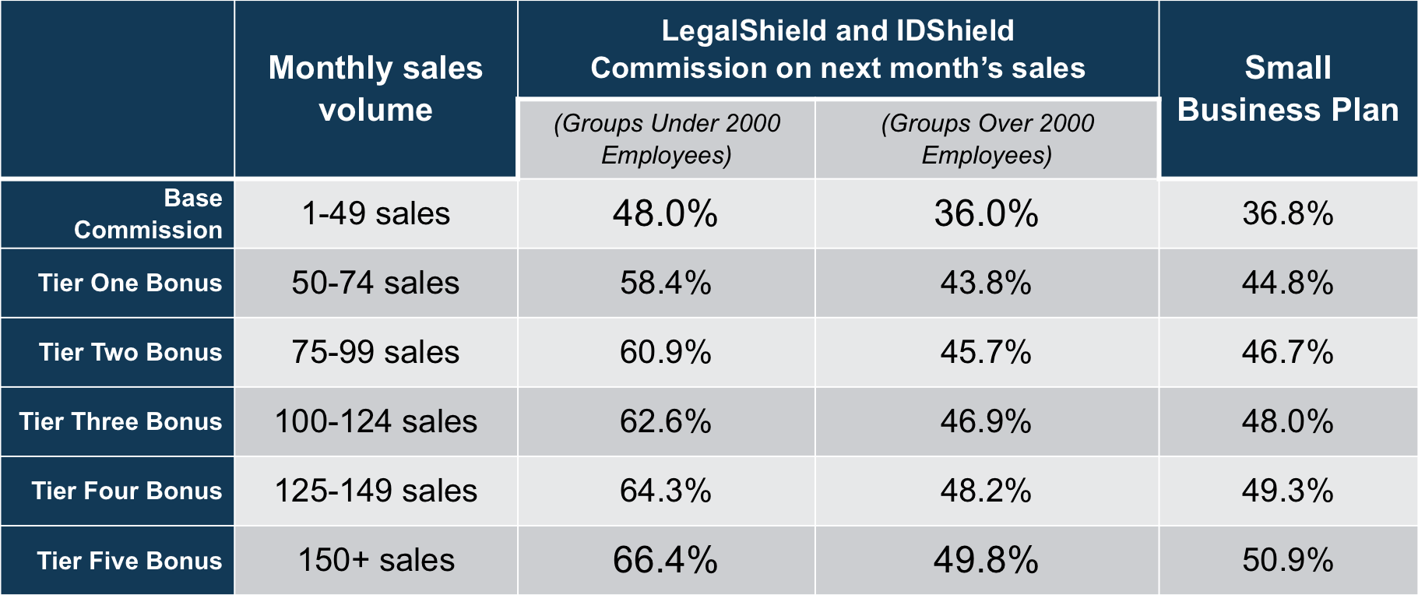
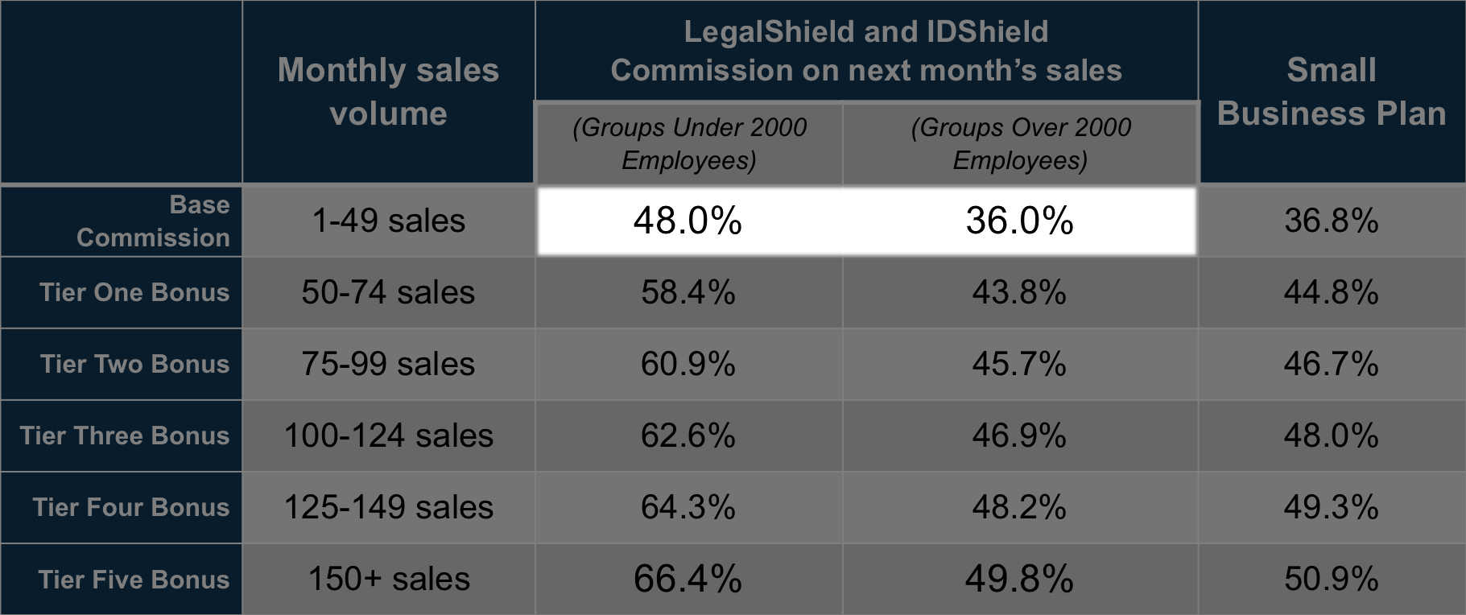
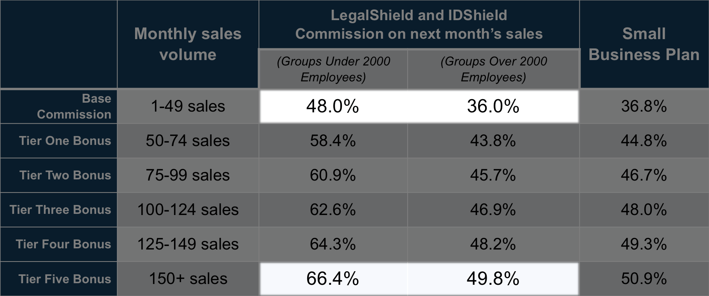
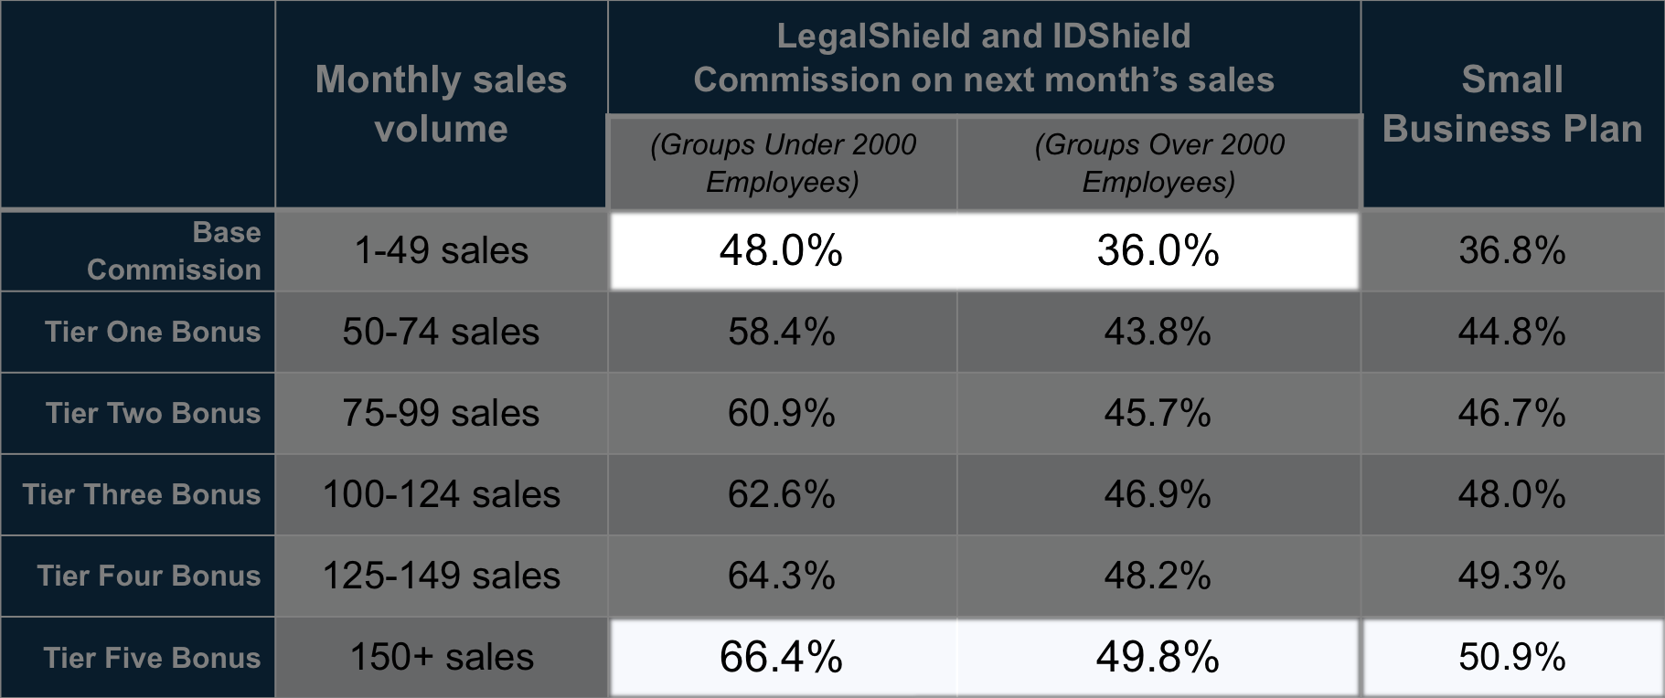
Advanced compensation plan 48%
LegalShield gives brokers and agents the option to earn advanced commissions the first year of the agreement. This program provides higher first-year commissions to offset introductory costs and provide incentives for producers. LegalShield also provides the opportunity for the broker or agent to appoint other brokers/agents and earn production bonuses.
Renewal commissions are variable based on overall member retention rates.
Notes:
The second option is the advanced compensation plan. Based on the number of lives in the group, commissions start at 48% or 36% for the first year, with volume bonuses that can raise the first year commission up to 66.4% or 49.8%. Small Business plans earn from 36.8% to 50.9%.

Slide 19
Residual Income—advanced commission plan
Rates range from 2.3% to 21.26%
Earned after first 12 months of membership
Varies based on Commission Level at time of sale and Monthly Retention Rate of all memberships sold in that calendar month
Month after month, year after year, for the life of the membership
Residual income offsets any debit balance
Refer to Commission plan for detailed description
Notes:
Residual income on the Advanced Commission option range from 2.3% to 21.26% and begins after the 12th month of membership
This variable component is based on member retention rates and the commission level at the time of the sale
Residuals continue as long as the membership is active
Residual income will first offset any debit balance accumulated from the advanced commission plan.

Slide 20
broker support
Quick access to revenue and commission reporting
Marketing support
Enrollment support
On-site enrollers available
Electronic, paper, web enrollment
Ongoing enrollment support
Informational web sites for clients
Electronic, paper and self-bill options
Producer product training
20
20
Notes:
To support our broker partners, LegalShield has created an extensive support organization.
Our on-line portal gives you quick access to revenue and commission reporting, as well as marketing materials and other marketing support.
For voluntary benefit selling, we have
on-site enrollers available,
electronic, paper and web enrollment options, as well as
ongoing enrollment support., including
informational web sites for clients, and
electronic, paper and self-bill options
In addition, we offer producer product training.

Slide 21
Why offer legalshield?
Industry-leading products
Established company
High customer satisfaction ratings
Comprehensive onboarding for new agents
Generous compensation plans
No sales quotas or territory restrictions
Notes:
What are the benefits of selling LegalShield voluntary benefits?
First of all, you have the satisfaction of providing industry leading products that fill an important need –equal access to justice and identity theft protection..
And, the
confidence that those services come from an established company with
high customer satisfaction ratings.
When you join LegalShield, you’ll benefit from our proven onboarding system for new Agents.
There are generous sales commission options with attractive residual income potential,
and all with no sales quotas or territory restrictions.

Slide 22
Why offer legalshield?
AOR changes do not impact renewal commission on existing memberships
Guaranteed issue
Simple administration
Deepen client relationships
Notes:
Unlike other insurance products, an Agent of Record change will not impact existing memberships. Those renewals stay with you for as long as the member is active!
Legal and ID theft protection products are guaranteed issue,
are easy to administer with enrollment support and flexible billing options.
Most of all, LegalShield can help you deepen your client relationships, ensuring you continue to support your customers for years to come.

Slide 23
Get started today!
Someone is going to sell your clients legal and identity theft protection products.
Will it be You?
Contact your LegalShield Independent Associate,
Or, visit business.legalshield.com
23
Notes:
Someone is going to sell your clients legal and identity theft protection products. The question is..Will it be You?
If you are interested in adding LegalShield and IDShield to your portfolio, Here are the next steps:
If you already have a LegalShield representative meet with them to discuss your contract options and ask any questions you may have.
If you don’t have a LegalShield representative , please send us an email and we’ll contact you,
Or, visit business.legalshield.com

Slide 24
Thank You
LegalShield
The information contained in this material is for illustrative purposes only and is not a contract. It is intended to provide a general overview of the legal plan benefits, identity protection benefits and commission opportunities. Please remember that only the plan contract can give actual terms, coverage, amounts, conditions, and exclusions. Check benefit availability in your state/province.
Marketed by Pre-Paid Legal Services, Inc. dba LegalShield or applicable subsidiary: Pre-Paid Legal CasualtySM, Inc. In Florida: Pre-Paid Legal Services, Inc., of Florida In Virginia: Legal Service Plans of Virginia, Inc. Pre-Paid Legal Access, Inc. PPL Legal Care of Canada, Inc.
©2016 LegalShield, Inc.
Notes:
Thank You for your interest in LegalShield.

