Slide 1
LegalShield Business Solutions Sales opportunity Briefing
USA -Entrepreneurs
Notes:
Thank you for your interest in learning more about selling LegalShield Business Solutions voluntary benefits and business services.

Slide 2
agenda
WHO we are
WHAT we sell and WHO buys it
WHY you should consider selling LegalShield
WHAT the LegalShield opportunity can mean for you
Notes:
During this presentation, we will cover the following points:
WHO is LegalShield
WHAT do we sell and WHO buys it
WHY you should consider selling LegalShield
And lastly WHAT the LegalShield opportunity can mean for you.

Slide 3
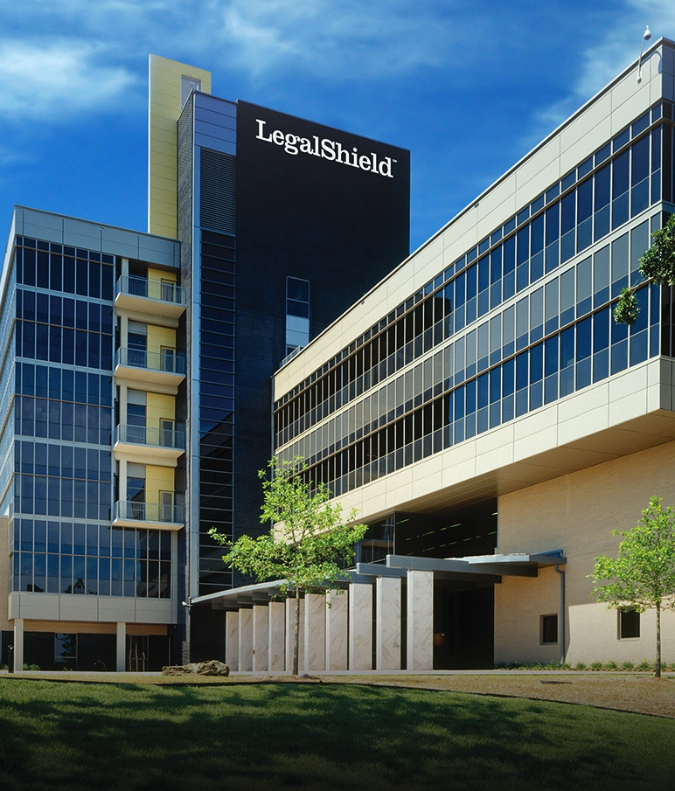
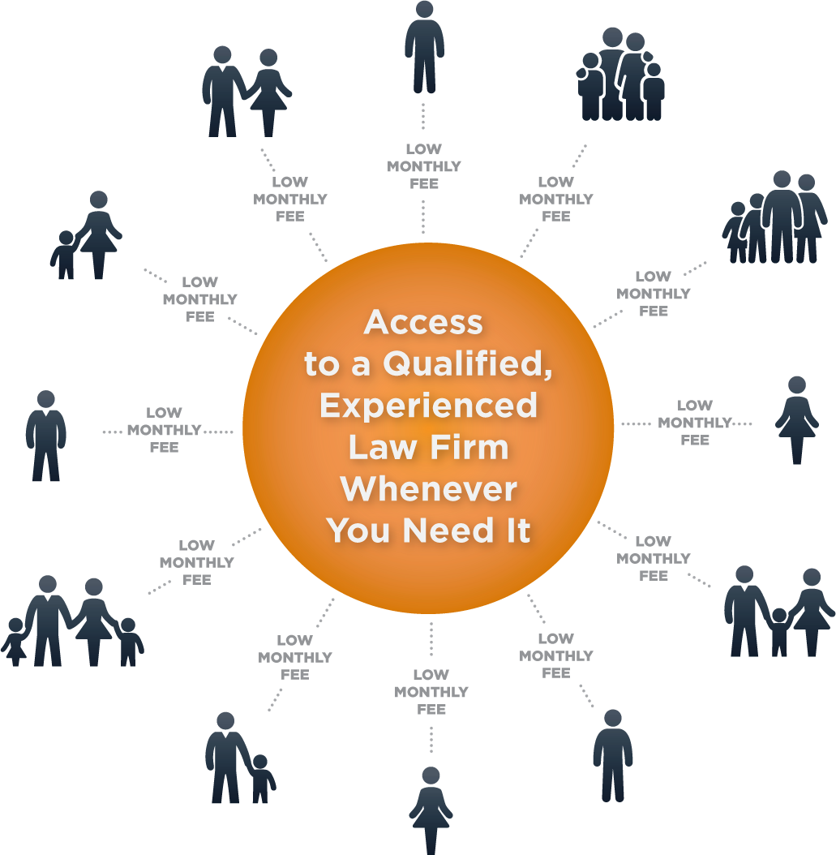
40+ YEARS IN BUSINESS
OVER 3.7 MILLION LIVES
Notes:
So, who is LegalShield?
X Established in 1972, LegalShield pioneered the concept of making legal services available and affordable to individuals, families and small businesses by using the
x “shared economy” approach. Lots of members pay a low monthly fee, which allows every member access to a qualified, experienced lawyer whenever they need one—even for just a quick question or consultation. No more worrying about high hourly rates.
X Our Legal Plans cover more than 3.7 million lives

Slide 4
1.7 MILLION LIVES
Notes:
For the past 16 years, we have provided peace of mind and comprehensive restoration to individuals and families through our identity theft protection service, IDShield.
xIDShield covers more than 1.7 million lives.

Slide 5
Specialized focus on B2B accounts
70,000 Business Accounts
Voluntary Benefit
Small Business
Independent Sales Associates
Insurance Agencies
Benefit Brokers
Notes:
LegalShield Business Solutions serve more than 70,000 businesses. All sizes of businesses offer LegalShield and IDShield to their employees as a
xvoluntary benefit.
xSmall Businesses with 100 employees or less also benefit from a Legal Plan designed just for them.
We sell our services as a voluntary benefit through
X independent sales associates,
X insurance agencies and
X benefit brokers.

Slide 6
Notes:
Another important aspect of the LegalShield business model is our direct sales organization.
Our direct sales force focuses on recruiting new sellers, as well as selling plans on a one-to-one basis to members who are not part of an employee group.

Slide 7
Specialized focus on business accounts
Notes:
Today, we are going to focus on opportunities within our business-to-business organization, LegalShield Business Solutions, and specifically to you as a Commission Seller

Slide 8
entrepreneurs
Notes:
LegalShield Entrepreneurs come from every walk of life and level of experience. Thousands of individuals have built successful businesses by offering LegalShield and IDShield and if you have the passion, you can too.

Slide 9
Traits of successful legalshield entrepreneurs
Want flexible working hours and growth potential
Self confident
Willing to learn the products and process
Willing to work hard to achieve a high income
Like building high-performing teams
Notes:
What are the typical traits of a successful Entrepreneur at LegalShield?
Well first, they appreciate flexibility, and are looking for a business opportunity with growth potential
They’re self-confident and believe in what they sell and they’re willing and eager to become and expert in LegalShield products .
Our sales entrepreneurs are willing to work hard to achieve a high income, but they especially enjoy building high performing teams of people – teaching, coaching, and mentoring others is a big part of their role, all in an effort to build a sustainable business.
And when you match up those skills with the opportunity in Business to Business sales, the possibilities are endless.

Slide 10
Business to Business
Work directly with
Business Owners
Human Resource Managers
Corporate executives
When qualified, work through
Benefit Brokers and Insurance Agents.
Small Business Legal plan
Voluntary Benefit plans
Notes:
You may be wondering, what are Business to Business sales?
Selling B2B means you are working with Business Owners, Human Resource Managers, Corporate executives or even Benefit Brokers and Insurance agents.
You would be selling directly to Businesses, and when qualified, selling through Brokers and Agents.
Selling the Small Business Legal plan as well as selling LegalShield and IDShield as a voluntary benefit are the primary activities of a B2B seller.

Slide 11
What are voluntary benefits?
Traditional
Life/disability
Dental
Vision
Supplemental medical
Emerging
Health, wellness and lifestyle
Legal and Identity Theft Protection
11
Notes:
So, what are voluntary benefits? Quite simply, these are products offered through an employer but paid for partially or solely by employees through payroll deduction. Companies use voluntary benefits to attract and retain their work force.
Traditional voluntary benefits include: Life/disability insurance
Dental insurance
Vision insurance and
Supplemental medical insurance
Emerging voluntary benefits include:
Health, wellness and lifestyle benefits, like pet insurance and student loan assistance.
And Legal and identity theft protection, which is what we offer at LegalShield.
Lets look a little closer at the services

Slide 12
Legal plans
Traffic-related issues
Estate planning
Contract Review
Legal advice on unlimited number of personal issues
Group plans start at $15.95/month
Exclusions and limitations apply. Services and benefits vary by state/province. See www.legalshield.com/fullplandetails and select your state/province for specifics.
Please review plan details for complete terms, conditions and exclusions before purchase.
12
Notes:
There are many reasons individuals and families should use a lawyer in their day to day lives.
Some of the most common uses of the LegalShield plan include consultation on:
X traffic related issues,
X estate planning-- including your will, living will and health care power of attorney--, and
X contract review. Additionally, members can call their provider firm for
X legal advice on an unlimited number of personal issues!
With LegalShield, members receive timely advice at a fraction of the cost of a lawyer’s hourly rate for covered services.
X LegalShield group legal plans start at $15.95 per month.

Slide 13
idshield
Comprehensive identity monitoring
Credit monitoring and alerts
Identity theft prevention consultation
Licensed Private Investigators
Identity restoration to pre-theft status
Group plans start at $8.45/month
Exclusions and limitations apply. Services and benefits vary in US/Canada. See www.idshield.com/plans-and-pricing for specifics. Please review plan details for complete terms, conditions and exclusions before purchase.
13
Notes:
IDShield gives members comprehensive monitoring of many aspects of their identity, including: Social Security number, driver’s license, passport,
credit cards, bank accounts and more. Similar to our legal plan, this benefit also provides
unlimited consultation for identity theft prevention.In the event the member’s identity is compromised, a
licensed private investigator will work to uncover evidence, restore the member’s identity, and
clear the record back to its pre-theft status.
IDShield Group Plans start at $8.45 a month

Slide 14
Small business plans
Consultation on day-to-day matters
Debt collection and vendor disputes
Contract Review
Worker’s compensation issues
Employee hiring and firing
Starts at $39/month
Exclusions and limitations apply. Services and benefits vary by state/province. See www.legalshield.com/business/plans-and-pricing and select your state/province for specifics.
Please review plan details for complete terms, conditions and exclusions before purchase.
14
Notes:
Companies with 100 or fewer employees run their businesses more efficiently with our Small Business Legal plan.
As part of the membership, business owners with up to 5 authorized users can access timely legal advice on everyday matters. Small Businesses appreciate that they can pick up the phone, call their provider firm, and ask questions without worrying about an outrageous bill at the end.
Debt collection letters, vendor disputes,
contract review and
consultation on human resource matters such as worker’s compensation issues, and
employee hiring and firing are just part of what’s covered. This gives small businesses legal tools they need to manage their finances and employees with confidence.
LegalShield offers a suite of small business plans ranging from $39 to $149 per month

Slide 15
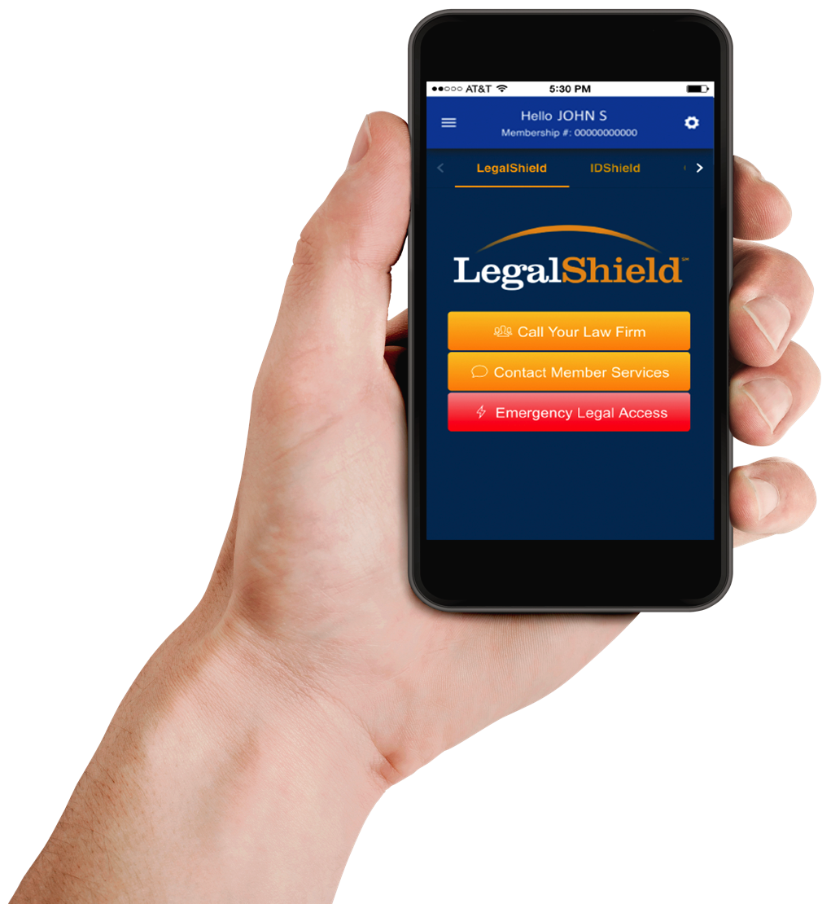
Definitively different
Nationwide system of dedicated law firms
Quality Assurance
Service level monitoring of law firm performance
Notes:
What makes us different?
LegalShield is unlike any other legal service plan provider. We are not a referral service nor a directory of lawyers. We take the guess work out of finding the right attorney to fit our members’ legal needs.
Our members have access to an unmatched network of dedicated law firms in 49 states and four Canadian provinces, and through our collective purchasing power, we are these law firms’ biggest client.
Our dedicated network of seasoned lawyers, with an average of 21 years experience, is carefully vetted and monitored to ensure quality, outstanding service is provided to our members. Our plans provide a wide spectrum of legal services to help our members traverse their legal needs, from the trivial to the traumatic.

Slide 16
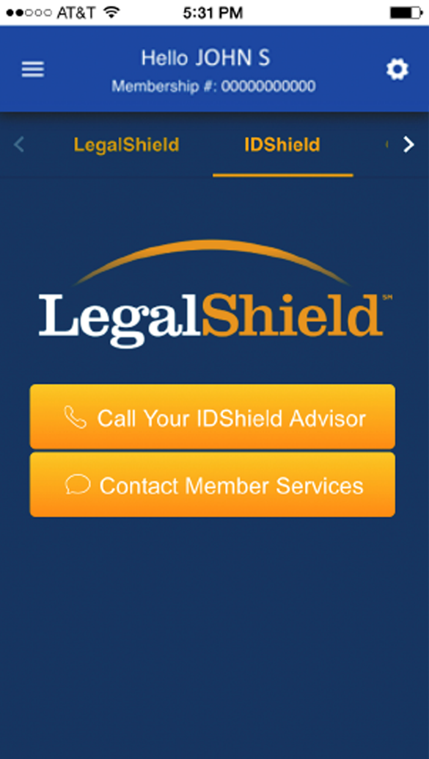
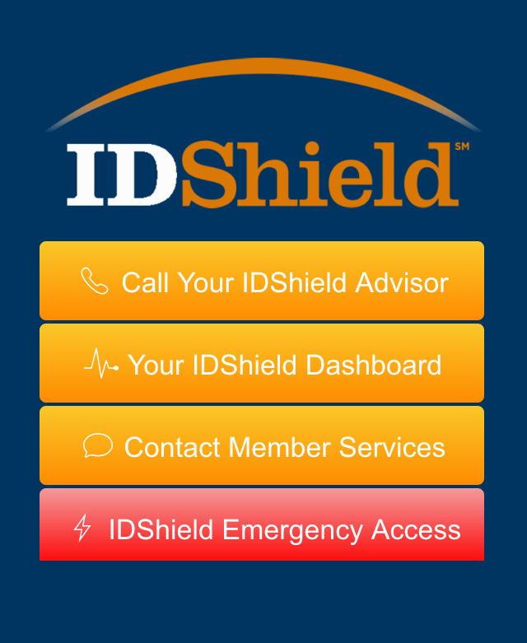
Definitively different
Highest identity theft service guarantee available
Identity theft services conducted by Licensed Private Investigators
24/7 emergency hotline for covered legal and ID theft issues
Easy access via mobile app
Notes:
Our identity theft protection has a $5 million service guarantee—the highest guarantee available in the industry. In addition, our identity theft services and consultations are conducted by licensed private investigators.
Our legal and identity theft services provide 24/7 emergency hotlines for covered issues.
And, you can Use the apps for easy access to your Provider Law Firm and Licensed private investigator!

Slide 17
The need
Nearly 90% of Americans say they do not have any form of legal insurance or legal protection service
More than 60% reported they would be interested in purchasing legal protection
Identity theft has topped the FTC ranking of complaints for 15 years
Legal Source: The Legal Needs of American Families. A Research Study Conducted by Decision Analyst, Inc. Commissioned by LegalShield
ID Theft source: CNN Money. “Identity Fraud Hits New Victim Every Two Seconds.” Ellis, Blake. 2014. (http://money.cnn.com/2014/02/06/pf/identity-fraud/)
17
Notes:
You may wonder, is there a market for these services?.
Studies show that Nearly 90% of Americans say they do not have any form of legal insurance or legal protection service. However, more than 60% reported they would be interested in purchasing legal protection.
In addition, identity theft has topped the Federal Trade Commission ranking of complaints for 15 years.
That means… a lot of opportunity!

Slide 18
Target market is small business
5.7 million companies with fewer than 100 employees
120 million workers employed by small businesses
543,000 new businesses are started every month
Source: Small Business Administration
18
Notes:
As noted earlier, LegalShield sells to companies across all industries and sizes—from home-based sole proprietors, to the Fortune 500.
However, we have a unique value proposition for small businesses with 100 or fewer employees.
There are 5.7 million of these companies,
employing 120 million workers. In addition,
543,000 new businesses are started every month!
The market is ready! Selling LegalShield and IDShield gives you an unprecedented opportunity in the business to business segment.

Slide 19
Why do companies want legalshield?
For their Employees
Companies with better benefits have less turnover, higher productivity
Attract and retain employees, without having to incur additional costs
Reduce absenteeism; increase productivity
For their Business
Support for legal issues concerning human resources, debt collection and more
19
Notes:
Why do companies want LegalShield and IDShield for their employees?
Well, Companies with better benefits have less turnover and higher productivity
They can Attract and retain employees, without having to incur additional costs
And studies have shown that when employees have access to legal and identity theft protection services it reduces absenteeism and increases productivity.
Companies buy Legal Plans for their small business to get day to day legal advice for issues concerning human resources, debt collection and more

Slide 20
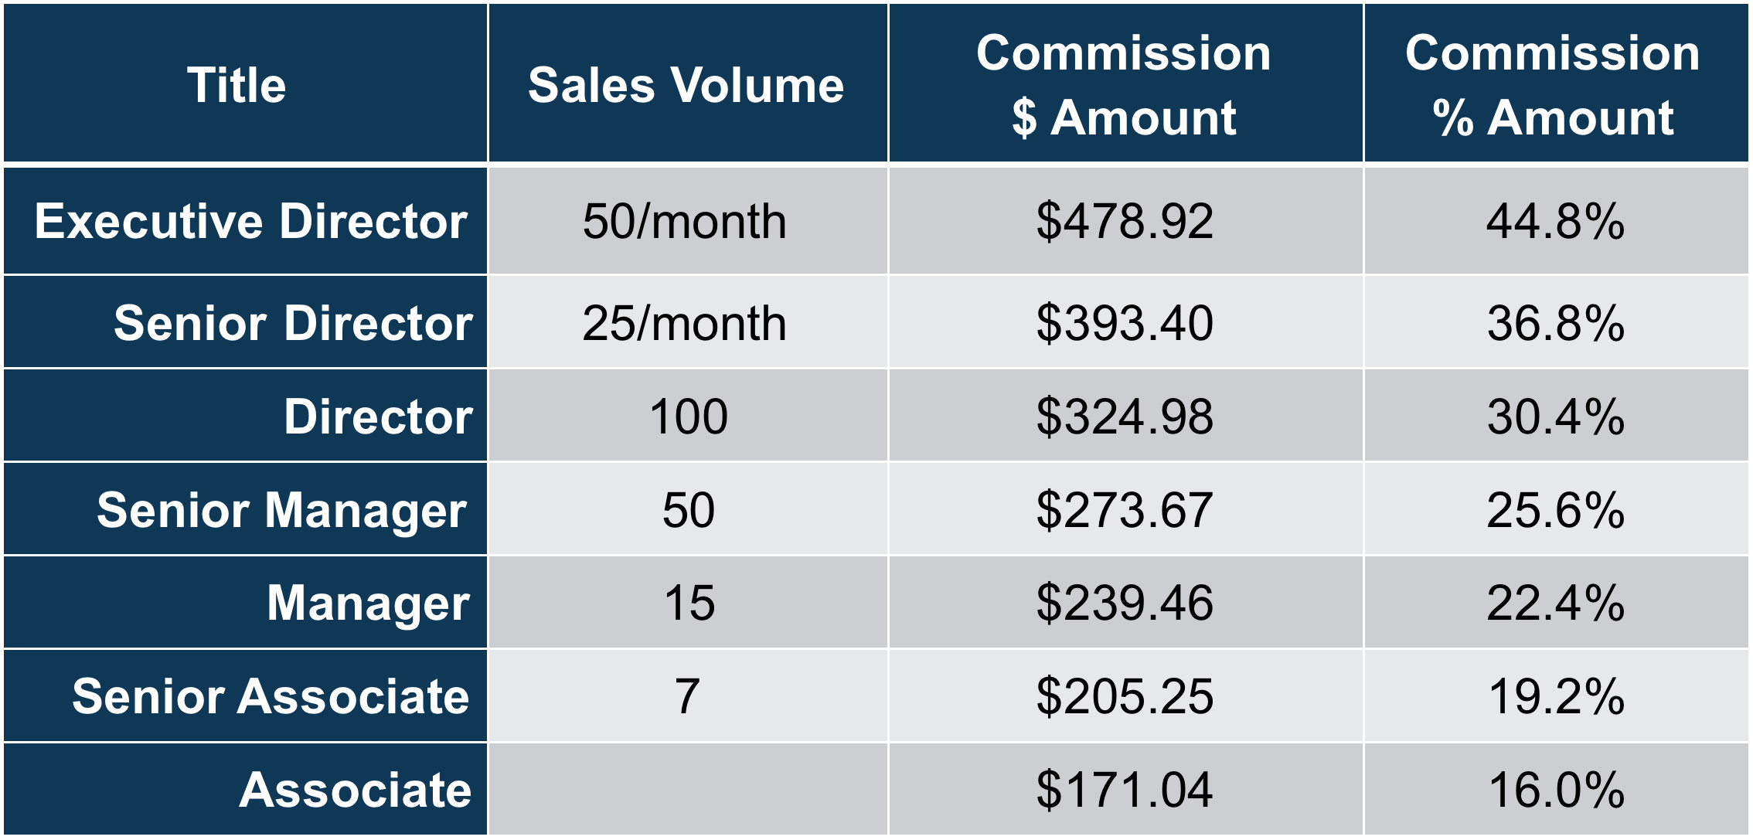
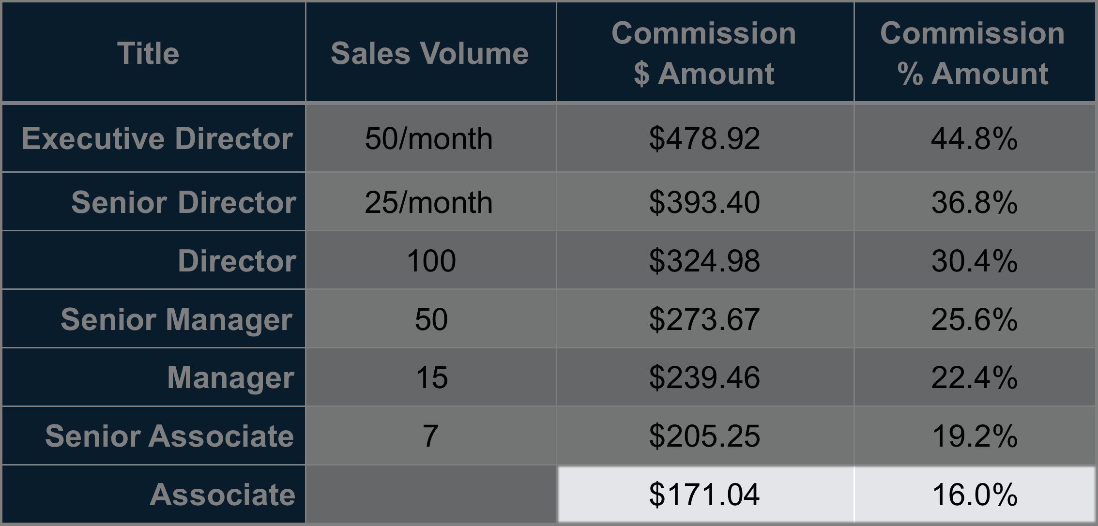
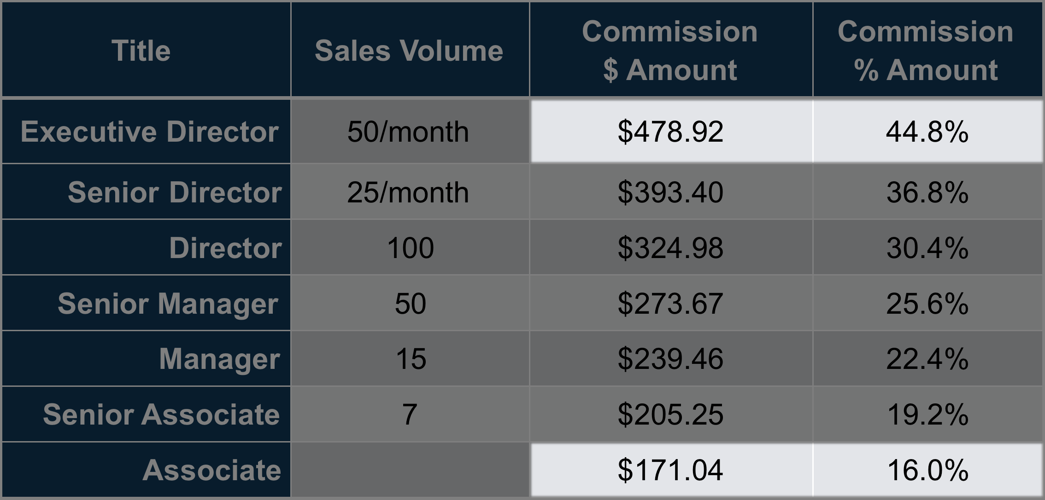
Smallbiz 50 compensation $89/mth
See a compensation plan for complete commission information
Notes:
At this point, You’re probably wondering what sort of commission and bonus options are available
Let’s first look at the commission plan for one of our Small Business Legal Plans, SmallBiz 50 which is $89/mth.
Your commission is based on your volume. When you first start out your commission is 16% of the annual premium, and you would earn $171.04 per sale. As you increase your volume, your commission rates increase. At Executive Director level, commissions are 44.8% or $478 per sale.

Slide 21
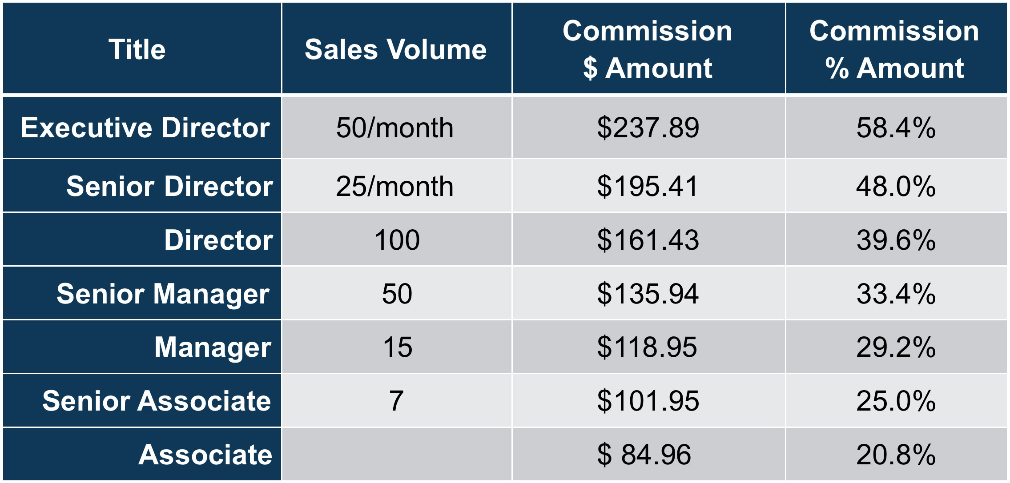
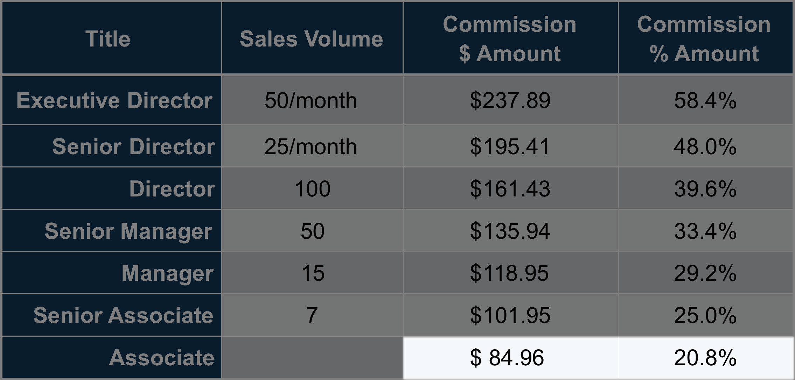
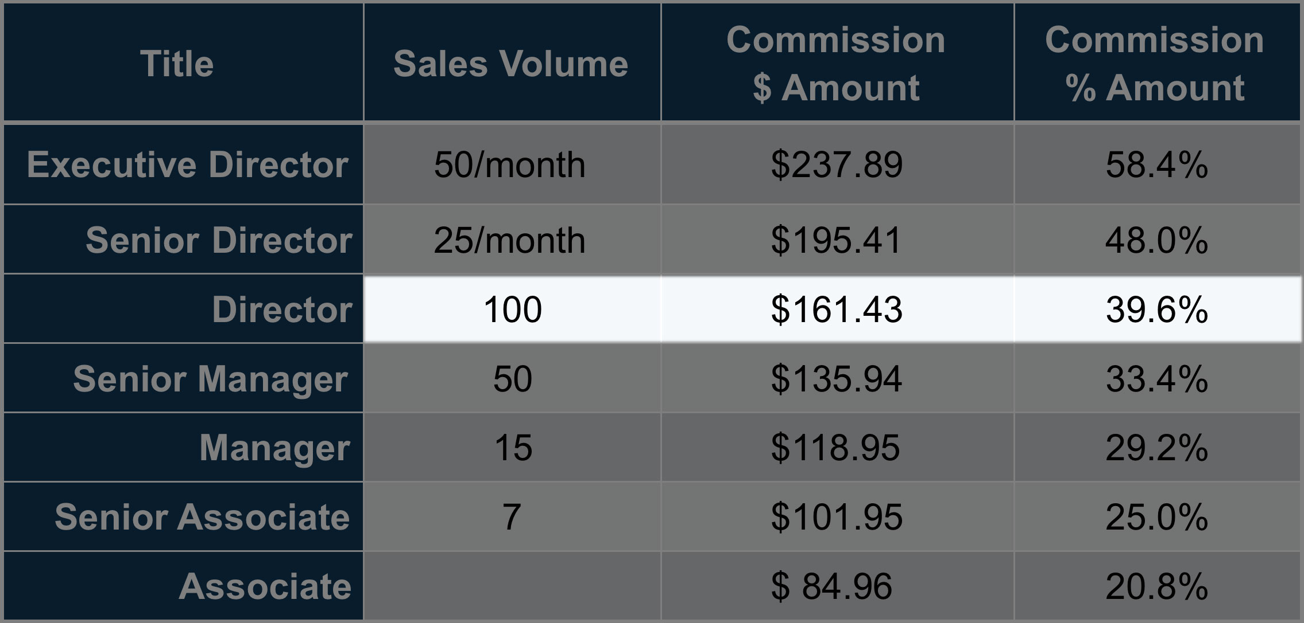
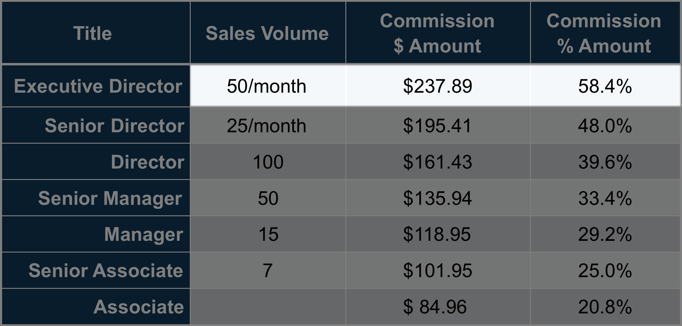
Legalshield and idshield bundled family plan $33.90/mth
See a compensation plan for complete commission information
Notes:
Lets now look at the Family Legal and IDShield bundled plan for groups under 2000 employees which is $33.90 per month.
For this plan you start at 20.8% of the annual premium. Sales of all products contribute to your total volume, and in this example when you have reached
100 sales, or Director level, your commission increases to 39.6%. Earn even
more commission with consistent monthly sales volume---up to 58.4%., but you will never fall below Director level once you have achieved it—that is a permanent position!
Things that sellers love about LegalShield, is that our commission plans are lucrative, and rewards can grow quickly.
When you build a sales team, you’re rewarded with override commissions on your teams production.

Slide 22
Residual Income—advanced commission plan
Month after month, year after year, for the life of the membership
Rates range from 1.34% to 21.28%
Earned after first 12 months of membership
Varies based on Commission Level at time of sale and Monthly Retention Rate of all memberships sold in that calendar month
Residual income offsets any debit balance
Refer to Commission plan for detailed description
Notes:
Another unique aspect of our compensation program is the ability to earn residual income on your sales. As long as the membership is active, you will receive a commission check, even if you stop selling LegalShield. That income can be part of the legacy left to your family too!
Residual income on the Advanced Commission option ranges from 1.34% to 21.28% and begins after the 12th month of membership
This variable component is based on the commission level at the time of the sale and the member retention rates
Residual income will first offset any debit balance accumulated from the advanced commission plan.

Slide 23
Recognition and incentives
You are eligible to increase your Performance Club monthly bonus from $300 to $500 if you purchase or lease a qualifying BMW.
Each year LegalShield sends its top
Associates on an exclusive trip to
fantastic destinations.
The company also provides special contests and promotions throughout the year including a Business Solutions incentive!
Note: See Performance Club brochure for all details and requirements. Must be enrolled in LegalShield Advantage
Notes:
Performance Club is our recognition program for top sellers. By achieving consistent sales success, you may be eligible for a Monthly bonus of $300, or $500 if you purchase or lease a qualifying BMW!
All expense paid trips are also part of Performance Club. LegalShield Business Solutions has contests and promotions throughout the year as well.
Please be sure to speak with your LegalShield representative about how all of our compensation programs work and how you can use them to maximize your income.

Slide 24
A unique opportunity for entrepreneurs
Low start up costs
No set territories or quotas
Industry-leading products
Established company
High customer satisfaction ratings
Tools to on-board new team members
Notes:
If you’re looking for a new business opportunity, you’ll be pleased to know that our
start-up costs are low, and you can build your organization
without concern for territory or quota. All that and the satisfaction of providing
industry leading products that fill an important need –equal access to justice and identity theft protection,
the confidence that those services come from an established company with
high customer satisfaction ratings. And
Proven tools to help on-board you and your team members

Slide 25
Entrepreneur support
Quick access to revenue and commission reporting
Marketing support
Enrollment support
Electronic, paper, web enrollment
Ongoing enrollment support
Informational web sites for clients
Electronic, paper and self-bill options
Product and Field training
25
25
Notes:
LegalShield also has an extensive support organization.
Our on-line portal gives you quick access to revenue and commission reporting, as well as marketing materials and other marketing support.
For voluntary benefit selling, there are electronic, paper and web enrollment options, as well as ongoing enrollment support, including informational web sites for clients, and electronic, paper and self-bill options
In addition, we offer extensive training programs to sell our products..

Slide 26
LegalShield Advantage
Benefit | Without LegalShield Advantage | With LegalShield Advantage
Individual Sales Performance Dashboard | ✓ | ✓
Online Product and Sales Training | ✓ | ✓
Ongoing Live Training and Weekly Newsletter | ✓ | ✓
Custom Web Site and eMail Address |  | ✓
Corporate Website Leads |  | ✓
FranklinCovey Personal Development Training |  | ✓
Corporate-sponsored Incentive Programs |  | ✓
Start up Fee - $249 with 1 year of LSAdvantage included
Notes:
LegalShield Advantage is our eService program and gives you the opportunity to invest in your business with extra technology and tools, as well as participate in Performance Club and the Business Solutions Incentive program. You also receive access to the well-respected FranklinCovey Personal Development training.
Becoming a LegalShield Independent Associate is a great investment. The Start up Fee is only $99 and
LegalShield Advantage is an additional $19.95/mth
For a start up fee of $249, you get 12 months of LegalShield Advantage included, that’s a savings of almost $90!

Slide 27
Some Success Stories
“
I work with business owners assisting them with programs to make them more profitable. I also help people who want to earn extra income or even replace a career like I did”
Bill Stovall, Greenville, North Carolina
Actual LegalShield Associate
Notes:
Here are some success stories from some of the Independent Associates who found success in selling and building a team.
Bill Stovall from Greenville North Carolina said
x“I work with business owners assisting them with programs to make them more profitable. I also help people who want to earn extra income or even replace a career like I did”

Slide 28
Some Success Stories
Nineteen months after starting LegalShield we sold our retail business. We work with the Small Business market, helping small business owners protect and grow their business. We strongly believe in the Business Solutions division and have enrolled more than 4,000 group members.”
Don Thompson, Cape Coral, FL
“
Actual LegalShield Associate
Notes:
Don Thompson from Cape Coral Florida told us
19 months after starting LegalShield we sold our retail business.. We work with the Small Business Market, helping small business owners protect and grow their business. We strongly believe in the Group Marketing division and have enrolled more than 4000 group members.”

Slide 29
Some Success Stories
Before LegalShield, I could not imagine having my own business. The time freedom and the ability to share our awesome services with others are both priceless. I know that this is a service that everybody needs; they just don’t know it exists.”
Rikita Burch, McDonough, Georgia
“
Actual LegalShield Associate
Notes:
And Rikita Burch from McDonough, Georgia says
xBefore LegalShield, I could not imagine having my own business. The time freedom and the ability to share our awesome services with others are both priceless. I know that this is a service that everybody needs; they just don’t know it exists.

Slide 30
Get started today!
Contact your LegalShield Independent Associate,
Or, visit business.legalshield.com
30
Notes:
So, are you interested in selling LegalShield and IDShield? Here are the next steps:
If you already have a LegalShield representative meet with them to discuss your contract options and ask any questions you may have.
If you don’t have a LegalShield representative , please send us an email at and we’ll contact you, or visit business.legalshield.com

Slide 31
Thank You
LegalShield
The information contained in this material is for illustrative purposes only and is not a contract. It is intended to provide a general overview of the legal plan benefits, identity protection benefits and commission opportunities. Please remember that only the plan contract can give actual terms, coverage, amounts, conditions, and exclusions. Check benefit availability in your state/province.
Marketed by Pre-Paid Legal Services, Inc. dba LegalShield or applicable subsidiary: Pre-Paid Legal CasualtySM, Inc. In Florida: Pre-Paid Legal Services, Inc., of Florida In Virginia: Legal Service Plans of Virginia, Inc. Pre-Paid Legal Access, Inc. PPL Legal Care of Canada, Inc.
©2016 LegalShield, Inc.
Notes:
Thank You for your interest in LegalShield.

