Slide 1
Technical Brief v1.0

Slide 2

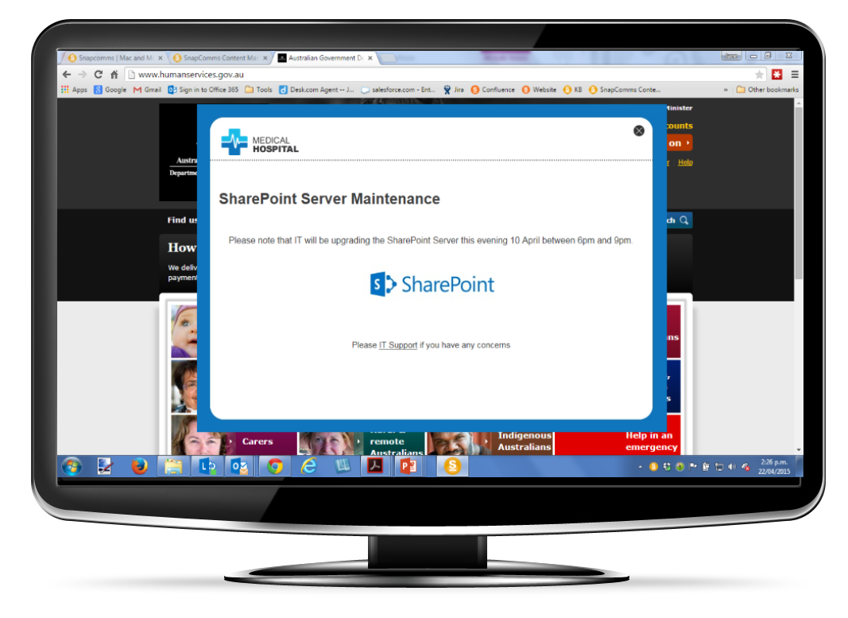
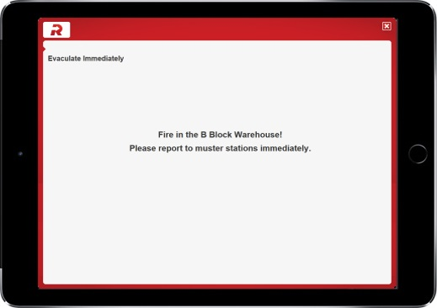
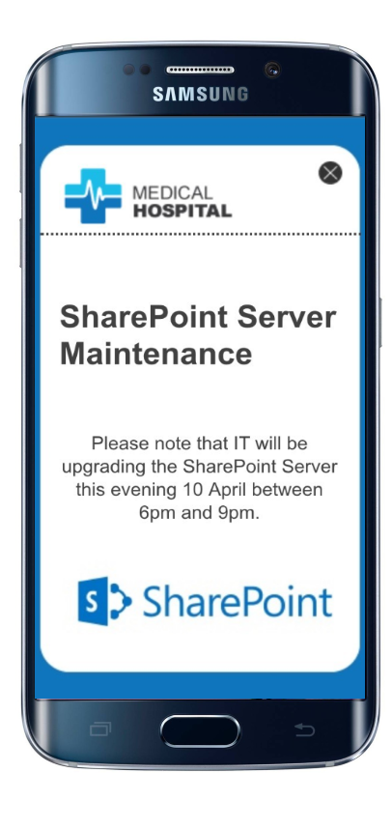
Communication tools that broadcast visual content
directly onto the screens of computers,
using multiple channels and formats
Easy to install. Easy and quick to use.
Measure delivery,
click-throughs, responses.

Slide 3
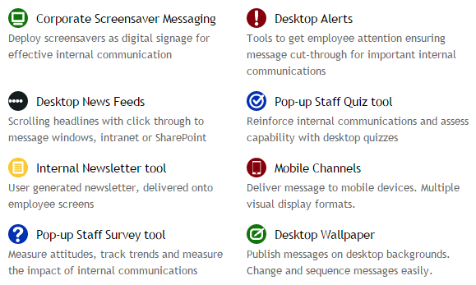
Communication Tools

Slide 4
In a nutshell SnapComms…
is an HTTP based Client / Server pull technology.
has Clients for Windows, MAC, iOS and Android.
uses HTTP/HTTPS on customizable ports.
supports WAN links, VPNs & Proxies.
has Cloud Hosted & Local Installation options.
is constantly tested and monitored for intrusion prevention
provides a high degree of data security
has one point of contact for support
is using brand able templates for content display

Slide 5
The SnapComms Server…
is necessary for local installation only.
is built with ASP.NET.
provides access to clients via a web service framework.
is supported on Win 2008 or higher.
works with SQL Server 2008 or higher.
requires IIS7 or higher.
comes with detailed installation documentation for applications and database.
includes extensive logging capabilities.
integrates Windows or Forms Authentication.
has detailed but easy to manage access control.

Slide 6
The SnapComms Windows Client…
is simple to deploy with MSI enabled deployment tools.
is supported on Windows 7 / IE8 and higher.
encrypts its data storage.
integrates into Thin-Client environments like Citrix.
integrates with Active Directory.
has a minimal user Interface to minimize support.

Slide 7
The Smartphone Clients…
work on iOS and Android and Windows
use a web service based API to access the server
support push notifications
provide a simple, fully touch enabled UI
are fully brandable
can be easily pre-configured
install directly from the application market places

Slide 8
The Network Connectivity…
is from ground up designed to be minimal.
ensures message content is only downloaded once and cached (encrypted) on the client.
uses standard HTTP protocols.
works through all standard compliant proxies.
is secured through data encryption via HTTPS.
is routed through a single, configurable port to make it easy to pass firewalls.
works perfectly with VPN and WAN link setups.

Slide 9
Active Directory Integration…
makes user, machine and group integration easy.
works fully transparently.
takes place on client side using standardized ADSI API.
doesn’t need to access to AD from the server.
supports multiple domains/forests and nested groups.
collects only clearly specified attributes.
synchronizes the data periodically (6 hours default).
is cached encrypted on the client.
encrypts it’s data exchange with the server.

Slide 10
SnapComms Security…
is a key policy.
has strong authentication and authorization processes.
includes secure data storage and data transfer.
is ensured by constant on going testing.
is tested with industry standard tools.
includes extensive intrusion testing.
minimizes the points of attack.
has well defined processes for quick escalation and counter measures.

Slide 11
SnapComms Support & Monitoring…
operates 24 x 7.
provides one single point of contact for all enquiries.
has call escalation policies.
bases on clear and easy to understand SLA agreements.
works with industry standard support management tools.
has well defined issue escalation procedures and paths.
guarantees service availability for the hosted solution.
provides a guaranteed response time.
makes your life easier.

Slide 12
Locally Hosted Security…
If the SnapComms solution is being installed locally within the customer own network environment, security relating to accessing and using the SnapComms platform resides with the customers internal network and security personnel…
…items to consider and review are:
use of Windows Authentication for administrator access to the SnapComms Content Manager…and use of VPN’s for remote administrator access
Click here for… Architecture Components of the SnapComms Solution (http://www.snapcomms.com/tech-info/Documents/Application-Components.pdf)
Click here for…Locally Hosted Systems Requirements
(http://support.snapcomms.com/customer/portal/articles/1031815-data-sheet-a-locally-hosted-solution-%E2%80%93-overview-system-requirements)
Click here for…Client Deployment Overview
(http://support.snapcomms.com/customer/portal/articles/1031816-data-sheet-b-snapcomms-client-deployment-overview---pc-mac)
Click here for…Active Directory Synchronization
(http://support.snapcomms.com/customer/portal/articles/1031818-data-sheet-d-synchronization-with-active-directory)

Slide 13
Cloud Hosted Security…
If the SnapComms solution is being hosted by SnapComms in a Public or Private Cloud environment…
…items to consider and review are:
SnapComms uses infrastructure and facilities provided by OVH (www.ovh.com) based out of Canada and France – OVH has obtained SOC 1 type I and SOC 2 type I (SSAE 16 and ISAE 3402) certification
Click here for… SnapComms Security Standards Overview (http://support.snapcomms.com/customer/portal/articles/1510783-snapcomms-security-standards)
Click here for…Cloud Environment Schematics and Policies
(http://support.snapcomms.com/customer/portal/articles/1332915-production-environment-schematics-and-policies)

Slide 14
References…
Overview of the SnapComms Architecture
SnapComms Client Deployment Overview
Thin Client Implementation
Integration with Active Directory
Assessment & Implementation of the Hosted Solution
Security Overview
Template Guidelines
Assessment & Implementation of a local installation
System Requirements for the locally installed solution
Implementation Tips

