Slide 1
EPM & BI Seminar 2016 Jason Kernan Executive Manager Finance Irish Life
24 Nov 2016

Slide 2
Agenda
About Irish Life
Irish Life & EPM
What was Reporting & Planning like prior to EPM
Reporting & Planning now
Future expected developments
Recap
Questions

Slide 3
About Irish Life
Established in Sept 1939
We look after the financial futures of over 1 million customers
No. 1 in the Life & Pensions market in Ireland
€1bn+ paid in Death Claims over last 5 years
Managing over €50bn assets
2500+ staff
Recently - Irish Life Health
2013 - acquired by Great-West Lifeco
Irish Life is now part of one of the worlds leading life assurance organisations
Great-West Lifeco is based in Winnipeg, Canada
22,500+ staff
28m+ customers

Slide 4
Irish Life & EPM
Implemented EPM in 2010 across a number of business divisions:
Retail
Corporate Business
Group Functions
Initially for Costs reporting & planning purposes
Further developments in recent years include:
Financial Reporting in Retail
Cost reporting & planning for Irish Life Investment Managers
Consolidation cube for reporting to Great-West Lifeco
Move from Oracle Financials to SAP
Cost reporting & planning for GWL European Technology Services

Slide 5
Irish Life & EPM
30+ users
Currently on version 11.1.2.2 of Enterprise Performance Management System
AKA – Essbase or Hyperion
Using EPM web front end as well as:
Financial Reporting Studio
Planning
Calculation Manager
Smart View
Oracle Data Integrator
SQL Developer
General Ledger moved from Oracle Financials to SAP in early 2016
Most of the control / development sits with the Finance function

Slide 6
Agenda
About Irish Life
Irish Life & EPM
What was Reporting & Planning like prior to EPM
Reporting & Planning now
Future expected developments
Recap
Questions

Slide 7
Reporting & Planning prior to EPM
Excel Hell!!!!!

Slide 8
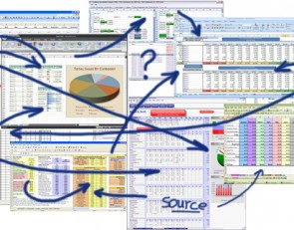
Reporting & Planning prior to EPM
Excel Hell!!!!!

Slide 9
Reporting & Planning prior to EPM
To be fair spreadsheets have Positives & Negatives
Positives
Flexibility
Easy to manipulate
Not many constraints

Slide 10
Reporting & Planning prior to EPM
To be fair spreadsheets have Positives & Negatives
Positives
Flexibility
Easy to manipulate
Not many constraints
Negatives
Flexibility
Easy to manipulate
Not many constraints

Slide 11
Reporting & Planning prior to EPM
To be fair spreadsheets have Positives & Negatives
Positives
Flexibility
Easy to manipulate
Not many constraints
Negatives
Flexibility
Easy to manipulate
Not many constraints
When it comes to Reporting & Planning some of the key things spreadsheets fail on are:
Integrity of Data Structures
Security
Repository of data
Controlled environment
Multi users

Slide 12
Reporting & Planning prior to EPM
In 2000 we implemented Oracle Financial Analyser (OFA)
OFA was Oracle’s offering in this space prior to acquiring Hyperion
OFA had good bits:
Better than excel!
Good for reporting actual v budget v forecast v last year
Structured data model for Payroll calculations
And some not so good bits:
Data refresh & Hierarchy rollouts slow
Payroll model calcs slow
Difficult system to develop in – the programming language was a black art!

Slide 13
Reporting & Planning prior to EPM
Where OFA struggled is that it failed to provide us with a complete solution
In OFA
Headcount (partly)
Costs
In Excel / Access
Headcount (partly)
Fixed Assets
Sales & Margins
Cost Allocation

Slide 14
Reporting & Planning prior to EPM
Where OFA struggled is that it failed to provide us with a complete solution
In OFA
Headcount (partly)
Costs
In Excel / Access
Headcount (partly)
Fixed Assets
Sales & Margins
Cost Allocation
Ultimately EPM now covers:
Headcount
Costs
Fixed Assets
Sales & Margins
Cost Allocation
Financial Reporting
Operating Profit
Structured data
Consistent approach
Security
Data Repository
Data in one place

Slide 15
Agenda
About Irish Life
Irish Life & EPM
What was Reporting & Planning like prior to EPM
Reporting & Planning now
Future expected developments
Recap
Questions

Slide 16
Reporting & Planning Now
EPM using many sources of data
Fixed Assets (SAP)
Oracle Relational Tables (Sales and Margins)
SAP (GL)
Access (Persistency Data)
EPM
Corepay (payroll system)
User driven – budgets & forecast (smartview & business rules)
Allows us to manage a lot of data in one place

Slide 17
Reporting & Planning Now
Key Benefits that Irish Life have seen
One data store for a wide range of data
All planning & reporting is within the system
Significant reduction in the amount of work being supplemented by excel / access
Potential for errors or inconsistencies reduced
Faster reporting / planning process
Hierarchy easy to create and maintain
Multiple & shared hierarchies
New reporting / planning – seller level profitability

Slide 18
Reporting & Planning Now
Key Benefits that Irish Life have seen
User interface between excel & EPM much better than OFA
Speed of rollups & calculations much quicker than OFA
Plenty of scope to add new models / data
Finance users in control of system
A significant positive for us when we had to integrate with Great-West Lifeco
Monthly faster close process
3 year annual detailed planning
There are no Finance files on the Critical Spreadsheet log

Slide 19
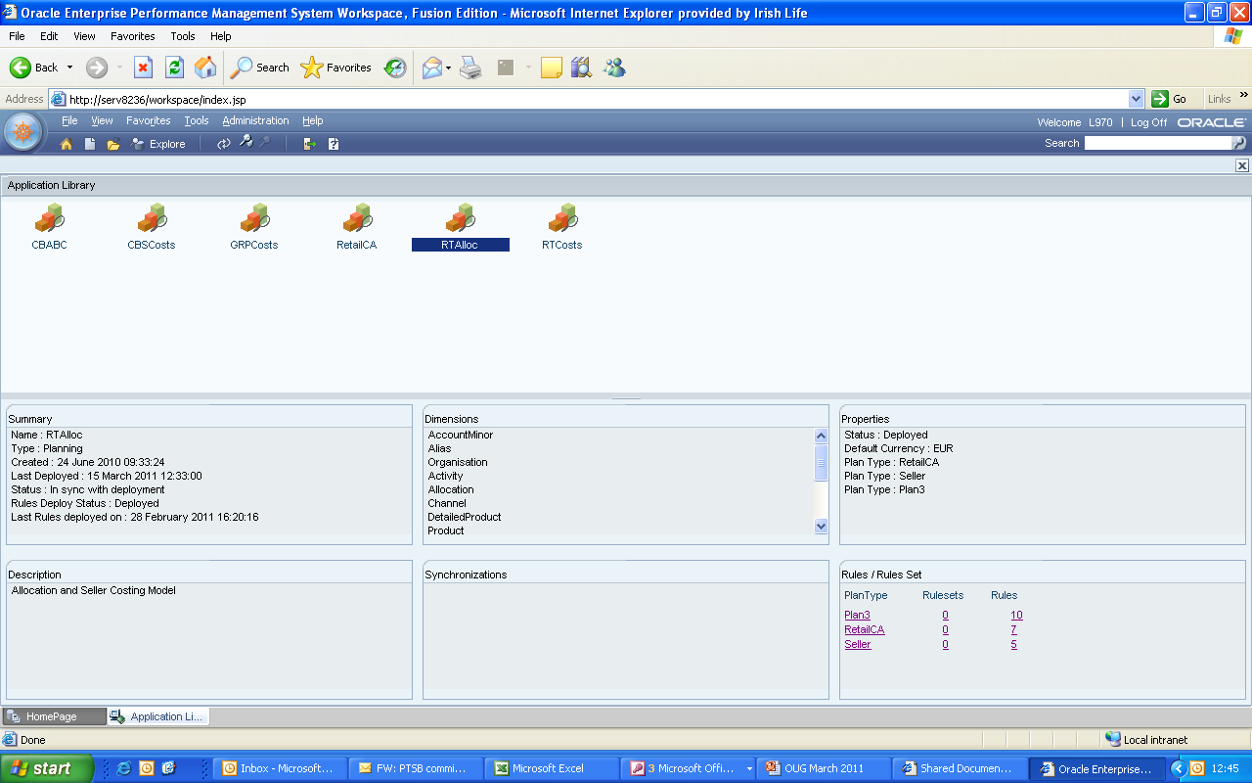
Reporting & Planning Now
Some screenshots of EPM - Application Library

Slide 20
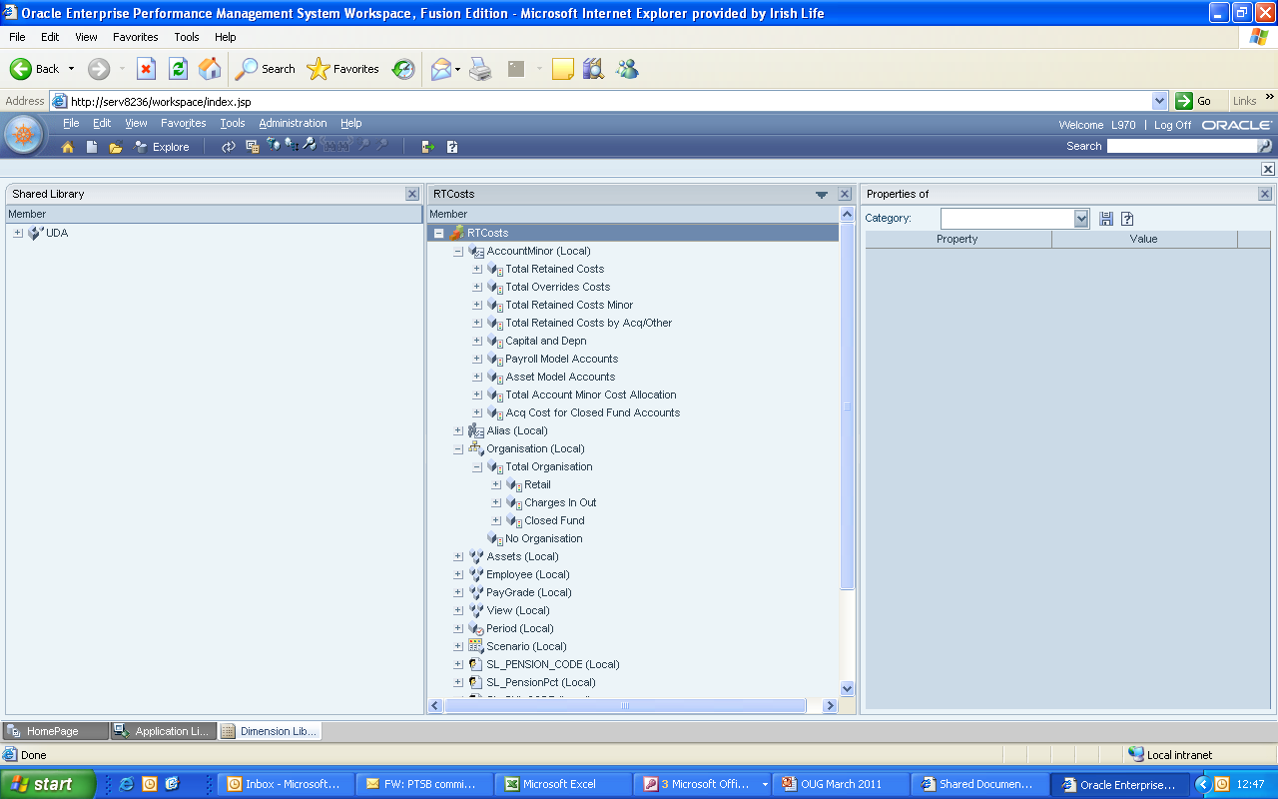
Reporting & Planning Now
Some screenshots of EPM - Dimension Library

Slide 21
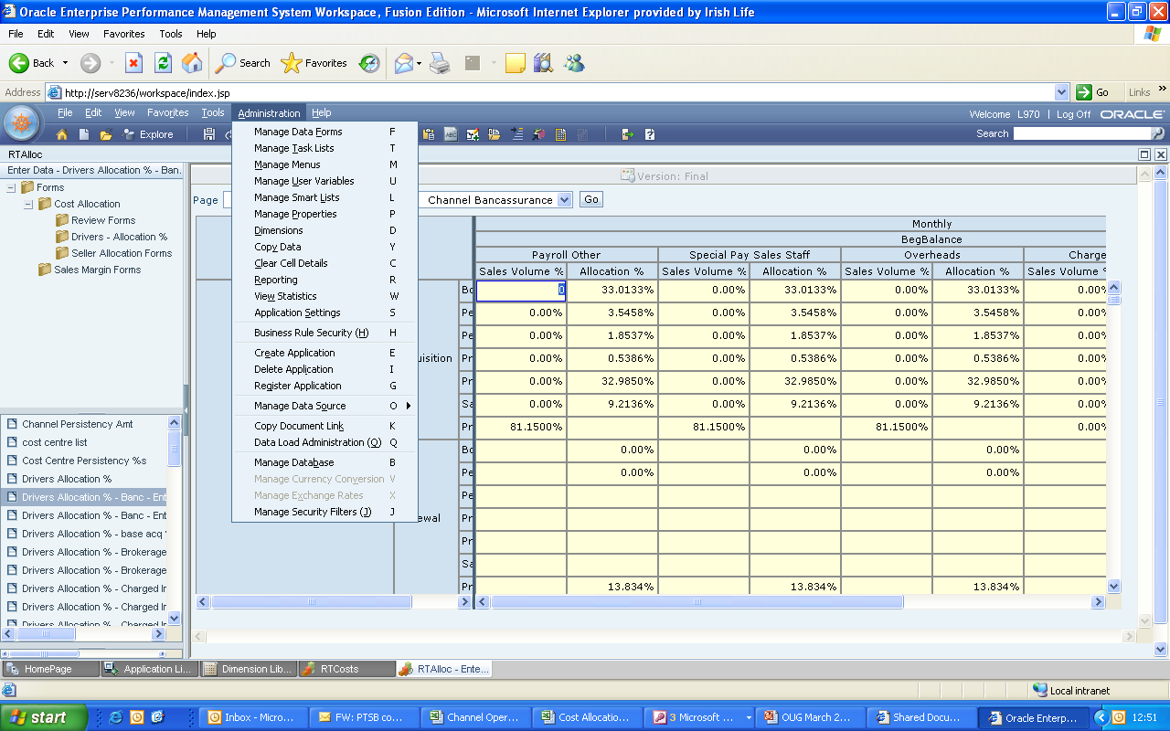
Reporting & Planning Now
Some screenshots of EPM – Planning Application

Slide 22
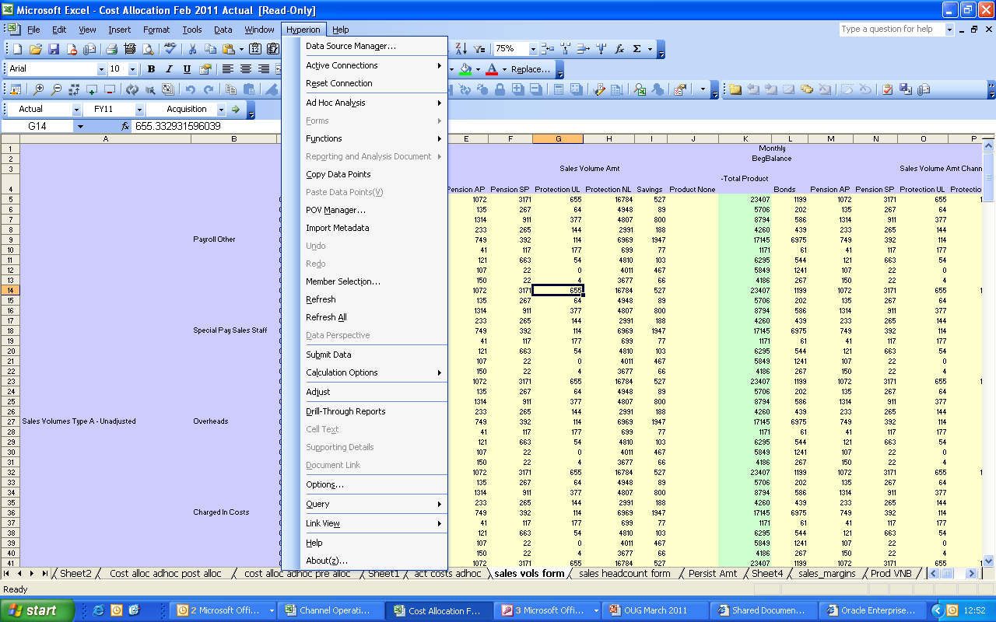
Reporting & Planning Now
Some screenshots of EPM – Excel Interface

Slide 23
Agenda
About Irish Life
Irish Life & EPM
What was Reporting & Planning like prior to EPM
Reporting & Planning now
Future expected developments
Recap
Questions

Slide 24
Future EPM developments in Irish Life
Data Repository
Continually looking for new data to push into the system
Anything where the historical data is in a spreadsheet
Group-wide Standards
Aim is to bring all Finance teams in the group to same standards

Slide 25
Agenda
About Irish Life
Irish Life & EPM
What was Reporting & Planning like prior to EPM
Reporting & Planning now
Future expected developments
Recap
Questions

Slide 26
Recap
Our implementation of EPM has given us significant benefits when it comes to reporting & planning
If your not sure about whether to switch to a system like this, then I’d recommend getting to see it:
arrange a site visit
Get a prototype built
Codec have worked with Irish Life very successfully for a number of years
We have always been happy to recommend them as a partner

Slide 27
Agenda

