Slide 1
JOIN THE FIGHT
United Way of Central Iowa

Slide 2
United Way LEADS THE FIGHT for the health, education and financial stability of all central Iowans.

Slide 3
United Way of Central Iowa is celebrating its 100th year in 2016.
The common thread year after year: If people are unhealthy, in poverty or failing in school, THE STATUS QUO IS NEVER GOOD ENOUGH.

Slide 4
What does United Way do?

Slide 5
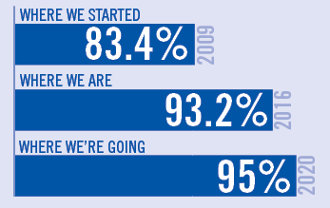
EDUCATION GOAL for 2020: Increase the percentage of central Iowa students who graduate from high school to 95 percent
United Way of Central Iowa

Slide 6
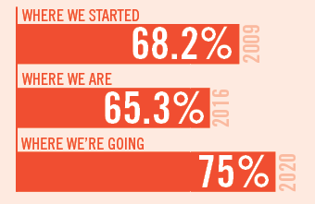
INCOME GOAL for 2020: Increase the percentage of central Iowans who are financially self-sufficient to 75 percent

Slide 7
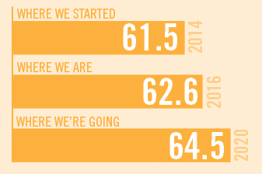
HEALTH GOAL for 2020: Increase central Iowa’s Gallup-Healthways Well-Being Index to 64.5
United Way of Central Iowa

Slide 8
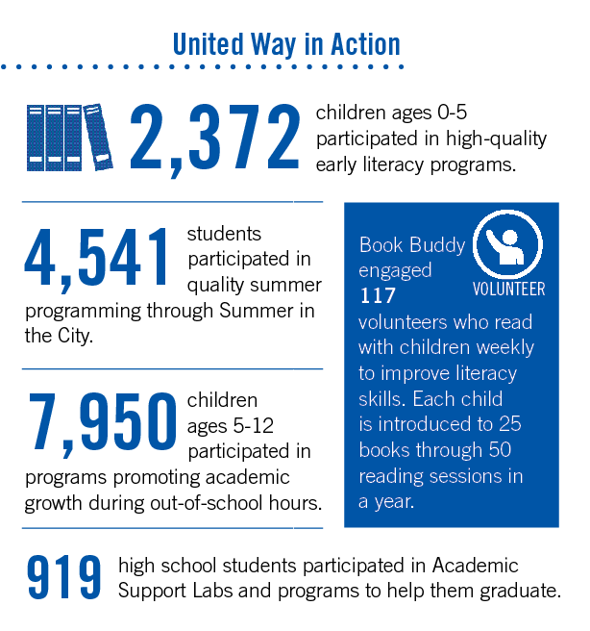

Slide 9
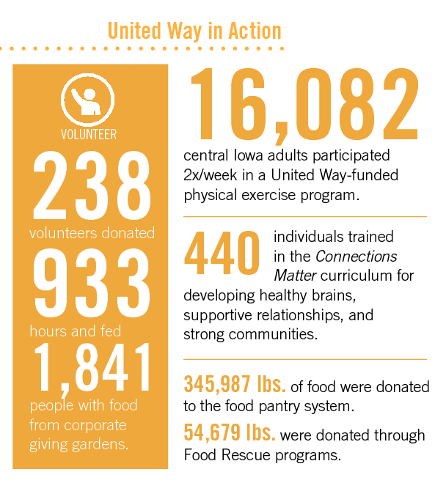

Slide 10
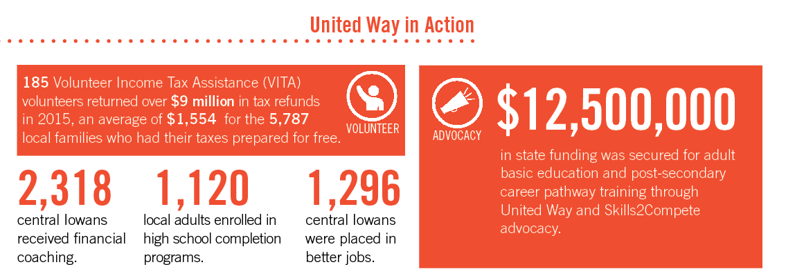

Slide 11
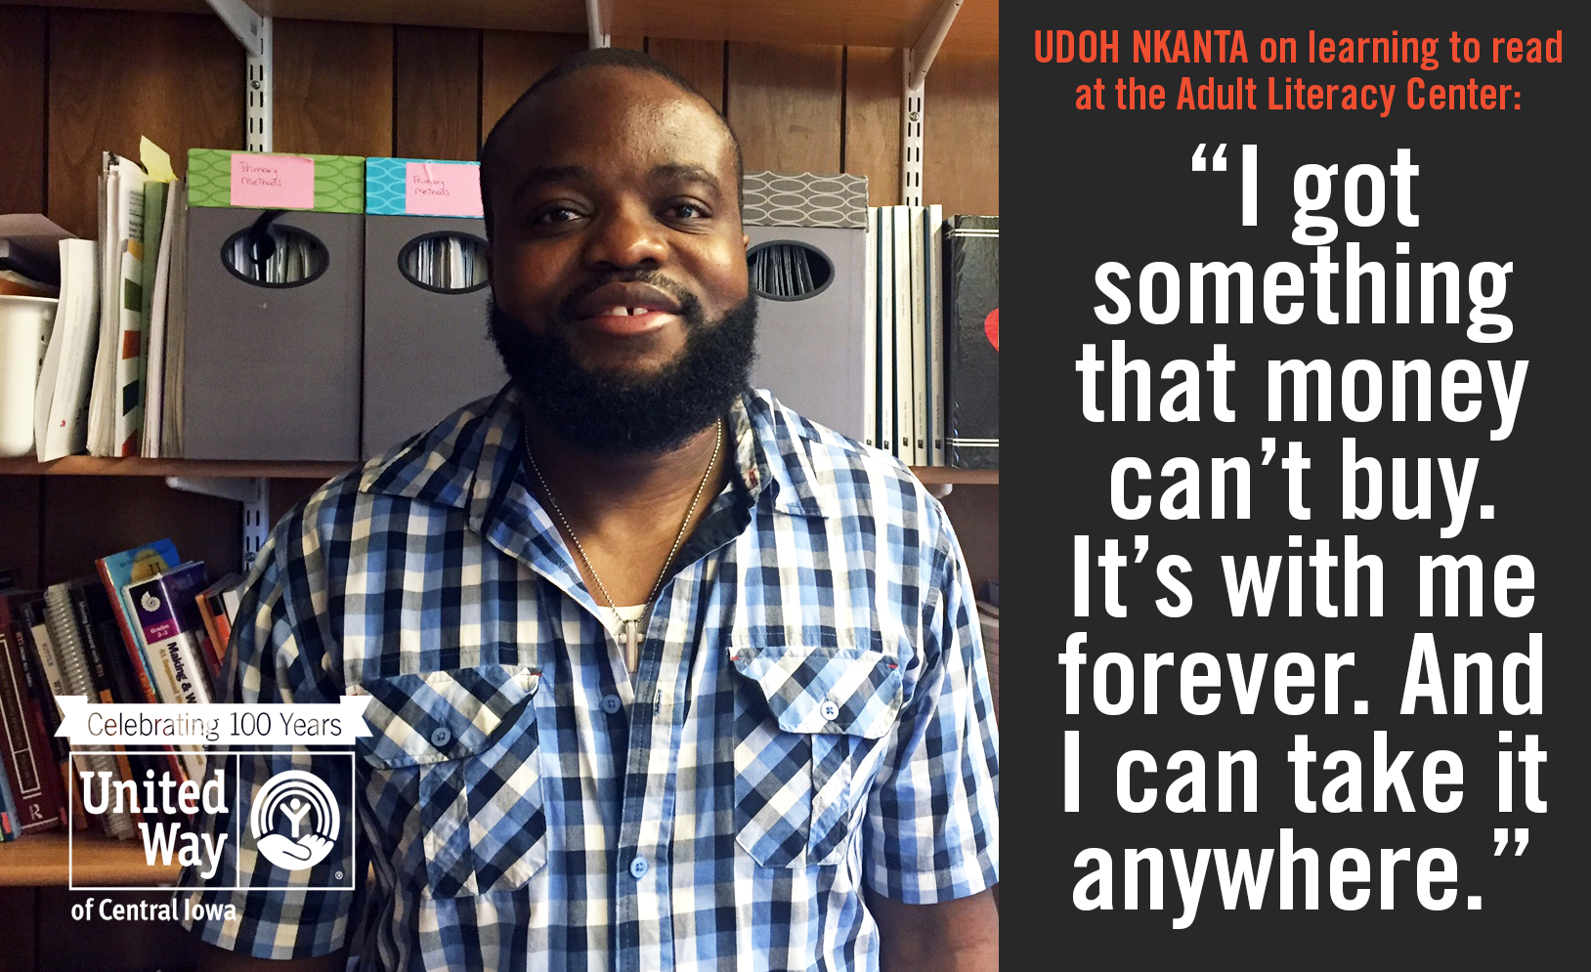

Slide 12
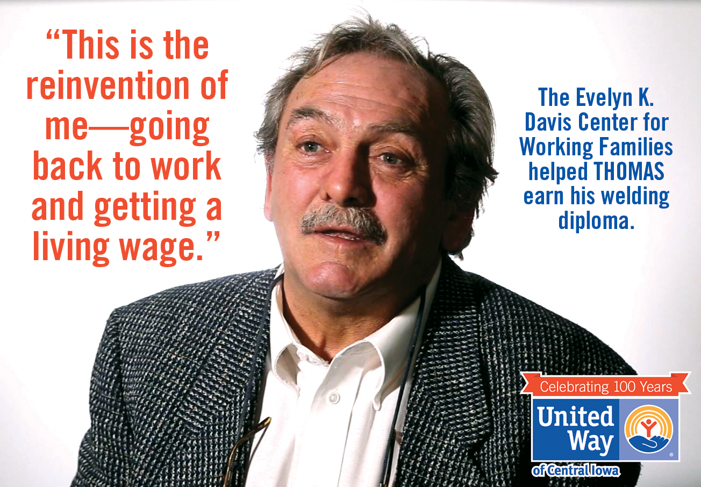

Slide 13
READ to SUCCEED is United Way’s groundbreaking, community-wide awareness and action campaign to help our kids get the skills they need to succeed as students and beyond.
1 in 5 central Iowa students do not read proficiently by the end of third grade, the No. 1 predictor of high school success.

Slide 14
Bridges to Success is a five-year program to help thousands of central Iowans earn their High School Equivalency Diploma (HSED) and gain the skills, training and confidence they need to attain self-sufficiency.
More than 33,000 people in central Iowa don’t have a high school diploma.

Slide 15
[COMPANY NAME]: [CAMPAIGN GOAL]
JOIN THE FIGHT
United Way of Central Iowa

Slide 16
LEAD THE WAY
You can be among central Iowa’s most generous donors by giving $1,000 or more annually.
If you can’t afford a leadership-level gift, you can still direct your dollars to invest in early childhood education or supportive middle school and high school programs.

Slide 17
It’s a
time
United Way LINC delivers unique events that elevate the community, connections and social calendar of individuals under 30.
Join our ranks by making an undesignated gift of $250 or more to United Way.

