Slide 1
ABOUT BALANCED SENIOR NUTRITION
Diane Hall founded Balanced Senior Nutrition because of her heartfelt desire to help older adults by balancing the best possible nutritional care with a quality, independent life. Her end goal is to create a warm, home-like and safe dining environment in which seniors can thrive.
Diane and her team of long term care specialists share this focus with our clients – ALFs, SNFs and continuing care communities through:
Diane Hall, RD, LD, NHA President
Clinical Dietitian Services Enhanced Dining Services Food Safety Training and Certification | Customized menus Mock Surveys Continuing Education Programs

Slide 2
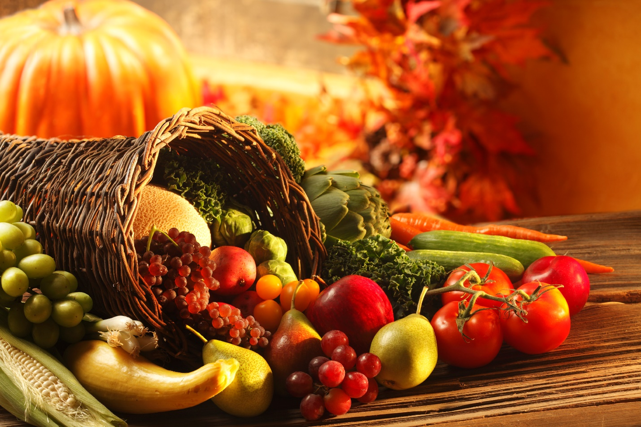
The Inside Scoop To Safe Holiday Cooking
Notes:
1. WHY IS FOOD SAFETY IMPORTANT ESPECIALLY AROUND THE HOLIDAYS?
The folks we are serving Kalei are usually older, which means because of aging and or illness, their immune system weakens, making them more susceptible to foodborne illness. And, as if that is not a good enough answer….think of the Thanksgiving meal and all the trimmings.
Cooks are preparing special foods they might not usually serve; with spending a lot of time spent in the kitchen. This means more ‘food handling’ which means more handwashing is needed
More foods are being prepared at different times and temperatures.- Which means more ‘food holding’ which means proper holding times and temperatures.
Did you know that the top 2 food factors that contribute to foodborne illness is Improper Holding and Poor Personal Hygiene(handwashing)? ------------------------------

Slide 3
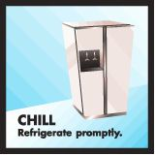
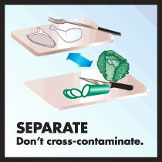
The Inside Scoop To Safe Holiday Cooking
Notes:
2. HOW DO YOU GET READY FOR A HOLIDAY MEAL?
Well, the 2 areas we just mentions, Food Holding and Personal Hygiene are explained in the 4 core objectives of Food Safety:
Bacteria can spread so keep clean hands, working area, equipment and food.
Separate raw and ready to eat foods, keep cutting boards separate and use different plates when transferring from raw to cooked foods.
Bacteria can be killed so cook proper temp.
Bacterial grows at room temperature, so chill quickly.

Slide 4
Notes:
3. WHAT’S THIS I HEAR ABOUT THE DIRTY DOZEN?
I will keep you guessing Kalei for a minute abut the Dirty Dozen while I talk about proper cleaning procedures. We start with our keeping our own hands clean don’t we?
Wash your hands with warm water and soap for at least 20 seconds before and after handling food.
E-Book “Inside Scoop on Safe Holiday Cooking” Handout to post for handwashing - not a bad idea to have available and talk about it often with residents, families, visitors and care partners.

Slide 5
CLEAN: Bacteria can spread throughout the kitchen and get on hands, cutting boards, knives and countertops and even in foods.
When handling raw turkey and eggs, wash your hands before and after.
Wash your cutting boards, dishes, utensils, counter and table tops with hot soapy water or in dishmachine after preparing each food item and before you go on to the next recipe.
Sanitize the counters and the cutting boards with 1 tablespoon unscented bleach to 1 gallon of water.
Rub firm-skin fruits and vegetables under running tap water with a clean vegetable brush. Do this even though the skins and rinds are not intended for consumption.
Notes:
Fruits & Vegetables: Harmful bacteria that may be in the soil or water where produce grows may come in contact with the fruits and vegetables and contaminate them. Or, fresh produce may become contaminated after it is harvested, such as during preparation or storage.
Eating contaminated produce (or fruit and vegetable juices made
from contaminated produce) can lead to foodborne illness, which can cause serious - and sometimes fatal - infections. --------------------------------------------
Cut away any damaged or bruised areas on fresh fruits and vegetables before preparing and/or eating. Produce that looks rotten should be discarded.
l All produce should be thoroughly washed before eating. This includes produce grown conventionally or organically at home, or produce that is purchased from a grocery store or farmer's market. Wash fruits and vegetables under running water just before eating, cutting or cooking.
l Even if you plan to peel the produce before eating, it is still important to wash it first.
l Washing fruits and vegetables with soap or detergent or using commercial produce washes is not recommended.
l Scrub firm produce, such as melons and cucumbers, with a clean produce brush. l Drying produce with a clean cloth towel or paper towel may further reduce bacteria
that may be present.
What about the Dirty Dozen??
E-Book has List of the Dirty Dozen : A single grape tested positive for 15 pesticides. The same was true for a single sweet bell pepper. Single samples of celery, cherry tomatoes and sweet bell peppers tested positive for 13 different pesticides, each.
Apples,Grapes,Celery,Cherry tomatoes,Sweet bell peppers,Cucumbers,Hot peppers,Imported nectarines,Peaches,Potatoes,Spinach,Strawberries
List of Clean: The Clean Fifteen: Least likely to be contaminated
Asparagus,Avocados,Cabbage,Cantaloupe,Sweet corn,Eggplant,Grapefruit,Kiwi,Mangos,Mushrooms,Onion,Papaya,Pineapple,Frozen sweet peas,Sweet potatoes
4. DOES THIS MEAN WE SHOULD RINSE THE TURKEY?

Slide 6
CLEAN: Don’t forget the sponges and dishcloths.
Clean sponges and dishcloths daily in dishwasher with a drying cycle, or microwave a damp sponge for one minute.
Replace sponges and dish cloths frequently. Discard if the sponge starts to smell.
Store sponges and cloths in a dry location.
Don’t use sponges on countertops. Consider using paper towels to clean up kitchen surfaces.
Don’t wipe up spills from the turkey, use a paper towel or disinfectant wipe instead.
Notes:
5. HOW DO WE PROPERLY USE SPONGES AND CLOTHES IN AN ASSISTED LIVING FACILITY? They sit at room temperature which is the danger zone so they need to be cleaned often. Read slide
-according to the Florida Department of Health; their Food Hygiene code, 64E-12,
it depends on how many residents your are serving? Over 5 residents creates Tier II with more food codes required.
E-book contains COPY OF THE ALF Florida Administrative Code, 58A, different Tiers of the Florida Department of Health; Food Hygiene Rule (64E-12) according to the size of ALF
vTier 1. Facilities meeting the definition of “adult family-care home” regardless of the number of residents as defined in Section 429.65(2), F.S., and other community based residential facilities with a maximum capacity to house up to 5 residents, shall comply with the following requirements:
Food used in the facility shall be clean, wholesome, free from spoilage and safe for human consumption.
vTier II. Except as described in subsection (1) above, if food service is provided in a facility with a maximum capacity to house from 6 to 10 residents, the facility shall comply with the following requirements:

Slide 7
Notes:
One of the four objectives of safe food handling is to keep from contaminating food by separating as much as possible.
There are so many ways to contaminate food and it starts before the food enters your house and increases the more food is handled during the preparation of the holiday meal. which can becomes a challenge --to keep foods from contamination.

Slide 8
SEPARATE: Cross contamination is how bacteria spreads.
From the grocery store to serving the dinner table…….
Separate raw turkey and eggs from fresh fruits and vegetables in your grocery shopping cart, grocery bags and in your refrigerator.
Use one cutting board for fresh produce and a separate one for raw meat.
Never place cooked food on a plate that previously held raw turkey. When handling raw turkey, keep it and its juices away from ready-to-eat foods. Don’t let cooked casseroles and dinner rolls (ready-to-eat)come into contact with raw turkey and its juices.
Do not touch food contact surfaces such as plates, bowls and glasses when serving.
Notes:
6. HOW COULD THE GROCERY STORE CONTAMINATE YOUR FOOD?
Watch as the bag boy or girl place items in your grocery bags. Are they putting raw foods with ready to eat foods? If so, that is one way foods could become contaminated while still in the store. Follow these steps to keep foods separted- read slide
E-book contains 2 illustrations of properly separting foods in the refrigerator and a poster size illustration of proper handling techniques when serving

Slide 9
Notes:
Do you have a thermometer- for cooking and chilling

Slide 10
COOK: Food is safely cooked when it reaches a high enough internal temperature to kill the harmful bacteria that cause foodborne illness.
Use a food thermometer which measures the internal temperature of cooked turkey to make sure it is cooked to a safe internal temperature.
Check the internal temperature in the innermost part of the thigh and wing and the thickest part of the breast with a food thermometer and cook until 165 F.
Make sure there are no cold spots in food (where bacteria can survive) when cooking in a microwave oven. For best results, cover food, stir and rotate for even cooking. If there is no turntable, rotate the dish by hand once or twice during cooking.
Bring turkey gravy to a boil when reheating. Heat other leftovers thoroughly to 165°F.
Notes:
7. DID THE FOOD CODE CHANGE FOR COOKING TEMPERATURE FOR TURKEY?
Used to be 180 and changed to 165 degrees.
E-Book contains Time table for Turkey Roasting with and without stuffing

Slide 11
Notes:
8. WHAT IS ONE OF THE MOST EFFICIENT WAYS OF REDUCING THE RISK OF FOODBORNE ILLNESS?
Do you have a thermometer?

Slide 12
CHILL: Bacteria spreads fastest at temperatures between 40F and 140F, so chilling food properly is one of the most effective ways to reduce the risk of foodborne illness.
Refrigerate foods quickly because cold temperatures slow the growth of harmful bacteria. Do not over-stuff the refrigerator. Cold air must circulate to help keep food safe.
Keep a constant refrigerator temperature of 40°F or below.
Use an appliance thermometer to be sure the temperature is consistently 40°F or below. The freezer temperature should be 0°F or below.
Refrigerate or freeze the turkey as soon as you get home from the store.
To thaw a turkey, refrigerate one day for every 4-5 pounds. So plan ahead, and get the turkey out of the freezer 3-4 days ahead.
Notes:
9. IS IT TRUE SOME BACTERIA ACTUALLY GROW IN THE REFRIGERATOR? Yes- listeria and bachelor’s bacteria; need it cold! Colder is better.
10. DO ALL PIES NEED TO BE REFRIGERATED? No-
Fruit pies keep at room temperature for a few days; you can store them, loosely covered, in the refrigerator for up to two days longer for quality measures.
But you want to Be sure to refrigerate pies containing eggs (pumpkin, pecan, custard and cream pies). Lemon meringue and all types of chiffon pies refrigerate up to
2-3 days.
Retail stores like Walmart that sell commercially produced pumpkin & pecan pies have perservatives and other ingredients added to make them shelf-stable. Once you have cut into the store-bought pies, they should be refrigerated and will hold 2-3 days.

Slide 13
CHILL: Leftovers and refrigerate food promptly.
Throw away perishable (turkey, cooked green bean and sweet potato casseroles) if at room temp > 2 hours, unless shelf-stable like cookies, crackers, bread and whole fruit.
Inside temp of turkey must be at 70 degrees within 2 hours of dropping below 140F.
Divide leftovers into shallow containers or smaller pieces for quicker cooling.
Eat or freeze leftovers within 3-4 days. Gravy is a different story. You should eat or freeze gravy within 2 days.
Notes:
E-Book contains Time table for Turkey Roasting with and without stuffing

Slide 14
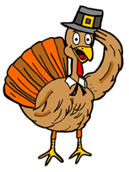
For a copy of this presentation, go to the Balanced Senior Nutrition website at www. seniornutrition.net/resources
Have a Happy and Healthy Thanksgiving Filled with Many Blessings!
Notes:
If you follow our easy tips, you too can serve a healthy holiday meal.

Slide 15
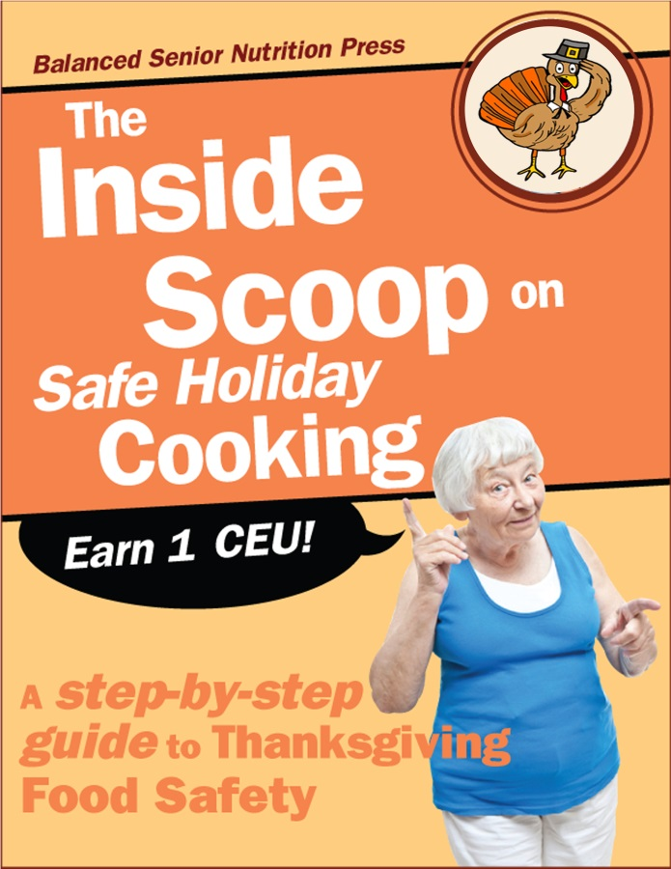
INTRODUCING an E-Book of a Different Sort — IT’S FUN TO READ!
Told through the eyes of the fictionalized residents and staff from Pioneer Village
Earn (1) One CEU through our E-Book; “The Inside Scoop on Safe Holiday Cooking”
Learn the (4) four core objectives of food safety.
Prepare holiday meals with safe food handling practices.
Use our forms to meet state requirements and the federal food code.
Notes:
If you need to earn (1) CEU in Nutrition & Food Safety, please consider The Inside Scoop on Safe Holiday Cooking for more information and resources regarding Food Handling. You will love how we have made learning FUN!

Slide 16
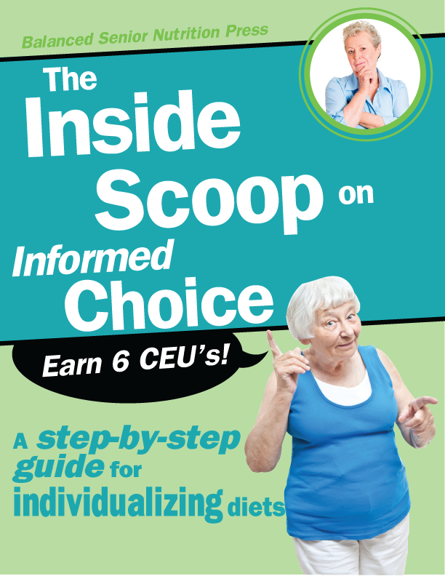
INTRODUCING a How-to-Guide of a Different Sort — IT’S FUN TO READ!
Told through the eyes of the fictionalized residents and staff from Pioneer Village
Why informed consent is critical when someone makes a risky decision related to meals.
Boost appetites and battle weight loss by making the change to real food first.
Use our Dining Assessments and Surveys forms while applying Quality Assurance and Performance Improvement (QAPI) processes, to achieve true, individualized dining.
Create self-directed care plans, step-by-step, using the comprehensive forms in this guidebook.
Notes:
Also, just a quick word about our manual, The Inside Scoop on Informed Choice. It too is written in a fun way using fictional characters to explain the process necessary when someone makes a risky decision about their meals. It also has forms for improving Customer service and Survey compliance regarding your food service.

Slide 17
Safe Holiday Cooking

