Slide 1
What is Energy Monitoring?

Slide 2
Market Direction
The lighting control industry being driven to manage energy holistically and to show ROI
Energy costs are going to go up
Changing regulations are impacting local building codes
Clean energy is expensive and unreliable for the supply side
Being green is not just a marketing strategy, it’s a necessity to be efficient and reduce operating expenses

Slide 3
What do you need?
Products that can actually help lower operating costs
Products help owners and facility managers prove that they’re doing the right thing
Transition from simply monitoring energy usage to management of energy

Slide 4
Energy Monitoring
Hardware and software that connects to your energy resources to provide a defined baseline of energy consumption
Knowing is the start – you need to see what your energy usage is as a starting point

Slide 5
Energy Monitoring Technologies

Slide 6
Calculated - Good
If we know that a load is 50W and it’s at 50%, can’t we just assume it’s using 25W?
Not really…
We can get fairly close with load profiling, but the wattage numbers don’t scale linearly
Commercially, ballasts are very difficult to accurately profile
The numbers produced by these guesses can be off by 20%
Really only works for lighting, not all loads

Slide 7
Current Monitoring - Better
Assume that the voltage is stable and measure the actual current
P=I*V
Can provide fairly accurate results for stable voltages
Has a problem with active loads, like ballasts
Power factor correction helps in the “on” state
“Off” state will read much higher than actual power due to phase shifts
Can expect a 10% error in measurements
Can be used for non-lighting loads

Slide 8
Power Metering - Best
Samples real voltage and real current at high frequencies
Compensates for phase offsets
Doesn’t get fooled by voltage drops or non-linear current scaling
Expensive
Errors can be smaller than 1%
Useful for measuring ANY electrical load

Slide 9
Crestron Solution
Whatever your level of energy sustainability, we can help make an impact
We have calculated, current monitoring and power metering solutions to help you grow and evolve your level of energy management

Slide 10
Crestron Calculated Solutions
Supported by every Crestron processor
No special products required
Lowest hardware cost
Great initial solution for starter retrofit applications
Works perfectly with Crestron’s range of wired and wireless dimmers and switches, including 120/240/277V

Slide 11
Crestron Current Monitoring
Crestron products include optional “PM” version to deliver current monitoring data
Green Light® Power Pack
Green Light® Integrated Lighting System
Green Light® DALI Ballasts

Slide 12
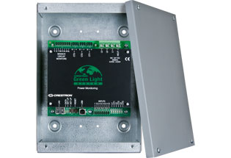
Crestron Energy Monitoring Solution
GLS-EM-MCU: Metering Control Unit
Ethernet based
Main Panel Feed Monitoring
and/or Branch Monitoring
Power metering across 3 phases (main legs)
Reports data to control system and Fusion EM
Monitors & logs Voltage, Current, & Active Power
Monitors up to 84 individual branch circuits (With GLS-EM-CTI)
Installs next to an electrical panel
Operable with 100-347V, split and 3 phase systems
Non-volatile memory reliability stores internally logged data

Slide 13
GLS-EM-MCU – Parts and Pieces
GLS-EM-MCU: Mains monitor
GLS-EM-CTI-*: Branch monitors
GLS-CT-*: Current transformers
These come in standard and high accuracy models
HA might allow us to claim revenue grade metering

Slide 14
GLS-EM-MCU
Main monitor
Need one per panel
Monitors three main feeds and four pulse inputs
Can support four branch monitors
Up to 84 branches
100-347VAC (Yes, 347!)

Slide 15
GLS-EM-CTI
Branch monitors
Comes in 6, 15 and 21 branch options
Specific for two and three phase systems
Connects to the GLS-EM-MCU via a 7-wire bus
Also has a pass-through for next GLS-EM-CTI unit
Reports through the GLS-EM-MCU

Slide 16
GLS-CT
Current transformers – every monitored leg needs one
Comes in multiple varieties:
20A
50A
200A
400A
600A
High Accuracy/Standard Accuracy
High accuracy version has factory calibration to remove small errors due to manufacturing differences
Improves error from 5% to <1% (May allow us to claim revenue grade – still investigating)

Slide 18
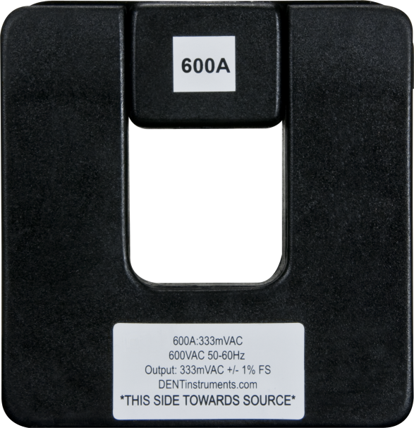
Available Information
Real Time Information - Power
Voltage
Active Power
Pulse Rate
Historical Information – Energy
Voltage
Current
Active Power
Energy
Pulse Usage
Power Factor
Energy Meter (aggregated)
Pule Meter (aggregated)

Slide 19
Pulse Metering
Allows for inclusion of 3rd party metering devices
Keeps precise count of pulse rate and pulse count
Typically used for water or natural gas

Slide 20
Odds and Ends
Often, for larger buildings, the main feed is much larger than 600A. How does this get monitored?
For these large installations the feed is typically broken up into multiple, parallel, 600A (or less) feeds
Our tools allow us to clamp one CT onto one parallel feed and instruct the monitor to compensate for the fact that multiple feeds are in use (Basic multiplication)

Slide 21
Energy Monitoring Technologies - Recap
Three monitoring technologies
Guessed/Estimated
Supported by all Crestron products
Not as accurate
Current Measurement Only
Supported by Crestron PM option products
Mid-level accuracy
Power Measurement
Measured by a dedicated device: GLS-EM-MCU
Most accurate option for measurement

Slide 22
Bringing It All Together
All of these work well independently
The real power is harnessed when you bring these technologies together into a overarching energy management strategy

Slide 23
The Next Step… Energy Management

Slide 24
Making the Transition from Monitoring to Management
Using the data gathered from the energy monitoring hardware and software, the facility manager realizes there’s an opportunity for savings
Now that there are metrics, the goal is to make the numbers move
We do this via our control products and Fusion™

Slide 25
What are the steps involved?
Metering your energy consumption and collecting the data by using an energy monitoring software
Uncover places to save energy - such as making upgrades or replacing inefficient equipment
Putting into place energy saving functions – such as demand response settings or eliminating wasted energy in unoccupied spaces
Tracking progress by analyzing the real-time data and comparing with historical information to what these efforts are actually achieving

Slide 26
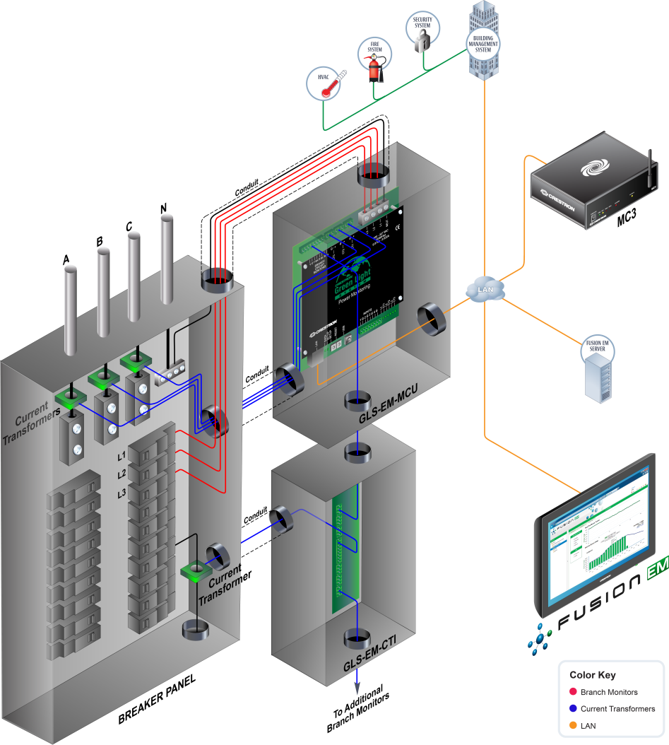
Crestron Energy Management
6-Part Panel-Based Energy Management System:
Electrical Panel
Current Transformers
(GLS-EM-CT)
Current Transformer Interface
(GLS-EM-CTI)
4. Meter Control Unit
(GLS-EM-MCU)
5. Control Processor
(MC3)
6. Analysis Software
(Fusion)

Slide 27
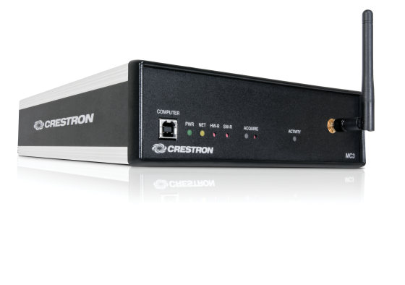
Crestron Building Management System Gateway
Seamless integration of lighting, shades, HVAC, security, IT, and AV with existing building management systems and other devices – no other gateway needed
Direct connection over BACnet/IP through Crestron 3 Series Control Processors
Works with BACnet/IP, LonWorks, Modbus, KNX and others

Slide 28
Bringing it all together: Monitor, Manage AND Control
The Crestron solution for the management of information and resources within the building to reduce energy consumption, save time and money is Fusion EM™
Fusion EM is the tool that allows you to Monitor, Manage and Control your entire operation

Slide 29
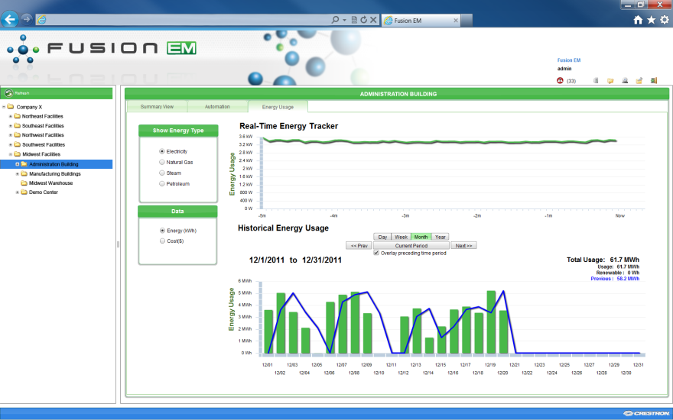
Bringing it all together: Monitor, Manage AND Control
Monitor: See all energy resources including data analysis from your energy monitoring devices. Compare historical vs. real-time energy usage
Manage: Use the software to implement change and automate functions and schedule events such as:
Temperature and lighting level set points
Demand response settings
Global lighting and climate control for unoccupied spaces
Control: Anticipate needs based on the occupants and usage. By using Fusion for predictive management of the facility you can ensure they are being utilized efficiently

Slide 30
Thank you! Want more information? Call us at 855.263.8454 or visit crestron.com

