Slide 1

Austin HubSpot User Group
Agenda - August 2013
11:30 - 11:45 Sign in/Networking/Order lunch
11:45 - 12:00 Announcements
12:00 - 12:30 Emails and list segmenting
12:30 - 1:00 Questions and wrap up
Notes:
Collection of useful inbound marketing resources.
Connect with Austin HubSpot User Group on LinkedIn - http://www.linkedin.com/groups/Austin-HubSpot-User-Group-HUG-4095357

Slide 2
Meetings Through the End of the Year
October 24 at the Flying Saucer
November 14 at the Flying Saucer
December - maybe a happy hour?
Notes:
Collection of useful inbound marketing resources.
Connect with Austin HubSpot User Group on LinkedIn - http://www.linkedin.com/groups/Austin-HubSpot-User-Group-HUG-4095357

Slide 3
Austin HubSpot User Group
Announcements:
Google’s not sharing keyword data anymore
Resources on the switch:
HubSpot Blog on the Shift
Moz Whiteboard Tuesday
http://greenfroggms.com/2013/09/25/google-encrypts-search-what-this-means-for-marketers/
Notes:
Collection of useful inbound marketing resources.
Connect with Austin HubSpot User Group on LinkedIn - http://www.linkedin.com/groups/Austin-HubSpot-User-Group-HUG-4095357

Slide 4
October Meeting Topic Options
Dealing with the Keyword debacle
  Pull in an SEO expert
  Discuss workarounds
Sales-marketing alignment
  HubSpot people call in
  Talk about Signals
  How to help your sales team close leads

Slide 5
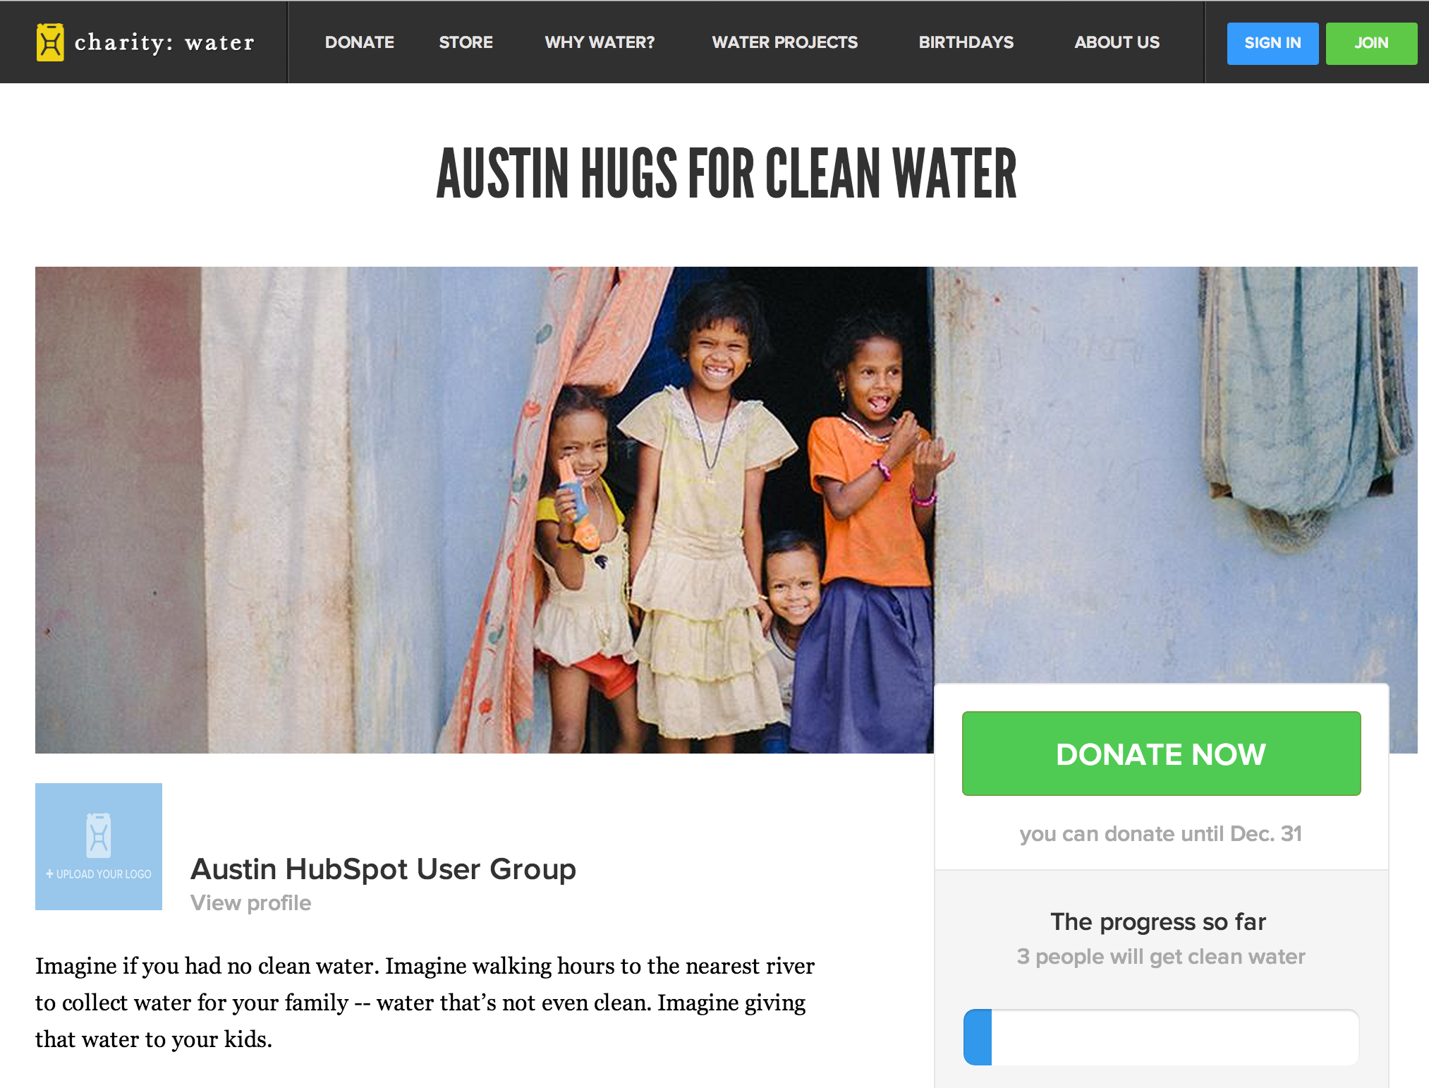
Local campaign URL - http://my.charitywater.org/austin-hugs-for-clean-water
Notes:
Connect with Austin HubSpot User Group on LinkedIn - http://www.linkedin.com/groups/Austin-HubSpot-User-Group-HUG-4095357

Slide 6
New Website!
We have a new website
Austin.hubspotusergroups.com
Brand new
Want to use it to better communicate, post old presentations, etc.
If you’d like to help with that, we’re looking for people
For now, sign up there so we can make sure you get the emails.

Slide 7
Introductions!
Name
Company
How long have you been using HubSpot?

Slide 8
Email and List Segmentation
Modified from This Presentation

Slide 13
What are some of your email goals?

Slide 24
Possible Segmentation Options
Segment by Persona
  Government buyers vs. private sectors
Segment by Sales Cycle
  Just beginning to research vs. talking to sales
Segment by Location
  Regional vs. National

Slide 25
What are some ways you segment?

Slide 47
How are you optimizing your emails?

Slide 48
Other Resources
Anatomy of a five star subject line
How 7 Experts Solve Their Most Painful Email Marketing Problems

