Slide 1
“ionizing radiation needs to be treated with care rather than fear and its risks should be kept in perspective with other risks”
Notes:
However, CT guided surgery involves the use of CT scans. Naturally, we are all concerned about the extra radiation that we will be subjecting our patients to. The ICRP puts it in the proper perspective for us with this statement. That ionizing radiation needs to be treated with care rather than fear and its risks should be kept in perspective with other risks. The corollary of this is that there are risks in NOT taking the CT scan which may be worse than the radiation. Let’s look at what CT scans do to our health.

Slide 2
Measurement of Radiation
Absorbed dose (milliGray) - the amount of radiation energy per unit mass received by patient
Effective dose (milliSievert) - “the dose that, if applied to the whole body, would involve the patient in the same degree of risk”
Background Equivalent Radiation Time (BERT) - the length of time it would take the patient to receive the same effective doses from naturally occurring background radiation such as radon or isotopes in food and drink
Notes:
In order to understand the effects of radiation, we need to be able to measure it. The milligray is a measurement of the amount of radiation that we received. It does not take into account the different radiosensitivity of different organs of the body. For example, the same amount of radiation to the bone presents a different risk than say the reproductive organs.
The Millisievert is a measurement of the effective dose. It factors in the differences in radiosensitivity of the different organs. It measures the dose that if applied to the whole body, would involve the patient in the same degree of risk. So, when we are assessing risks associated with diagnostic radiology, the millisievert is a more meaning unit of measurement than the milligray.
However, we are subjecting to radiation all the time, even when we are not having radiological investigations. There is radiation from cosmic rays, there are radon or isotopes in the food and drinks that we consume. So, we need to see the radiological investigations in that perspective. The BERT, which stands for background equivalent radiation time, gives us an idea of what kind of radiation we are subjected to in various radiological assessments compared with the background radiation that hits us all the time.

Slide 3
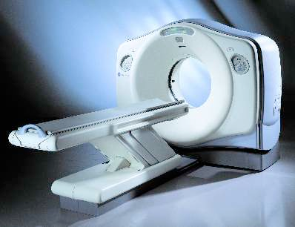
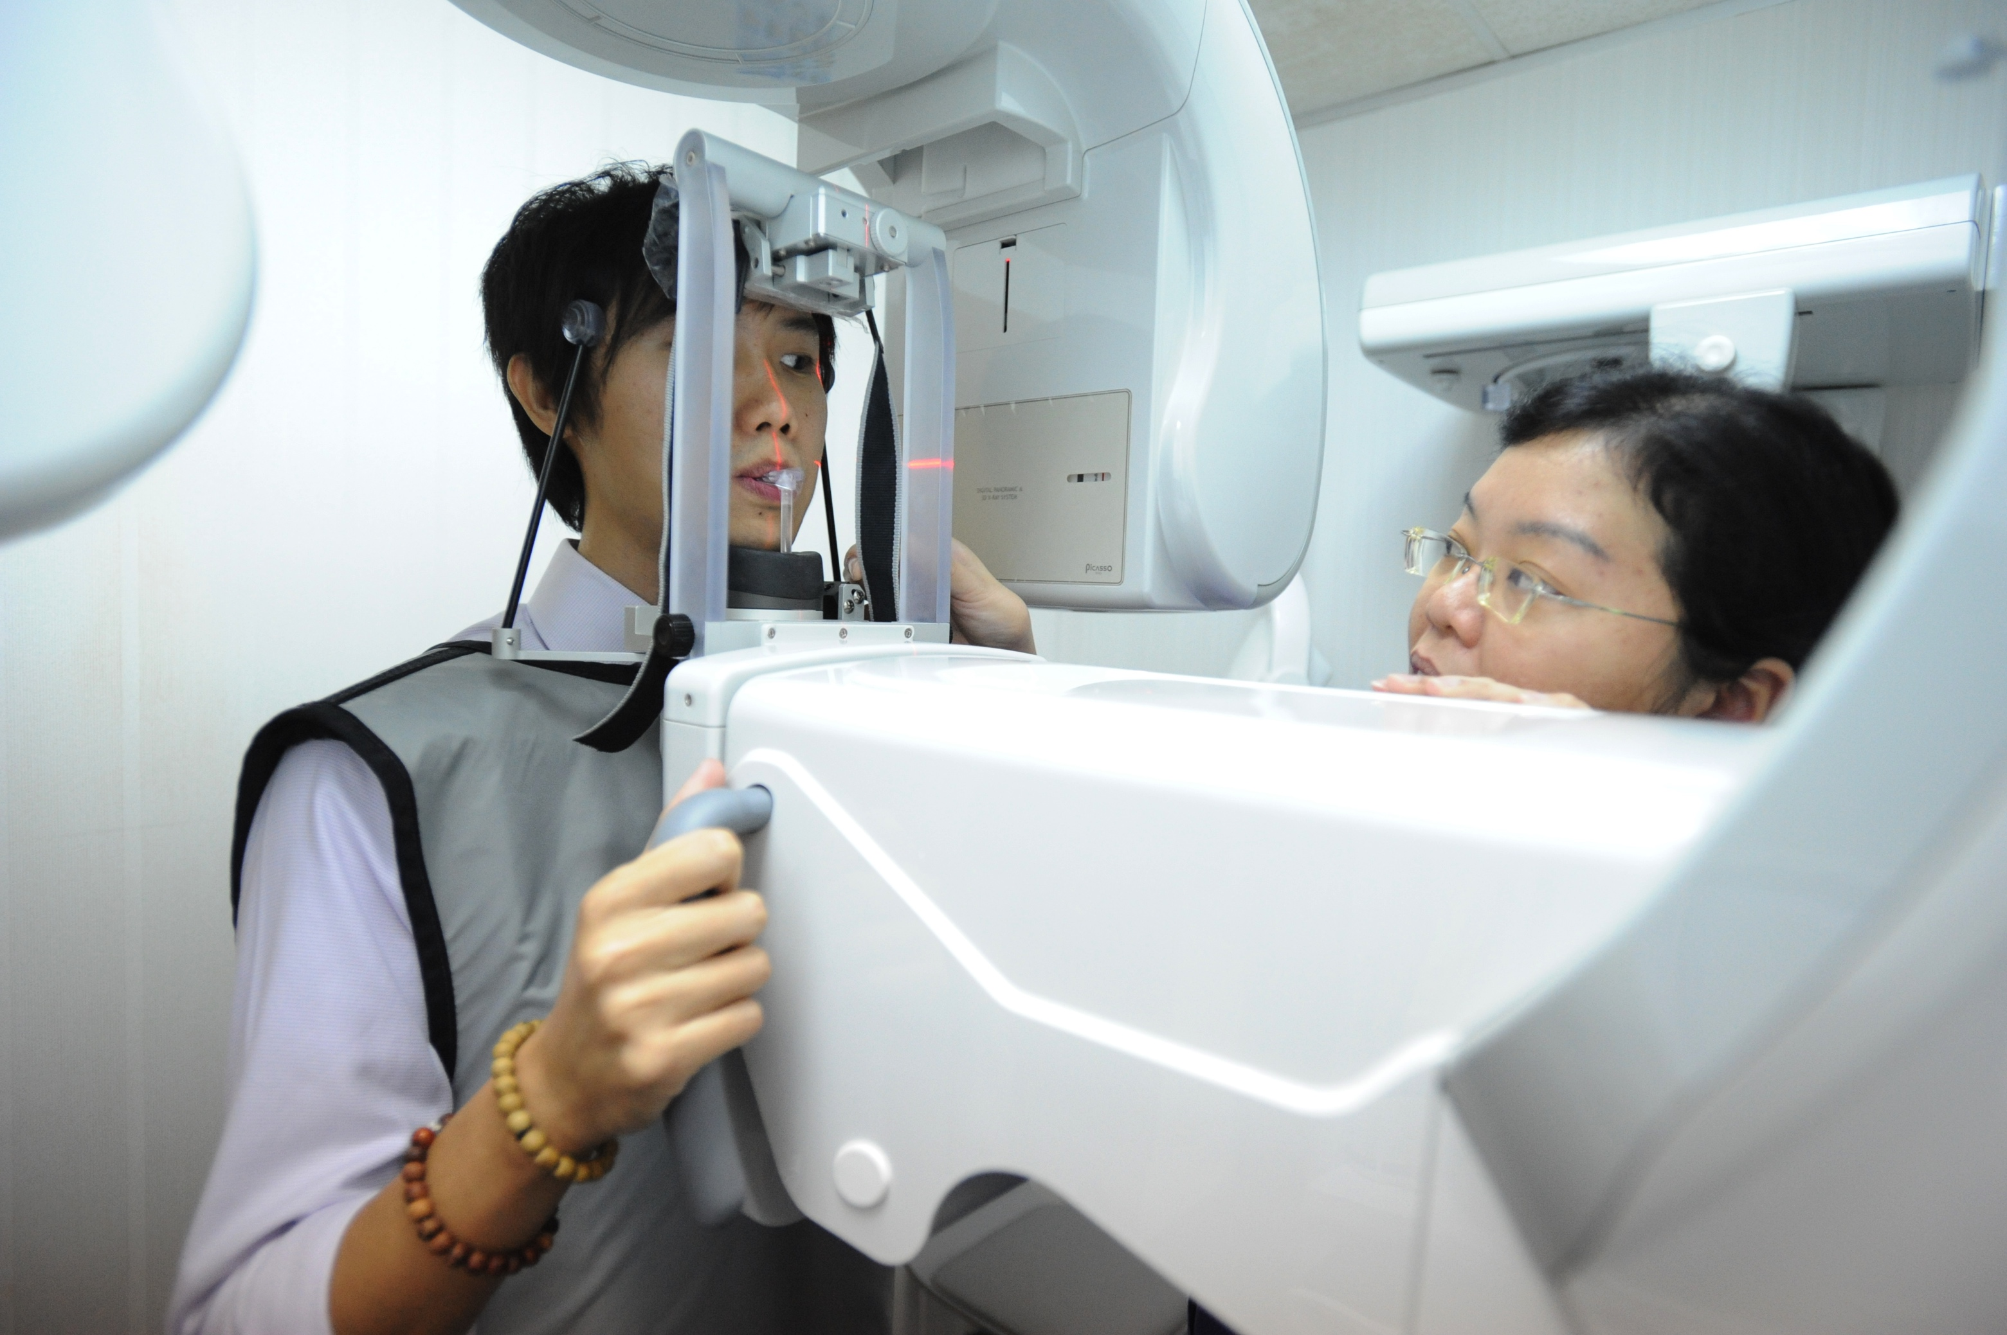
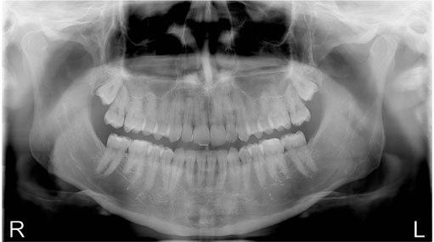
Radiation doses from dental x-ray examinations
Conventional CT
250 uSv
42 days BERT
Single Periapical
1-2uSv
4 hours BERT
CBCT
29uSv
5 days BERT
6 hour flight
24uSv
4 days BERT
DPT
20uSv
3.5 days BERT
Notes:
Let’s look at what we do everyday in our practice.
A pa at 1-2uSv is equivalent to 4 hours of background radiation.
OPG at 20 uSV is similar to 3.5 days
A CBCT at 29 uSv is only slightly more than an OPG and is same as 5 days worth of background radiation
Compared with the CBCT, the conventional hospital ct subjects the patient to 8 times the more radiation at 250uSv and 42 days of BERT
Put this in perspective with something that we do when we go for holidays and conferences. A six hour flight has the same effect as 4 days of background radiation, some where between the OPG and CBCT
But why this fear of radiation. What are we afraid of? The most common fear of radiation is attributed to it cancer-causing capability

Slide 4
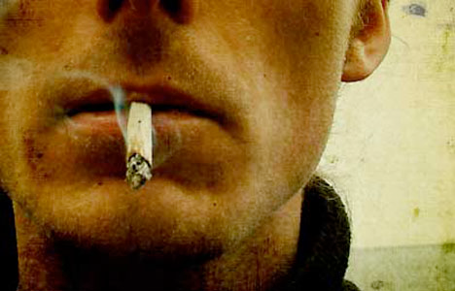
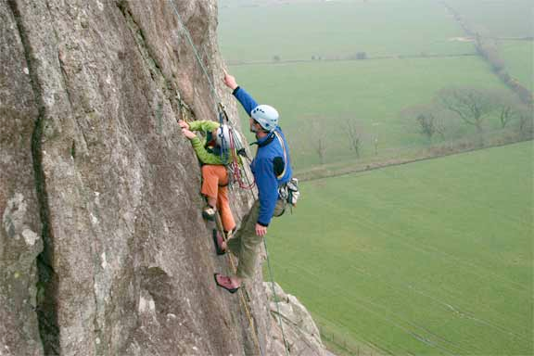
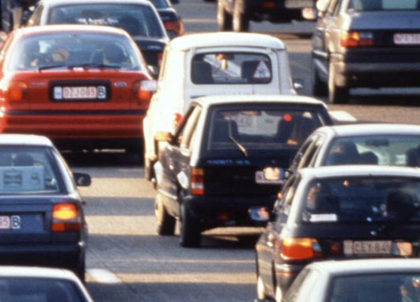
Working in a factory for 180 days
One hospital CT maxilla: 1 in 80,000 chance of dying from cancer caused by the radiation
Smoking 10 cigarettes just once in your life
=
Rock climbing for 25 minutes
Travelling 600 miles by car

Slide 5
having said that...
The benefit from each exposure to radiation must be greater than the risk
Radiation doses must be kept as low as reasonably achievable (ALARA)
Notes:
This is not to say that we need not be concern. We should still do our best to minimize radiation and should always wear the risks against the benefits of radiological investigations. Given the great difference in risks levels between CBCT and conventional CTs, and that there is no difference in level of information between the two, it is logical to make use of CBCT instead of the conventional ct.

