Slide 1
Case Study Template
Template Resources for Partners
Notes:
SOURCES:
The Guide to Creating Case Studies for your Agency (http://cdn2.hubspot.net/hub/53/file-934781289-pdf/Offer-_Creating_Case_Studies_for_Your_Agency/the-guide-to-creating-case-studies-for-your-agency-hubspot.pdf)
Case Study Written Format, Victoria Aviles
HubSpot’s WeDo Technologies Case Study (http://www.hubspot.com/customers/wedo-technologies)

Slide 2
Table of Contents
Title Page
Executive Summary
About The Client
Marketing Challenges
How YOUR AGENCY Helped
How HubSpot Software Helped*
Supporting Quotes and Visuals
Customer Results, Return on Investment and Future Plans
Call-to-Action
*If applicable

Slide 3
Case Study Title
Subtitle
Tips:
Select the most striking accomplishment for your case study's headline.
Keep your headline short, without any jargon or acronyms, but be sure to catch your reader’s attention by promising to solve a problem they too might have.
Example: “YOUR CLIENT Sees a 6.3X Increase In Customer Conversion Rate From Email Marketing With an Inbound Marketing Strategy”

Slide 4
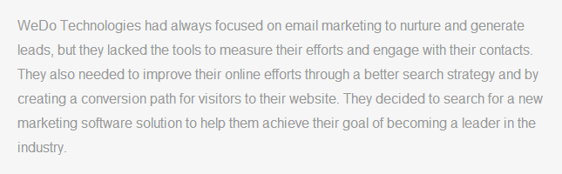
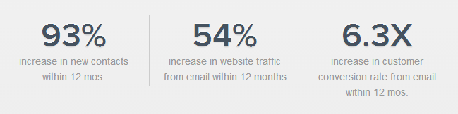
Executive Summary (~50 words)
Provide a mini headline once you have your reader’s initial attention.
Write 2-4 sentences summarizing the whole story, making sure to include the most relevant points of the case study. Example:
Then showcase 2-3 bullet points with metrics that prove your client’s success. Examples:

Slide 5

About The Client
Pull a short description of your client from LinkedIn or their company website. Make sure to hyperlink the company name to their website.
Example:
Make sure to answer:
Who is the client?
How did this client’s problems reflect a larger industry or market issue?
Are there new competitors, or did consumer behavior change?

Slide 6
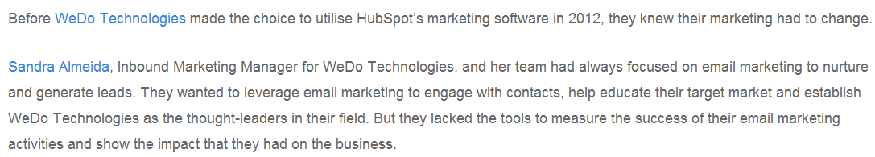
Marketing Challenges (~100 words)
Write 2-3 short paragraphs describing what your client was doing before your agency and what challenges this presented and/or what goals were trying to be achieved.
Be sure to address:
What pain points were present when your customer contacted you?
What was the first meeting like?
What negative consequences did the client want to avoid?
Example:

Slide 7
How Your Agency Helped (~100-150 words)
Write 2-3 short paragraphs describing how your agency worked with your client to find a solution to its challenges and implement a winning strategy.
If HubSpot was part of the solution, describe how your customer created and implemented an inbound marketing strategy, specific tools they used and how they saw value in the integration of these tools working together. Make sure to include any hyperlinks where tools are referenced.
Be sure to answer:
What insights did you uncover about the brand and its market?
How did you use this to develop a strategic plan for reaching the brand’s goals?
What was the solution and how was it implemented?
How did you communicate with the client?
What type of relationship did you build?
What goals were achieved through this relationship? What results did you see?

Slide 8
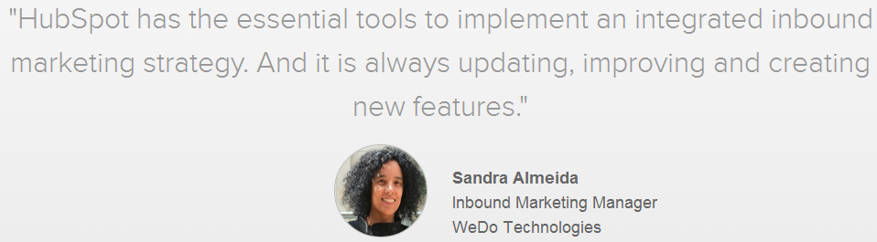
Quotes
Pick one or two quotes that you would feature at the bottom of one of your case study’s sections. Include a head shot of your customer alongside the quote.
Feel free to insert additional quotes into the body of your case study if you feel you have enough and they are compelling. Example:
Ask your customer these questions to get a few authenticating quotes:
What was the main problem you struggled with?
What was the determining factor for choosing our agency?
What did you like about working with our team?
What was the main benefit you saw from working with our team?

Slide 9
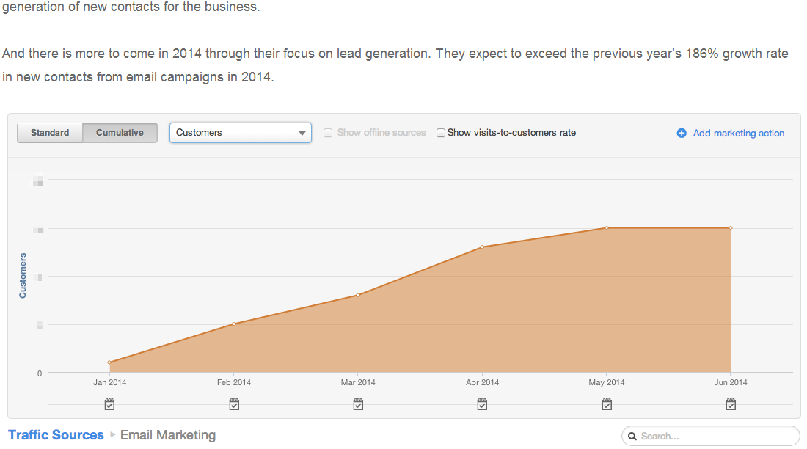
Visuals
If you could have one image to support the story, what would it be?
It can be something on your client’s website, or something you’d have to ask the client to send. For example, it could be your client’s ebook landing page report that shows increased lead generation, or the performance of a stellar CTA. Make sure to hyperlink the image back to the original source. Example:

Slide 10
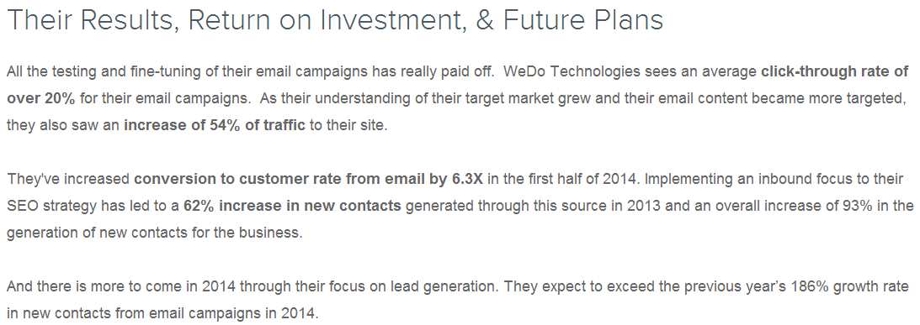
Results
Write a 2-3 paragraph conclusion to prove that your agency impacted the client’s business and helped them to achieve their goals.
Feel free to repeat the metrics from the bullet points in your introductory section as part of the text, particularly if they’ve been able to quantify or speak to the ROI of their investment.
End your story on your client’s aspirations for future growth with your agency and HubSpot, if appropriate. Example:

Slide 11

Call-to-Action
One of the most important parts to a case study is the call-to-action.
Now is the time to invite your reader to fill out a form and/or download an offer.
Use your CTA to lead your prospect to a landing page or a contact form. Get more information on who is reading your case study, and who is interested in your agency.

